Slide 1
Mixed Use Zones Project
PSC Work Session – June 28, 2016

Slide 2
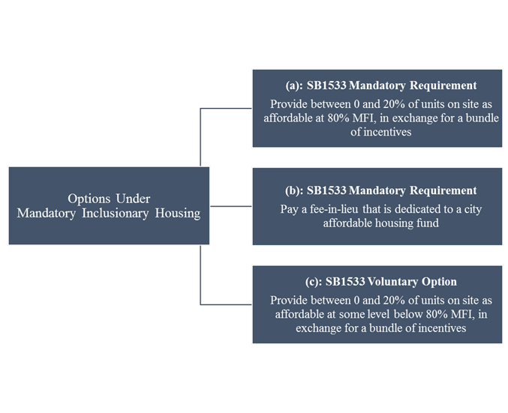
Inclusionary Housing Program Concept

Slide 3
Process/Timeline
IH Code Concept Development and Staff Coordination
Discussion Draft
Outreach to Stakeholder Groups
PSC Hearing and Recommendation
June 2016
July 2016
August 2016
September 2016
October 2016
December 2016
Draft Proposed Zoning Code
Commissioner Saltzman Program Recommendations
Draft Code Concept Proposal
Panel of Experts Review
Community Forums
City Council Hearing on IH Program and Zoning Code

Slide 4
Topic 3: Base and Bonus FAR allowances
Staff Recommendation:
Retain proposed structure of base and bonus FAR allowances, subject to future changes resulting from Inclusionary Zoning/Housing work.
Notes:
4

Slide 5
Topic 3: Zoning Concept: Bonus for Community Benefits
Setting “base” and “bonus” levels will be a key part of concept modeling, testing and refinement.
Current allowances
Base allowance
Bonus allowance

Slide 6
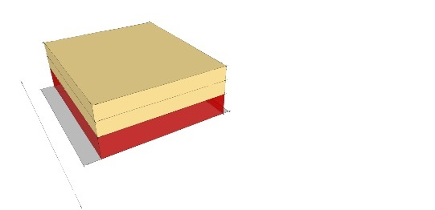
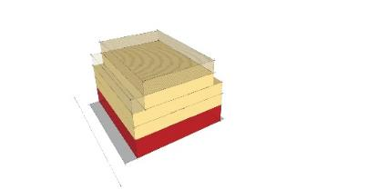
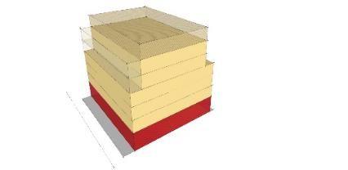
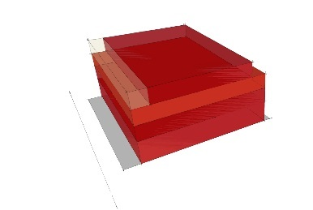

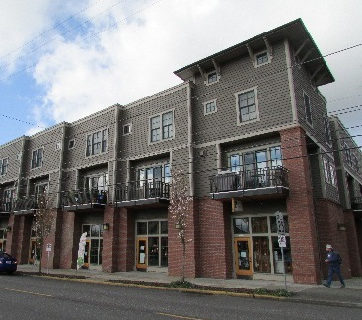
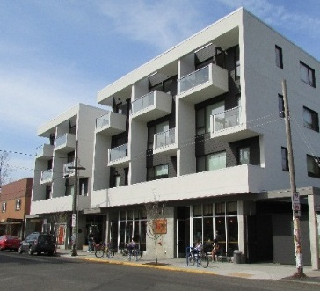
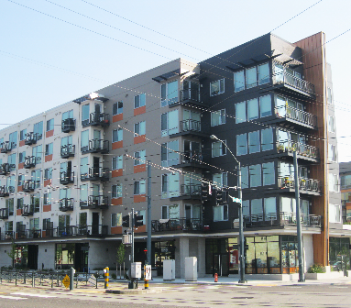
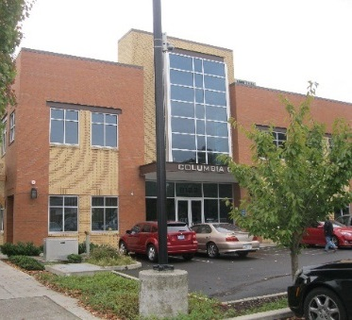
Topic 3: FAR Recommendations
 | Commercial Mixed Use 1 (CM1) | Commercial Mixed Use 2 (CM2) | Commercial Mixed Use 3 (CM3) | Commercial Employment (CE)
Preliminary Form
Examples
Height Limit FAR | 1.5:1 | 2.5:1 | 3:1 | 2.5:1
Bonus Ht Limit Bonus FAR | 2.5:1 | 4:1 | 5:1 | 3:1

Slide 7
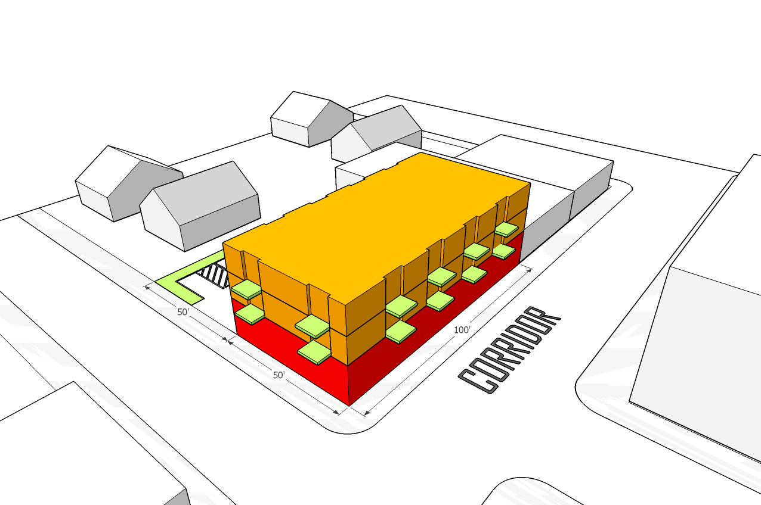
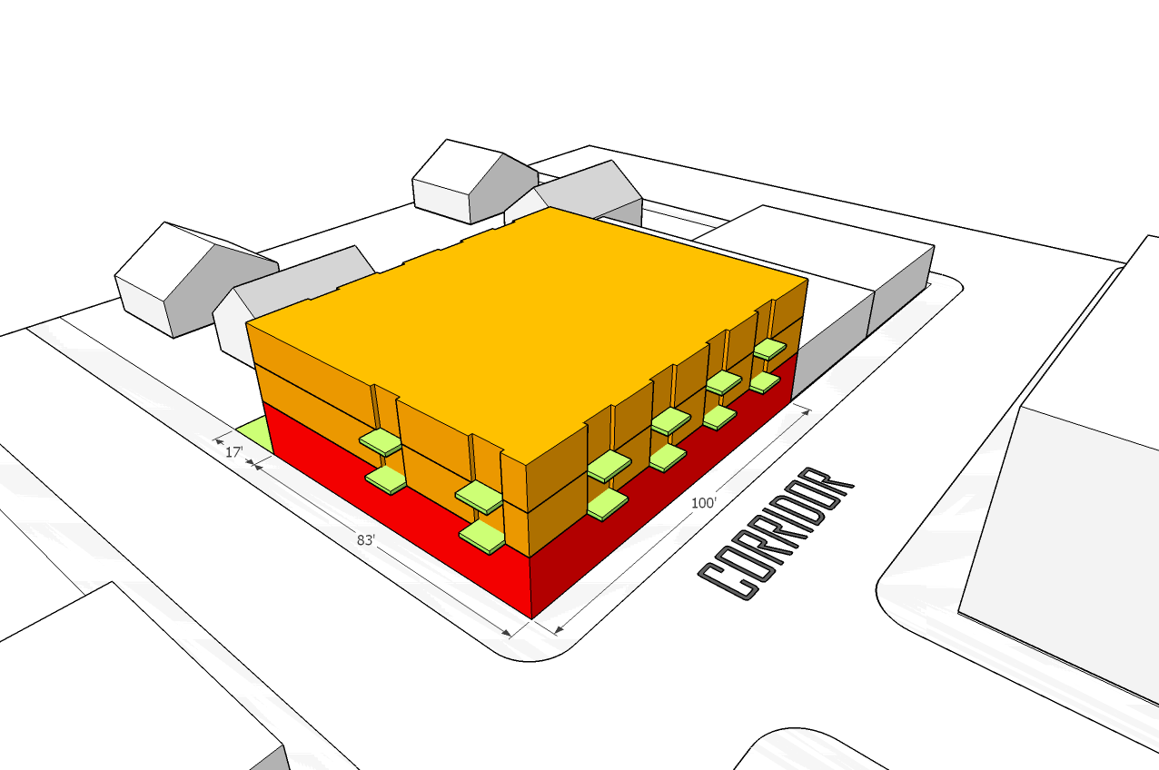
CM1 Zone
 | Small Scale Zones
 | CM1 | CN1 | CN2 | CO1
Height – Maximum Base (feet) | 35’ | 30’ | 30’ | 30’
Height – Maximum with Bonus | 35’ | 30’ | 30’ | 30’
FAR – Maximum Base | 1.5:1 | .75:1 | .75:1 | .75:1
FAR – Maximum* w/ Bonus | 2.5:1 | 2.5:1 | 2:1 | 1.5:1
* existing = estimated max for housing
Commercial
Retail Sales And Service | L | L | Y | N
Office | L | L | Y | Y
Quick Vehicle Servicing | N | N | L | N
Vehicle Repair | N | N | N | N
Commercial Parking | N | N | N | N
Self-Service Storage | N | N | N | N
Residential
Household Living | Y | Y | Y | Y
Group Living | L/CU | L/CU | L/CU | L/CU
Industrial
Manufacturing and Production | L | L/CU | L/CU | N
Warehouse and Freight Movement | N | N | N | N
Wholesale Sales | N | N | N | N
Industrial Service | N | N | N | N
Institutional
Basic Utilities | Y/CU | Y/CU | Y/CU | Y/CU
Community Service | L/CU | L/CU | L/CU | L/CU
Parks and Open Areas | Y | Y | Y | Y
Schools, Religious Institutions, etc. | Y | Y | Y | Y

Slide 8
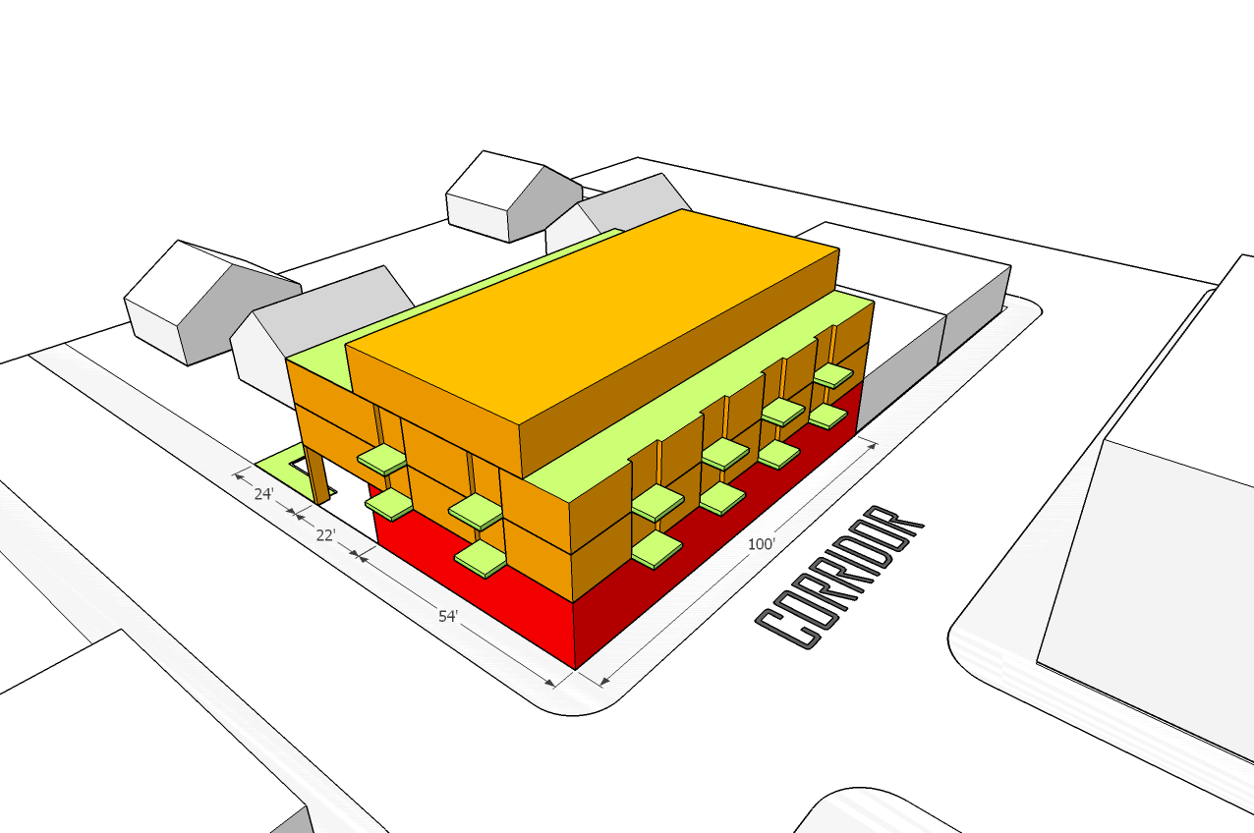
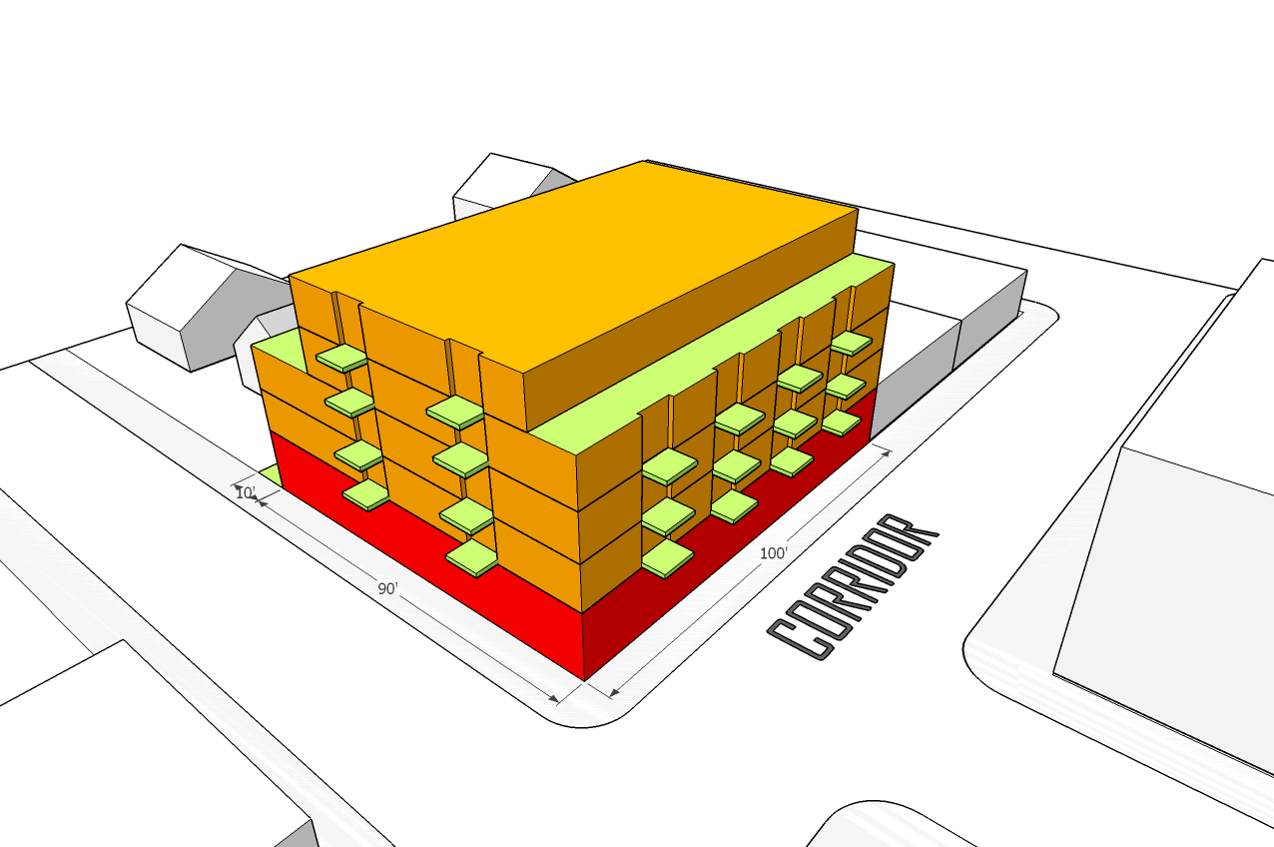
CM2 Zone
 | Medium Scale Zones
 | CM2 | CO2 | CM | CS
Height – Maximum Base (feet) | 45’ | 45’ | 45’ | 45’
Height – Maximum with Bonus | 55’* | 45’ | 45’ | 45’
FAR – Maximum Base | 2.5:1 | 2:1 | 1:1 | 3:1
FAR – Maximum* w/ Bonus | 4:1 | 2.6:1 | 4:1 | 4:1
* existing = estimated max for housing
Commercial
Retail Sales And Service | Y | L | L | Y
Office | Y | Y | L | Y
Quick Vehicle Servicing | N | N | N | N
Vehicle Repair | Y | N | N | Y
Commercial Parking | L | N | N | Y
Self-Service Storage | N | N | N | N
Residential
Household Living | Y | Y | Y | Y
Group Living | L/CU | L/CU | L/CU | L/CU
Industrial
Manufacturing and Production | L | N | L/CU | L/CU
Warehouse and Freight Movement | N | N | N | N
Wholesale Sales | L | N | L | L
Industrial Service | CU | N | N | CU
Institutional
Basic Utilities | Y/CU | Y/CU | Y/CU | Y/CU
Community Service | L/CU | L/CU | L/CU | L/CU
Parks and Open Areas | Y | Y | Y | Y
Schools, Religious Institutions, etc. | Y | Y | Y | Y

Slide 9
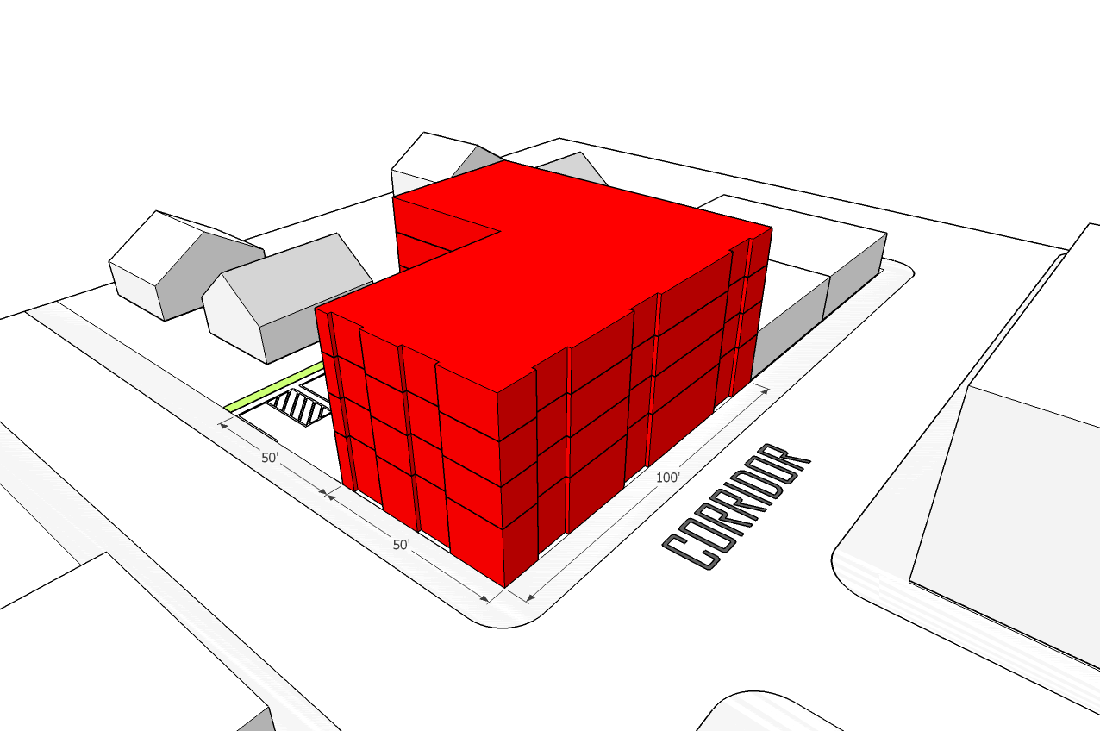
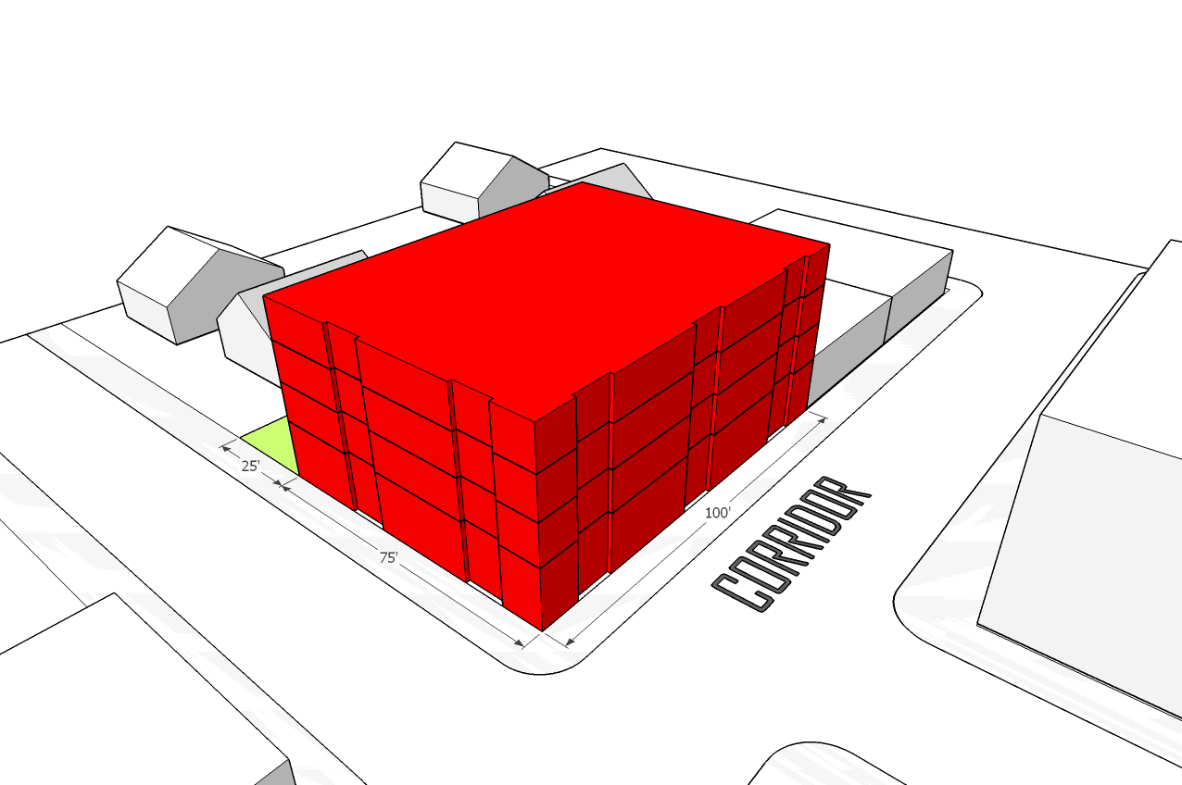
CE Zone
 | Medium Scale Zones
 | CE | CG
Height – Maximum Base (feet) | 45’ | 45’
Height – Maximum with Bonus | 45’ | 45’
FAR – Maximum Base | 2.5:1 | 3:1
FAR – Maximum* w/ Bonus | 3:1 | 3.4:1
* existing = estimated max for housing
Commercial
Retail Sales And Service | Y | Y
Office | Y | Y
Quick Vehicle Servicing | Y | Y
Vehicle Repair | Y | Y
Commercial Parking | Y | CU
Self-Service Storage | Y | L
Residential
Household Living | Y | Y
Group Living | L/CU | L/CU
Industrial
Manufacturing and Production | L | L/CU
Warehouse and Freight Movement | L | CU
Wholesale Sales | L | L
Industrial Service | CU | CU
Institutional
Basic Utilities | Y/CU | Y/CU
Community Service | L/CU | L/CU
Parks and Open Areas | Y | Y
Schools, Religious Institutions, etc. | Y | Y

Slide 10
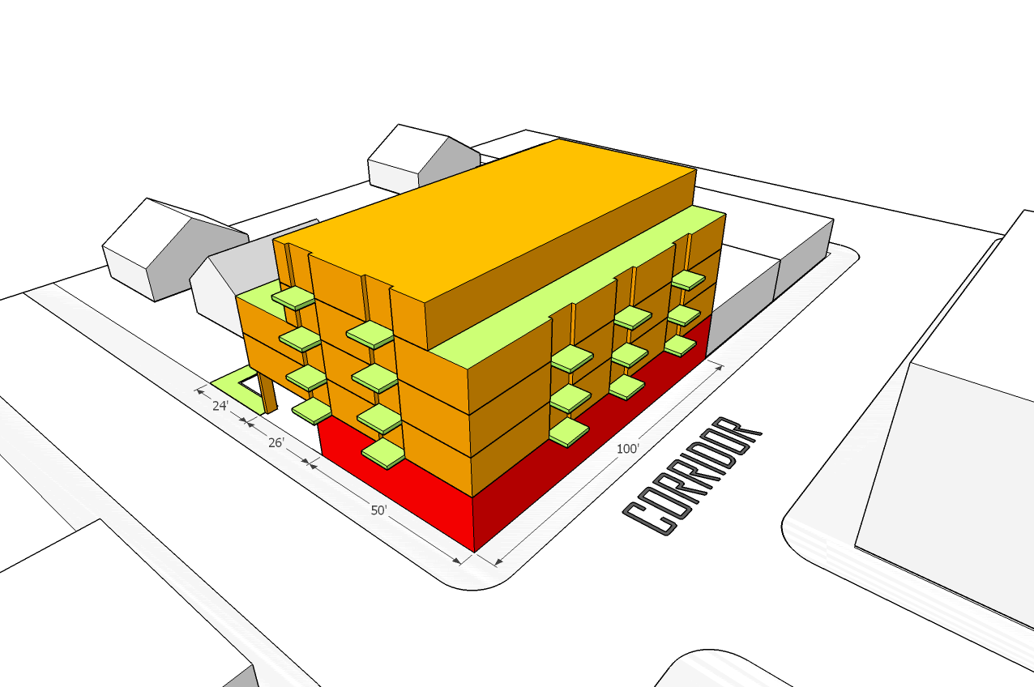
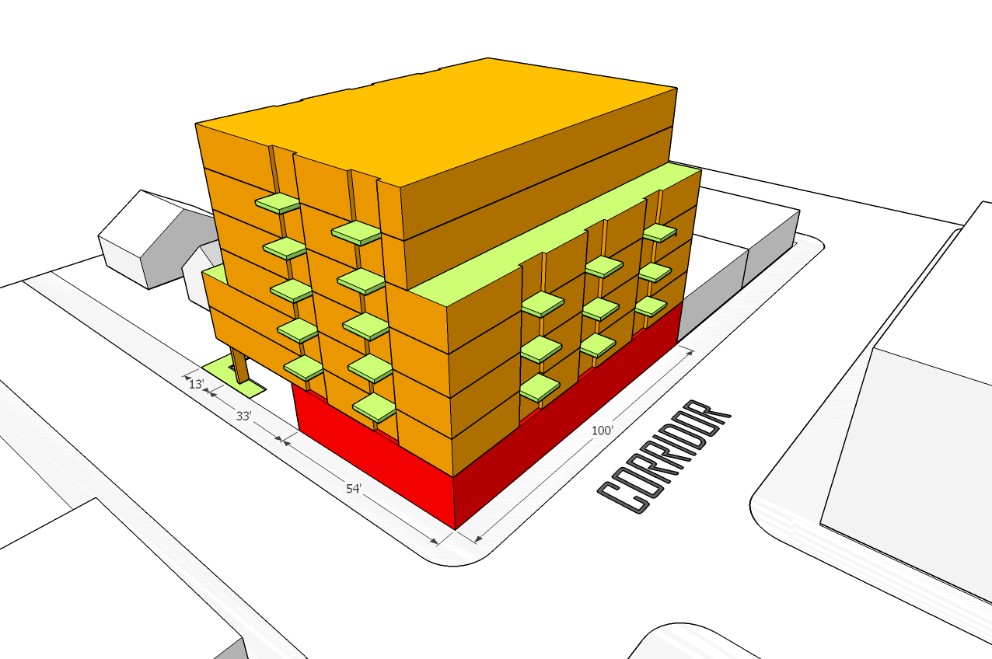
CM3 Zone
 | Large Scale Zones
 | CM3 | EX | CX
Height – Maximum Base (feet) | 65’ | 65’ | 75’
Height – Maximum with Bonus | 75’ | 65’ | 75’
FAR – Maximum Base | 3:1 | 3:1 | 4:1
FAR – Maximum* w/ Bonus | 5:1 | 3:1 | 7:1
* existing = estimated max for housing
Commercial
Retail Sales And Service | Y | Y | Y
Office | Y | Y | Y
Quick Vehicle Servicing | N | N | L
Vehicle Repair | Y | Y | L
Commercial Parking | L | CU | CU
Self-Service Storage | L | L | L
Residential
Household Living | Y | Y | Y
Group Living | L/CU | L/CU | L/CU
Industrial
Manufacturing and Production | L | Y | L/CU
Warehouse and Freight Movement | L | Y | N
Wholesale Sales | L | Y | L
Industrial Service | CU | Y | CU
Institutional
Basic Utilities | Y/CU | Y/CU | Y/CU
Community Service | L/CU | L | L/CU
Parks and Open Areas | Y | Y | Y
Schools, Religious Institutions, etc. | Y | Y | Y

Slide 11
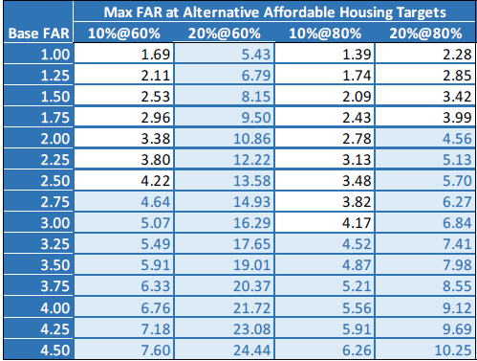
Topic 3: FAR Base and Bonus Analysis
CM1
CM2
CM3

Slide 12
Topic 4: Development and Design standards
Staff Recommendation:
Retain proposed height limits.
Allow 3-foot additional height for high ground floor citywide.
Retain step-downs to adjacent Residential zones.
Retain bonus step-backs in CM2, CM3 zones.
Remove step-back over 55’ in CM3 zone on narrow streets.
Retain building articulation and length standards.
Notes:
12

Slide 13
Topic 3: FAR Recommendations
 | Commercial Mixed Use 1 (CM1) | Commercial Mixed Use 2 (CM2) | Commercial Mixed Use 3 (CM3) | Commercial Employment (CE)
Preliminary Form
Examples
Height Limit FAR | 35’ (3) | 45’ (4) | 65’ (6) | 45’ (4)
Bonus Ht Limit Bonus FAR | 35’ (3) | 55’ (5)* * In key locations | 75’ (7) | 45’ (4)

Slide 14
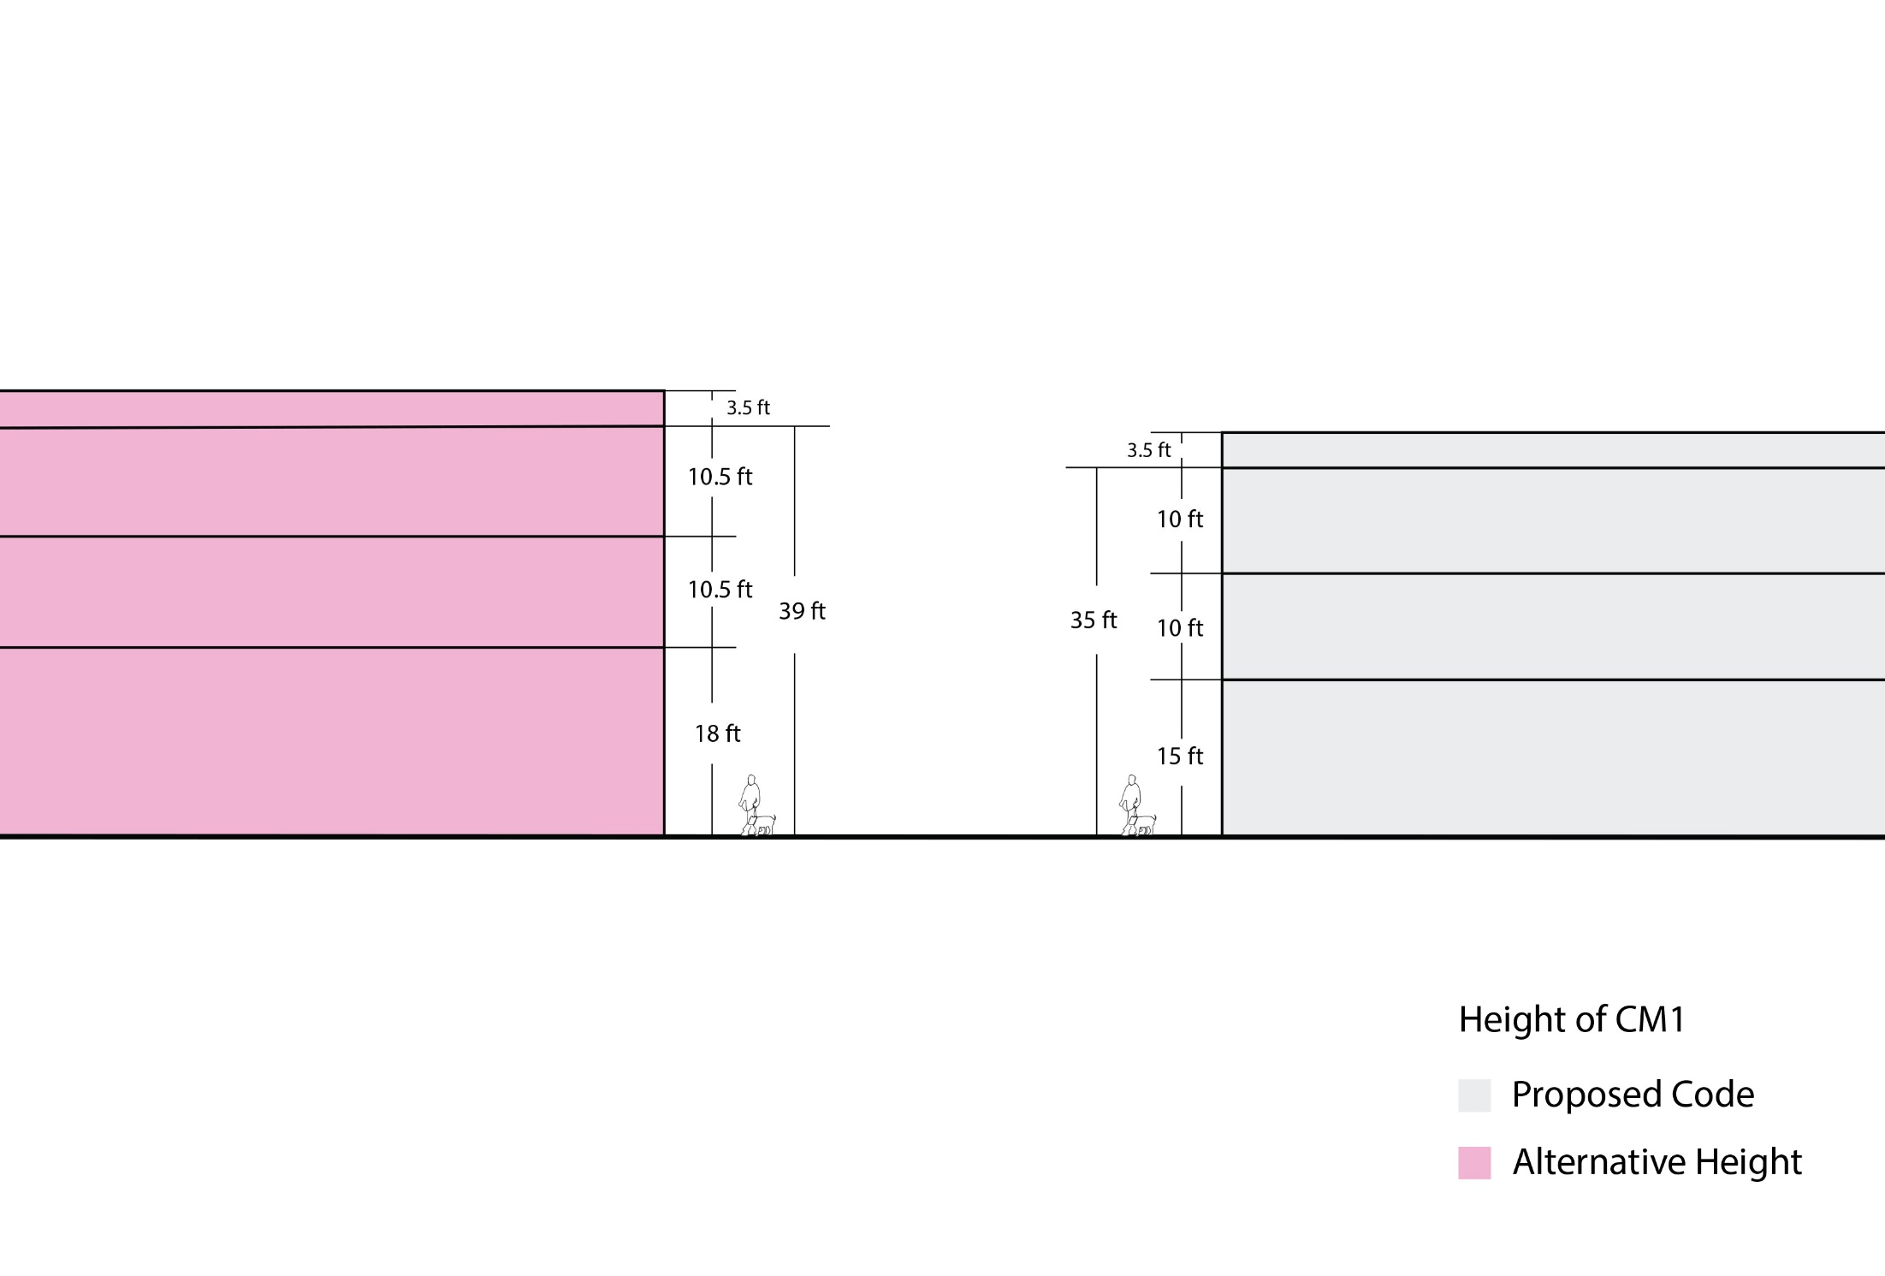
Topic 4: Height Alternative – CM1

Slide 15
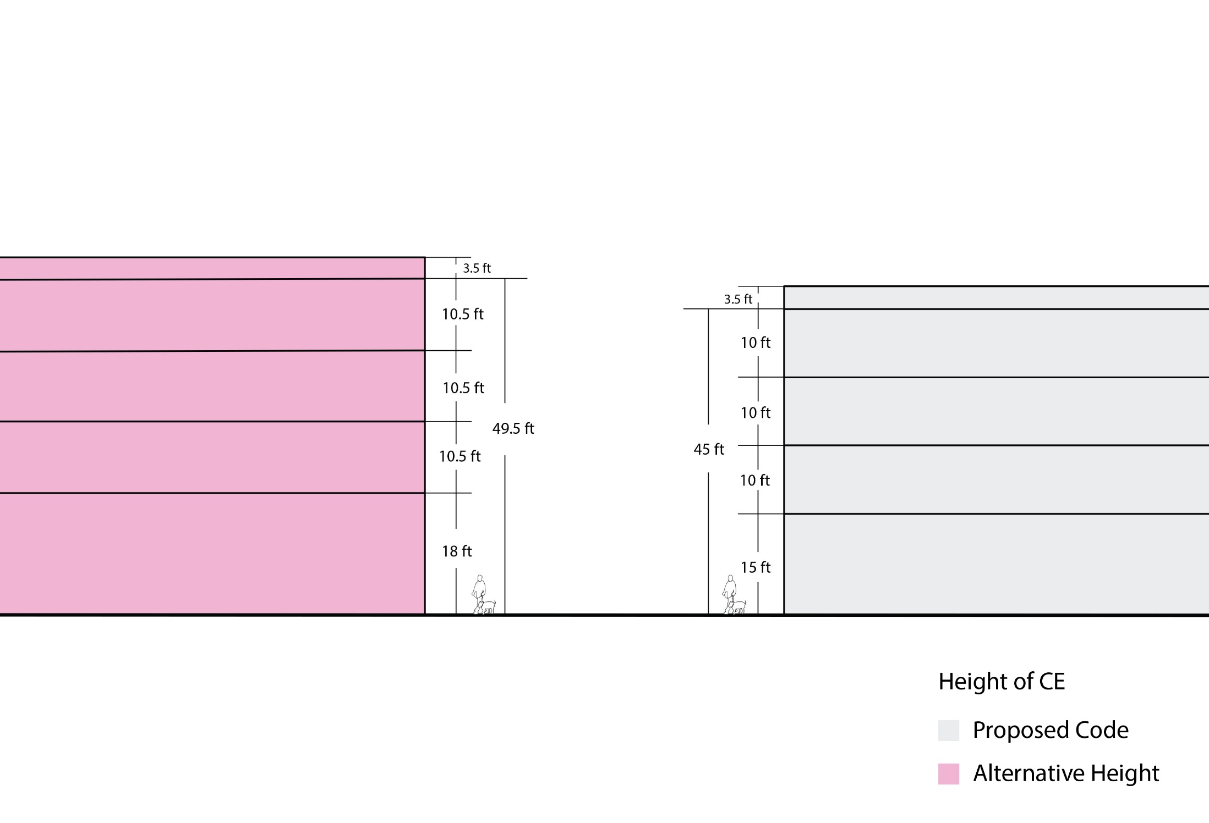
Height Alternative - CE

Slide 16
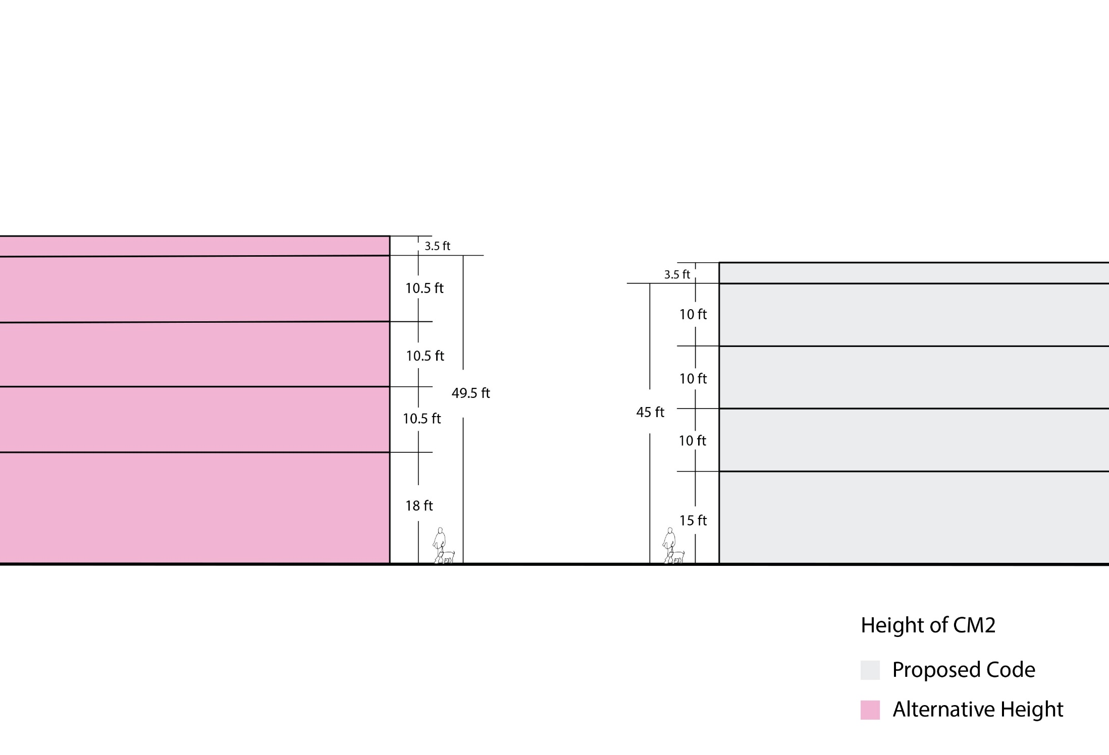
Height Alternative – CM2

Slide 17
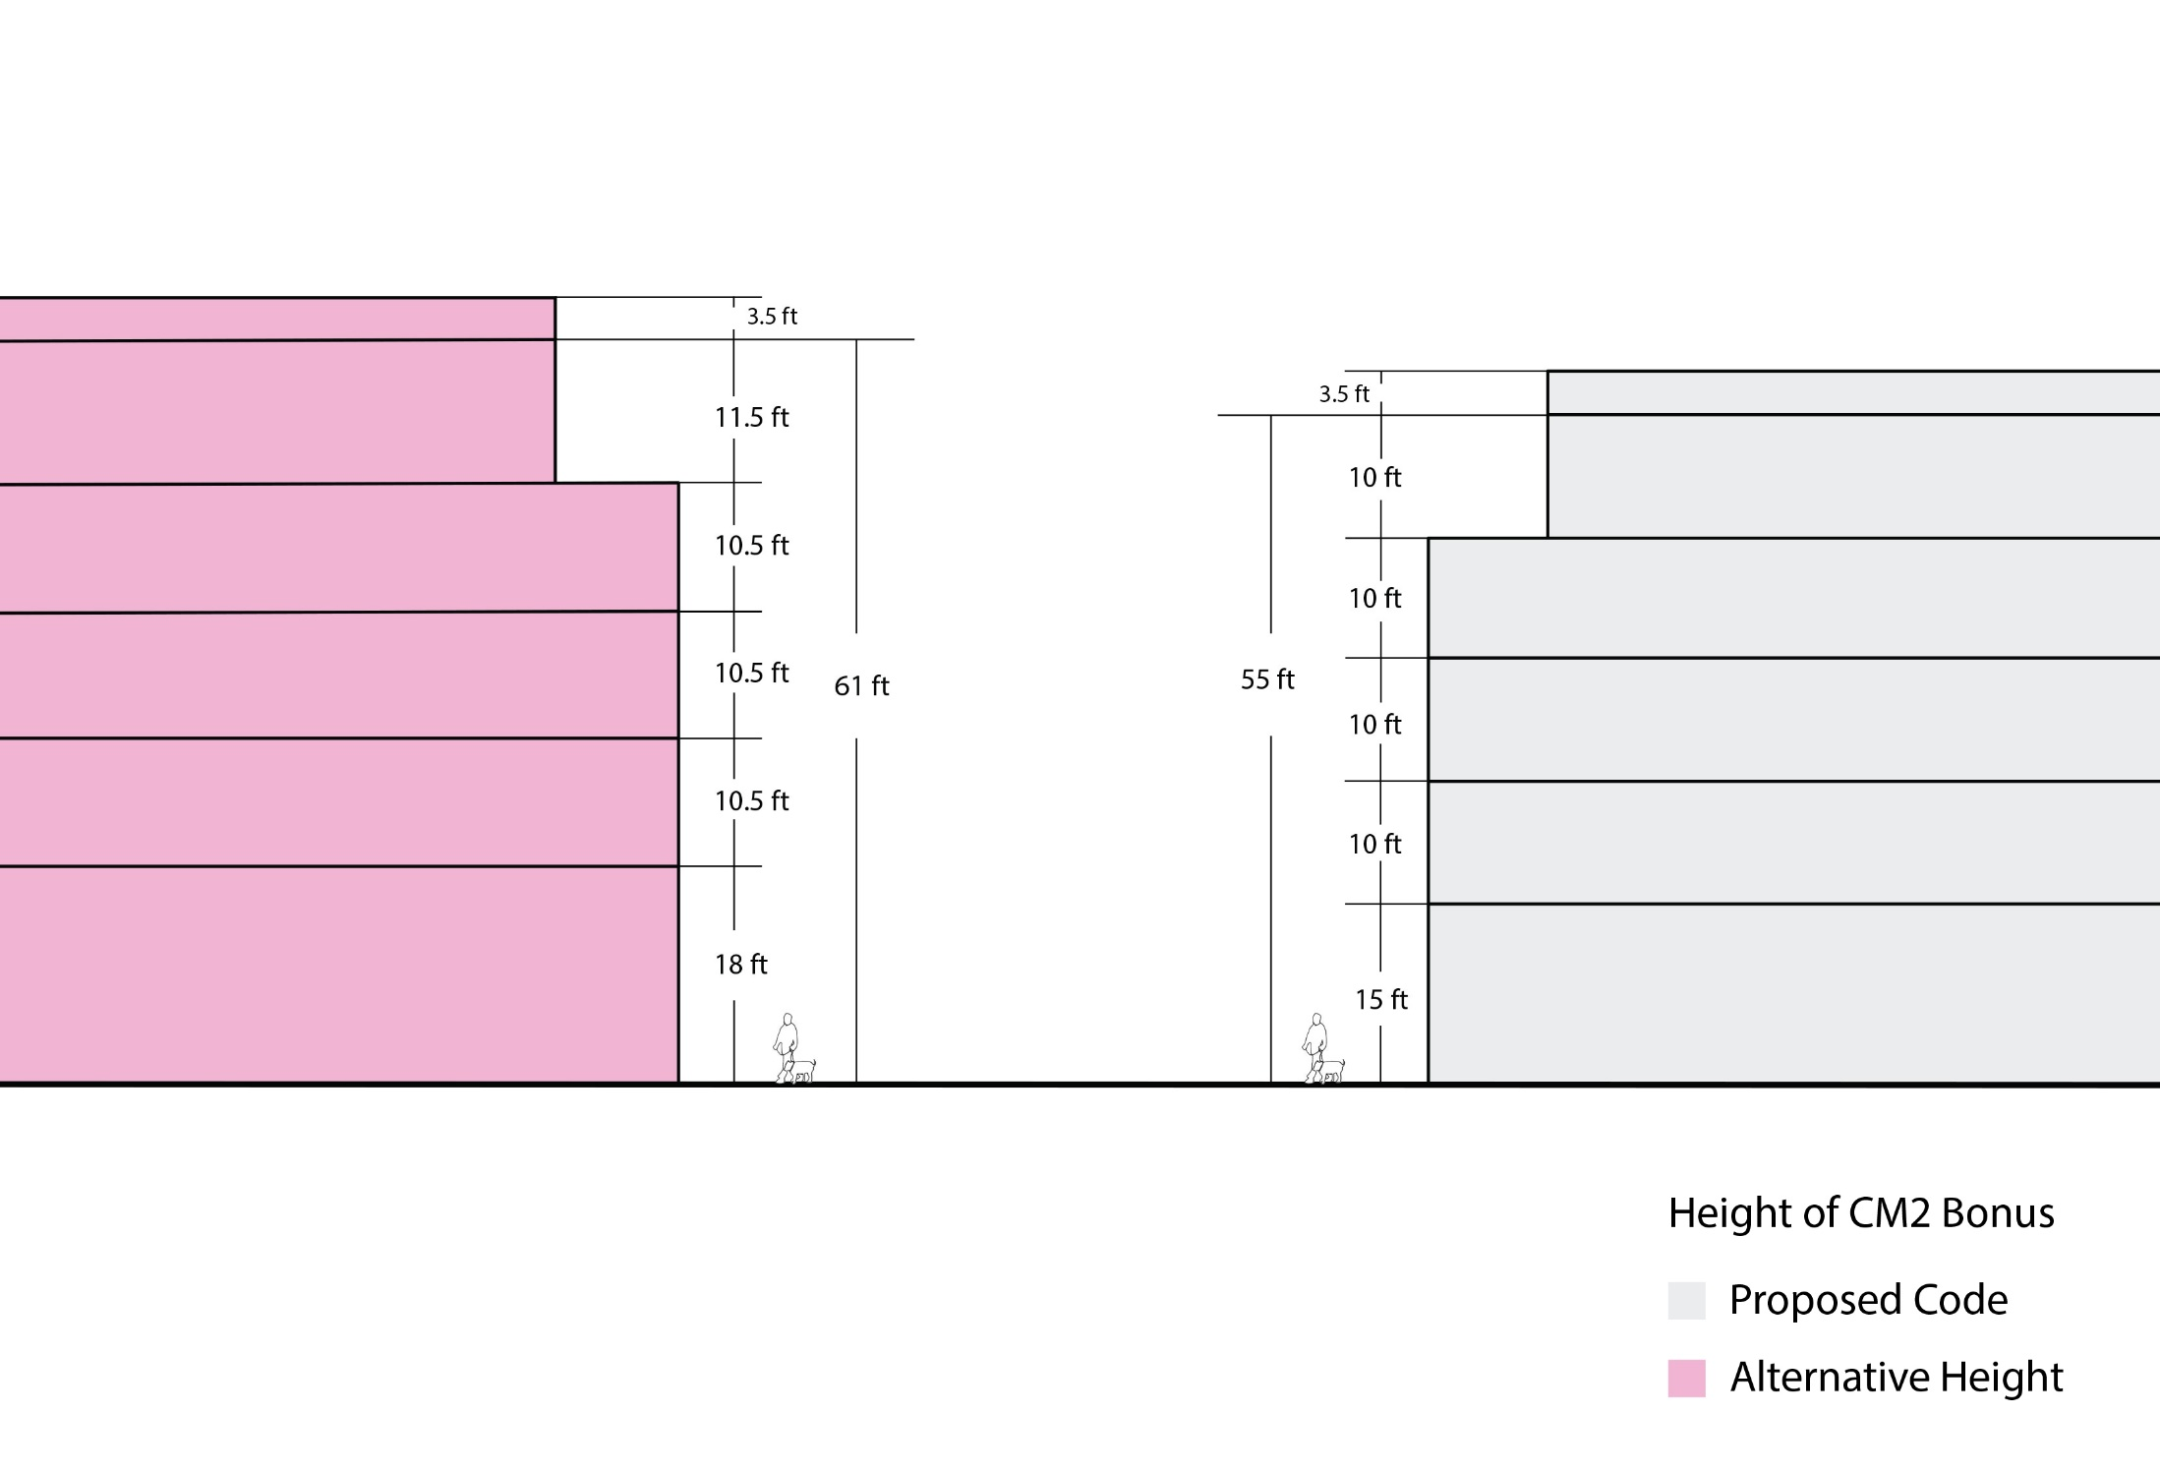
Height Alternative – CM2 Bonus

Slide 18
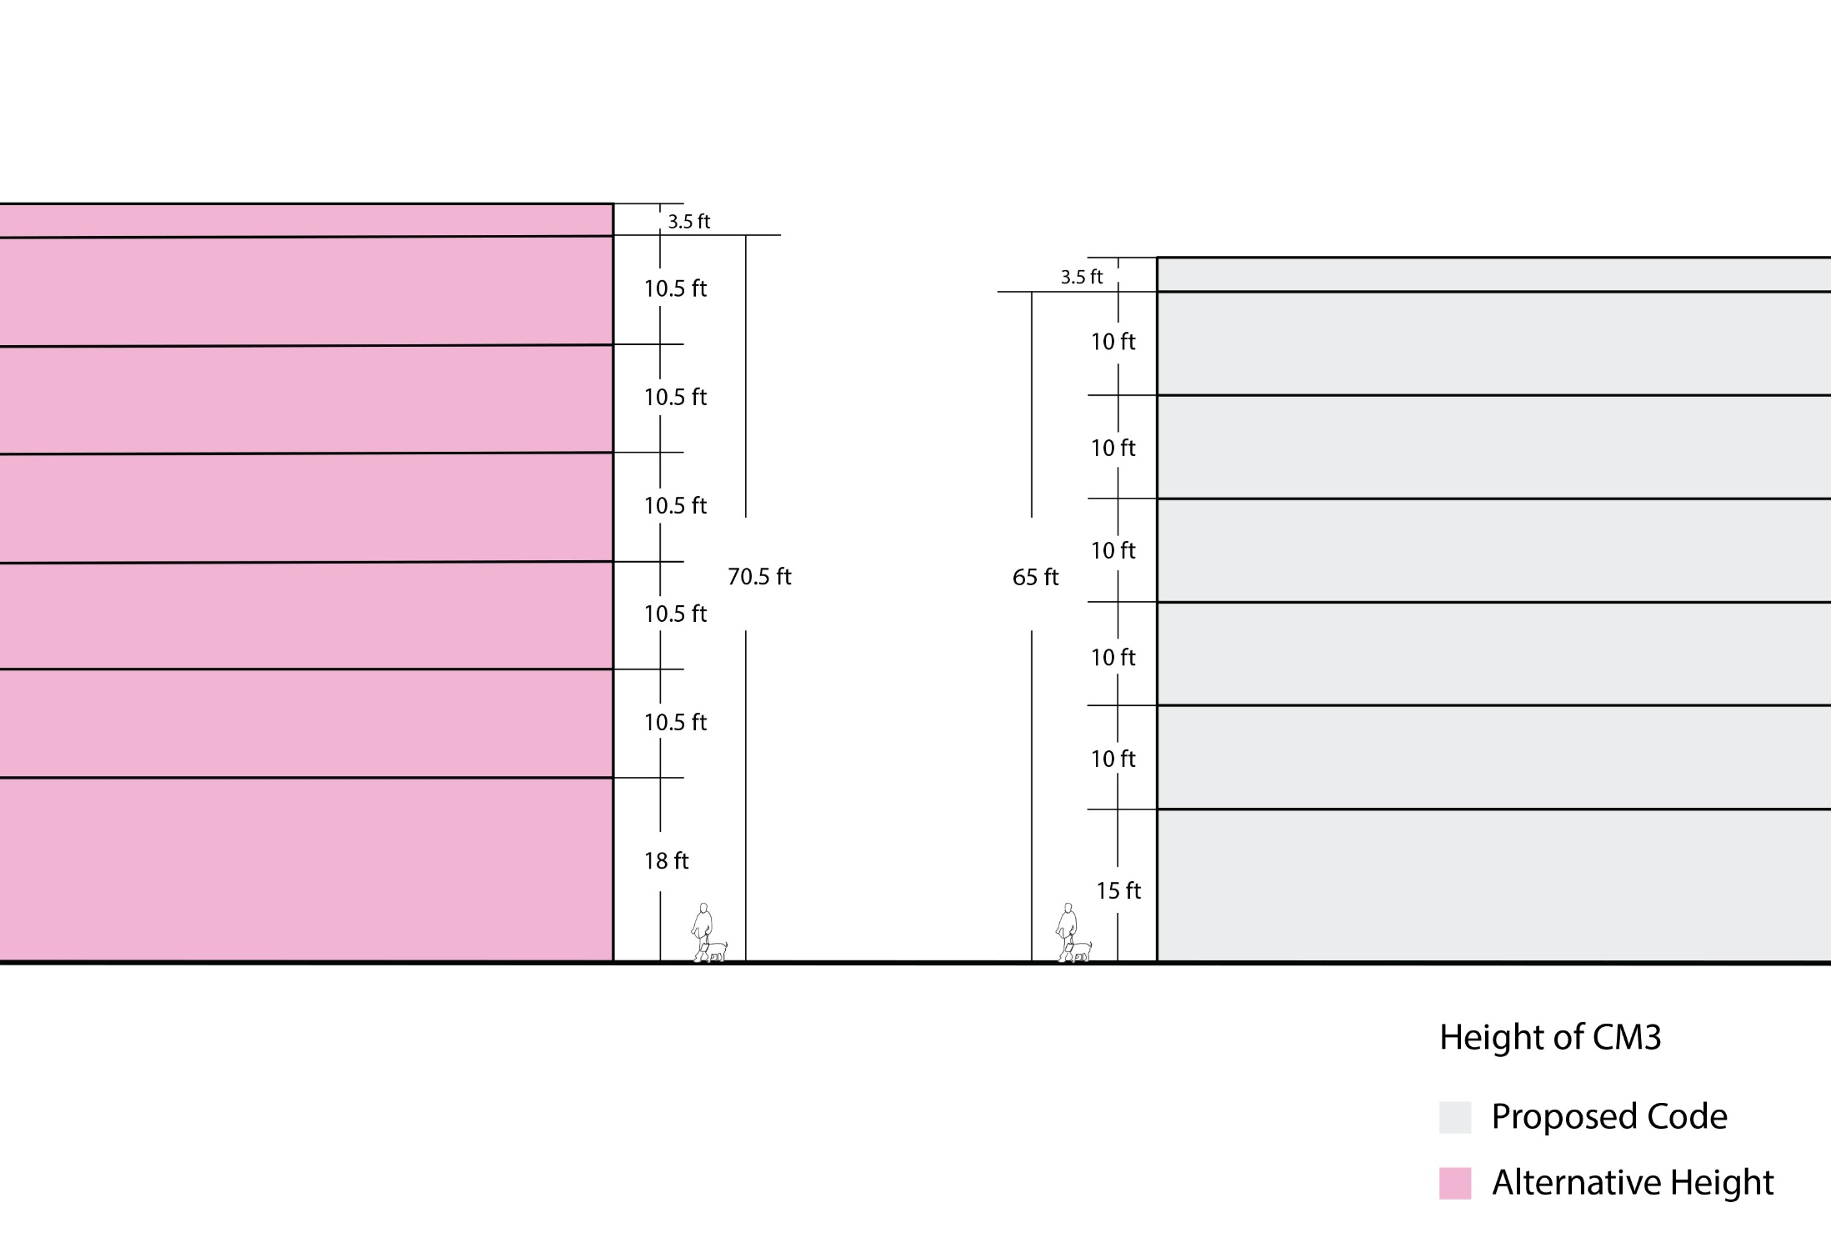
Height Alternative – CM3

Slide 19
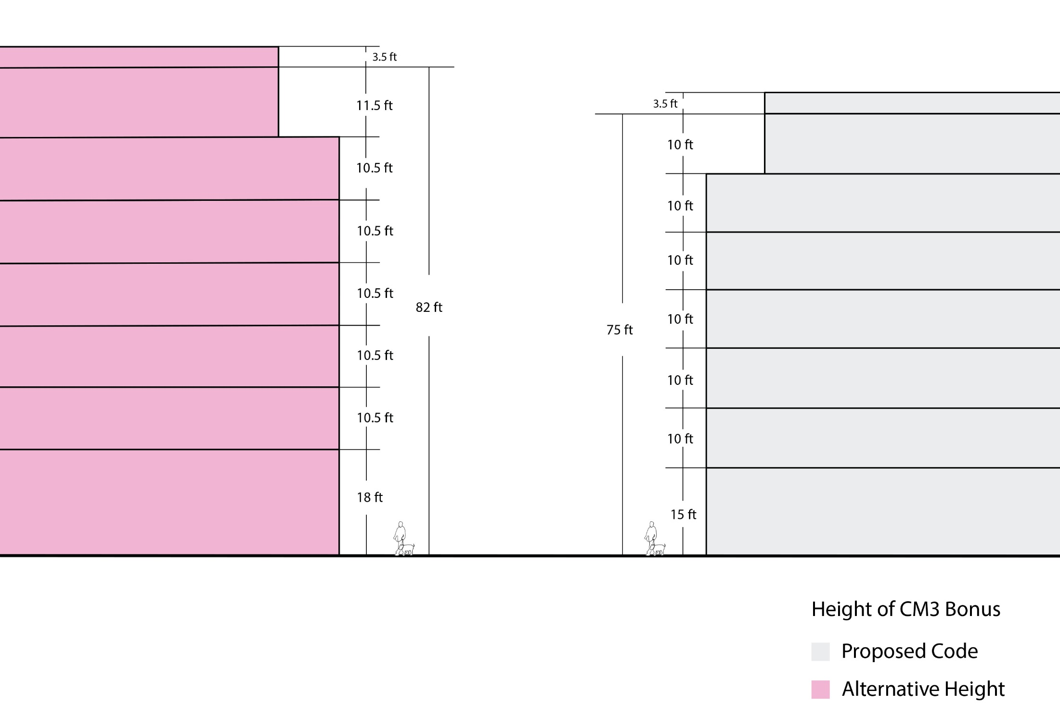
Height Alternative – CM3 Bonus

Slide 20
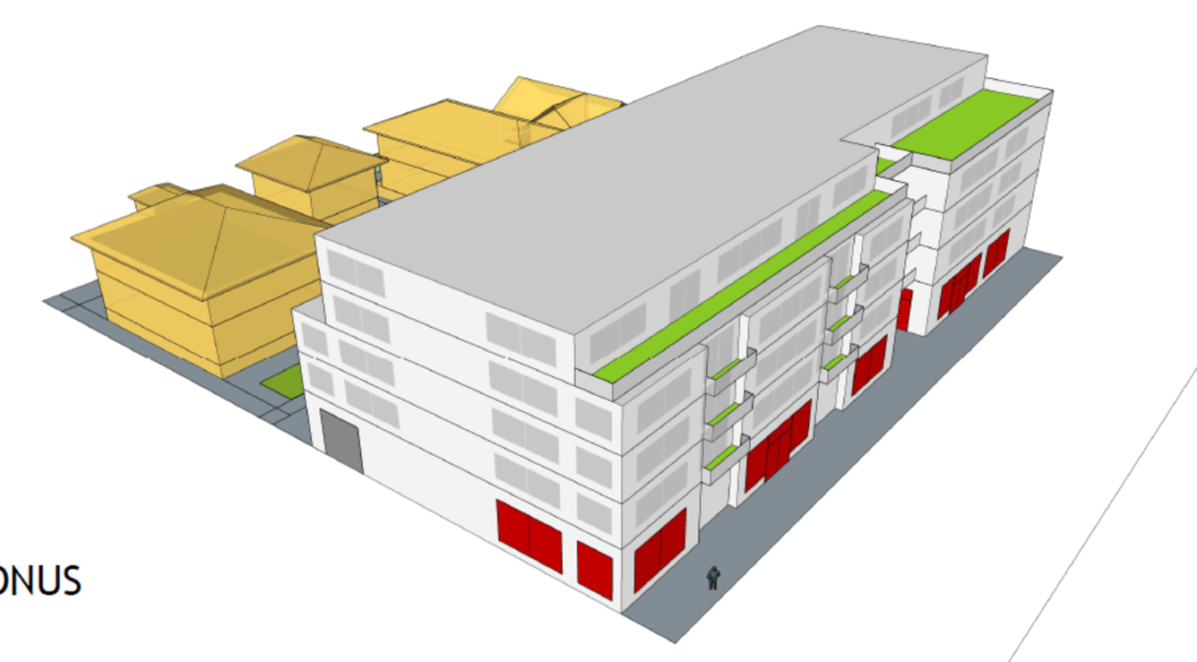
Building Form Standards
Step Down Height and Building Articulation
“Step down”
Adjacent to lower-density residential zones
“Step back”
For bonus height
CM3 on narrow streets

Slide 21
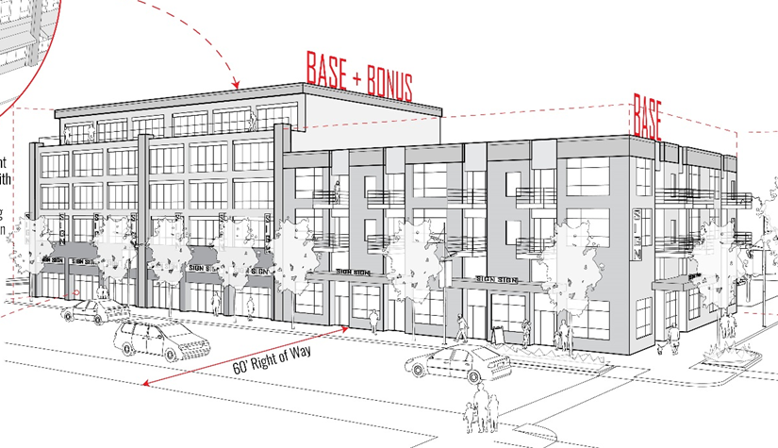
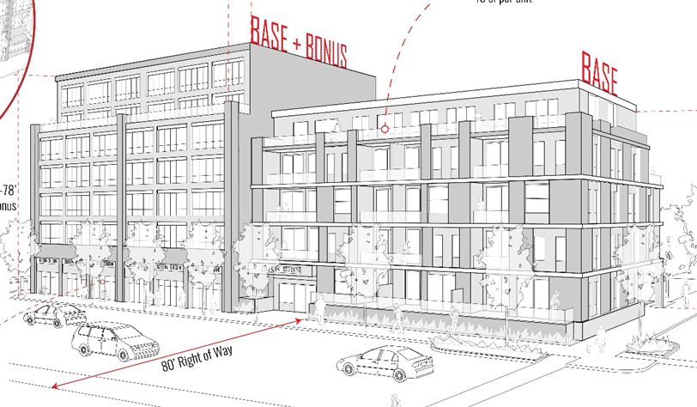
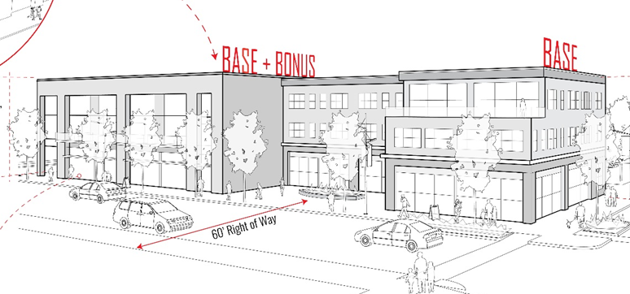
When Step Downs or Step Backs Are Required
 | CM1 | CM2 and CE | CM3
Step Downs to Residential Zones | Never required | Adjacent to SFR zones | Adjacent to SFR zones and R3 – R1 MFR zones
Front Step Backs | Never required | Only required for bonus height above 4 stories (45’) | Required for bonus height above 6 stories (65’) and on narrow streets above 5 stories (55’)

Slide 22
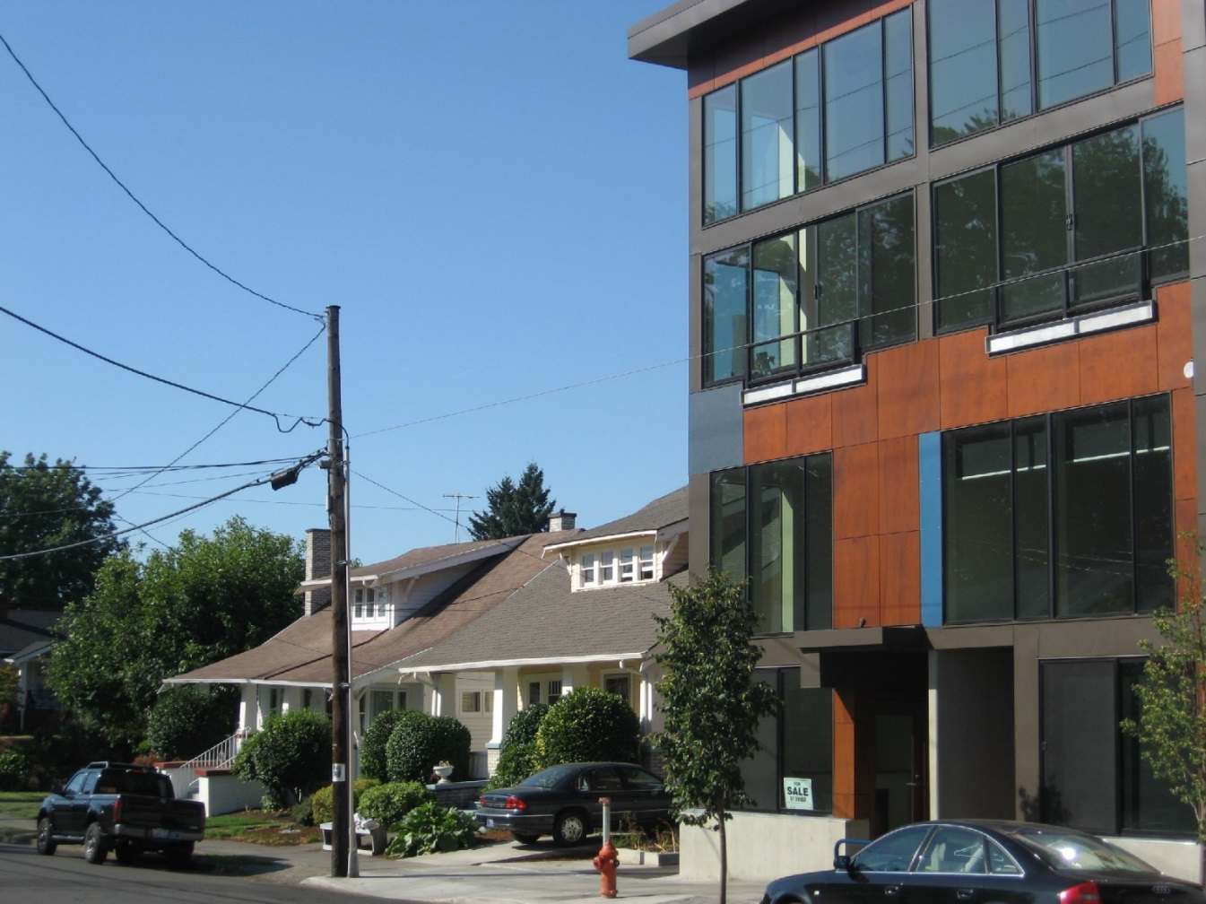
Addresses community concerns about need for scale transitions adjacent to single-dwelling zoning
Height Step Downs to Residential Zoning

Slide 23
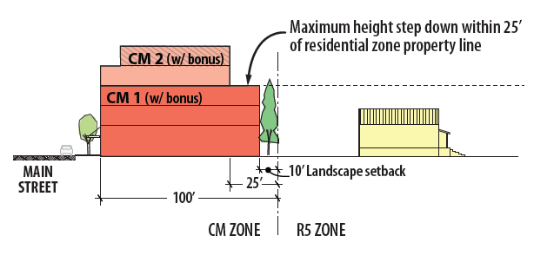
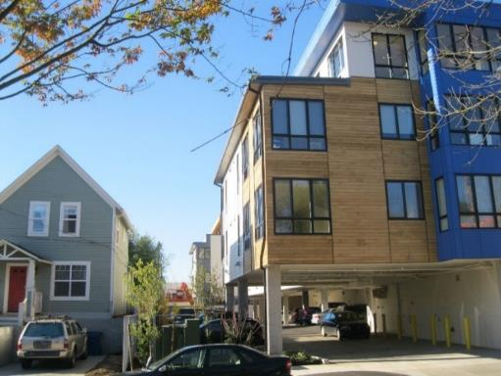
Within 25’ of abutting residential zones:
- Height limited to 35’ adjacent to SFR zones
- Height limited to 45’ adjacent to R3 – R1 MFR zones
Height Step Downs to Residential Zones
MUZ Proposal

Slide 24
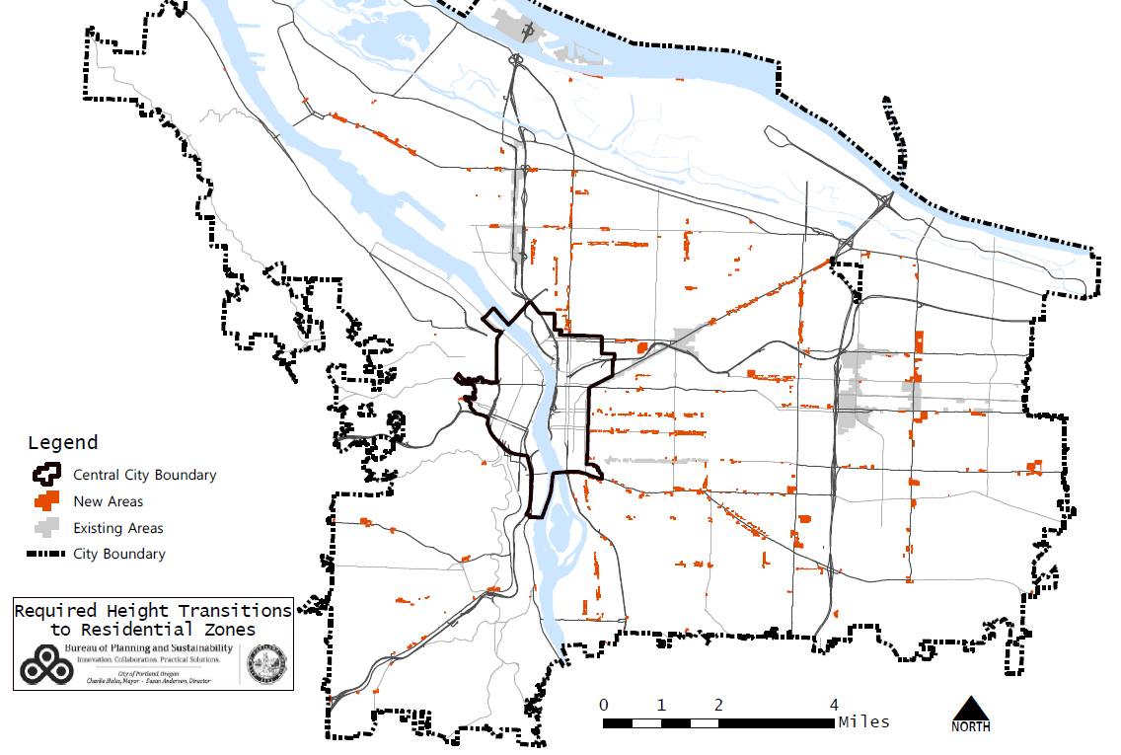
Map of where height transitions will apply
Height Step Downs to Residential Zoning

Slide 25
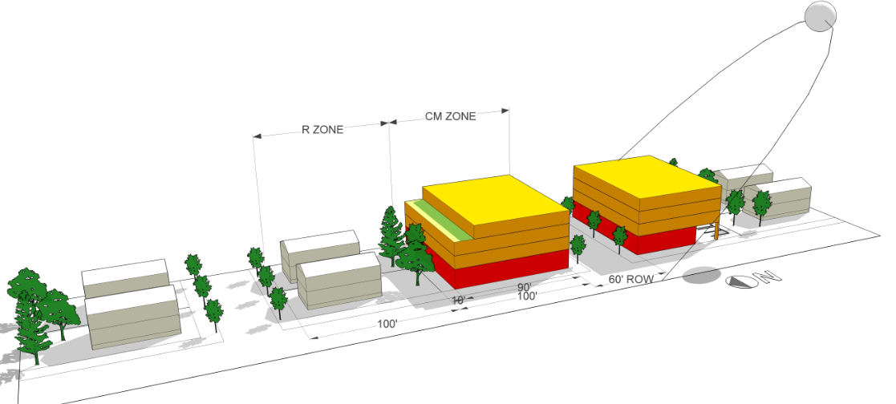
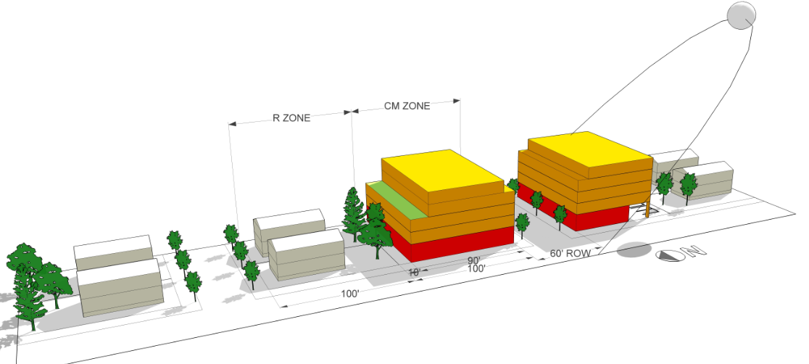
Front Step Backs
Bonus height step backs
Solar access modeling for CM2 zone: both 4-stories and 5th story bonus preserve solar access across the street (Spring and Fall equinox)

Slide 26
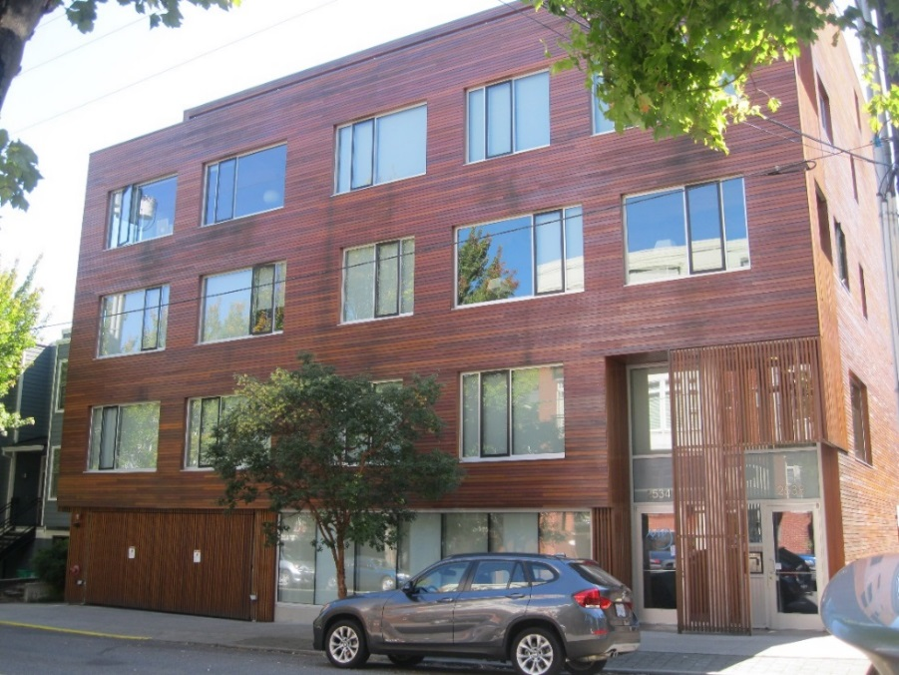
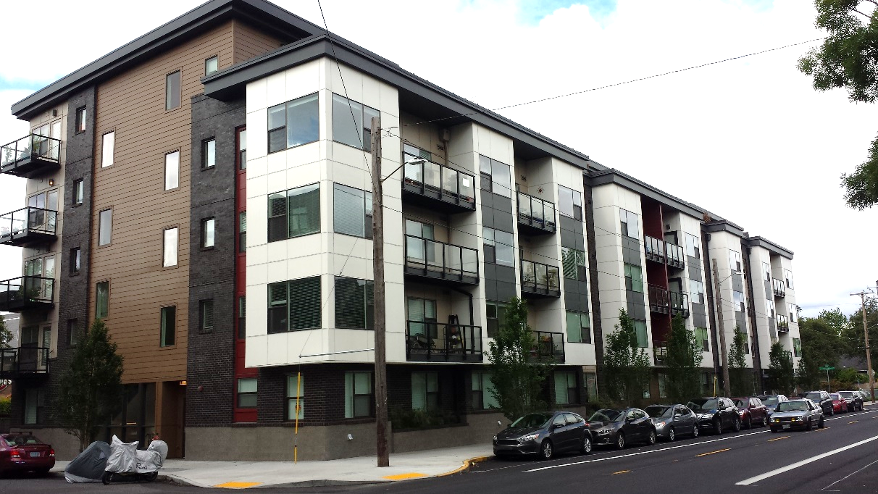
Front Step Backs - Examples
Step backs not required on secondary streets
Mixed use zoning typically less continuous on side streets
Avoids costs and design issues of step backs on all frontages

Slide 27
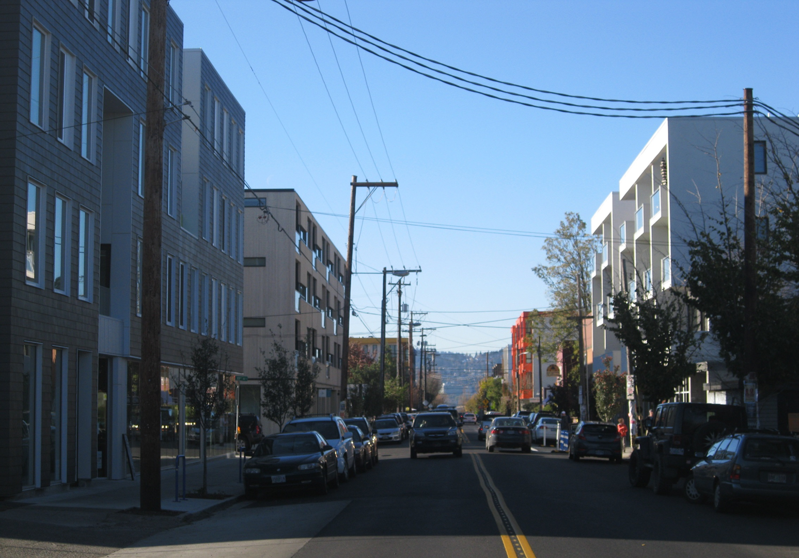
Front Step Backs
Bonus height step backs
Responds to community concerns about building scale
Retains base zone street wall height, stepping back additional bonus height to minimize appearance of greater scale

Slide 28
Front Step Backs
Bonus height step backs
Responds to community concerns about building scale
Retains base zone street wall height, stepping back additional bonus height to minimize appearance of greater scale

Slide 29
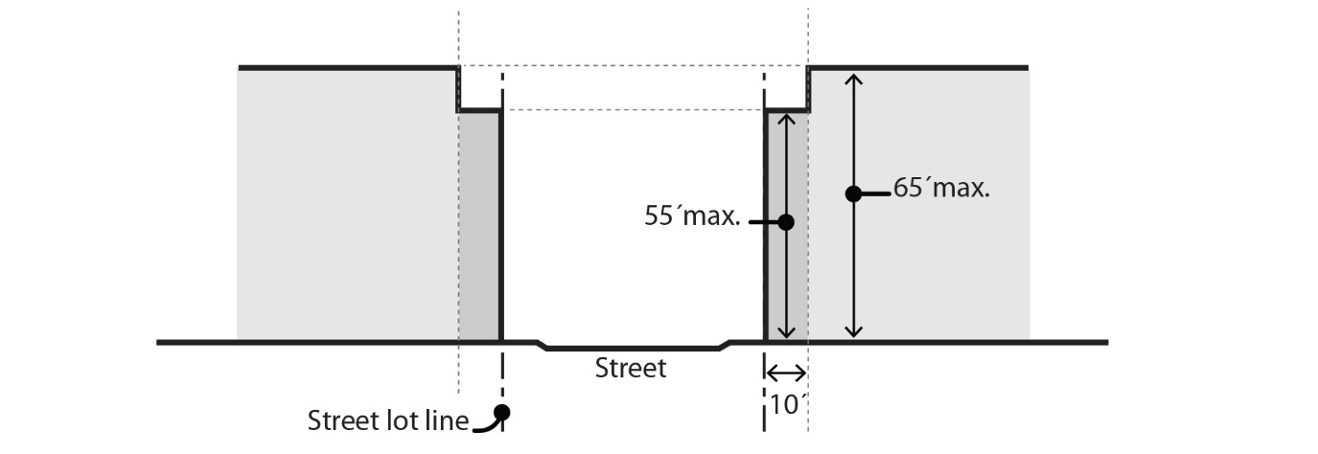
CM3 - Front Step Backs (drop from proposal)
CM3 zone along narrow streets:
Limit street wall height to 55’ along streets with less than 70 feet of ROW
Responds to solar access and street space enclosure considerations
Height-to-street-width analysis

Slide 30
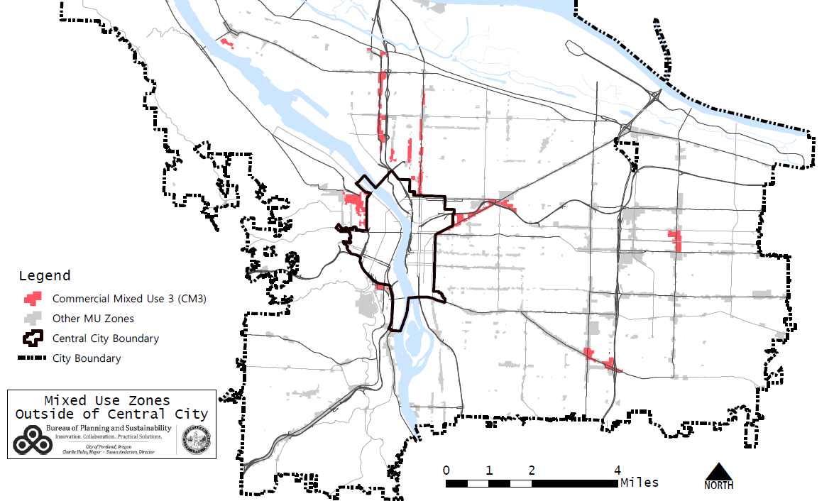
CM3 Front Step Backs (drop from proposal)
CM3 zone along narrow streets
Some areas where CM3 step downs (above 5th story) would apply

Slide 31
Façade Articulation
  Façade Articulation:
  CM2: required when over 35’ and over 3500 SF area
  CM3: required when over 45’ and over 4500 SF area
  Only counts façade planes within 20 feet of lot line

Slide 32
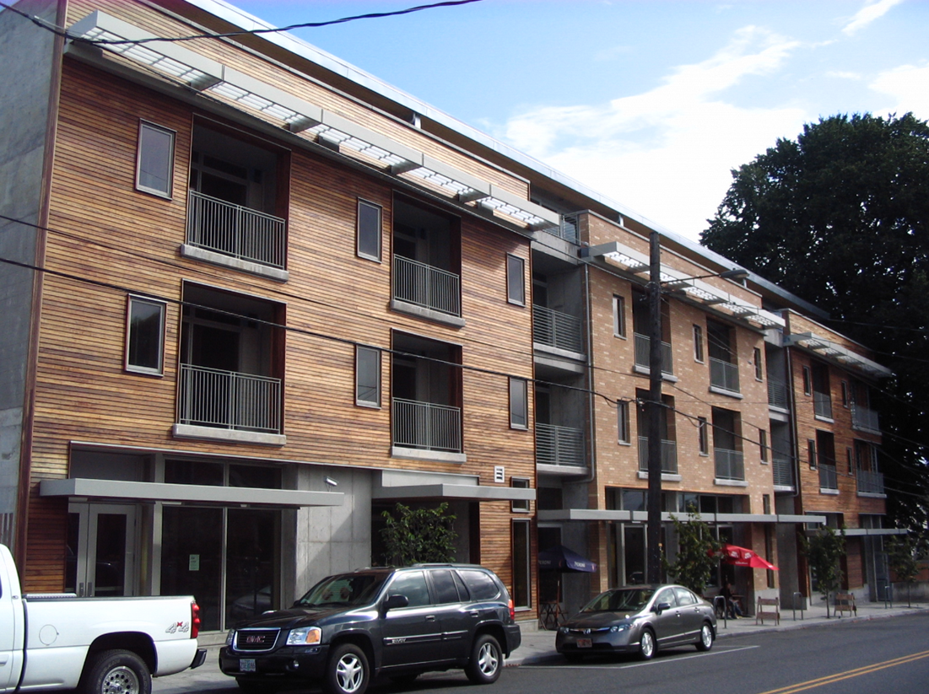
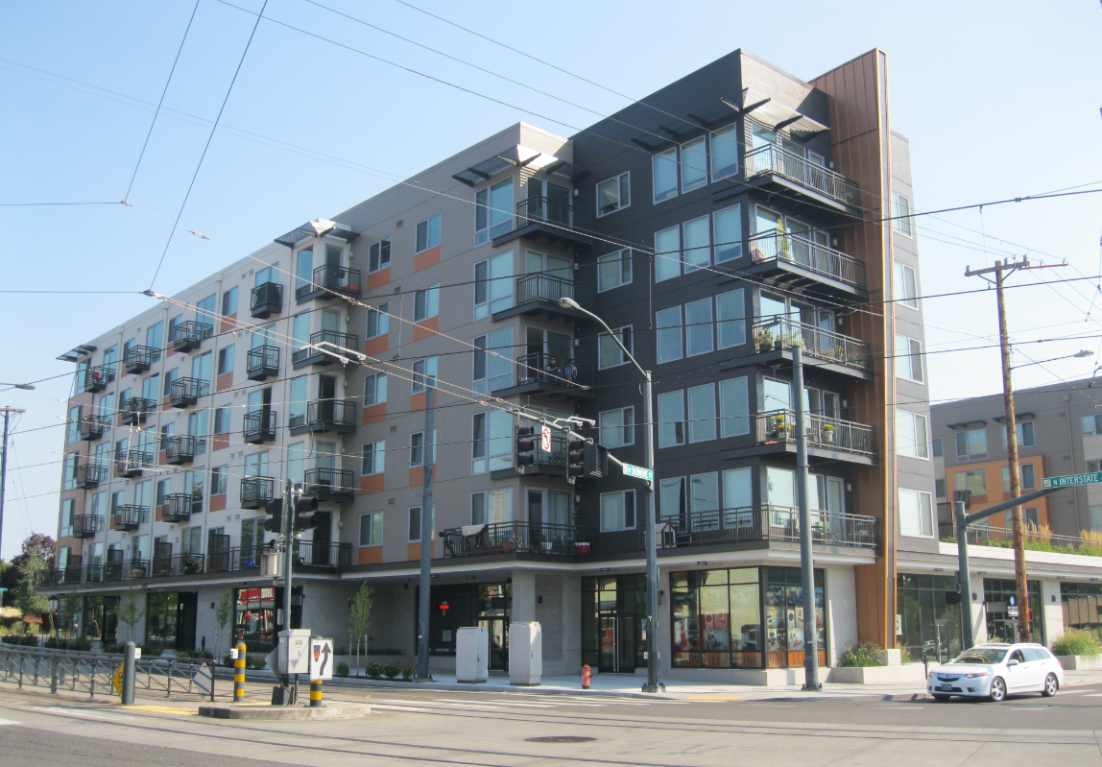
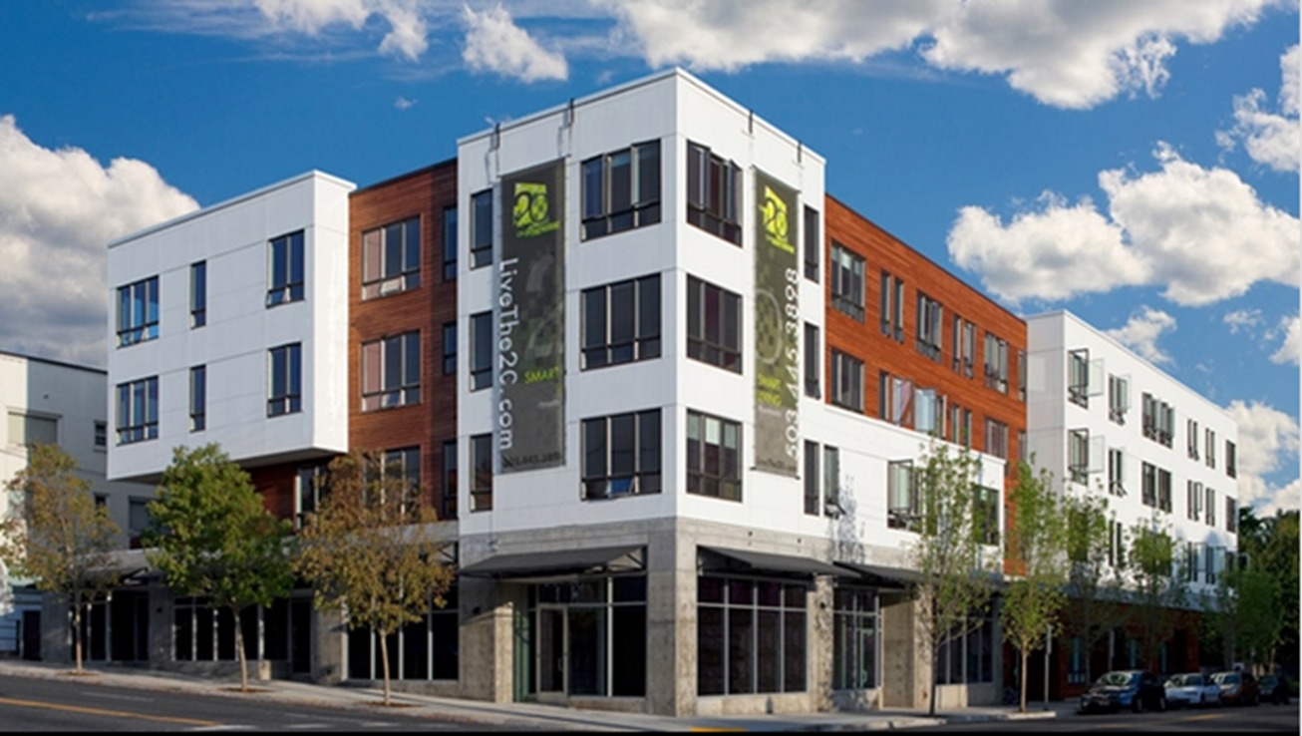
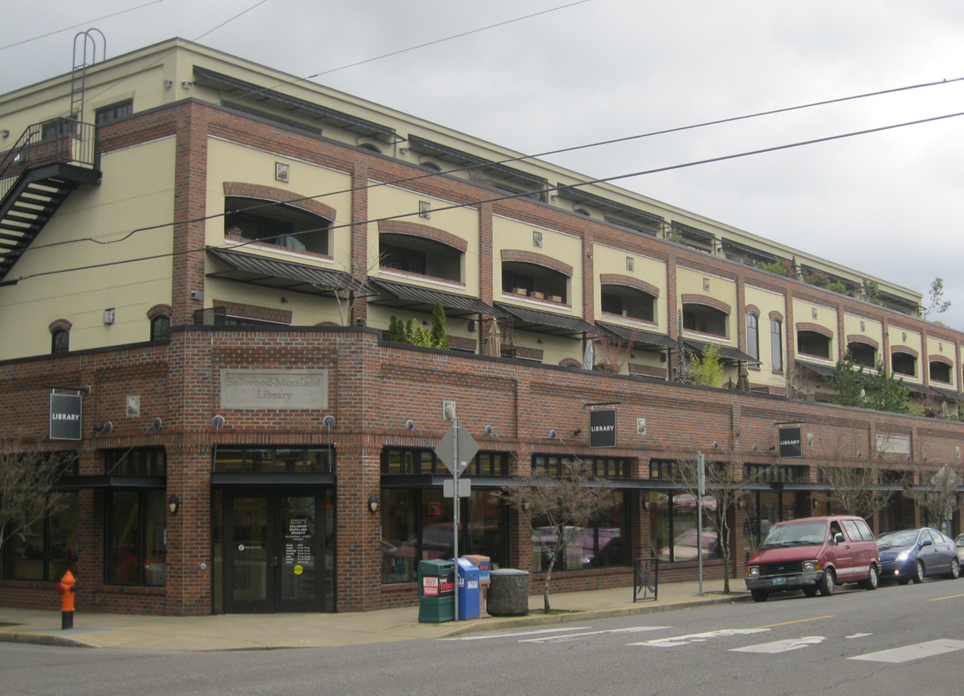
Façade Articulation
  Examples providing 25% (or more) façade articulation
  - can be met through a variety of design approaches

Slide 33
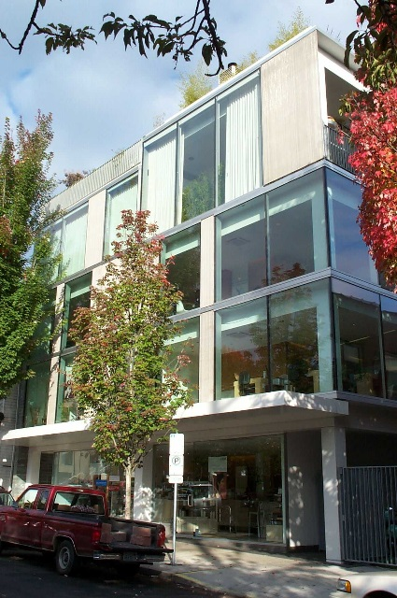
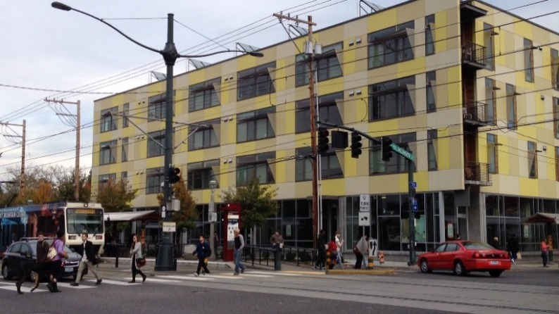
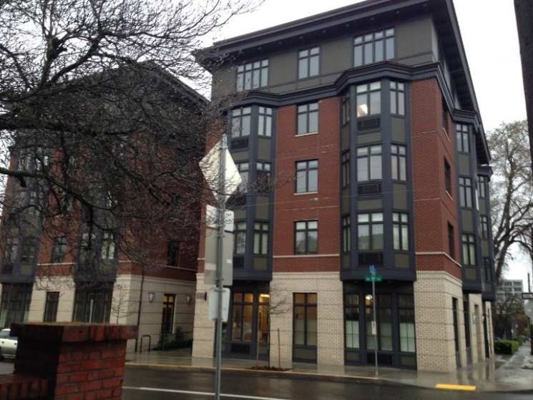
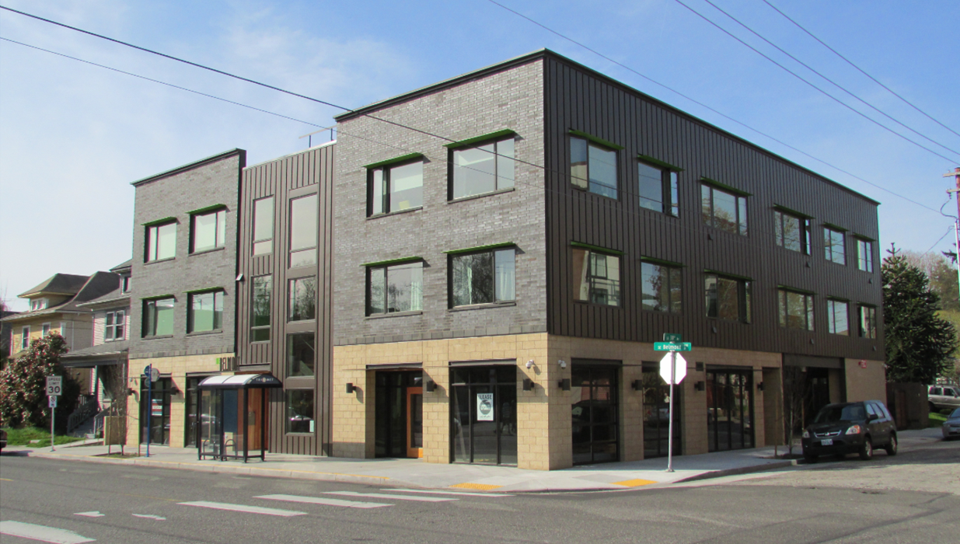
Façade Articulation
  Examples that would not require façade articulation
  ( façades smaller than triggering threshold )
CM2
CM3
(two separate façade areas)

Slide 34
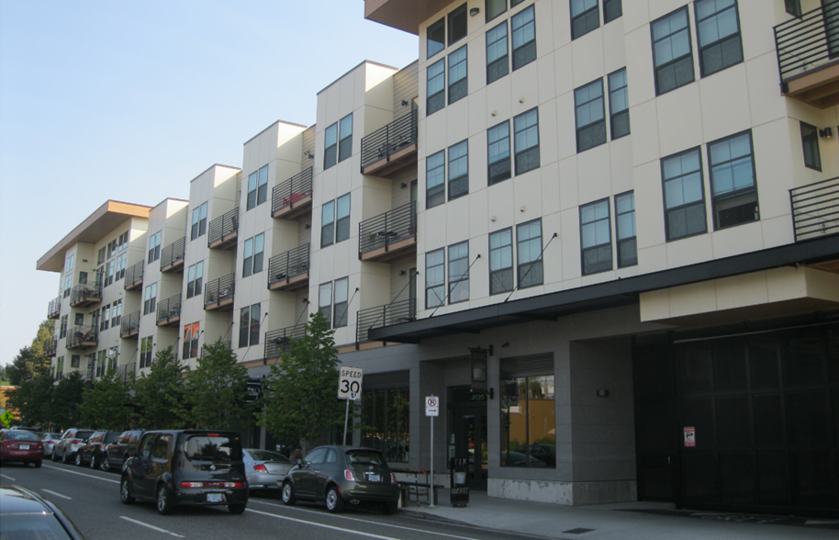
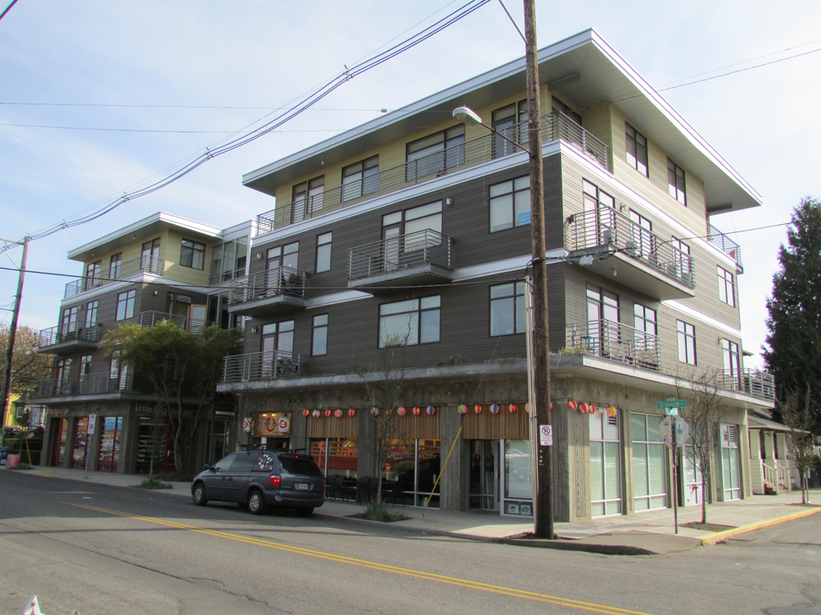
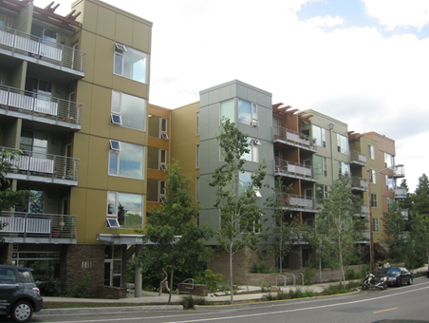
Responds to community interest in continuing the fine grain development patterns of neighborhood mixed use areas, avoiding “monolithic” buildings.
Building Length Limits
Building with façade length exceeding the common 200’ pattern
Divided building volumes

Slide 35



Building Length
- Limits building length to 200’ close to street frontages
Building Length Limits

Slide 36
Topic 5: Drive Thrus; QVS; development standards
Staff Recommendation:
CE zone: allow drive throughs and Quick Vehicle Servicing uses.
CM1, CM2, CM3: allow existing drive throughs and Quick Vehicle Servicing uses; prohibit new facilities.
Revise code to allow “Click and Collect” type facilities.
Retain DT + QVS prohibition in Centers Main Street overlay.
Revise buffering standards adjacent to Residential zones.
Notes:
36

Slide 37

Topic 5: Drive Thrus; QVS; development standards
Insert Maps
Notes:
37

Slide 38

Topic 5: Drive Thrus; QVS; development standards
Insert Maps
Notes:
38

Slide 39
Topic 6: CE Zoning - grocery, etc.; Development standards
Staff Recommendation:
Limited CE zone changes in response to requests.
Consider limited RTF recommendations for CE zoning.
Consider limited expansion of CE zoning based on Policy 4.24:
“Prohibit drive-through facilities in the Central City and limit development of new ones in the Inner Ring Districts and centers in order to support a pedestrian-oriented environment.”
Retain proposed development standards.
Notes:
39

Slide 40

Proposed Zoning Map
Centers Map
Notes:
40

Slide 41

CE Requests + RTF Recommendations
Centers Map
Notes:
41

Slide 42
CE Requests
Centers Map
Notes:
42

Slide 43
CE Requests + RTF Recommendations
Centers Map
Notes:
43

Slide 44
CE Requests + RTF Recommendations
Centers Map
Notes:
44

Slide 45

CE/Drive Thru Policy Expansion Areas – CM1
Map Broad CE Allowances in CM1
Notes:
45

Slide 46

CE/Drive Thru Policy Expansion Areas – CM2
Map Broad CE Allowances in CM1
Notes:
46

Slide 47

Development Standards
Insert Maps
Notes:
47

Slide 48

Development Standards
Insert Maps
Notes:
48

Slide 49

Development Standards
Insert Maps
Notes:
49

Slide 50

Development Standards
Insert Maps
Notes:
50

Slide 51

Auto-Accommodating Development
Insert Maps
Notes:
51

Slide 52

Development Standards
Alternative maximum building setback
for large retailers
Provides flexibility for shopping centers.
Allows large retail buildings to be set behind parking, when smaller secondary buildings are built close to public streets.
Proposed Draft reduces qualifying threshold from a 100,000 SF to 60,000 SF retail building.
Notes:
52

Slide 53
Topic 7: Code Issues raised in testimony and identified by: PSC; Design, Historic Landmarks and Urban Forestry Commissions; BDS; BPS
Staff Recommendation:
Tentatively approve staff recommendations shown in items 7.1 to 7.5.
Provide direction on 7.1.F and 7.5.A.
Review final code prior to August 9, 2016 work session.
Notes:
53

Slide 54

Topic 7: Street Frontage Design
Ground Floor Options for Residential Uses
- Design to accommodate future commercial uses, or
- Setback or elevate units for privacy

Slide 55



Street Frontage Design
Historic examples with shared entrances
Require all ground level units to have separate entrances?
Allow as an option.
Continue to allow other configurations that use shared entrances.

Slide 56



Side Setback Requirements
Require a minimum of five feet between residential windows and property lines
Topic 7: Residential Livability Standards

Slide 57


Topic 7: Ground Floor Windows
  Ground Floor Windows
  40% window standards is increase over current 25%
  Accommodates a range of uses – office, car repair, medical, etc.
  60% standard is geared to retail – strategically applied

Slide 58

Topic 7: CM1 Expand Hours Limitations to 15K SF lots

Slide 59
Resource Slides

