Slide 1



Ensuring Accountability,
Inspiring Trust.

Slide 2

Sending Your Records To PARC
A step-by-step guide for packing and shipping boxes

Slide 3
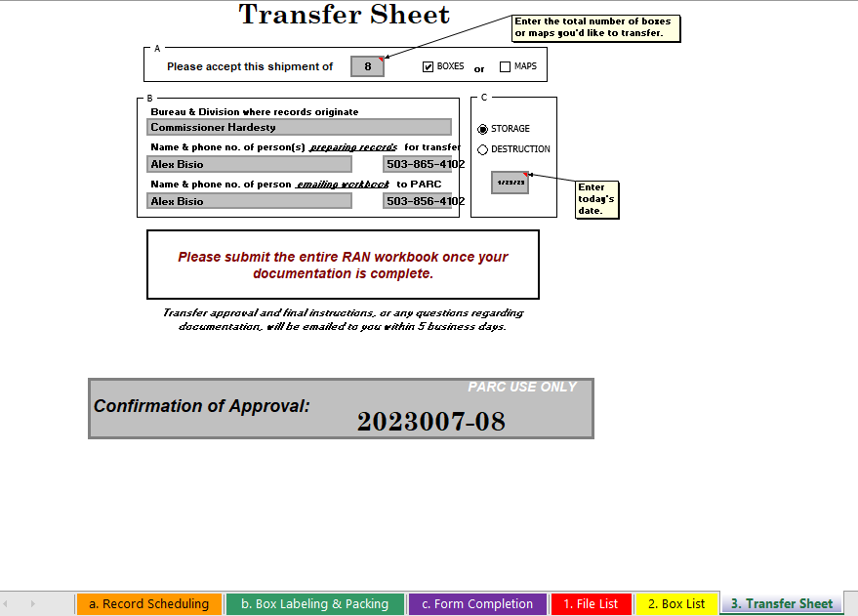
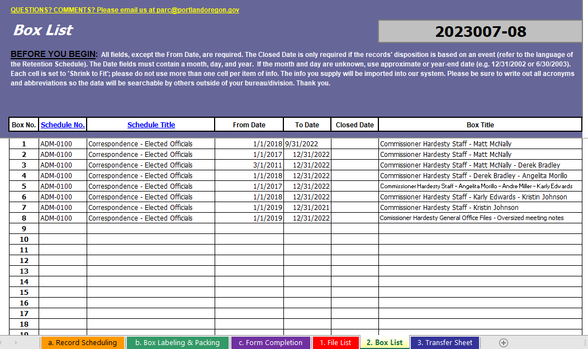
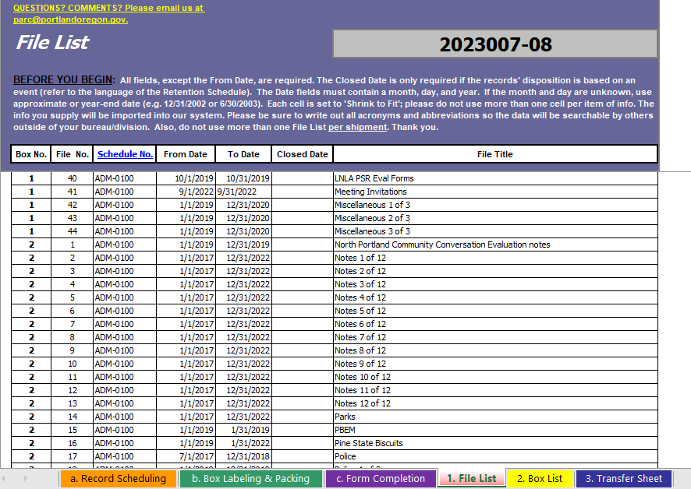
What Will I Find In This Tutorial?
  This PowerPoint will work as a step-by-step guide for preparing your RAN Workbook.
  If you need instructions for packing your boxes, please visit this link for a brief tutorial.
RAN Workbook tabs 1, 2, 3.

Slide 4

What This Guide Will Cover
  Things to know before you start
  Preparing files
  Packing files into a box
  What to do with non-standard files/materials
  Box labeling guidelines
  Getting a confirmation number
  Scheduling box pickup for delivery to PARC
  What happens after boxes are received at PARC

Slide 5

So, You Want to Send Records to PARC
Things to Know Before You Start

Slide 6
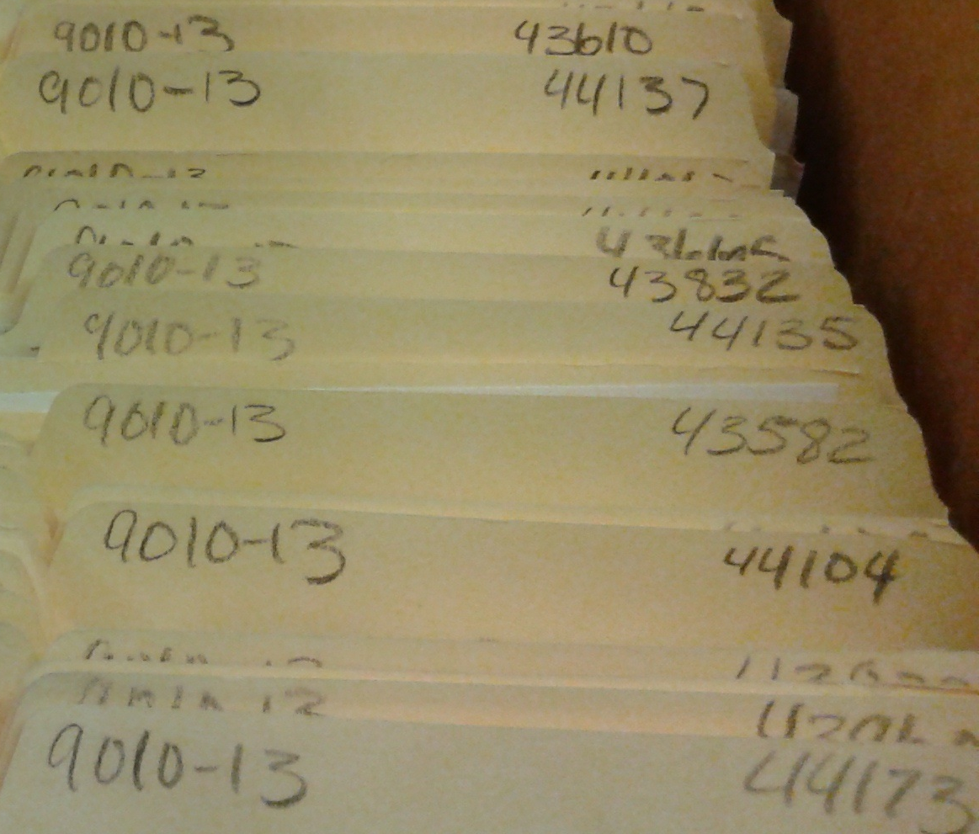
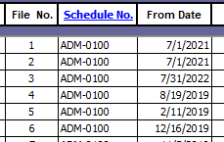
One Box, One Schedule
  All files within a box must have the same Retention Schedule number
  If you do not yet know the retention schedule to use, all schedules can be found online here: Records Retention Schedules
  (For detailed instructions on using retention schedules see the Records Activity Notice (RAN) Tutorial)
The schedule number doesn’t have to appear on the folder tab, but this is a good illustration of the folders all having the same schedule.
See folders shown on the file list.

Slide 7

No Binders, Please
  Binders are not accepted for storage or direct destruction. Please remove all materials from their binders and place in folders, titling the folders using the binder title.
  If the materials need to be split up into multiple folders, include 1 of 3, 2 of 3, etc. in the folder title so anyone working with the files will know that the multiple folders are considered part of a whole.

Slide 8
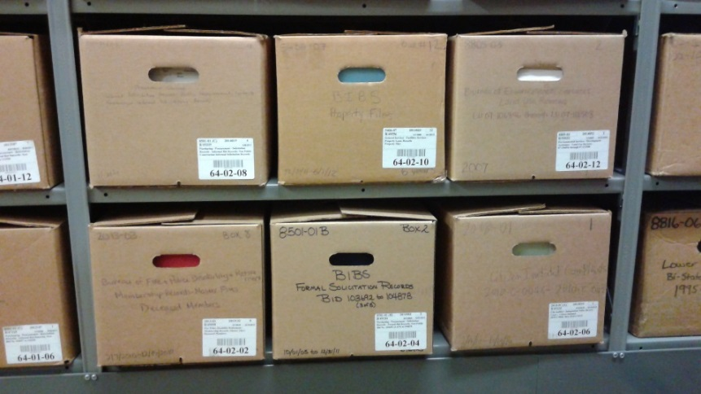
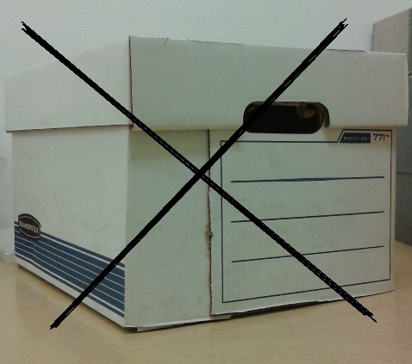
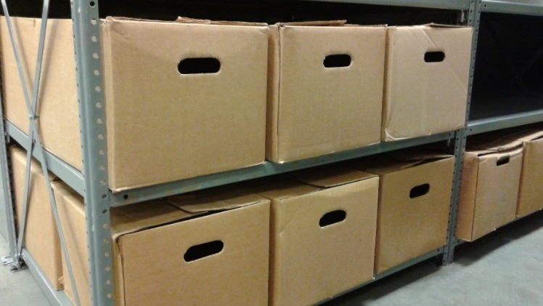
The Right Box: Choose Wisely
  You must use approved boxes that are new, or in very good condition.
  If you need boxes, go to the Ordering Archives Boxes instructions on the Records Center website.
Standard boxes:
Non-standard boxes will not be accepted.

Slide 9
Assembling a Box
  Boxes will likely take less than a minute to assemble and because of their design require no additional securing. This means if you are having to use tape, staples, twine or anything else to keep the box together - it is not assembled correctly.
  If you are having trouble assembling boxes please contact PARC for assistance.

Slide 10
Preparing Files
Labeling and Tips

Slide 11
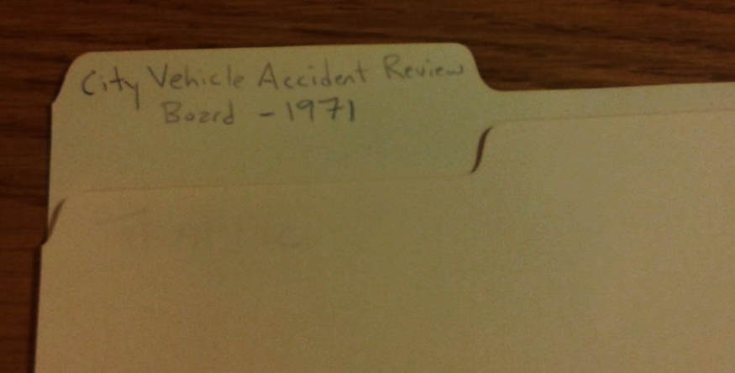
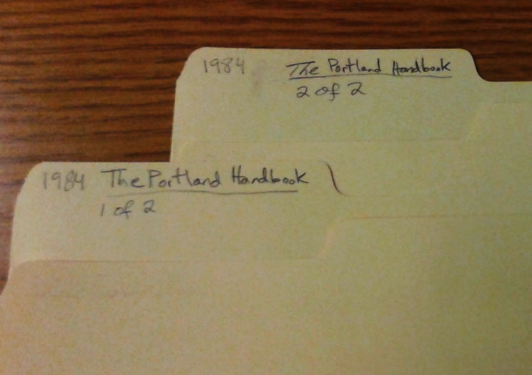
Preparing Files
  Label folders along the top so that the writing faces the front of the box (handwritten is best using pencil or permanent ink; do not use felt tip markers).
  If files are part of a set, label folders ‘1 of 2’, ‘2 of 2’, etc.
  If materials do not fit in standard folders, please contact PARC staff.
Files should be in folders or pockets, please contact PARC if you believe there are special circumstances preventing this.

Slide 12
Preparing Files
  Do not use rubber bands
    Rubber bands are notorious for losing their elasticity and becoming brittle after a short period of time.
    The chemicals in the rubber band will also permanently react with the paper, staining the records and sometimes sticking to paper causing it to tear if an attempt is made to remove the rubber band.

Slide 13
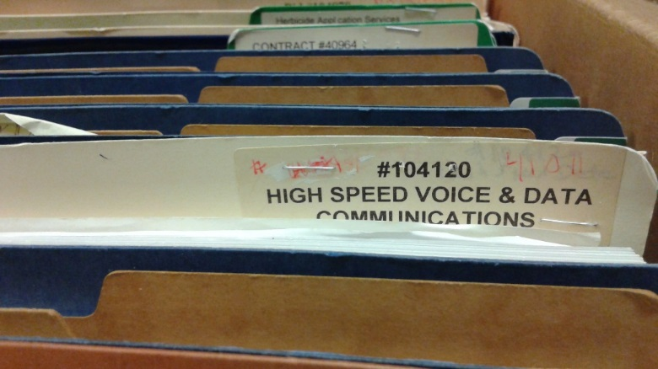
Preparing Files
  Staple adhesive labels onto the folder
    Did you know that it only takes a few years for the adhesive on a label to fail? If you do use adhesive labels, stapling them onto the file will ensure that the labels do not fall off when they lose their adhesion.
    If adhesive labels are used, staple the labels to the folders (although it is still best to handwrite titles on folders when possible).
See file label attached to folder with staple.

Slide 14
Packing Files Into A Box
What to Know

Slide 15
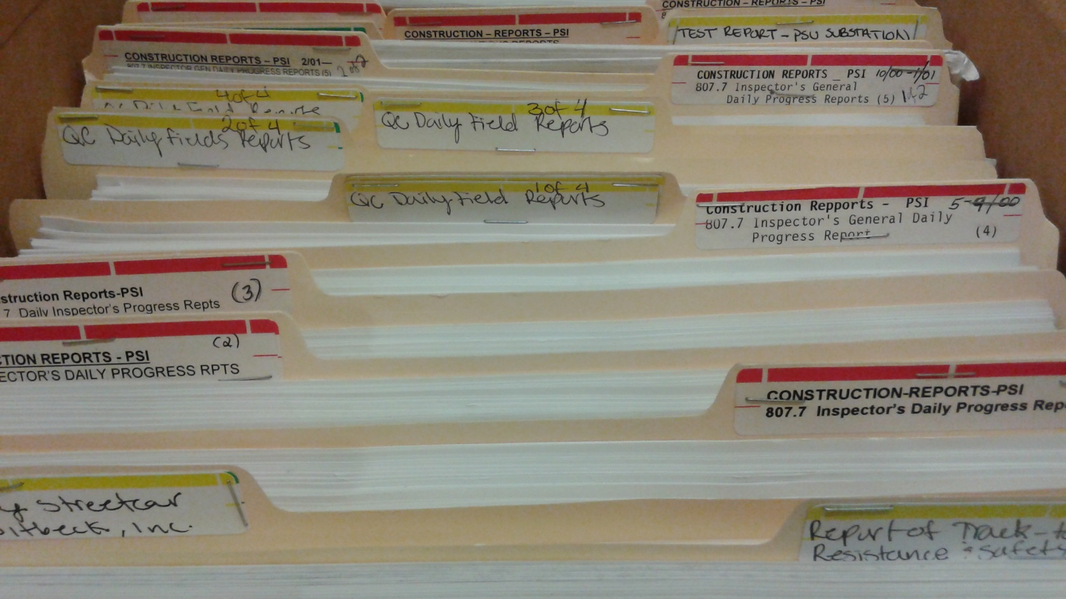
Packing Files Into A Box
  Must be upright in the box, not stacked, and face the front of the box (which is the side you will label, see slides 19-20). Make sure the file listed as 1 on the File List is the first file at the front of the box.
  If you have legal sized folders, please contact PARC.
Folders packed into a box with labels facing forward, in the order they are entered on the File List.

Slide 16
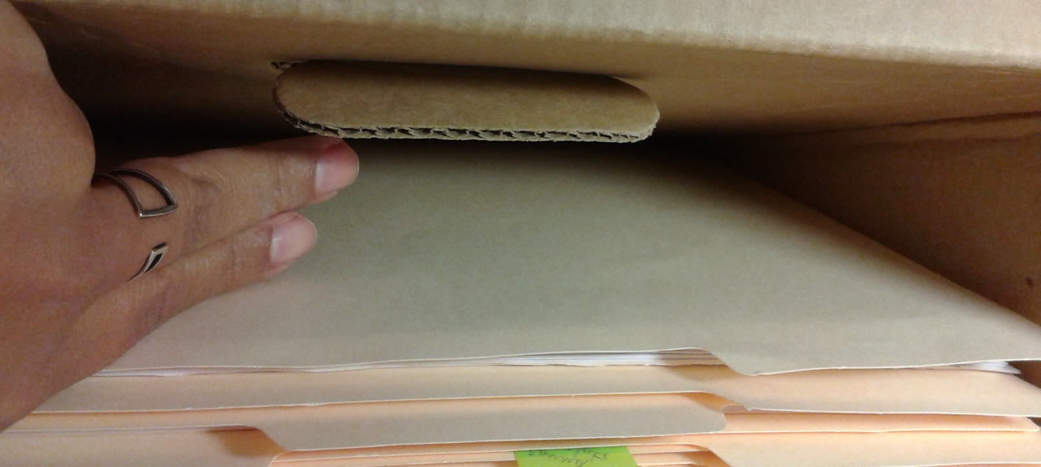
Packing Files Into A Box
  Boxes MUST BE FULL, leaving approximately 1-2 inches of space to allow for access (folders should have no room to slouch or be able to slide under one another). Boxes weighing greater than 50lbs will not be accepted for storage.
  Partially filled boxes will not be accepted for storage. If the box is not full, do not use fillers like crumpled paper or small boxes. Instead, wait until you have enough files to fill up the box.
  If there will never be enough files to send a full box, contact PARC staff to discuss alternative options.

Slide 17
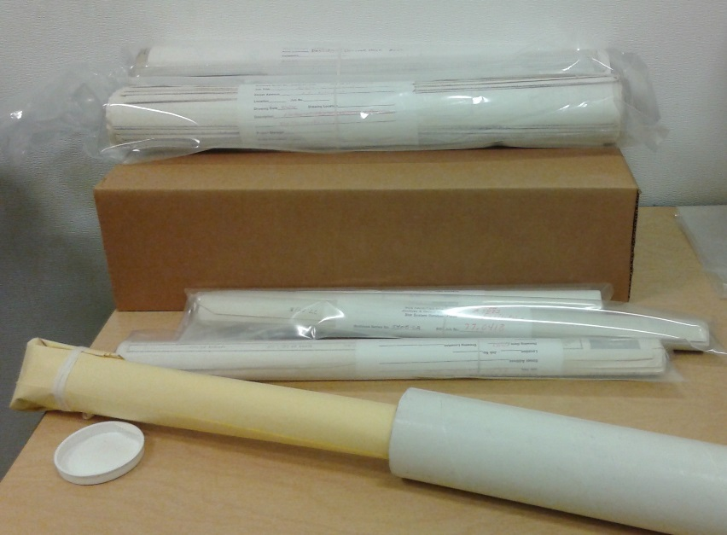
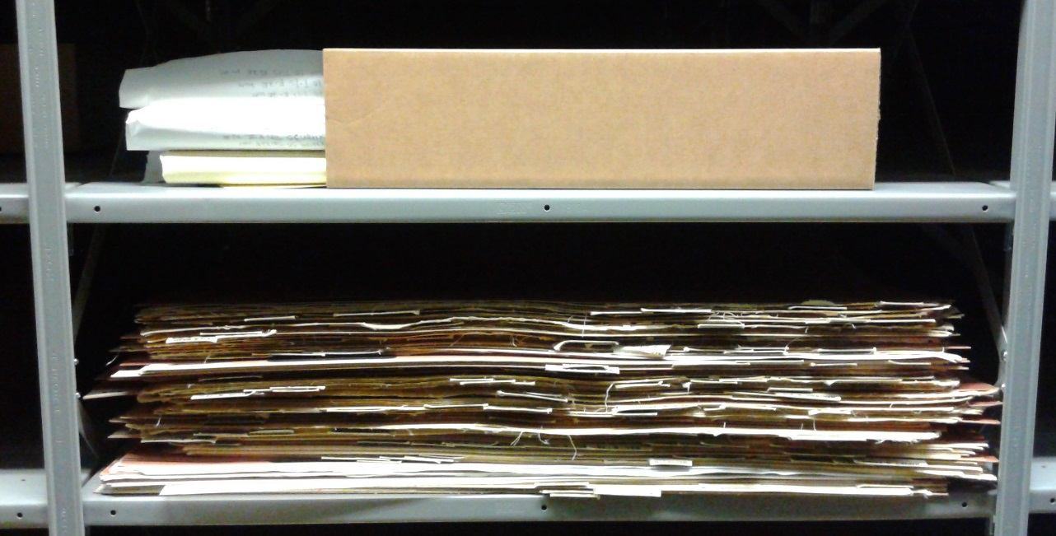
Packing Files Into A Box
  If records do not fit into a standard box – such as oversized/undersized materials, rolled maps or plans, or index cards - contact PARC for help on how best to transfer those records.
Email: parc@portlandoregon.gov
Phone: 503-865-4100
Non-standard records stored at PARC.

Slide 18
Once A Box Is Full
  Once a box is full, you can fill out a File List for the box.
  If you need help filling out the File List, see the following section in the Records Activity Notebook [RAN] Tutorial.
  If you have multiple boxes you can wait to fill out the entire RAN (including the File List) once all boxes are packed and labeled.

Slide 19
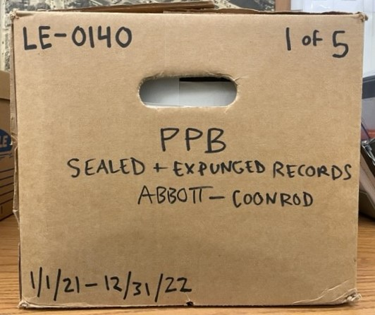
Label the Box Using The Following Guidelines
  The information you write on the front of the box is the same as what you fill in for the Box List on the RAN.
  Do not use labels or sheets of paper taped to the box to supply this information. You must write the information directly on the box.
Example of the front of a records stored at PARC – more detail on next slide.

Slide 20
Label the Box Using The Following Guidelines
  Retention Schedule Number (e.g.: IT-0040, LE-0170 (b) , ADM-0100)
  Box Number (e.g.: 1; 1 of 3 – number of boxes will be the same as the number of boxes listed on the Box List)
  Bureau (e.g.: PPB, OMF, City Auditor, FDPR)
  Schedule Title (e.g.: Land Use Review (LUR) Records, General Ledgers, Sealed and Expungement Records)
  Box Title (e.g.: Audit Schedules)
  From Date (e.g.: 7/1/2011)
  To Date (e.g.: 6/30/2012)
1
2
3
4
5
6
7
Leave space open for PARC label
Example of the front of a records stored at PARC with labels.

Slide 21
Next Steps
After the Box is Packed

Slide 22
You’re Almost Finished!
  With the box(es) packed, you can go to the Records Activity Notice (RAN) Workbook and fill in the File List (if you haven’t already), Box List, and Transfer Sheet.
  If you need help filling out the RAN, there is a step-by-step tutorial available here: Records Activity Notice (RAN) Tutorial.
Before emailing the RAN to PARC for approval, double check that the order of the folders in the box matches the File List order. When the RAN is approved you will receive a confirmation number, which allows you to send the boxes to PARC.

Slide 23
You’re Almost Finished!
  After the RAN is approved and you have a confirmation number, print the Transfer Sheet from the approved RAN (that is where the confirmation number is given) and tape it to the top of the first box.
  Contact Printing & Distribution to schedule a pickup for delivery to PARC by going to P&D Online Service Request.
  If you have any questions about filling out the request, please contact P&D's Customer Service (Heather.Saby@portlandoregon.gov or 503-823-4448).

Slide 24
What Happens Next?
  The review includes:
  Boxes are packed properly for storage (looking to see if boxes are under or over packed; folders are positioned correctly within the box)
  Boxes are properly labeled
  Dates match between those on the RAN and those on boxes
  The files in the box match the File List
  Folders are labeled correctly
Once boxes arrive at PARC they are reviewed by staff. If there are any issues with the boxes or files, the employee whose name is listed as the ‘Preparer’ on the RAN’s Transfer Sheet will receive an email with instructions to correct the issues.

Slide 25
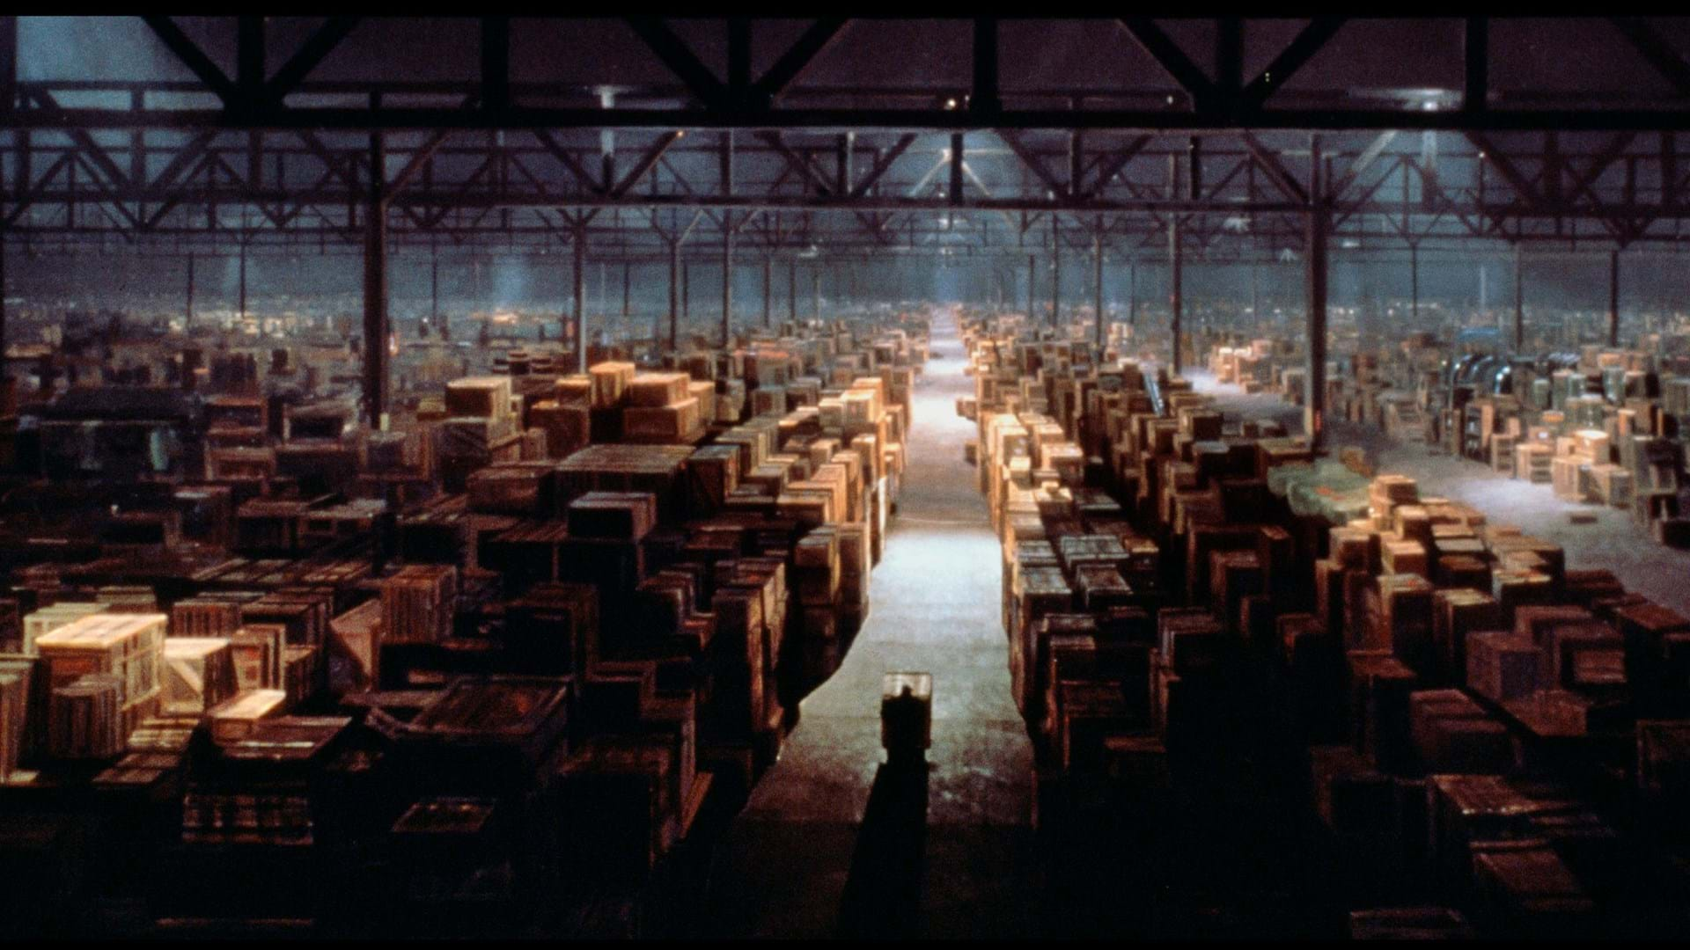
You’re Finished!
If there are no issues with the shipment, file metadata will be entered into TRIM/HPRM within a few days (depending on the size of the shipment) and be ready for requesting.
If you have any questions please contact PARC.

Slide 26
Thank you!

Slide 27



auditorsoffice@portlandoregon.gov
City Hall
1221 SW Fourth Ave
Portland, OR 97204
503-823-4078
portland.gov/auditor

