Slide 1
Ensuring Accountability,
Inspiring Trust.

Slide 2
Record Activity Notice (RAN) Workbook A step-by-step guide to filling out a RAN workbook

Slide 3
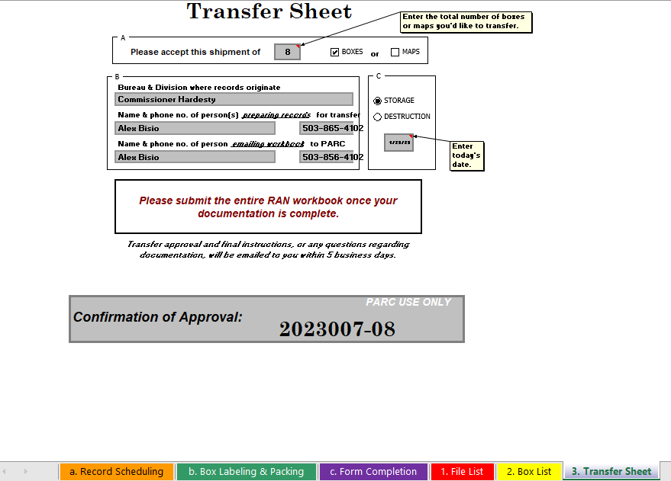
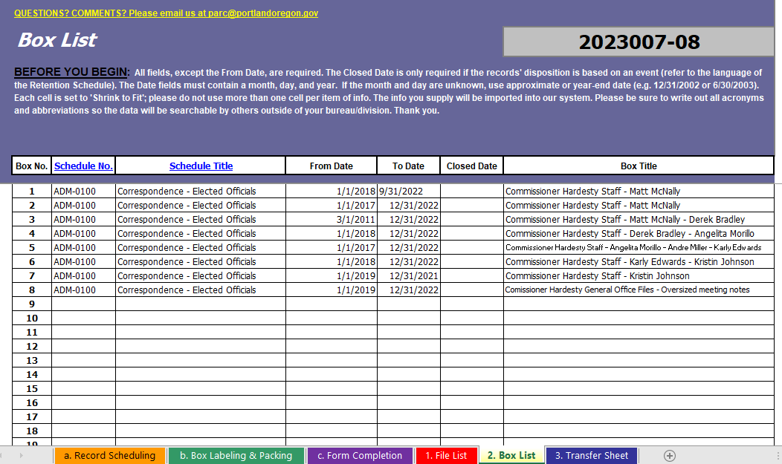
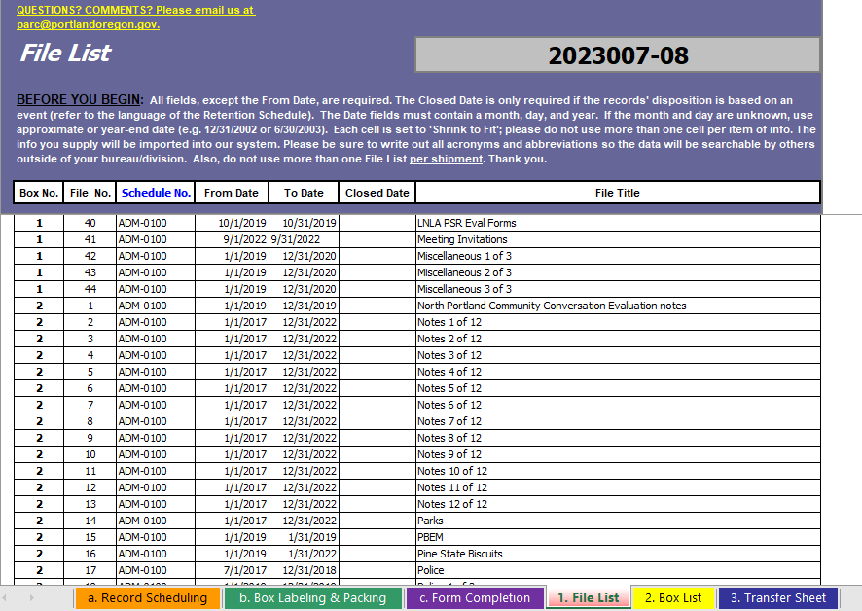
What Will I Find In This Tutorial?
This PowerPoint will work as a step-by-step guide for preparing your RAN Workbook.
If you need instructions for packing your boxes, please visit this link for a brief tutorial.
RAN Workbook tabs 1, 2, 3.

Slide 4
What Will I Find In This Tutorial?
The RAN is required to send records to the Archives and Records Center (Records Center). This tutorial will cover:
Step-by-step instructions for filling out the three pages that make up the workbook: Transfer Sheet, File List, and Box List;
numbering the files and boxes;
finding the proper dates to fill the From, To, and Closed Date fields on the File List and the Box List;
reading and applying the Retention Schedules;
finalizing your RAN before submitting to the Records Center.

Slide 5
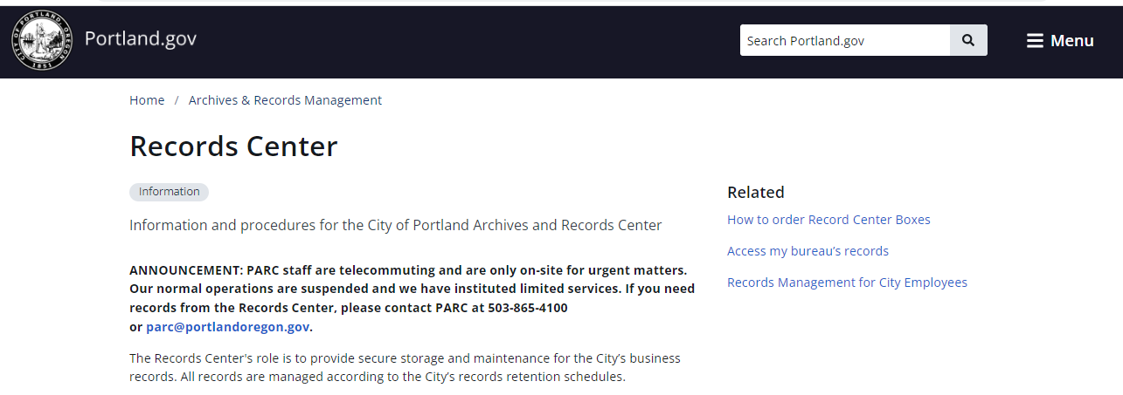
Preparing to Send Records to the Records Center
When you are ready to send records to the Records Center, start on our website where you will find the most recent version of the RAN workbook and the information you need to complete the required forms and properly fill your boxes.
Every group of boxes you send to the Records Center must include a RAN.
Every RAN must be submitted to us by a permanent employee of your bureau.

Slide 6
Navigating the RAN Workbook

Slide 7
Navigating the RAN Workbook
RAN workbook is an Excel workbook made up of six spreadsheets.
You can move between spreadsheets by clicking on the colorful tabs at the bottom of the workbook:
The first three tabs (a, b, c) of the workbook provide instructions and information on preparing the RAN and packing the boxes, and the remaining three tabs (1, 2, 3) are what you will fill out.
The six RAN Workbook tabs: A, B, C, 1, 2, 3.

Slide 8
Things to Keep In Mind When Filling Out The RAN Workbook
Do not use acronyms or abbreviations on the RAN
If acronyms are used on the physical record, please include the acronym in parentheses on the RAN. Example: Portland Bureau of Transportation (PBOT).
If we receive RANs with abbreviations or acronyms that are not also spelled out completely, the workbook will be returned for you to correct and resubmit.
The one exception to this rule is the standard abbreviations for street names. Example: Use ‘SW Harrison St’ instead of ‘Southwest Harrison Street’.

Slide 9
Things to Keep In Mind When Filling Out The RAN Workbook
Do not use Excel formulas to populate the fields on your workbook.
The information you enter in the workbook is directly imported into TRIM/Content Manager. If formulas are used, the information will not transfer.
Dates must be formatted MM/DD/YYYY.

Slide 10
Completing the Transfer Sheet

Slide 11
Transfer Sheet: Section A
There are three sections on the Transfer Sheet: A, B, & C.
In Section A, enter the number of boxes you are sending, and indicate whether they are standard Records Center boxes or rolled maps.
→ Maps must be individually rolled and labelled in the appropriate paper and tied with twine. Please contact the Archives and Records Center for a list of approved materials.
Screenshot of Section A of the Transfer Sheet, RAN Workbook.

Slide 12
Transfer Sheet: Sections B & C
Section B tells us who you are and how we can contact you. Identify both the person who prepared the RAN, and the person who is emailing the workbook to us. The person emailing the RAN must be a permanent employee.
Section C tells us whether you are sending the records for storage or destruction.
All three sections must be filled out completely.
Screenshot of Sections B & C of the Transfer Sheet, RAN Workbook.

Slide 13
Creating the File List Numbering & Retention Schedules

Slide 14
Box and File Numbers
When filling out the RAN, all boxes and their files are assigned a number. You can have up to 25 boxes in a shipment. Please see the tutorial for packing boxes.
The file numbers in each box start with #1. If you have 5 boxes, each box will begin with file #1.
The quantity of files in each box will depend upon the number of files needed to fill the box. There is no set number of files that will be accepted per box as long as the files are packed appropriately.
Screenshot of the File List, RAN Workbook.

Slide 15
Retention Schedules: Why do we need them?
Records Retention Schedules categorize records by function and establish their legally required lifespan, called a retention period. The retention schedule assigned to a record will determine whether the record will ultimately be destroyed or retained permanently.
As a city employee, you are required to manage the records related to your work. This responsibility includes following the policies set by the Records Retention Schedules.
For more information on how to use the Retention Schedules, visit the link below:
https://www.portland.gov/archives/retention-schedules

Slide 16
Reading Retention Schedules
Each Retention Schedule will have a number and a title, along with a description of the records falling within this category. Please note that these are general descriptions and are not comprehensive.
After the description, there is often a section for notes about the record. You’ll find additional information about legal restrictions, identifying if it is a vital record to the City, who the office of record is, and the legal authority.
(Series, schedule number, title, description) (Legal restrictions and authority, retention details)

Slide 17
Reading Retention Schedules
The record copy is the single copy of a document, often the original, which is designated as the official copy to be preserved for the entire retention period.
Often records have archival value. Under Retention Notes, it will state that the City Archives must be consulted about the preservation of permanent records or that the records are subject to review by the City Archives prior to destruction.
(Series, schedule number, title, description) (Legal restrictions and authority, retention details)

Slide 18
Choosing a Retention Schedule
First you must decide which Records Retention Schedule fits the records you are sending. Keep in mind, only one Retention Schedule can be represented in a box.
The Office of Record column will indicate whether a schedule number can be used by any Originating bureau or is only for a specific department.
The Office of Record section in the schedules identifies who keeps the official version of the record. In some cases, more than one office may keep the same type of record.
Link to Retention Schedules: https://www.portland.gov/archives/retention-schedules

Slide 19
Retention Schedules
Once you find the Retention Schedule that best matches the records, you’ll need both the Retention Schedule Number and Title.
Remember, only one retention schedule can be represented in a box.
Number Title
Screenshot of Retention Schedule number ADM-0770.

Slide 20
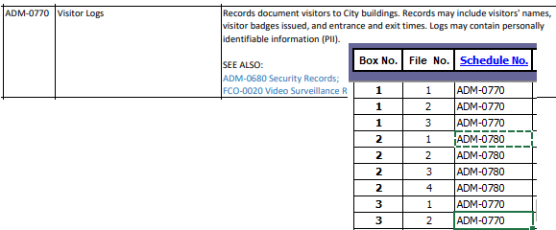
Retention Schedules: Schedule Number and Title
You will find the schedule number and title for each retention schedule.
File List form: Only the retention schedule number is needed.
Box List form: Both the retention schedule number and title are needed.

Slide 21
Creating the File List Dates, Titles, Direct Destructions

Slide 22
File List: From Date and To Date
The From Date represents the oldest record in the file. The To Date is the most recent date. Exact dates are not necessary, and you can round to the end of the year.
For example, if your files are all created within the year 2014, you can use 01/01/2014 as the From Date and 12/31/2014 as the To Date.
The date must be entered in the MM/DD/YYYY format.
The From Date is not mandatory; however, it can be very useful when locating and identifying records.
The To Date is mandatory for each file and box.

Slide 23
File List: Closed Date
The Closed Date is the date a record becomes inactive, and the retention period begins. This field is mandatory for all non-permanent records.
The Closed Date varies according to the type of record. For instance, the retention clock for contracts doesn’t begin until the contract is closed. Warranties must wait for the warranty to expire before the retention periods begins. Other records have their retention countdown beginning as soon as the record is created.
Record the actual date. The retention period is automatically calculated based on the Closed Date entered into TRIM/Content Manager – you do not need to calculate the destruction date.

Slide 24
File List: Title
The file title describes the file contents and should contain enough description that people can find the record in the future.
All titles must be unique.
If you have multiple files for a subject or project, you can make each title unique by adding numbers. For example, if you have a large project called “North Park Blocks, ” you can number the files as follows:
North Park Blocks 1 of 3
North Park Blocks 2 of 3
North Park Blocks 3 of 3
Make sure the file titles on the physical records match the titles provided on the RAN workbook.

Slide 25
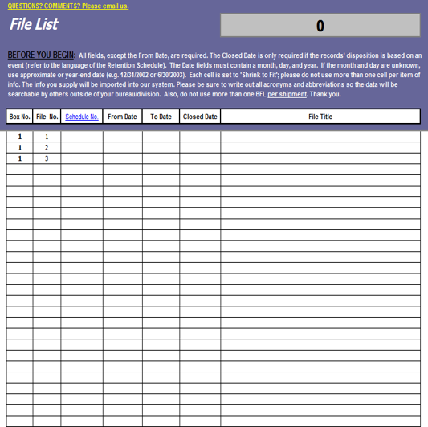
Direct Destructions
Direct Destructions are records that have already fulfilled their legal retention requirements or are convenience copies. These records will not be stored and can be destroyed.
We document the records that come in
for direct destruction. However, the whole
RAN does not need to be filled out.
When sending over direct destructions,
DO NOT fill out the File List.
Only the Transfer Sheet and Box List need to be completed.

Slide 26
Creating the Box List Dates, Titles

Slide 27
Box List: From Date and To Date
Just like the From Date and To Date on the File List, the From Date represents the earliest dated record in the box, while the To Date represents the most contemporary date.
A simple way to figure out the date range for the Box List is by using the sort function in Excel. This is not a mandatory process but may be helpful when working with a large number of files. You may be able to easily determine the range without sorting.

Slide 28
Box List: Sorting to find the From Date and To Date
Here are the steps to using the sort function in Excel:
Open a new separate Excel spreadsheet.
Copy and past the From Dates from the File List for each box. Sort the date from newest to oldest by right clicking, selecting sort, and selecting sort newest to oldest. The date at the bottom of the list will represent the earliest date, and that will become your From Date on the Box List.
Do the same with the To Date. This time you will sort oldest to newest. The bottom date will represent the latest date within the box. This will become your To Date on the Box List.

Slide 29
Box List: Closed Date
The Closed Date is the data used to monitor the retention of a record. All records that are not permanent must have a Closed Date.
To find the Closed Date of a box, you must find the most contemporary closed date that is within the box. This can be done by sorting the closed date from the File List. Follow the same sorting instructions found in the previous slide.

Slide 30
Box List: Title
The box title is the place to uniquely describe the record.
You should choose a title that will encompass and represent all of the files held within the box.
Keep in mind, this is how a box will be located in the future by people who are unfamiliar with the records.
If boxes have similar contents and end up having identical titles, try to differentiate the box titles by adding things such as date or alphabetical ranges.

Slide 31
Finishing Touches

Slide 32
Finishing Touches
Once each page has been filled out, take a moment to go back and look everything over. Make sure you didn’t miss a section.
Check spelling. Keep in mind, we do not accept abbreviations beyond the standard abbreviations for street names. Words must be spelled out completely.
Double check to make sure your dates are correct.
If you need a reference example, see tab C. File Completion in the RAN workbook for an example of a partially filled out RAN.

Slide 33
Send for Confirmation
Attach the full RAN to an email and address to parc@portlandoregon.gov.
Each RAN Workbook must first be reviewed and approved by Records Center staff before you can send the boxes.
Once approved, the Records Center will send the RAN, along with a confirmation number and instructions for shipping the boxes to the Records Center for storage, using Printing & Distribution.

Slide 34
Send for Confirmation
If you have changes or corrections that need to be made, a confirmation number will not be given until the changes are addressed.
Boxes without an accompanying confirmation number will not be accepted.
If you need help packing your boxes, please see the step-by-step box packing tutorial available here.

Slide 35
Additional Training
If additional training is needed, please contact the Portland City Archives & Records Center at 503-865-4100 or parc@portlandoregon.gov.
Trainings for temporary employees MUST also be attended by a permanent employee.

Slide 36
Thank you!

Slide 37
auditorsoffice@portlandoregon.gov
City Hall
1221 SW Fourth Ave
Portland, OR 97204
503-823-4078
portland.gov/auditor

