Slide 1

CITY OF PORTLAND, OREGON
Staff Presentation to the
Portland Design Commission
4th Design Advice Hearing
EA 14-220633 DA
SW 4th & Harrison Mixed Use
June 18, 2015
Notes:
5 add’l public comments rec’d – H.O.
aesthetics & safety impacts of loading bay location
Traffic impacts
Community, neighborhood & pedestrian safety concerns
FAR concern – ability to use bonus
Lack of parking
Shading of open spaces
Loss of trees
Odors from supermarket trash
Very recent comment rec’d not yet rev’d
PBOT here
Resp some comments
Address site access & building projection into 4th

Slide 2
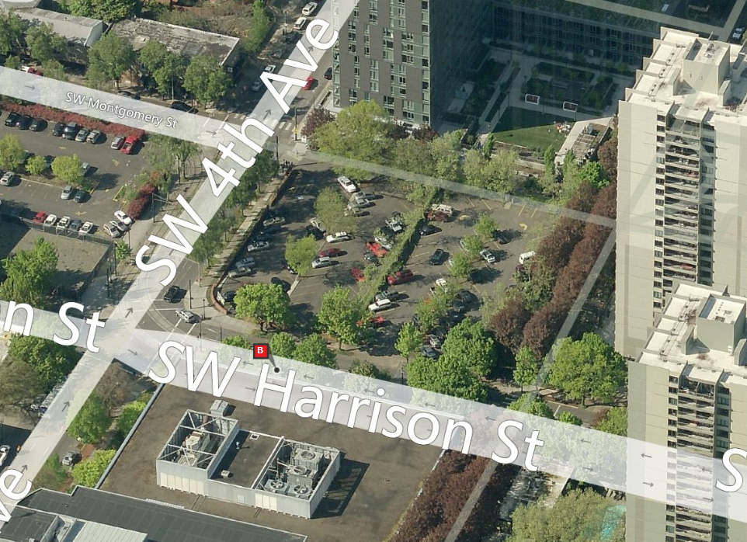
Context
44,747 SF site
Developed with surface parking
4th & Harrison street frontages:
Streetcar alignments & frequent bus lines
Regional Transitway / Major Transit Priority Streets
Harrison is an Access Restricted Street & raised median
4th Avenue is one-way northbound

Slide 3
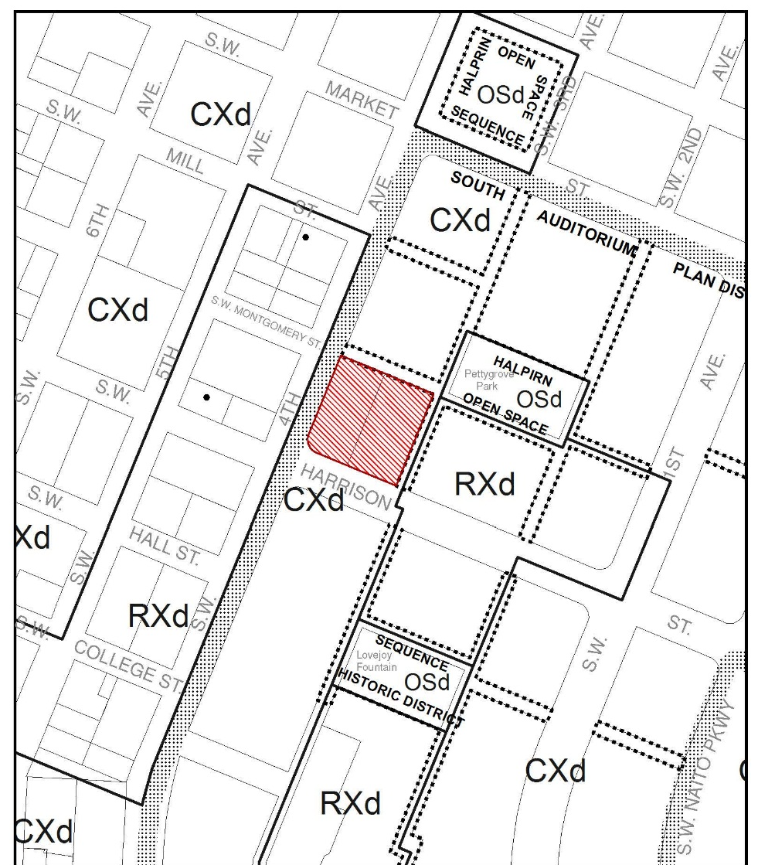

Halprin Open Space Sequence
Historic District
Zoning
CXd - Central Commercial zone w/a Design Overlay
Central City & South Auditorium plan districts
6:1 FAR + 3:1 w/bonuses
175’ height maximum
Downtown Pedestrian District

Slide 4
South Auditorium
Plan District
Context

Slide 5
Site & Ground Level
Garage & Loading Access
Setbacks & Landscaping
Transparent & Active Uses
Challenges with both street frontage - streetcar, one-way, raised median with catenaries, rush hour traffic
Ganged on Harrison
Additional loading within both streets
DAR #3 concerns - on same frontage & loading off Harrison
Notes:
3 DARs:
Dec 2014
Feb 2015
March 2015
Focus all 3 –
Appropriate massing site given adjacent to designated open spaces & HD & height limit
Site access challenges given constraints of both street frontages
Activity and access at ground level given 4 public frontages
Compatibility with simple, strong composition of bldgs in the SAPD

Slide 6
6’
Partial landscape
Site & Ground Level
Garage & Loading Access
Setbacks & Landscaping
Transparent & Active Uses
6’ to 0’
No landscaping
15’ to 5’ at ground floor
No landscaping
SAPD minimum building setbacks & landscaping
4th & Harrison – both very urban & edge of SAPD, street trees must be provided
Pedestrian mall – hardscape correlates with outdoor active spaces at NW and SE corner and entry at NE

Slide 7
Site & Ground Level
Garage & Loading Access
Setbacks & Landscaping
Transparent & Active Uses
DAR #3 concern – transparent and active
Increased active uses at NW and SE corners - swapping retail & residential lobby
Spandrel glass - along street & pedestrian mall frontages
Podium façade along pedestrian mall - metal panel with window slots along mezzanine levels

Slide 8
Massing
L-shape at SW corner
Height along Pedestrian mall & park
DAR #3 – support along street frontage & stepping back at NE
Two bars at SW corner (break “L”) – acknowledge & respond to difference characteristics of both street frontages.
Two levels atop podium at NE corner – 21’ above Cyan north bar, yet setback 10’, creates outdoor, green spaces along open space
Shadow impacts – Late day March & September

Slide 9
Material / Façade Design
Large Projecting Glass Façade at SW corner
  Emphasizes significant corner
  Responds to verticality & simplicity of buildings in SAPD
  Major Encroachment or meet oriel windows standards
Metal with punched windows façade
  Extensive facades may appear flat (2.5” total depth)

Slide 10
1. Garage & Loading Access on Harrison
2. Massing
  - “L” shape at southwest corner
  - Height along pedestrian mall & park
  3. Ground Level
    - Transparent & active
    - Building setbacks & landscape Modifications
4. Material / Façade Design
  - Large projecting glass façade at SW corner
  - Metal panel with punched windows
Summary

