Slide 1

City of Portland
Bureau of Development Services
Staff Presentation to the
Design Commission
EA 14-208933 DA
Front 17

Slide 2
Summary of the Proposal
Mixed-use apartment, office and retail project;
Approximately 220 apartments, ground floor retail, 6-story office building, and parking for 175-250 cars;
Two primary buildings:
  Six story office building on the south end; and
  Large superstructure with three 5-story apartment ‘building’ volumes over podium/base, with 7 attached townhomes facing NW 17th
Extensive green spaces proposed atop podium base; and
On-site pedestrian plaza, driveway and surface parking in alignment with NW 16th Avenue across NW Front.

Slide 3
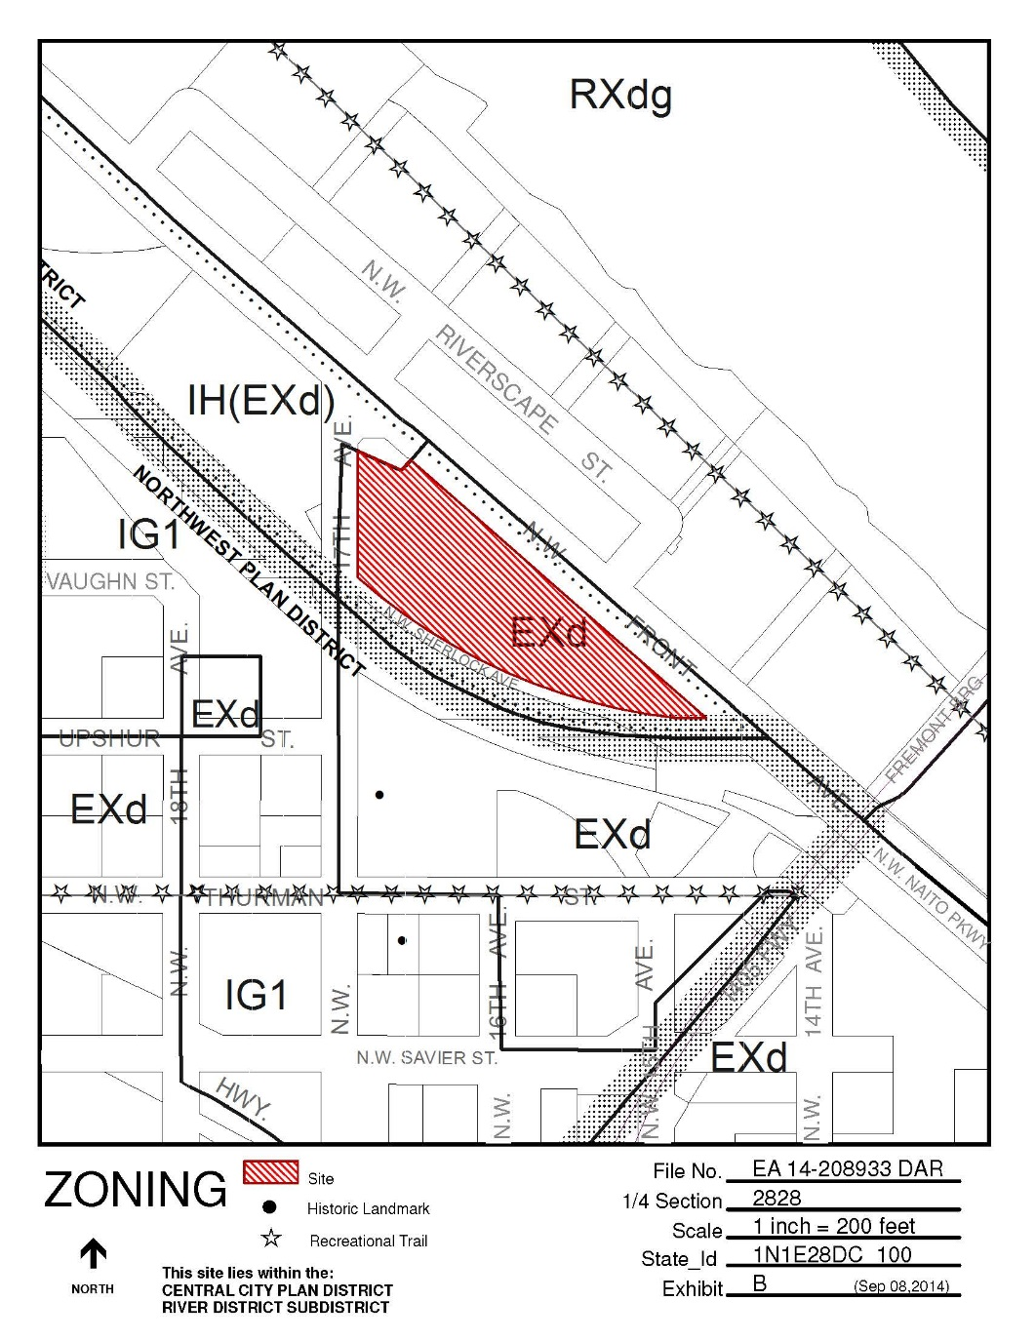
Zoning
Recent ZC from IG1 to EXd (LU 13-154170 ZC):
COA to provide trip generation, signal warrant info with permits
2:1 Max FAR (3:1 bonus poss.)
100’ maximum height
NOT in N. Pearl Subarea (open area issues N/A)
No required building line, active use, special areas, parking access restrictions*
*access to 17th restricted by UPRR
NW Terminal/Sherlock is a street (unimproved, adjacent to rail)
Parking regulated by type (CCPR req’d. for Growth or Office >2/1Ksf)
MOD’s & AD’s TBD (Loading, driveway
landscaping, Ground Floor Windows,
ST Bike Parking Location – need
scalable elevations & plans to verify)

Slide 4
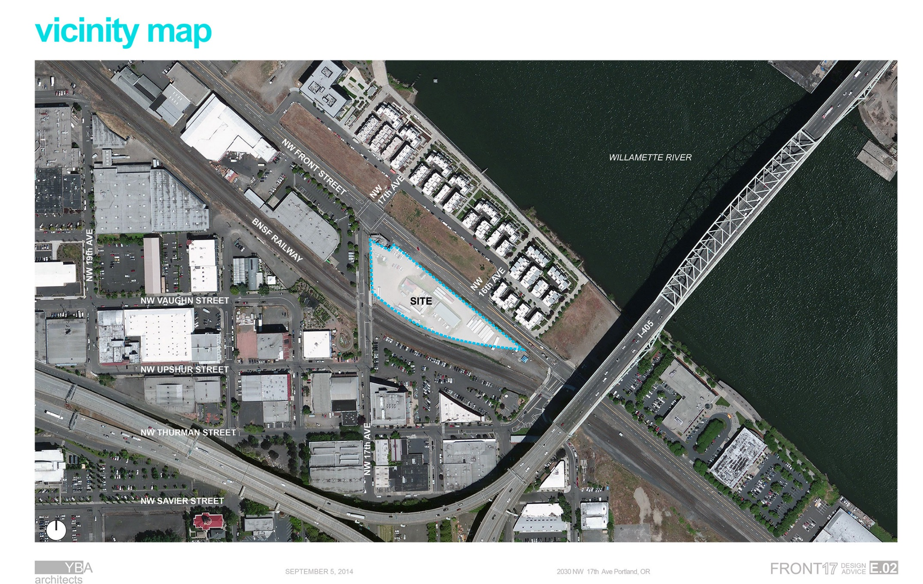

Slide 5
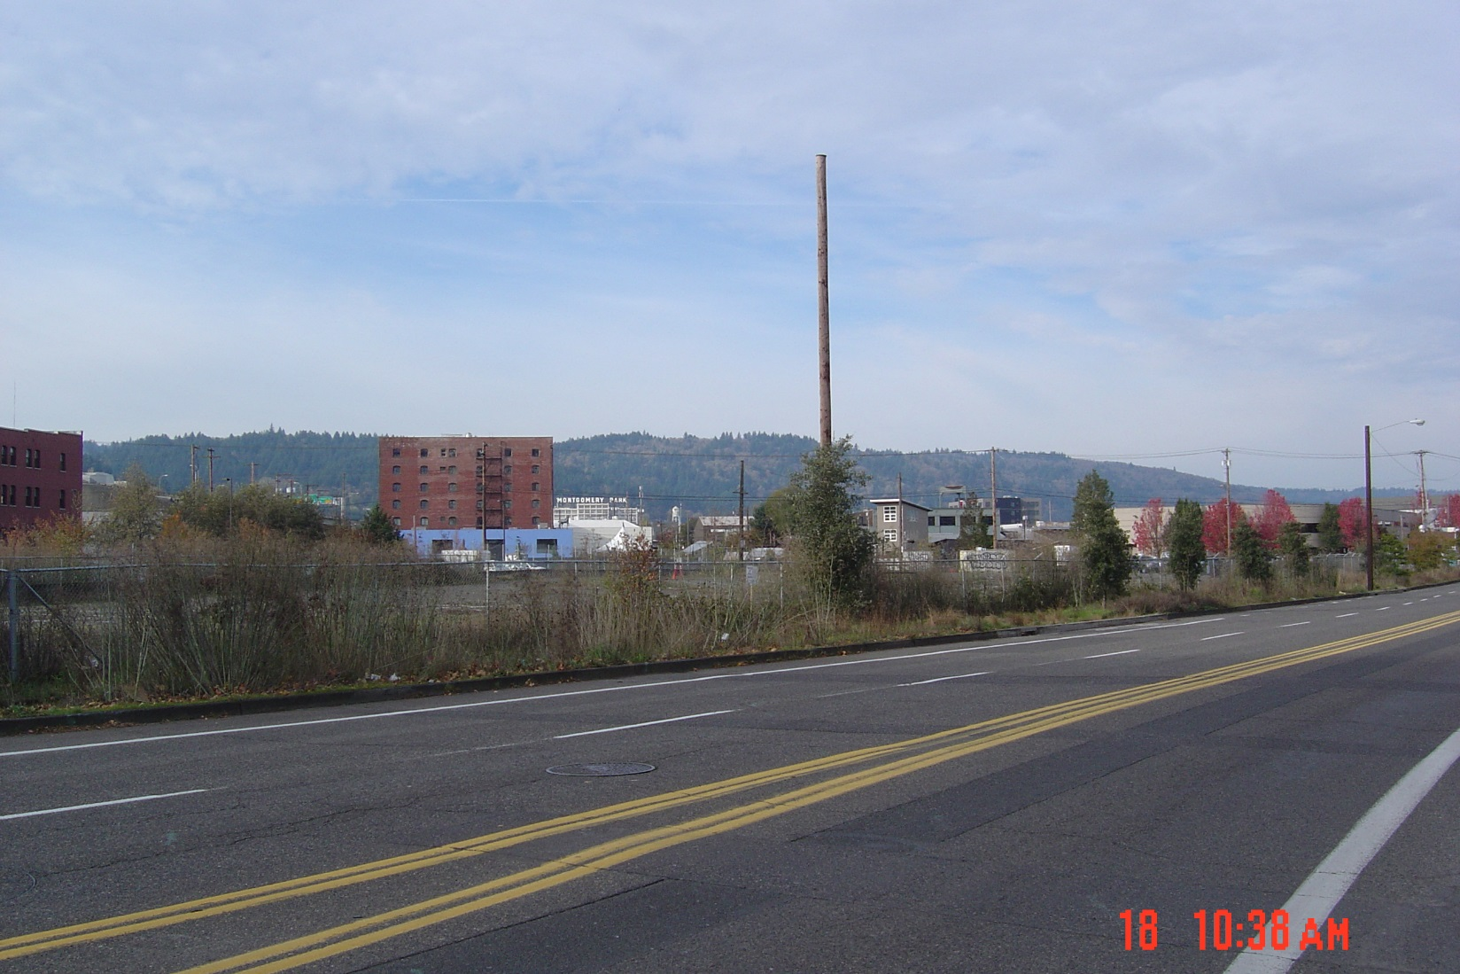

Slide 6
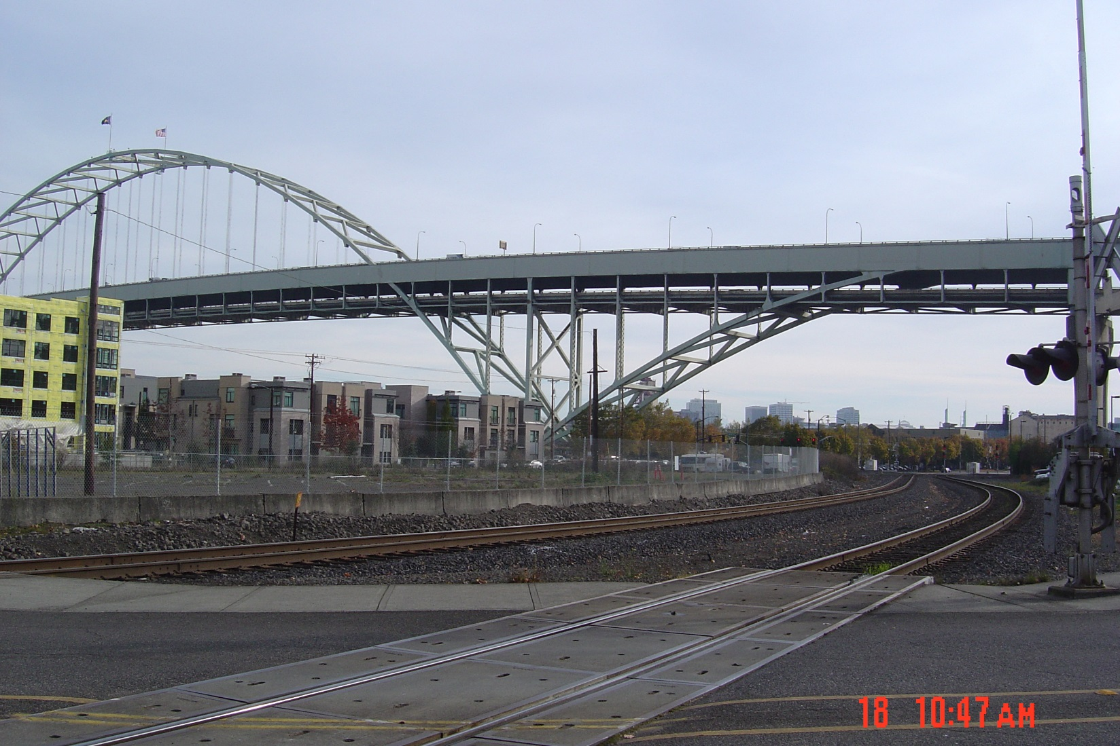

Slide 7
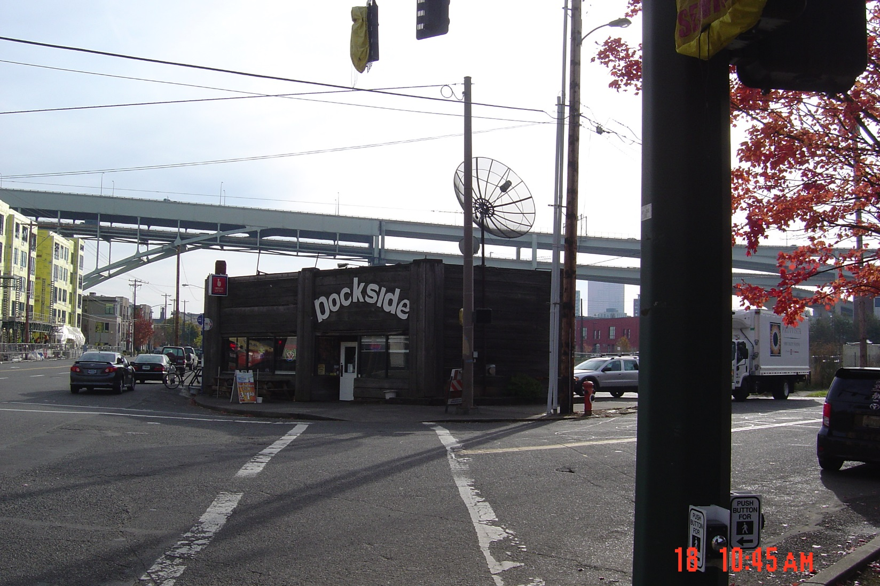

Slide 8
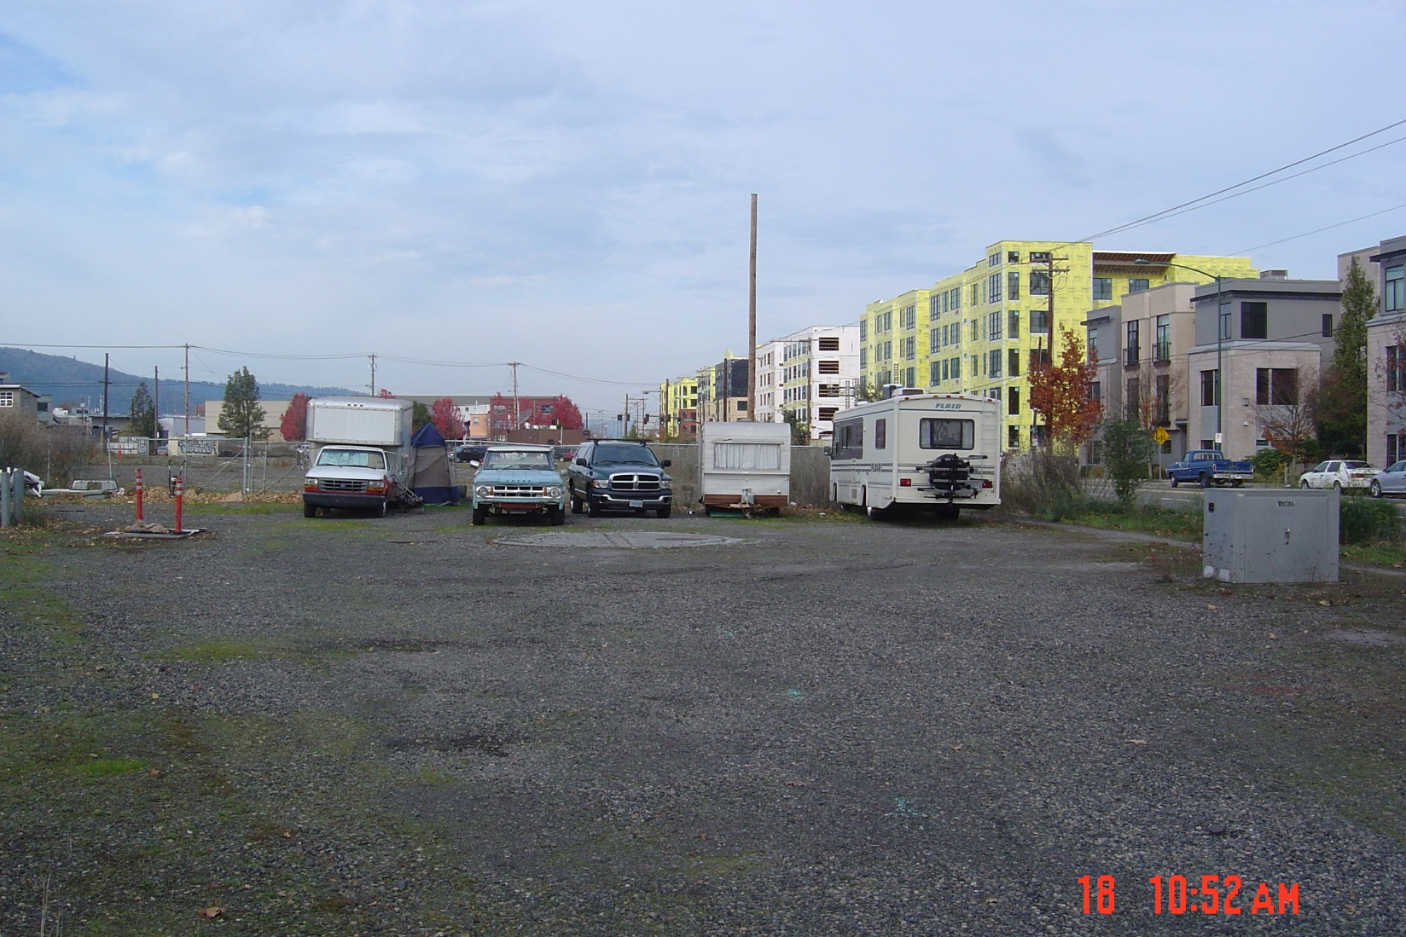

Slide 9
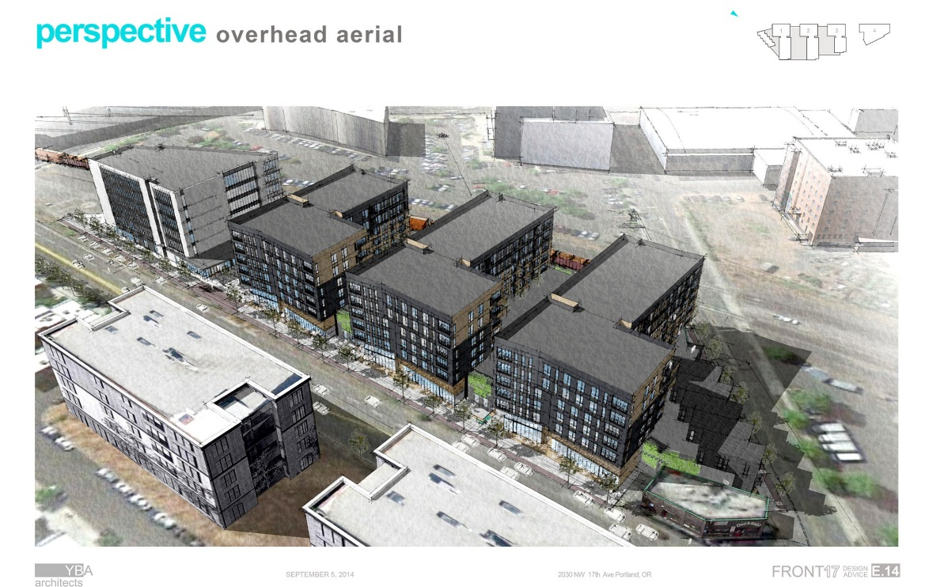
11.20.15 DAR Feedback
Retail emphasis and site history/context in analysis is helpful
Refine office building, giving equally careful consideration vs. apartments
Simplify overall – risk of too many different materials, breaks, undulations, etc.
Three apartment ‘buildings’ too similar in design, skin/materials and massing
Integrate with surrounding context, block structure, Riverscape
Break down podium or make it a more intentional in design, less of a visual/ped barrier
Consider a break through the podium, connect visually & functionally with railroad

Slide 10
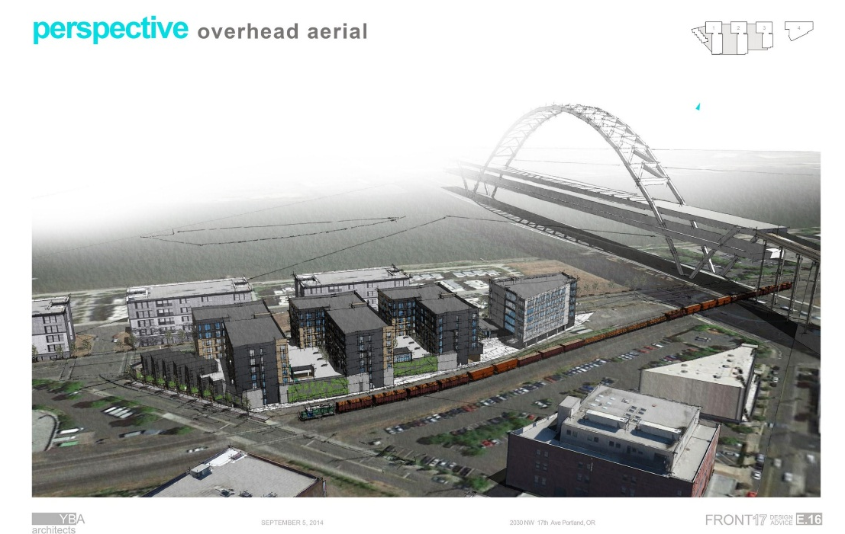
11.20.15 DAR Feedback, cont’d.
Back edge is ‘choppy’ and ‘incoherent’ and needs refinement, activate base
Exposed surface parking is suburban: better integrate and/or screen vehicles
Tuck-under parking also problematic
Clarify concept of locking/interlocking forms and materials shifts on apartments: push for clearer, simpler and more powerful
Ceraclad and materials with exposed fasteners (Okoskin) can be problematic: specific fastener placement, design, finish etc. must be considered and shown in drawings if proposed
Show how residents access bike parking, vehicle parking, trash areas, entries, etc.
Greenwalls are hard to maintain: plants/irrigation/medium need consideration, and greenwall features must work architecturally on their own even without plants

Slide 11
REVISED Proposal
Podium revisions to better reflect block structure, Riverscape open spaces w/ deeper courtyards, fewer townhouses on 17th
Apartment materials: ceraclad and zinc standing seam option eliminated (Okoskin and steel standing seam remain)
Office building design revised with folding planes, textural metals & brick
Subtle skin/design refinements for 3 apartment volumes at podium
WEST ½: New ped-bike path in ROW with new connections & active spaces along south side of podium building, bike parking
EAST ½: New shared ped-bike path and vehicle circulation w/ 2nd driveway to Front Avenue in public ROW

Slide 12
Potential areas of discussion
Massing/Block Structure/Context (Is the revised podium design moving in the right direction, or should a more significant break-through/alley be pursued? Are the street-level courtyards on both N and S sides successful in context with surroundings?);
Pedestrian Environment (Are commissioners supportive of the bike/ped-only trail and ‘frontage’ along the rear of the property? Feedback on low 4’ metal fence at rail edge? Character and materials at ground floor successfully refined, simplified, sturdy? Greenwalls at grade approvable?);
Design Repetition/Distinctiveness (Are the buildings still too similar in form and materials? Are subtle shifts in the pattern of folds enough, or should they go further?);
Entry Plaza (Is revised treatment adequately “street-like”? Discuss new plaza design and vehicle versus pedestrian environment);
Bike Parking & Access (revisions look great for residents along south side, but what about for retail spaces along Front? Integrate into plazas? Lobby access points OK?);
Materials (Okoskin with exposed fasteners OK in this quantity and with ground floor application? Comments of textural metals for office building? Other materials comments?); and
Other Items at Commissioner Discretion.

Slide 13
fin

