Slide 1
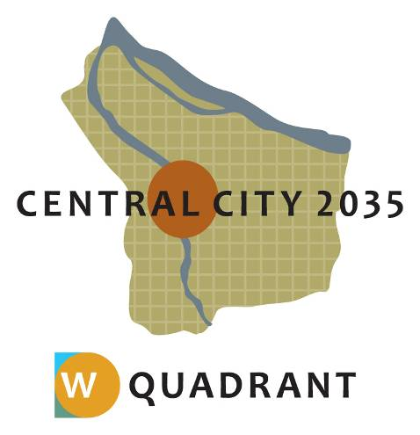
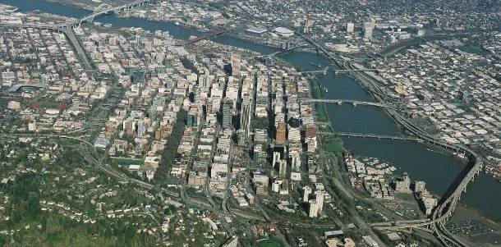
Central City 2035:
West Quadrant Plan
Portland Design Commission
Briefing – June 19, 2014

Slide 2
Central City 2035:
Updating the 1988 Central City Plan

Slide 3
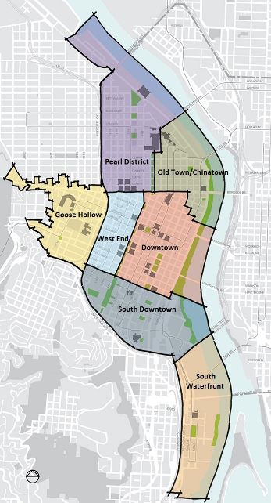

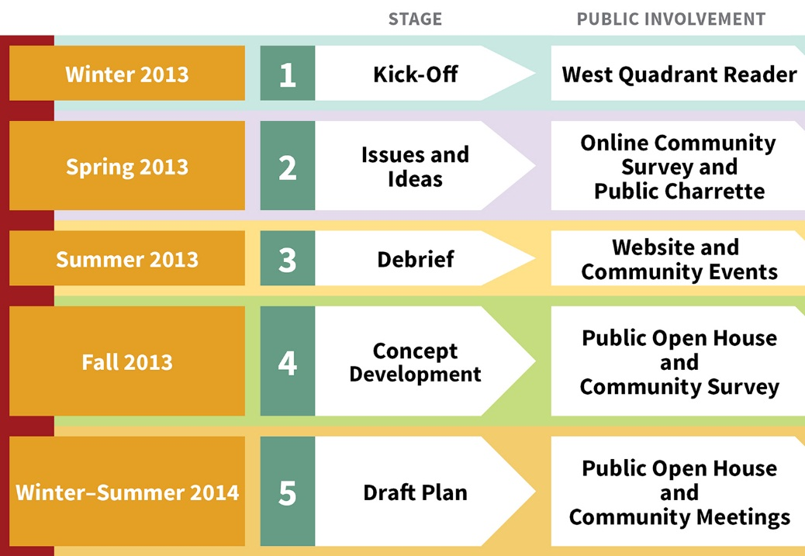
West Quadrant Plan
Notes:
Mention SAC

Slide 4
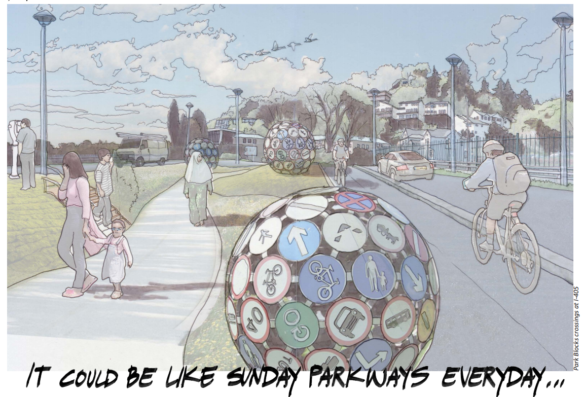
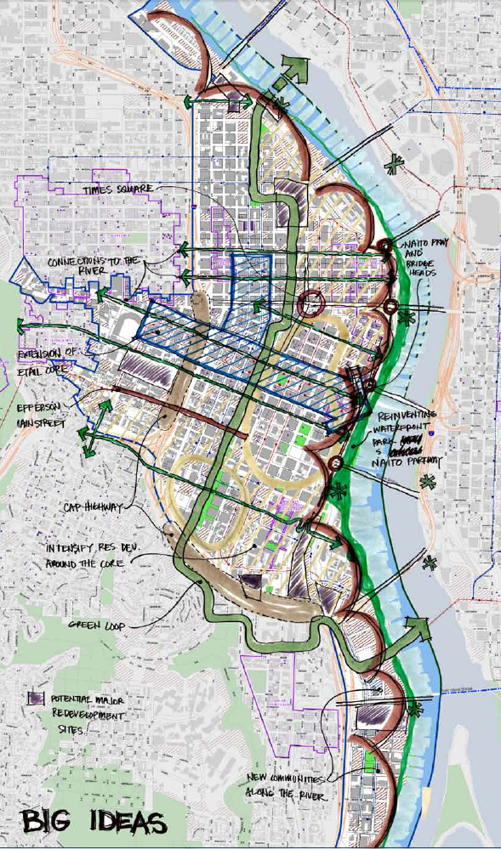
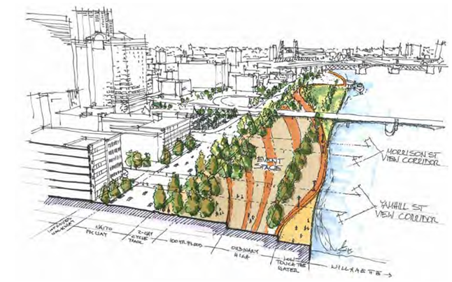
Big Ideas: Waterfront and Green Loop

Slide 5
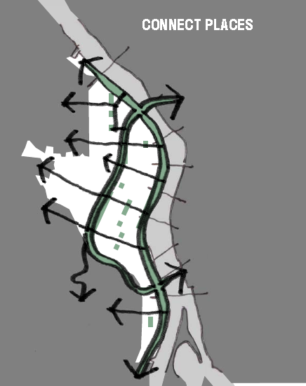
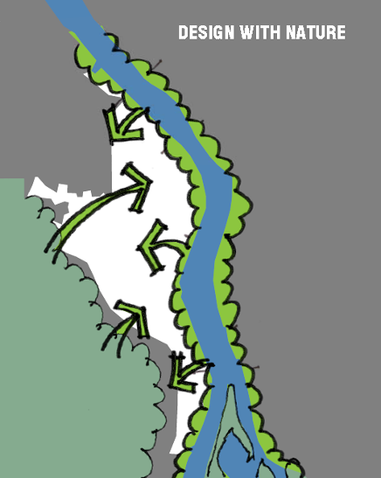
West Quadrant Urban Design Principles

Slide 6
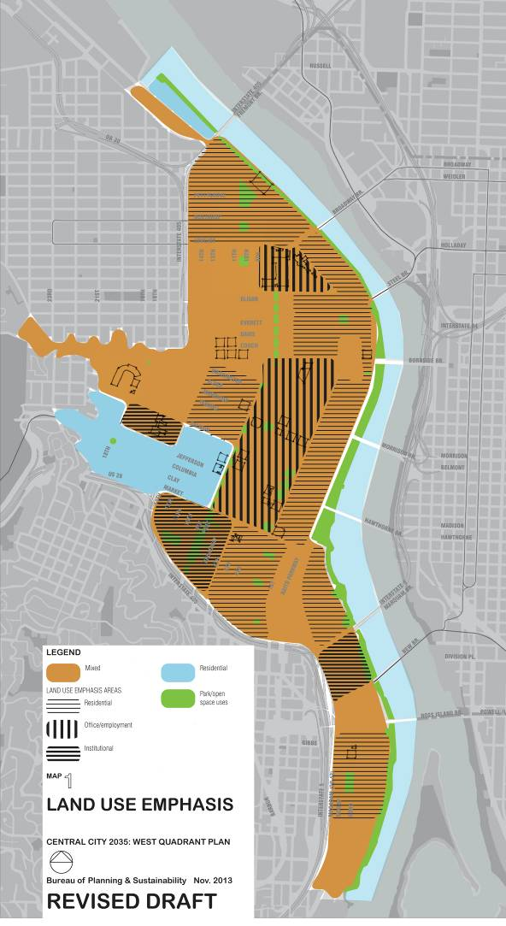
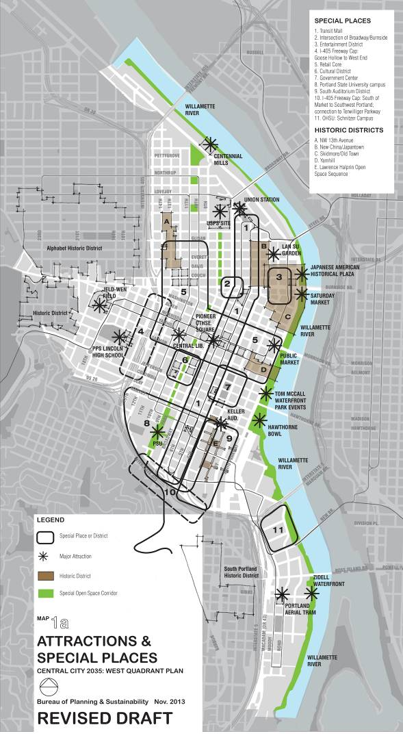
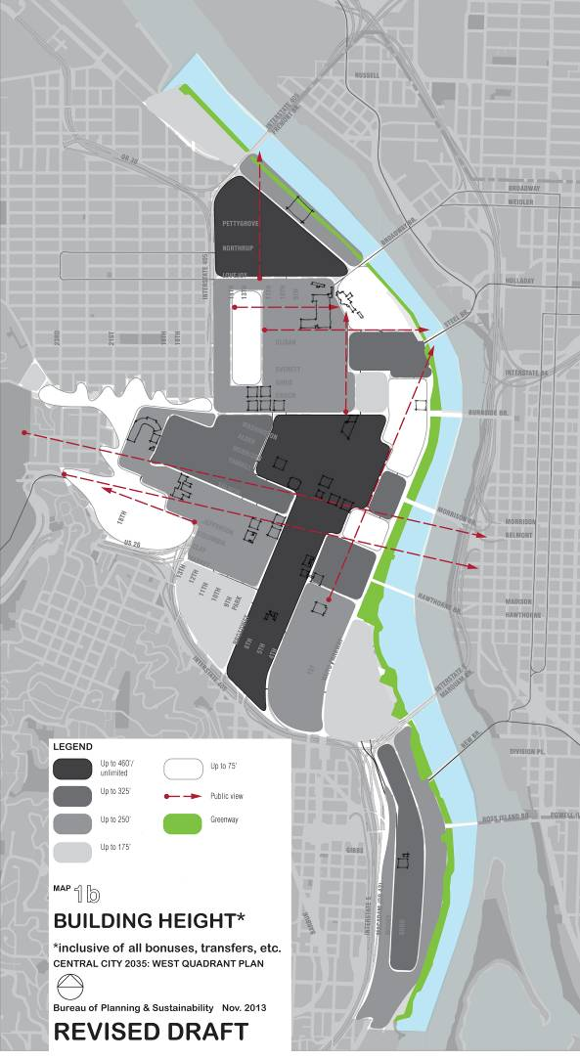
West Quadrant Concept Maps

Slide 7
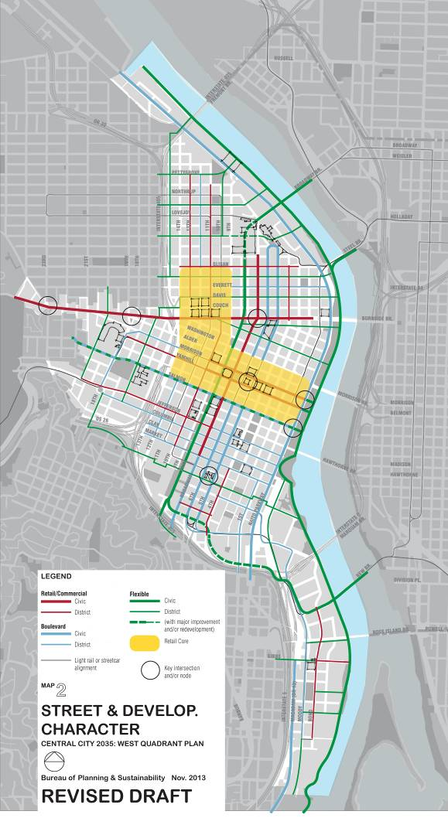
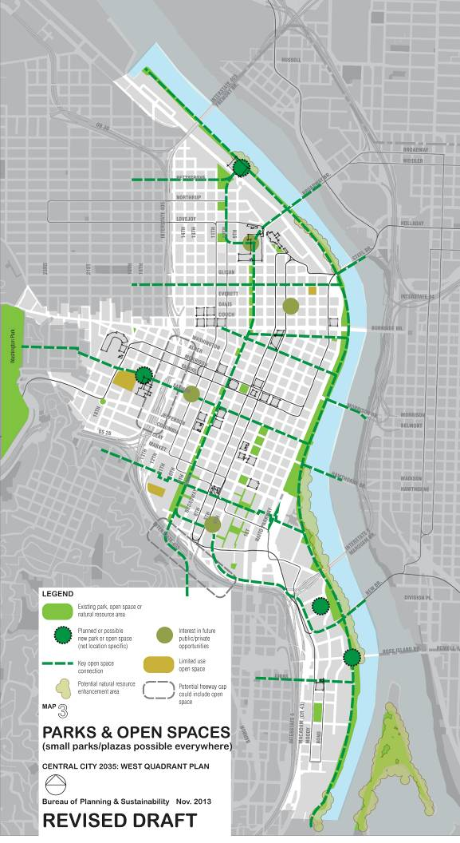
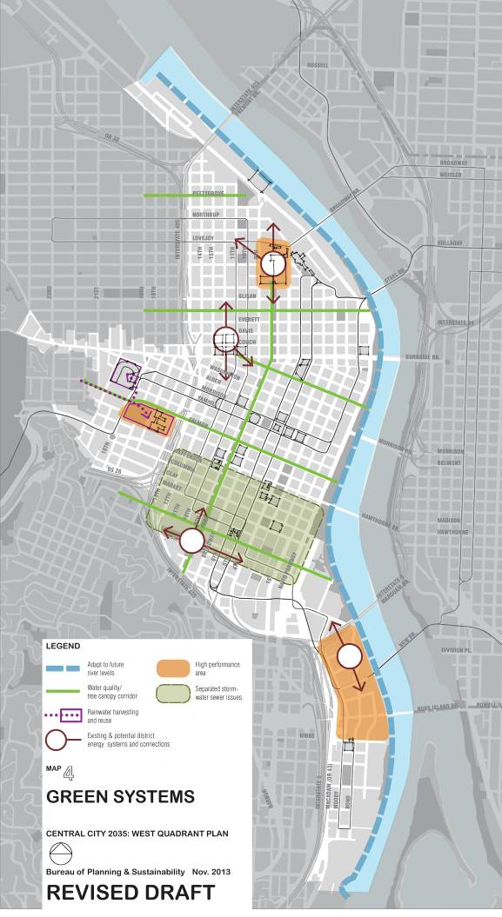
West Quadrant Concept Maps

Slide 8
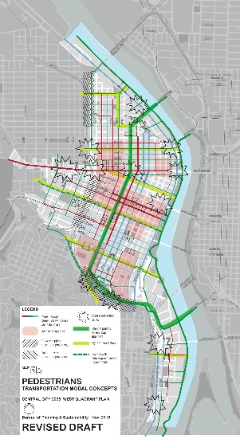
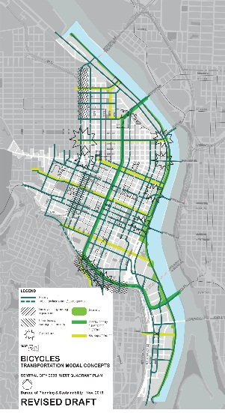
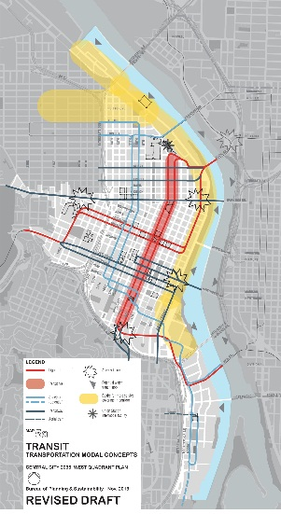
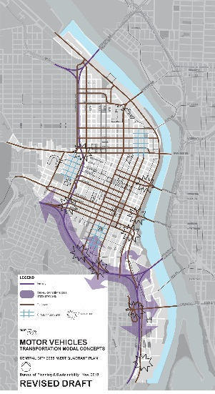
West Quadrant Concept Maps

Slide 9
West Quadrant Plan Structure
Goose Hollow
Downtown
District Goal
District Character and Concept Diagrams
Policies
  Regional Center: Economy
  & Innovation
  Housing and Neighborhoods
  Transportation
  Willamette River
  Urban Design
  Environment
Implementation Actions
Performance Targets
South Downtown
West End
Old Town/Chinatown
Pearl District
South Waterfront
Notes:
Use Lower Albina as example:
Goal: “Strengthen Lower Albina as an industrial and employment area by reinforcing the working harbor and providing for diverse employment and development opportunities. Enliven historic Russell Street with mixed-use and commercial activities that are compatible with industrial and employment uses.”
Policy examples: “Working Harbor. Protect the Lower Albina working harbor and support river-dependent uses”.
Action examples include subdistrict boundary changes, zoning changes, recommendations for future programs, projects and studies all intended to further the policies and help the district reach the goal.
Actions are prioritized and given a horizon (adopt with plan, 2-5 years, 6-20 years or ongoing). N/NE Quadrant had 80-odd actions for 2 CC Subdistricts. Hopefully, the districts on the west side might not need quite as many…

Slide 10
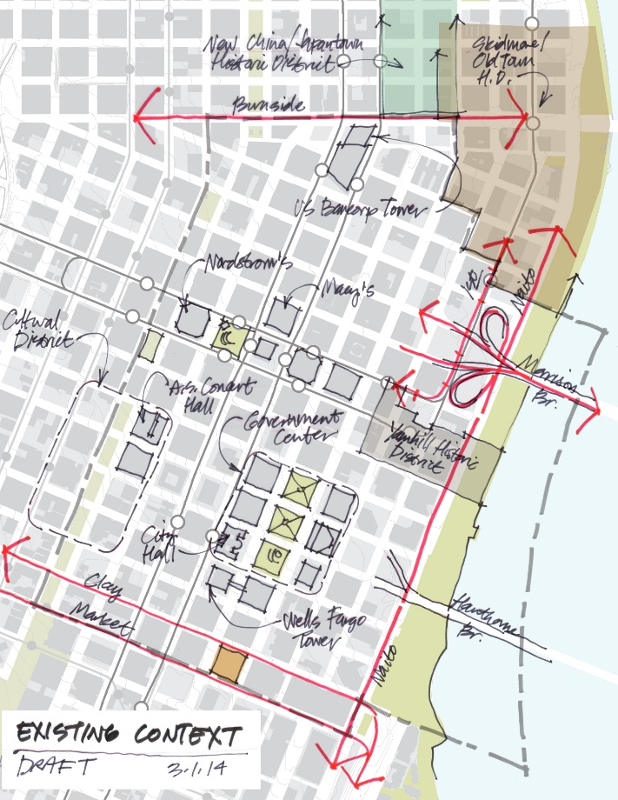
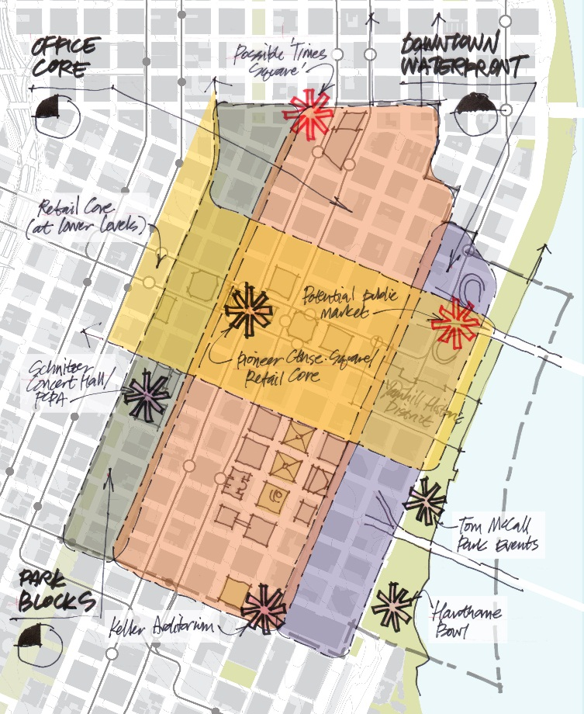
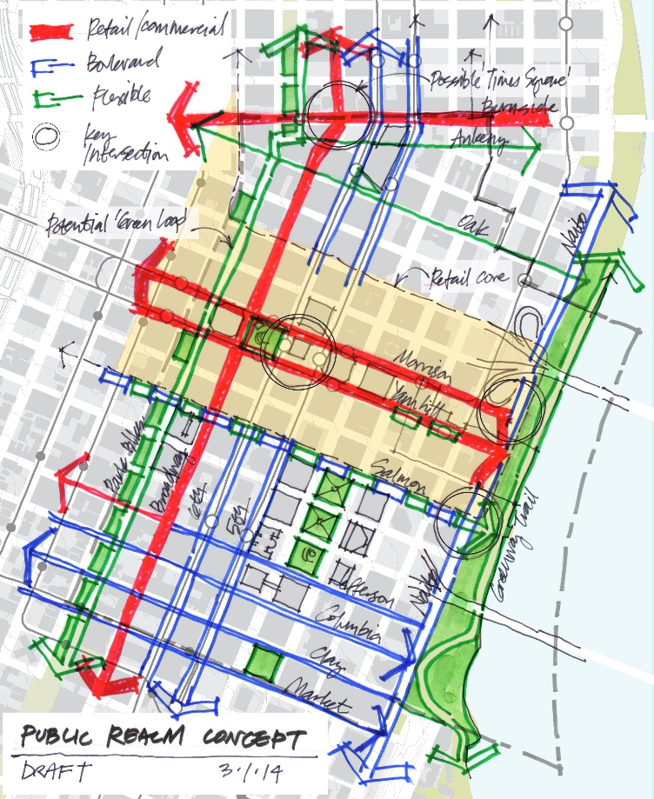
Downtown: Draft District Character & Concept Diagrams
Notes:
Use Lower Albina as example:
Goal: “Strengthen Lower Albina as an industrial and employment area by reinforcing the working harbor and providing for diverse employment and development opportunities. Enliven historic Russell Street with mixed-use and commercial activities that are compatible with industrial and employment uses.”
Policy examples: “Working Harbor. Protect the Lower Albina working harbor and support river-dependent uses”.
Action examples include subdistrict boundary changes, zoning changes, recommendations for future programs, projects and studies all intended to further the policies and help the district reach the goal.
Actions are prioritized and given a horizon (adopt with plan, 2-5 years, 6-20 years or ongoing). N/NE Quadrant had 80-odd actions for 2 CC Subdistricts. Hopefully, the districts on the west side might not need quite as many…

Slide 11
Downtown Policies and Actions: Highlights
Maintain the Downtown Office Core as the regions’ preeminent office concentration.
Support the Retail Core and strategy.
Improve access to the river and increase the attractiveness of the riverfront. (update and implement WF Park Master Plan)
Encourage new housing particularly along SW Naito Parkway and increase maximum building heights at Morrison and Hawthorne Bridgeheads.
Implement a “Green Loop” through the district with bicycle facilities, park-like pedestrian environments, and wildlife connections.
Protect the historic character of the Yamhill Historic District by encouraging restoration and sensitive infill development.
Enhance pedestrian experience in the Cultural District.
Encourage more events, entertainment, and civic spaces.
Support tourism.
Notes:
Use Lower Albina as example:
Goal: “Strengthen Lower Albina as an industrial and employment area by reinforcing the working harbor and providing for diverse employment and development opportunities. Enliven historic Russell Street with mixed-use and commercial activities that are compatible with industrial and employment uses.”
Policy examples: “Working Harbor. Protect the Lower Albina working harbor and support river-dependent uses”.
Action examples include subdistrict boundary changes, zoning changes, recommendations for future programs, projects and studies all intended to further the policies and help the district reach the goal.
Actions are prioritized and given a horizon (adopt with plan, 2-5 years, 6-20 years or ongoing). N/NE Quadrant had 80-odd actions for 2 CC Subdistricts. Hopefully, the districts on the west side might not need quite as many…

Slide 12
Draft District Action Item Examples (Downtown)
# | Action | Timeline |  |  |  | Imple- menters
 |  | CC2035 (2015) | 2 – 5 Years | 6 – 20 Years | Ongoing
RC9 | Explore options for redeveloping the City-owned parking garage at 3rd and Alder. Provide public parking; add mixed use development including retail. |  |  | X |  | PDC, PBOT, BPS
HN4 | Provide incentives to increase residential development along SW Naito Parkway and the South Park Blocks. | X |  |  |  | BPS, PHB
TR3 | Improve public transportation services along the Waterfront and Naito Parkway. |  |  | X |  | TriMet, PBOT
UD8* | Study the feasibility of creating an urban civic space at the intersection of West Burnside and Broadway. |  | X |  |  | BPS, PDC, PBOT, PPR
EN5 | Develop a strategy for inventorying, removing and replacing trees in the South Park Blocks to eliminate safety hazards while maintaining or enhancing canopy coverage and habitat. |  | X |  |  | PPR
Notes:
Use Lower Albina as example:
Goal: “Strengthen Lower Albina as an industrial and employment area by reinforcing the working harbor and providing for diverse employment and development opportunities. Enliven historic Russell Street with mixed-use and commercial activities that are compatible with industrial and employment uses.”
Policy examples: “Working Harbor. Protect the Lower Albina working harbor and support river-dependent uses”.
Action examples include subdistrict boundary changes, zoning changes, recommendations for future programs, projects and studies all intended to further the policies and help the district reach the goal.
Actions are prioritized and given a horizon (adopt with plan, 2-5 years, 6-20 years or ongoing). N/NE Quadrant had 80-odd actions for 2 CC Subdistricts. Hopefully, the districts on the west side might not need quite as many…

Slide 13
Draft Performance Target Examples (Downtown)
Regional Center: Job growth
Housing and Neighborhoods: Housing units, workforce housing units
Transportation: Mode split
Urban Design: Active street frontage, development along Naito
Environment: Acres of eco-roofs, tree canopy, linear feet of riverbank enhancement
Some targets will be at the Central City-wide scale and others will be at the district scale. Targets will continue to be refined through the CC2035 process
Notes:
Use Lower Albina as example:
Goal: “Strengthen Lower Albina as an industrial and employment area by reinforcing the working harbor and providing for diverse employment and development opportunities. Enliven historic Russell Street with mixed-use and commercial activities that are compatible with industrial and employment uses.”
Policy examples: “Working Harbor. Protect the Lower Albina working harbor and support river-dependent uses”.
Action examples include subdistrict boundary changes, zoning changes, recommendations for future programs, projects and studies all intended to further the policies and help the district reach the goal.
Actions are prioritized and given a horizon (adopt with plan, 2-5 years, 6-20 years or ongoing). N/NE Quadrant had 80-odd actions for 2 CC Subdistricts. Hopefully, the districts on the west side might not need quite as many…

Slide 14
West Quadrant: Selected UD Issues
Design Guideline Updates
Additional/Revised Development Standards
Street Hierarchy Implementation
Historic Resources Issues
Building Heights
Central Waterfront

Slide 15
Development standard and design guideline updates
Additional/Revised Development Standards
Setbacks, step-backs
Height, Floor Area Ratios
UPDATES TO FOLLOW:
Central City Fundamental Design Guidelines
District design guidelines
Historic District, Greenway design guidelines
Bird-friendly building facades
Reflectivity, glare
Pedestrian orientation, livability

Slide 16
Street hierarchy implementation
Integrated streetscape and building design
RETAIL/COMMERCIAL:
Busy
Contiguous retail
Lots of people
Multimodal
BOULEVARD:
Busy
Large tree canopy
Generous landscaping
Swales
FLEXIBLE:
Low traffic, low speed
Pedestrian/bike friendly
Interconnected network
May be trails

Slide 17
Street hierarchy implementation
Zoning Code development standards, regulations, maps
Design guidelines
Street design standards and related modal classifications

Slide 18
West End: Historic Preservation
Policy: Encourage the preservation, renovation and rehabilitation of existing and historic buildings
  UD2 Develop historic preservation transfer tools to encourage FAR and height transfers from historic resources
  UD3 Prepare an updated inventory of historic resources for the district
  UD4 Revise the two National Register downtown development MPD forms to encompass a broader range of historic resources in the West End
  HN1 Add flexibility for more commercial uses in existing structures within the RX zone
Notes:
Middle John r, pba

Slide 19
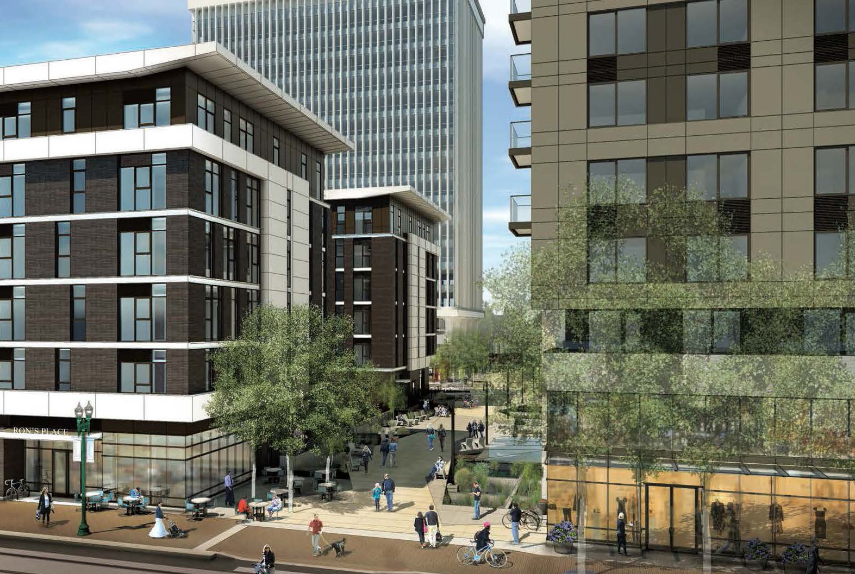
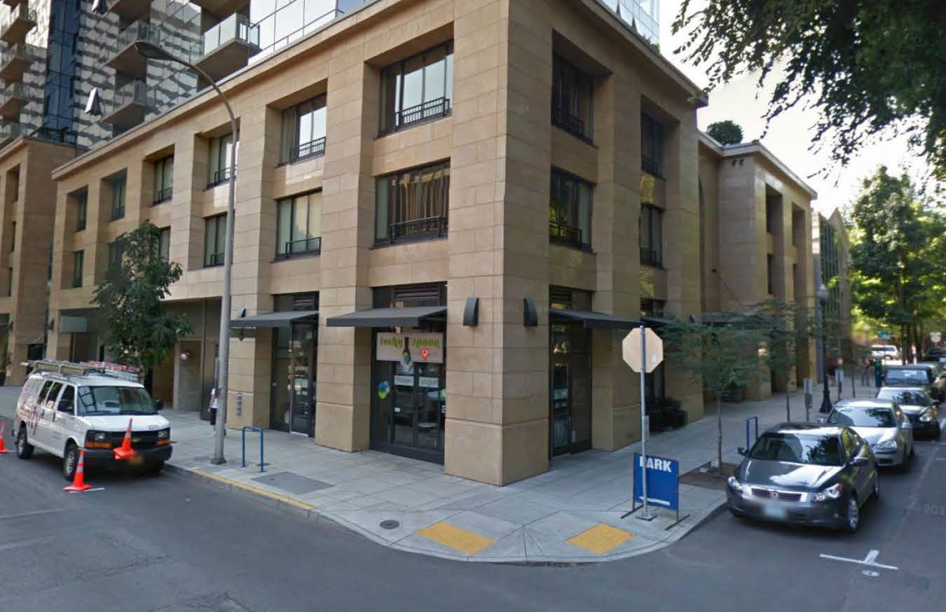
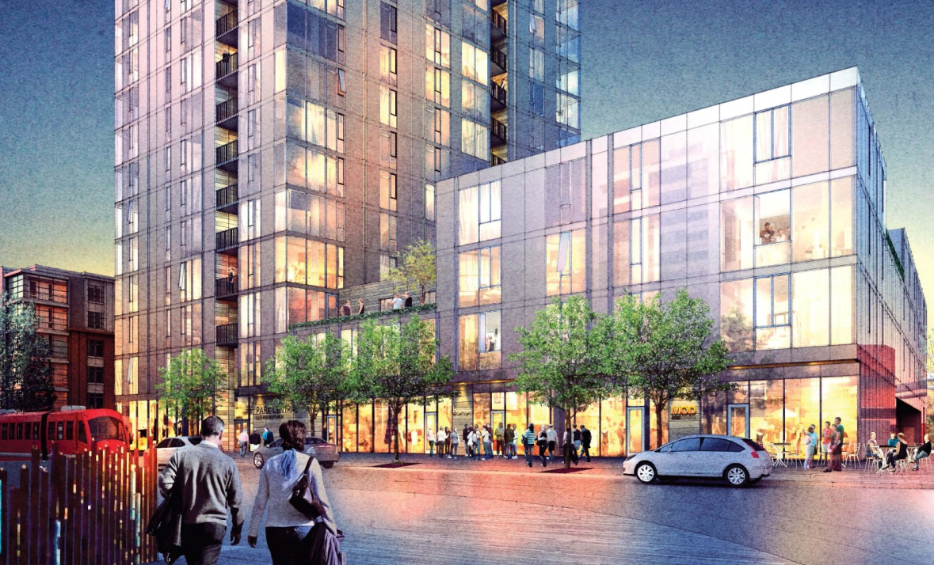
West End: District Character and Livability
Policy: Encourage infill development that respects the district’s diverse urban character
  UD9 Develop zoning tools such as setbacks, step-backs and lower podiums that create varied urban forms, an inviting public realm and integration of infill development with existing district character.
Notes:
Middle John r, pba

Slide 20
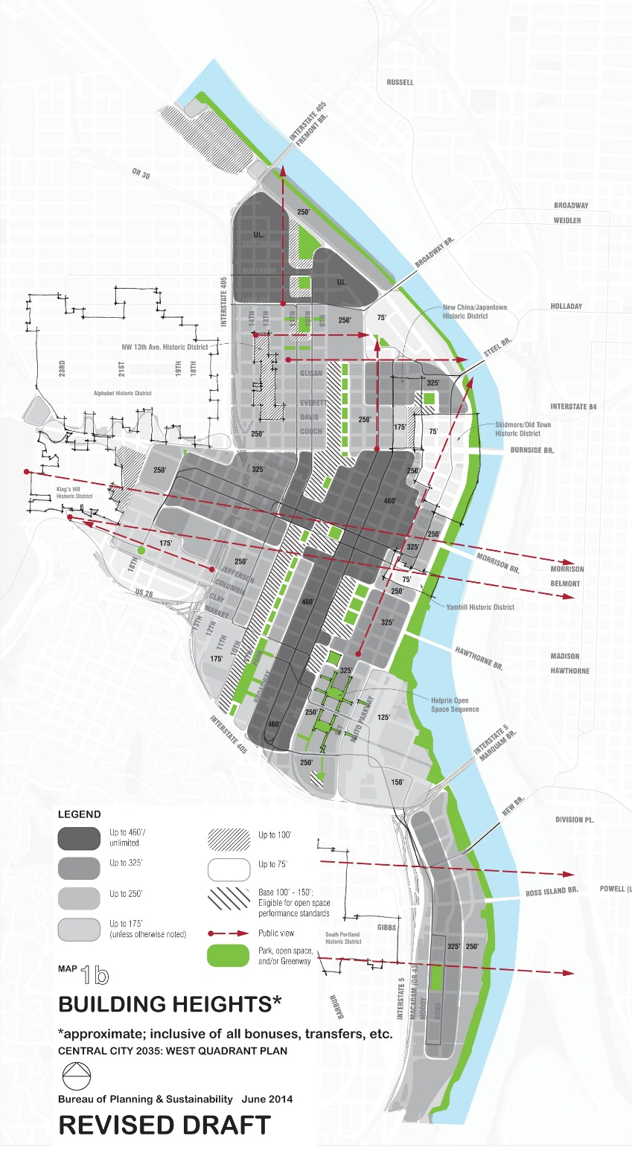
Building heights

Slide 21
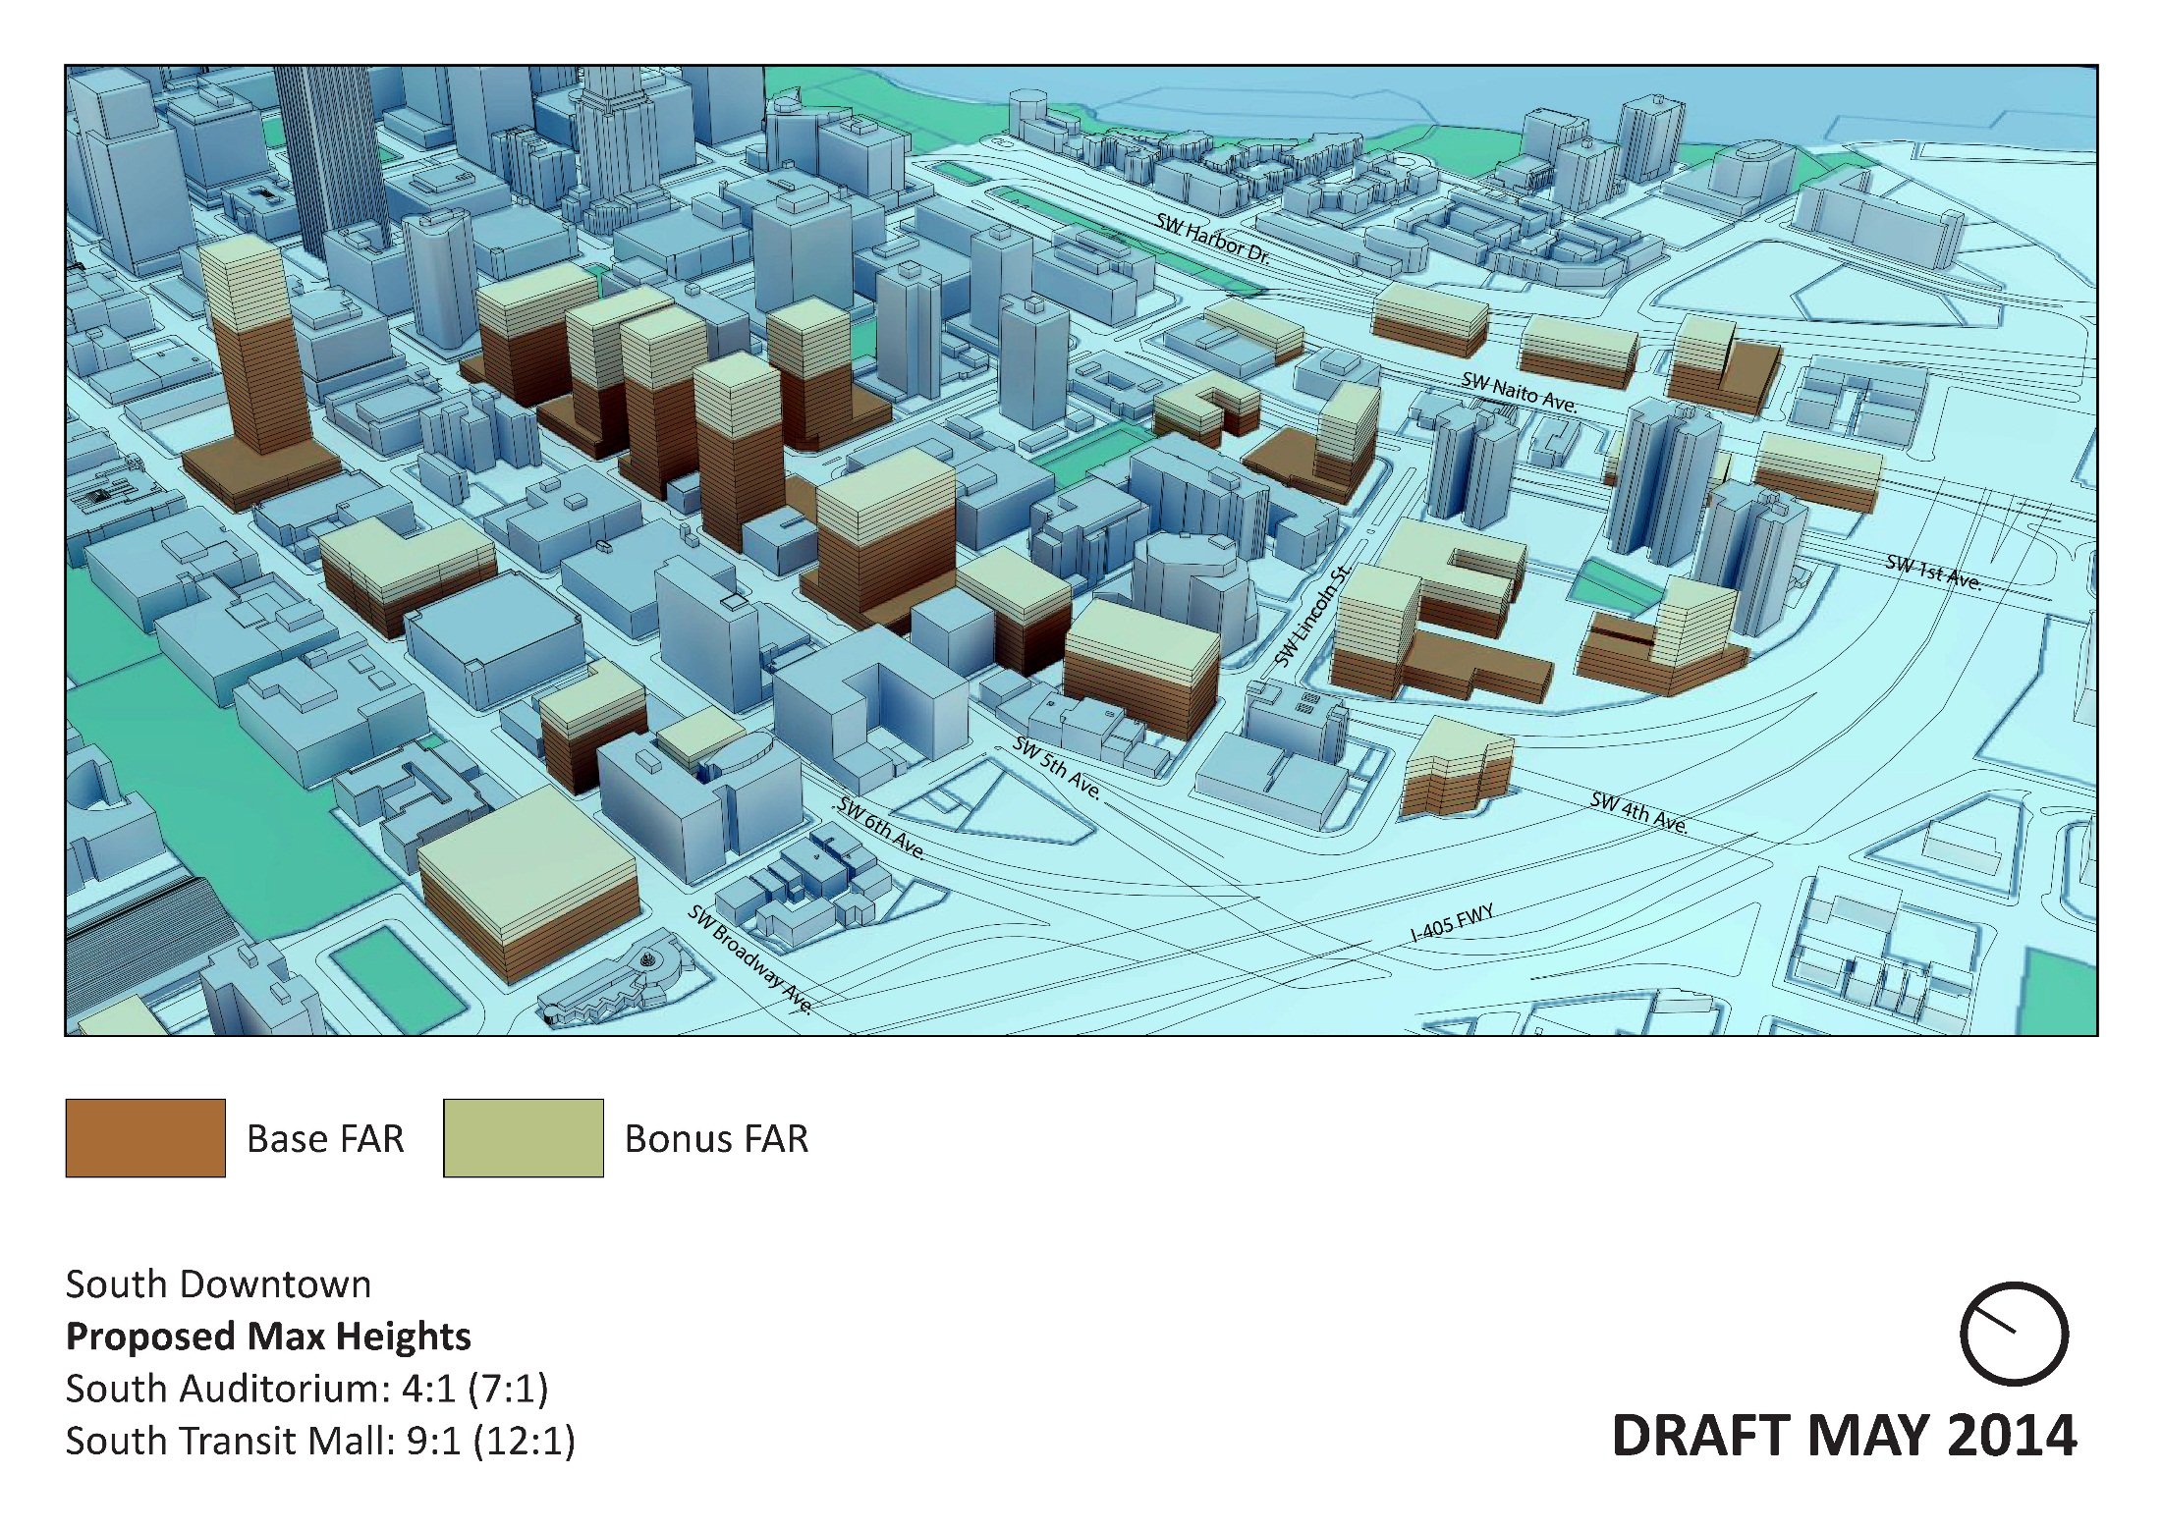

Slide 22
Central waterfront
Regional Center Economy & Innovation
  Policy RC5: Naito Parkway Commercial
  Policy RC7b: Riverfront Tourism
  Policy RC7c: River Tours, Transit, Cruises
  Action RC3: Riverfront Development
  Action RC5: Ship docking facilities
  Action RC7: Active programming and small retail uses in WF Park
  Action RC8: Tourist services in WF Park
  Action RC11: WF Park Promotion
  Policy HN1: Naito Pkwy housing
  Action HN4: Naito Pkwy housing incentives
  Policy TR6: Water access and transportation
  Action TR2: Reduce Ped/Bike Conflicts on WF Park trail
  Action TR3: Improve Naito public transportation
  Policy UD4: WF Park
  Action UD2: Update Greenway Plan
  Action UD3: Update WF Park Master Plan
  Action UD4: WF Park management/programming
  Policy EN1: In-water habitat
  Policy EN2: Water Quality
  Action EN2: Hawthorne Bowl mooring facilities
  Action EN3: Green infrastructure for water quality
Housing & Neighborhoods
Transportation
Urban Design
Environment

Slide 23
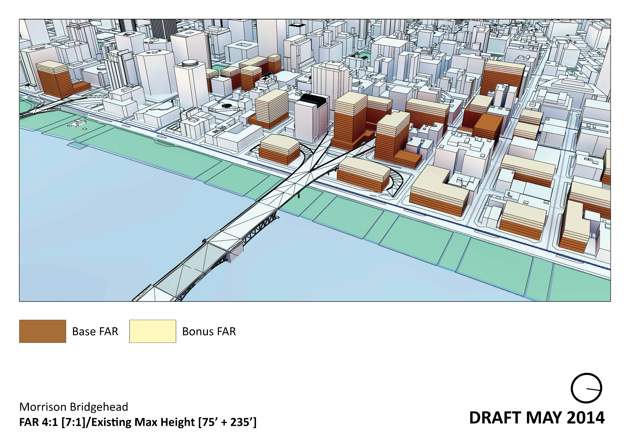
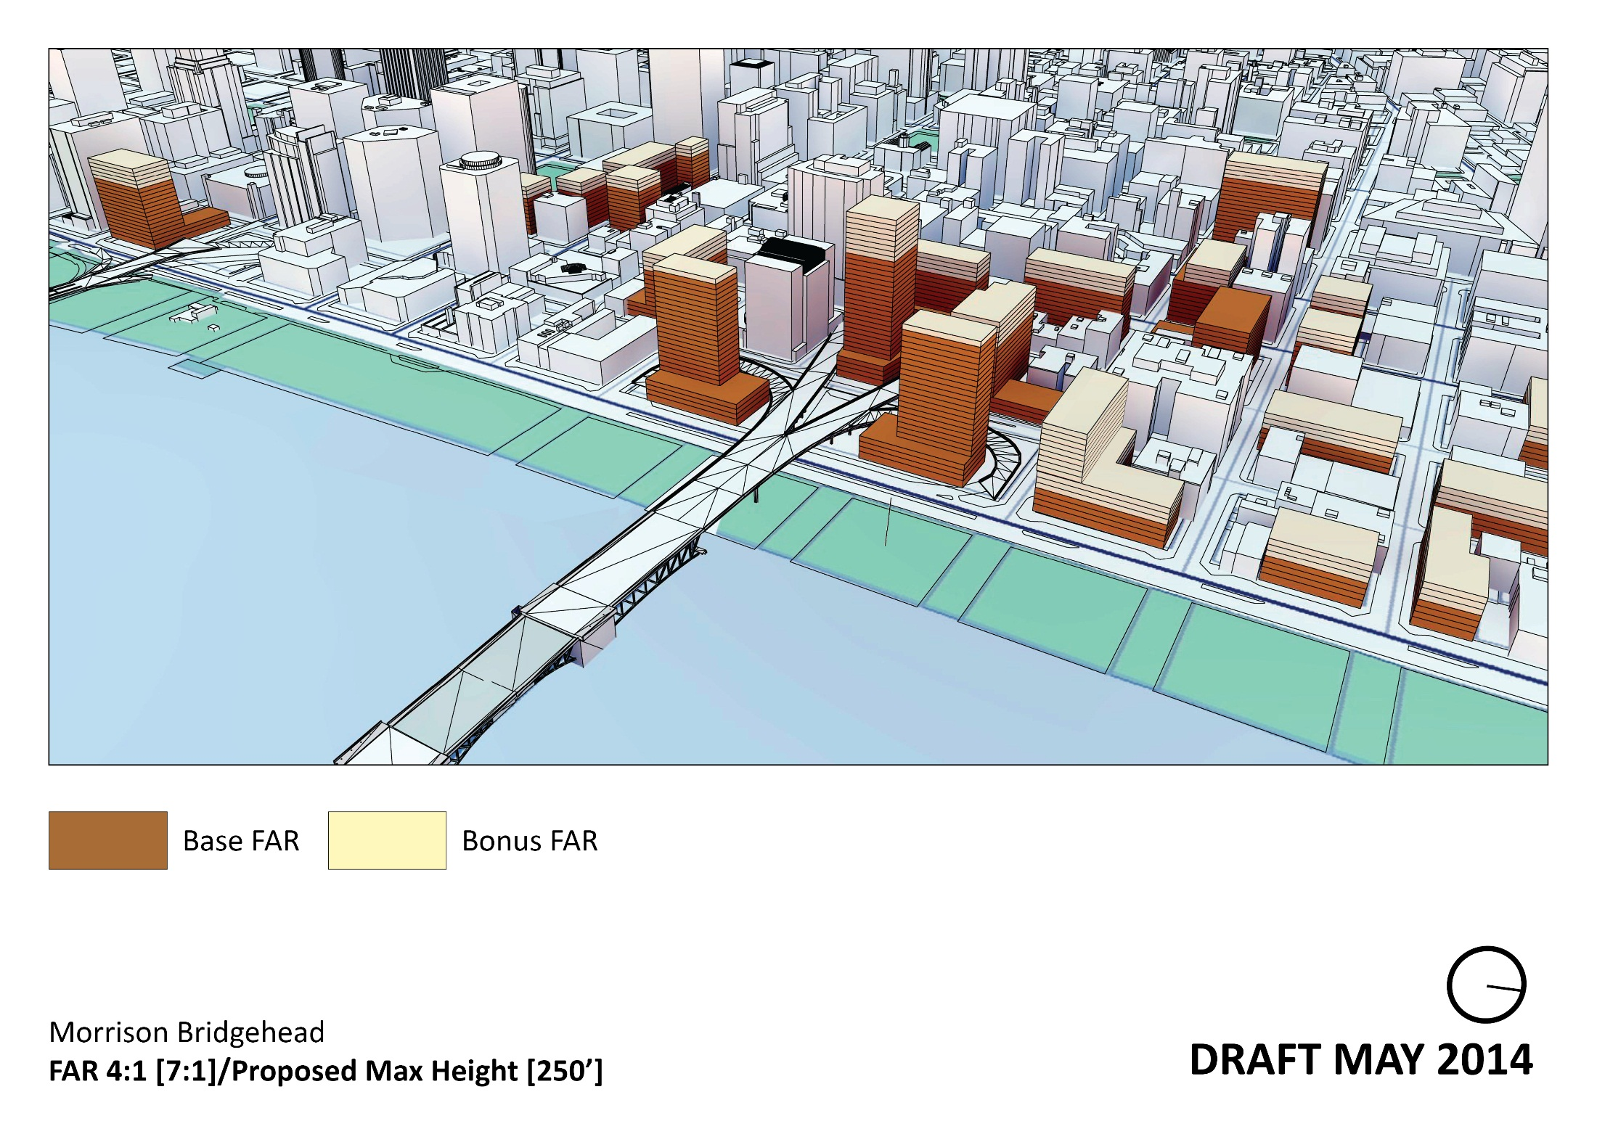
Add Mark’s 9 3D slides

Slide 24
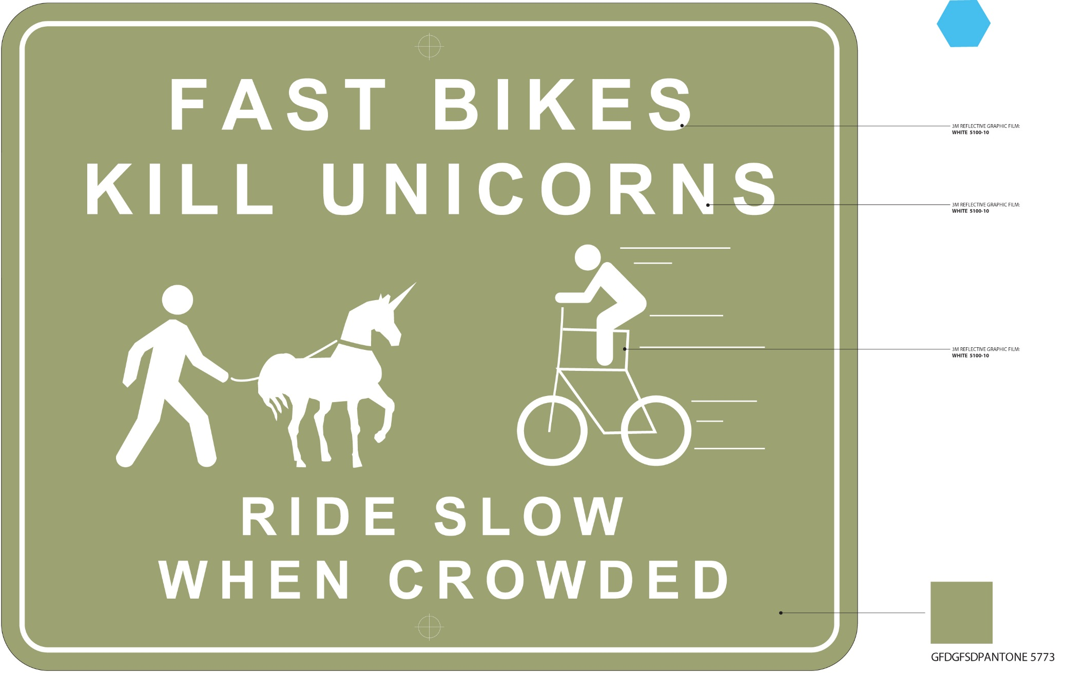

Slide 25
West Quadrant Plan
Next Steps
SAC Meeting #16, July 21
PSC Briefing, August 12
PSC Hearing, September 9
City Council, October – BY RESOLUTION
Implementation and CC2035 Integration work: 2014-2015
CC2035 Plan Adoption, Late 2015 - early 2016 w/ORDINANCE
Continued implementation post-adoption to include Central City design guidelines update

