Slide 1
Block 37
Zoning & Design Guideline Evaluation
May 15, 2014

Slide 2
BLOCK 37
Zoning
Design Guidelines
Essential Issues

Slide 3
ZONING
Gaines Special Height Corridor
Gaines has been designated a special view corridor to protect views to the river from the west-hills. Building must step back 20 feet from the property line above the 50 foot level.

Slide 4
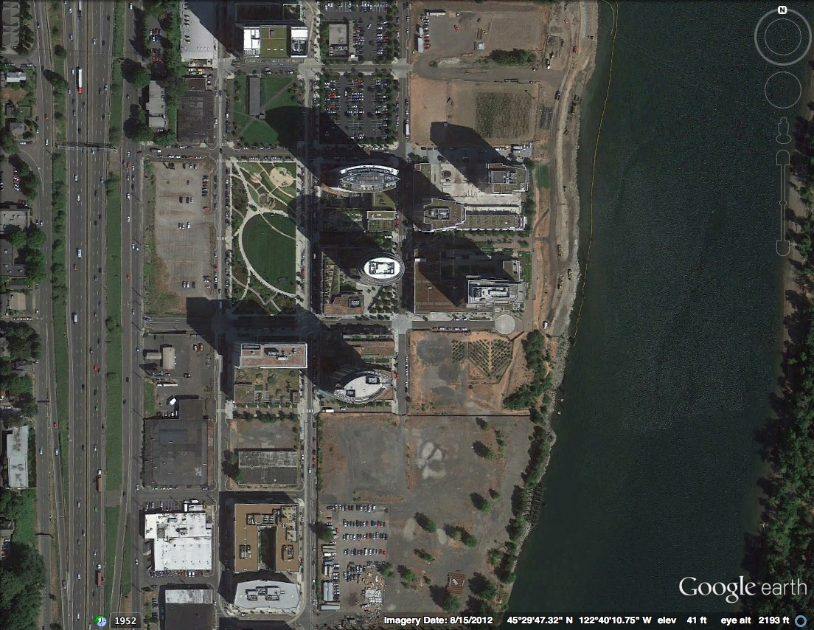
Mirabella
220
Meriwether
245
Gaines View Corridor
John Ross
294
Atwater 214 Units
Riva
294
Ardea
356
Block 37
281 Units
Gaines Special Height Corridor

Slide 5
Code Compliant
20’ setback above 4th floor along Gaines
Mirabella
220
Meriwether
245
Gaines View Corridor
John Ross
294
Atwater 214 Units
Riva
294
Ardea
356
Block 37
281 Units
Gaines Special Height Corridor

Slide 6
Code Compliant
20’ setback above 4th floor along Gaines
Mirabella
220
Meriwether
245
Not Code Compliant above 4th floor along Gaines
Gaines View Corridor
John Ross
294
Atwater 214 Units
Riva
294
Ardea
356
Block 37
281 Units
Gaines Special Height Corridor

Slide 7
Gaines Street
60’
Required Zoning Profile
20’
Atwater
Block 37
50’
View Corridor – Code Compliant Building

Slide 8
Gaines Street
Block 37 Profile
14’ Encroachment into view corridor above 4th floor
60’
20’
Atwater
Block 37
Block 37 – Not Code Compliant

Slide 9
Code Compliant
Gaines Street View Corridor
Ground-Floor Retail on Both Sides of the Street

Slide 10
Code Compliant
Not Code Compliant
Gaines Street View Corridor
Ground-Floor Retail on Both Sides of the Street

Slide 11
100’
Code Compliant
Not Code Compliant
Gaines Street View Corridor
Ground-Floor Retail on Both Sides of the Street

Slide 12
100’
Code Compliant
60’
Not Code Compliant
Gaines Street View Corridor
Ground-Floor Retail on Both Sides of the Street

Slide 13
Gaines Street
60’
Shadow with Code Profile
25’
20’
Atwater
Block 37
50’
Gaines Street
Shadow Profile

Slide 14
Gaines Street
60’
Shadow with Block 37 Profile
25’
20’
Atwater
Block 37
Gaines Street
Shadow Profile

Slide 15
Tower
Block 37 Shadow Study – Tower Comparison

Slide 16
Block 37 Shadow Study – Tower Comparison

Slide 17
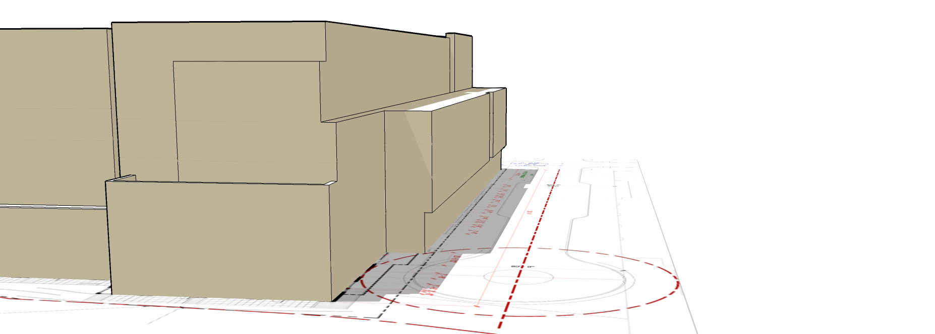
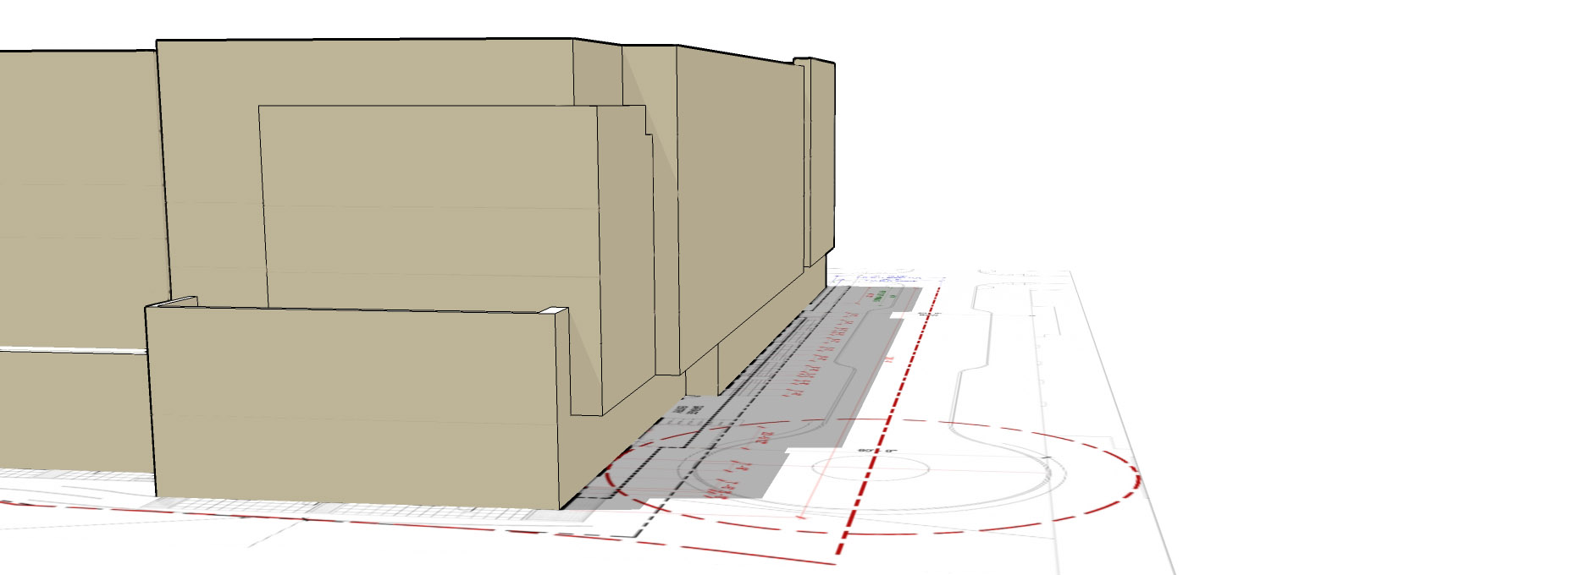
Gaines Street
Center Line
Summer Solstice
Code Compliant
Summer Solstice
Block 37 Current Design
Block 37 Shadow Study - Actual

Slide 18
ZONING
SW Lane Access Way
Buildings must be a minimum of 30 feet from the center line of SW Lane.

Slide 19
Mirabella
220
Meriwether
245
John Ross
294
Atwater 214 Units
SW Lane
Block 37
281 Units
Riva
294
Ardea
356
SW Lane

Slide 20
Mirabella
220
Meriwether
245
John Ross
294
Atwater 214 Units
SW Lane
Block 37
281 Units
Riva
294
Ardea
356
Not Code Compliant
Building 26’ from center line of SW Lane
(Code is 30’)
SW Lane

Slide 21
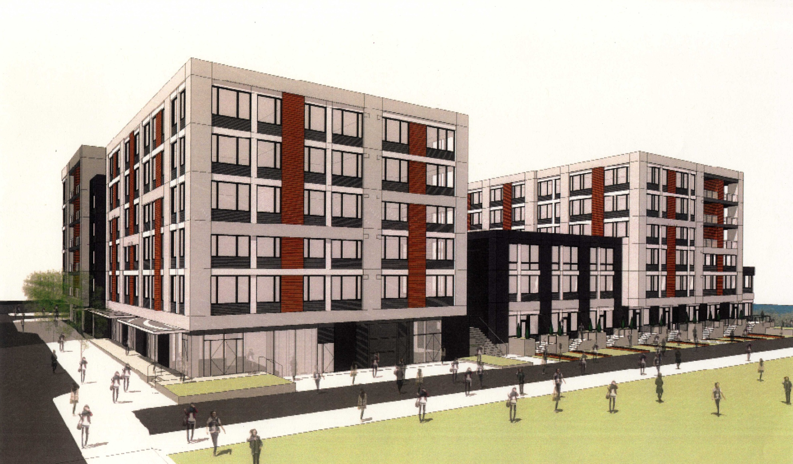
Façade Encroaches
4 feet
Into
SW Lane
Façade Encroaches
4 feet
Into
SW Lane
SW Lane Facade

Slide 22
Mirabella
220
Meriwether
245
Not Code Compliant Above 4th floor along Gaines
Gaines View Corridor
John Ross
294
Atwater 214 Units
SW Lane
Block 37
281 Units
Riva
294
Ardea
356
Not Code Compliant
Building 26’ from center line of SW Lane
(Code is 30’)
Code Compliance

Slide 23
Development Parcel
Block 37 Proposal

Slide 24
4’ Into Setback
Floors 2 thru 6
Block 37 Issues

Slide 25
14’ Into View Corridor Floors 5 and 6
4’ Into Setback
Floors 2 thru 6
Block 37 Issues

Slide 26
14’ Into View Corridor Floors 5 and 6
4’ Into Setback
Floors 2 thru 6
Greenway Crowded
Block 37 Issues

Slide 27
Block 37 Adjustments

Slide 28
Block 37 – Shift North 5 Feet

Slide 29
Code
Compliance
Block 37 – Modified

Slide 30
Code Compliant 20’ Setback Floors 5 &6
Block 37 – Modified

Slide 31
Greenway Crowding?
Block 37 – Modified

Slide 32
Block 37 -Modified

Slide 33
20 Units
12 Units
Block 37 – Modified

Slide 34
Developer Bonus - Over 30 Units
Block 37 Proposal

Slide 35
BLOCK 37
Zoning
Design Guidelines
Essential Issues

Slide 36
SOUTH WATERFRONT DESIGN GUIDELINES - A1-1
Develop River Edge Variety
Vary the footprint and façade plane of buildings that face the Willamette River to create a diversity of building forms and urban spaces adjacent to the greenway. This guideline may be accomplished by articulating the façade plane to step down to the greenway.

Slide 37
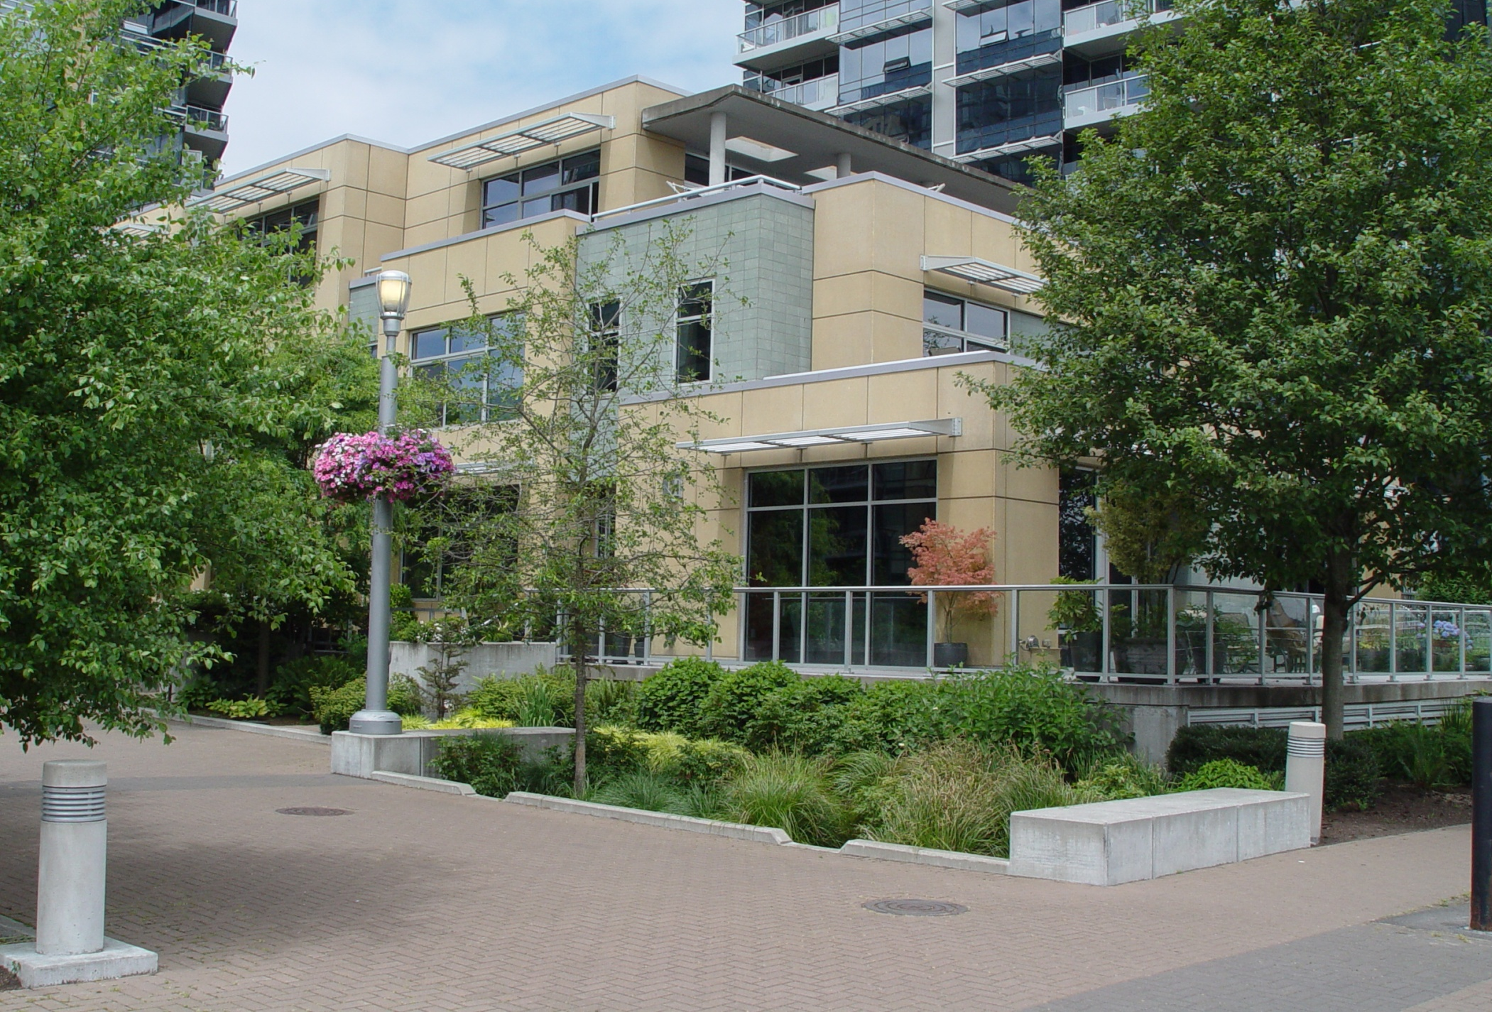
Meriwether Façade (Steps down to the Greenway)

Slide 38
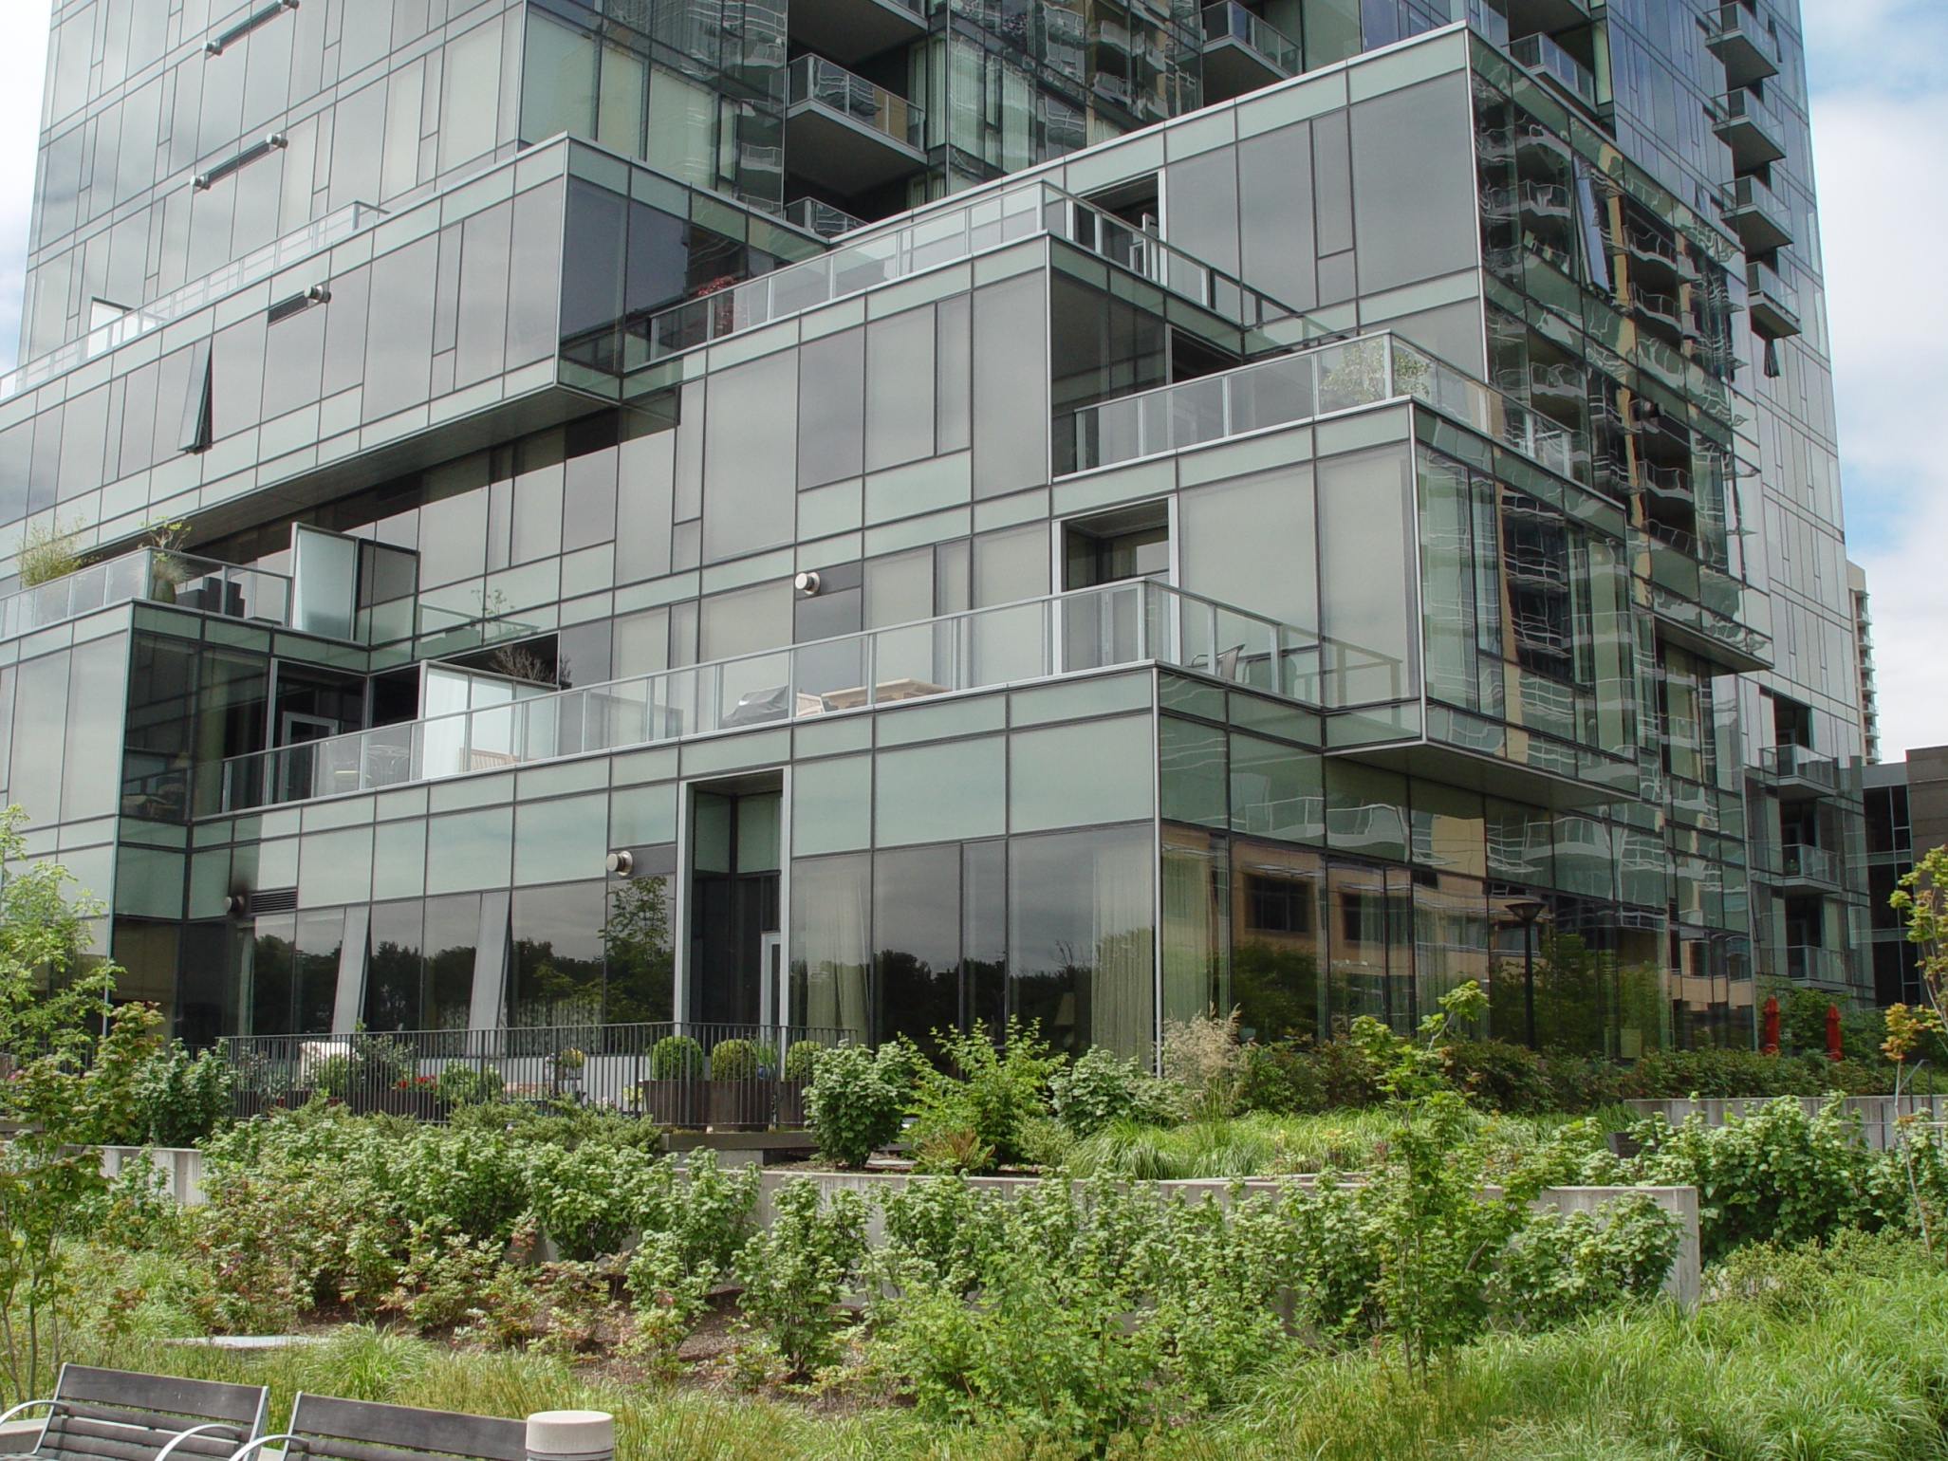
Atwater Façade (Steps down to the Greenway)

Slide 39
Vertical
Facade
Block 37 Facing Greenway

Slide 40
River
21 Feet
Setbacks from Greenway

Slide 41
River
26 Feet
21 Feet
Setbacks from Greenway

Slide 42
River
25 Feet
26 Feet
21 Feet
Setbacks from Greenway

Slide 43
River
8 Feet
25 Feet
26 Feet
21 Feet
Setbacks from Greenway

Slide 44
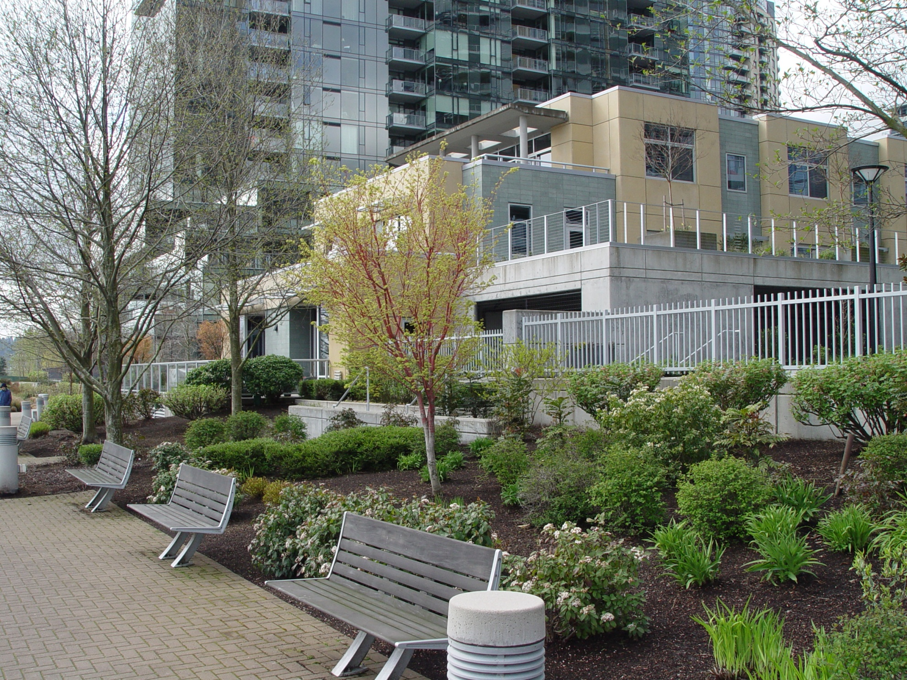
21/26 Feet From Greenway
Meriwether Facing Greenway

Slide 45
8 Feet From The
Greenway
Block 37 Facing Greenway

Slide 46
SOUTH WATERFRONT DESIGN GUIDELINES - A1-1
Develop River Edge Variety
1) The NE corner of Block 37 crowds the greenway.
2) The Block 37 façade plane does not step down to the
Greenway.

Slide 47
SOUTH WATERFRONT COMMUNITY ASSOCIATION GUIDELINES - 2007
Riverwalk and Universal Accessway
Riverwalk shall refer to the zone between the development frontages along the river and the Greenway. The Riverwalk shall include the Universal Accessways within this Zone.
Universal Accessways shall refer to mixed-use pedestrian, bicycle and vehicular passageways between development blocks, or along the South Waterfront Greenway. The function and character of the street may be different than Typical City of Portland standards, especially insofar as users share the same space and sidewalk areas are not delineated. In the Central District, Lane Streets, as well as portions of the Riverwalk, are Universal Accessways.

Slide 48
Greenway
Riverwalk
Mirabella
Meriwether
Riverwalk &
Universal
Accessway
John Ross
Atwater
Universal
Accessway
Riva
Ardea
356
Block 37
South Waterfront District Street Types

Slide 49
Greenway
Riverwalk & Universal Accessway Missing
Riverwalk
Mirabella
Meriwether
Riverwalk &
Universal
Accessway
John Ross
Atwater
Universal
Accessway
Riva
Ardea
356
Block 37
South Waterfront Community Association Guidelines

Slide 50
FUNDAMENTAL DESIGN GUIDELINE - A 4
Use Unifying Elements
Integrate unifying elements that help unify and connect individual buildings. This guideline may be accomplished by integrating elements from existing buildings in new development.

Slide 51
FUNDAMENTAL DESIGN GUIDELINE - C 4
Complement the Context of Existing Buildings
Designers and developers who propose significantly different building styles and/or materials must be able to prove that the new design builds on or complements the existing design vocabulary. This guideline may be accomplished by using elements that are common to the area’s design vocabulary.

Slide 52
FUNDAMENTAL DESIGN GUIDELINE - C 2
Promote Permanence and Quality
Use design principles and building materials that promote quality and permanence.

Slide 53
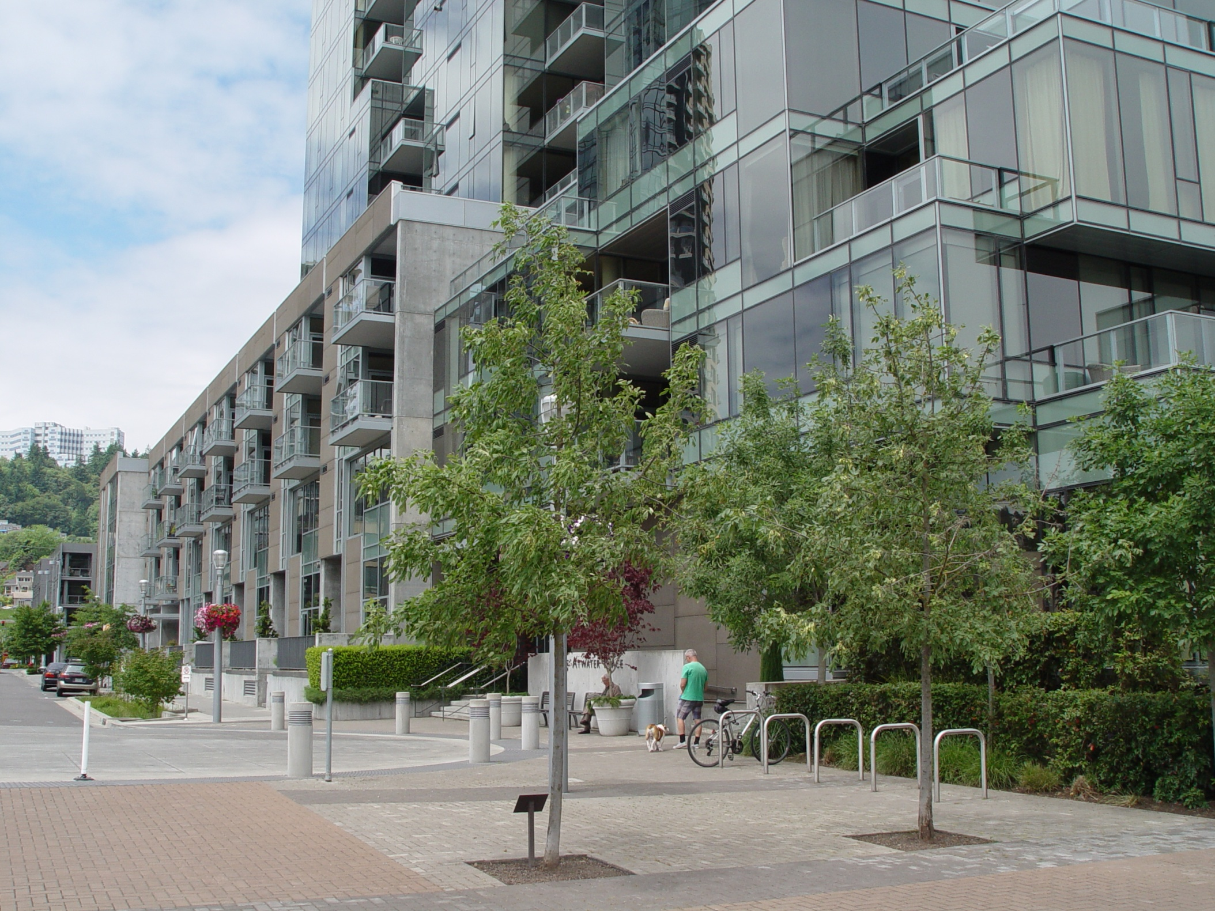
Atwater Façade on Gaines Street

Slide 54
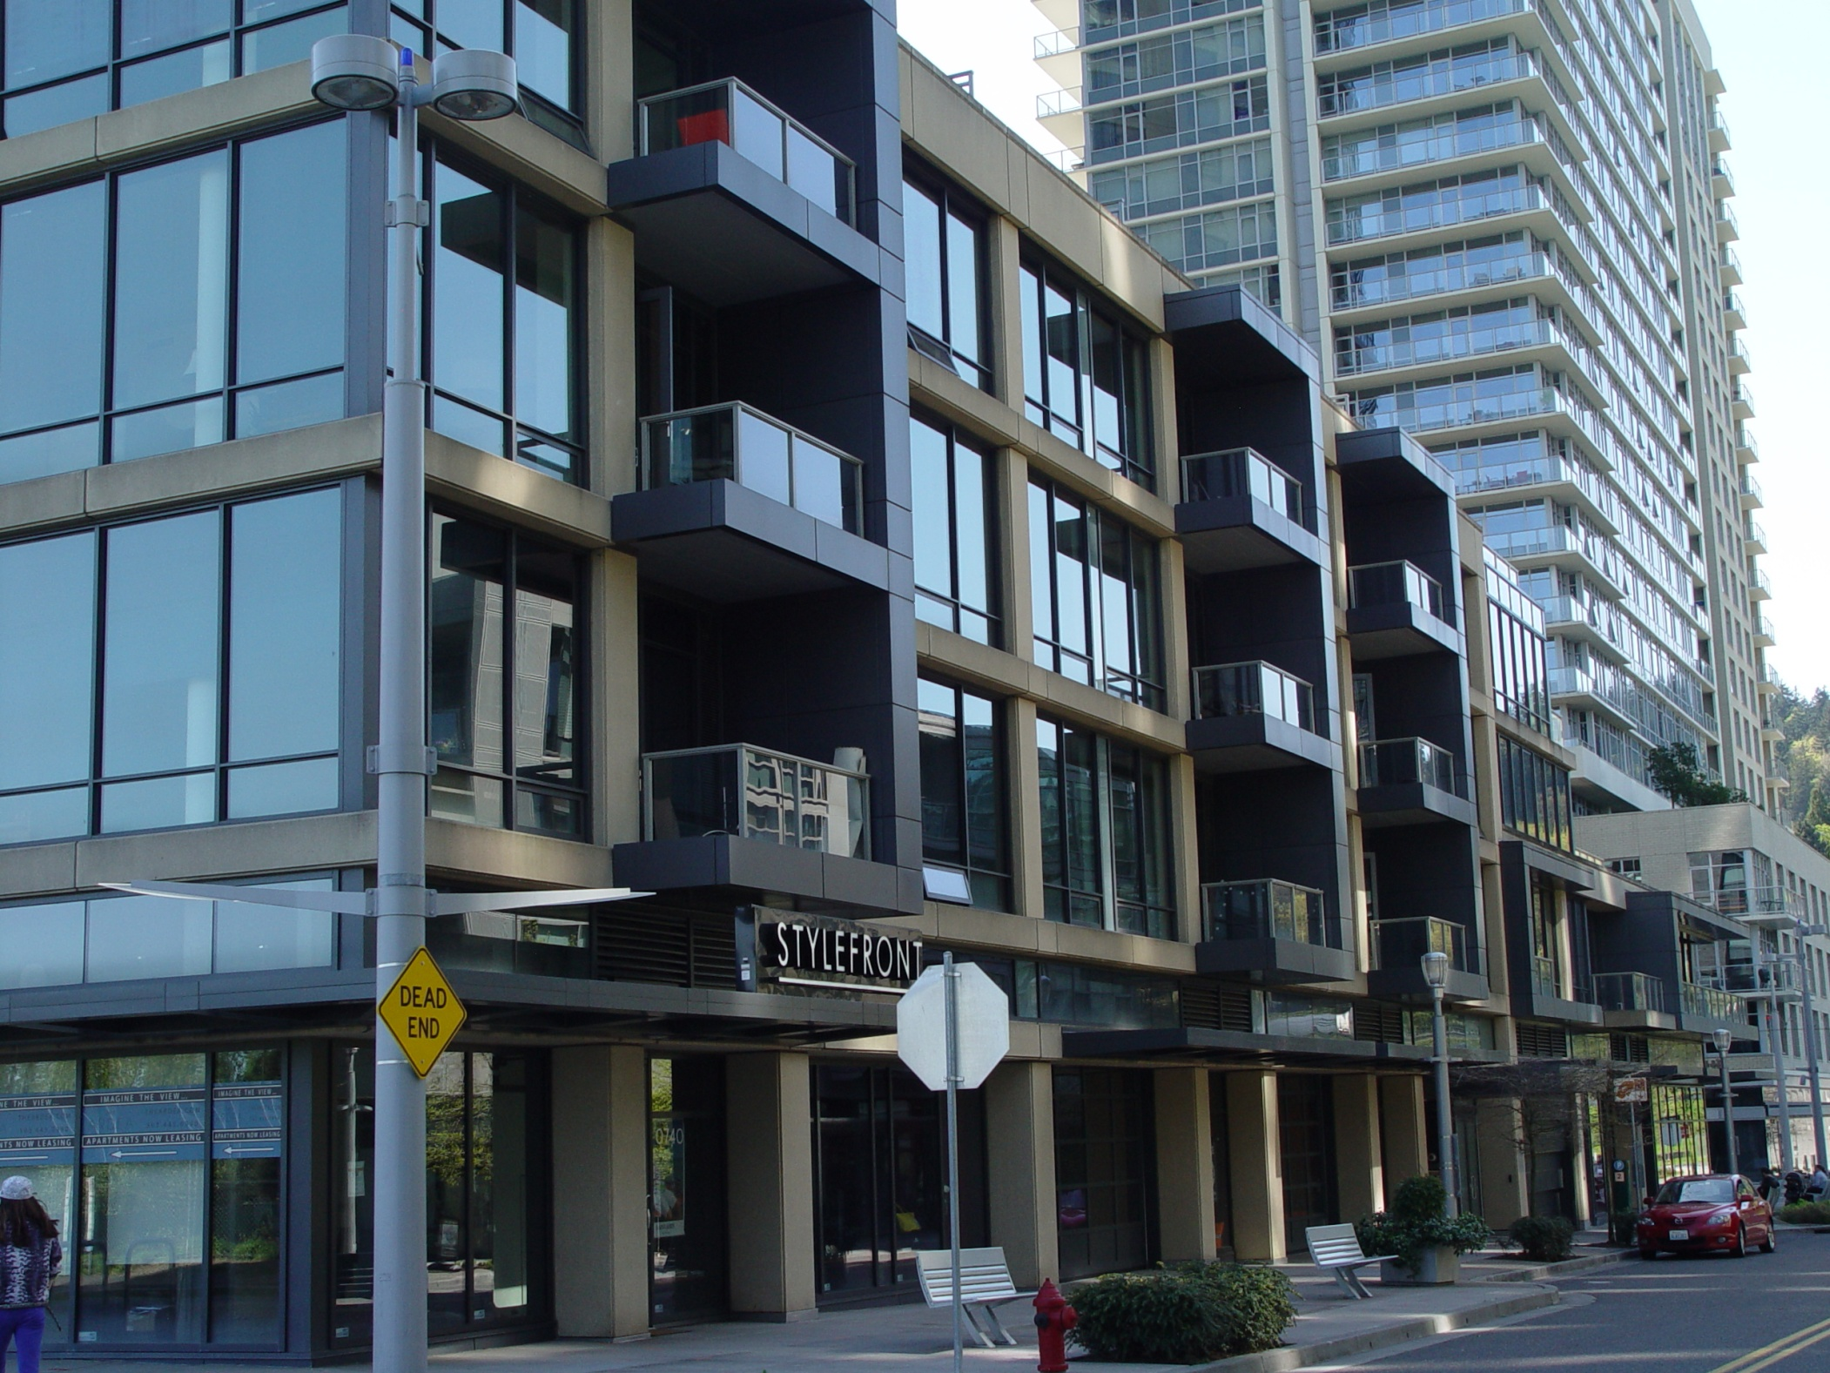
Ardea Façade on Gaines Street

Slide 55
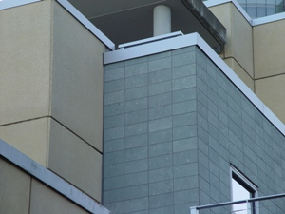
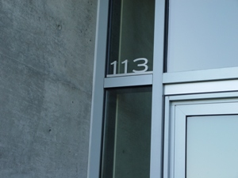
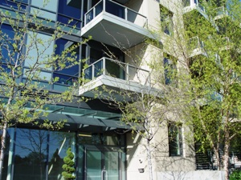
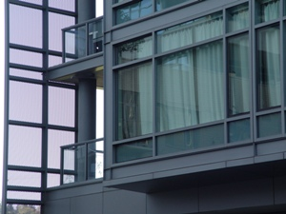
Typical South Waterfront Materials (Glass/Brick/Steel/Concrete)

Slide 56
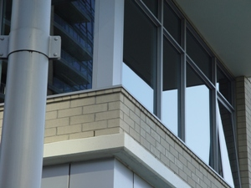
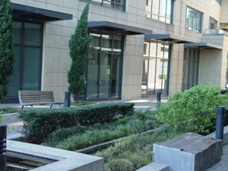
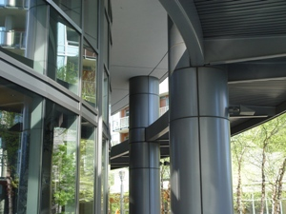
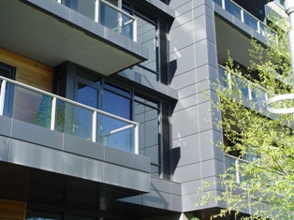
Typical South Waterfront Materials (Glass/Brick/Steel/Concrete)

Slide 57
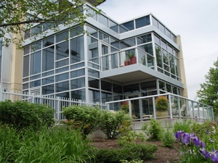
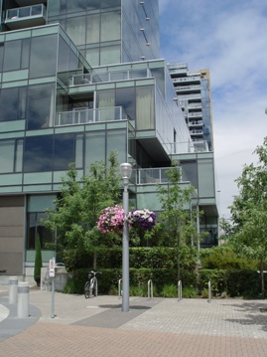
Typical Stair Stepping of Facades

Slide 58
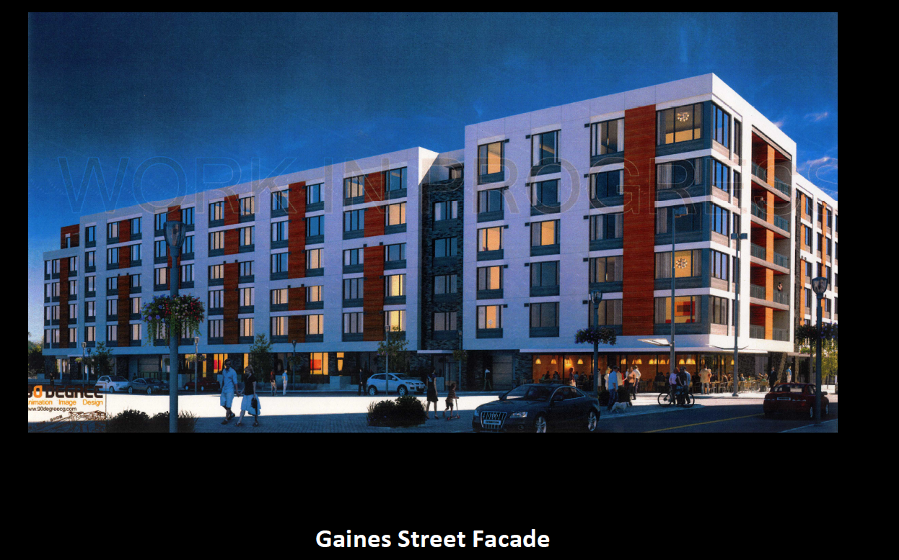
Gaines
Street
Facade
Block 37 - Vertical expression with stucco/panels/vinyl windows

Slide 59
A Brutal Massing
Building Length - 325’
A Flat Façade
No Segmentation /Articulation
White Color Accentuates Mass
Gaines
Street
Facade
Block 37 Gaines Facade

Slide 60
FUNDAMENTAL DESIGN GUIDELINE - A 4
Use Unifying Elements
Block 37 does not attempt to integrate design features, colors or materials from adjacent buildings.

Slide 61
FUNDAMENTAL DESIGN GUIDELINE - C 4
Complement the Context of Existing Buildings
The Block 37 massing and design vocabulary are foreign to the neighborhood.

Slide 62
FUNDAMENTAL DESIGN GUIDELINE - C 2
Promote Permanence and Quality
Block 37 materials do not promote quality or permanence.

Slide 63
FUNDAMENTAL DESIGN GUIDELINE - C 1
Enhance View Opportunities
Size and place new buildings to protect existing views and view corridors.

Slide 64
2 Floors In View
Corridor
Gaines
Street
Facade
Gaines Street/Parkway Corner

Slide 65
FUNDAMENTAL DESIGN GUIDELINE - C 1
Enhance View Opportunities
The six floor corner on Gaines degrades the view corridor and the reason for the additional floors has nothing to do with retail.

Slide 66
FUNDAMENTAL DESIGN GUIDELINE - C 11
Integrate Roofs and Use Rooftops
Size and place rooftop mechanical equipment, penthouses, other components, and related screening elements to enhance views of the Central City’s skyline as well as views from other buildings or vantage points. This guideline may be accomplished by incorporating stormwater management or gardens (eco-roofs).

Slide 67
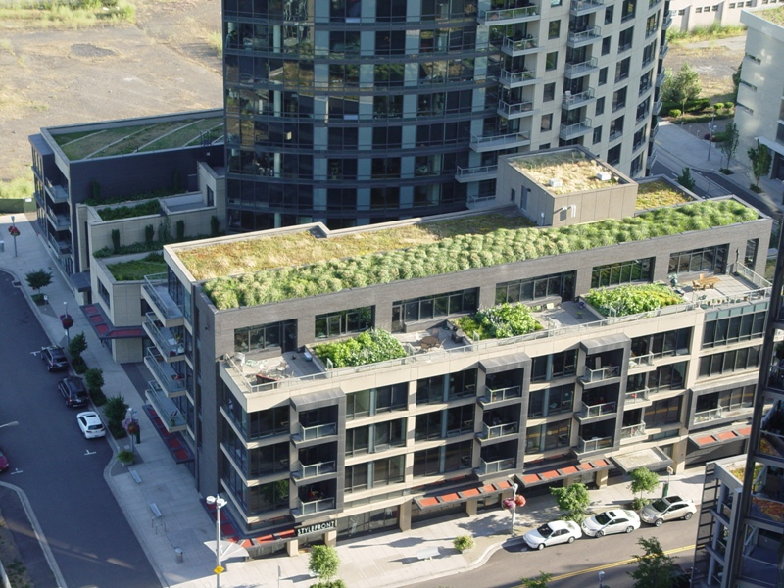
Typical Roof Treatment

Slide 68
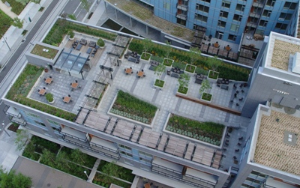
Typical Roof Treatment

Slide 69
FUNDAMENTAL DESIGN GUIDELINE - C 11
Integrate Roofs and Use Rooftops
The Block 37 proposal for colored gravel on the roof is a temporary solution.

Slide 70
BLOCK 37
Zoning
Design Guidelines
Essential Issues

Slide 71
PARKING
All eight buildings adjacent to Block 37 provide on-site parking for tenants and owners. Existing on-street parking is limited.

Slide 72
Mirabella
220
16
Meriwether
245
Existing
On-street Parking 87 Spaces
12
11
Atwater 214 Units
John Ross
294
7
4
6
Ardea
356
9
Riva
294
10
Block 37
12
On-street Parking within 2 Blocks of Block 37 – 87 Spaces

Slide 73
Mirabella
220
16
Meriwether
245
Existing
On-street Parking 87 Spaces
12
11
Atwater 214 Units
John Ross
294
7
4
6
Ardea
356
9
Riva
294
10
Block 37
12
Pedestrian “Green Street”
On-street Parking within 2 Blocks of Block 37 – 87 Spaces

Slide 74
Mirabella
220
16
Meriwether
245
Block 37
Parking Shortage
80 Spaces
Existing
On-street Parking 87 Spaces
12
11
Atwater 214 Units
John Ross
294
7
4
6
Block 37
281 Units
Parking for
201 Units
Riva
294
10
Ardea
356
9
12
Pedestrian “Green Street”
On-street Parking within 2 Blocks of Block 37 – 87 Spaces

Slide 75
Mirabella
220
16
Meriwether
245
Block 37
Parking Shortage
80 Spaces
Existing
On-street Parking 87 Spaces
12
11
Atwater 214 Units
John Ross
294
7
4
6
Block 37
281 Units
Parking for
201 Units
Riva
294
10
Ardea
356
9
Abernethy
199 Apartments
196 Parking Spaces
12
Pedestrian “Green Street”
On-street Parking within 2 Blocks of Block 37 – 87 Spaces

Slide 76
Mirabella
220
Retail/Commercial Space
40,000 SF
Meriwether
245
John Ross
294
Atwater 214 Units
Riva
294
Ardea
356
Block 37
281 Units
294 Units
Retail/Commercial Parking Need @ 3 Spaces/1,000 SF = 120 Spaces

Slide 77
Mirabella
220
Retail/Commercial Parking Shortage
30 Spaces
Meriwether
245
Block 37
Parking Shortage
80 Spaces
John Ross
294
Atwater 214 Units
Riva
294
Ardea
356
Block 37
281 Units
294 Units
Retail/Commercial Parking Need @ 3 Spaces/1,000 SF = 120 Spaces

Slide 78
Retail/Commercial Core
Mirabella
220
Meriwether
245
John Ross
294
Atwater 214 Units
Riva
294
Ardea
356
Block 37
281 Units
294 Units
South Waterfront Retail/Commercial Core

Slide 79
Missing Streets
Mirabella
220
Existing Streets
Meriwether
245
Atwater 214 Units
Riva
294
Ardea
356
Block 37
294 Units
Streets Within 2 Blocks of Block 37

Slide 80
Retail Fundamentals
Configuration
Disciplined
CRANDALL ARAMBULA PC
Auto
Access
Convenient
Presentation
Attractive
Retail
Success
Parking
Grandma
Friendly
Pedestrian
Environment
Comfortable
&High Quality
Pedestrian
Crossings
Safe &
Special

Slide 81
Residential Buildings | Number of Units | Built Parking Stalls | Stalls Per Unit | Parking Deficit
Meriwether East/West | 245 | 382 | 1.6 | 0
John Ross | 303 | 394 | 1.3 | 0
Atwater | 214 | 300 | 1.4 | 0
Mirabella | 220 | 275 | 1.49 | 0
Matisse | 274 | 282 | 1.03 | 0
Ardea | 323 | 382 | 1.3 | 0
Riva On The Park | 294 | 304 | 1.03 | 0
Block 37 | 281 | 201 | 0.7 | (80)
Abernathy | 199 | 196 | 0.985 | (3)
South Waterfront Parking

Slide 82
PARKING
Block 37 parking shortage will:
Severely restrict potential for future neighborhood retail and commercial services
Degrade values of existing buildings because of on-street parking shortage

Slide 83
GARAGE ACCESS
The current design places Block 37’s automobile garage entrance on the eastern edge of SW Gaines Street, immediately adjacent to the cul-de-sac and Greenway. This brings garage traffic in close proximity to what is expected to be high pedestrian and bicycle traffic.
The risk of pedestrian versus automobile incidents is greatly increased as a result of this altered placement.

Slide 84
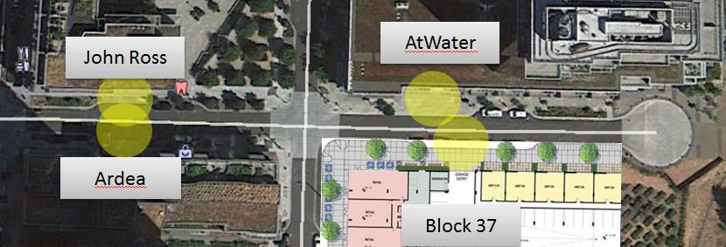
Garage Access

Slide 85
Garage Access

Slide 86
Block 37 Approval Conditions
Zoning – Building to be:
In conformance with Gaines view corridor zoning
In conformance with SW Lane setback zoning

Slide 87
Block 37 Approval Conditions
Zoning – Building to be:
In conformance with Gaines view corridor zoning
In conformance with SW Lane setback zoning
Design Guidelines – Building to be:
In conformance with South Waterfront Community Association Guidelines requiring Riverwalk and Universal Accessway
Pulled back from Greenway at least 20 feet
Stepped back from Greenway
Segmented along Gaines to break up the 325’ facade
In character and compatible with other South Waterfront buildings
Constructed with an eco-roof

Slide 88
Block 37 Approval Conditions
Zoning – Building to be:
In conformance with Gaines view corridor zoning
In conformance with SW Lane setback zoning
Design Guidelines – Building to be:
In conformance with South Waterfront Community Association Guidelines requiring Riverwalk and Universal Accessway
Pulled back from Greenway at least 20 feet
Stepped back from Greenway
Segmented along Gaines to break up the 325’ facade
In character and compatible with other South Waterfront buildings
Constructed with an eco-roof
Essentials – Provide:
One parking space for each unit
Parking garage entry opposite Atwater garage entry

Slide 89
Block 37
Zoning & Design Guideline Evaluation
May 15, 2014

