Slide 1
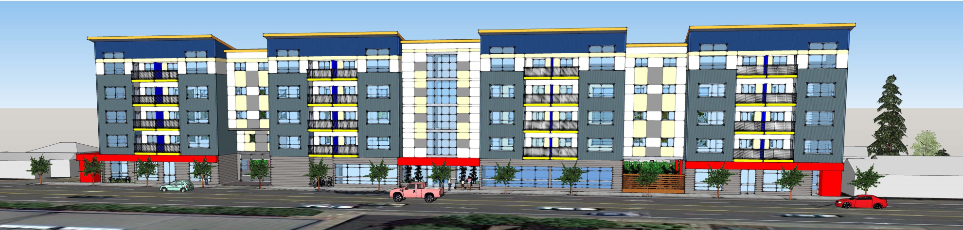
HAZELWOOD PLAZA
222 NE 102nd Ave. Portland, OR
61 RESIDENTIAL UNITS
ALBERTO RINKEVICH RICARDO BERDICHEVSKY
ARDESIGN QUAIL COURT MANAGEMENT
4810 SW LOWELL CT. PORTLAND, OR 97221 3570 RIVER PARKWAY PORTLAND, OR 9729
503-927-1758 FAX 503-922-2613 503-477-4587 FAX 503-954-2612

Slide 2
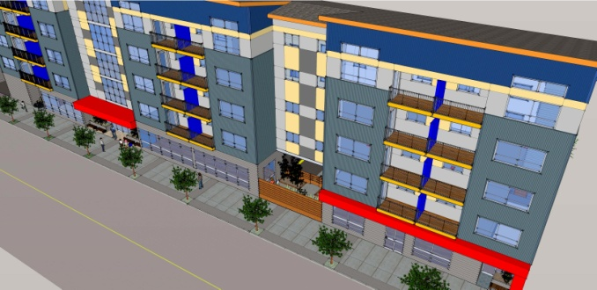
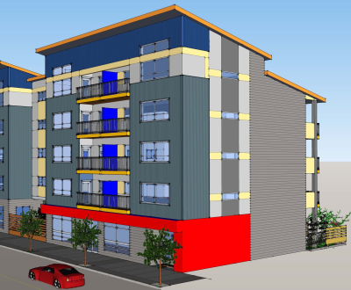
Project location: 222 NE 102nd. Ave. Portland, OR
Neighborhood: Hazelwood
Plan District: Gateway Plan district
Design Guidelines: Gateway regional district
Zoning: CMd, Mixed
Residential/Commercial with design Overlay Maximum building height : 75 feet
Floor area ratio (FAR): Max. 4:1
Min. 1:1
Parking: Not required, 52 provided
Bicycle parking: Long term : 80 provided, 72 required
Short term: 6 provided, 6 required

Slide 3
Design Strategy
Answer to the government's social housing demands
Rigorous formal and constructive order
To articulate and break the longitudinal dimension of the building defined by the urban parameters
Emphasize the facades composition utilizing materials colors and textures
To achieve budget objectives
Building to be easily identifiable by the end user

Slide 4
Project Description
Property Address
No. Residential Units
Net Rentable Area (NRSF)
Common Area
Gross Building Area
No. Buildings
No. of Floors
Site Area
Building Construction
Roof Type
Building Exterior
Air Conditioning System
Ventilation
Green Building Goal
222 NE 102nd Avenue
59 , 2 live/work units, 36 1BR, 23 2BR
46,696 sq. ft.
12,322 sq. ft.
59,018 sq. ft.
1
4/5 residential floors with tuck under parking
24,338 sq. ft.
Ground Fl. Concrete + Wood framing
Composite / seamed metal
Prepainted corrugated metal panel and
Prefinished cement board siding,
Metal balcony
Split air conditioners
Corridors Fan + Heat Recovery Ventilator
Windows @ Bike Rms. and 5th. Fl. Corridor
Comply and certify for Enterprise Green
Communities’ criteria for affordable housing

Slide 5
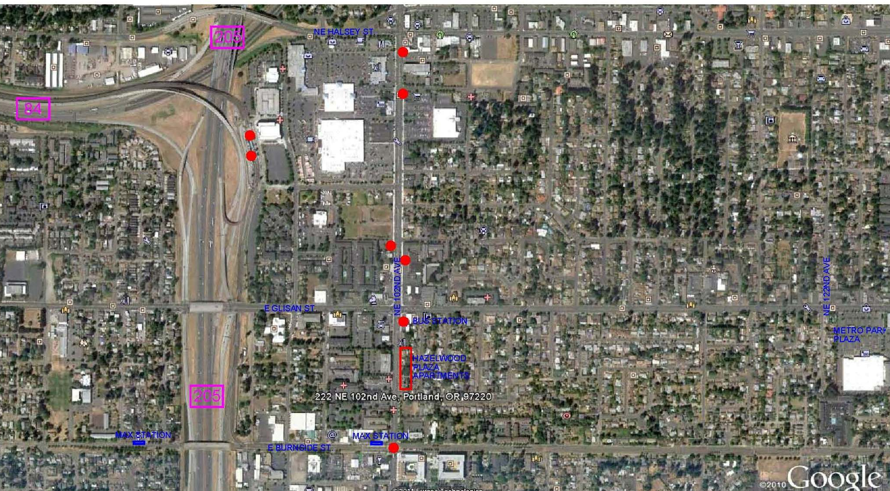
Vicinity
GATEWAY
TRANSIT CENTER
i-205 SHOPPING MALL
SE 102 ND / SE WASHINGTON ST.

Slide 6
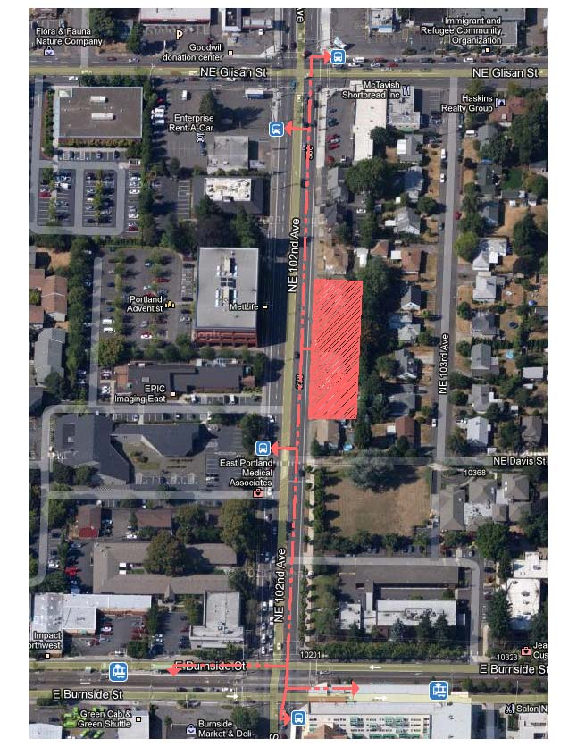
GATEWAY REGIONAL CENTER DESIGN GUIDELINES
1- New development adjacent to102nd should support the
improved street by incorporating a setback with landscape
plantings and trees between the building and sidewalk
2- Orienting larger building volumes to the street, creating a multistory built edge, increases opportunities for the development of quieter private
3- Integrating building setback areas that function as
extensions of the sidewalk along main streets
4- Integrating building setback areas that function as extensions of
the sidewalk along main streets
5- Developing a strong street orientation along residential or
commercial streets
6- Incorporating large ground floor windows facing the sidewalk
7- Orient semi-public building spaces to the sidewalk and street
8- Orienting main entrances and/or lobbies to the sidewalk
9- Consolidating motor vehicle access points
10-Using integrated systems of building elements to provide a
human scale at the ground level
11-Integrate the different ground-level building elements with
the building’s architecture
12-Developing residential buildings that provide foundations for
new communities
13-Incorporate building mechanical equipment and/or service areas
in a manner that does not detract from the pedestrian environment
14-Incorporating stormwater management systems into surface parking
15-Use design principles and building materials that convey quality
and permanence

Slide 7
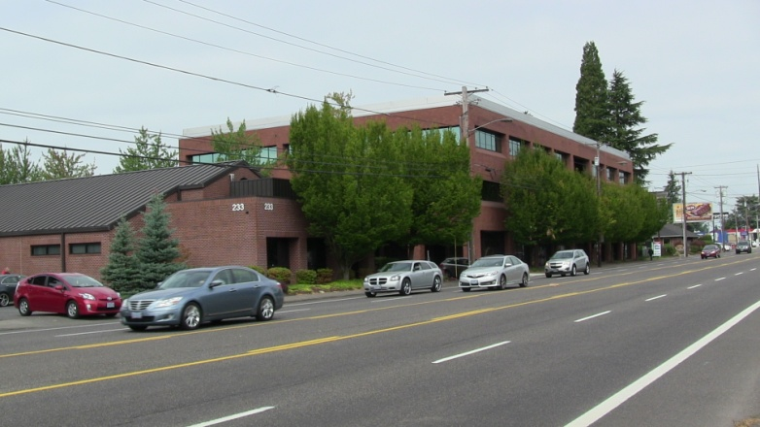
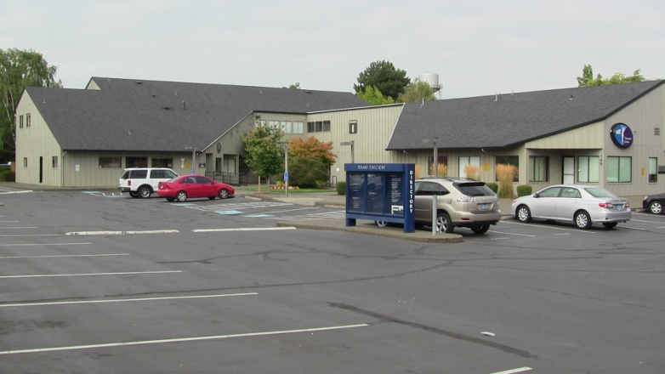
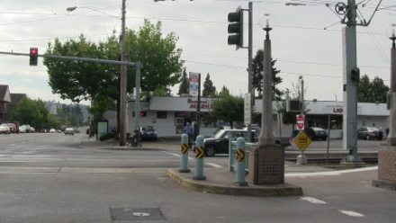
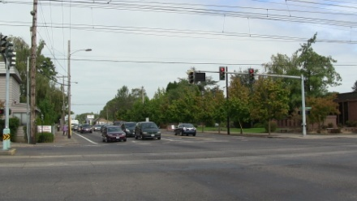
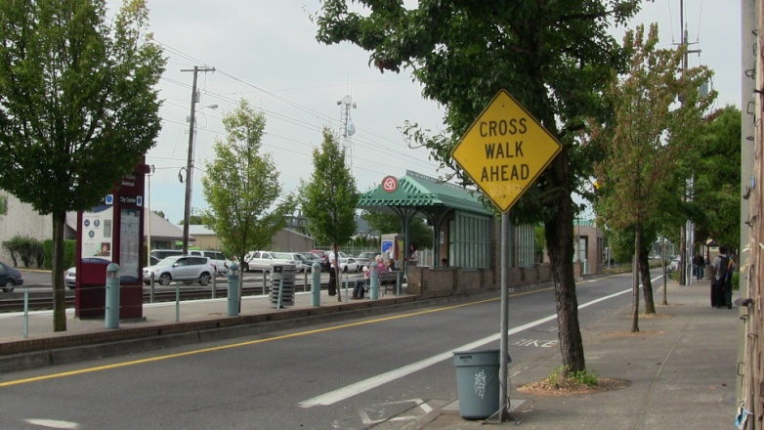
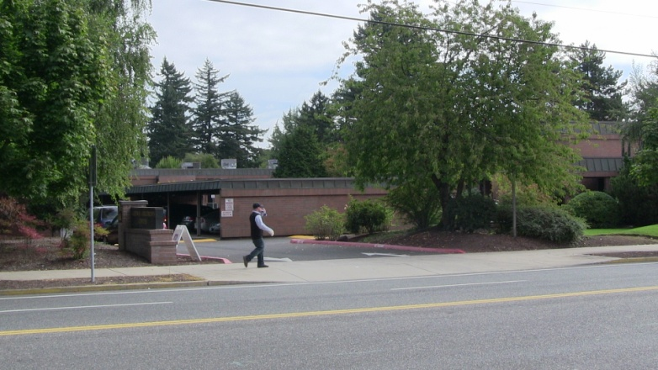
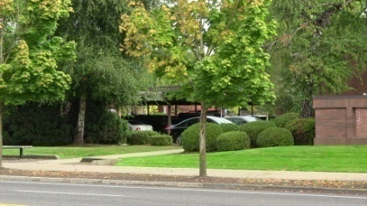
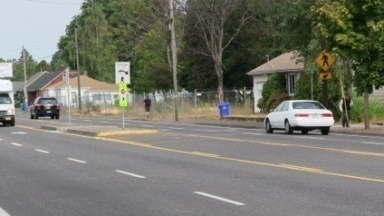
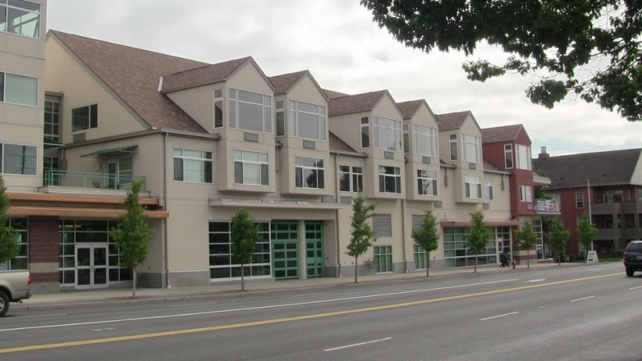
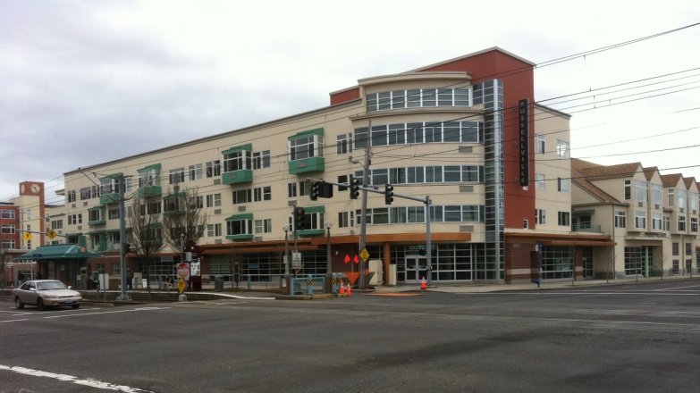
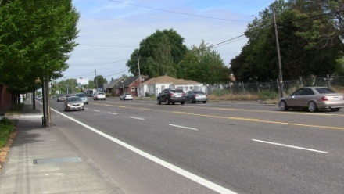
Vicinity photos

Slide 8
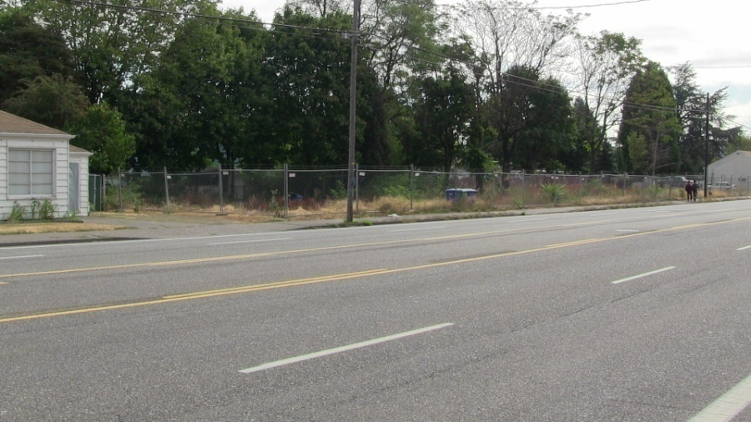
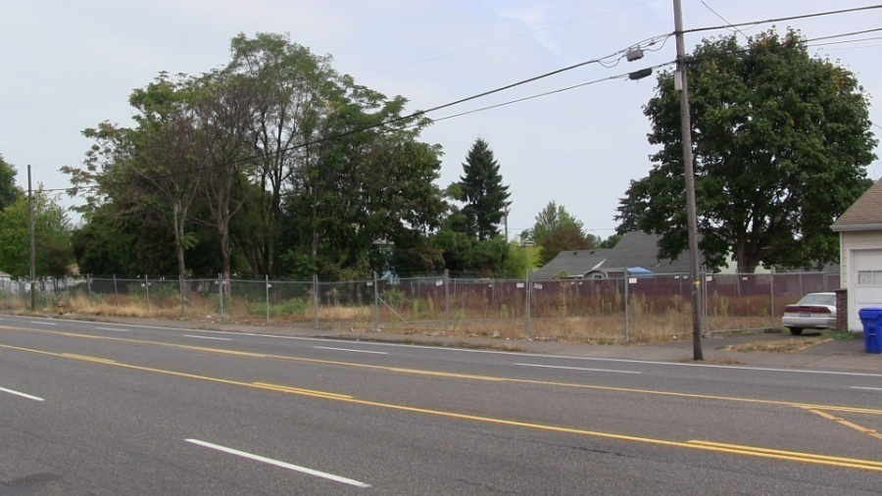
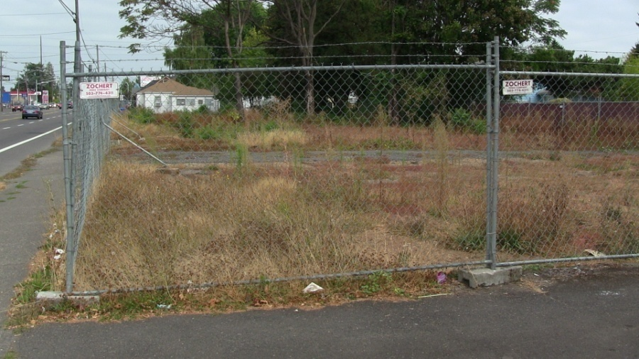
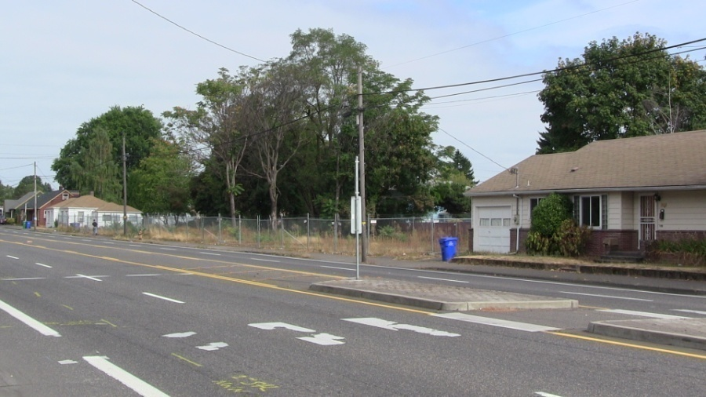
Site – current photos
the site is tapered, with one long side facing the street and one long side bounded by four small properties
the site was rezoned (consolidate 4 in 1 big lot) to replace four dilapidated townhouses with a 61-unit apartment building.

Slide 9
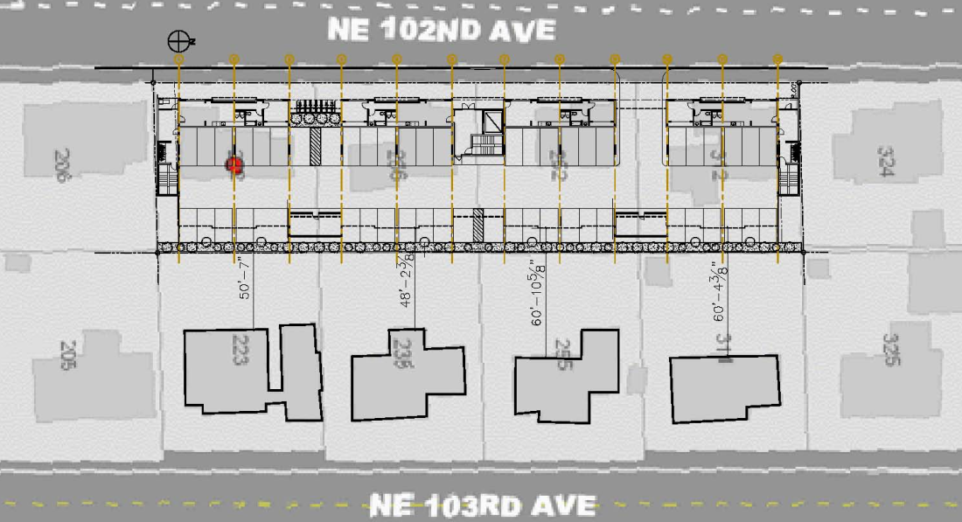
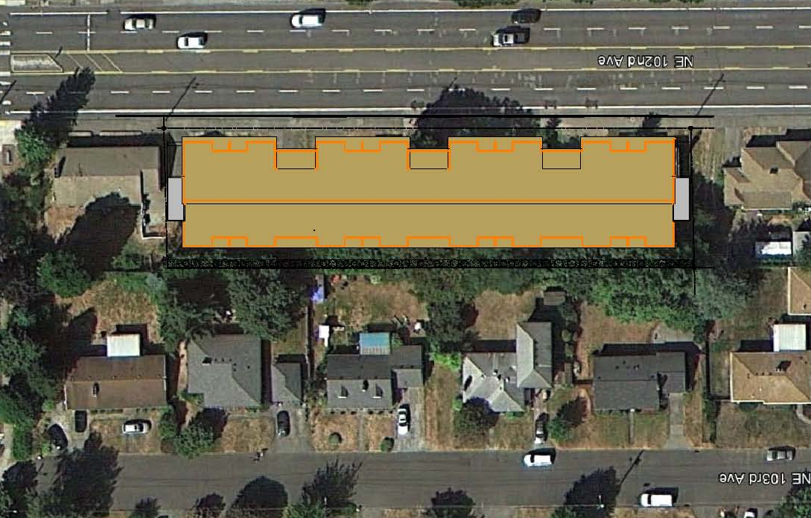
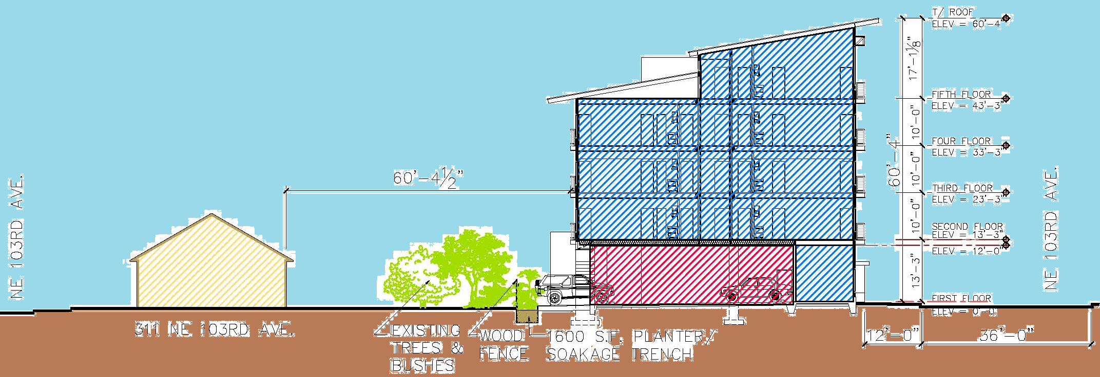
Site plans & section
Site Plan
Site + Roof Plan
Site Section
The building gently steps up in scale from the lower two story residences to the taller, denser 102nd. Avenue

Slide 10
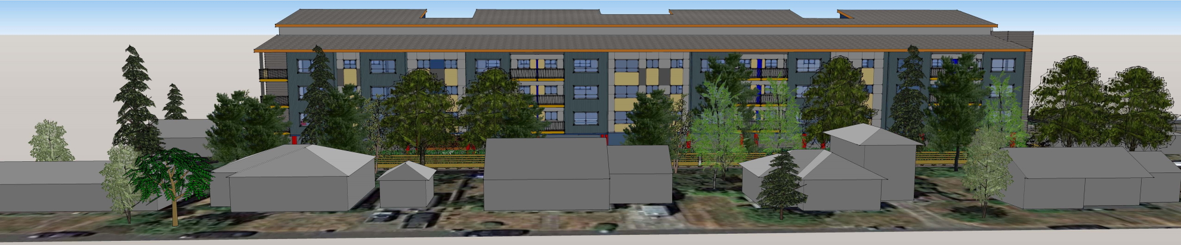
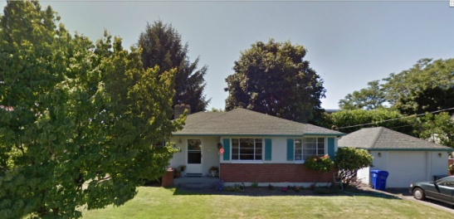
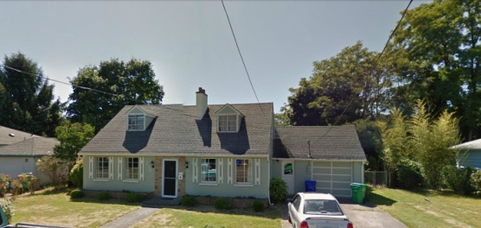
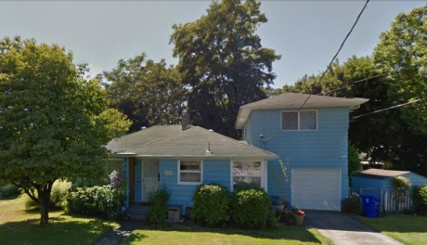
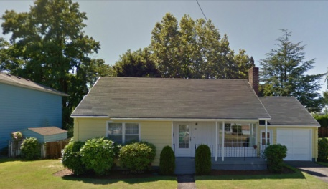
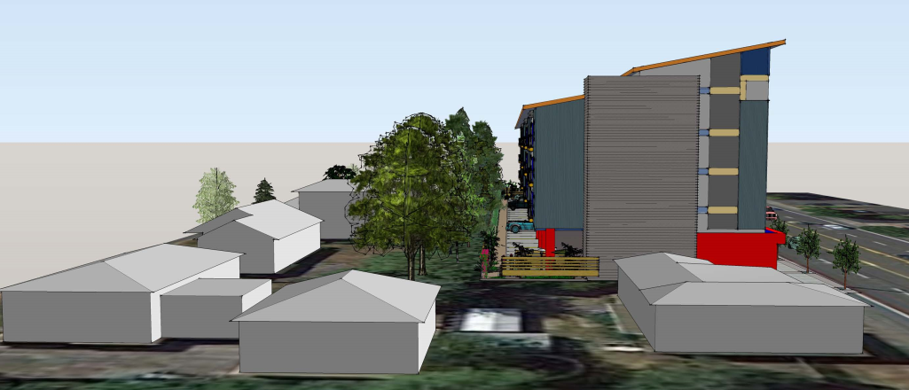
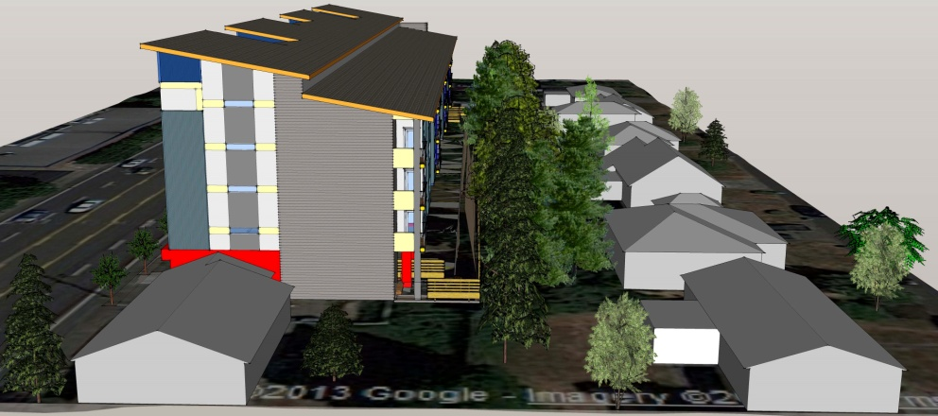
View from NE 103 Ave.
219 239 259 309
View from the South View from the north

Slide 11
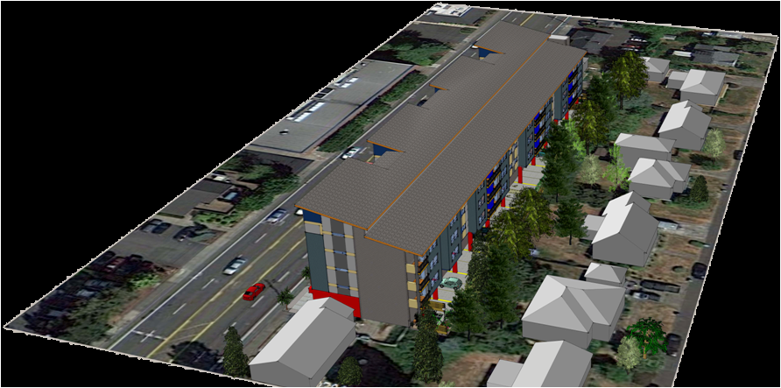
Aerial View

Slide 12
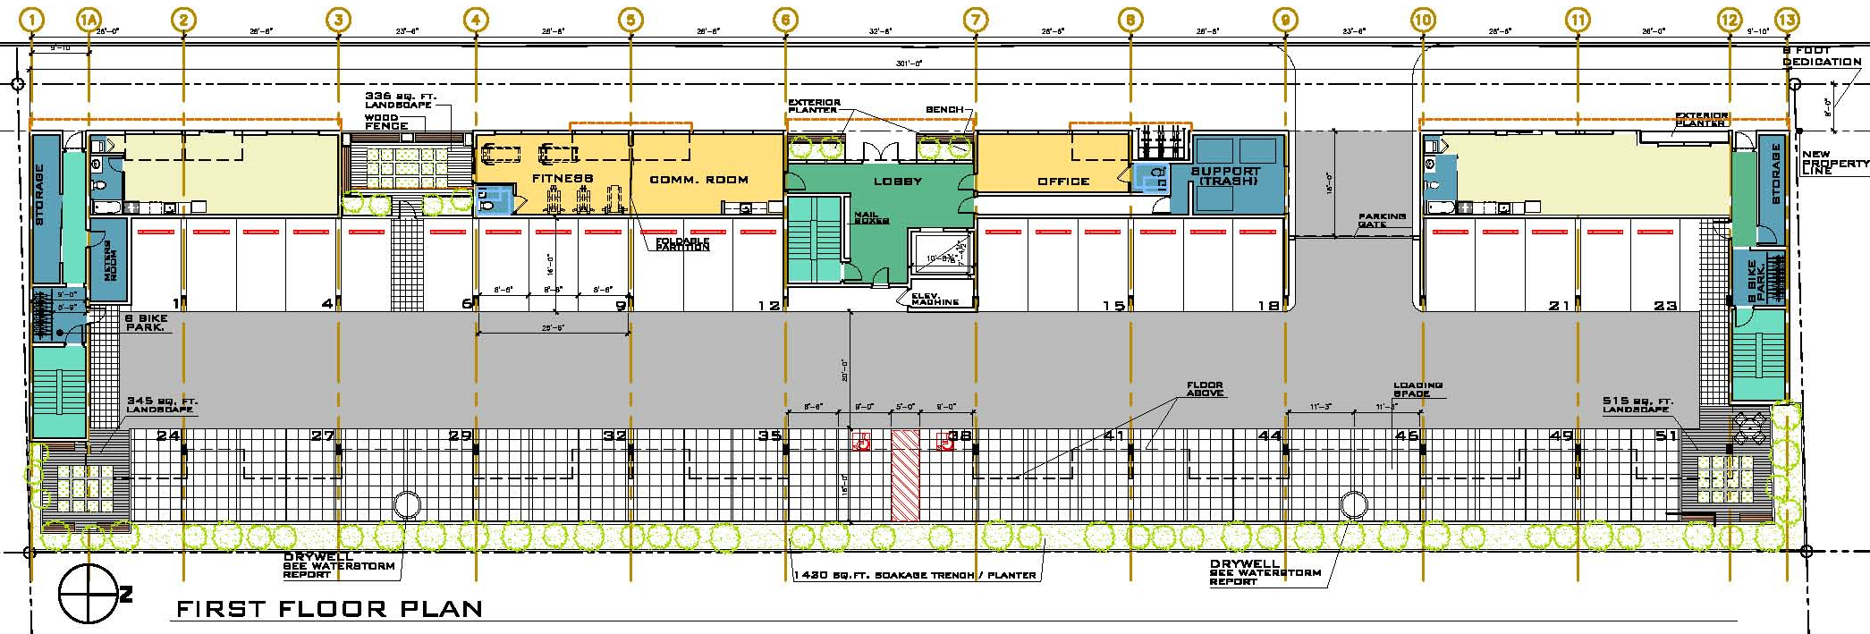
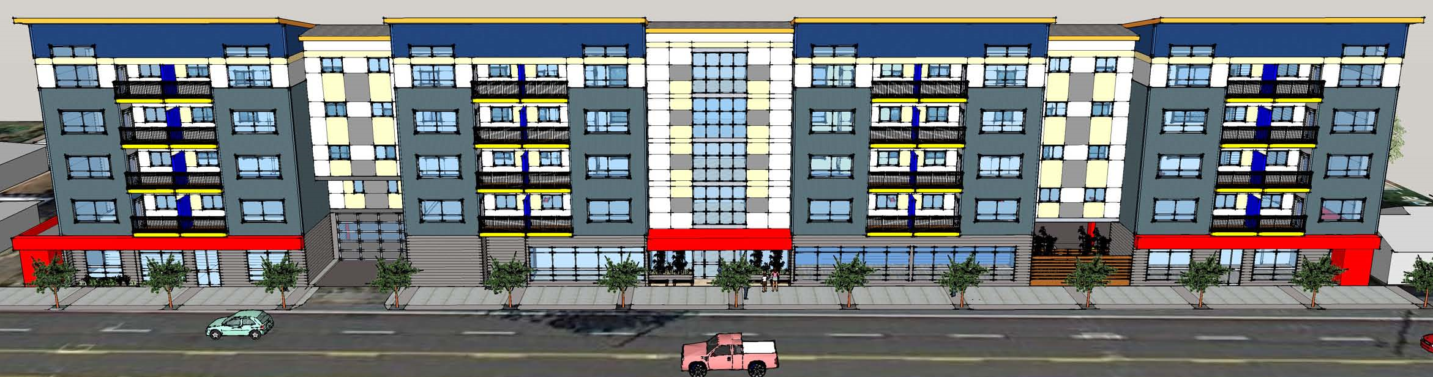
First Floor Plan

Slide 13
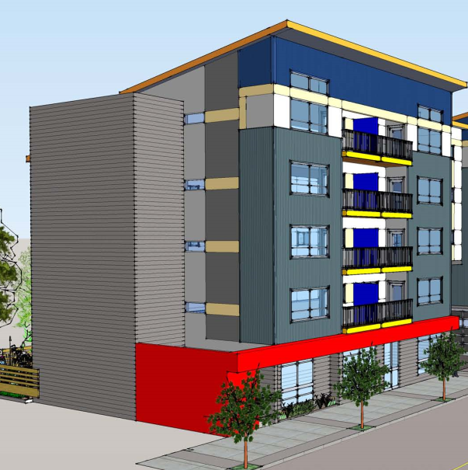
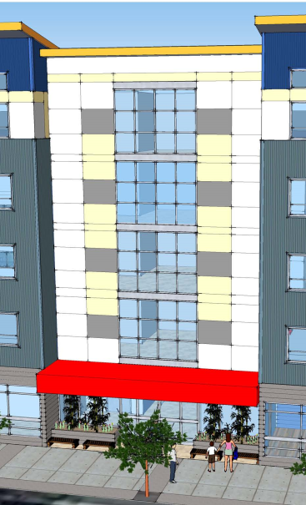
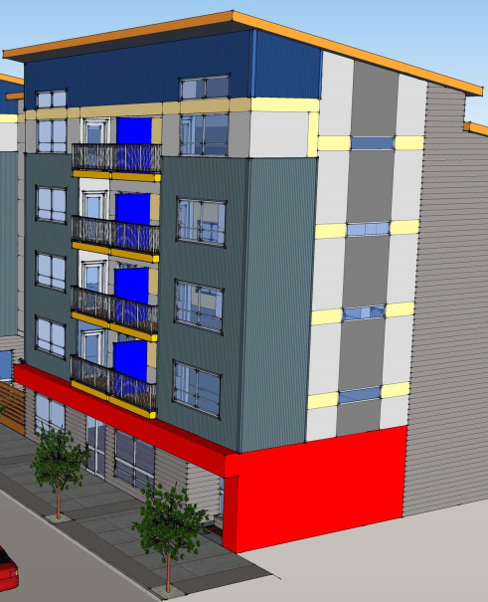
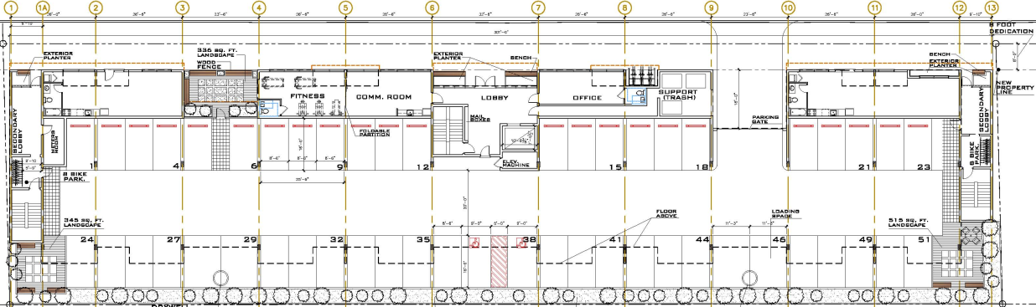
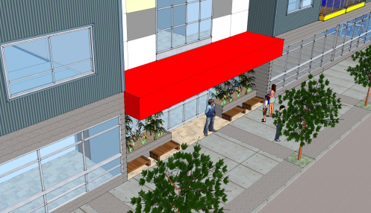
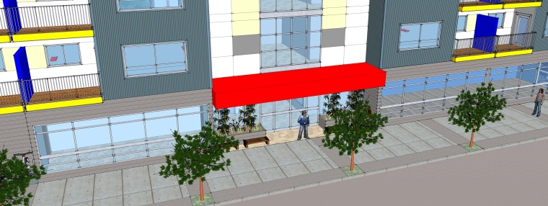
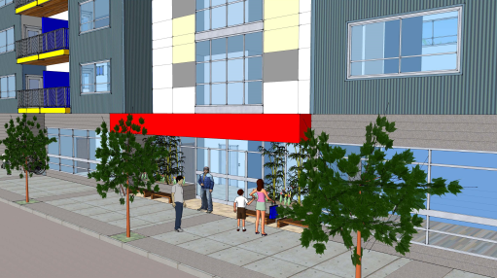
Building entries
Main entrance with curtain wall
2 secondary entrances at each end of the building (Emergency exit)

Slide 14
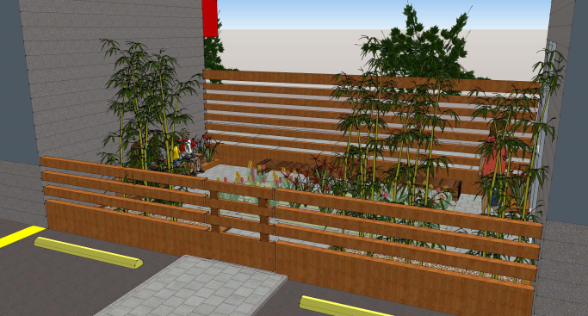
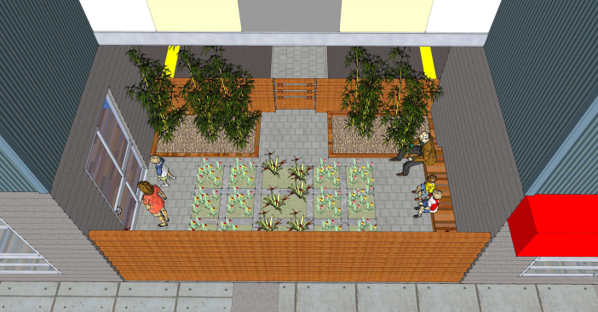
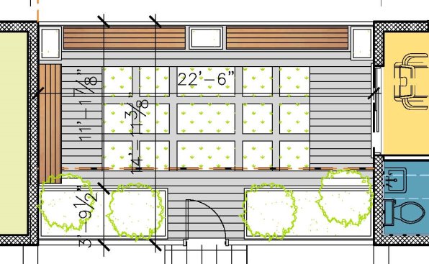
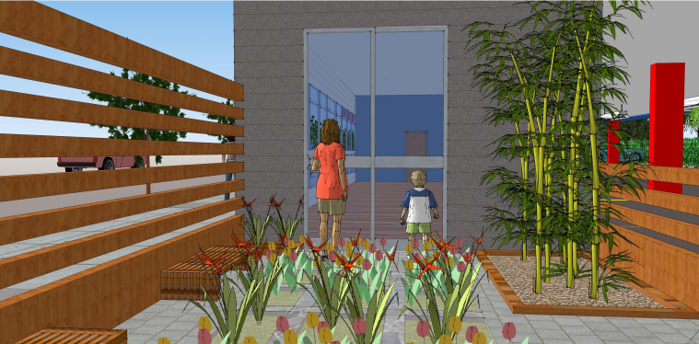
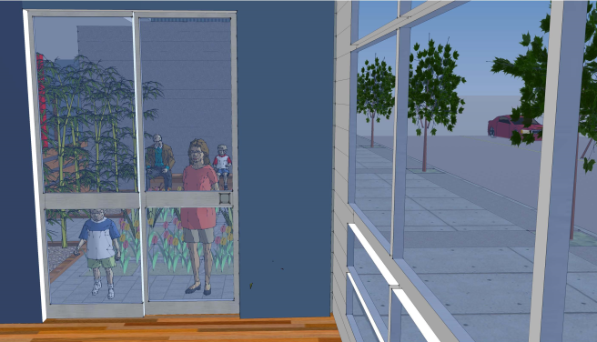
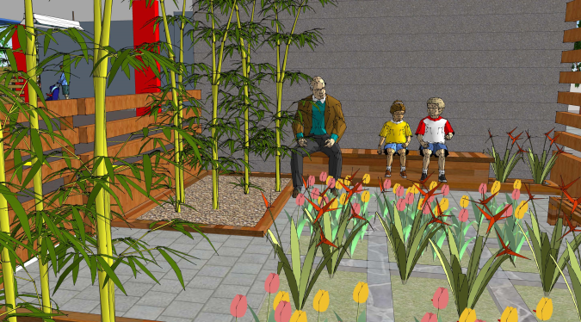
Exterior Landscape Areas
Community piazza
Public / privet use
336 sq. ft.
24’-0”
15’-0”

Slide 15
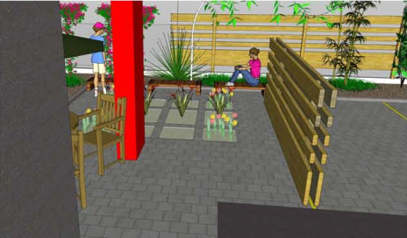
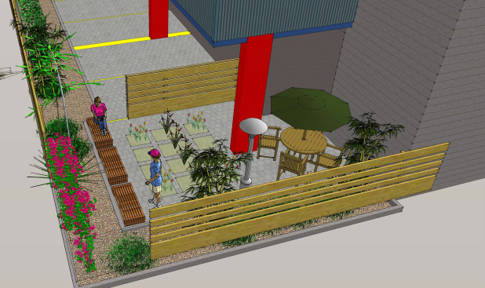
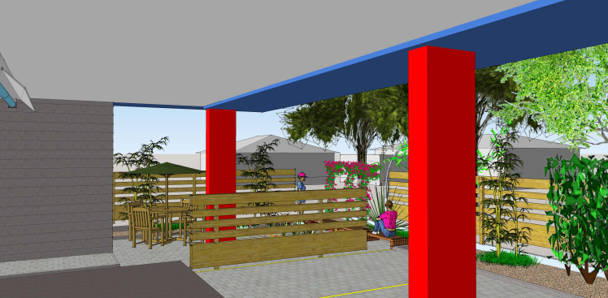
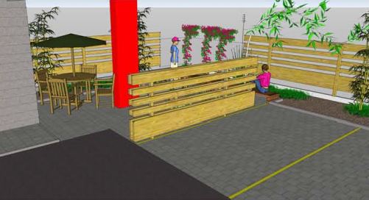








Interior Landscape Areas
2 interior landscape areas
privet use
345 sq. ft. N area
515 sq. ft. S area

Slide 16






Active ground floor

Slide 17




Live / work units
Consider making the units live / work units and having more storefront, commercial type windows
Pull the glass down
725 sq.ft..
Covered entrance
Storefront windows
Open space adaptable to apartments or offices
615 sq.ft.

Slide 18


Floor Plans (2nd-3rd-4th)

Slide 19


Fifth Floor and Roof Plans

Slide 20

Long term bicycle parking

Slide 21







Elevations
CURTAIN WALL
COMPOSITE / METAL ROOF
METAL RAILING
PREFINISHED
CEMENT BOARD
GROUND FACE
BLOCK
PREPAINTED CORRUGATED METAL PANEL
PPAINTED
CEMENT BOARD

Slide 22


Elevations
WALL SECTION

Slide 23



Elevations Comparison

Slide 24



Wall sections
PANEL INSTALL – SCREW LOCATION

Slide 25



Wall sections
METAL SILL
METAL TRIM
HEADER

Slide 26



Axonometric view & wall section
3
2
1

Slide 27



PREFINISHED
CEMENTBOARD
Wall section details + finishes
2
GROUND FACE CONCRETE
BLOCK
PREPAINTED CORRUGATED METAL PANEL

Slide 28

Modular Construction

Slide 29
Modifications Request
You need to offer something in order to convince us that the modifications are justified
Ground Floor Active Use Requirement (33.526.280 D.2)
The Ground Floor Active Use areas requires 25'-0" deep in interior spaces that front onto a sidewalk.
Request: in order to allow a better screening of the parking garage from the 102nd. street and a more efficient design and operation of the parking garage we request to reduce to 15'-0" deep of the apartments located at the front of the building.
Loading Parking Standards (33.266319 D.b)
Size of loading spaces. Required loading spaces must meet the standards of this
subsection.
b. Standard B: The loading space must be at least 18 feet long, 9 feet wide, and have a clearance of 10 feet.
Request: A 16 foot deep loading space instead of the 18 feet required

Slide 30
Parking area setbacks and landscaping (33.266.130 G.3a)
Amount of interior landscaping required. In all zones, interior landscaping must be provided for sites where there are more than 10 parking spaces on the entire site. At least 45 square feet of interior
landscaped area must be provided for each parking space.
Request: 28 of the parking spots located in the back side of the parking lot are partially exposed. As a result of this situation the code demand 1,260 sq.ft. of interior landscape. We are providing three landscaped areas: one in the front of the building at the South of the main entrance (336 sq.ft.), a second one
on the SE corner of the site (345 sq.ft.) and the third one in the opposite corner of the site, NE (515 sq.ft.). These 1,196 sq.ft. in addition to 1,300 sq.ft planter
located on the East property line. Our request is to be exempted from fulfilling the required missing (64 sq. ft.) landscape.

Slide 31


Stormwater Management
The proposed stormwater management for the project will follow the City of Portland’s Stormwater Management Manual (SWMM) requirements. The proposed stormwater management will fall under category 2 of SWMM, total onsite infiltration with a vegetated facility that flows to a subsurface infiltration facility. The proposed stormwater planters are located on the east side of the site, due to their proximity to the east property line, these planters will be lined. Disposal of the stormwater runoff will infiltrate on-site using drywells. The drywells will be places so that they meet setback requirements.

Slide 32





General Images

Slide 33








General Images

Slide 34






Pedestrian Images

