Slide 1
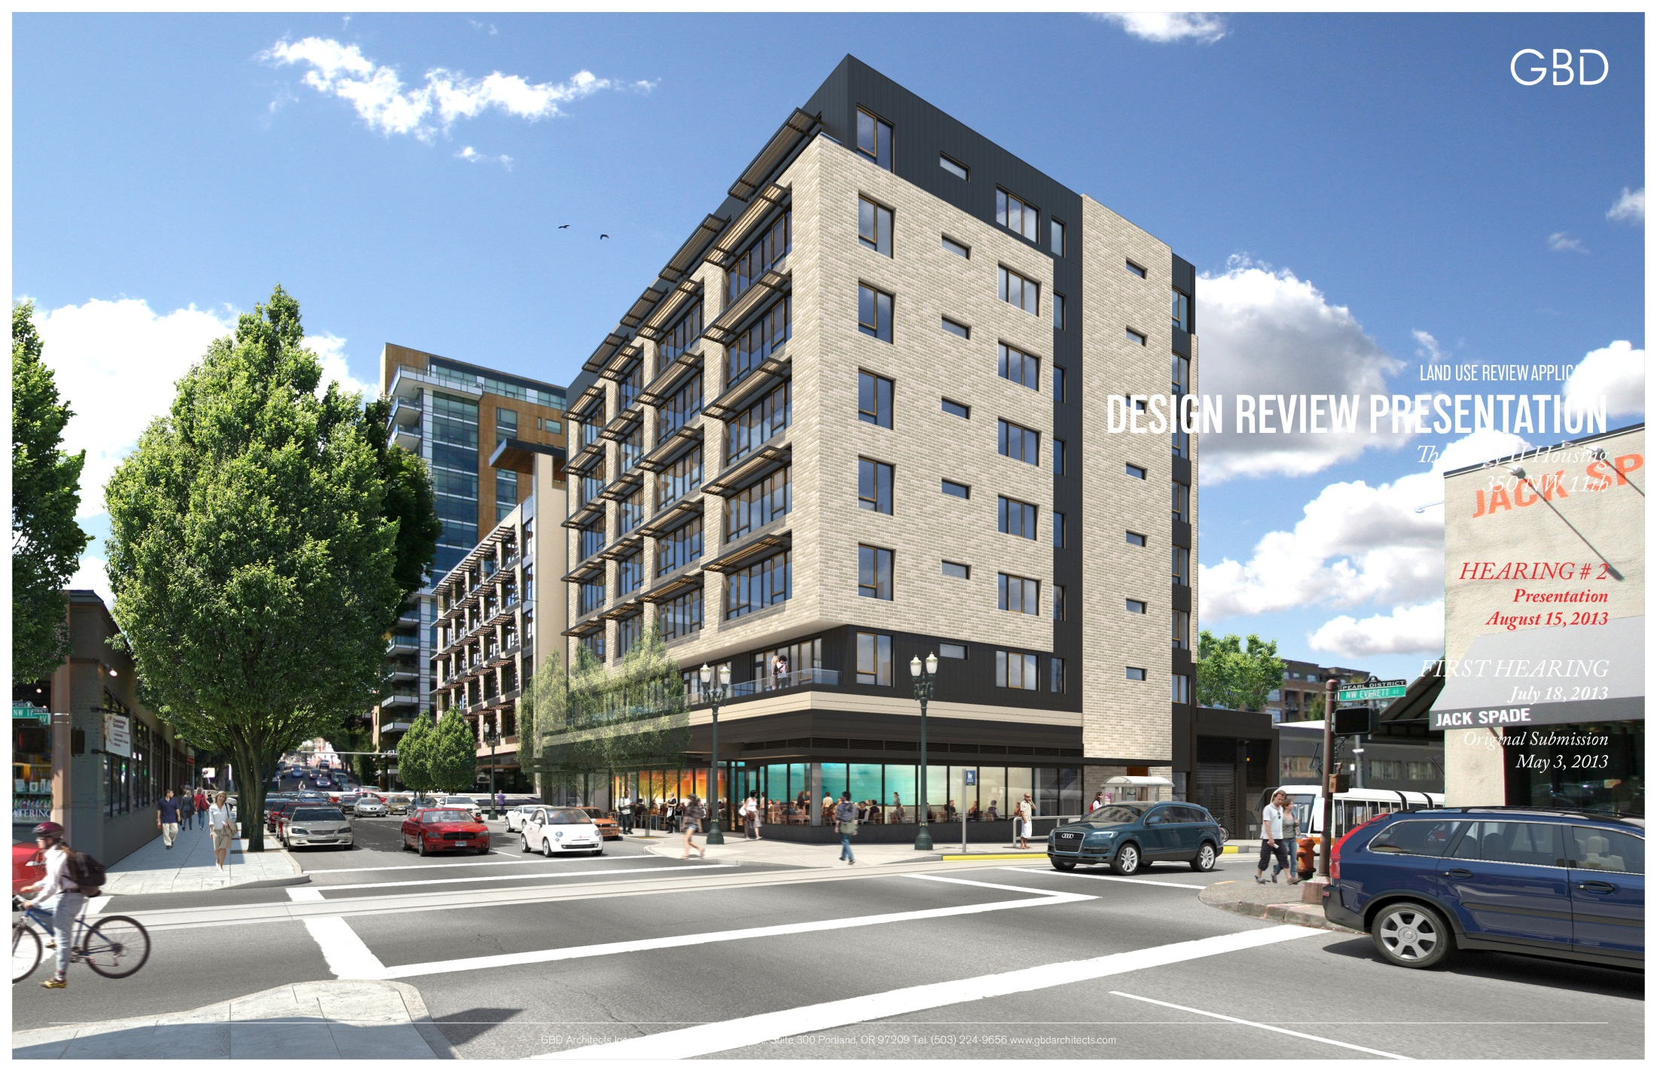

Slide 2
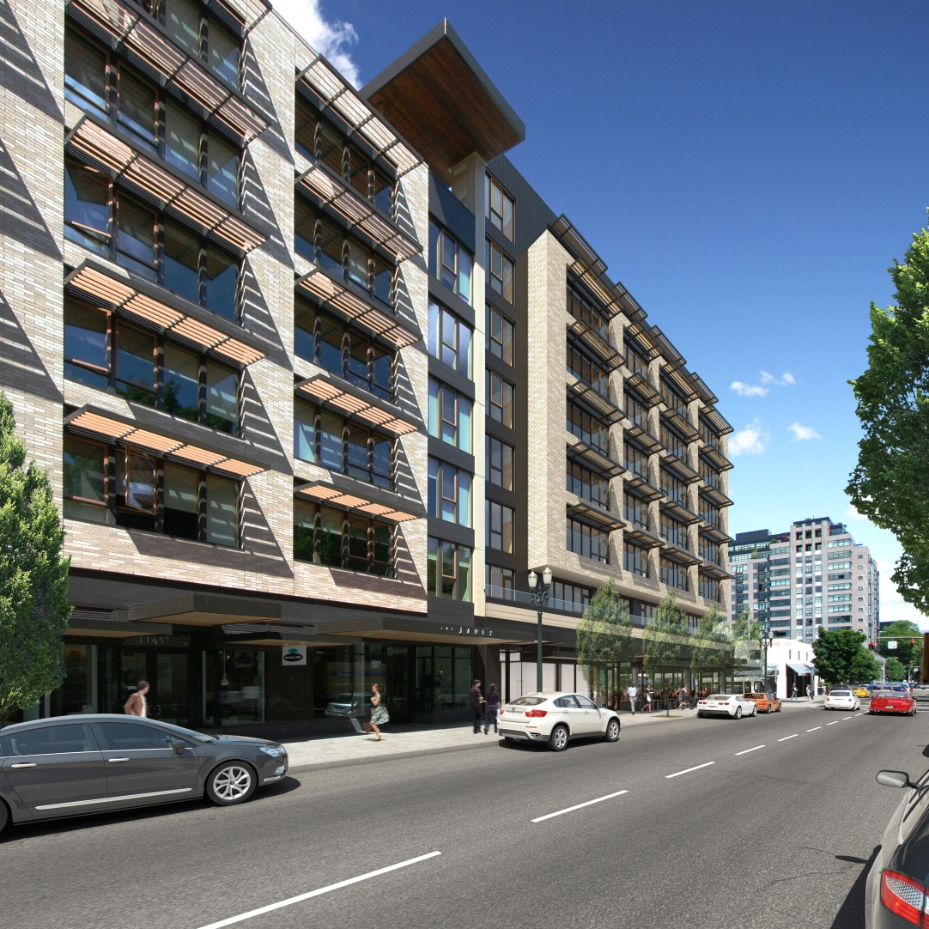
DESIGN REVIEW HEARING SUMMARY
Project Overview - Abbreviated
Comments from Design Commission July 18
Design Revisions
Request Design Commission Approval
Review Requested Modifications and Adjustment

Slide 3
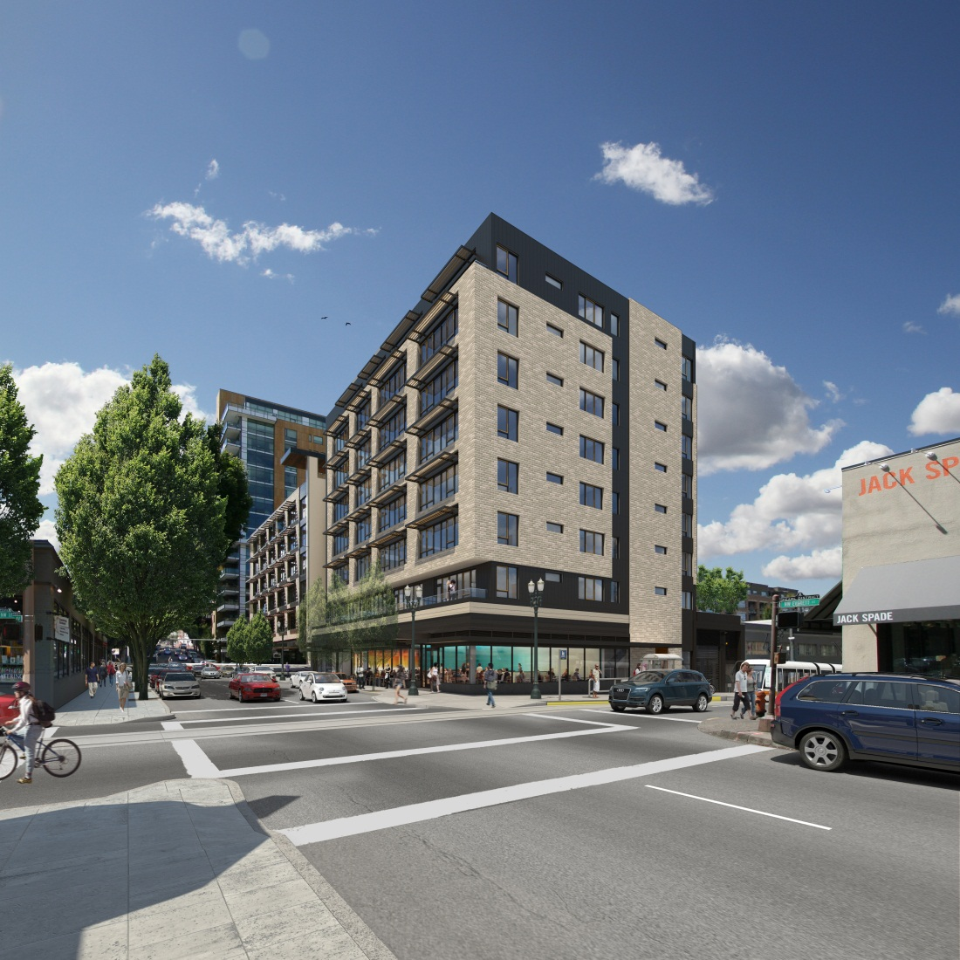
THE JANEY II
PROJECT OVERVIEW
Located in River District of Portland’s Central City on 100’ x 100’ parcel.
Existing building on site constructed in 1906.
Removal of existing building will be replaced with 8 story building: 7 stories of market rate apartments and ground level retail and parking stalls.
Ground floor: 2,300 sf retail, 43 structured parking stalls (40 of them in mechanized parking system).
Seven floors with 62 housing units
Second level contains private terraces with eco-roof to the north and terraces to the south.
Rooftop amenity room and deck of 730 sf.
1

Slide 4
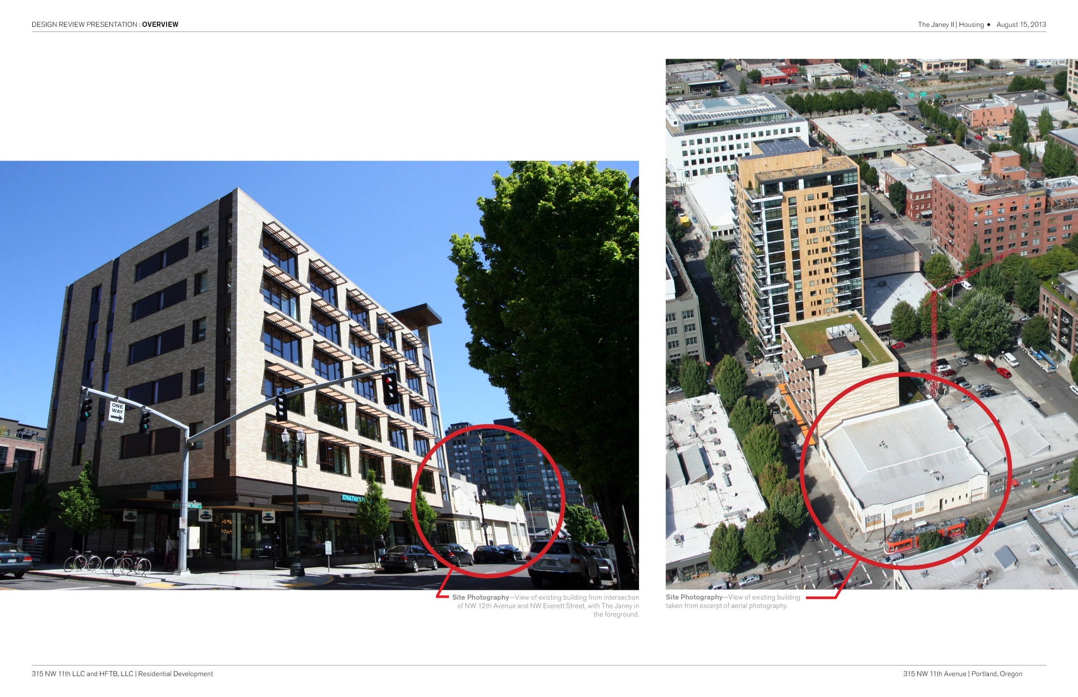

Slide 5
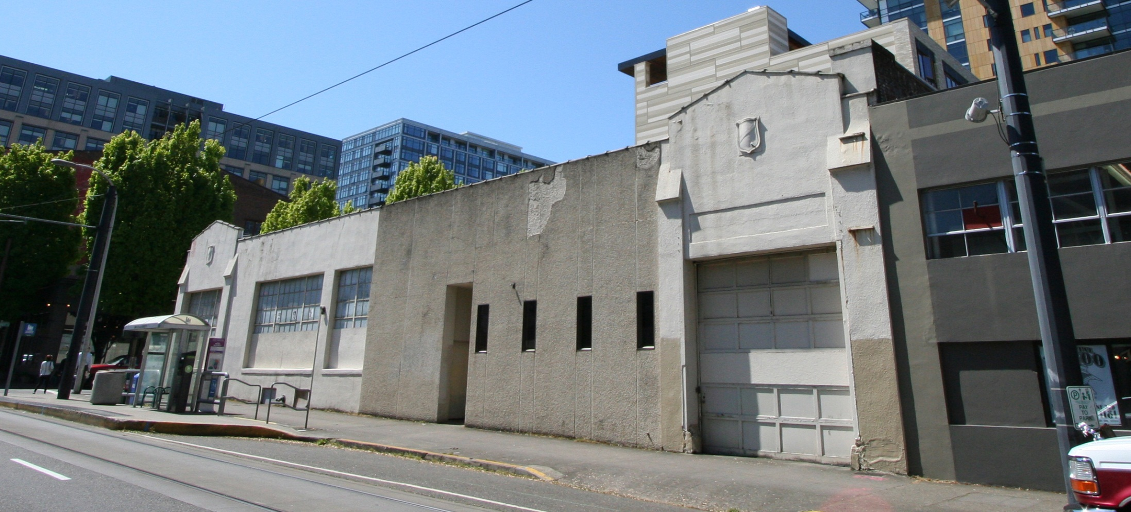
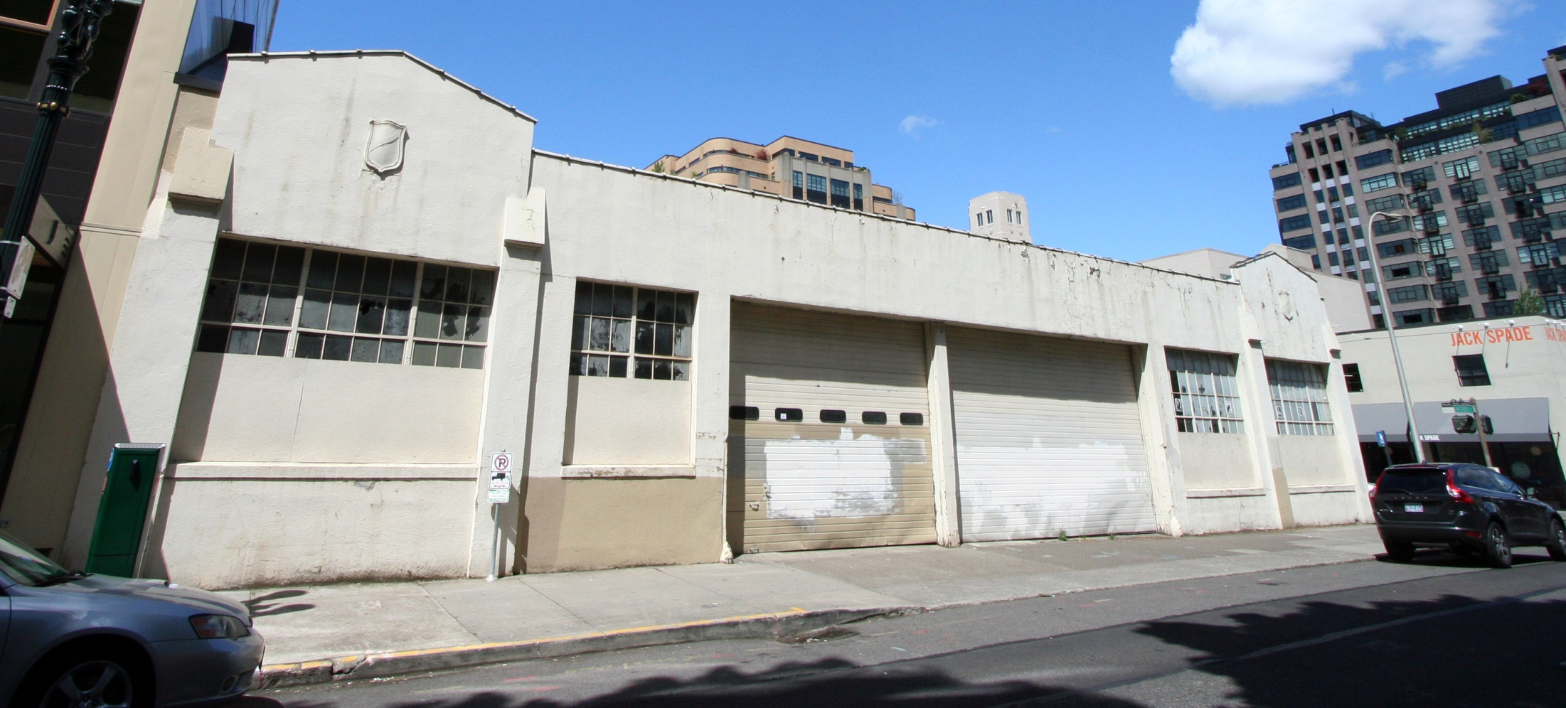
THE JANEY II
EXISTING SITE CONDITIONS SHAPING THE PROJECT
NW 11TH AVENUE
NW EVERETT STREET

Slide 6
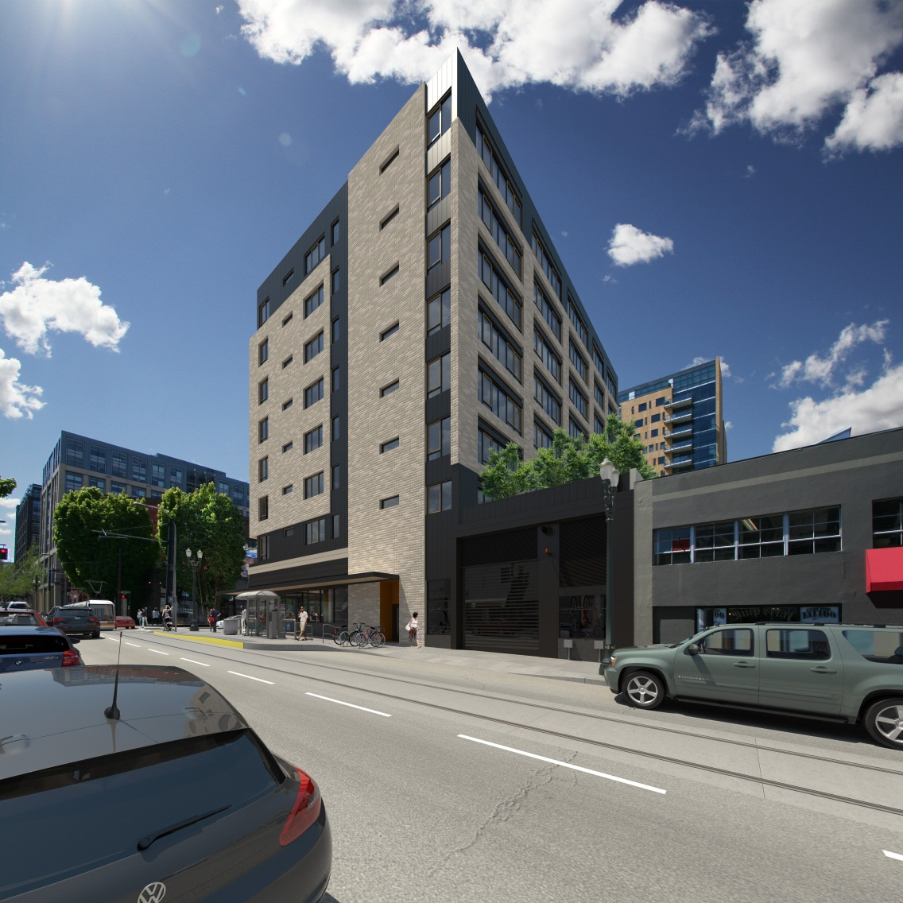
THE JANEY II
COMMENTS FROM DESIGN COMMISSION
Overall, nice project. Would like to see investigation on…
SOUTH FAÇADE AND THE HORIZONTAL BAND BORROWED FROM THE JANEY
NORTH FAÇADE MORE CONNECTED TO DESIGN LANGUAGE ELSEWHERE
THE 11TH AVENUE PEDESTRIAN EXPERIENCE, INCLUDING ADDED INTEREST ON THE NORTHEAST CORNER WHERE AT THE GARAGE DOOR
2

Slide 7
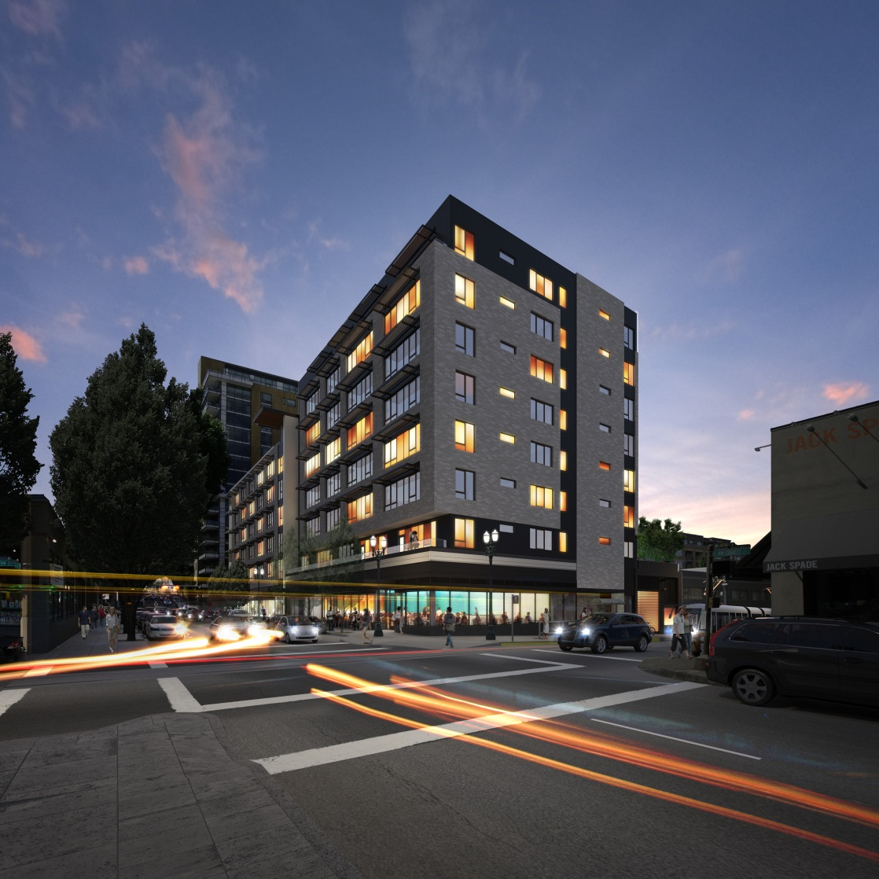
THE JANEY II
DESIGN REVISIONS
THE JANEY II
DESIGN REVISIONS
SOUTH FAÇADE AND THE HORIZONTAL BAND BORROWED FROM THE JANEY
3

Slide 8
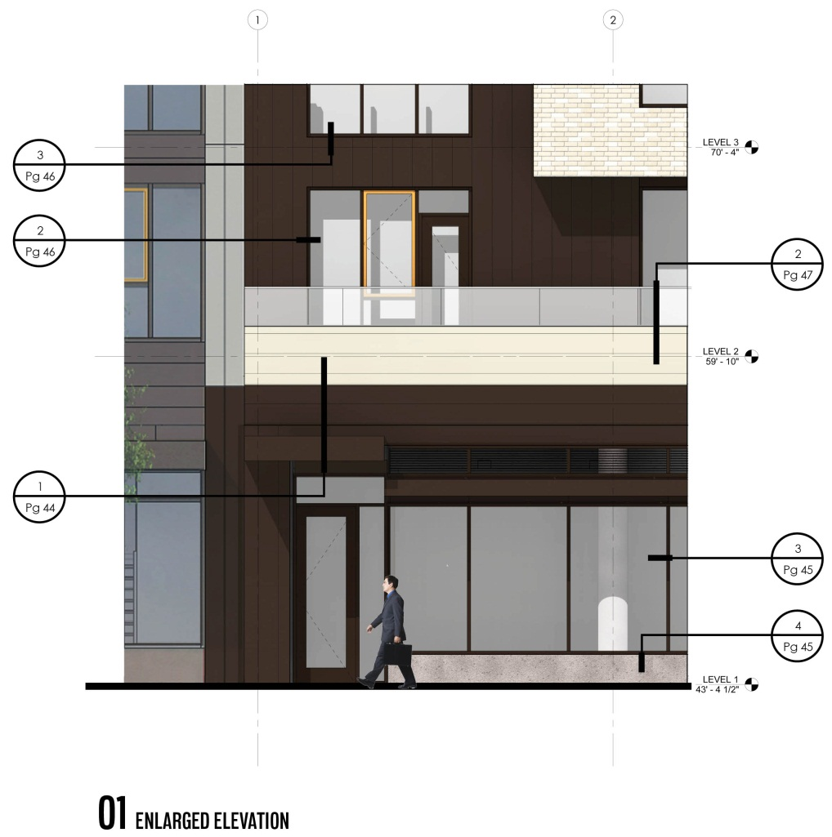
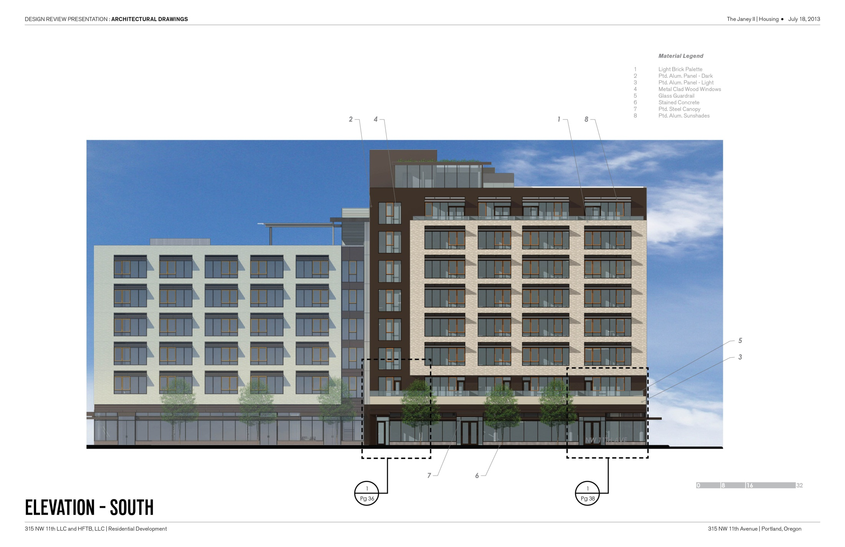
JULY 18TH SCHEME
METAL PANEL ALIGNMENT
ENLARGED ELEVATION

Slide 9
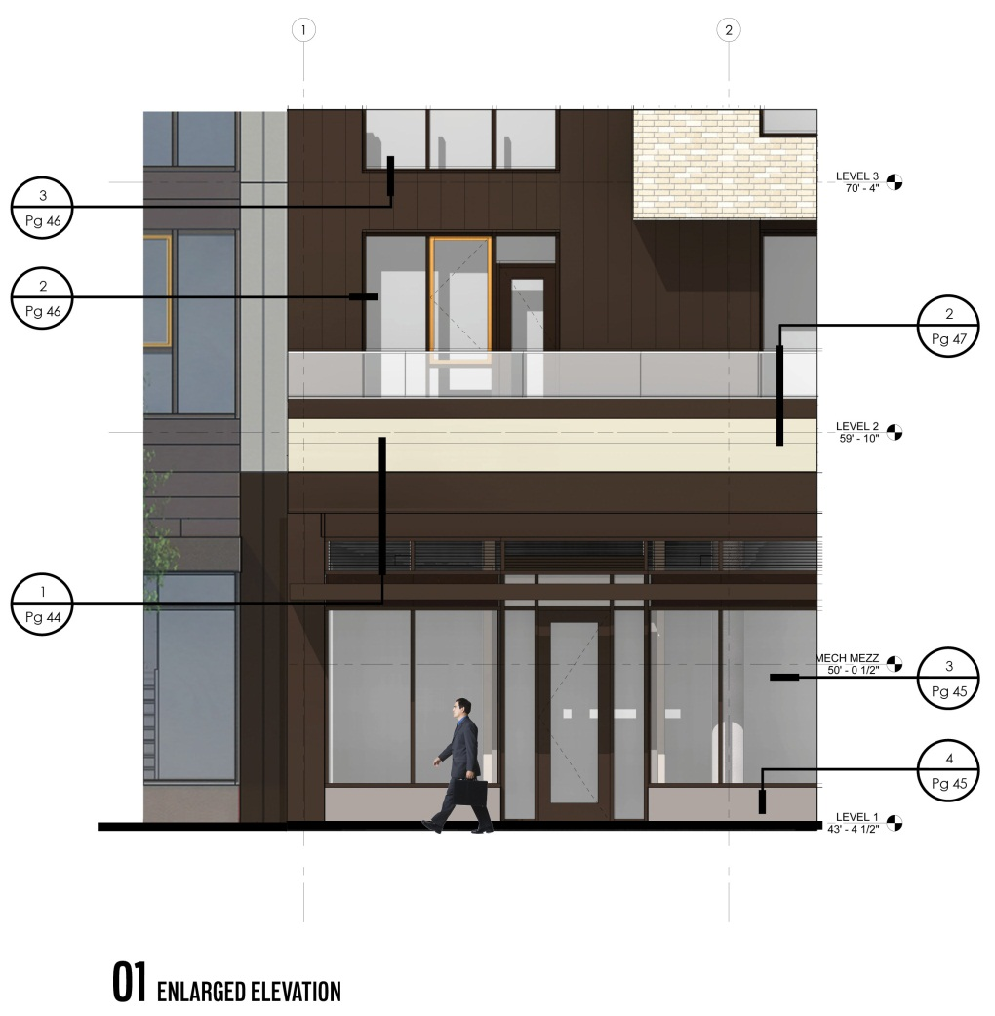
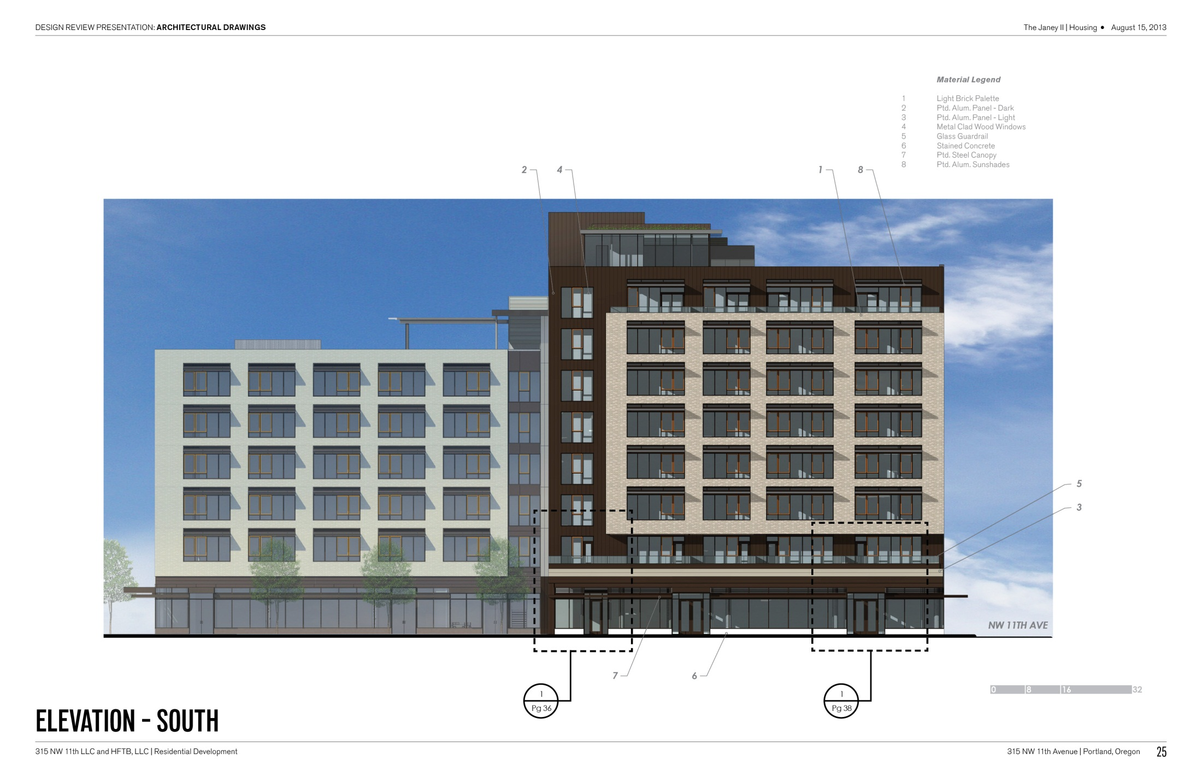
AUGUST 15 REVISION
JULY 18 SCHEME
AUGUST 15 REVISION
AUGUST 15 REVISION
METAL PANEL ALIGNMENT
AREA UPDATED SINCE LAST SUBMITTAL
ENLARGED ELEVATION

Slide 10
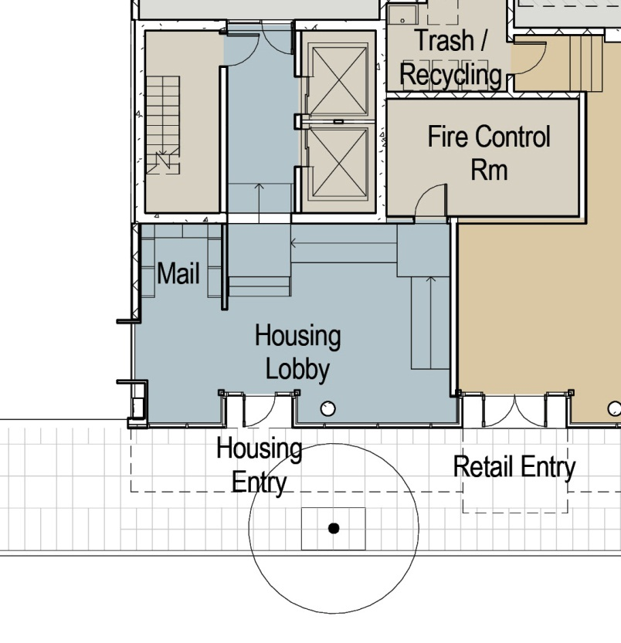
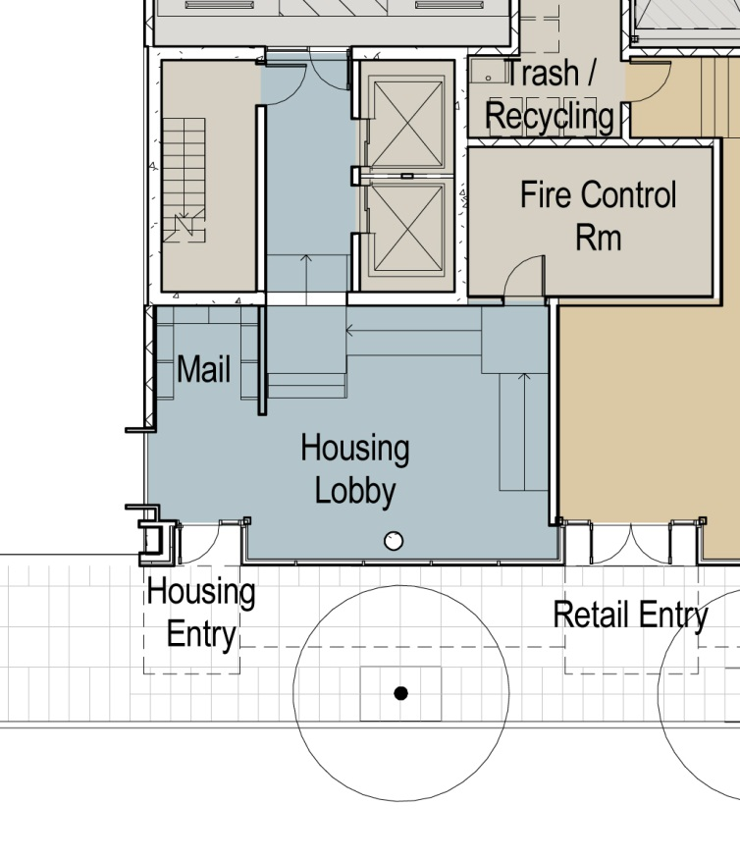
AUGUST 15 REVISION
JULY 18 SCHEME

Slide 11
THE JANEY II
DESIGN REVISIONS
SOUTH FAÇADE AND THE HORIZONTAL BAND BORROWED FROM THE JANEY
NORTH FAÇADE MORE CONNECTED TO DESIGN LANGUAGE ELSEWHERE

Slide 12
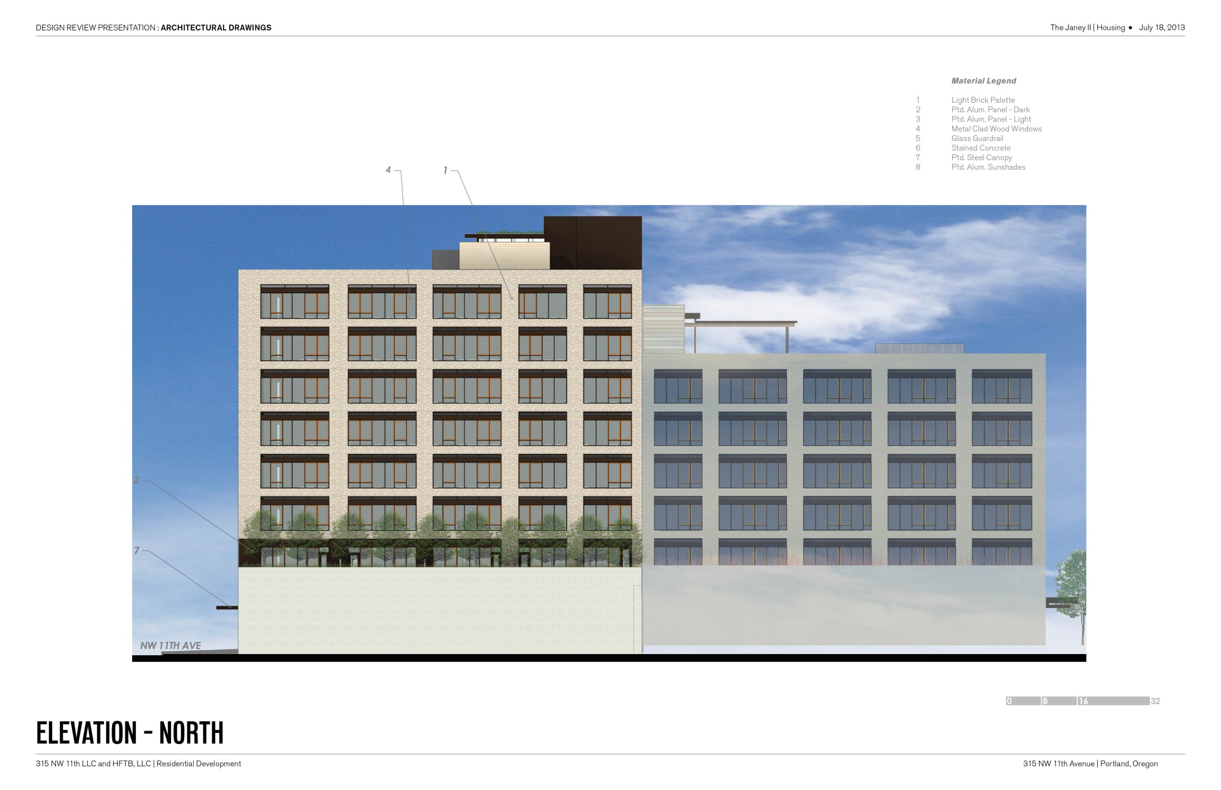
JULY 18TH SCHEME
BRICK VENEER
METAL PANEL
FIVE FOOT SETBACK

Slide 13
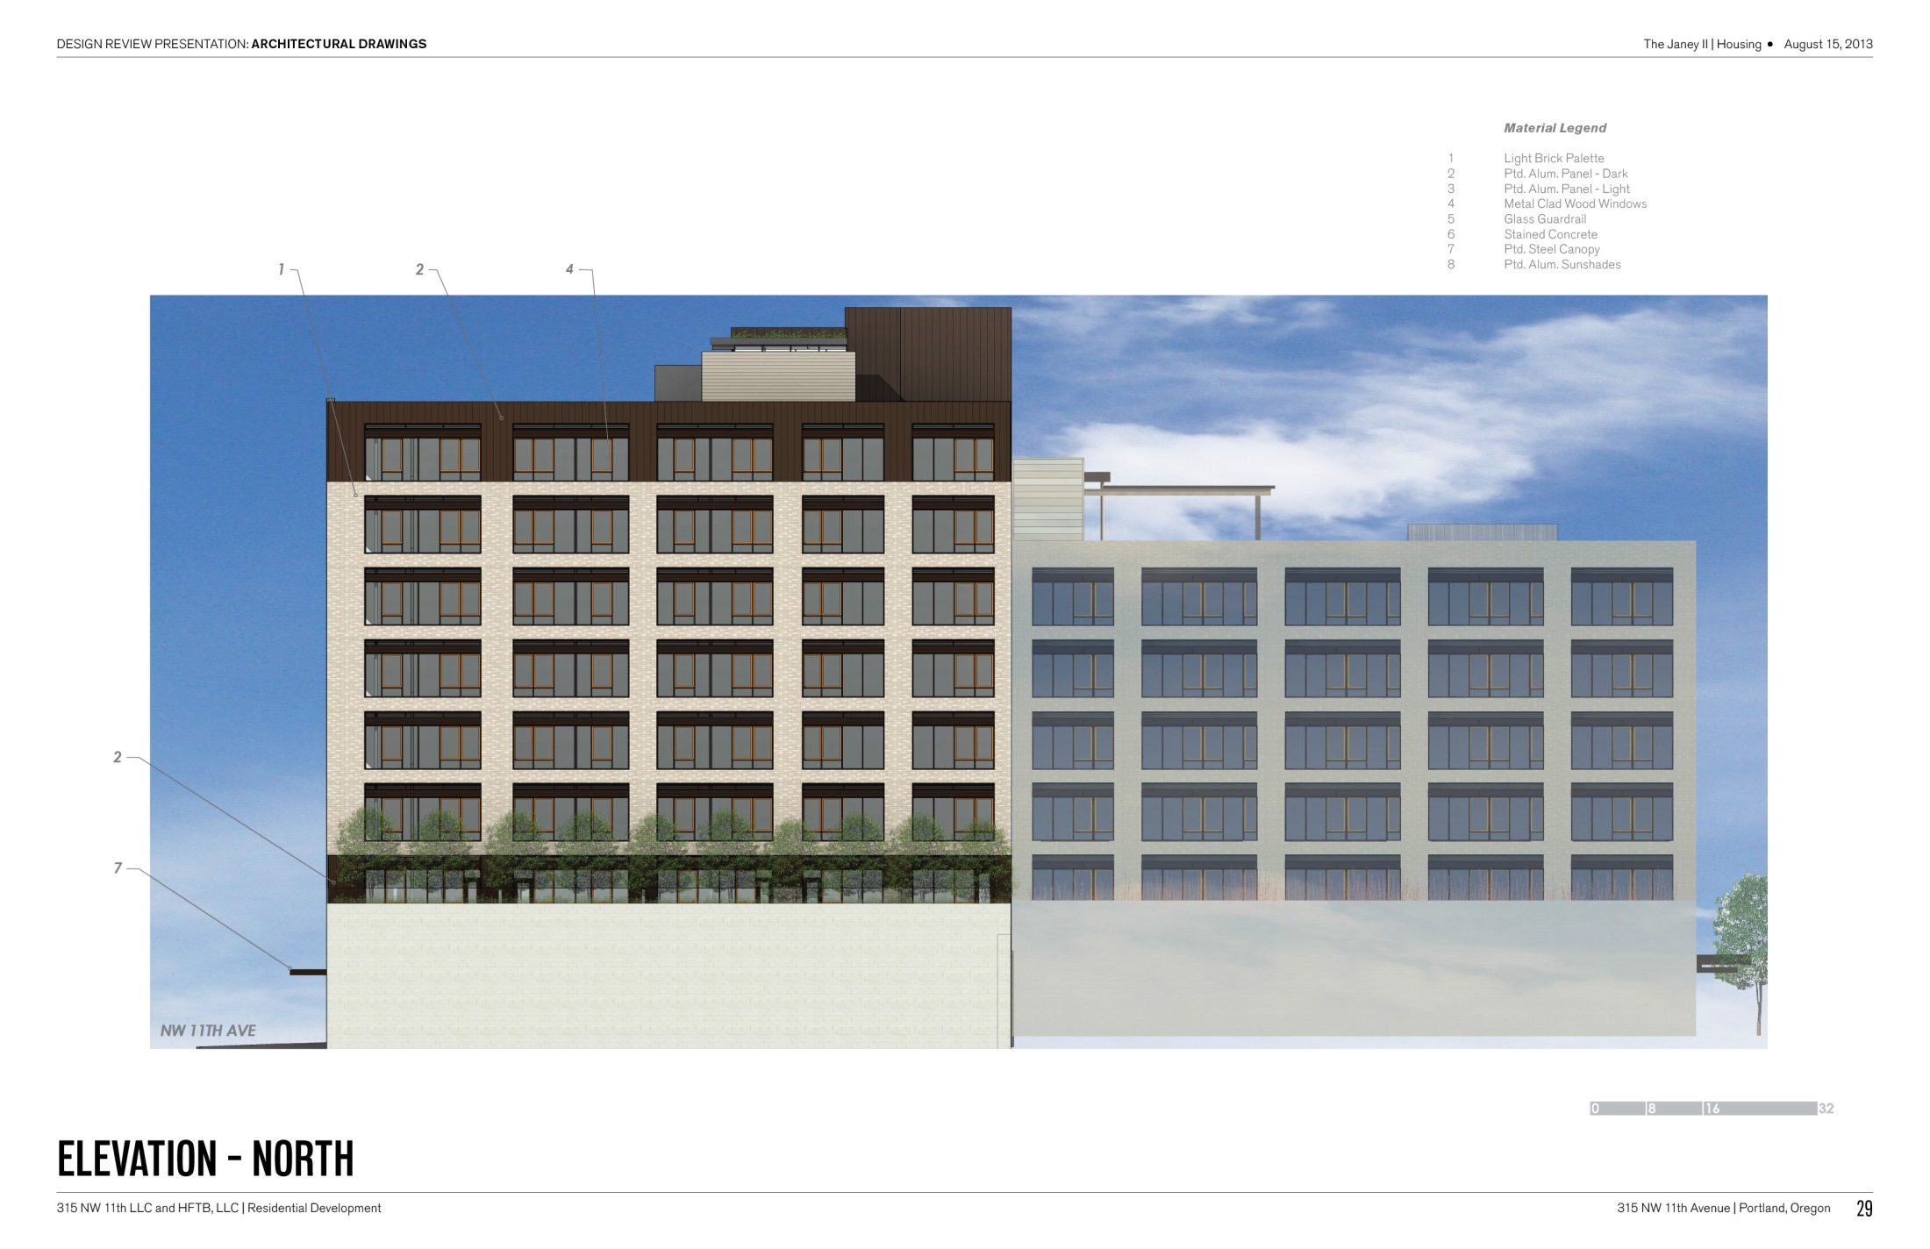
AUGUST 15 REVISION
METAL PANEL
BRICK VENEER
METAL PANEL
FIVE FOOT SETBACK

Slide 14
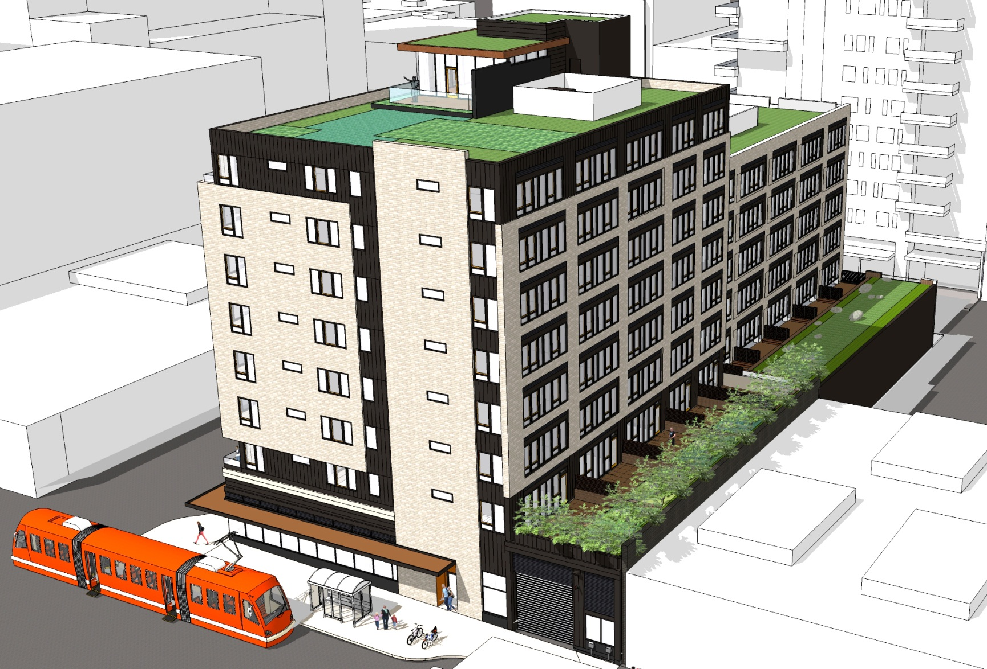

Slide 15
THE JANEY II
DESIGN REVISIONS
SOUTH FAÇADE AND THE HORIZONTAL BAND BORROWED FROM THE JANEY
NORTH FAÇADE MORE CONNECTED TO DESIGN LANGUAGE ELSEWHERE
THE 11TH AVENUE PEDESTRIAN EXPERIENCE, INCLUDING ADDED INTEREST ON THE NORTHEAST CORNER WHERE AT THE GARAGE DOOR

Slide 16
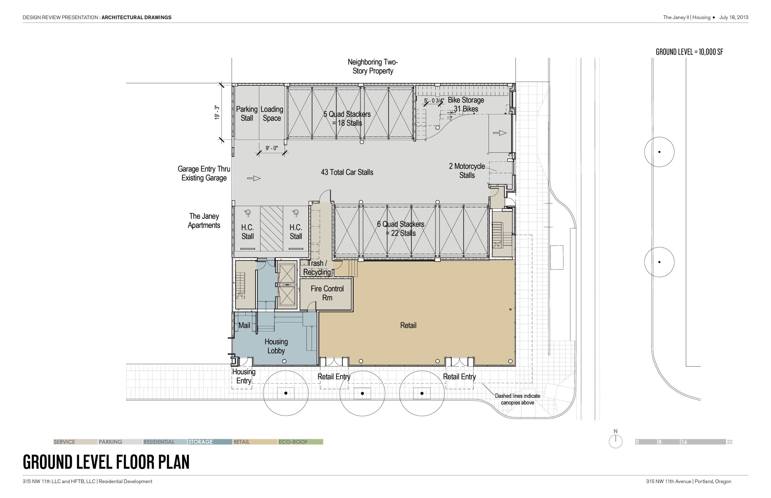
JULY 18TH SCHEME
(31) BIKE STALLS
MTL. PANEL RECESS
GLAZED OVERHEAD DOOR
WINDOW INTO PARKING
(2) MOTORCYCLE STALLS

Slide 17
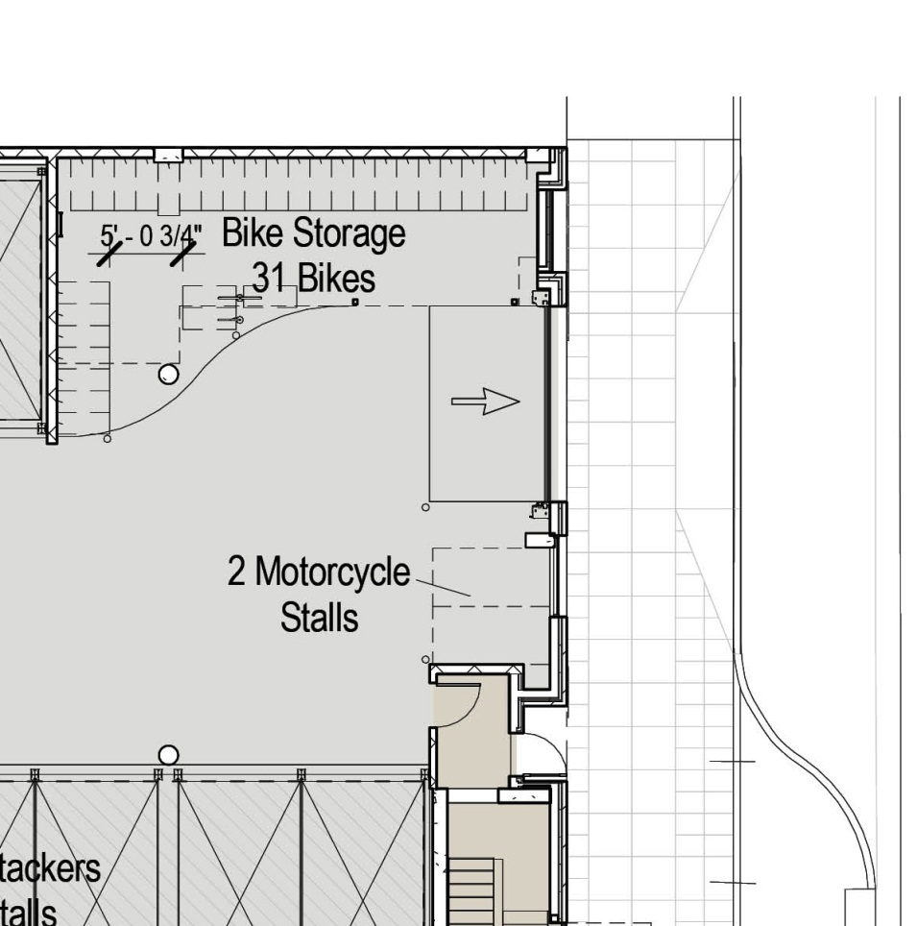
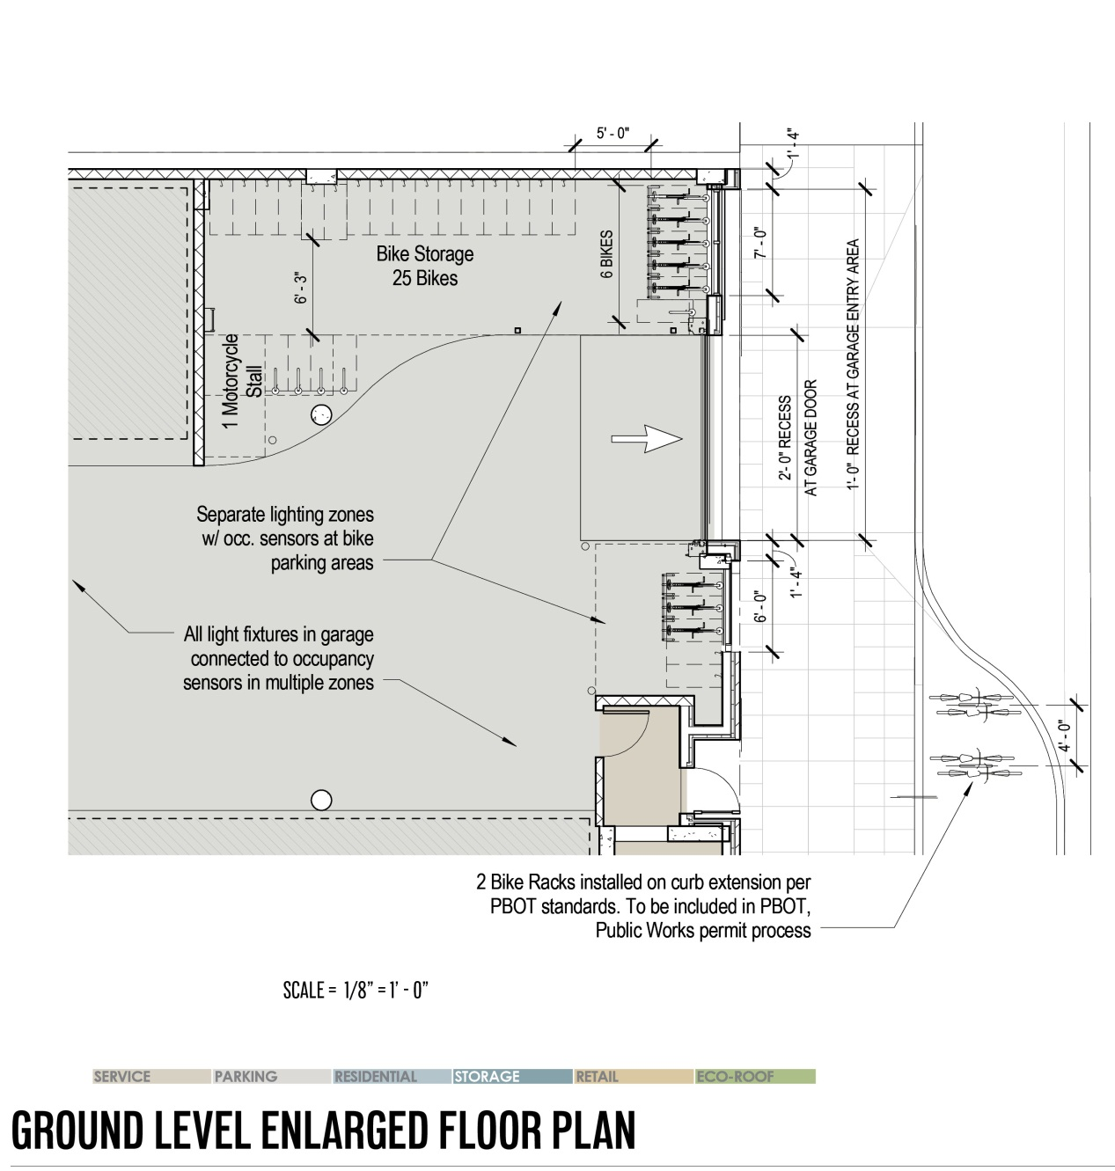
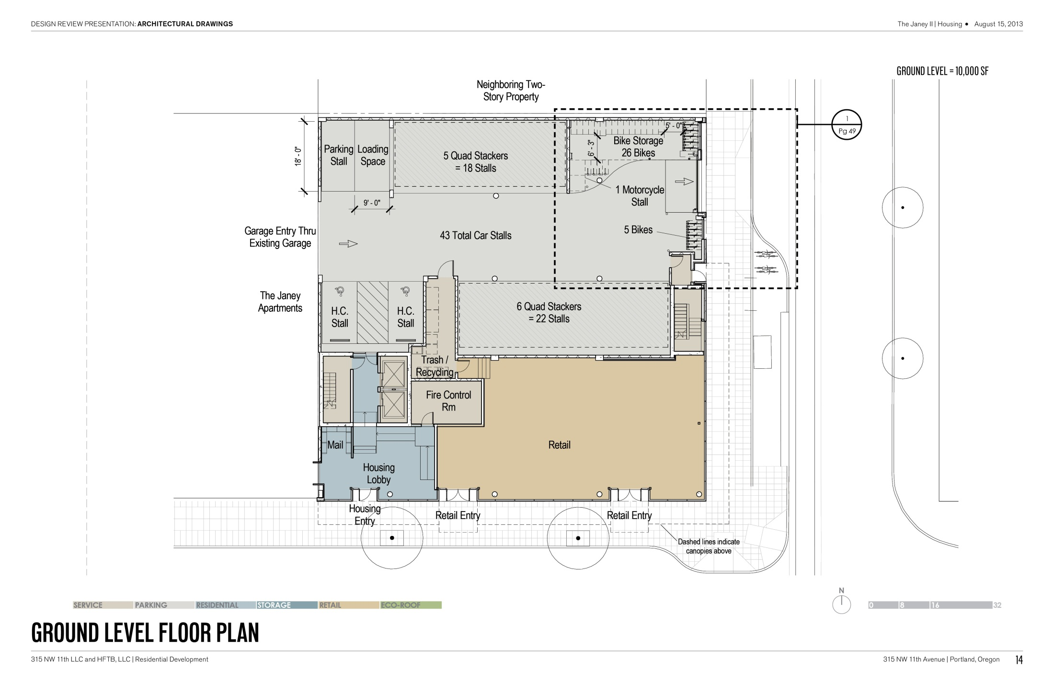
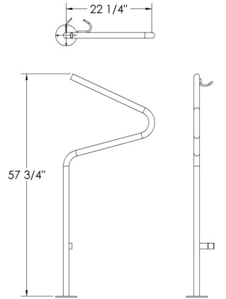
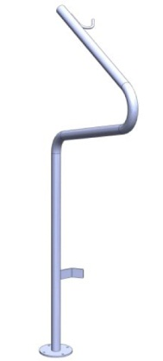
JULY 18 SCHEME
AUGUST 15 REVISION
AUGUST 15 REVISION
ENLARGED PLAN

Slide 18
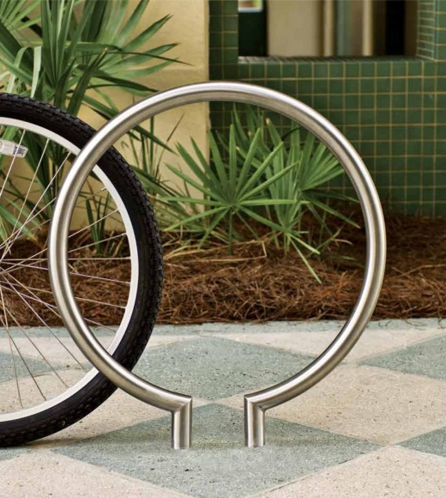
AUGUST 15 REVISION

Slide 19
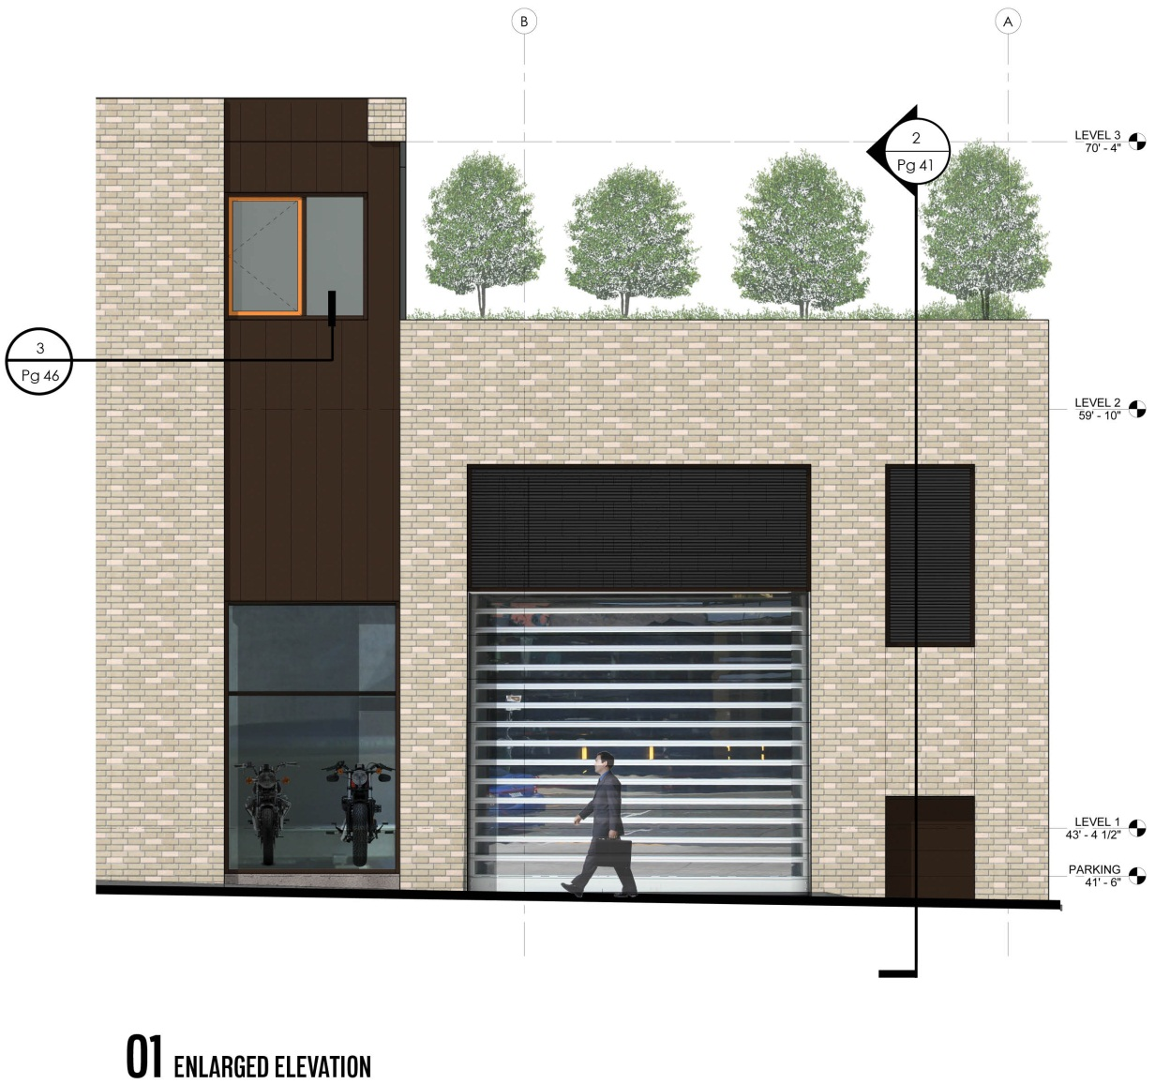
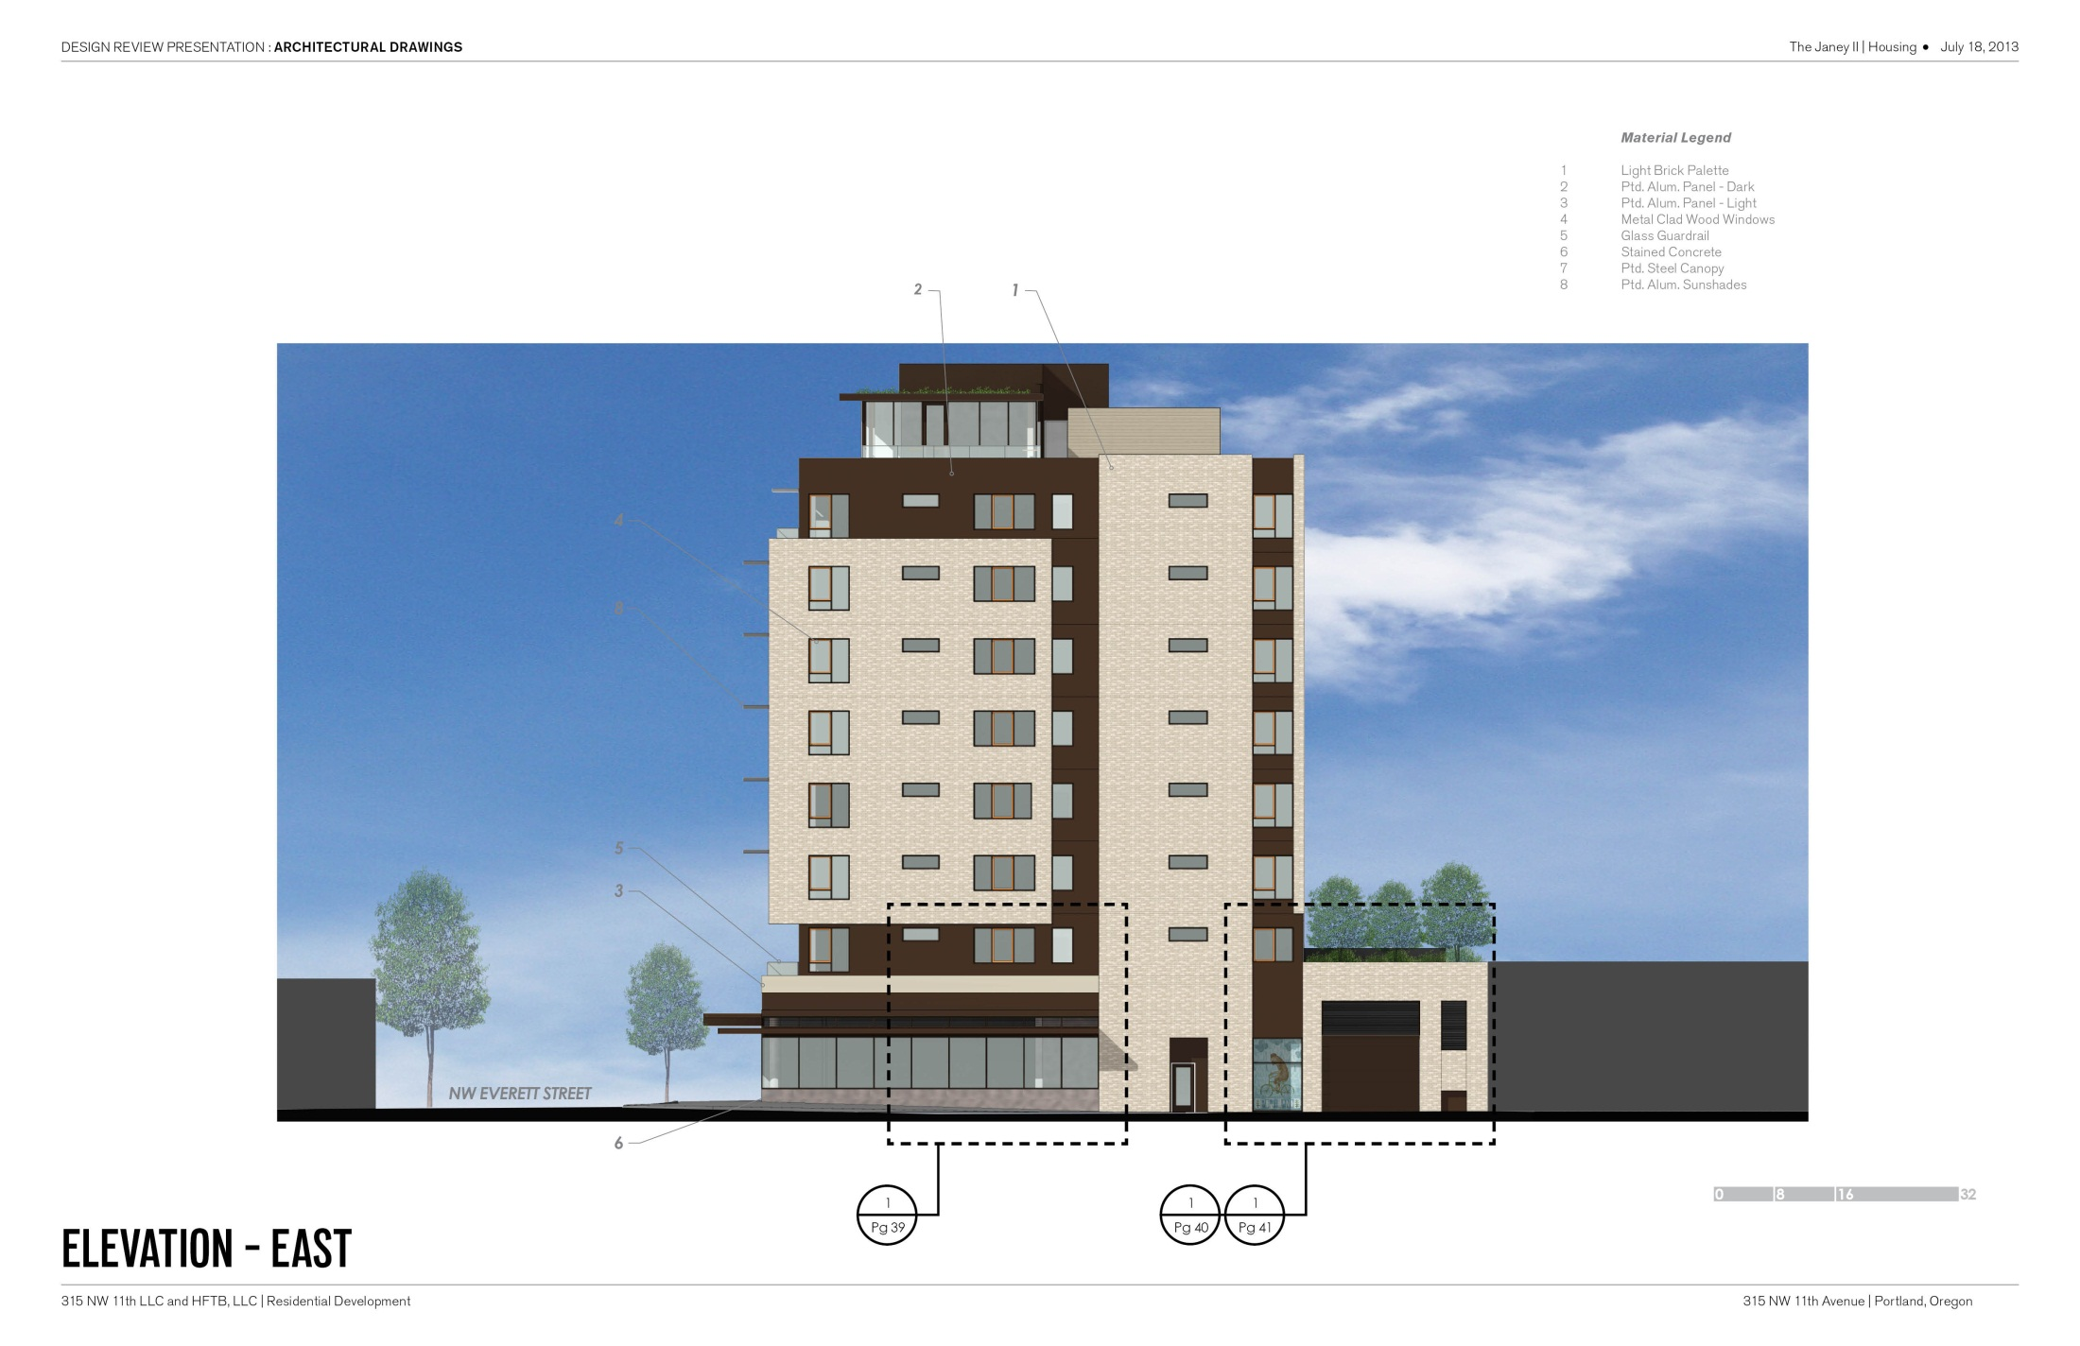
JULY 18TH SCHEME
ENLARGED ELEVATION

Slide 20
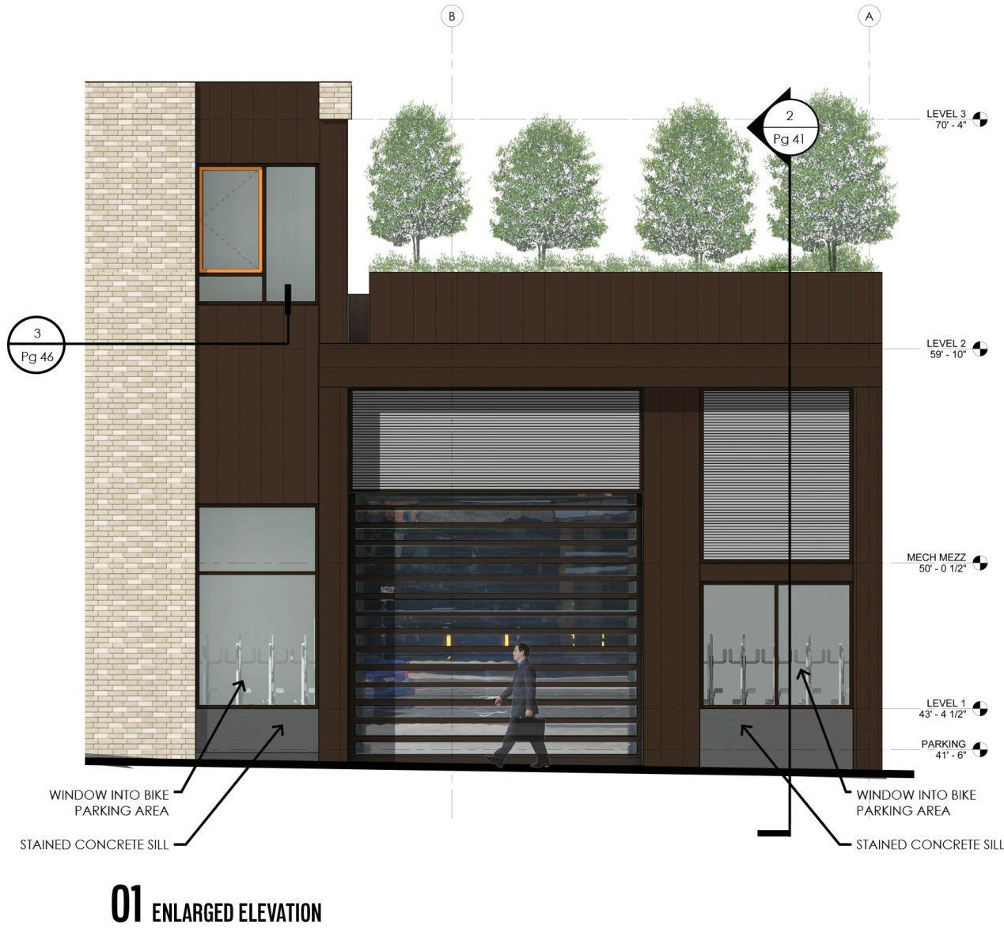
AUGUST 15 REVISION
AUGUST 15 REVISION
JULY 18TH SCHEME
AUGUST 15 REVISION
METAL CLAD
WOOD WINDOWS
METAL PANEL
METAL PANEL
METAL LOUVERS
OVERHEAD DOOR
WITH SOLID SLATS
WINDOW INTO BIKE AREA
WINDOW INTO BIKE AREA
ENLARGED ELEVATION

Slide 21
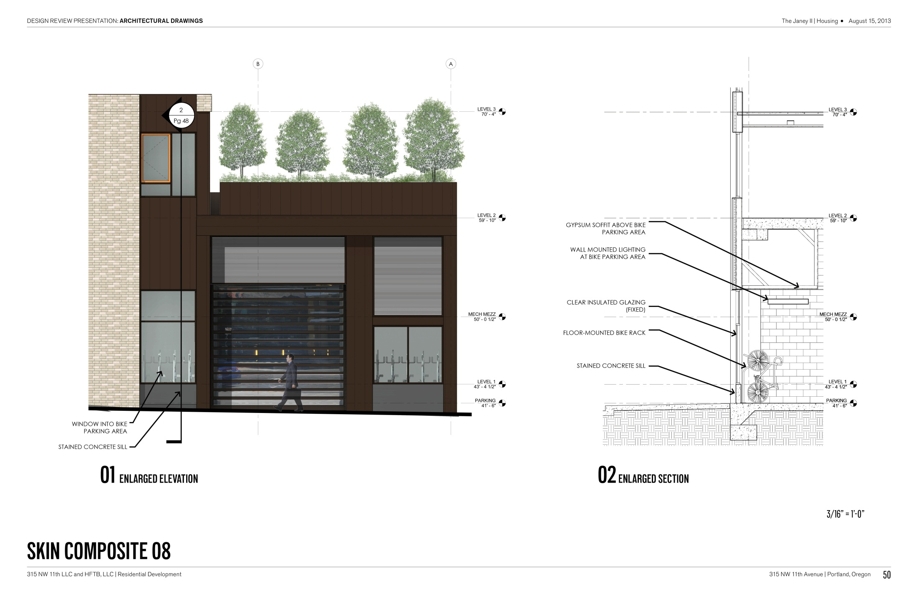
AUGUST 15 REVISION

Slide 22
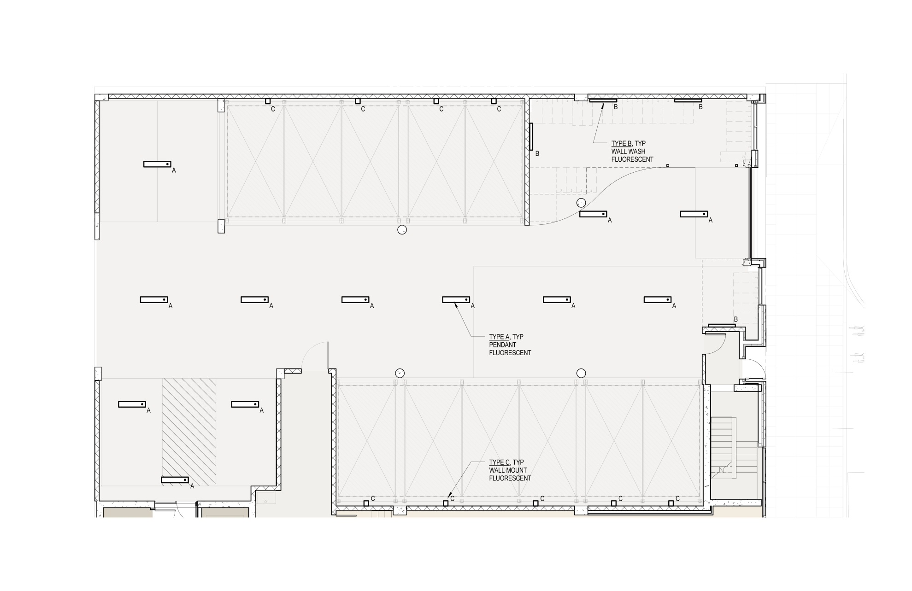
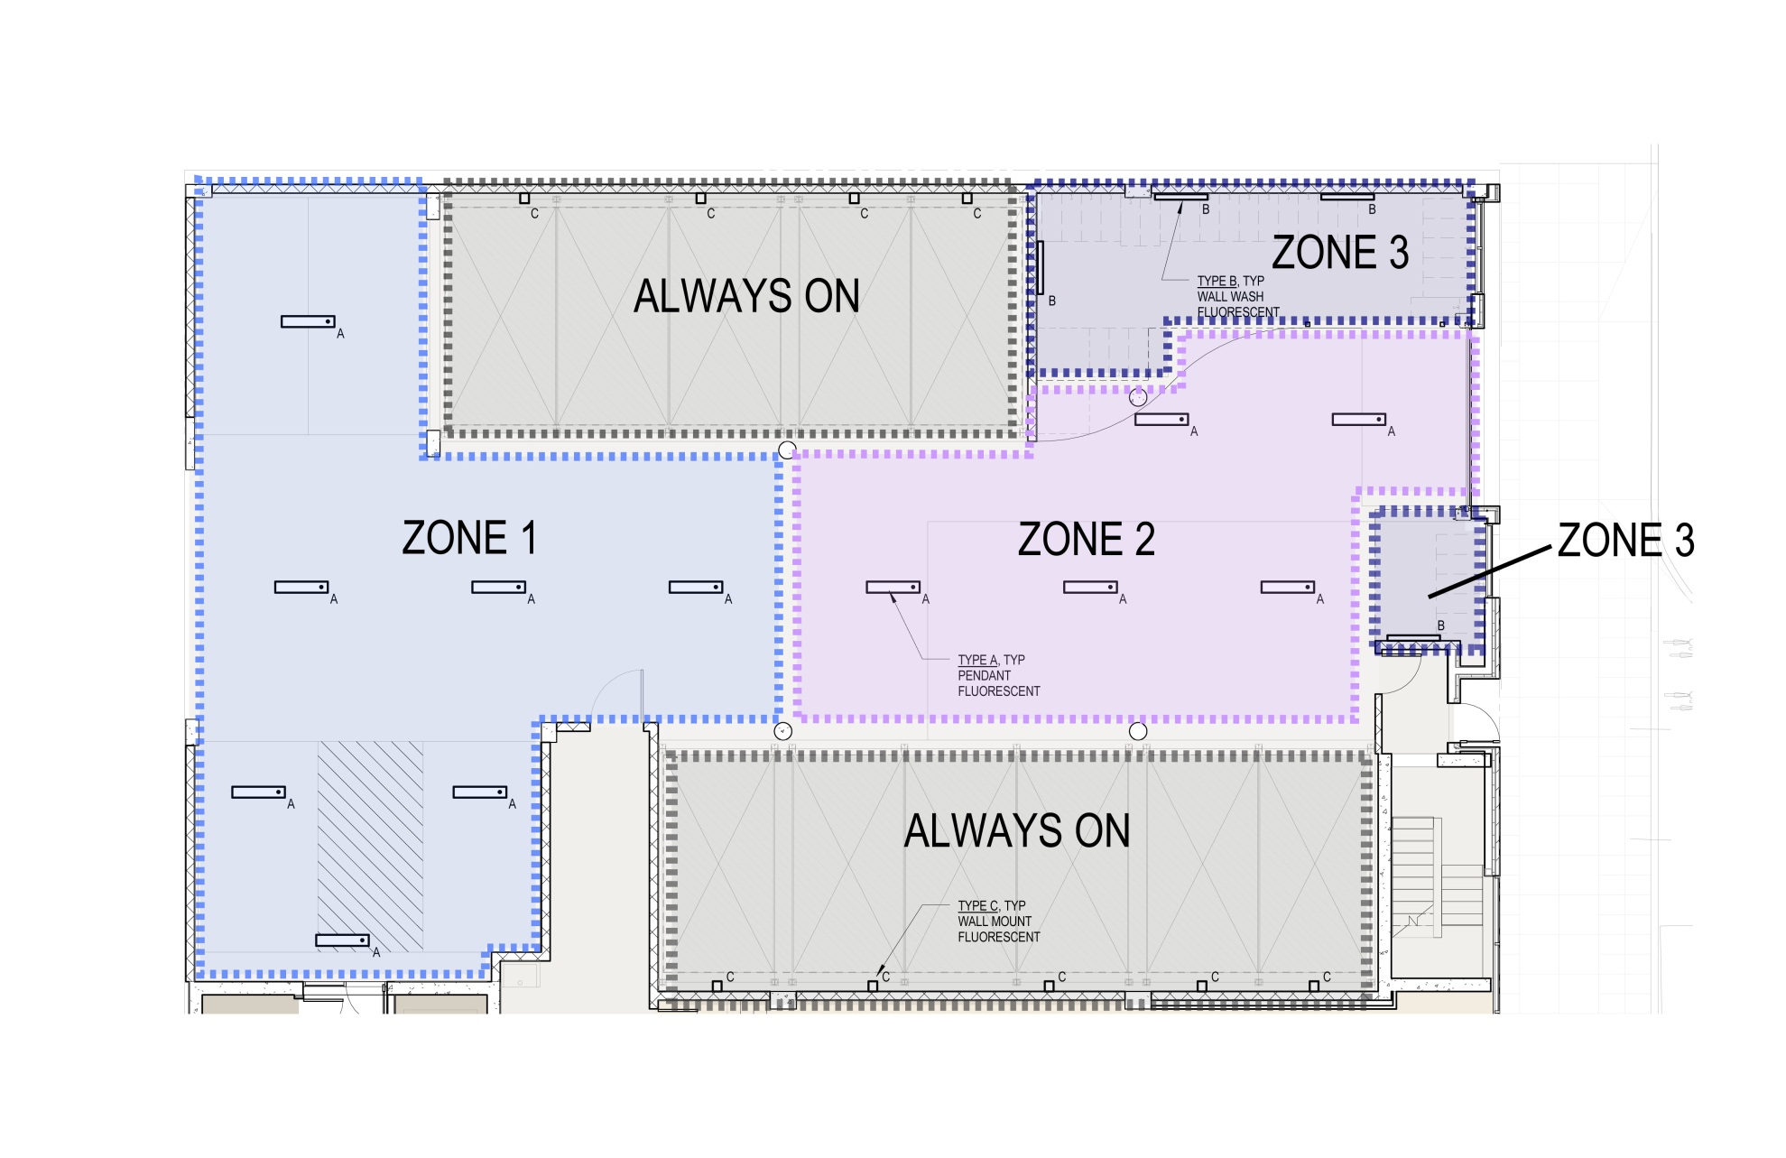
AUGUST 15 REVISION
LIGHTING STRATEGY AT GARAGE

Slide 23
TYPE B – BIKE PARKING AREA

Slide 24
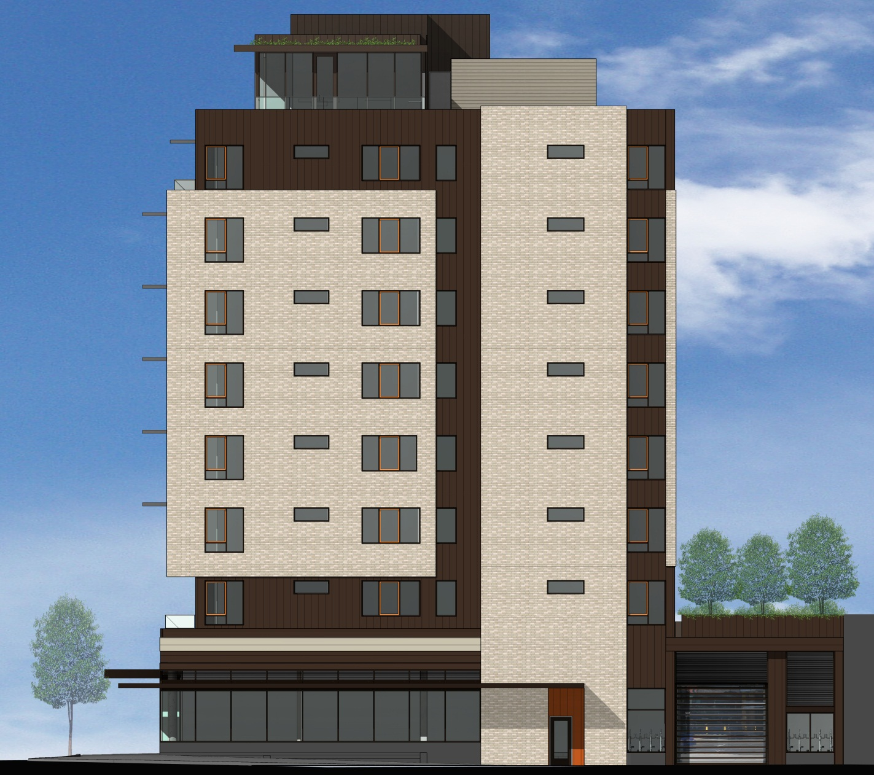

Slide 25
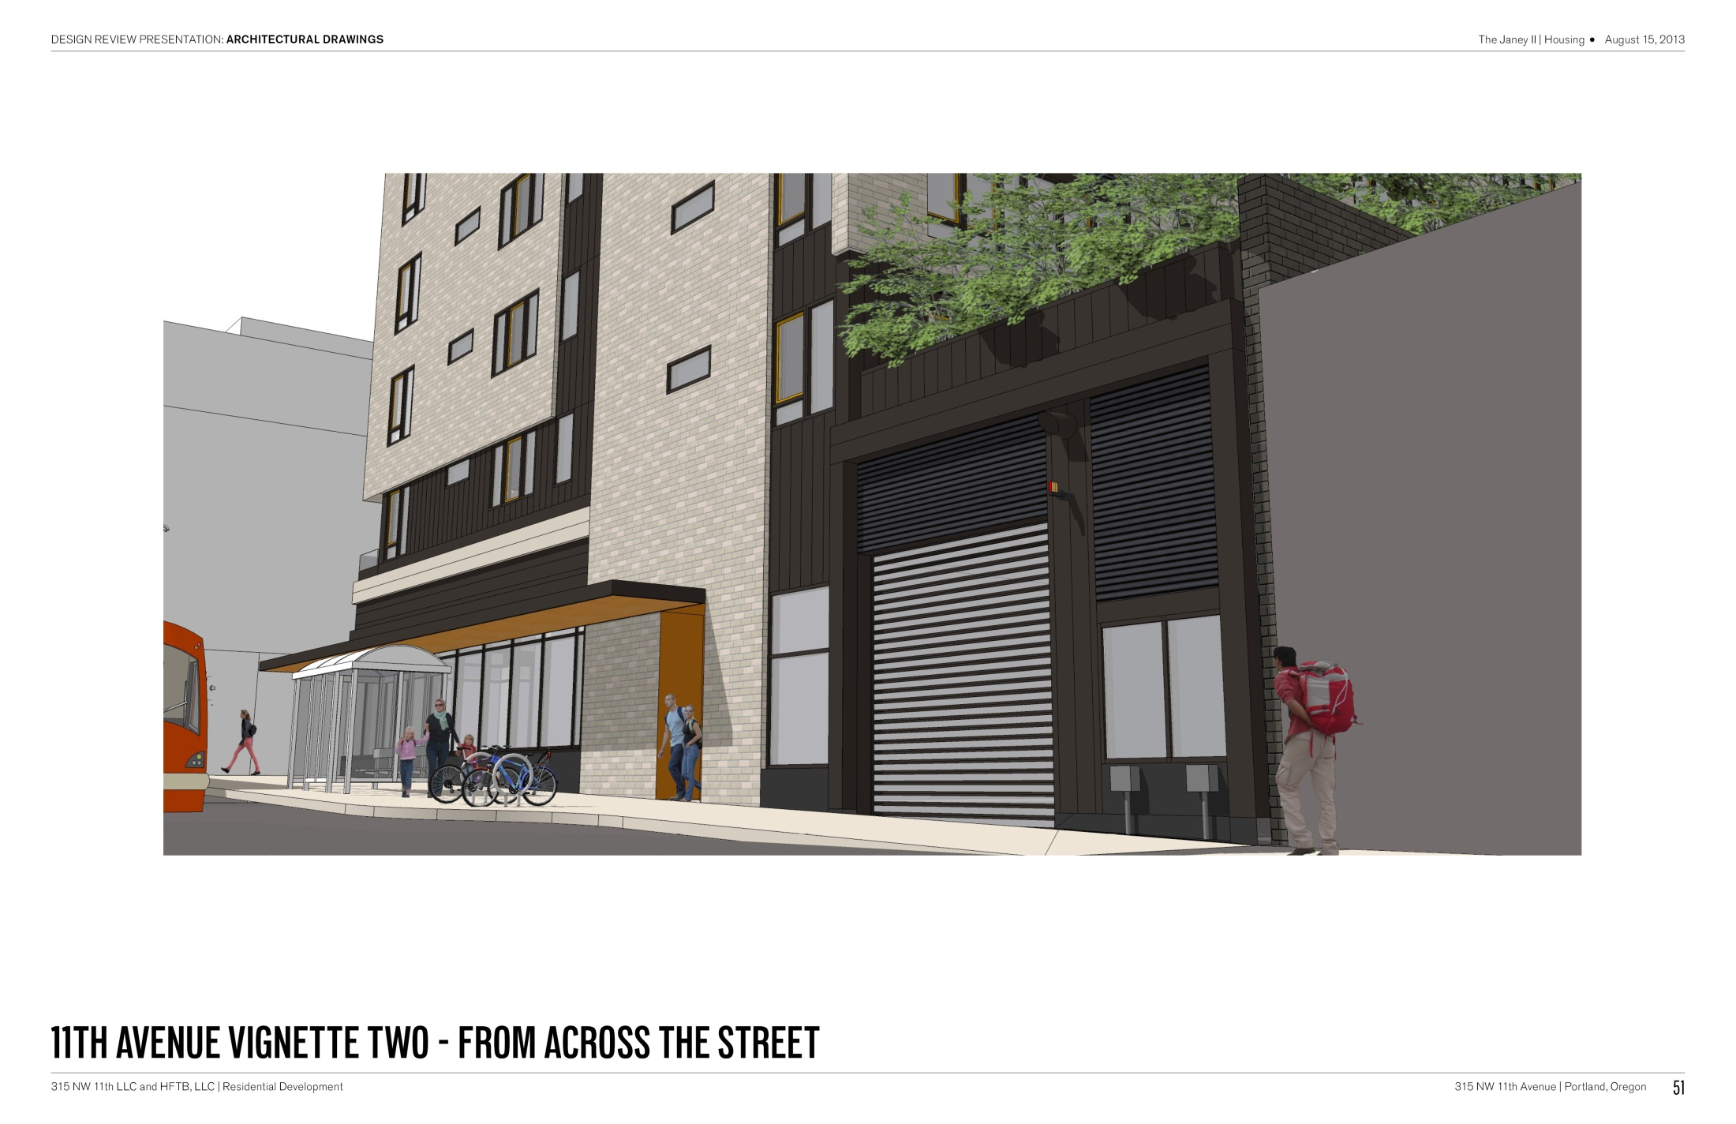
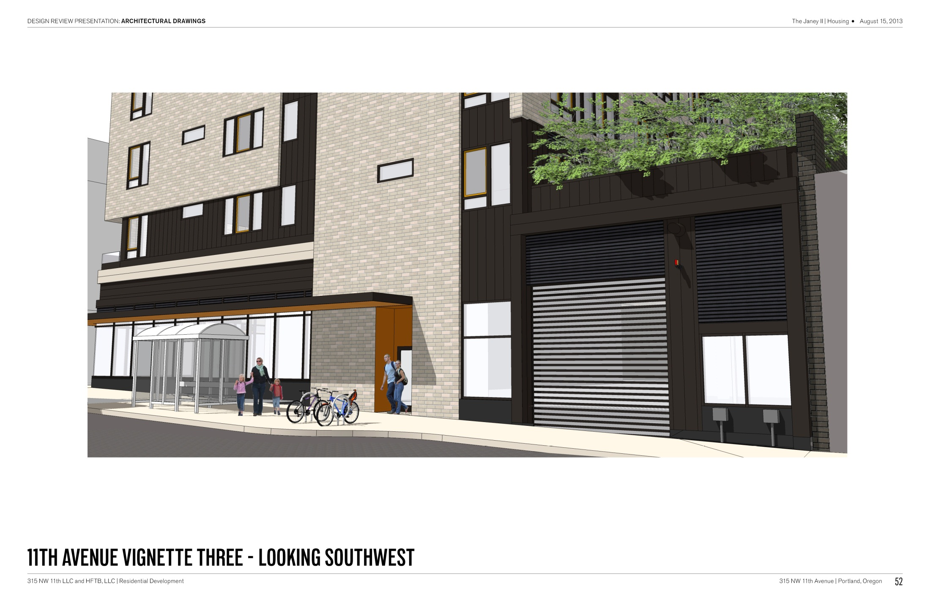
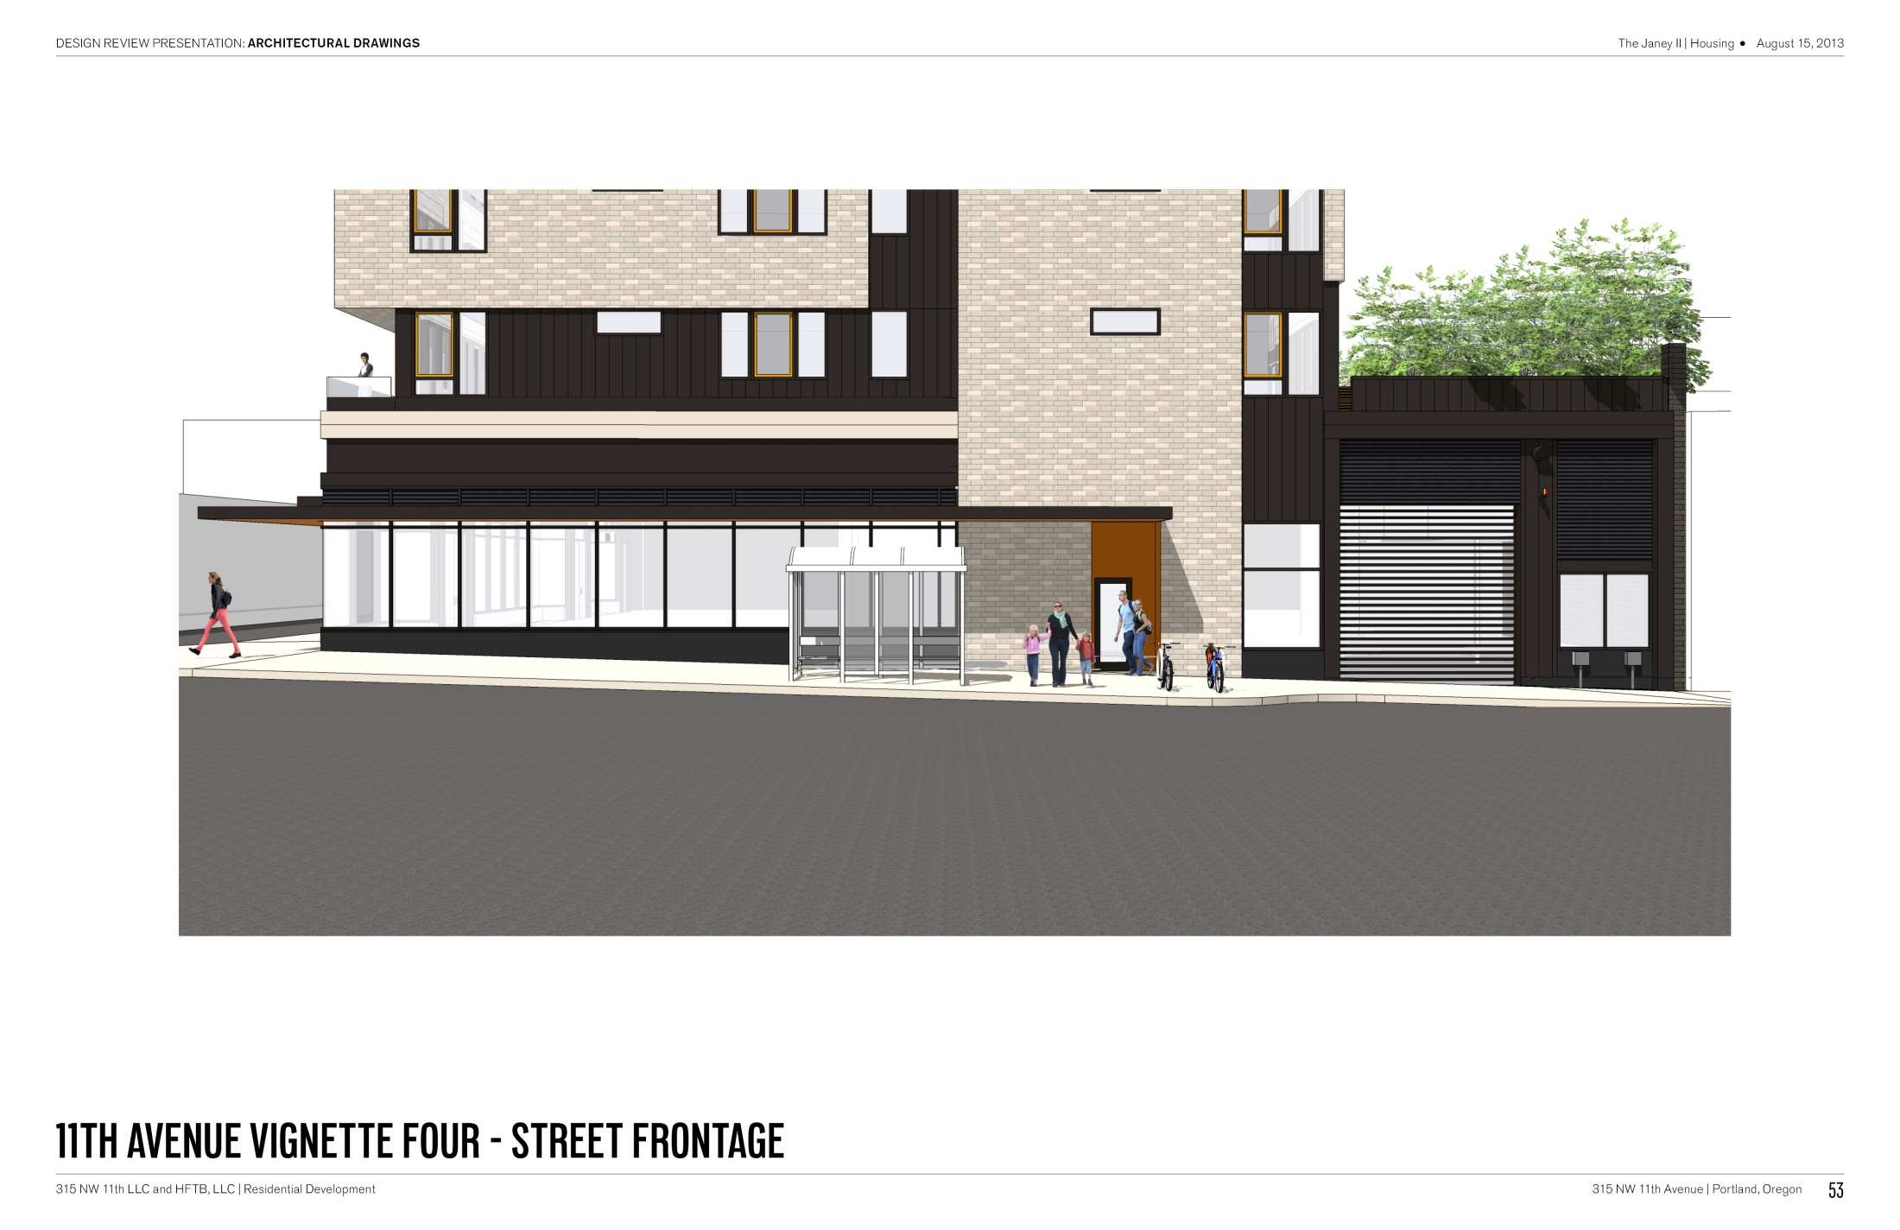
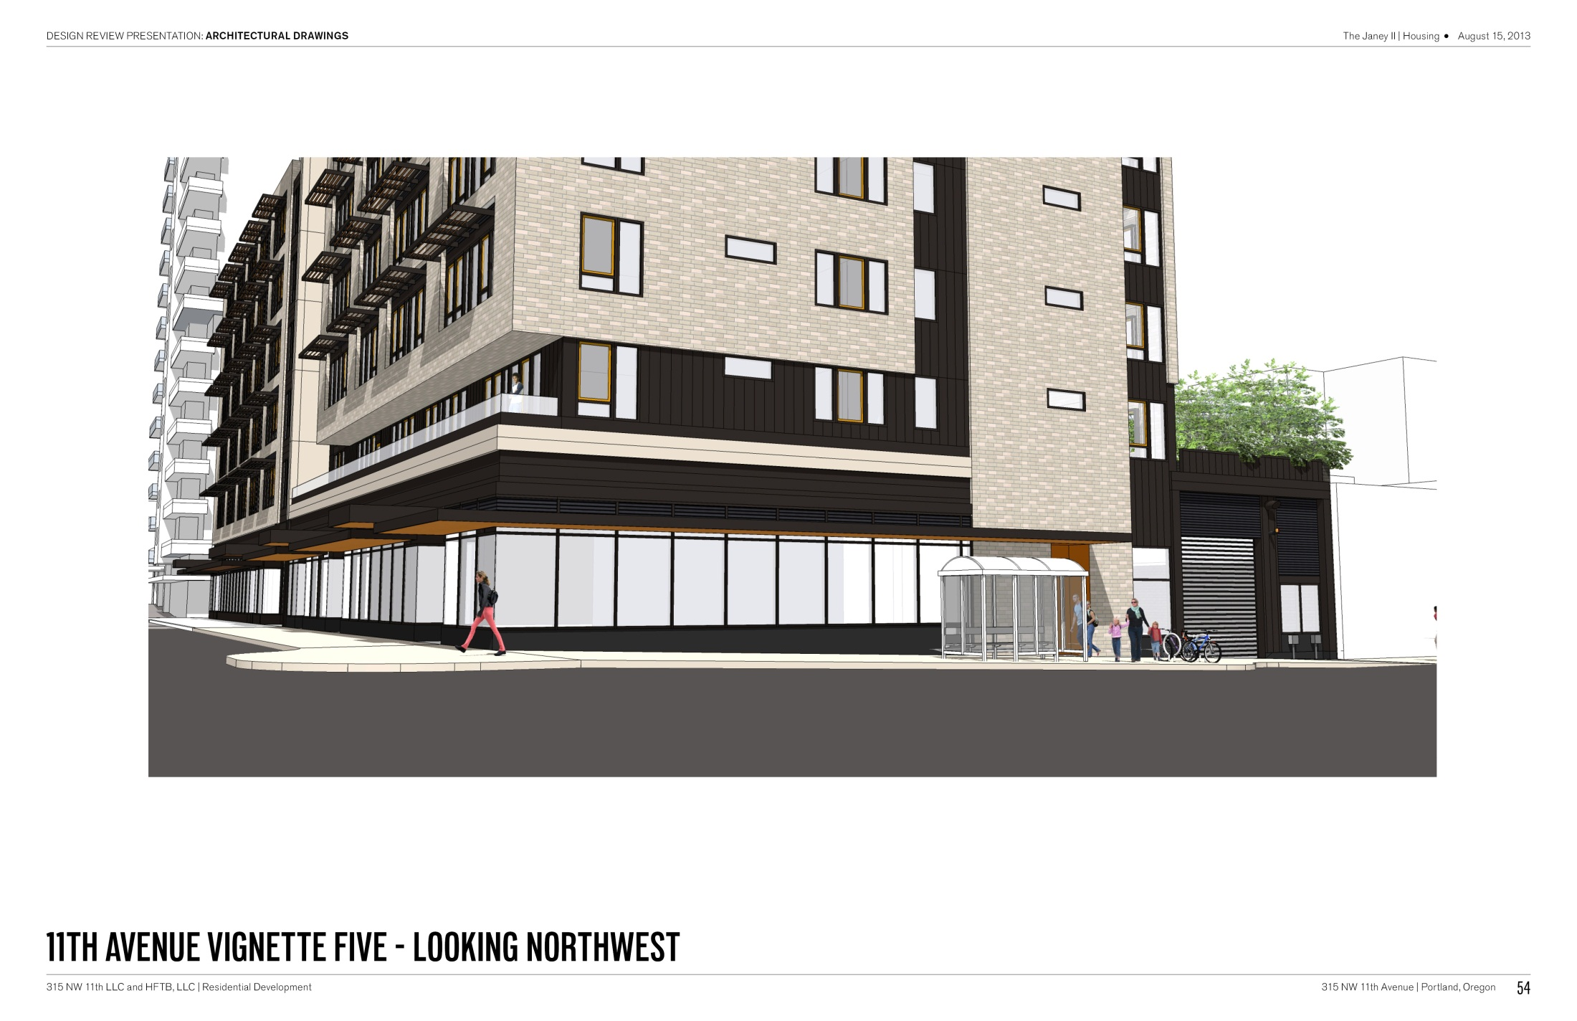
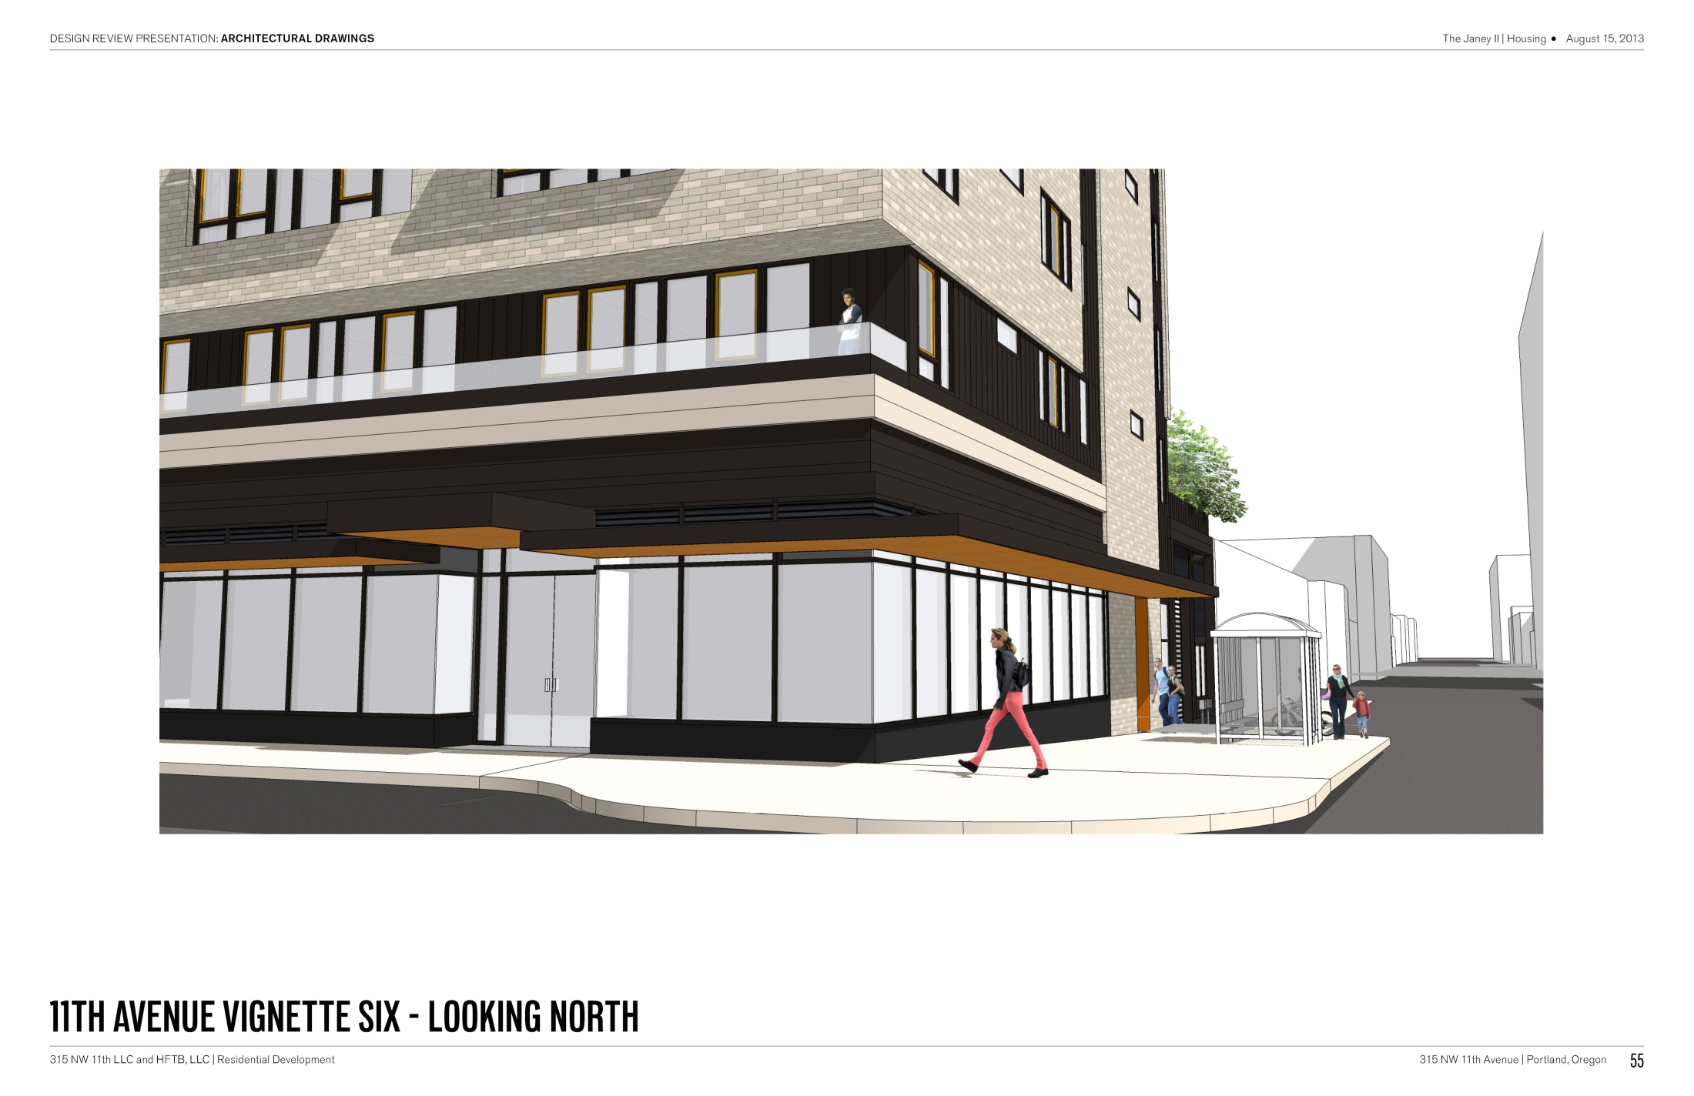

Slide 27
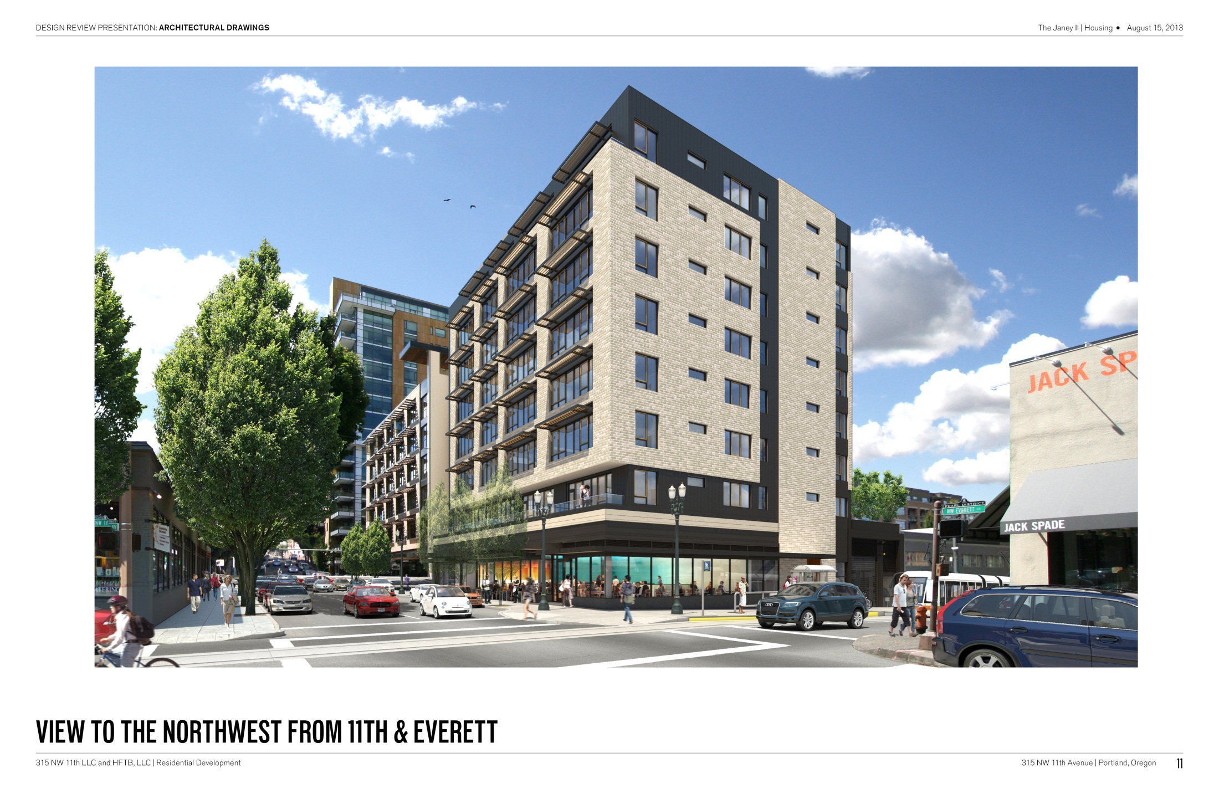

Slide 28
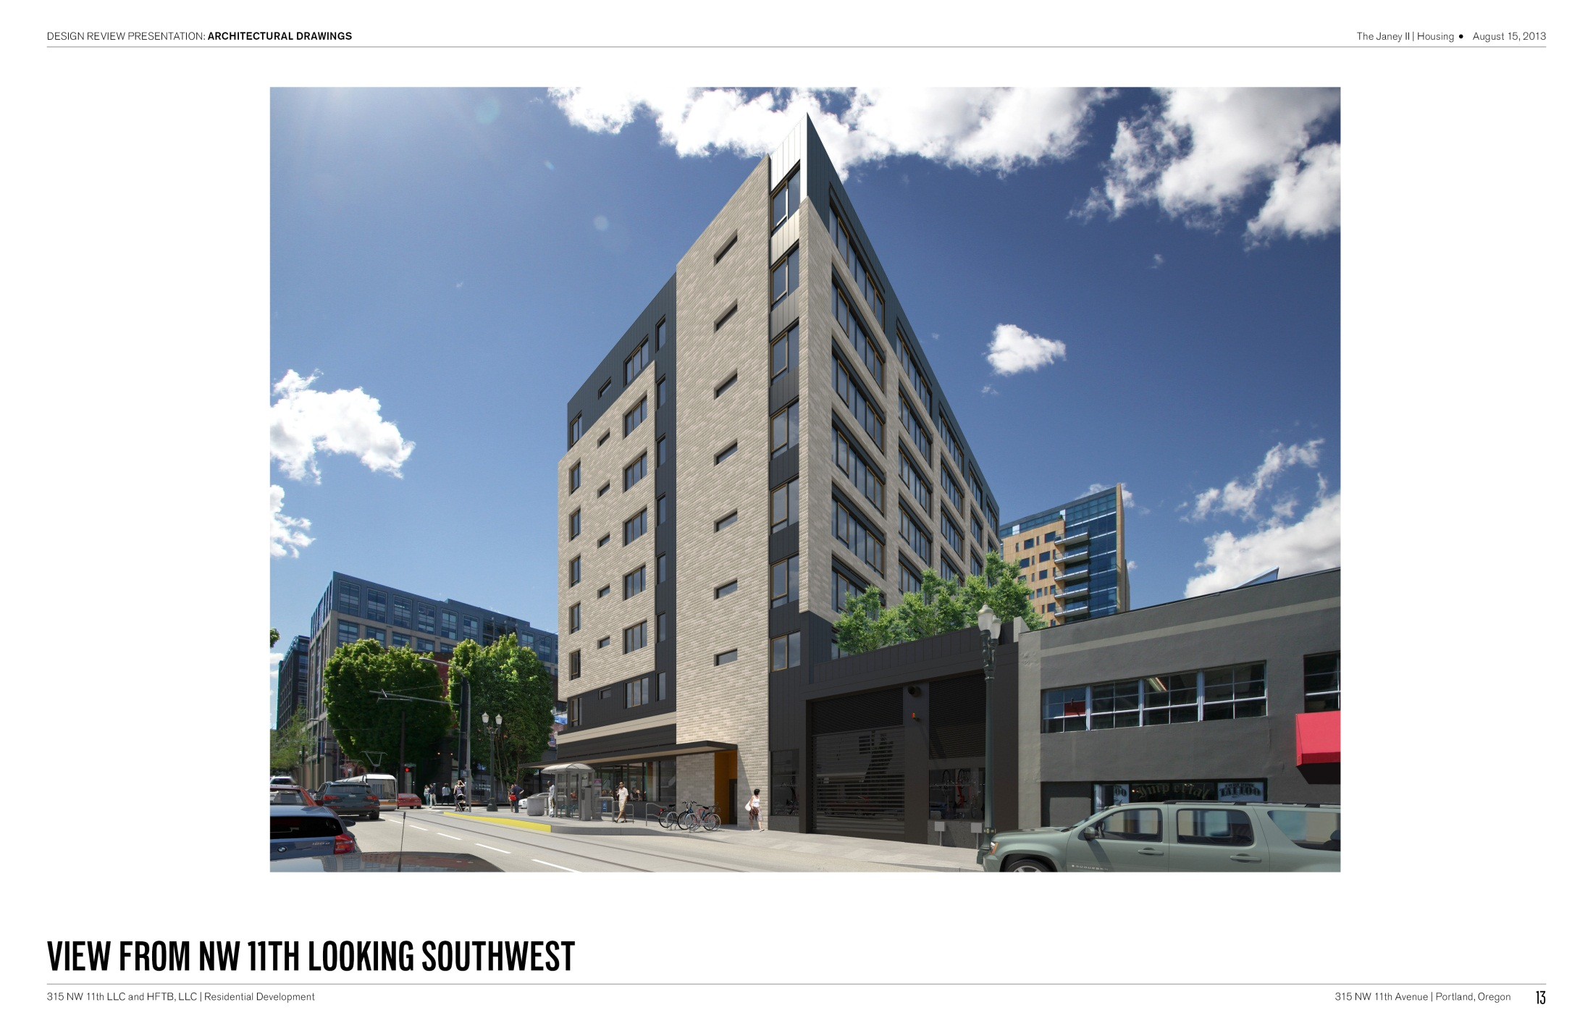

Slide 30
DESIGN REVIEW HEARING
IN SUMMARY, WE ARE REQUESTING APPROVAL OF:
DESIGN
OVERALL DESIGN OF BUILDING
ADJUSMENT AND MODIFICATIONS
Minimum 50% of Ground Floor Active areas
Minimum 50% of the length and 25% of the ground level wall area
Parking on NW 11th Avenue

Slide 31
THANK YOU

Slide 33
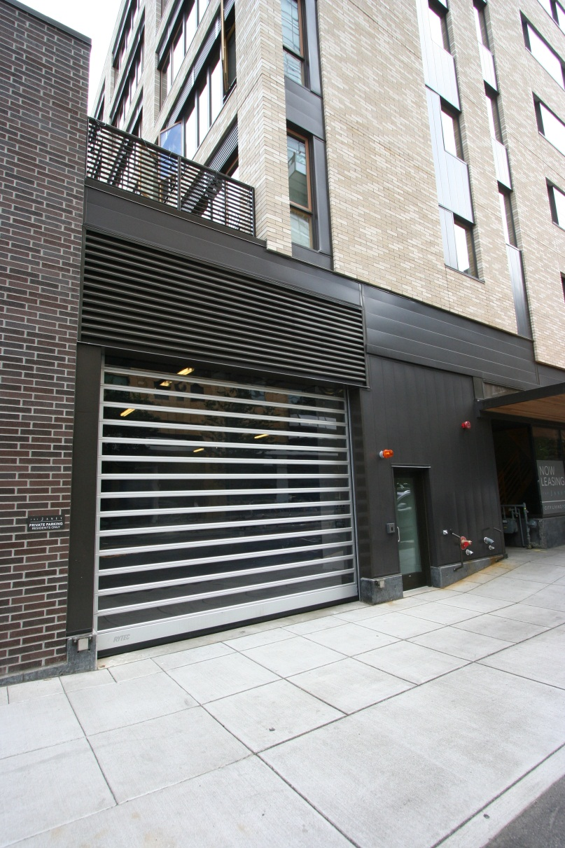
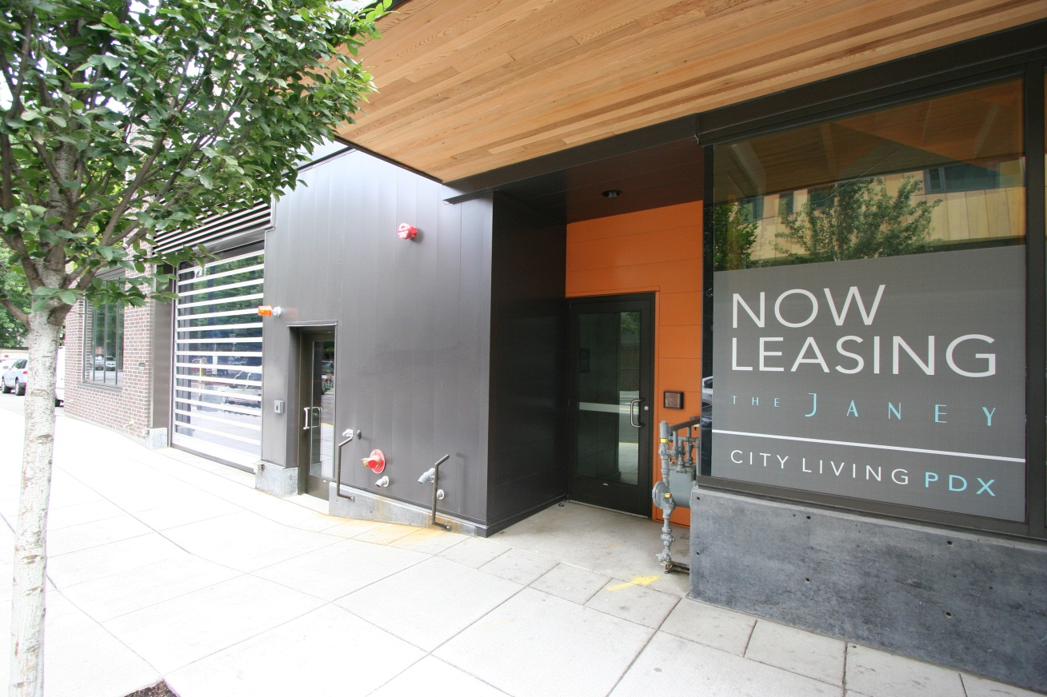
THE JANEY’S METAL PANEL AT SIDEWALK

Slide 35
THE JANEY II
MODIFICATIONS AND ADJUSTMENTS
Modifications:
Minimum 50% of Ground Floor Active areas that front a streetcar alignment with parking encroachment into the required Active Zone within 100’ of the streetcar alignment.
In the EX Zone, the windows must be at least 50 percent of the length and 25 percent of the ground level wall area.
4
Adjustment:
Access to Parking on NW 11th Avenue will not be approved except when granted under adjustment procedures

Slide 36
MODIFICATION (1):
Minimum 50% of Ground Floor Active areas that front a streetcar alignment with parking encroachment into the required Active Zone within 100’ of the streetcar alignment.
Due to the requirement to provide parking for the apartment dwellers, we are unable to meet the 50% Active Use on the ground floor along NW 11th Avenue. As shown on the floor plan on page C4, we are proposing a 38 foot zone (38% of the 100-foot site) of active use on the ground floor, along NW 11th, that meets all of the listed requirements. In addition to the 38 foot zone, we have an 8 foot zone of clear-glazed windows at the egress stair directly north of the retail area. We have also added a “display window” that is approximately 7 feet wide between the stairway exit door and the garage door to provide an additional interest along the NW 11th facade. We request approval to be allowed to reduce the Ground Floor Active Area along NW 11th Avenue from 50% to 38%.

Slide 37
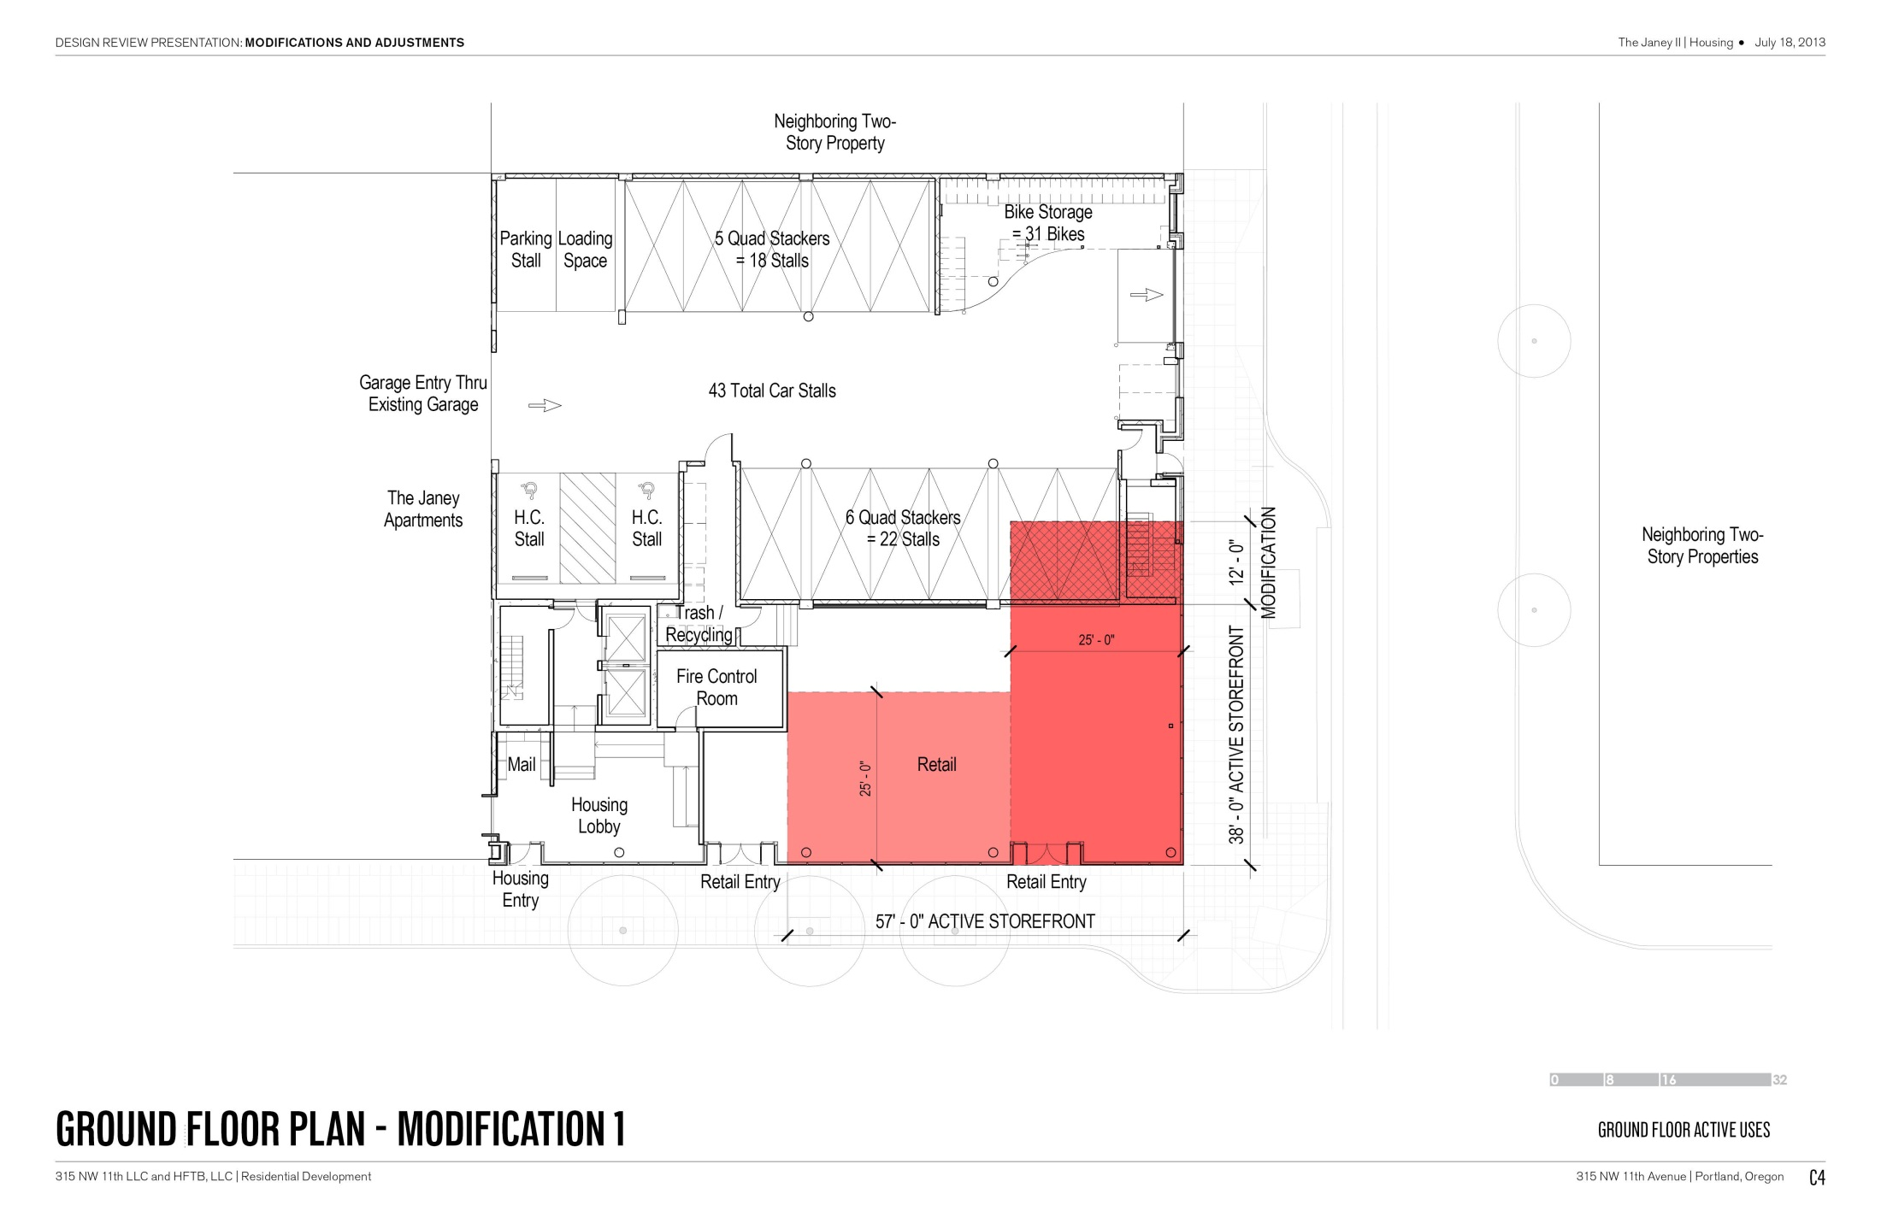

Slide 38
MODIFICATION (2):
In the EX Zone, the windows must be at least 50 percent of the length and 25 percent of the ground level wall area.
Due to the project requirement for providing parking for the apartment dwellers, along with the request to provide access to the parking garage along NW 11th Avenue (See Modification 1 and Adjustment 1), we are unable to provide more than 38 feet of qualifying ground floor windows along NW 11th Avenue. As the site is 100’ along NW 11th, the 38 feet of window falls below the design parameters provided by this code section, which call for a minimum of 50% of qualified ground floor window length provided. To help minimize the impact of the reduced area of ground floor windows, we are providing a clear-vision-glazed storefront into the egress stairs, which will add an additional level of interest along the NW 11th Avenue facade (see ground floor plan on page C5). In addition, this proposal includes a display window that adds another 7 feet in length of interest along the NW 11th street facade. By including these additional features, aside from the 38 feet of windows into the retail space, this proposal is hoping to provide a pleasant and diverse pedestrian experience along NW 11th Avenue. We request approval to be allowed to reduce the Ground Floor Windows along NW 11th Avenue from 50% to 38%.

Slide 39
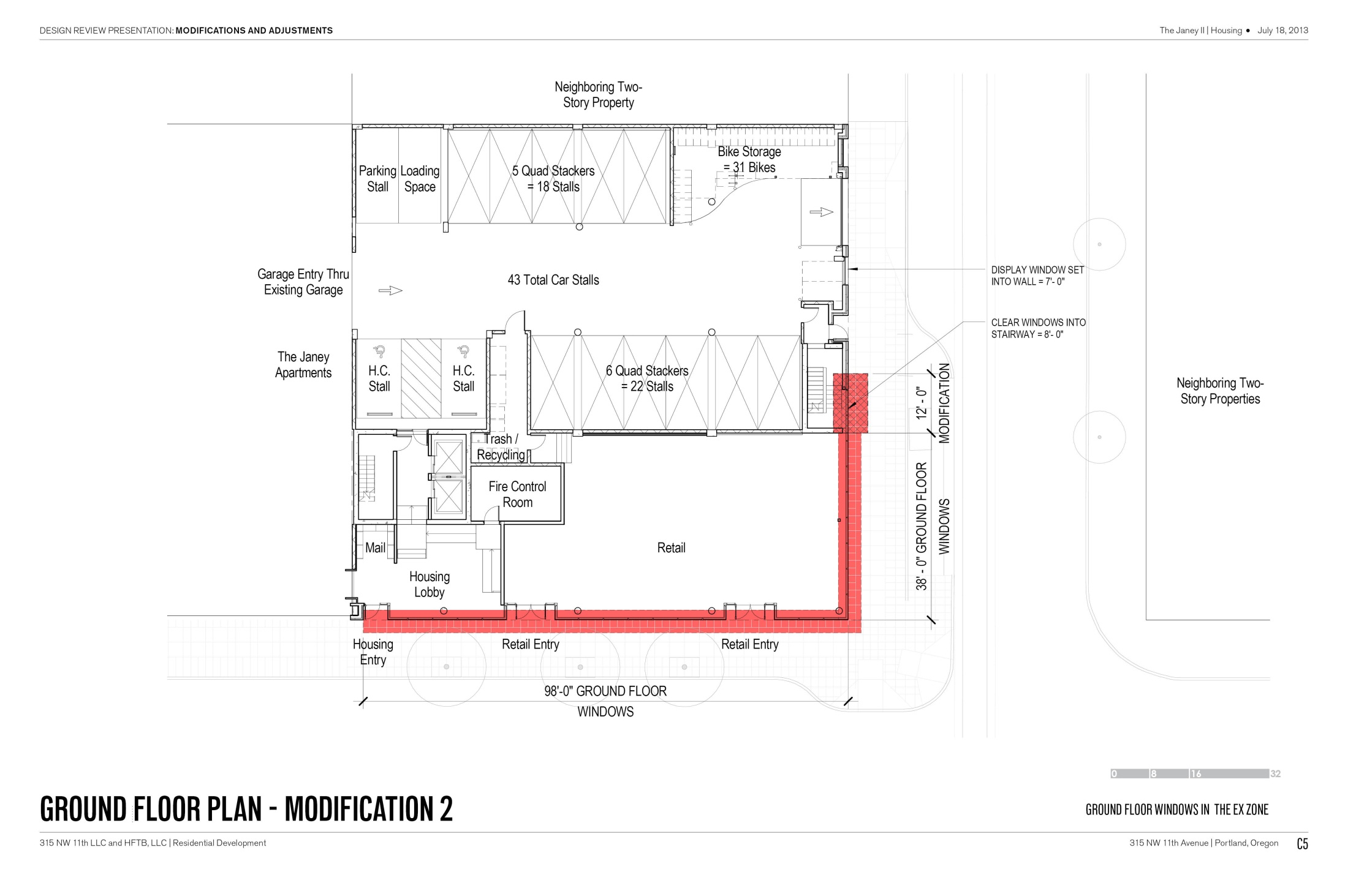

Slide 40
ADJUSTMENT (1):
Access to Parking on NW 11th Avenue will not be approved except when granted under adjustment procedures
Due to the proposed project requirement for providing the apartment dwellers with parking and, due to our 1/4 block site on the corner of NW 11th Avenue and NW Everett street, we are left with providing access on one of those two streets. Because of the high traffic volume and vehicular speeds along NW Everett Street, the alternative location for access along NW 11th Avenue is preferred - as requested by PBOT and confirmed with PBOT’s Development Service Manager. To help minimize the impact of providing this parking access on NW 11th, we are proposing a one-way egress out of the proposed new parking garage by connecting the new building with the adjacent, existing Janey building, where ingress will take place - see plan on page C6. The Janey is designed with an ultra high-speed overhead coiling door (Rytec Spiral FV, with a speed of 100 inches per second, see page C7 for door cut-sheet) that allows for quick access and minimizes cueing outside the existing garage door along NW 12th Avenue. By providing the same fast-acting/high-speed overhead door on the new building (with the same clear dimensions), the cueing on the inside will also be minimized and vehicular ingress (on NW 12th) and egress (on NW 11th) will be fast and efficient. The two buildings will be connected by an opening along the property line that is wider than the ingress and egress doors, which will avoid any additional burden to the existing parking garage. Therefore, we request approval to access our parking area through the garage door located on the northeast end of the property, mid-block along NW 11th Avenue.

Slide 41
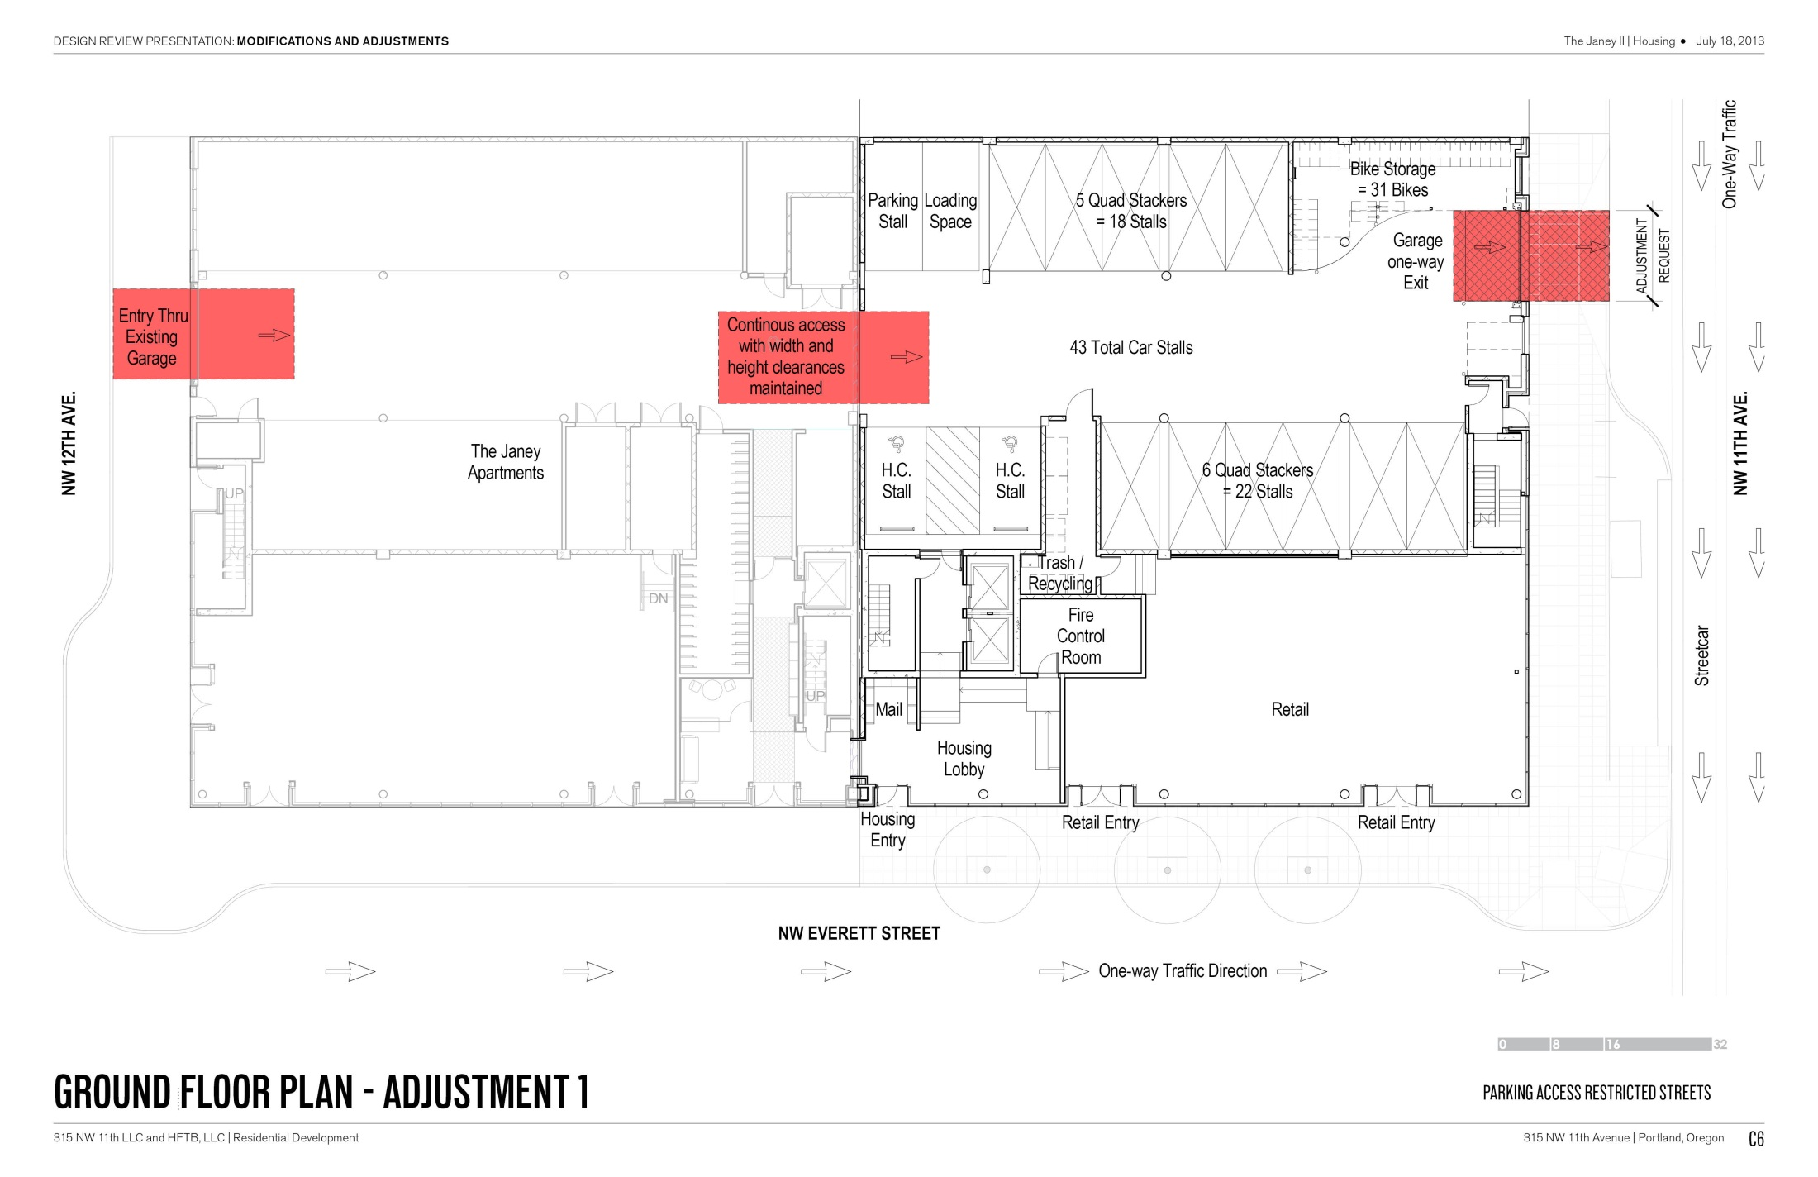

Slide 42
THE END

