Slide 1
Block 37
DAR – Aug. 1, 2013

Slide 2
Project Overview
Parking/bikes
Retail/amenity
Housing/roof decks
zoning
248 stalls
439 bikes
6,090 sf retail
4,276 sf amenity
276 units
18,121 SF Roof Decks
331,351 GSF
.90 parking ratio
Goal = 1:1 ratio
Residential parking only
Retail located along SW River Parkway
Amenities located throughout building
14 Studios
31 Two Bedrooms
231 One Bedrooms
13,600 SF Patio on 2nd Flr
4,528 SF Roof Deck on 6th Flr
4.55 FAR
Max FAR = 5:1
74’ Height
Max Height = 125’
Bonus Height Allowed up to 250’
.9 Parking Ratio
No Minimum Parking Requirement

Slide 3
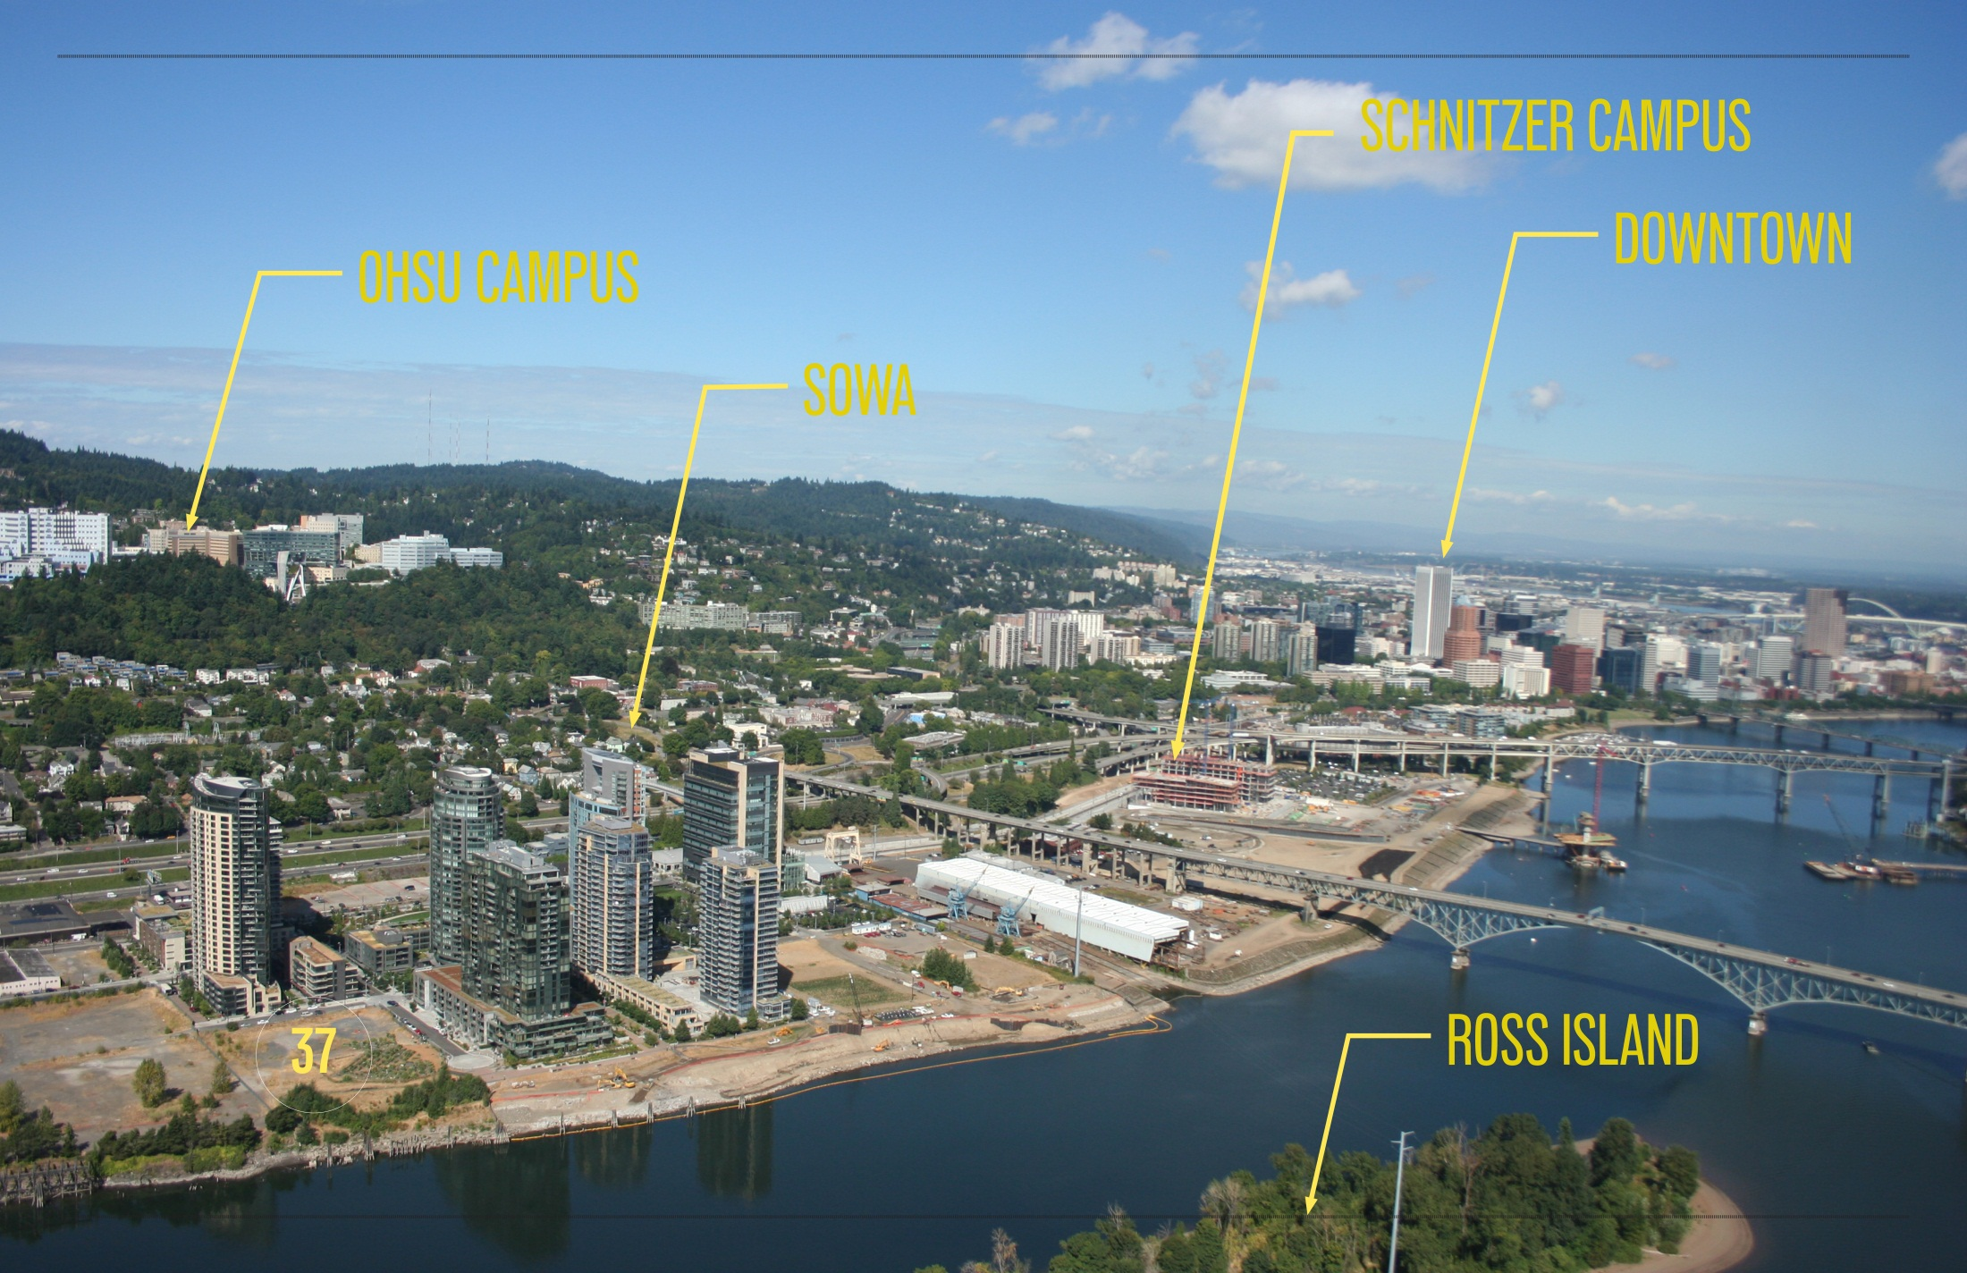
Portland Vicinity

Slide 4
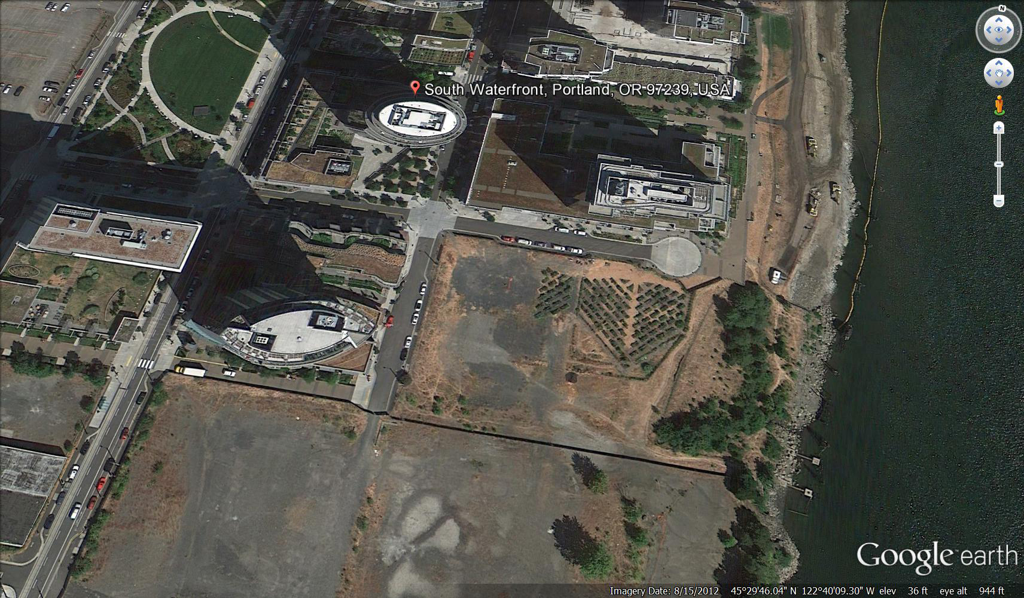
Site Photo
JOHN ROSS
ATWATER
ARDEA
37

Slide 5
Neighbors Concerns
Greenway Setback
Parking Entry
Roof Top Mechanical

Slide 6
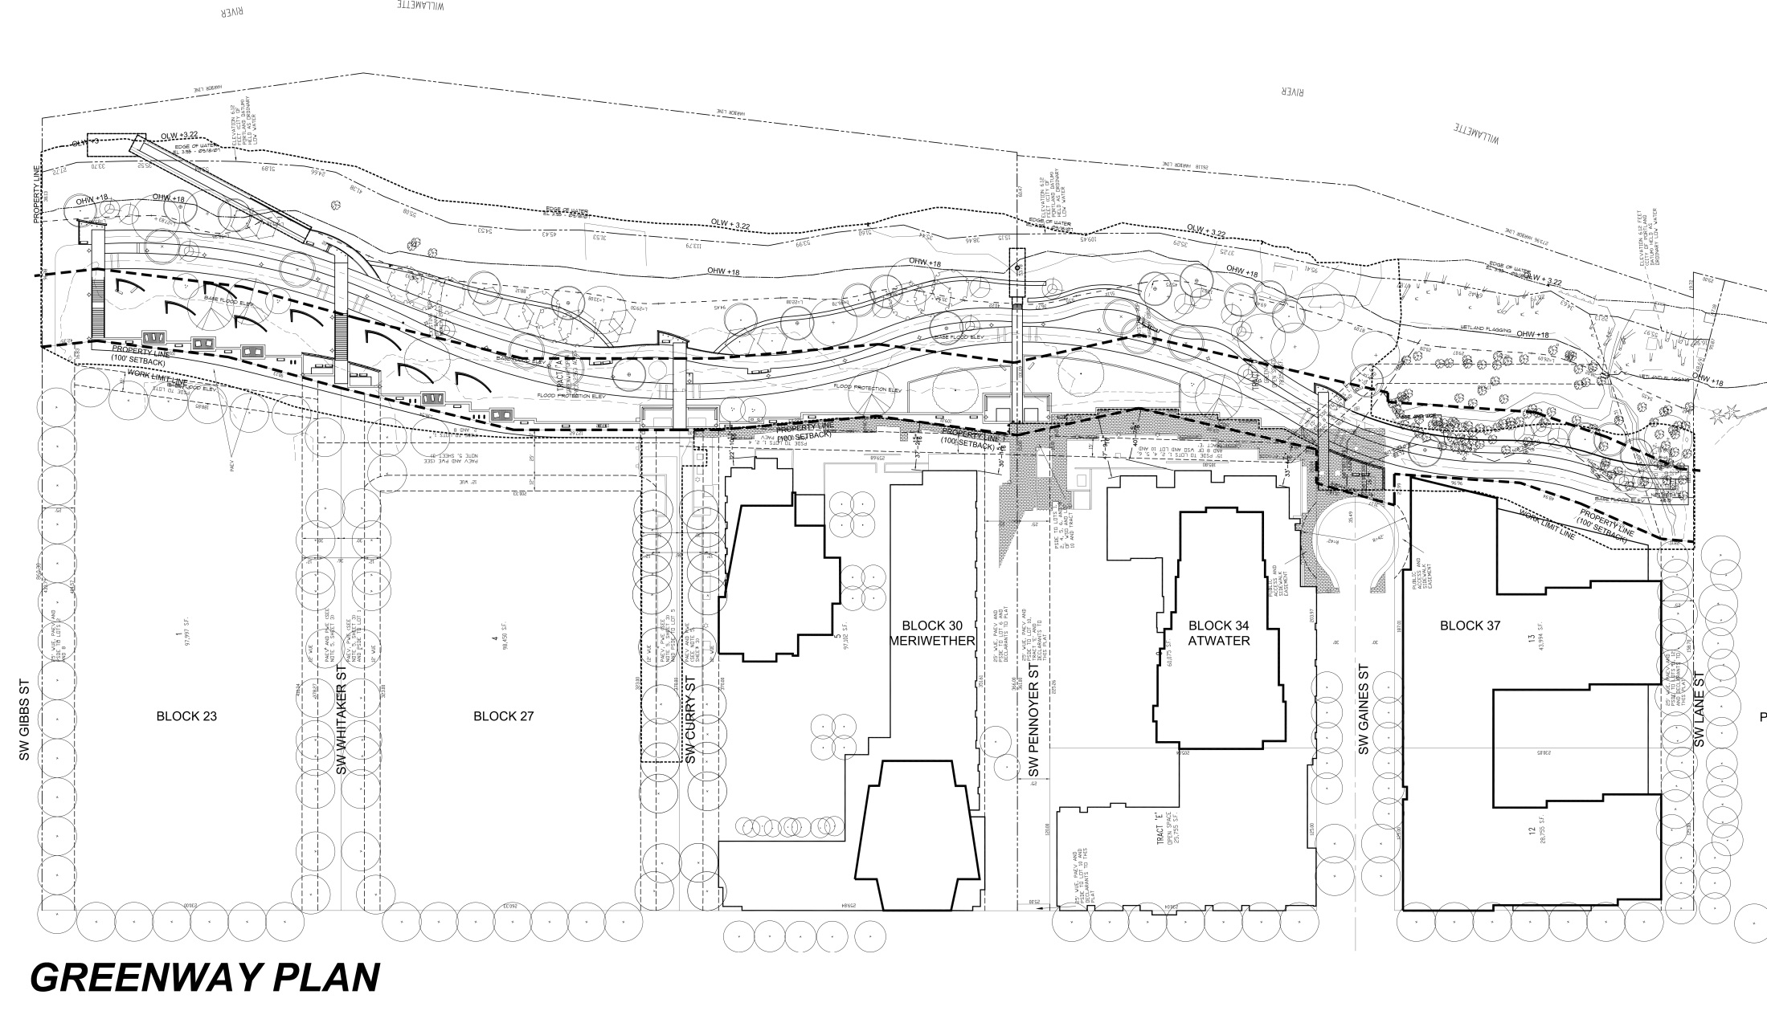
Greenway Plan - Phasing
Phase I
Phase II

Slide 7
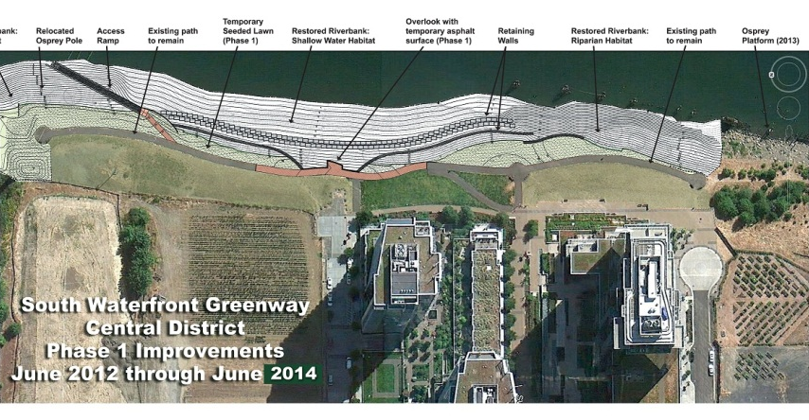
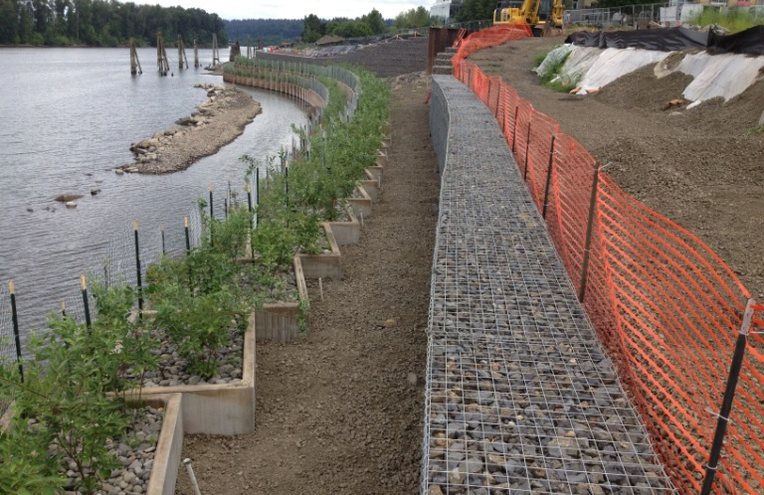
Greenway Plan

Slide 8
Top of Bank Greenway Setbacks
100’ setback
To Building No Greater Than 75’ High
125’ setback
To Building No Greater Than 125’ High
150’ setback
37
To Building of Maximum Bonus Ht.

Slide 9
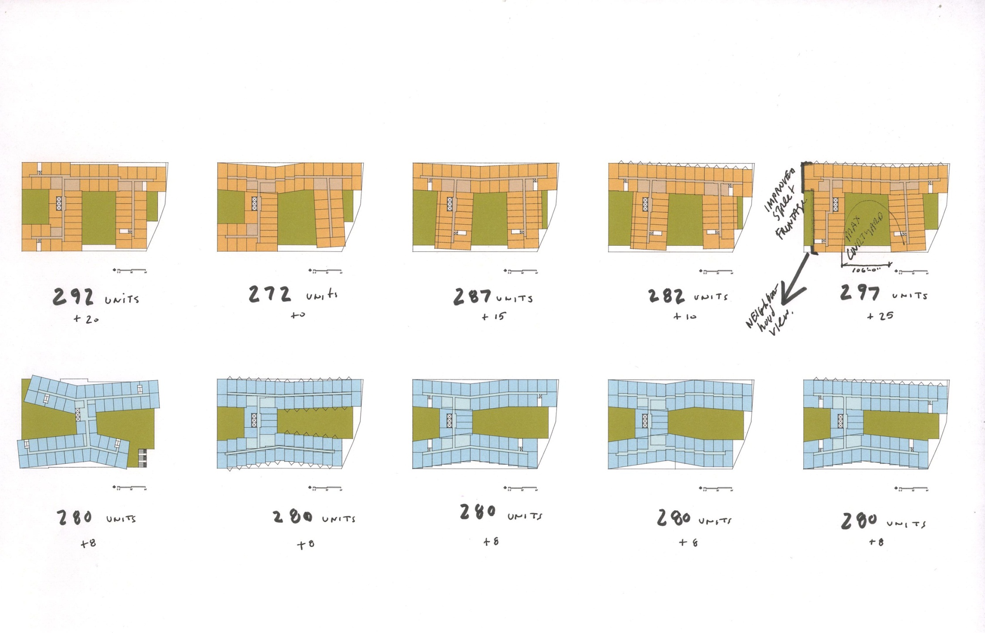
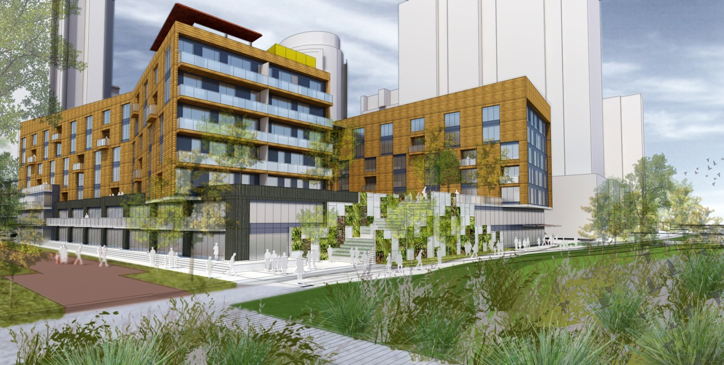
Design Process

Slide 10
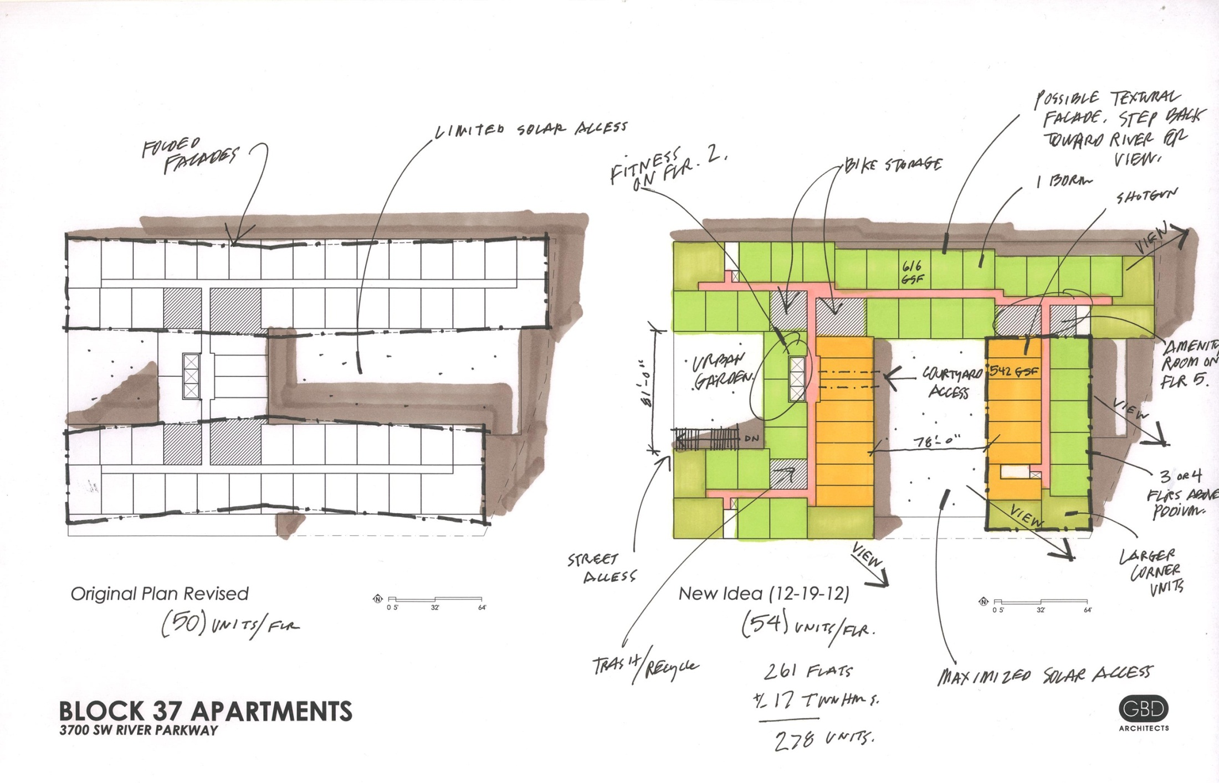
Design Process

Slide 11
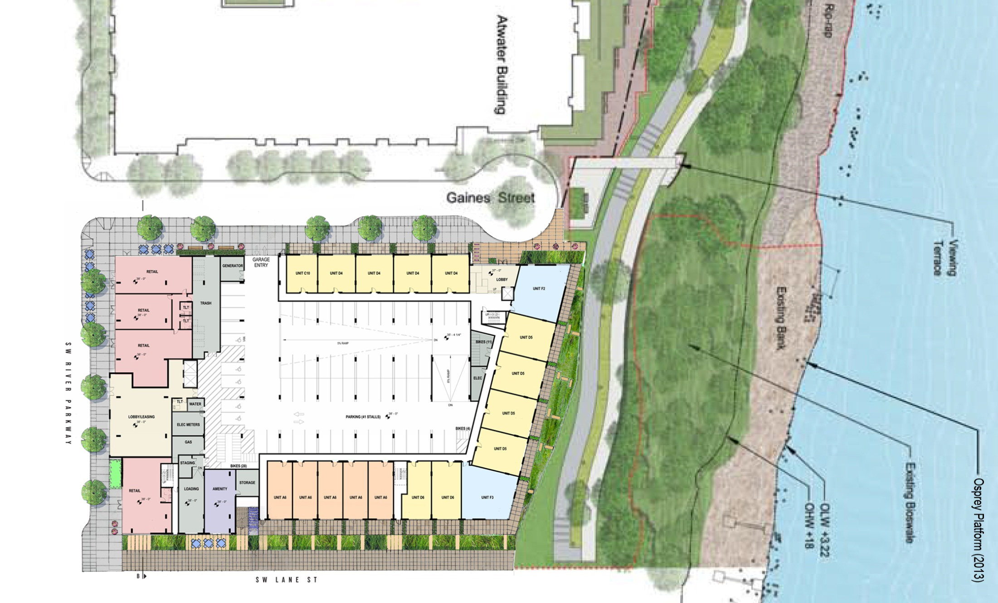
Ground Plan
SETBACK 7’-6”
FROM PROP LINE
SETBACK VARIES
9’-0” TO 23’-0”
FROM PROP LINE
SETBACK 9’-0”
FROM PROP LINE

Slide 12
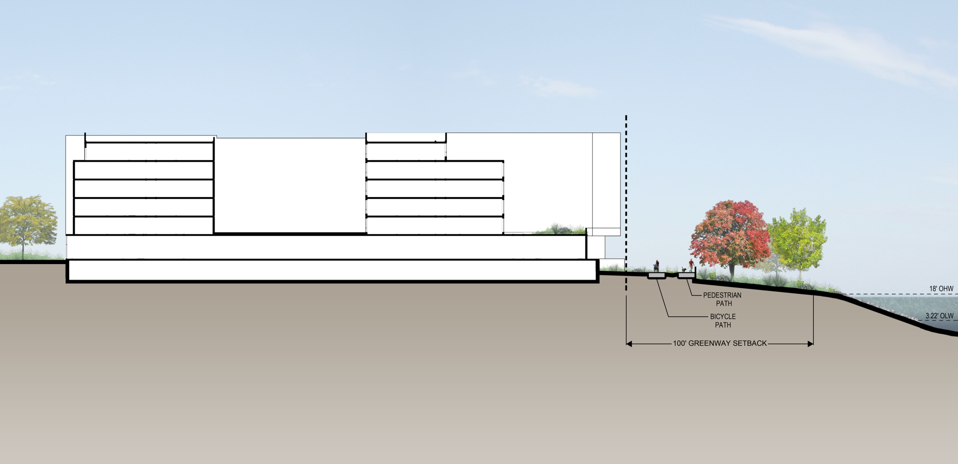
Section Looking North
114’-0”
85’-0”
23’-0”

Slide 13
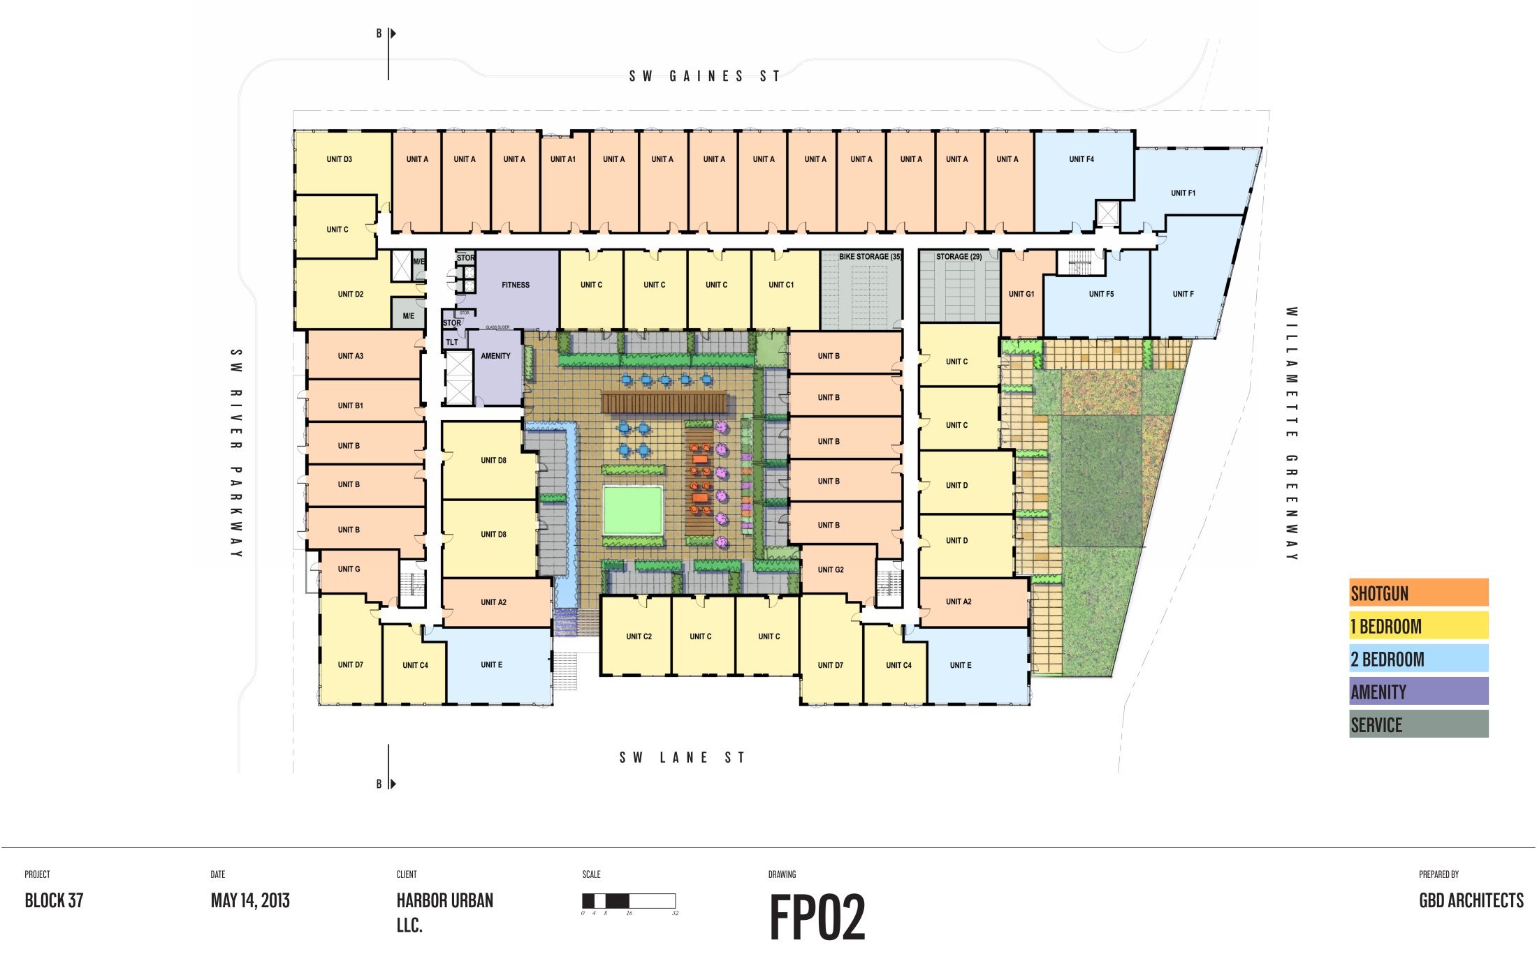
Courtyard Plan
SETBACK 13’-0” FROM PROP LINE
c
GREENROOF
AMENITY DECK

Slide 14
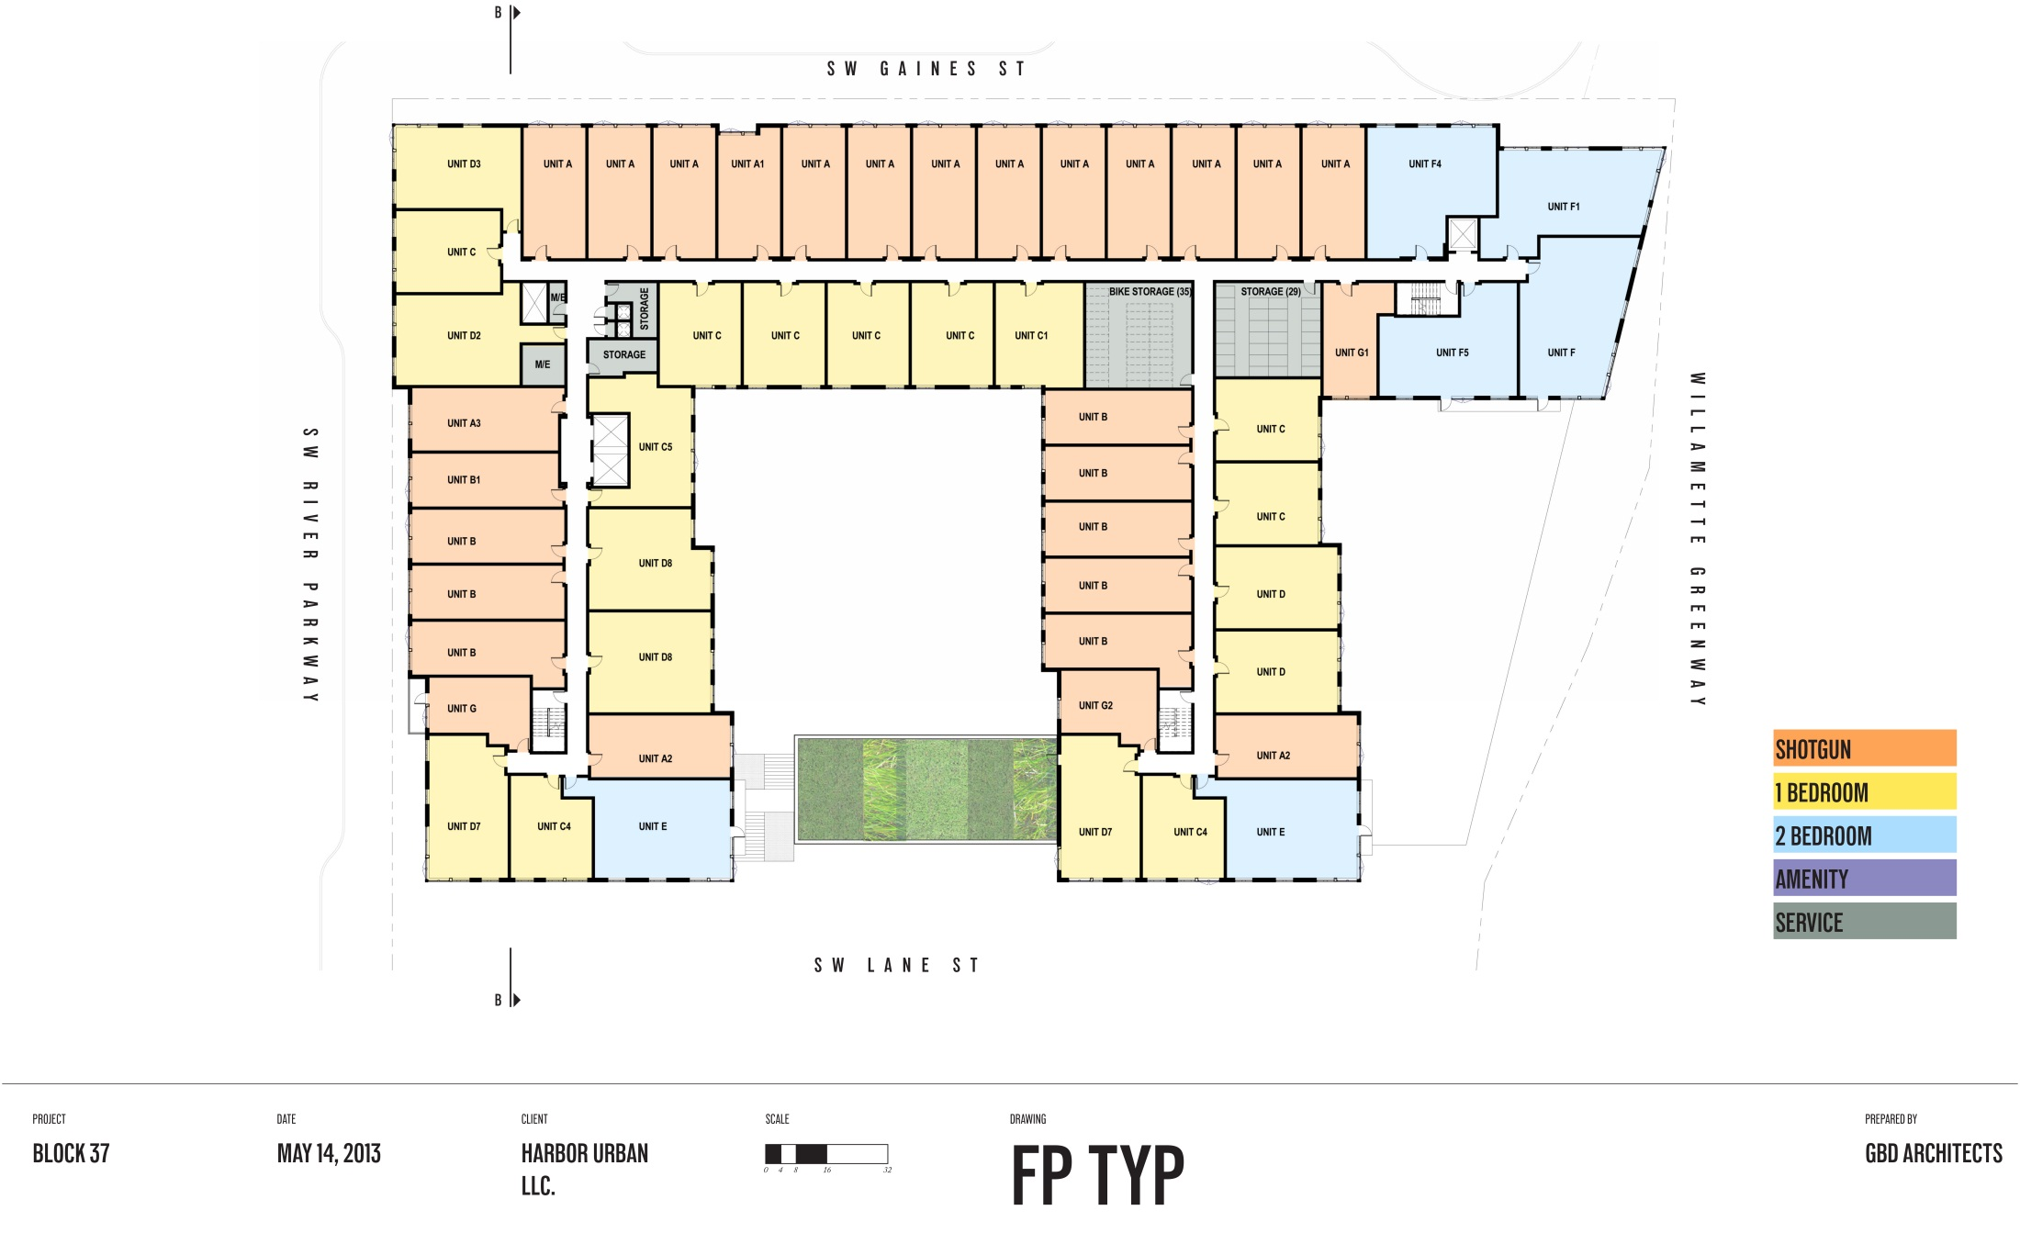
Typical Plan
50’-0”
PROPERTY LINE
GREENROOF

Slide 15
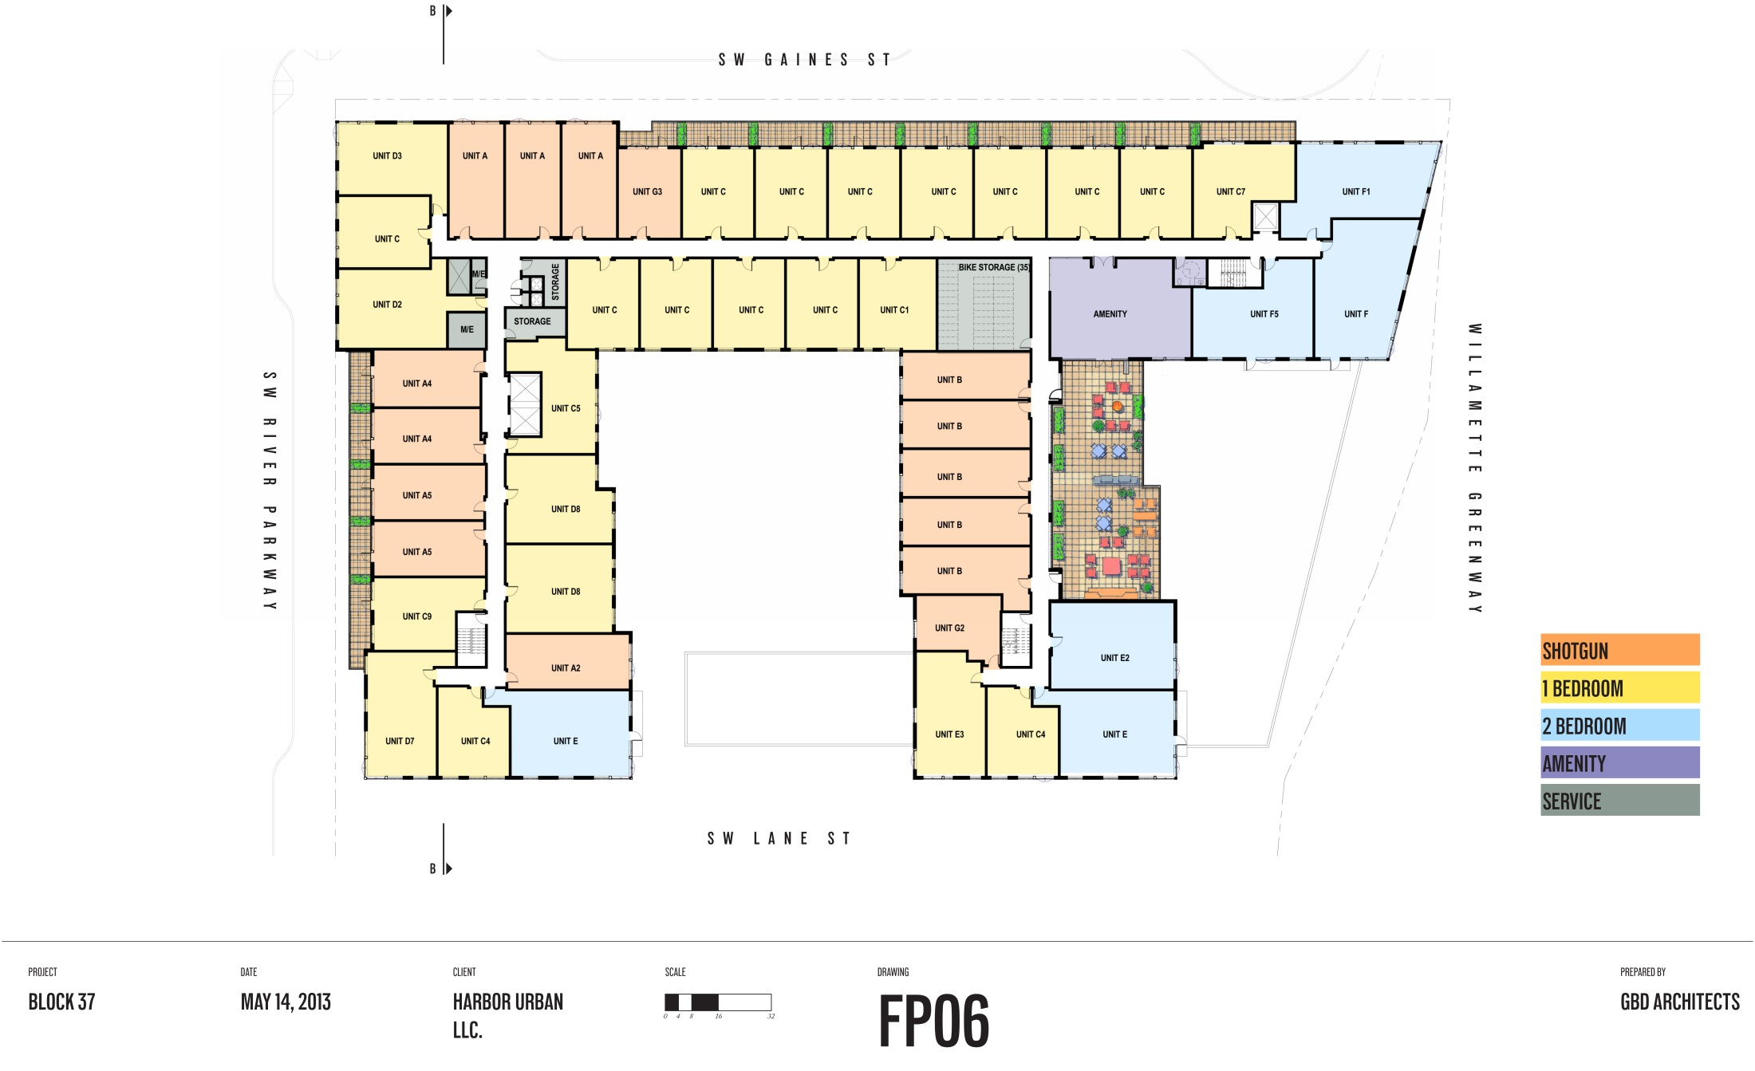
6th Floor Plan
PROPERTY LINE
SETBACK 13’-0” FROM PROP LINE
AMENITY DECK
PROPERTY LINE

Slide 16
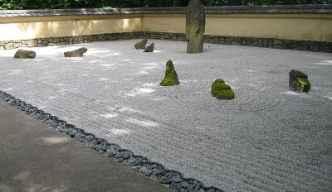
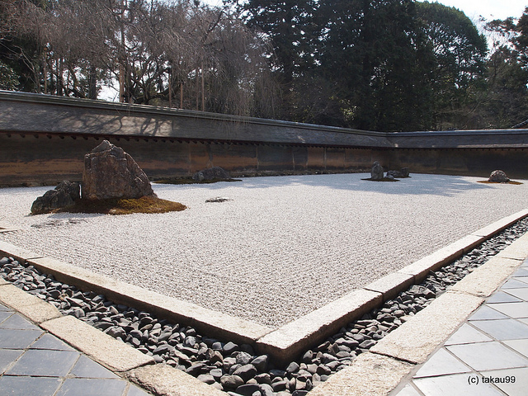
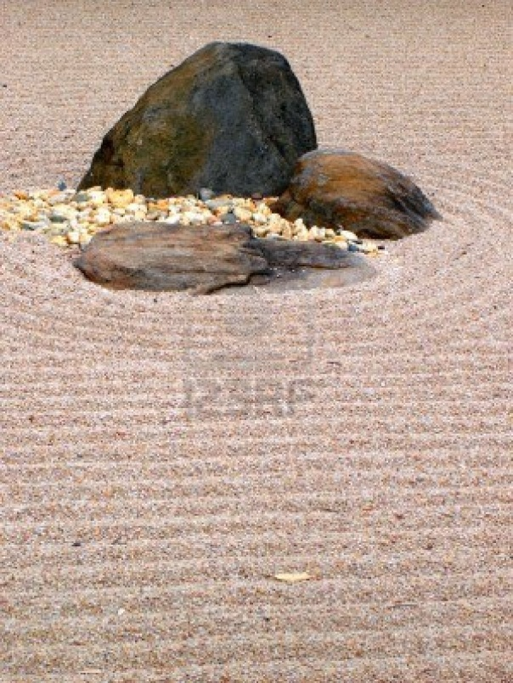
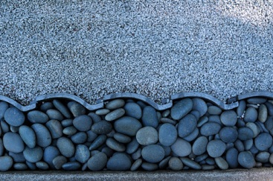
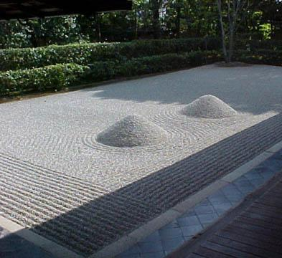
What’s on the Roof??

Slide 17
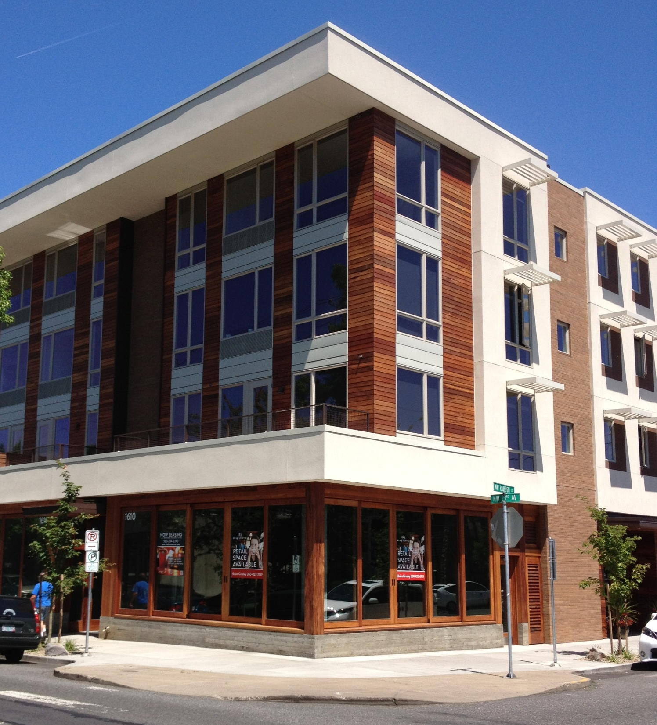
Local Design Precedent
Natural/contemporary aesthetic
Operable Wood Storefronts
Textural Materials
Vibrant Color Palette
Pedestrian Friendly
Quality Detailing

Slide 18
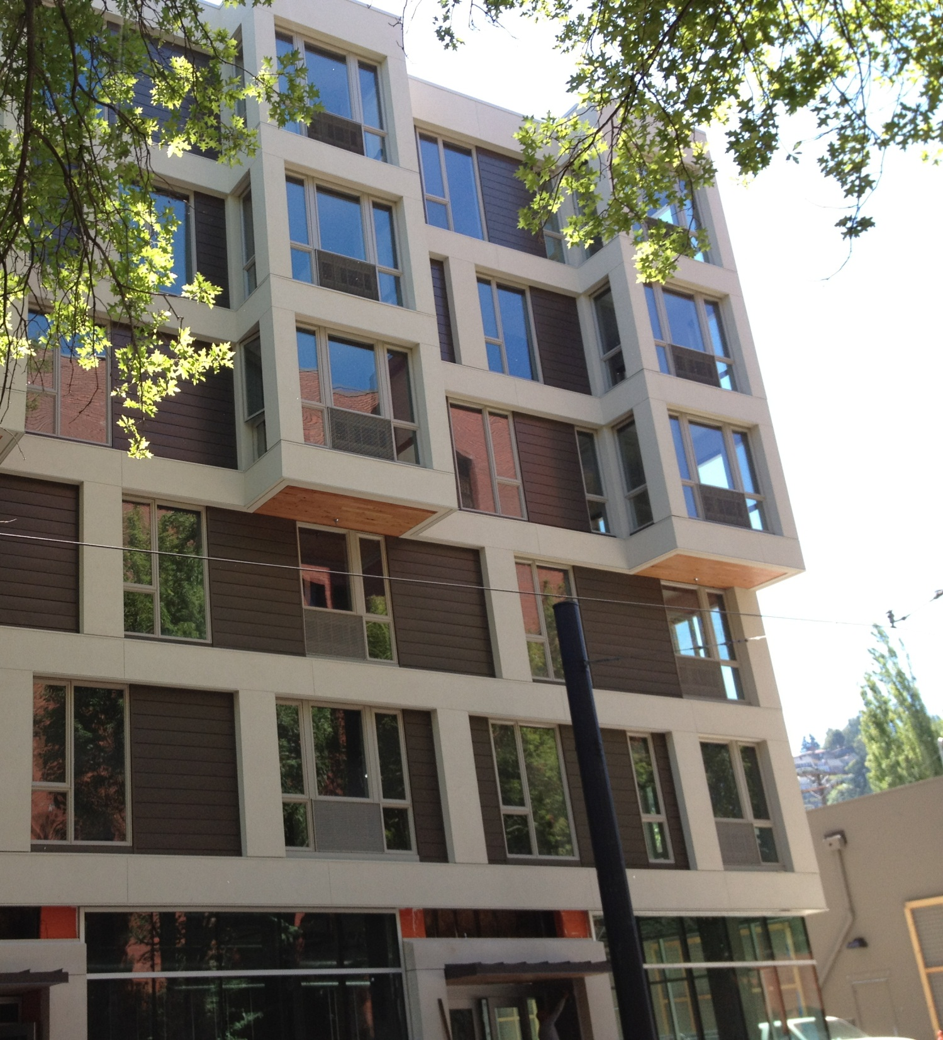
Local Design Precedent
Visually appealing
Large Windows
Facade Depth
Organized Chaos
Ground Floor Transparency

Slide 19
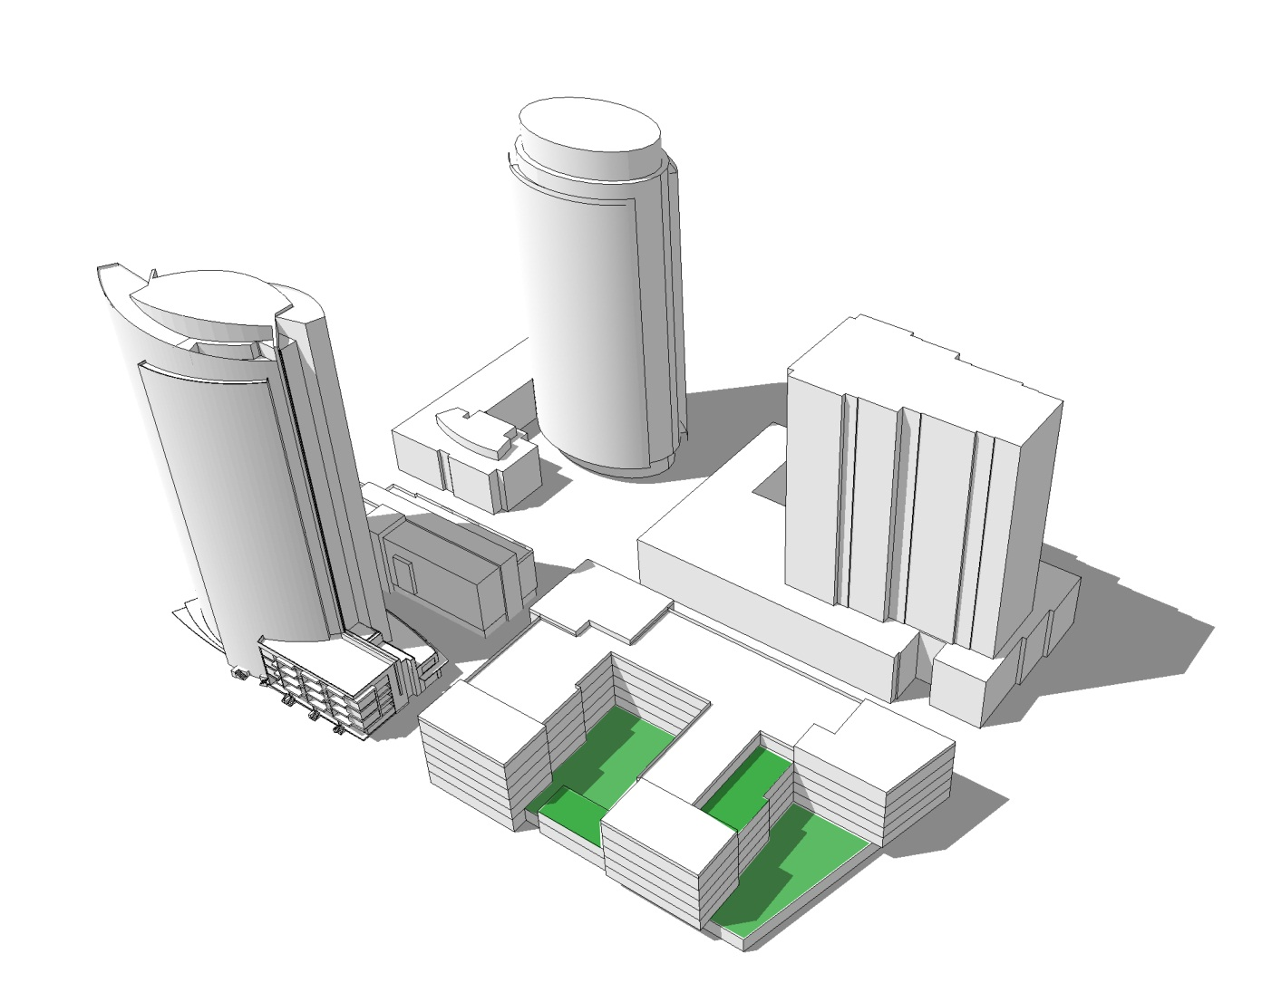
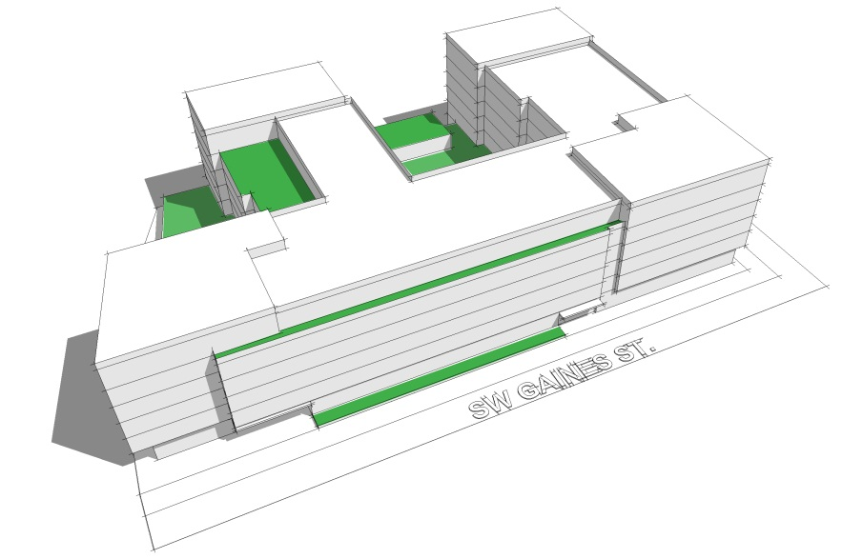
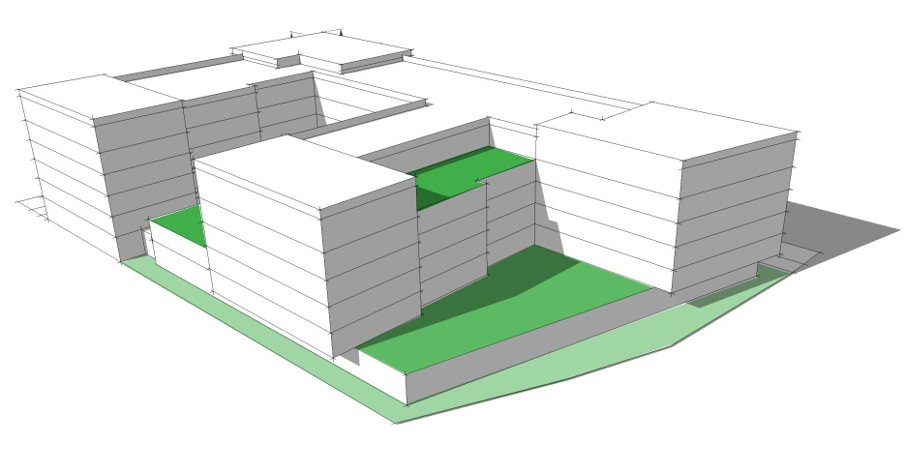
Massing Model
ROCK GARDEN
CITY
RIVER

Slide 20
Diagrams

Slide 21
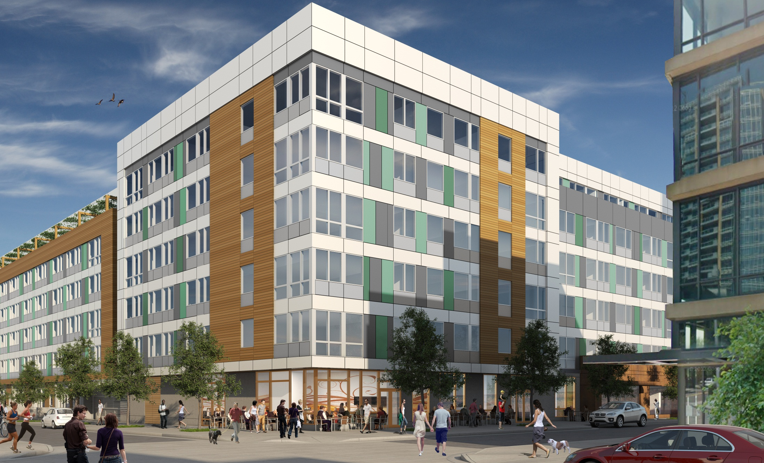
SOWA Neighborhood Presentation

Slide 22
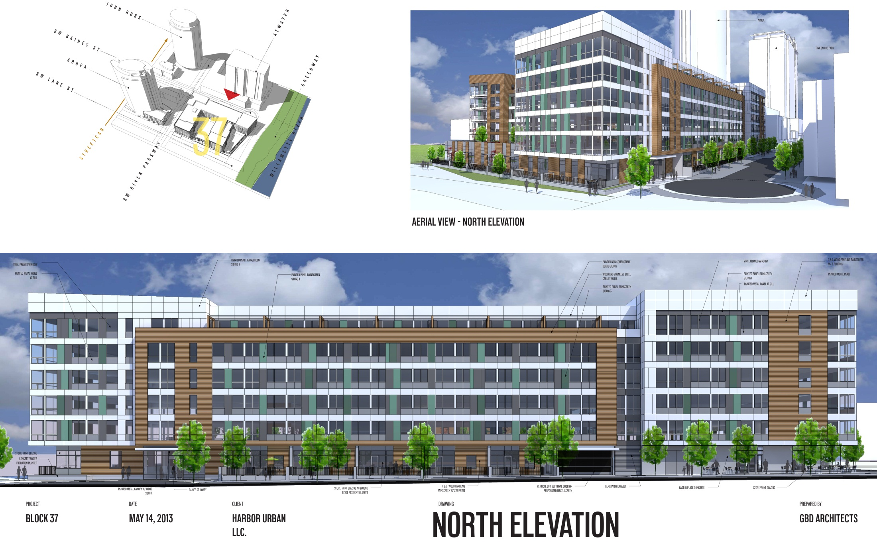
Elevations

Slide 23
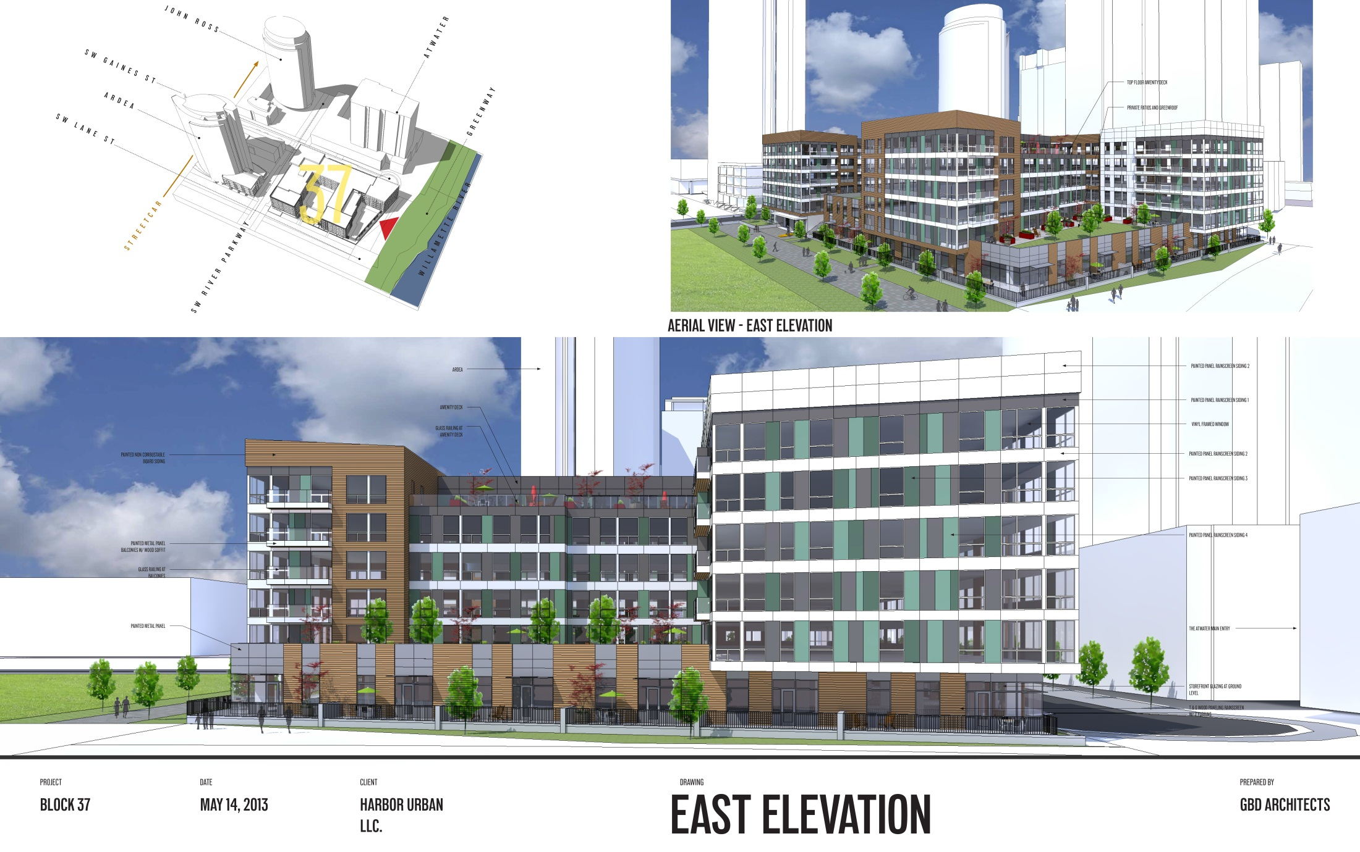
Elevations

Slide 24
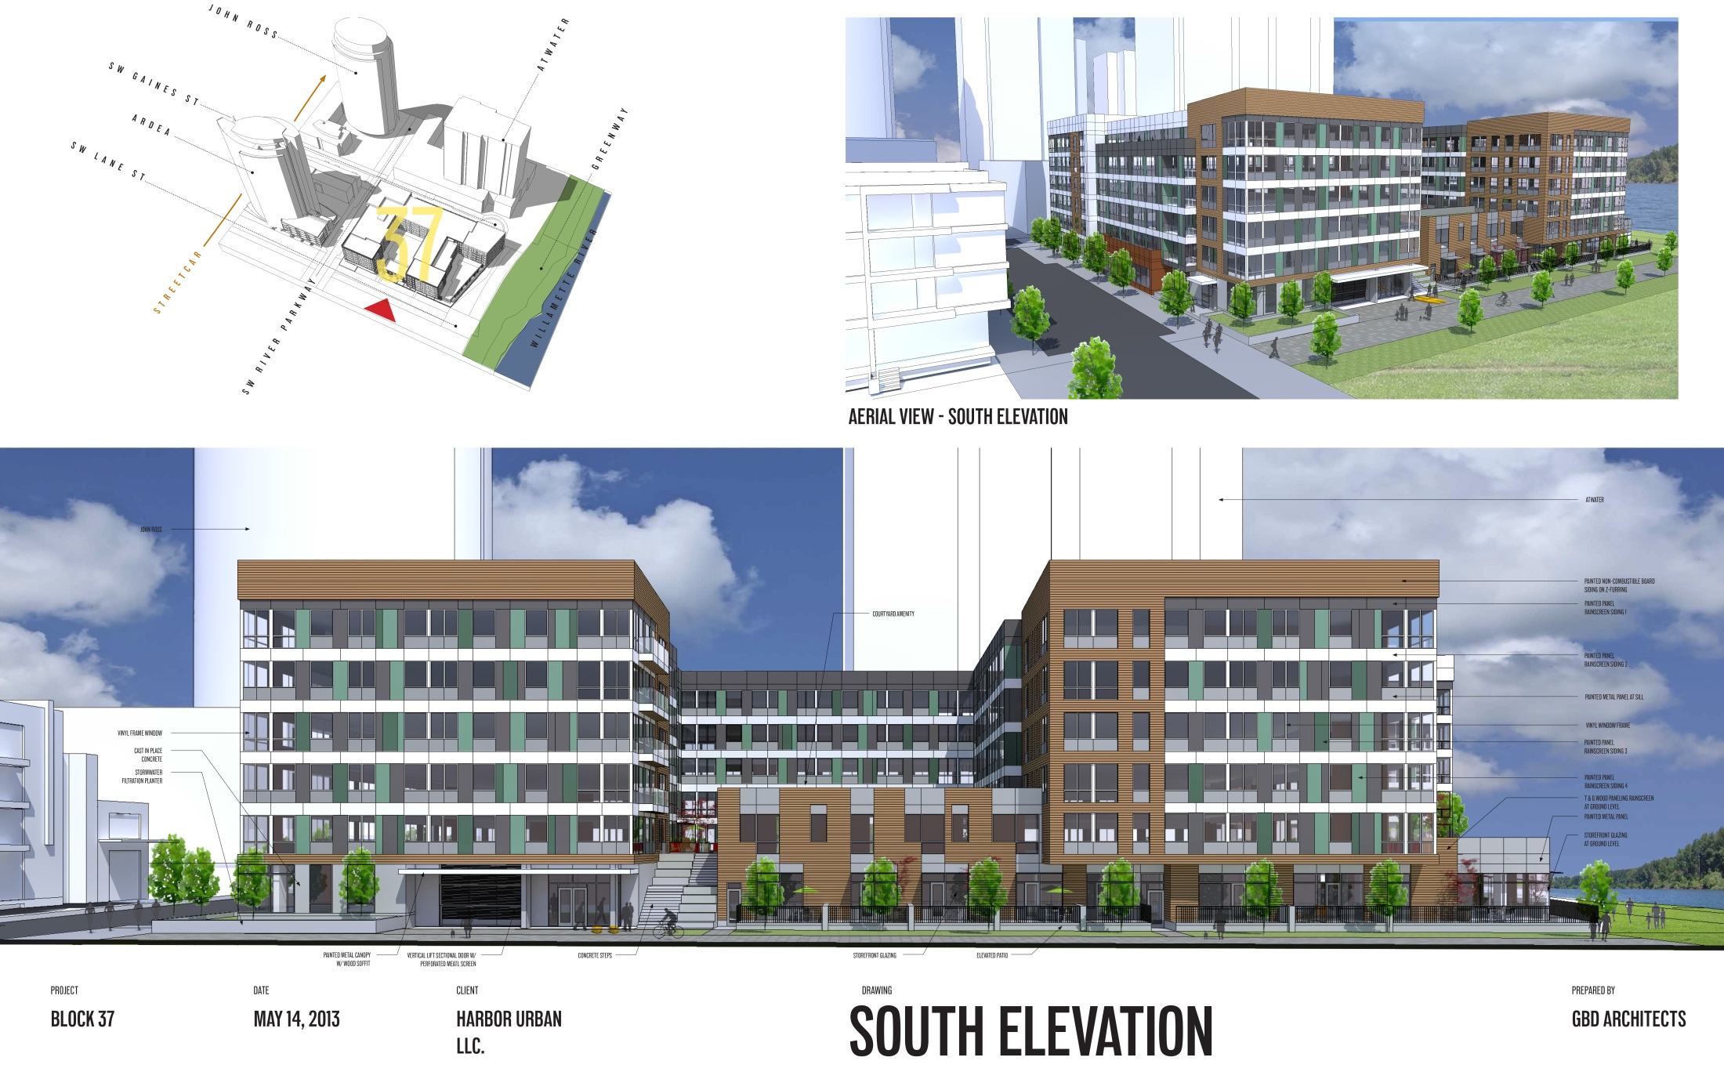
Elevations

Slide 25
Elevations

Slide 26
Modification Requests
Setback on SW Gaines St.

Slide 27
Special building height corridors and tower orientation.
Purpose. Special building heights along designated east-west corridors and tower orientation standards provide visual access to the Greenway from points west of the district, provide visual access to the Tualatin Hills from points east of the district, provide access to sunlight along designated streets, and encourage an urban form that is visually permeable and varied.
2. Special building heights. The portion of a building that is within 50 feet of the centerline of a street or accessway designated as a special building height corridor may be no more than 50 feet in height.

Slide 28
Setback On SW Gaines St.

Slide 29
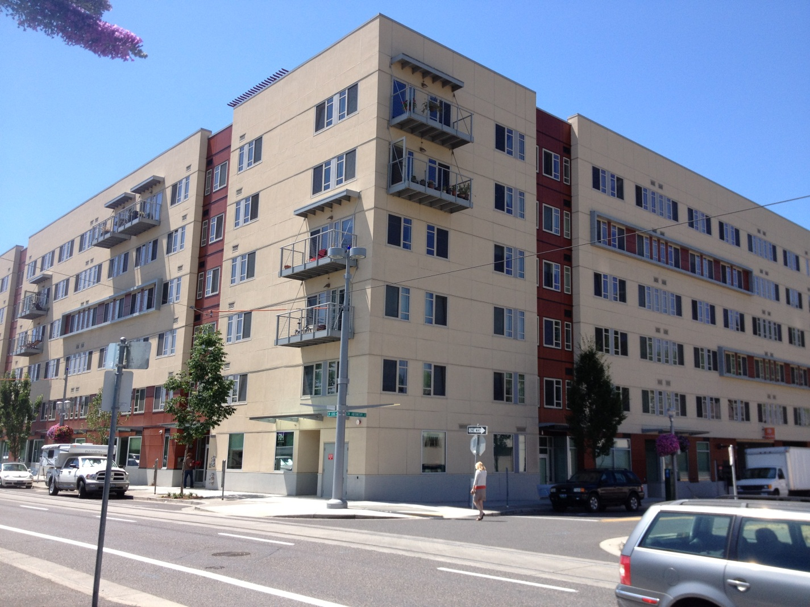
Setback On SW Gaines St.

Slide 30
Setback On SW Gaines St.

Slide 31
Setback On SW Gaines St.

Slide 32
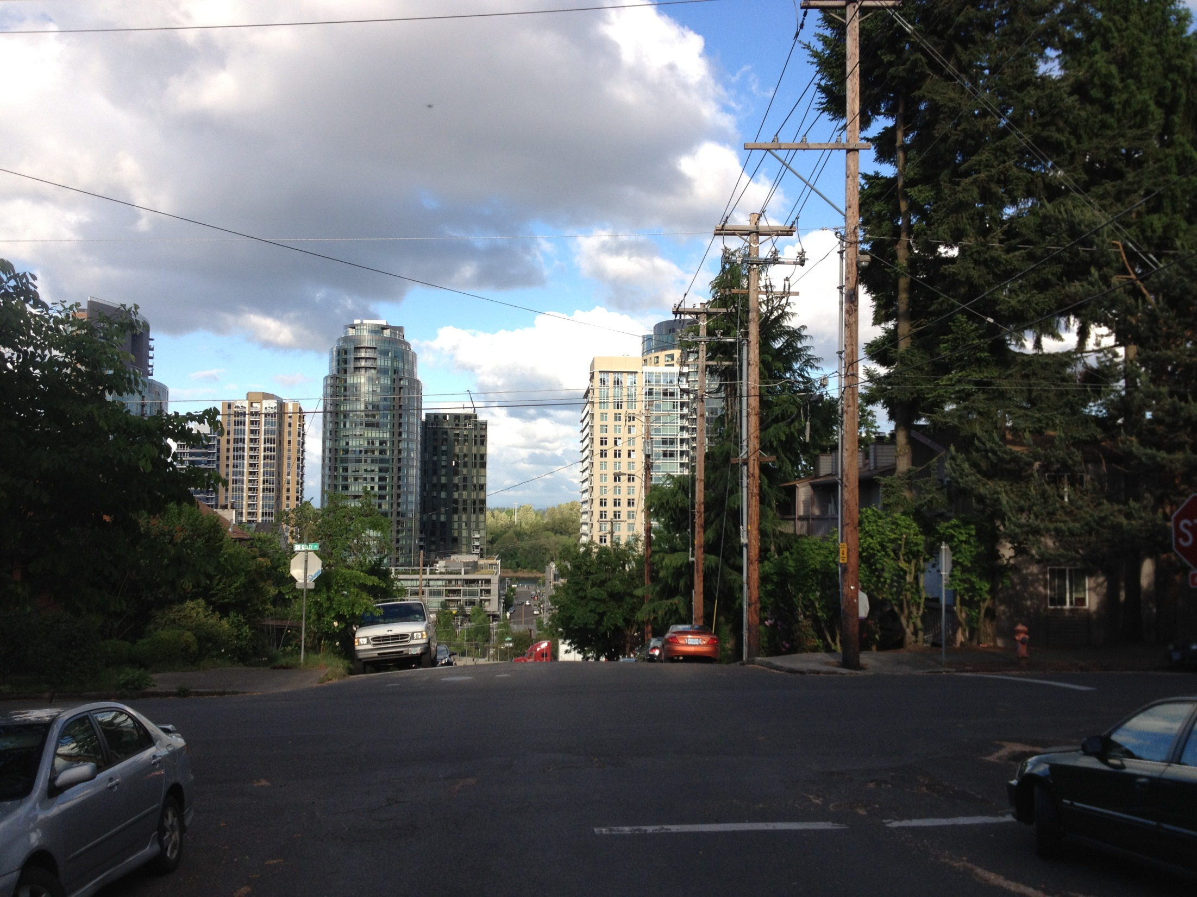
Setback On SW Gaines St.

Slide 33
Setback On SW Gaines St.

Slide 34
Modification Requests
Setback on SW Gaines St.
Setback on SW Lane St.
Loading on SW Lane St.

Slide 35
B. Accessways
1. Purpose. Accessways provide physical access and connections to the
Greenway for neighbors, visitors, and residents of South Waterfront who might otherwise be cut off from the Willamette River and the Greenway trail. Accessways are generally extensions of existing and planned east-west public rights-of-way, and may or may not provide vehicle access. Accessways provide safe and convenient bicycle and pedestrian connections to and from the Greenway trail. Accessways contribute to stormwater management in the subdistrict. They also provide a visual connection to the South Waterfront Greenway Area and provide a transition from the natural emphasis of the South Waterfront Greenway Area to the urban emphasis of the rest of the
district.
3. Setback. If the accessway is 60 feet wide or less, buildings must be set back at least 30 feet from the centerline of the accessway. If the accessway is wider than 60 feet, the building must meet the building

Slide 36
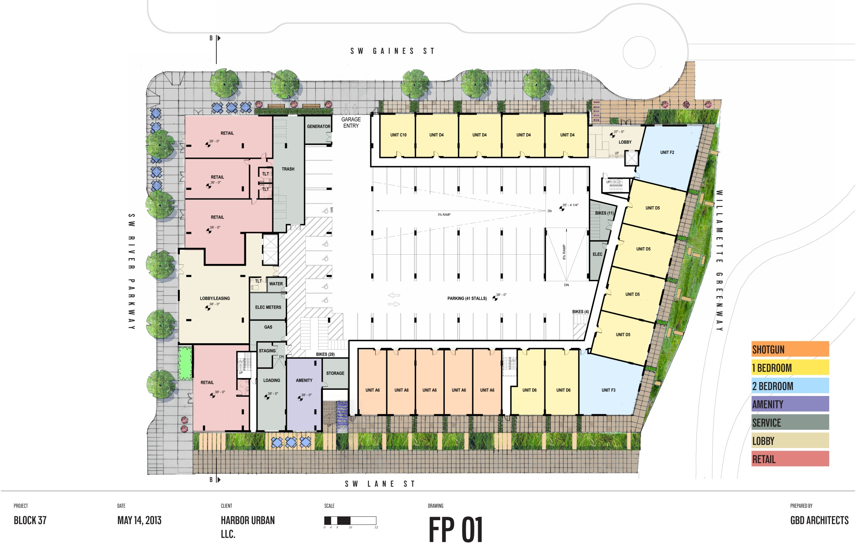
Setback On SW Lane St.
AMENITY DECK
5’-0” Setback
5’-0” Setback
LOADING ACCESS

Slide 37
Elevations

Slide 38
Q&A

