Slide 1
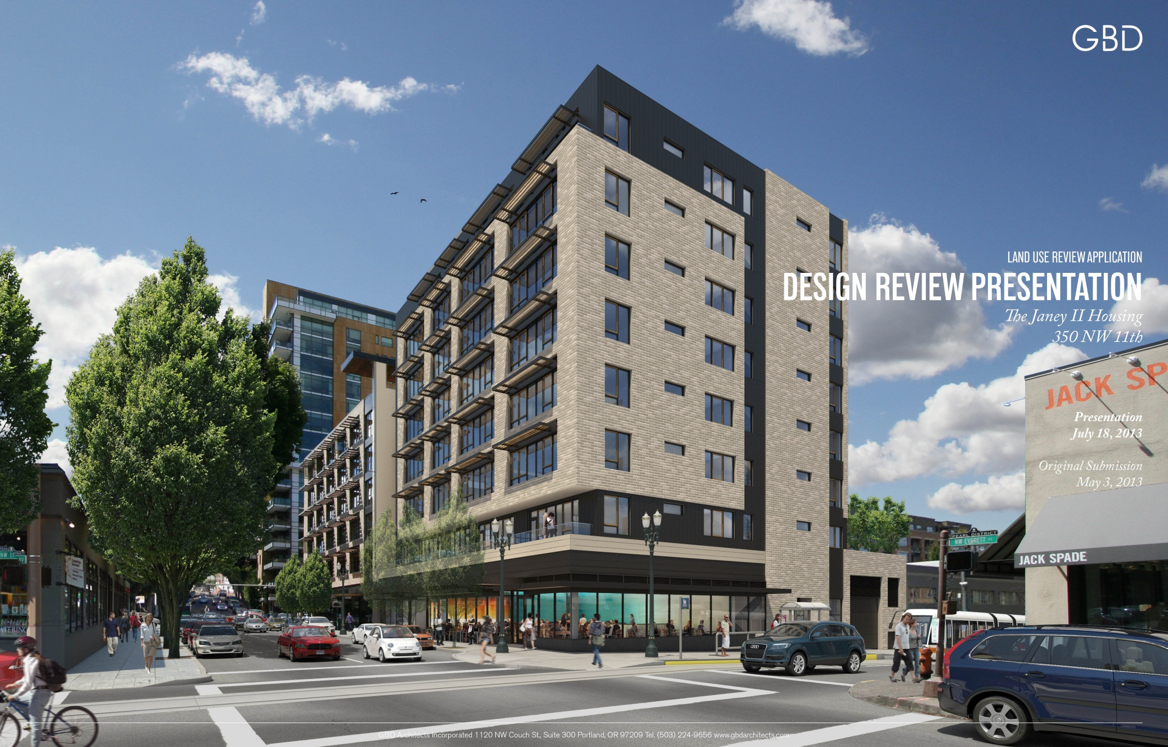

Slide 2
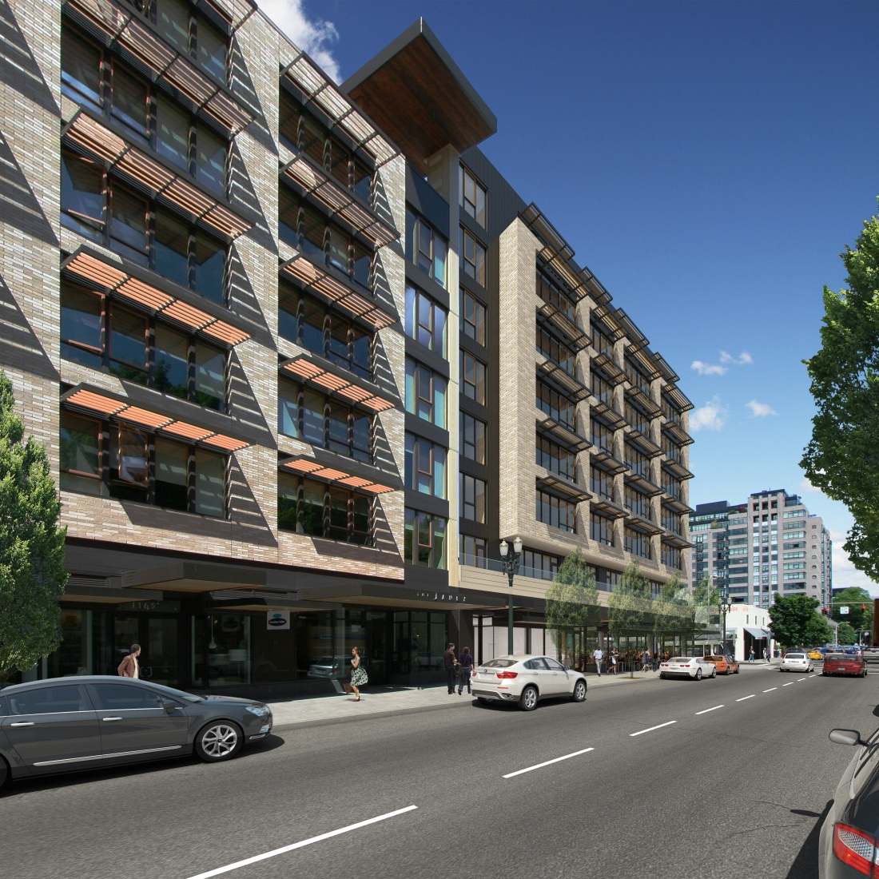
DESIGN REVIEW HEARING SUMMARY
Project Overview
Design Evolution
Design Solution
Review Requested Modifications and Adjustment
Request Design Commission Approval

Slide 3
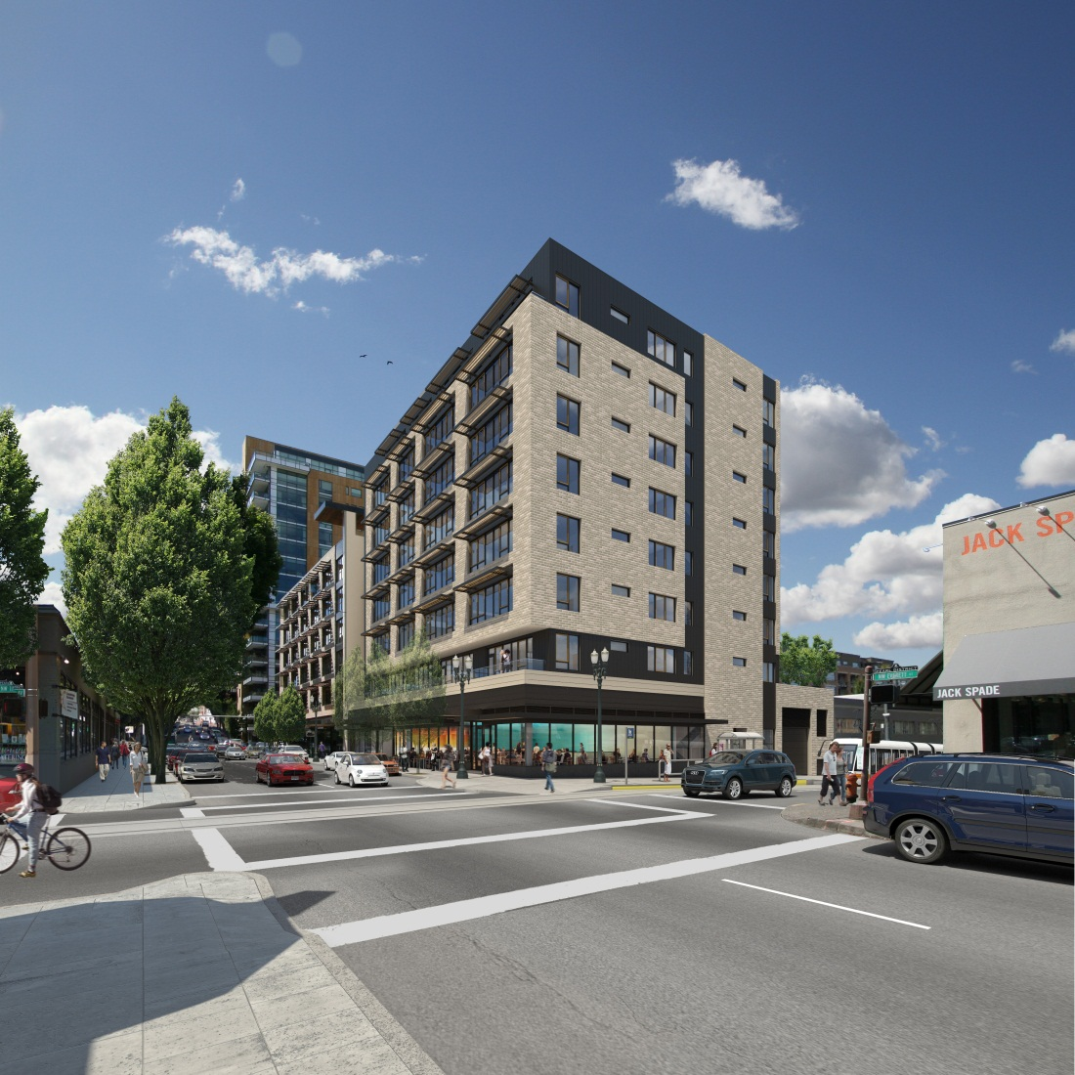
THE JANEY II
PROJECT OVERVIEW
Located in River District of Portland’s Central City on 100’ x 100’ parcel.
Existing building on site constructed in 1906.
Removal of existing building will be replaced with 8 story building: 7 stories of market rate apartments and ground level retail and parking stalls.
Ground floor: 2,300 sf retail, 43 structured parking stalls (40 of them in mechanized parking system).
Seven floors with 62 housing units
Second level contains private terraces with eco-roof to the north and terraces to the south.
Rooftop amenity room and deck of 730 sf.
1

Slide 4
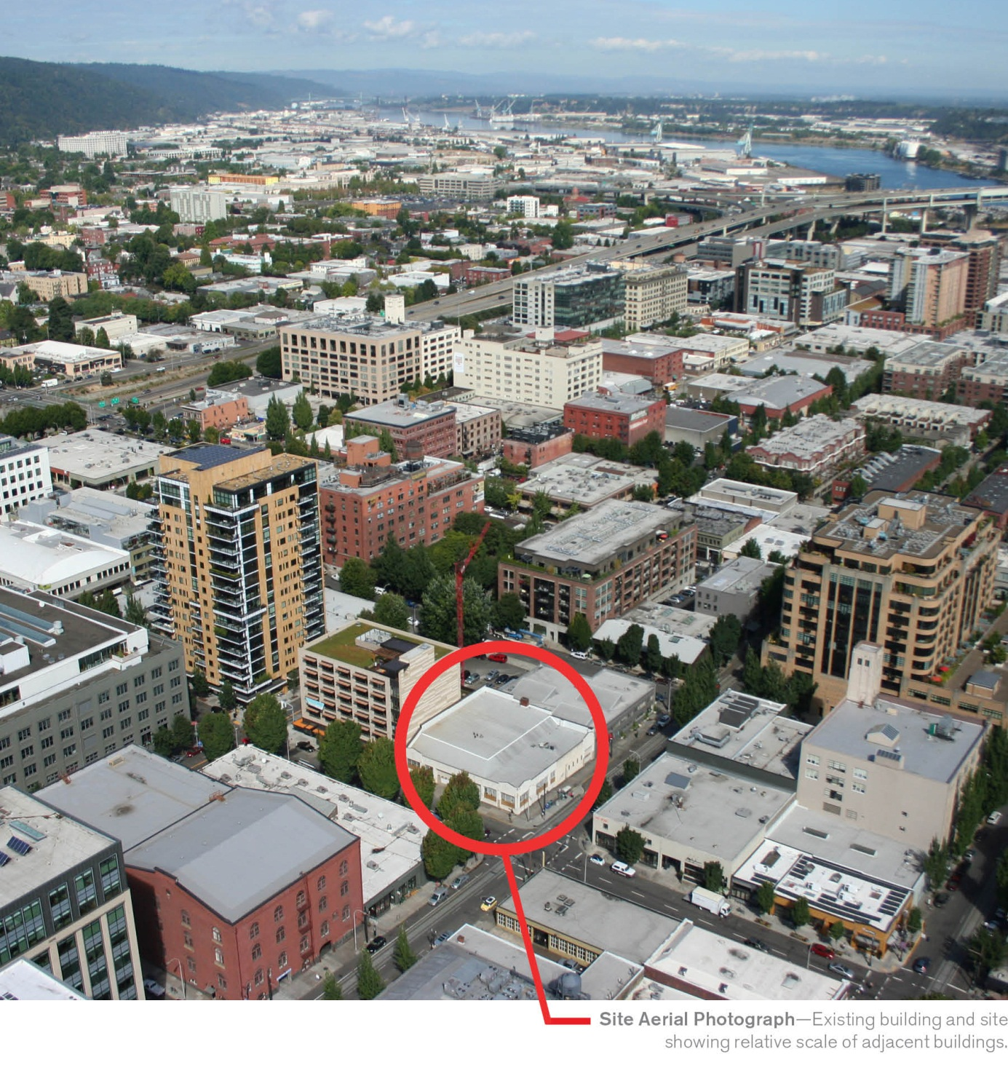

Slide 5
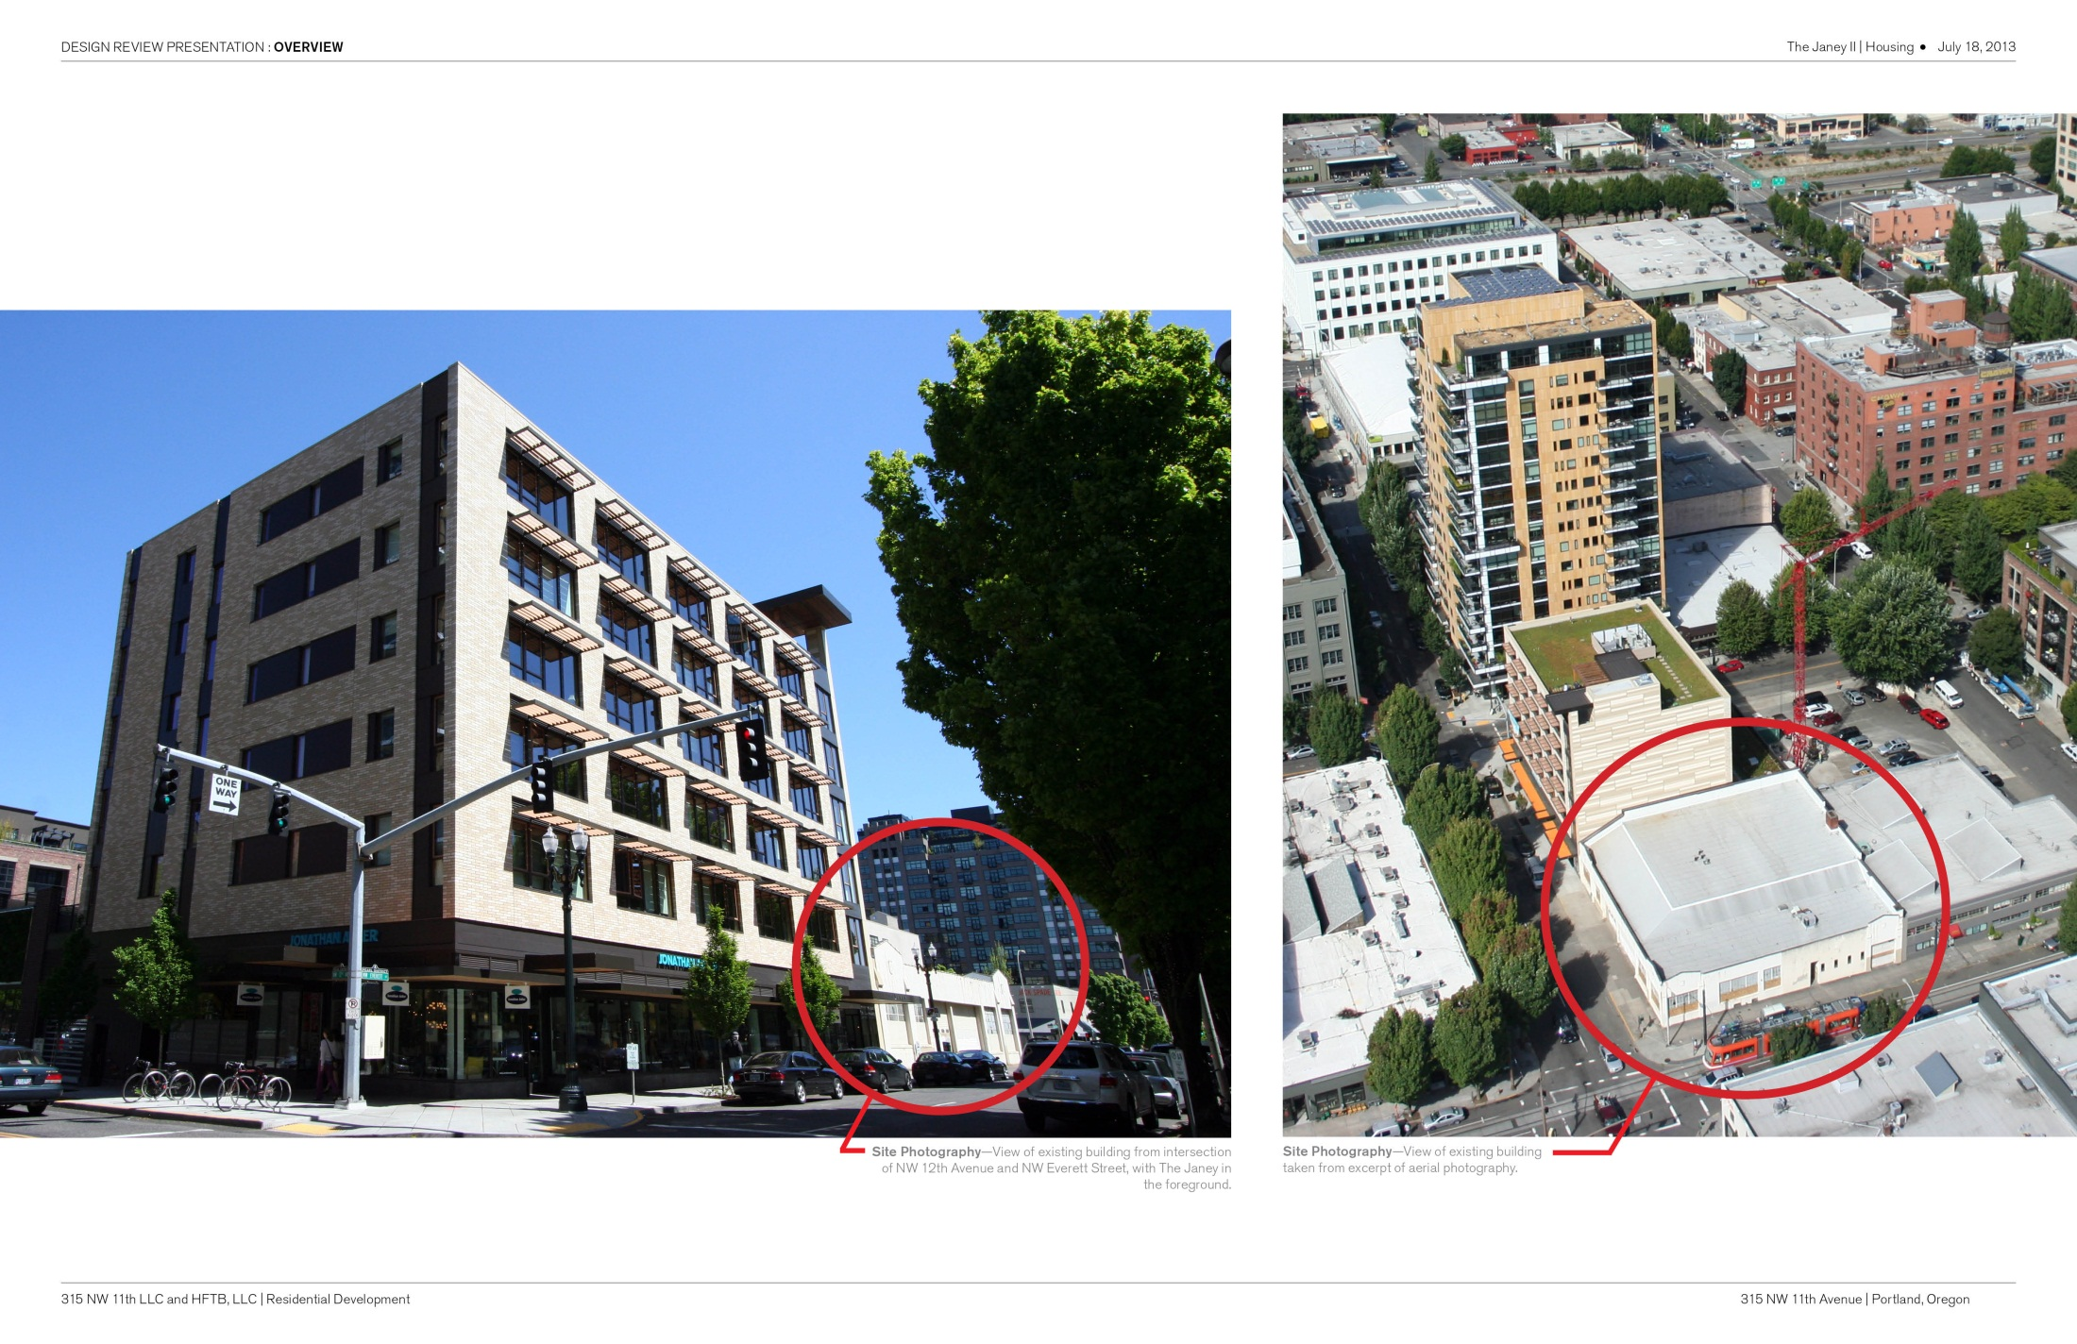

Slide 6
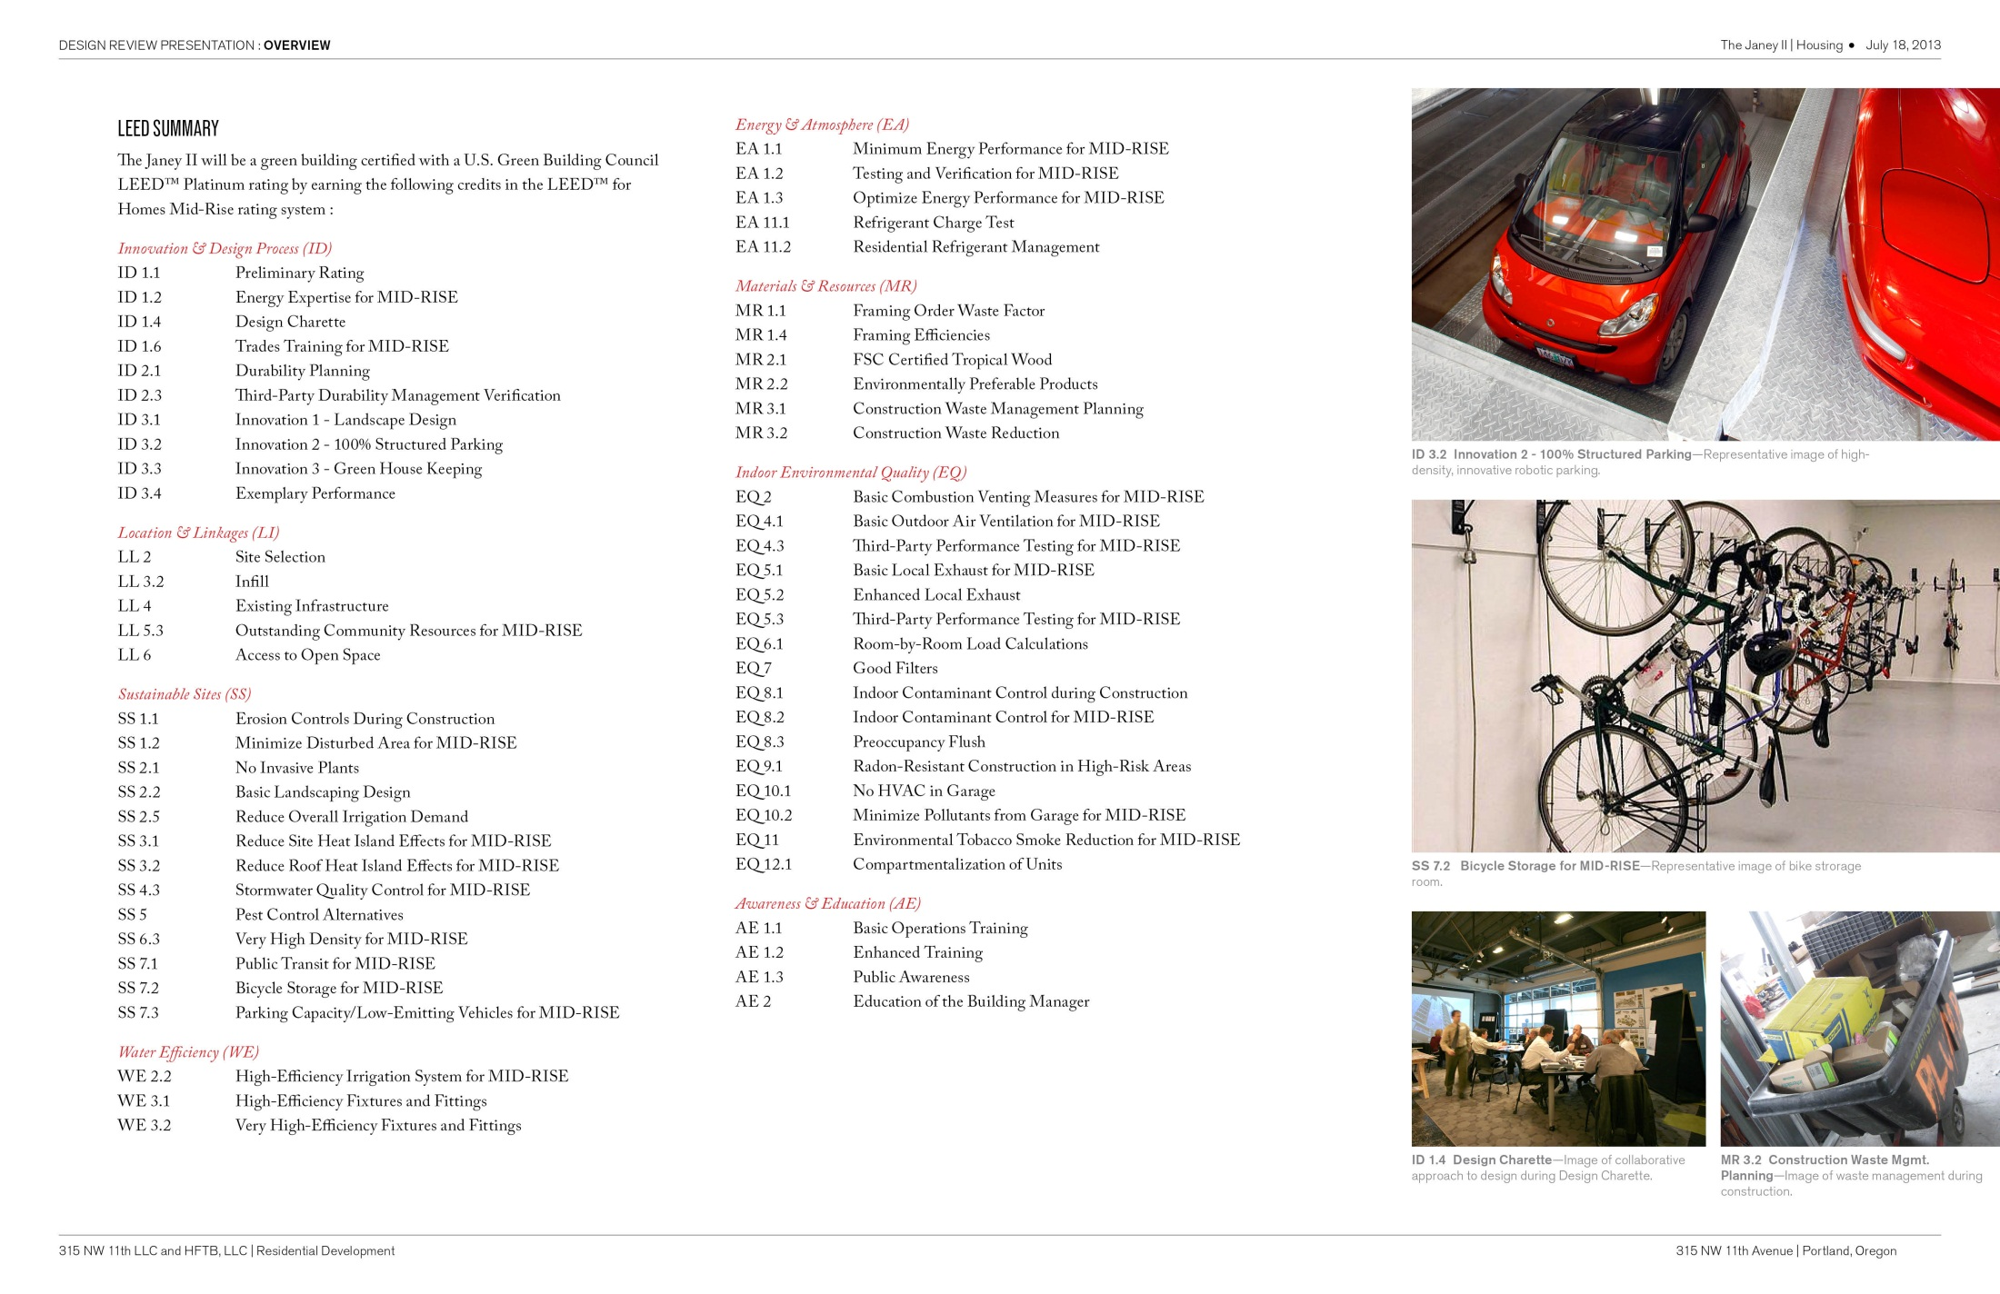
PURSUING LEED PLATINUM

Slide 7
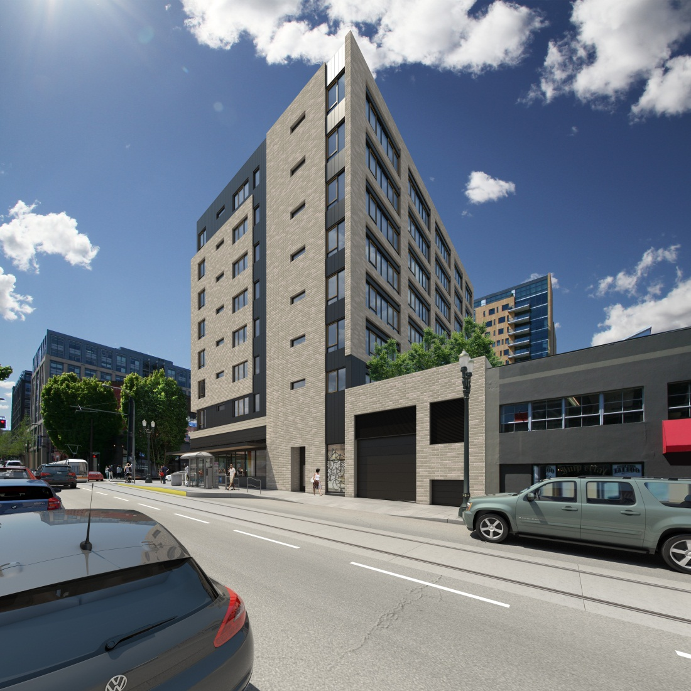
THE JANEY II
DESIGN EVOLUTION
THIS PROPOSAL TAKES CUES FROM:
THE SURROUNDING CHARACTER OF THE PEARL DISTRICT NEIGHBORHOOD
THE FLAVOR OF THE NORTHWEST REGION
…AND MORE IMPORTANTLY…
2

Slide 8
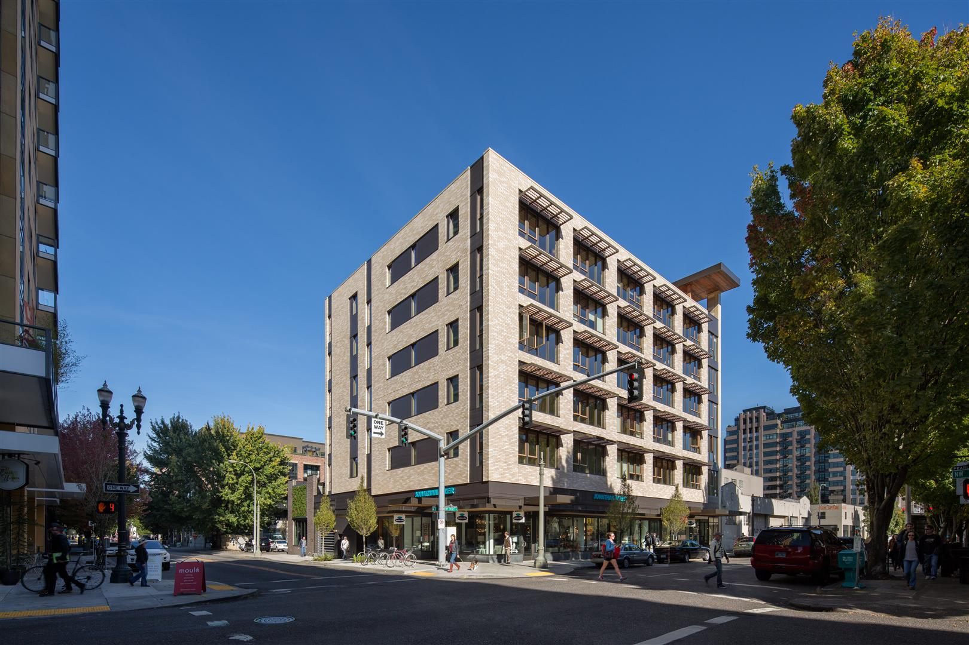
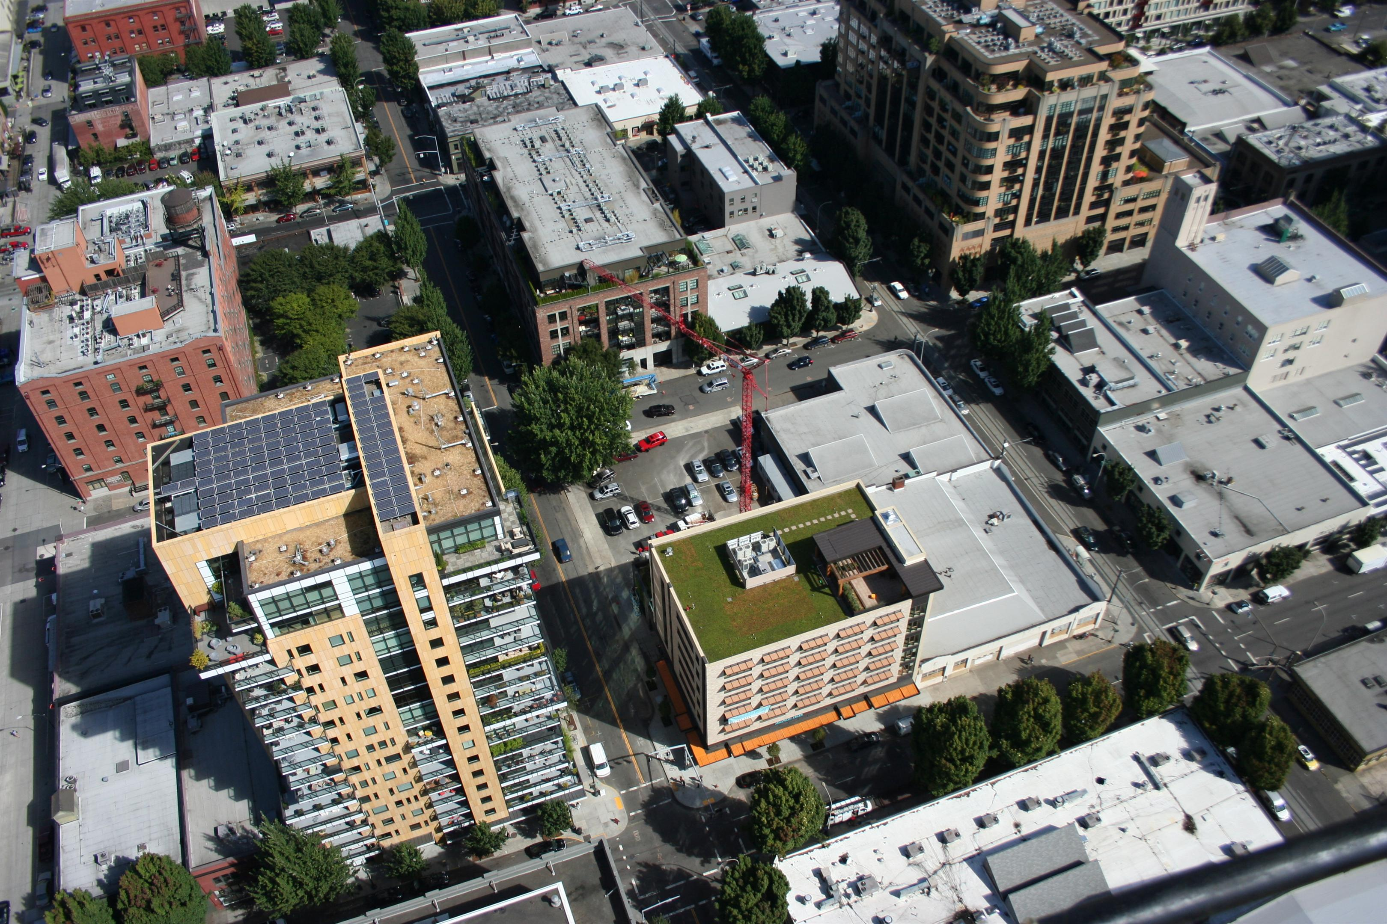
THE JANEY
THE JANEY II
SITE
UNDER ONE OWNERSHIP

Slide 9
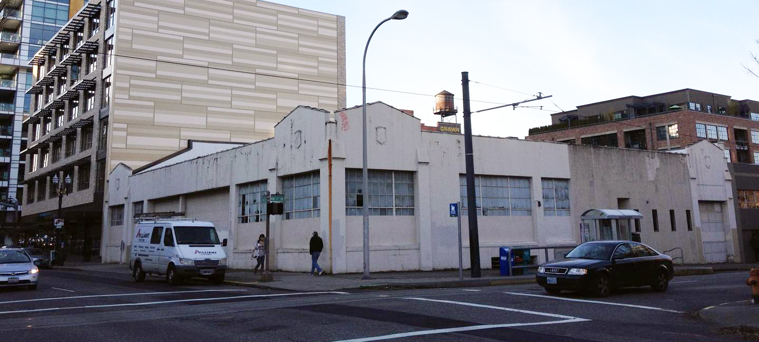
EXISTING CURB CUT AND OVERHEAD DOOR FOR UNDEGROUND PARKING
THE JANEY II
EXISTING SITE CONDITIONS SHAPING THE PROJECT
EXISTING CURB CUTS ALONG EVERETT FOR OVERHEAD DOORS

Slide 10
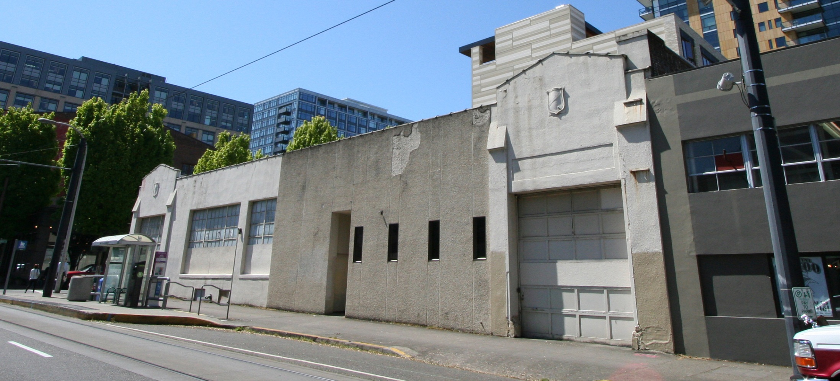
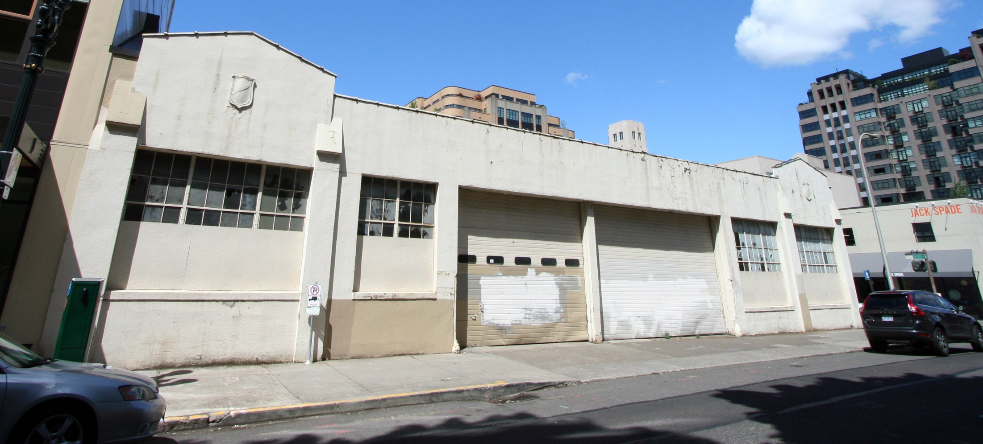
THE JANEY II
EXISTING SITE CONDITIONS SHAPING THE PROJECT
NW 11TH AVENUE
NW EVERETT STREET

Slide 11
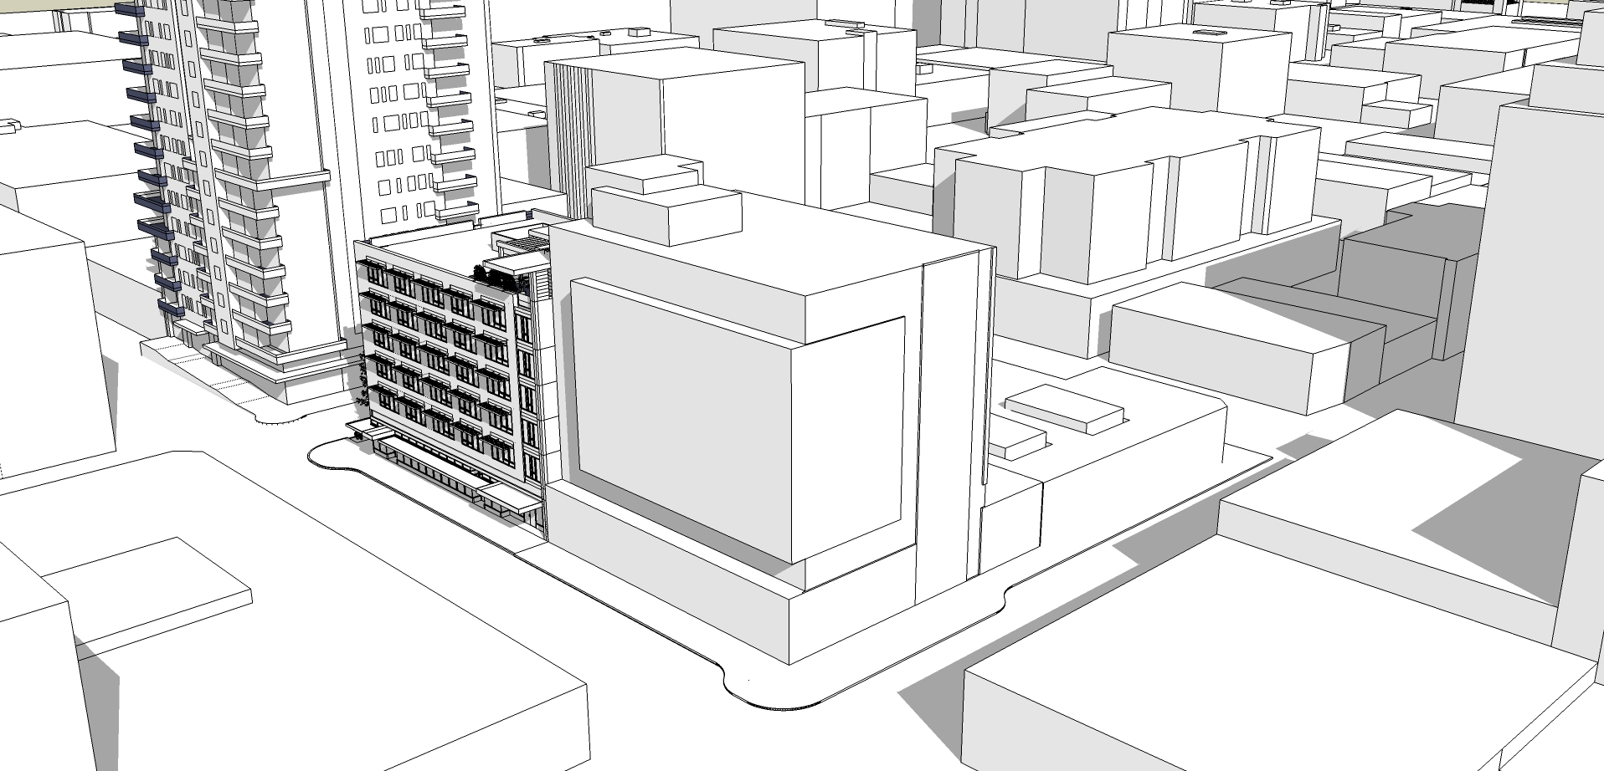
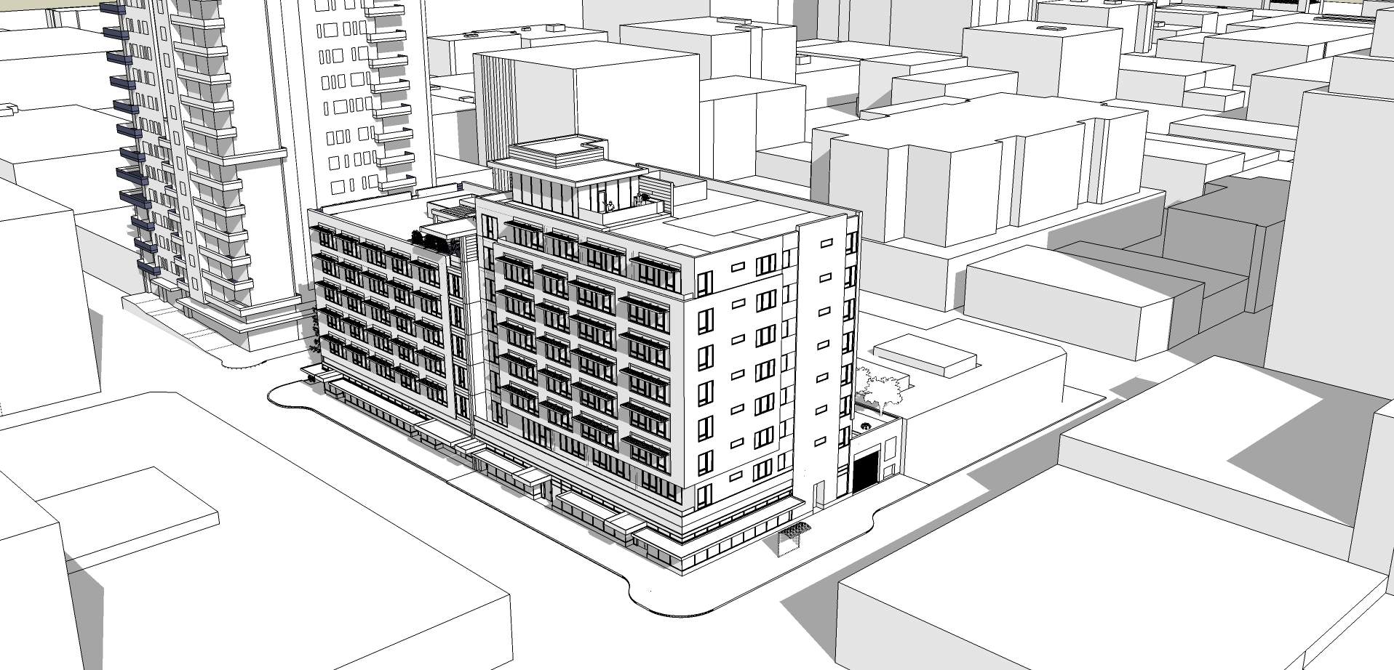
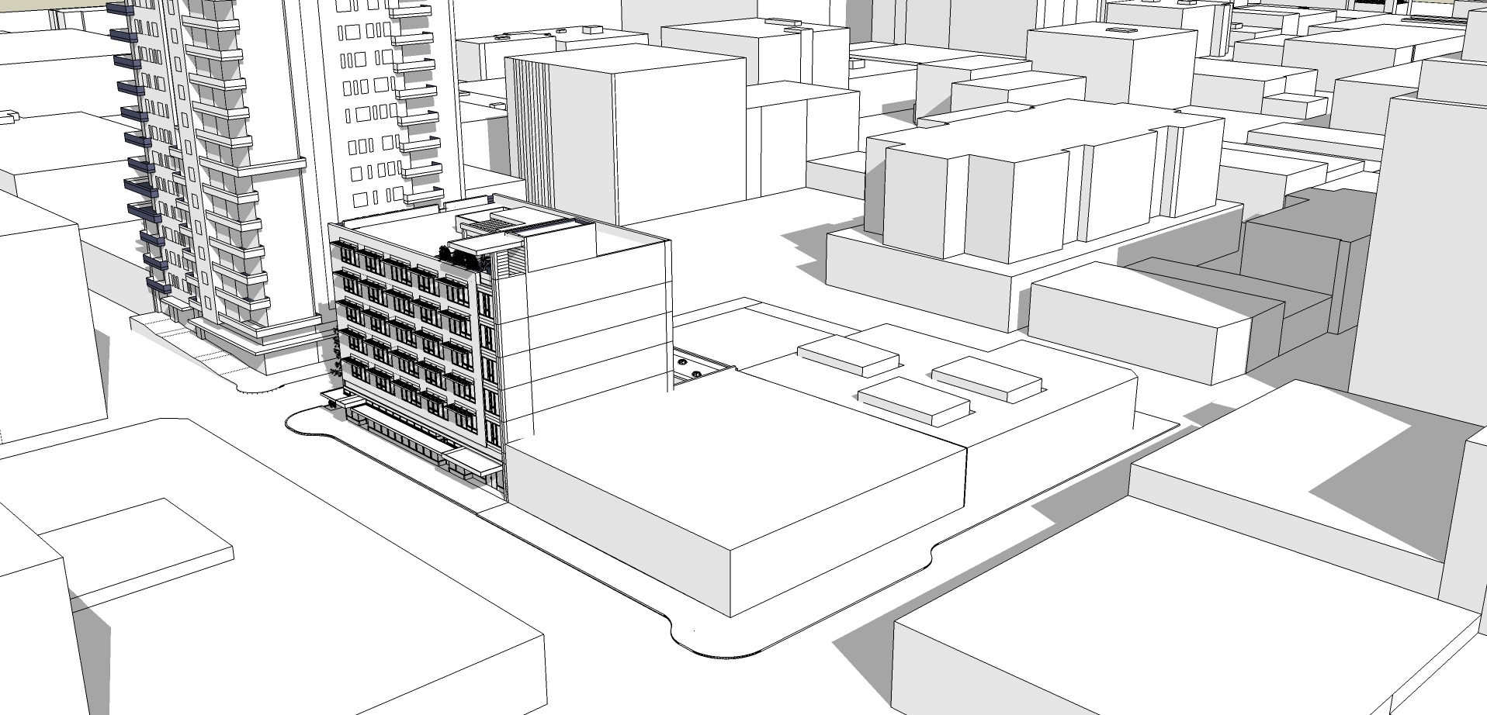
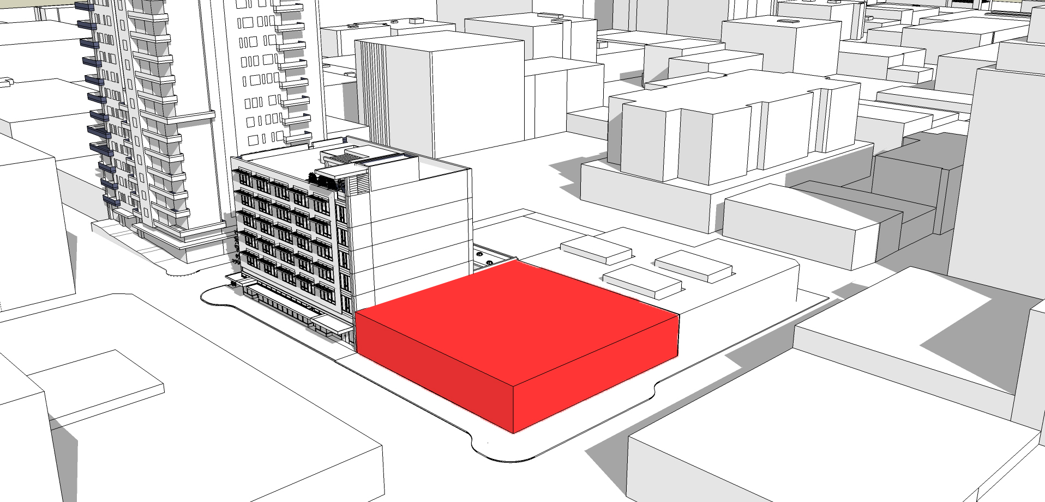
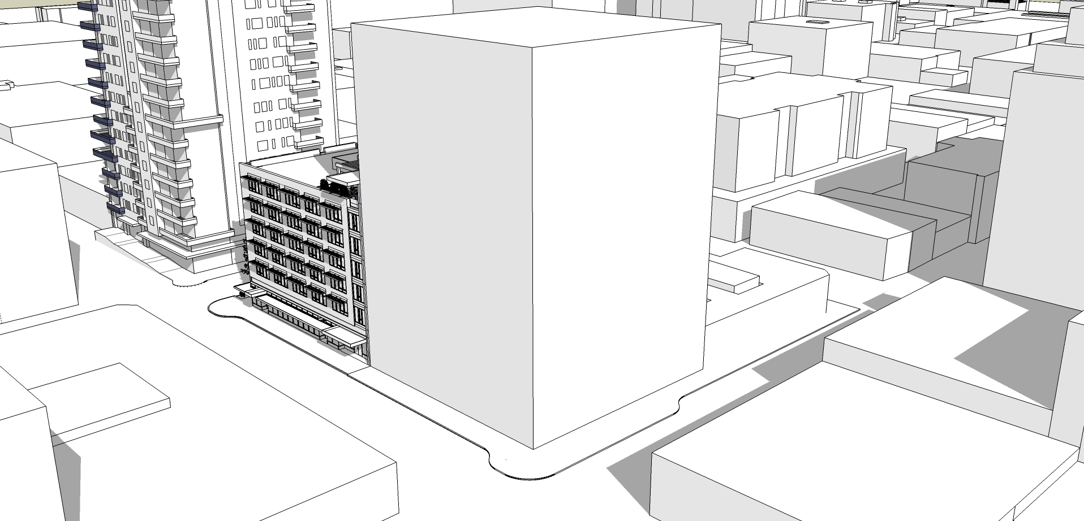
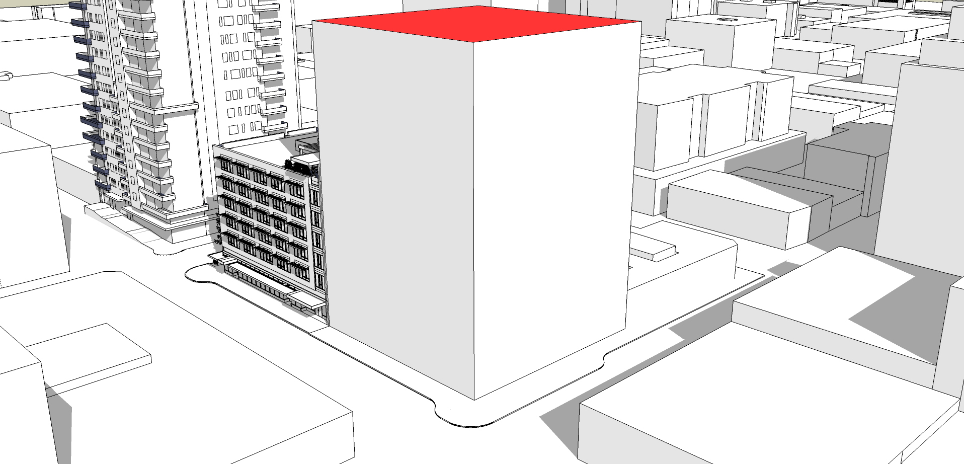
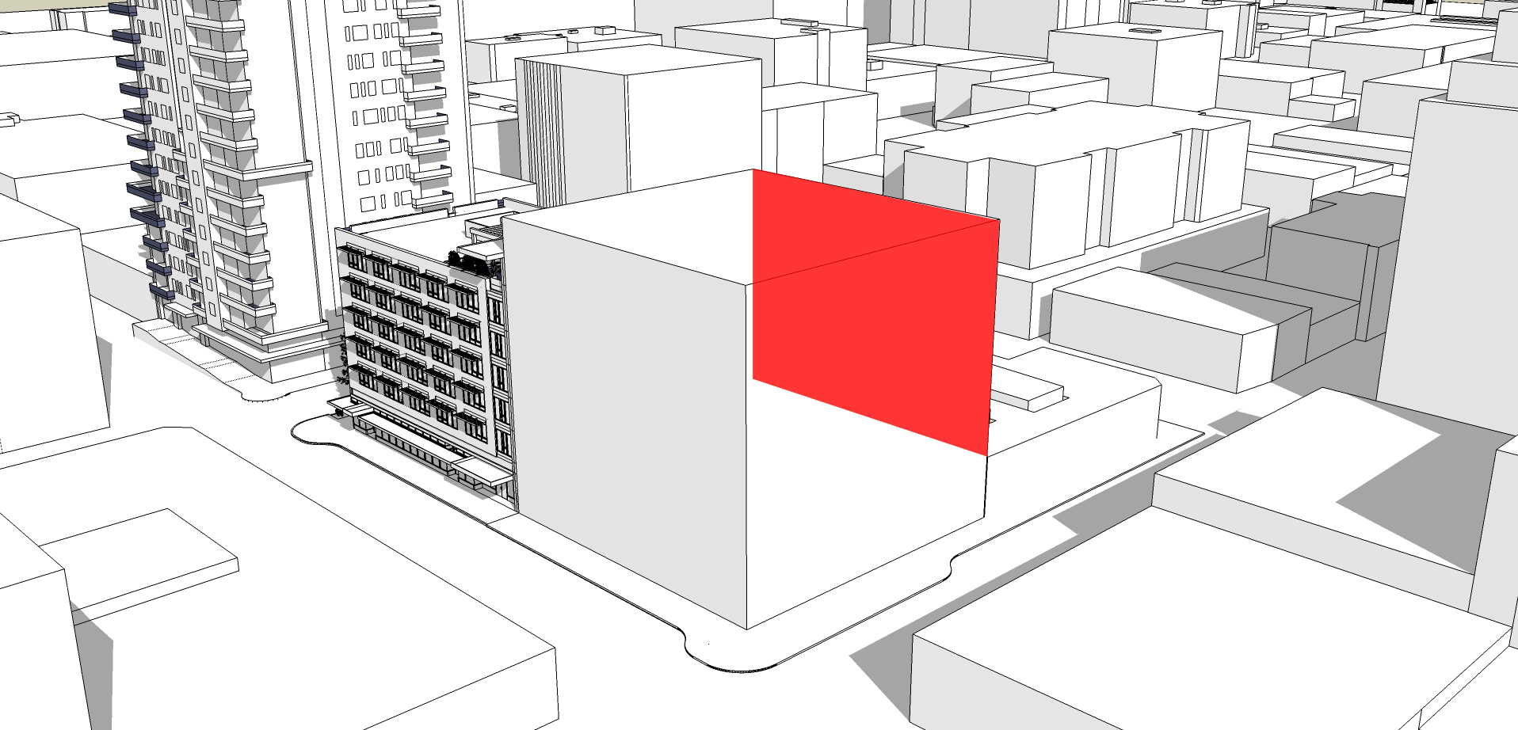
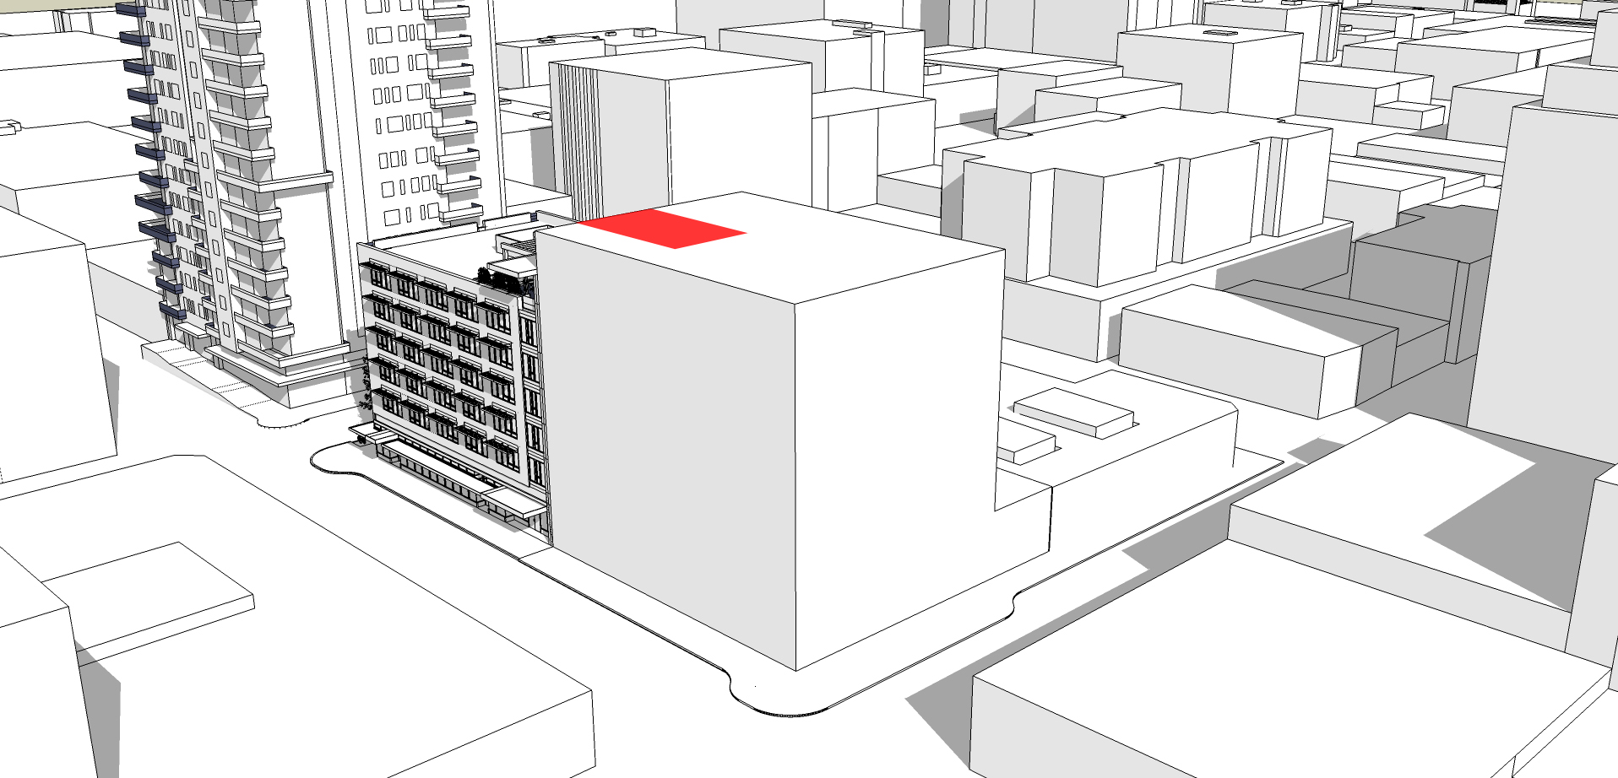
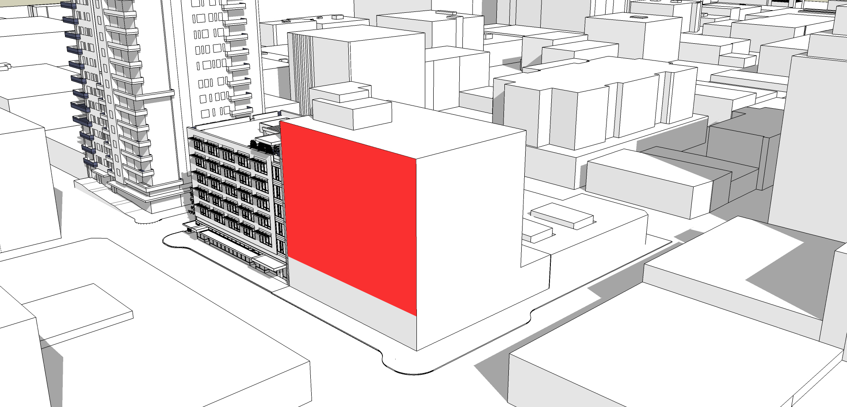
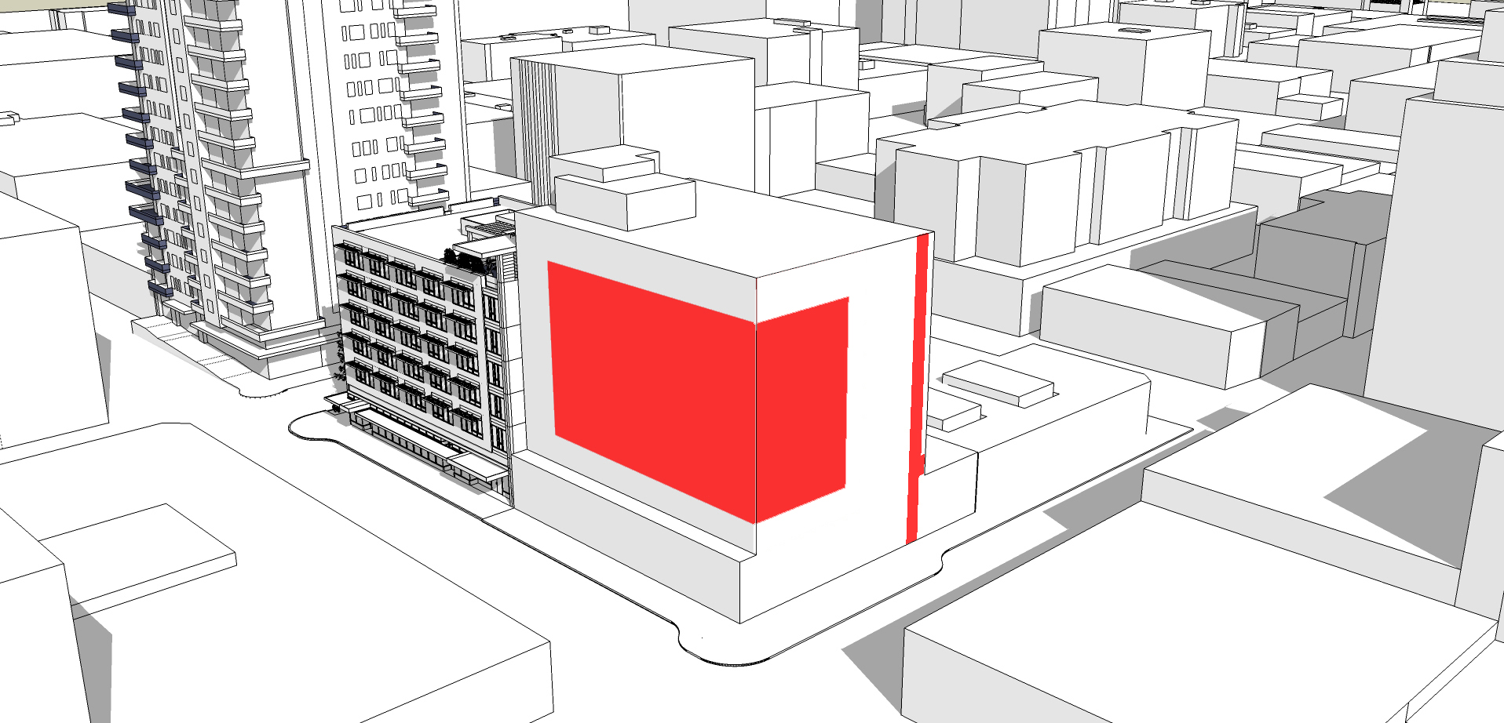

Slide 12
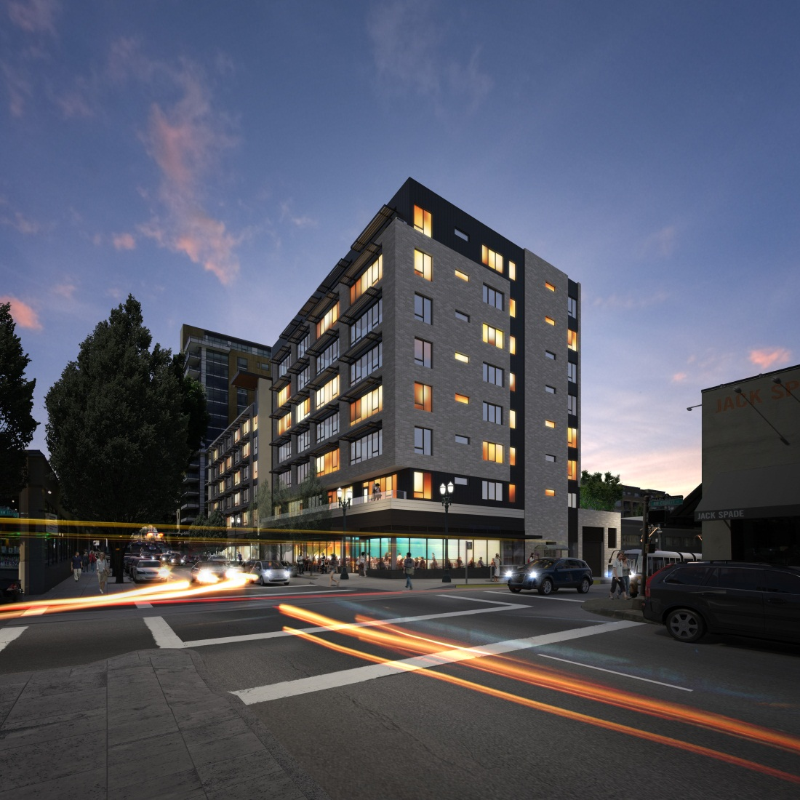
THE JANEY II
DESIGN SOLUTION
3

Slide 13
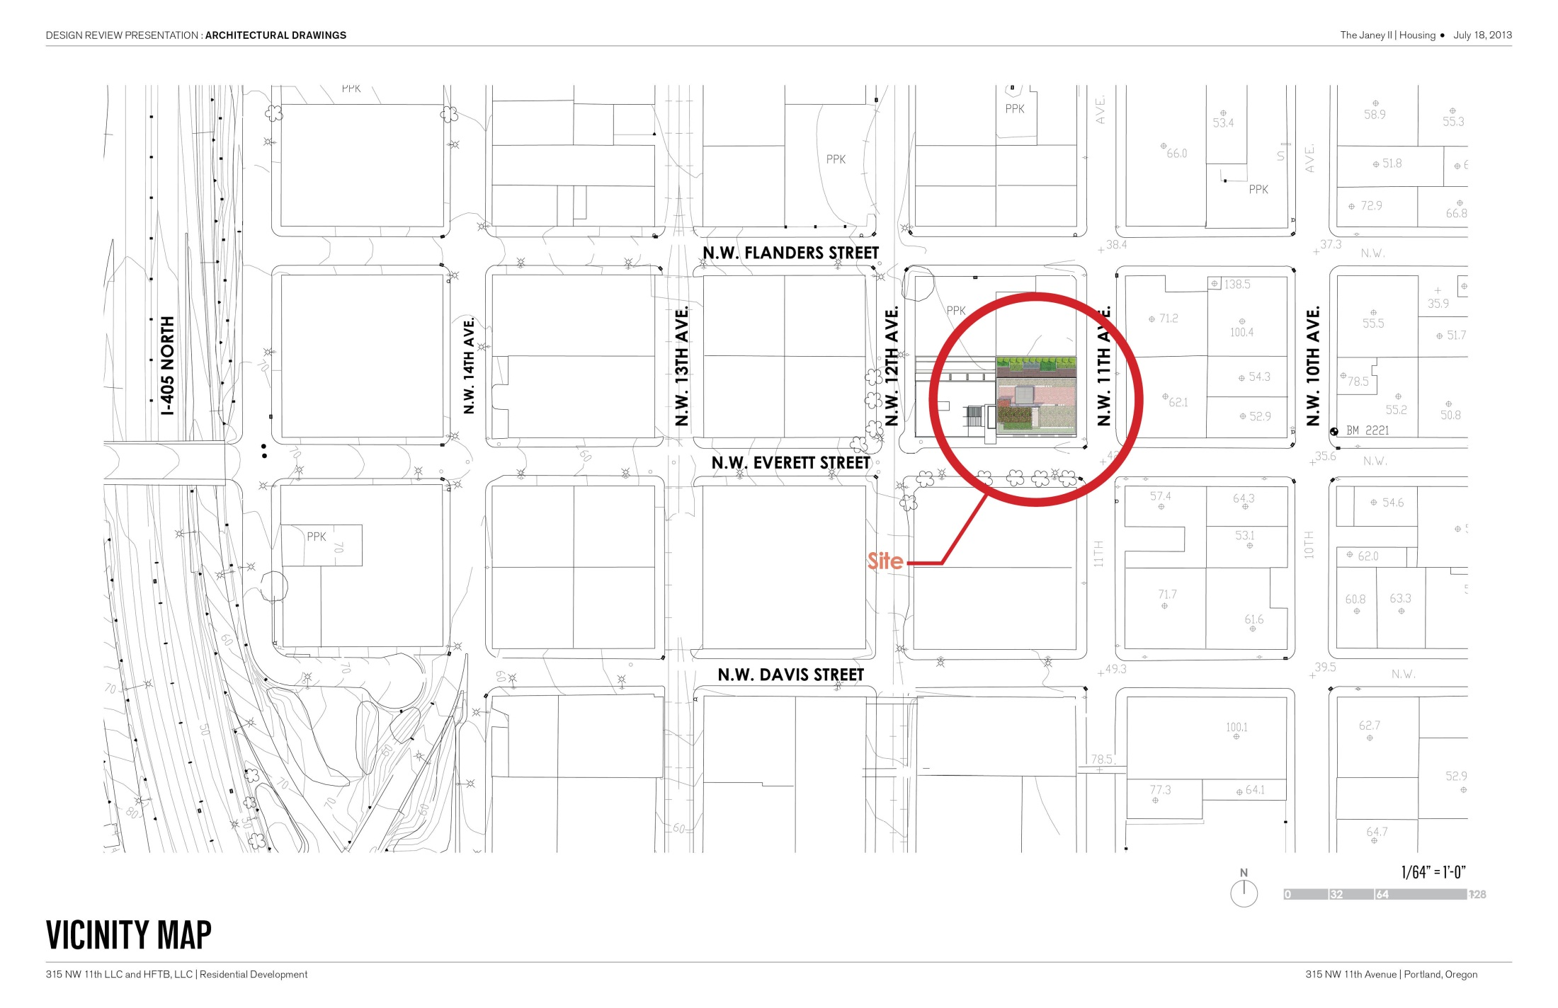
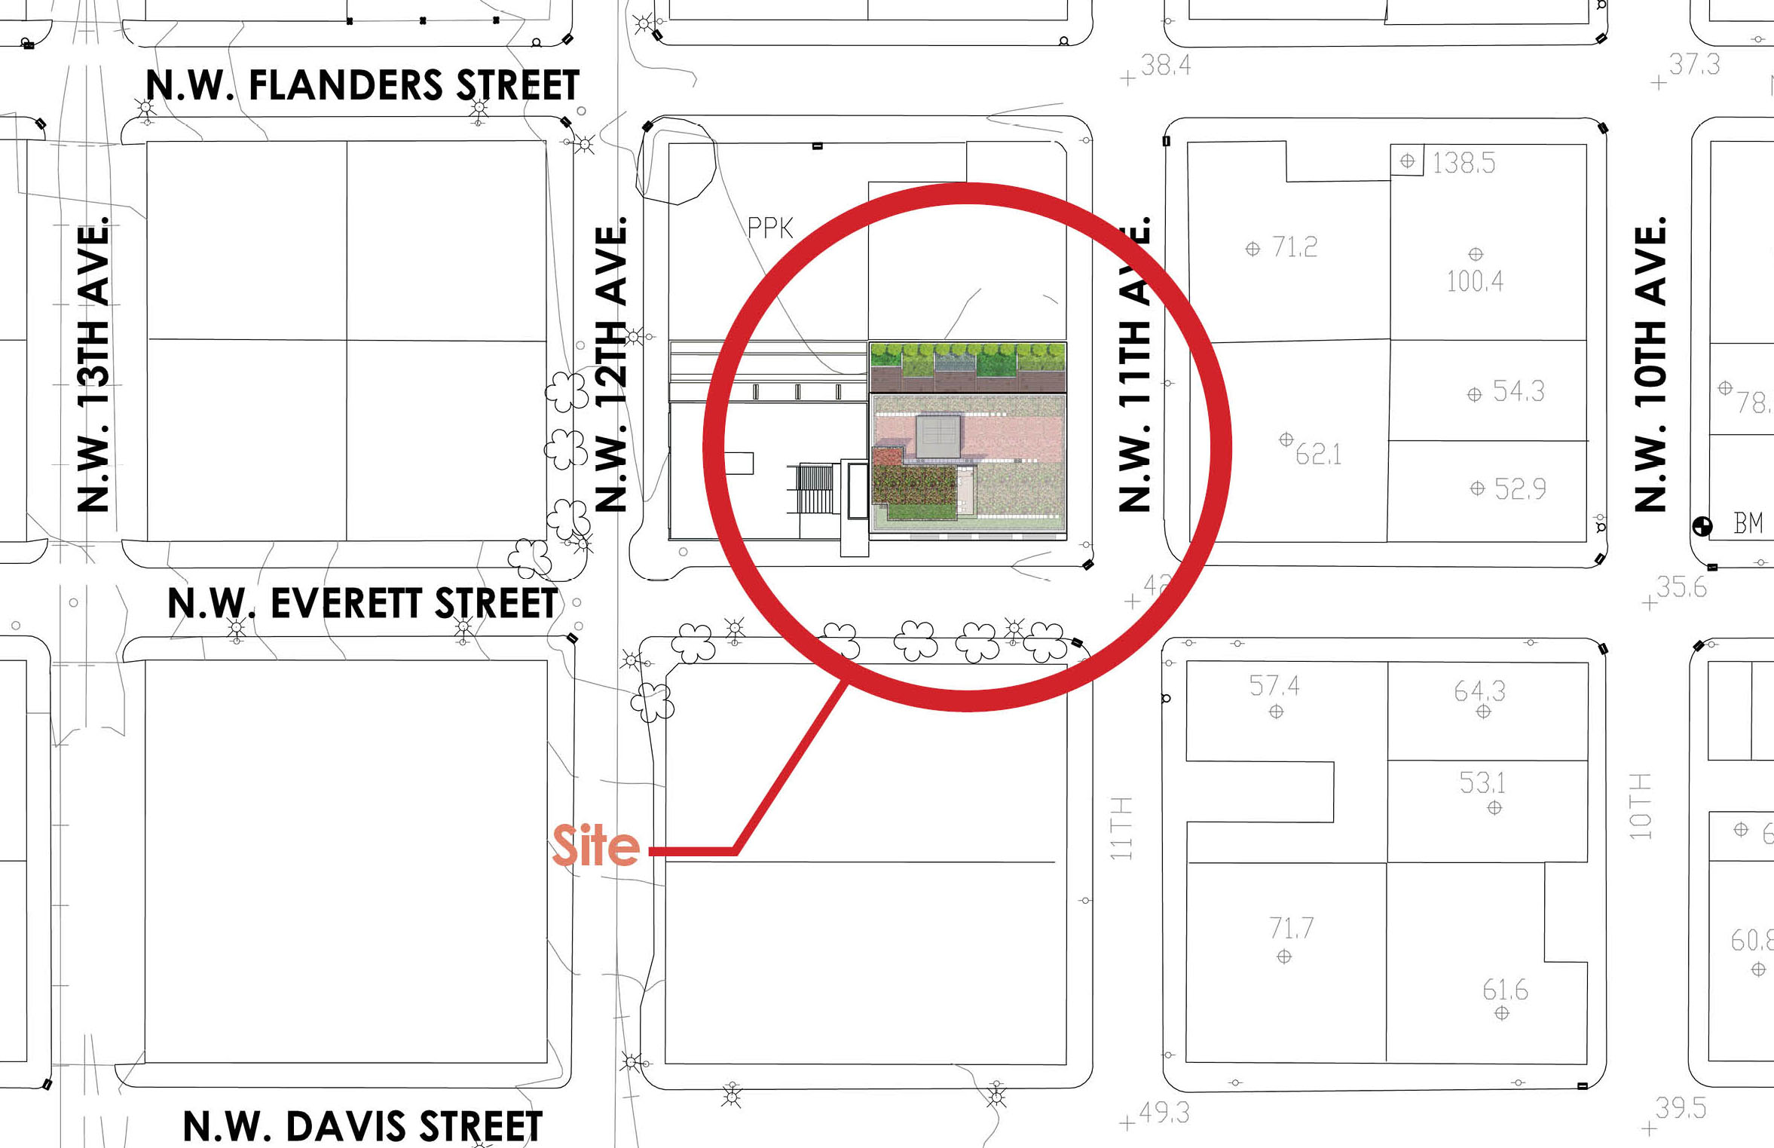

Slide 14
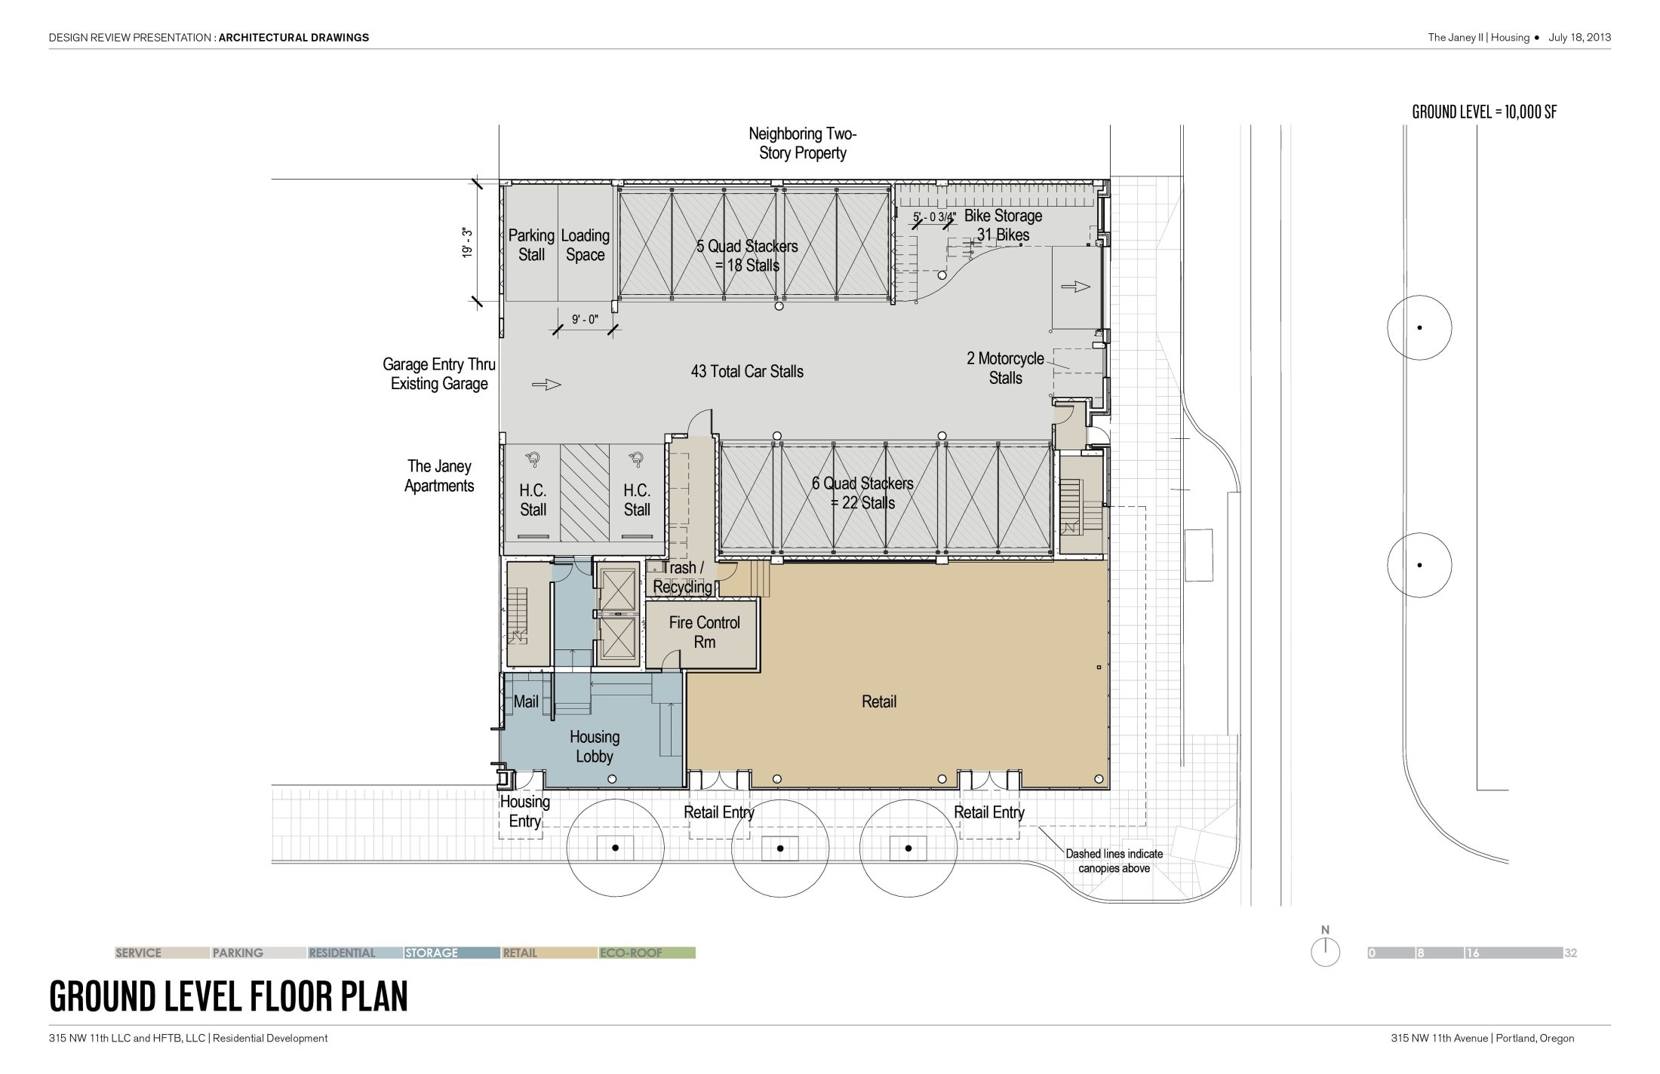
(1) SURFACE STALL
LOADING ZONE – Standard B
(31) BIKE STALLS
(18) MECHANICAL PARKING
(2) ADA STALLS
(22) MECHANICAL PARKING

Slide 15
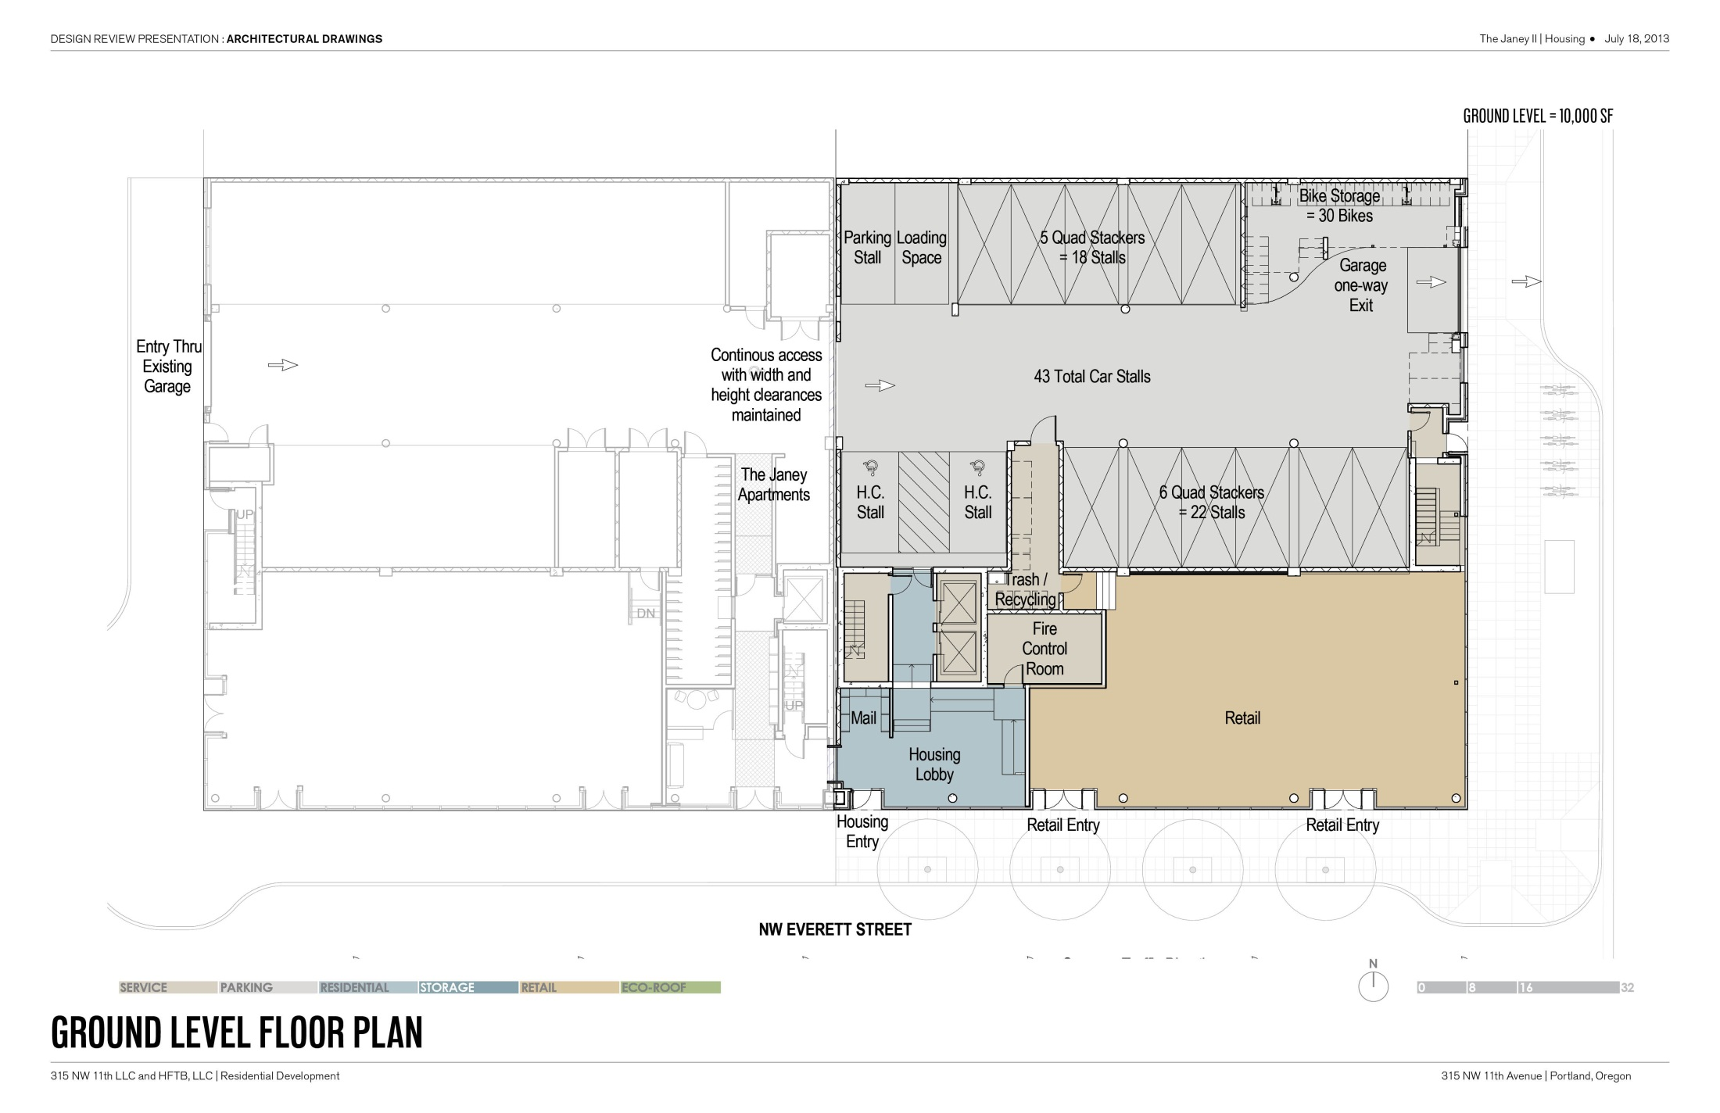

Slide 16
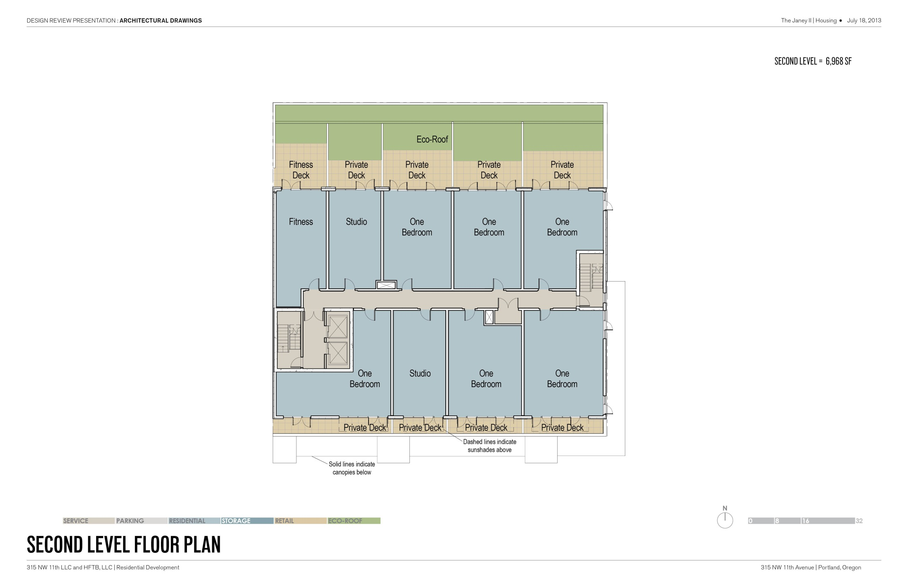
ECO-ROOF
(5) PRIVATE DECKS
(9) HOUSING UNITS
(4) PRIVATE DECKS

Slide 17
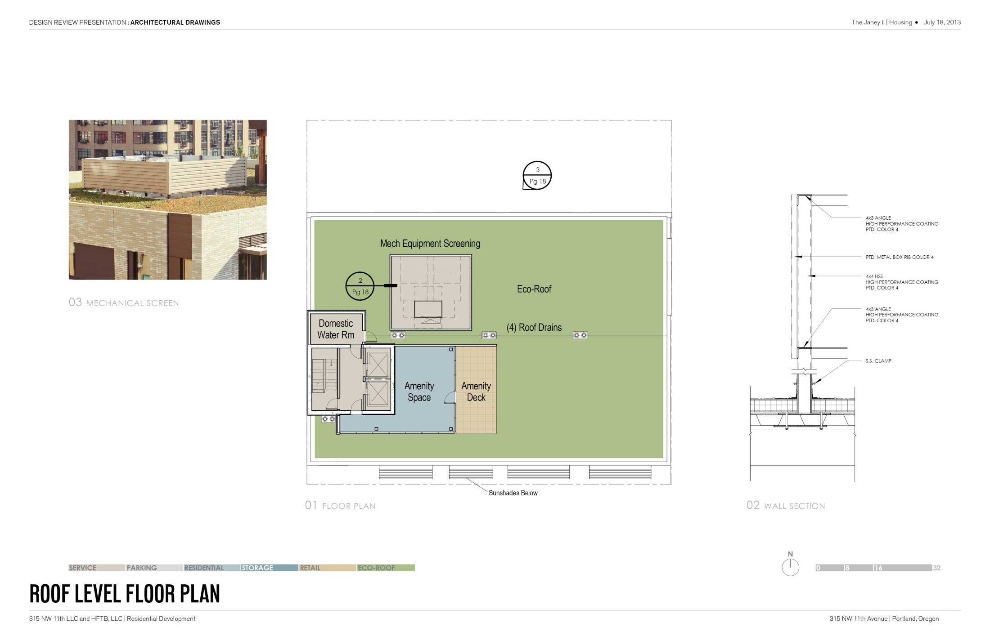
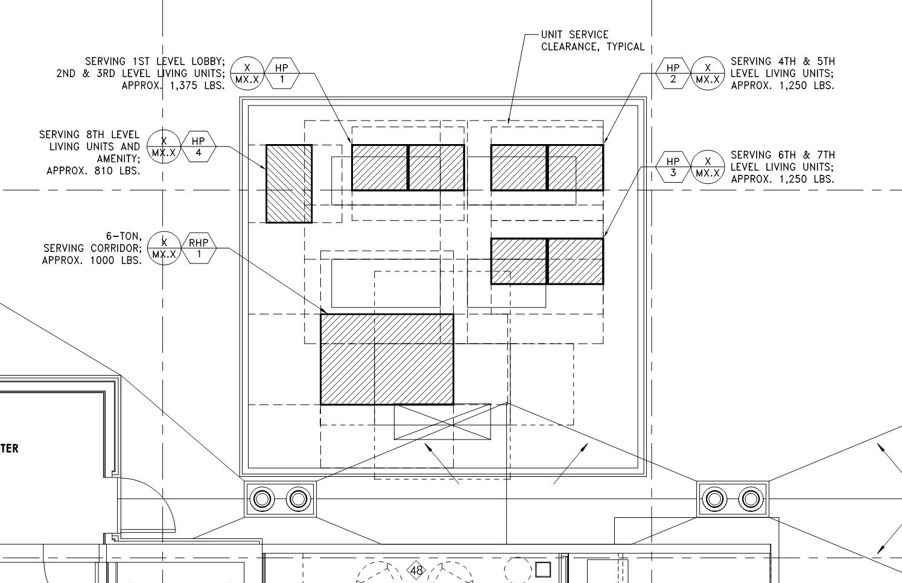
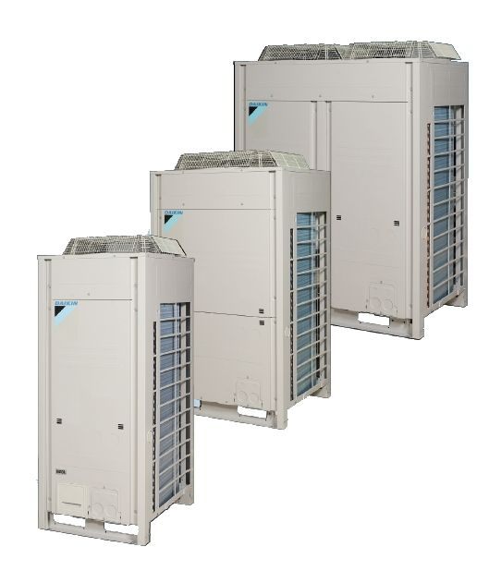
MECHANICAL SCREEN
HEAT PUMPS FOR ALL RESIDENTIAL UNITS, RESIDENTIAL LOBBY AND RETAIL SPACE
ROOF-TOP UNIT SERVING ALL RESIDENTIAL CORRIDORS
DAIKIN VRV HEAT PUMPS

Slide 18
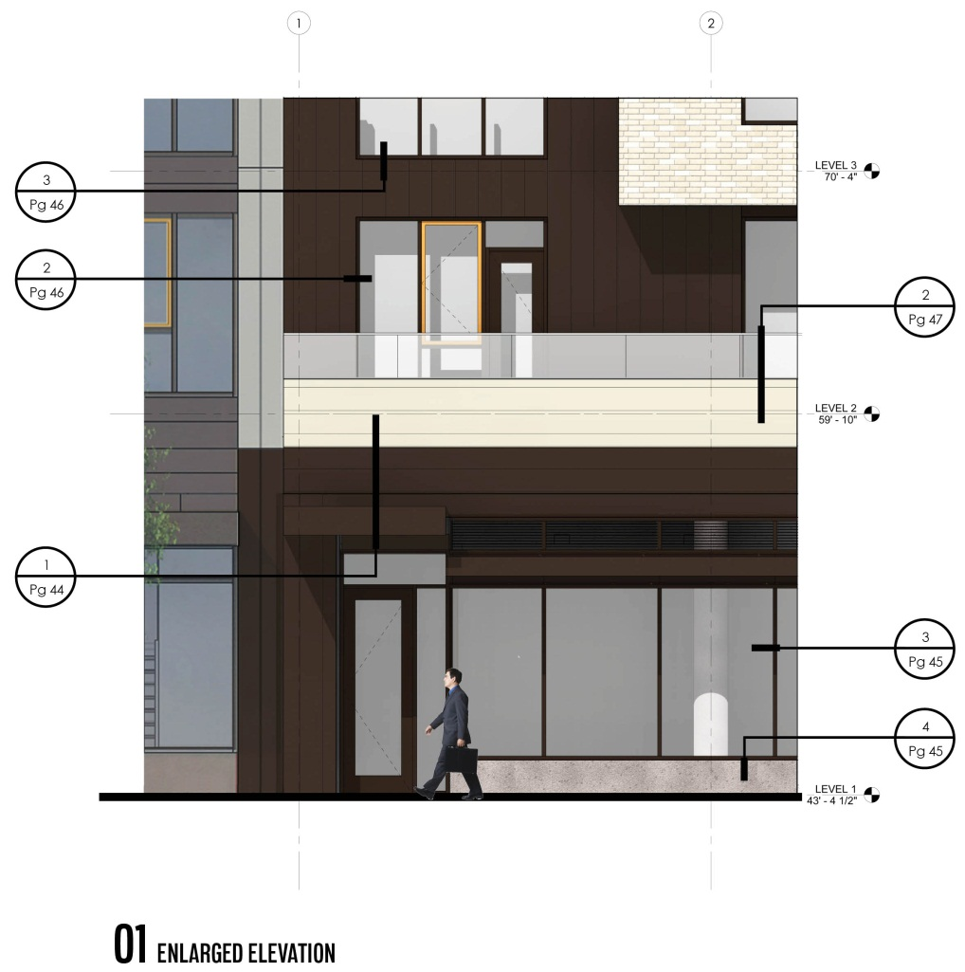
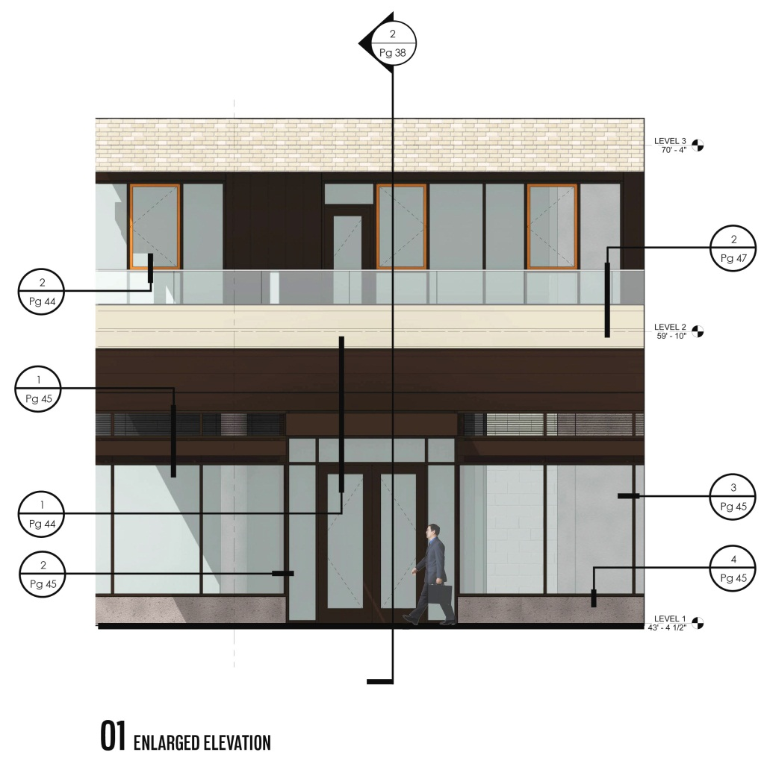
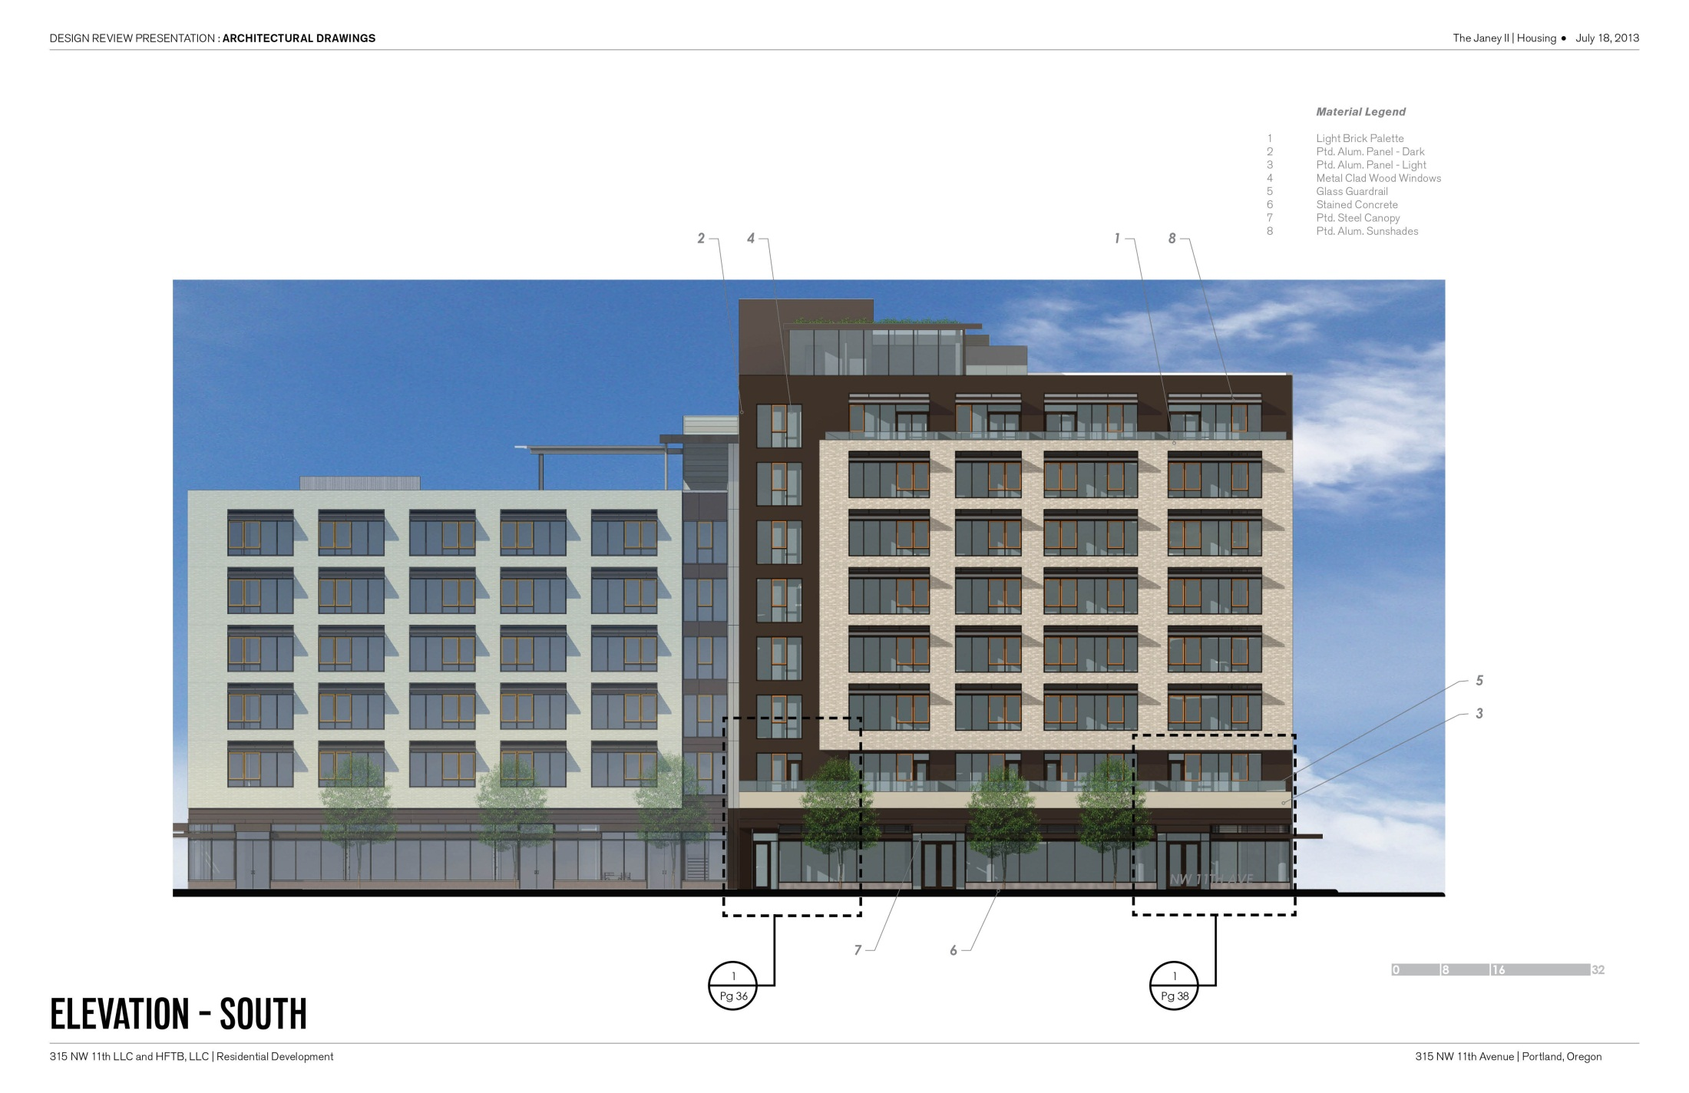
BRICK VENEER
METAL PANEL
BRICK VENEER
METAL CLAD
WOOD WINDOWS
METAL CLAD
WOOD WINDOWS
GLASS GUARDRAIL
GLASS GUARDRAIL
METAL PANEL
METAL PANEL
HOUSING ENTRY CANOPY
RETAIL ENTRY CANOPY
VISION GLAZING AT STOREFRONT
VISION GLAZING AT STOREFRONT
ENLARGED ELEVATION
ENLARGED ELEVATION

Slide 19
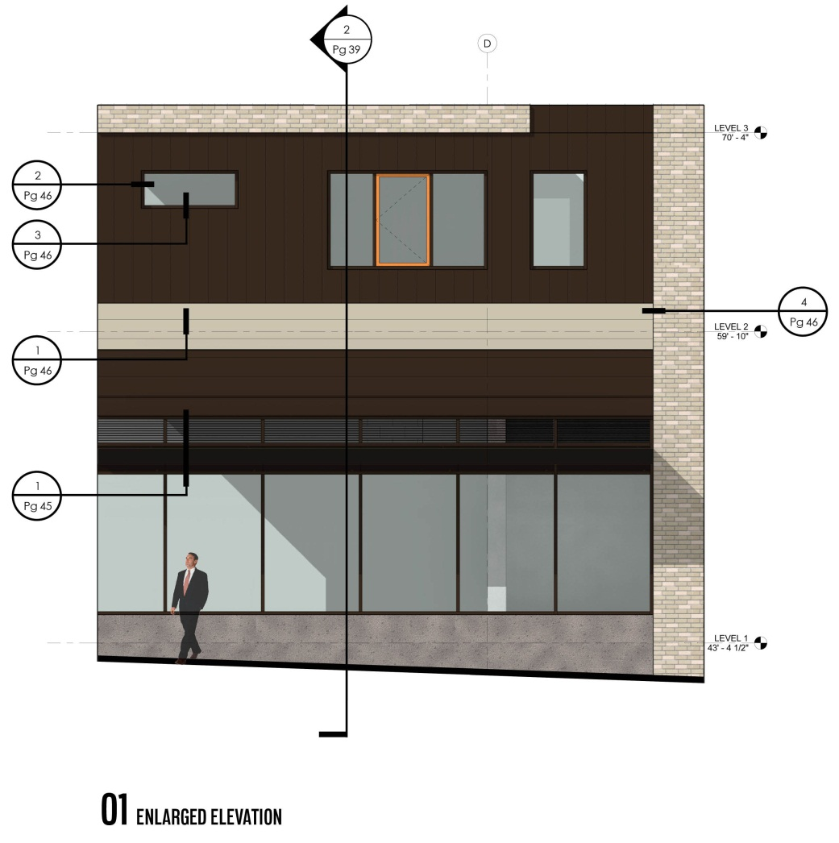
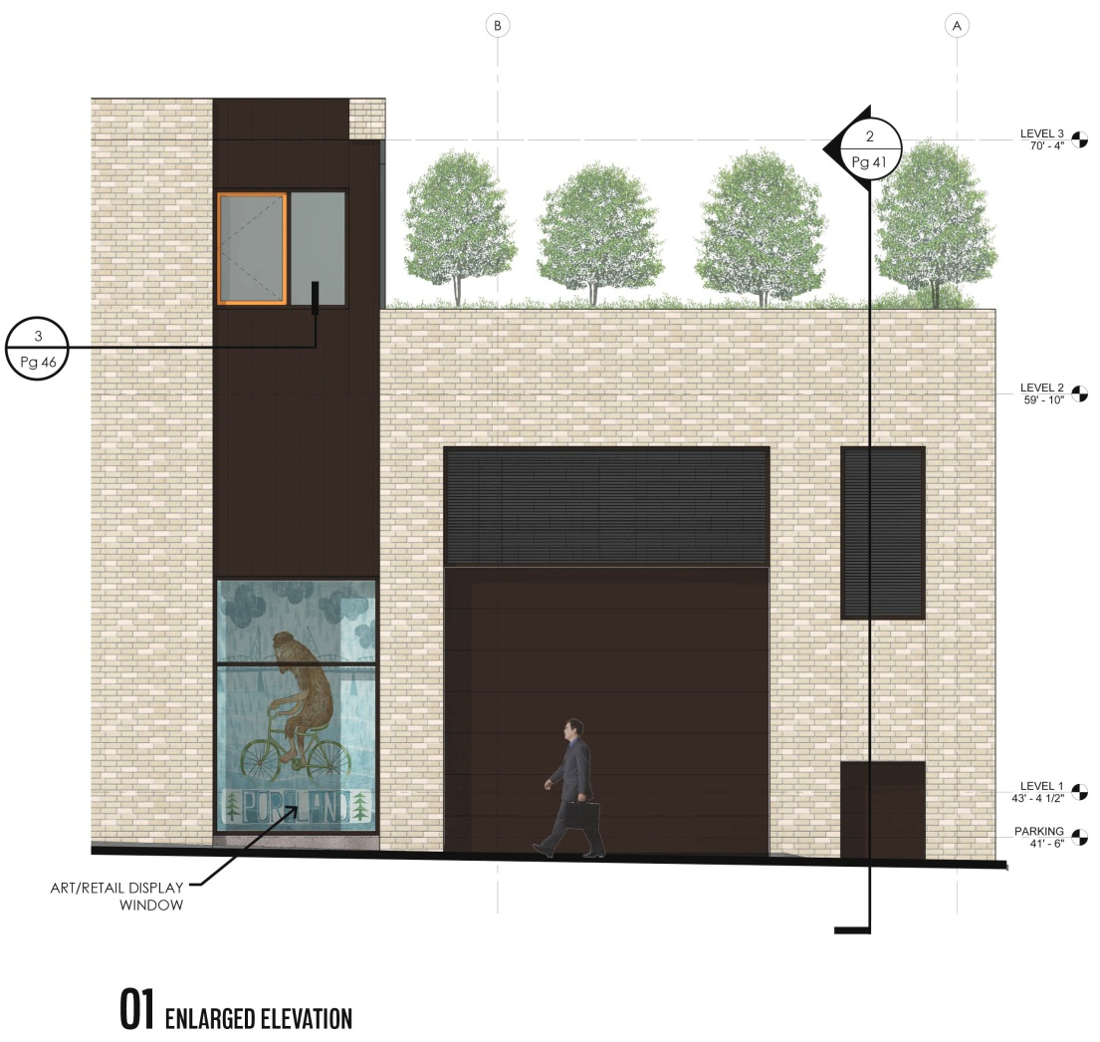
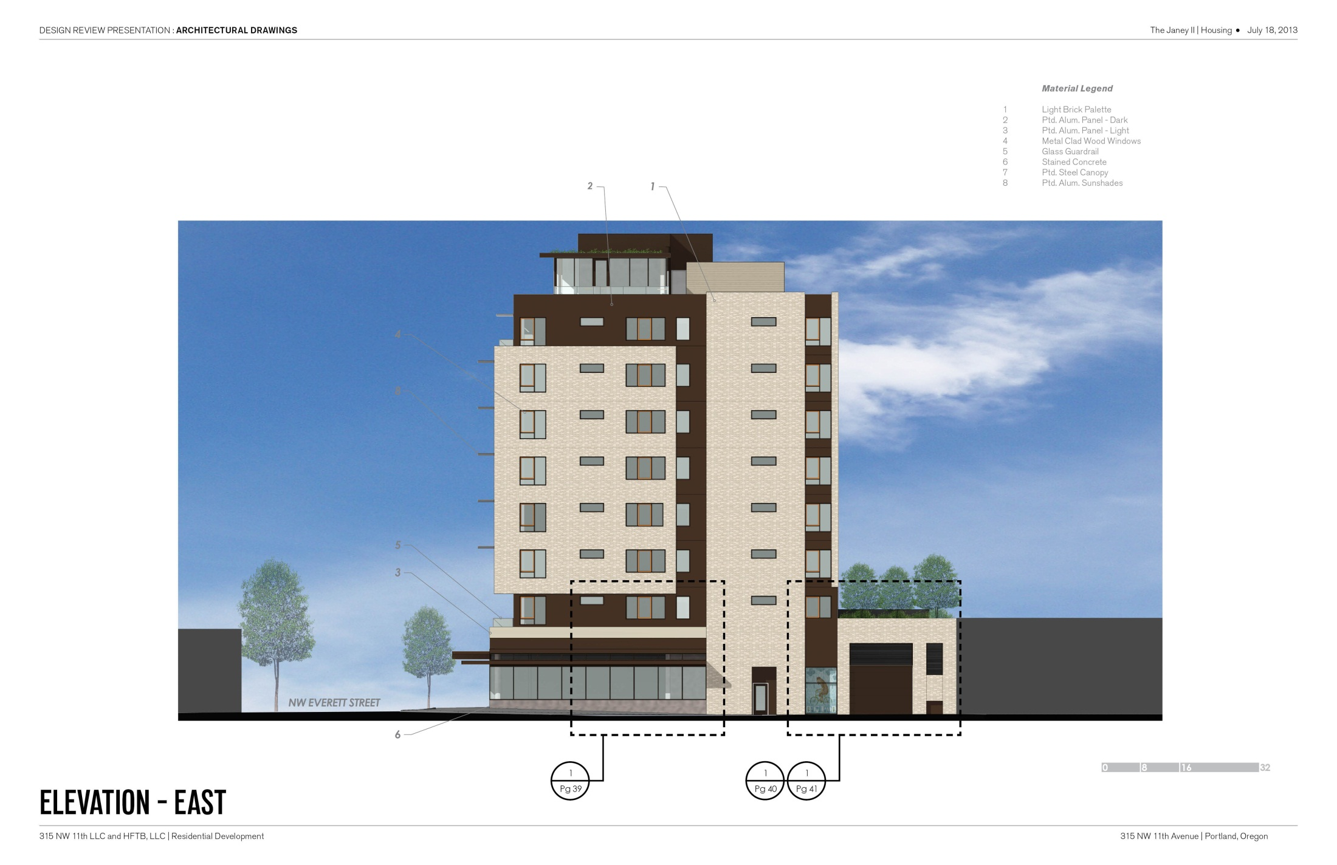
BRICK VENEER
METAL PANEL
METAL CLAD
WOOD WINDOWS
METAL CLAD
WOOD WINDOWS
BRICK VENEER
METAL PANEL
METAL PANEL
METAL LOUVERS
METAL LOUVERS
OVERHEAD DOOR
WITH SOLID SLATS
VISION GLAZING AT STOREFRONT
DISPLAY WINDOW
CONCRETE STEM WALL
METAL PANEL ALCOVE – GAS METERS
ENLARGED ELEVATION
ENLARGED ELEVATION

Slide 20
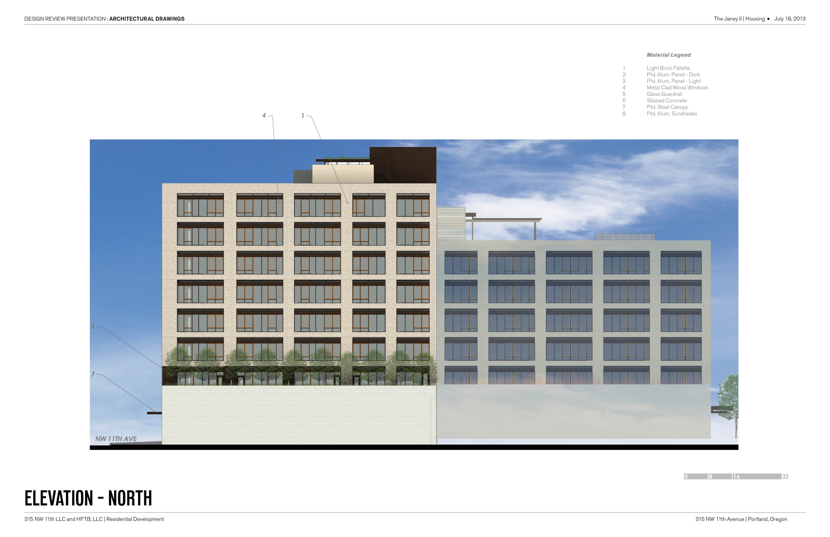
FIVE FOOT SETBACK

Slide 21
REVISED FROM SUBMITTED PACKAGE

Slide 23
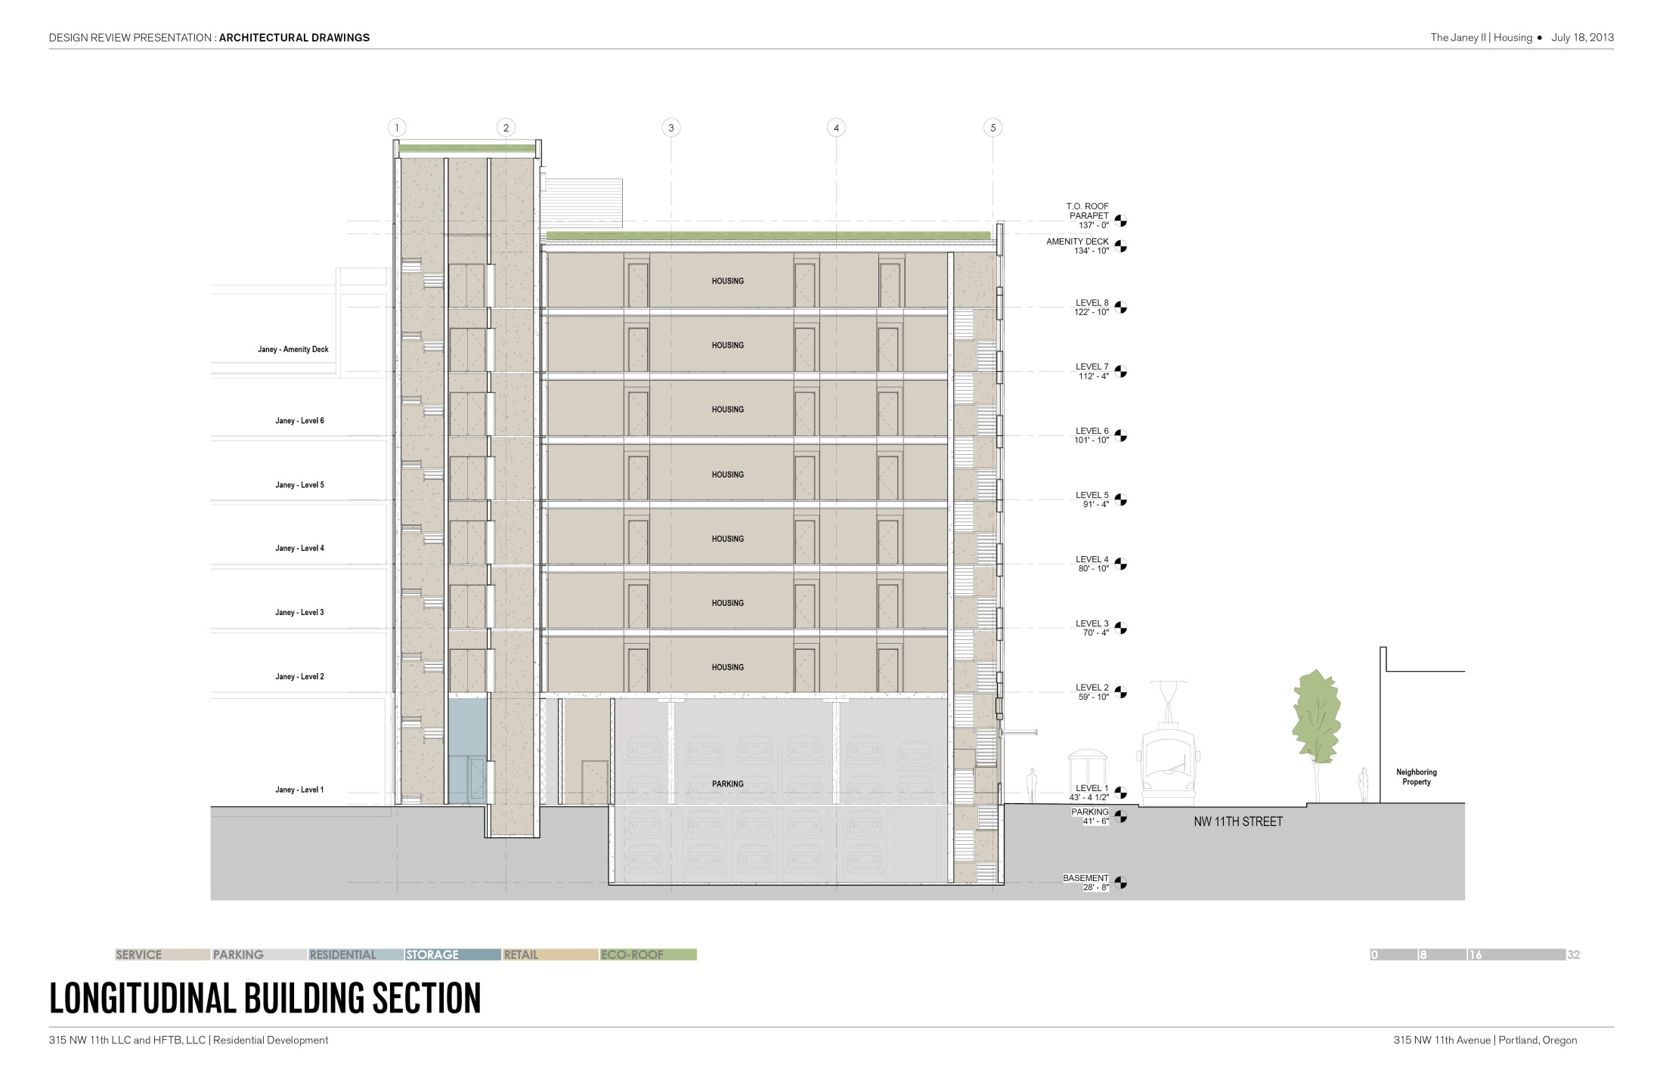
ECO-ROOF
ECO-ROOF
1 LEVEL AMENITY SPACE/ECO-ROOF
7 LEVELS OF HOUSING
PARKING
1 LEVEL OF RETAIL AND PARKING
CAR STACKER PIT

Slide 24
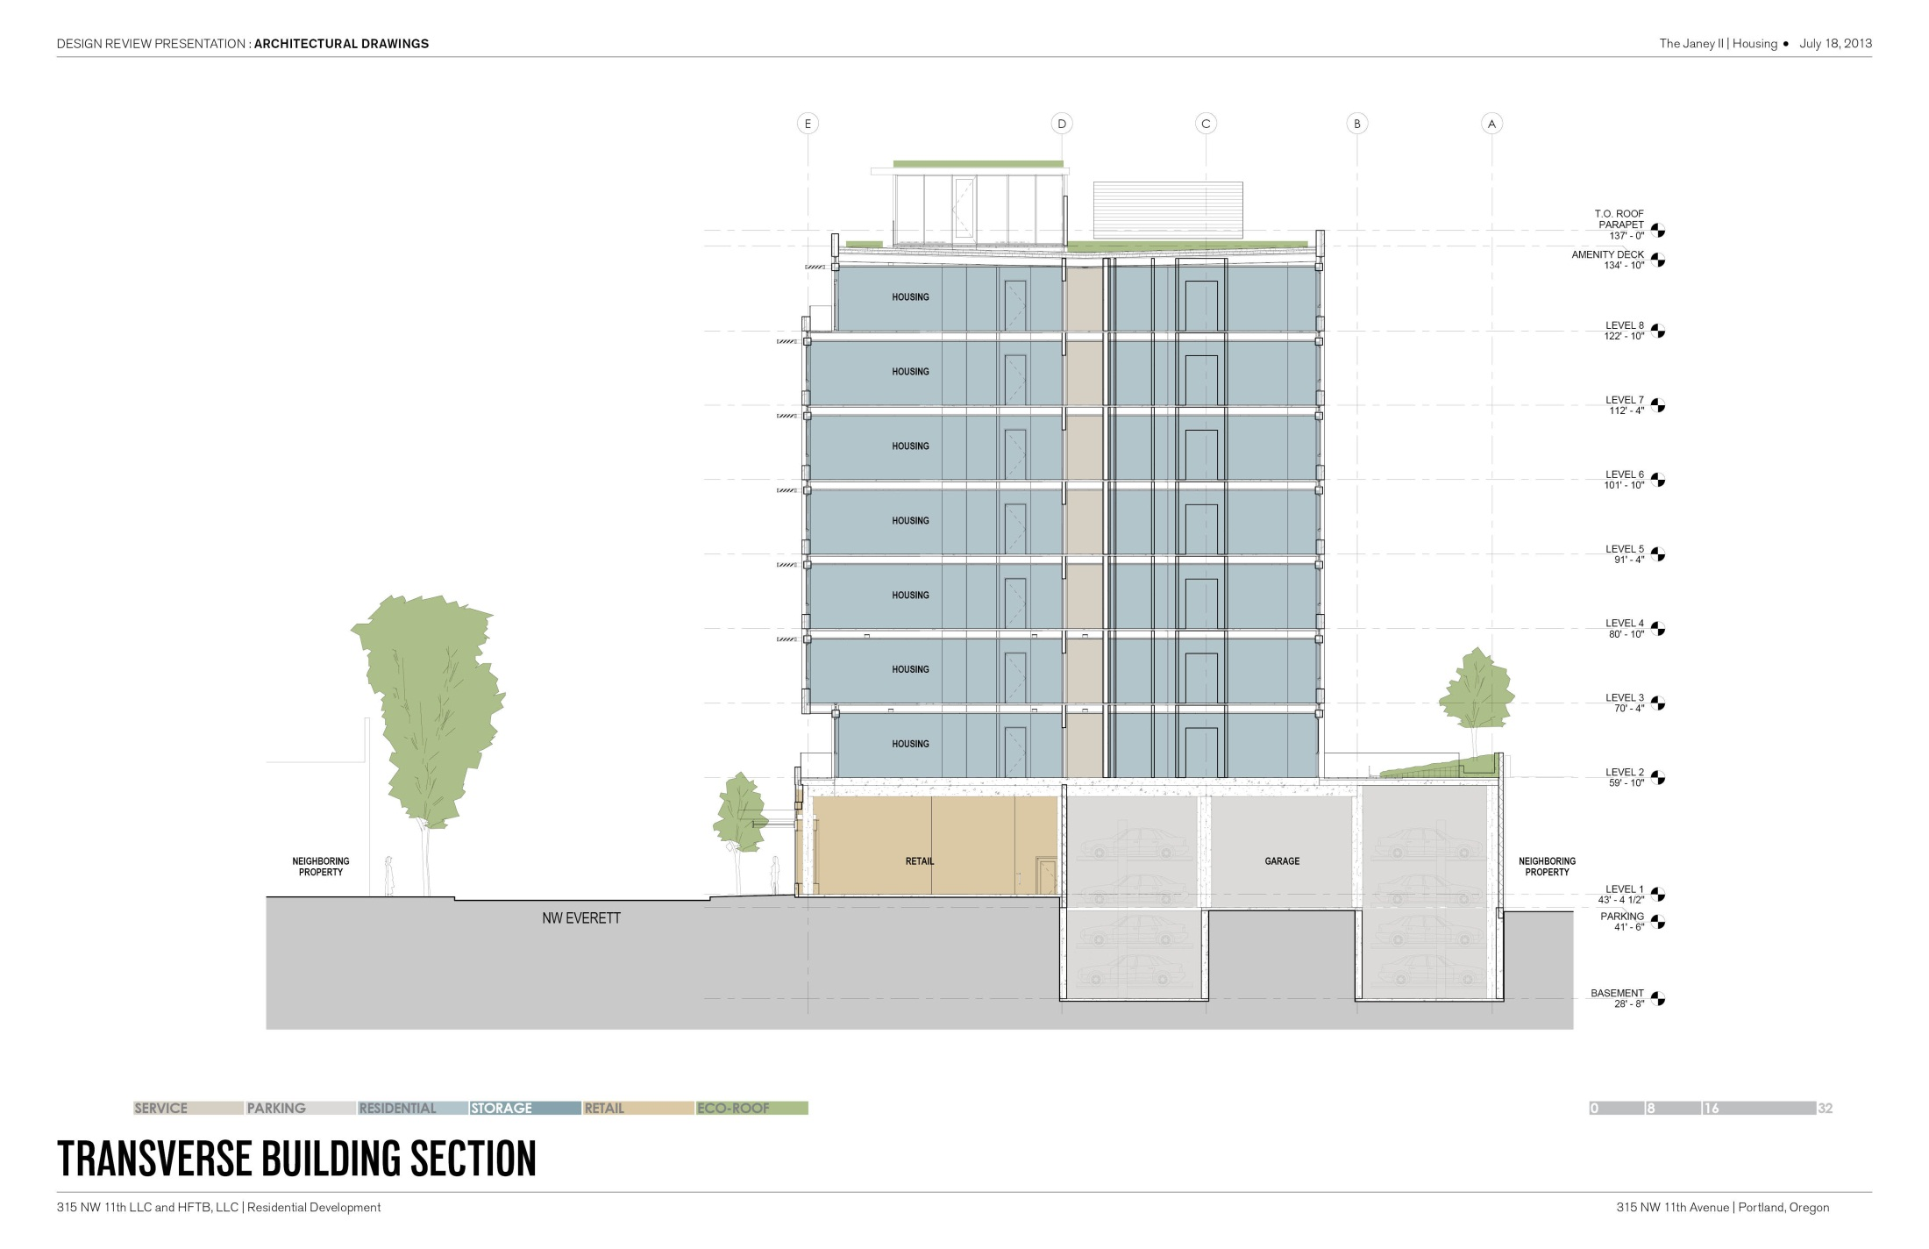
ECO-ROOF
REVISED FROM SUBMITTED PACKAGE
1 LEVEL AMENITY SPACE
ECO-ROOF
7 LEVELS OF HOUSING
ECO-ROOF
1 LEVEL OF RETAIL AND PARKING
RETAIL
PARKING
CAR STACKER PITS

Slide 25
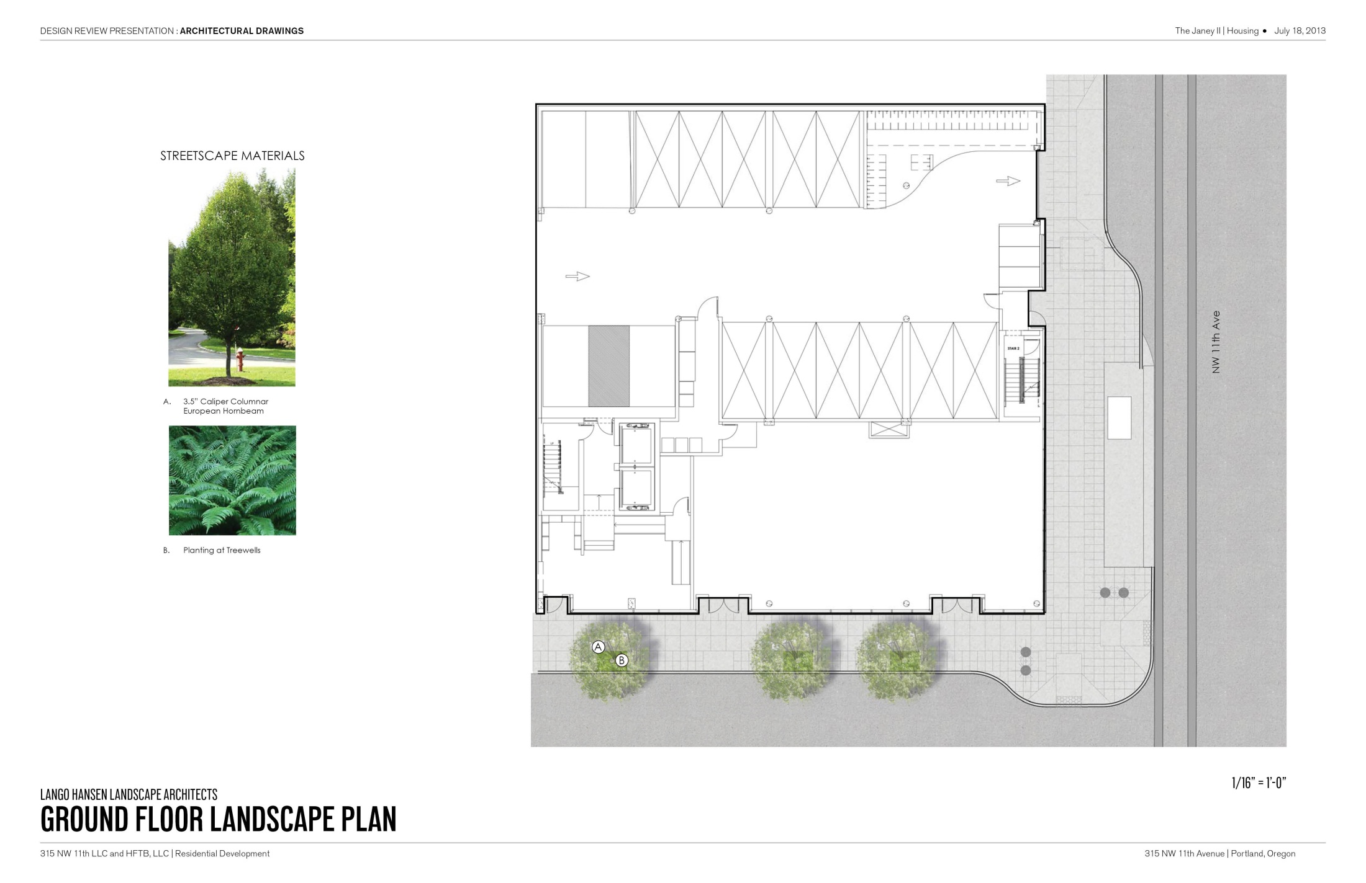

Slide 26
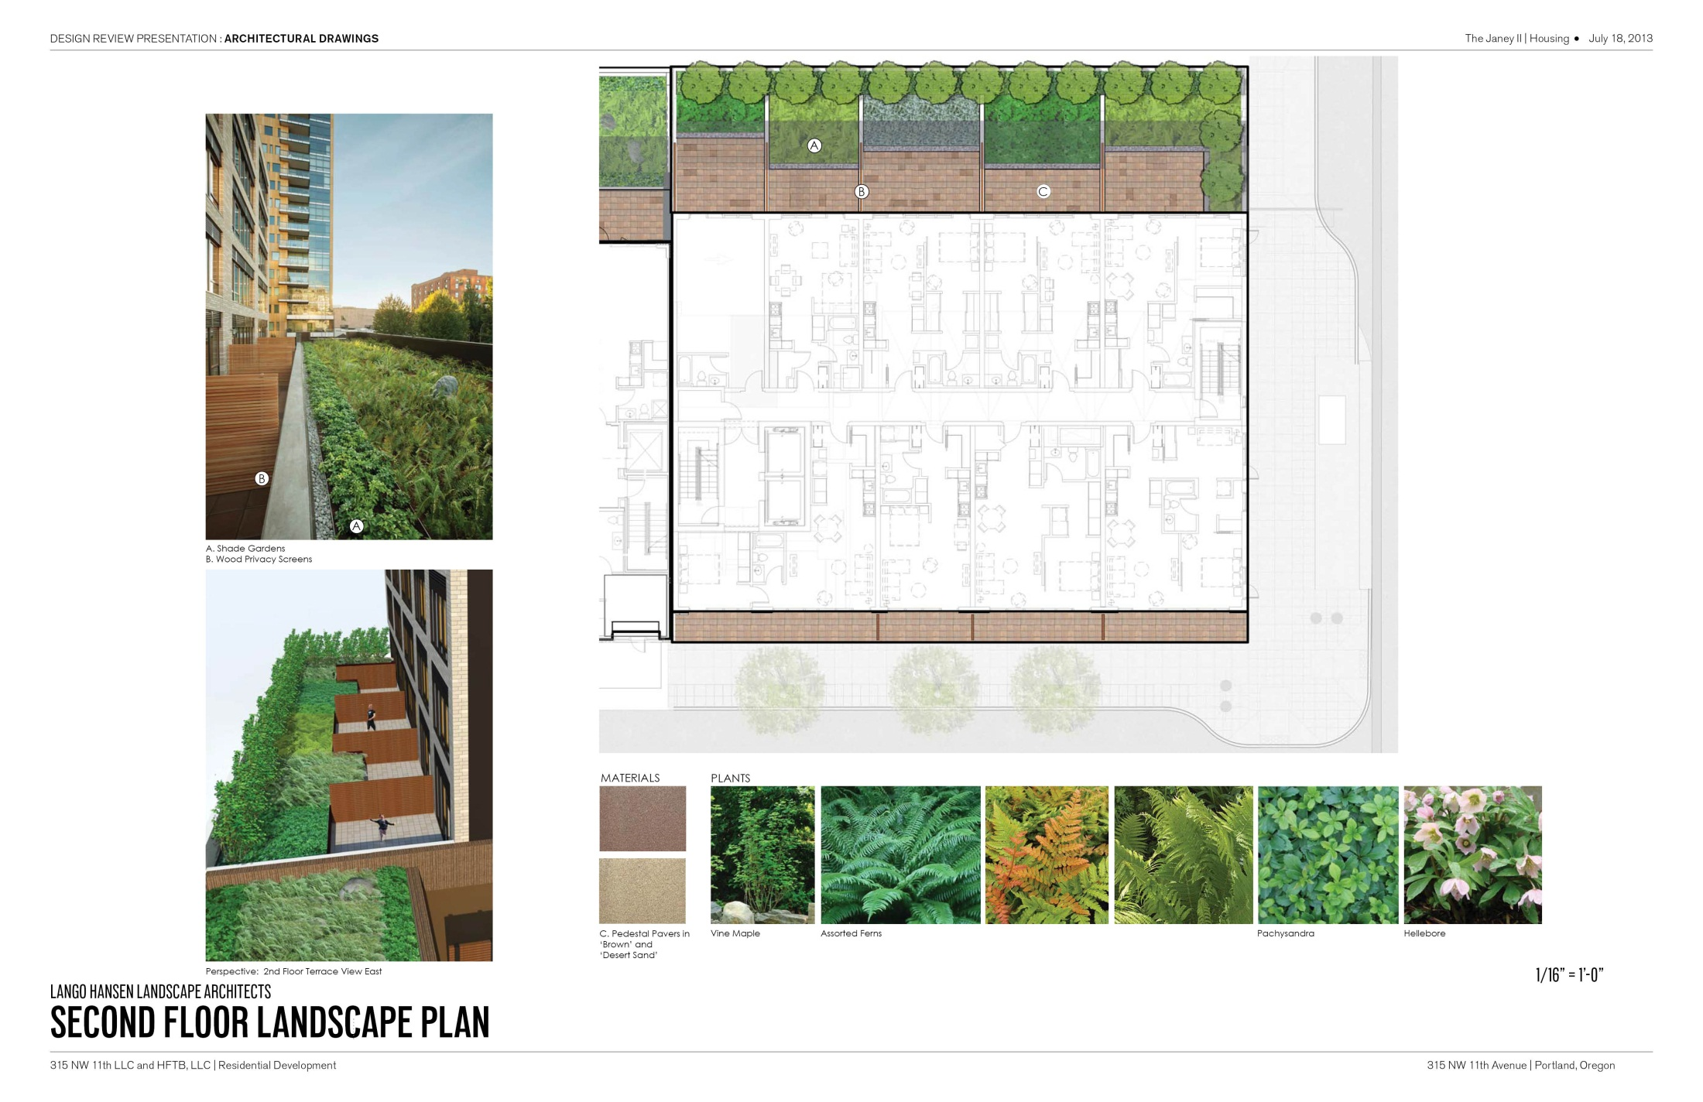

Slide 27
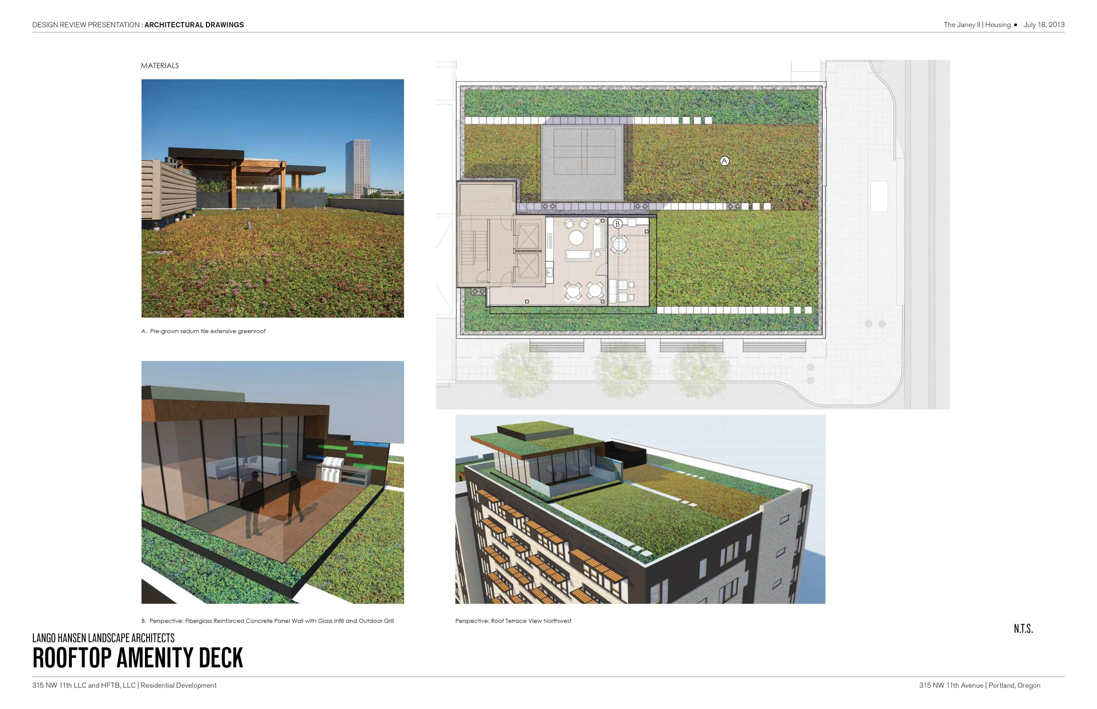

Slide 28
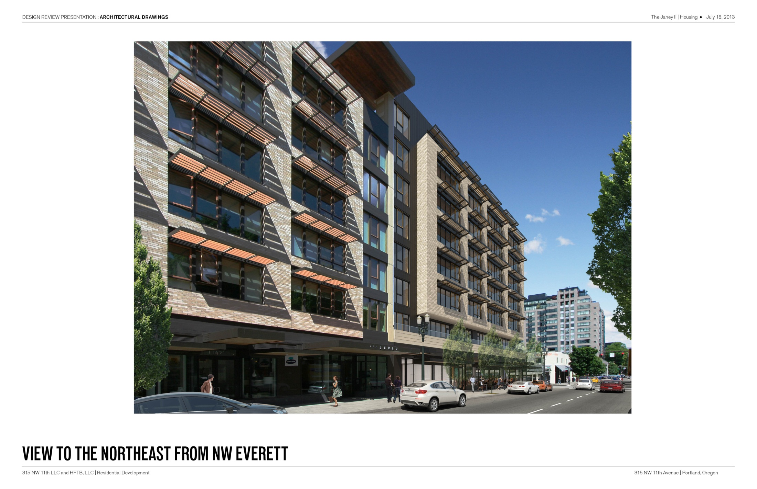

Slide 29
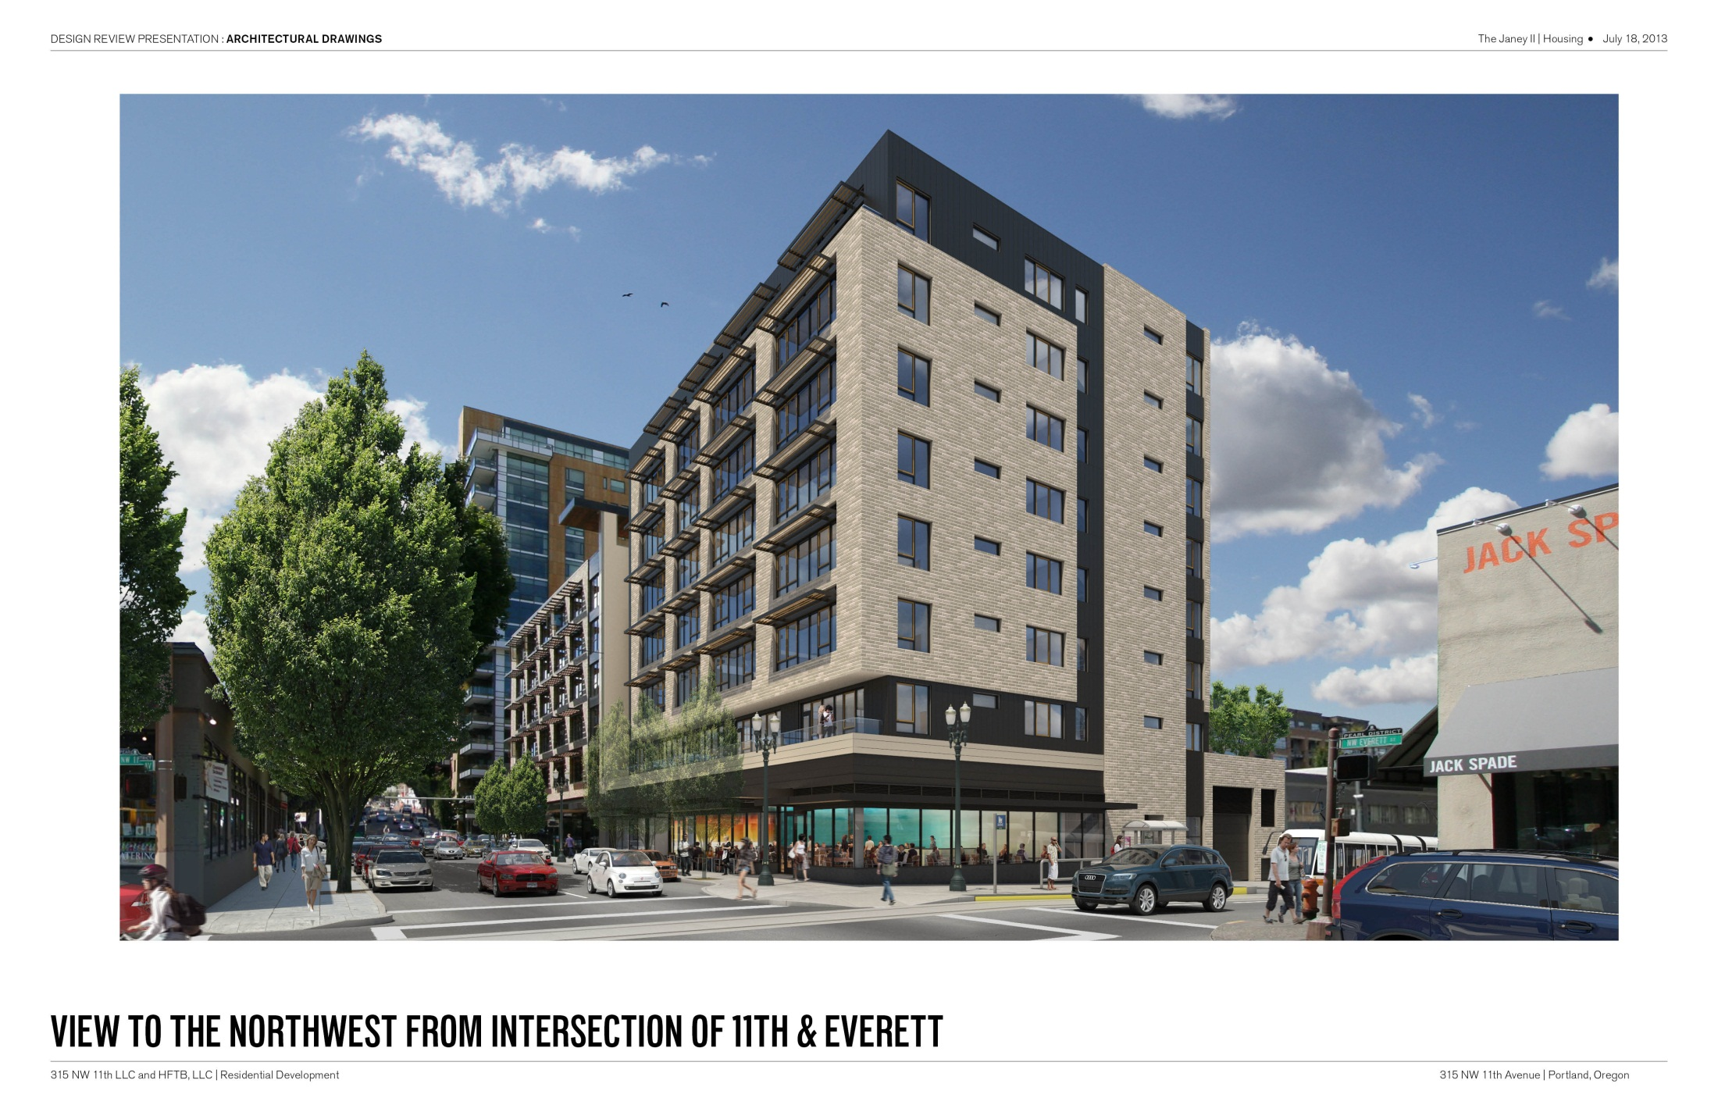

Slide 30
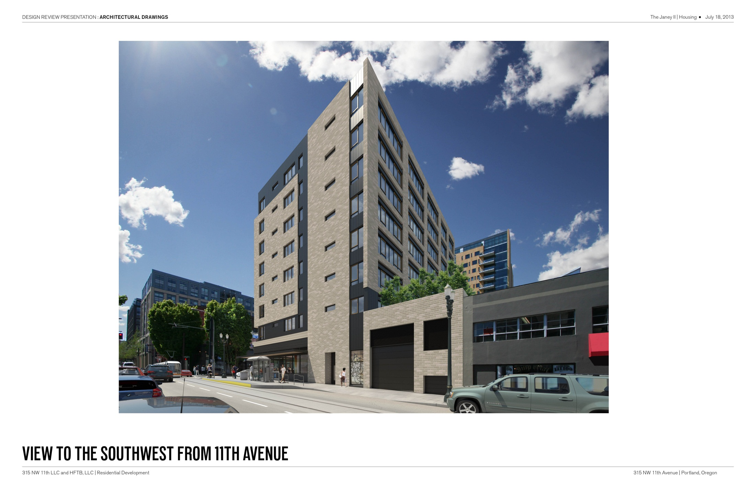

Slide 32
THE JANEY II
MODIFICATIONS AND ADJUSTMENTS
Modifications:
Minimum 50% of Ground Floor Active areas that front a streetcar alignment with parking encroachment into the required Active Zone within 100’ of the streetcar alignment.
In the EX Zone, the windows must be at least 50 percent of the length and 25 percent of the ground level wall area.
4
Adjustment:
Access to Parking on NW 11th Avenue will not be approved except when granted under adjustment procedures

Slide 33
MODIFICATION (1):
Minimum 50% of Ground Floor Active areas that front a streetcar alignment with parking encroachment into the required Active Zone within 100’ of the streetcar alignment.
Due to the requirement to provide parking for the apartment dwellers, we are unable to meet the 50% Active Use on the ground floor along NW 11th Avenue. As shown on the floor plan on page C4, we are proposing a 38 foot zone (38% of the 100-foot site) of active use on the ground floor, along NW 11th, that meets all of the listed requirements. In addition to the 38 foot zone, we have an 8 foot zone of clear-glazed windows at the egress stair directly north of the retail area. We have also added a “display window” that is approximately 7 feet wide between the stairway exit door and the garage door to provide an additional interest along the NW 11th facade. We request approval to be allowed to reduce the Ground Floor Active Area along NW 11th Avenue from 50% to 38%.

Slide 34
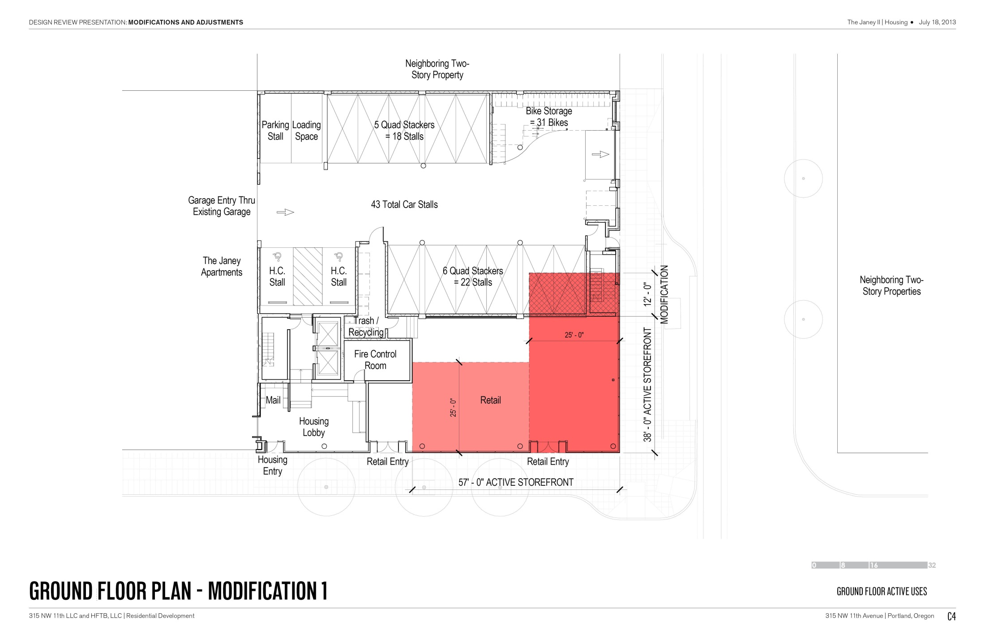

Slide 35
MODIFICATION (2):
In the EX Zone, the windows must be at least 50 percent of the length and 25 percent of the ground level wall area.
Due to the project requirement for providing parking for the apartment dwellers, along with the request to provide access to the parking garage along NW 11th Avenue (See Modification 1 and Adjustment 1), we are unable to provide more than 38 feet of qualifying ground floor windows along NW 11th Avenue. As the site is 100’ along NW 11th, the 38 feet of window falls below the design parameters provided by this code section, which call for a minimum of 50% of qualified ground floor window length provided. To help minimize the impact of the reduced area of ground floor windows, we are providing a clear-vision-glazed storefront into the egress stairs, which will add an additional level of interest along the NW 11th Avenue facade (see ground floor plan on page C5). In addition, this proposal includes a display window that adds another 7 feet in length of interest along the NW 11th street facade. By including these additional features, aside from the 38 feet of windows into the retail space, this proposal is hoping to provide a pleasant and diverse pedestrian experience along NW 11th Avenue. We request approval to be allowed to reduce the Ground Floor Windows along NW 11th Avenue from 50% to 38%.

Slide 36
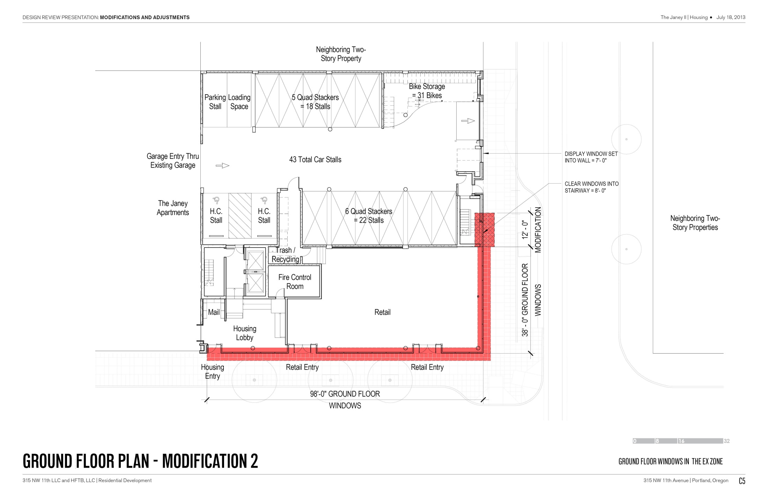

Slide 37
ADJUSTMENT (1):
Access to Parking on NW 11th Avenue will not be approved except when granted under adjustment procedures
Due to the proposed project requirement for providing the apartment dwellers with parking and, due to our 1/4 block site on the corner of NW 11th Avenue and NW Everett street, we are left with providing access on one of those two streets. Because of the high traffic volume and vehicular speeds along NW Everett Street, the alternative location for access along NW 11th Avenue is preferred - as requested by PBOT and confirmed with PBOT’s Development Service Manager. To help minimize the impact of providing this parking access on NW 11th, we are proposing a one-way egress out of the proposed new parking garage by connecting the new building with the adjacent, existing Janey building, where ingress will take place - see plan on page C6. The Janey is designed with an ultra high-speed overhead coiling door (Rytec Spiral FV, with a speed of 100 inches per second, see page C7 for door cut-sheet) that allows for quick access and minimizes cueing outside the existing garage door along NW 12th Avenue. By providing the same fast-acting/high-speed overhead door on the new building (with the same clear dimensions), the cueing on the inside will also be minimized and vehicular ingress (on NW 12th) and egress (on NW 11th) will be fast and efficient. The two buildings will be connected by an opening along the property line that is wider than the ingress and egress doors, which will avoid any additional burden to the existing parking garage. Therefore, we request approval to access our parking area through the garage door located on the northeast end of the property, mid-block along NW 11th Avenue.

Slide 38
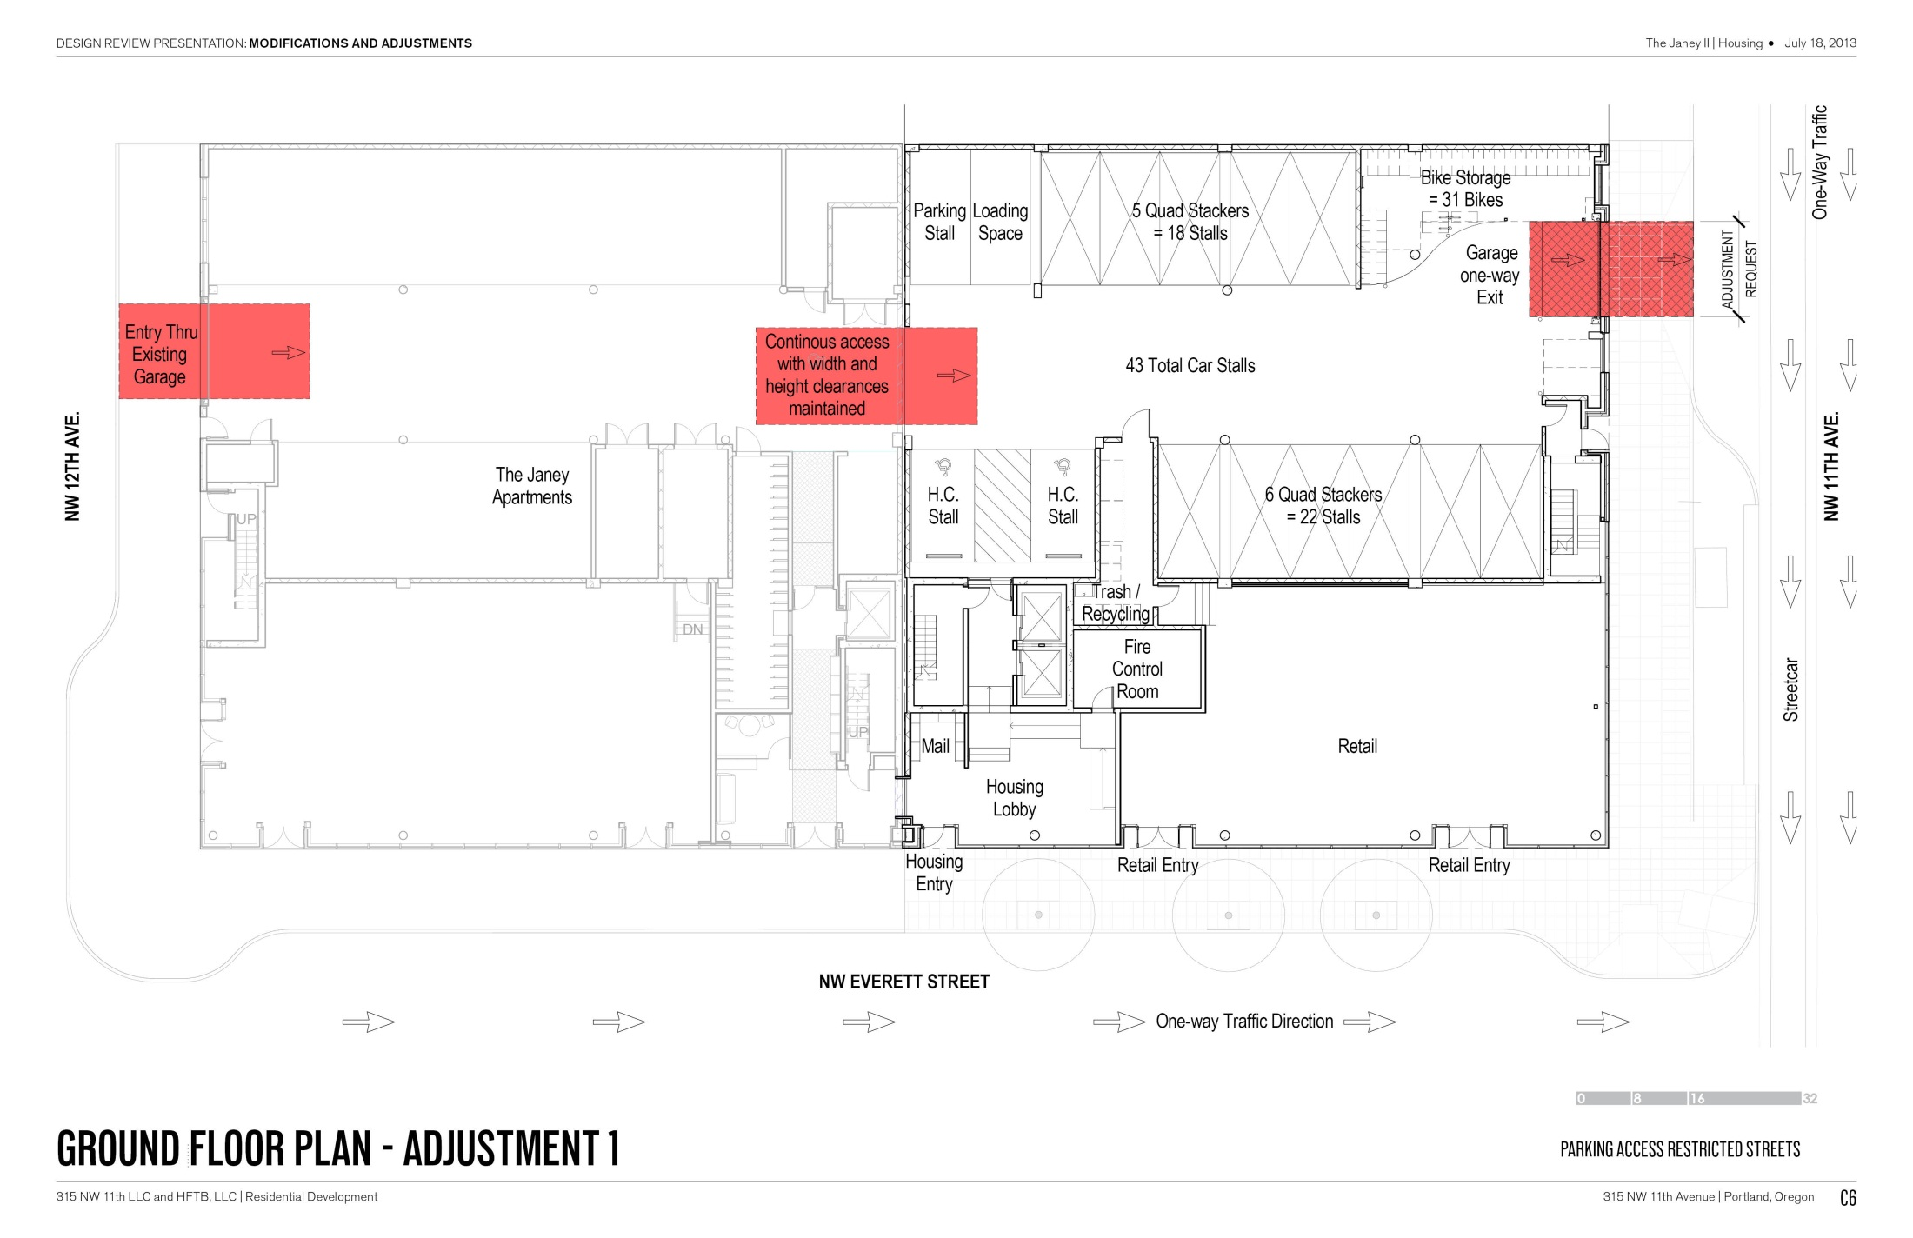

Slide 39
DESIGN REVIEW HEARING
IN SUMMARY, WE ARE REQUESTING APPROVAL OF:
DESIGN
OVERALL DESIGN OF BUILDING
ADJUSMENT AND MODIFICATIONS
Minimum 50% of Ground Floor Active areas
Minimum 50% of the length and 25% of the ground level wall area
Parking on NW 11th Avenue

Slide 40
APPENDIX A
ADDRESSING THE CONCERNS BROUGHT UP IN THE STAFF REPORT ALONG 11TH AVENUE…
…WE PROPOSE THE FOLLOWING:
A

Slide 42
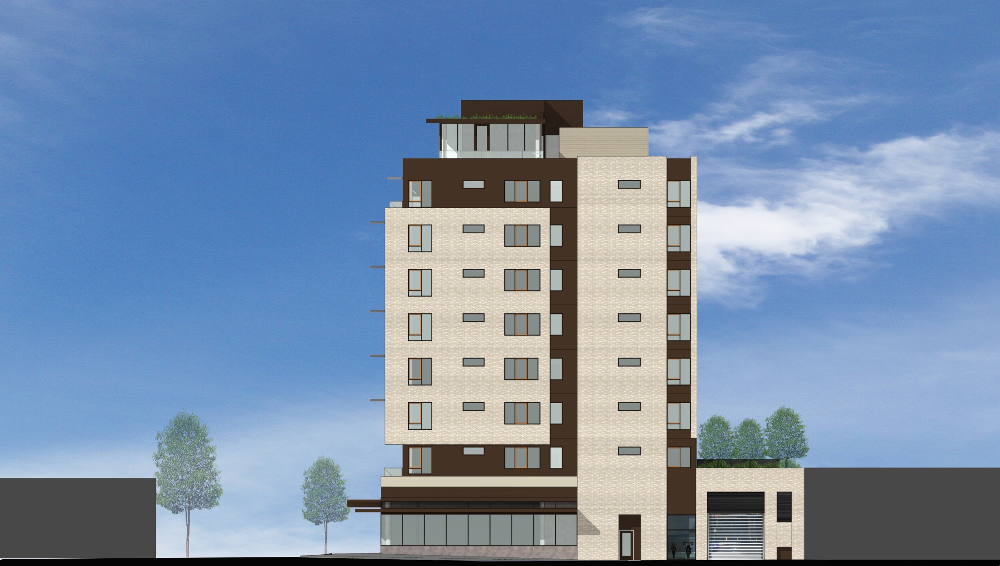

Slide 45
THE JANEY

Slide 46
THE JANEY

Slide 47
THANK YOU

