Slide 1
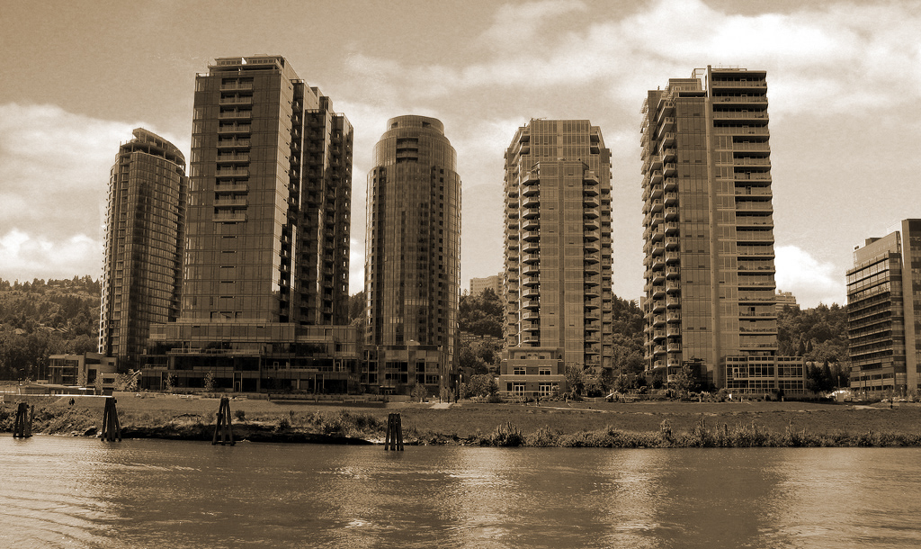
Design Advice Request May 16, 2013

Slide 2
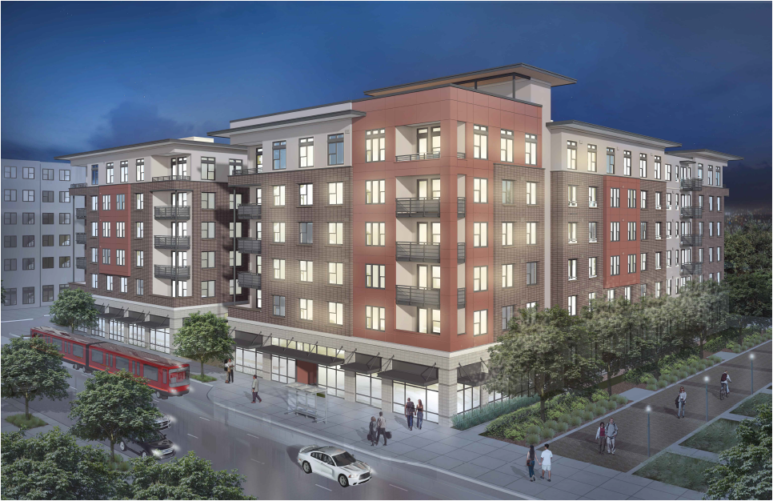
FORMER VIEW BLOCK 43 APARTMENTS

Slide 3
DAR Comments April 4, 2013
Establish a clear hierarchy of the entrances
Provide direct connections to SW Lane
Provide stoops along Moody to activate the street
A more urban edge is preferred all around the building
Simplify the outside with a systematic material palette
Limit material palette to 3 materials; a 4th material is ok if the use is systematic
Remove structural column from corner balcony conditions
No small canopies over door guards at SW Moody
Integrate vents
Incorporate lighting on all ground level facades, particularly at entry points
Relocate garage gate to face of building
Rework courtyard entry to be oriented more for people than bike parking
Usability of the courtyard needs consideration; simplify
Create connection between building architecture and landscape design

Slide 4
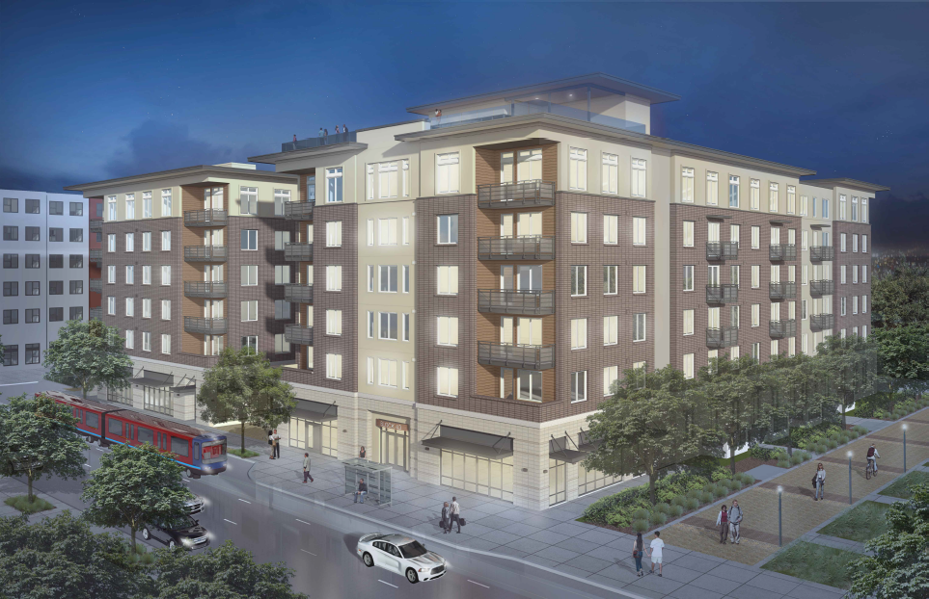
CURRENT VIEW BLOCK 43 APARTMENTS
Block 43 Apartments

Slide 5
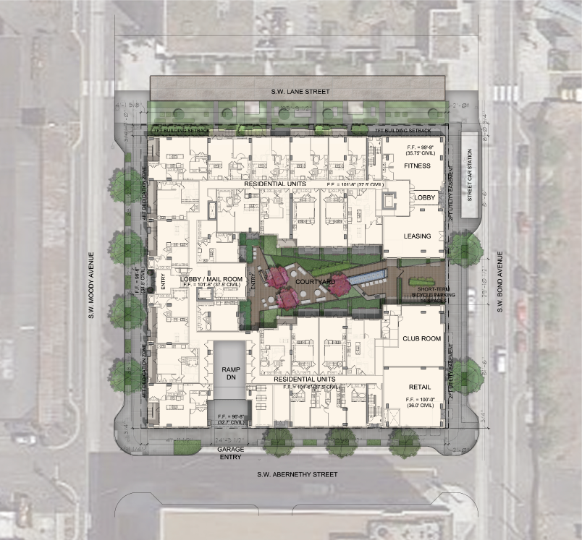
Block 43 Site Plan
SW Lane St.
SW Moody Ave.
SW Bond Ave.
SW Abernethy St.

Slide 6
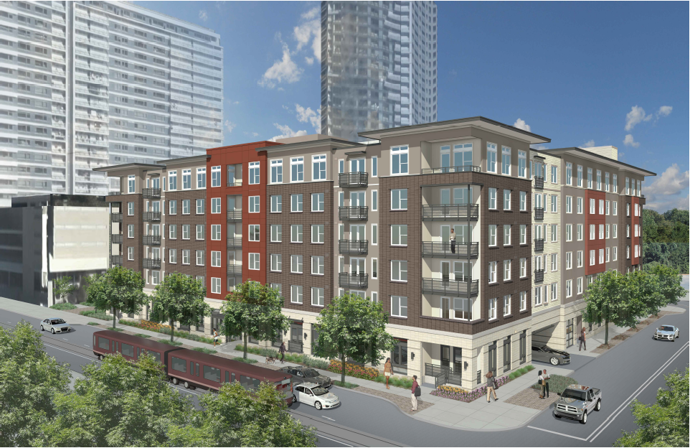
Former View – From SW Corner on Moody

Slide 7
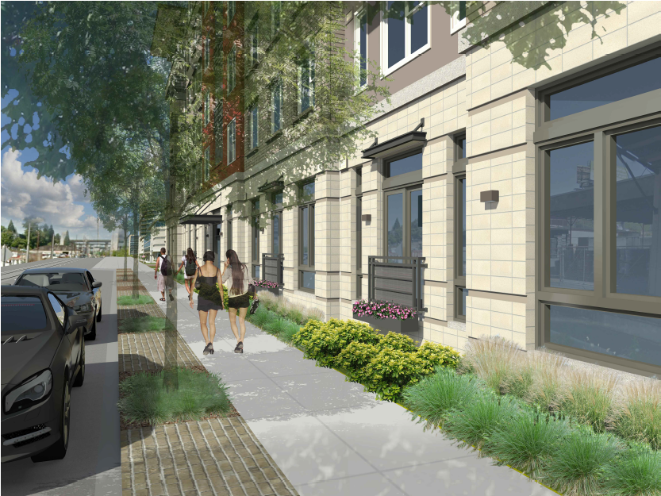
Former View – Street View Along Moody

Slide 8
Response
Establish a clear hierarchy of the entrances
Provide stoops along Moody to activate the street
A more urban edge is preferred all around the building
Simplify the outside with a systematic material palette
Remove structural column from corner balcony conditions
No small canopies over door guards at SW Moody
Incorporate lighting on all ground level facades, particularly at entry points

Slide 9
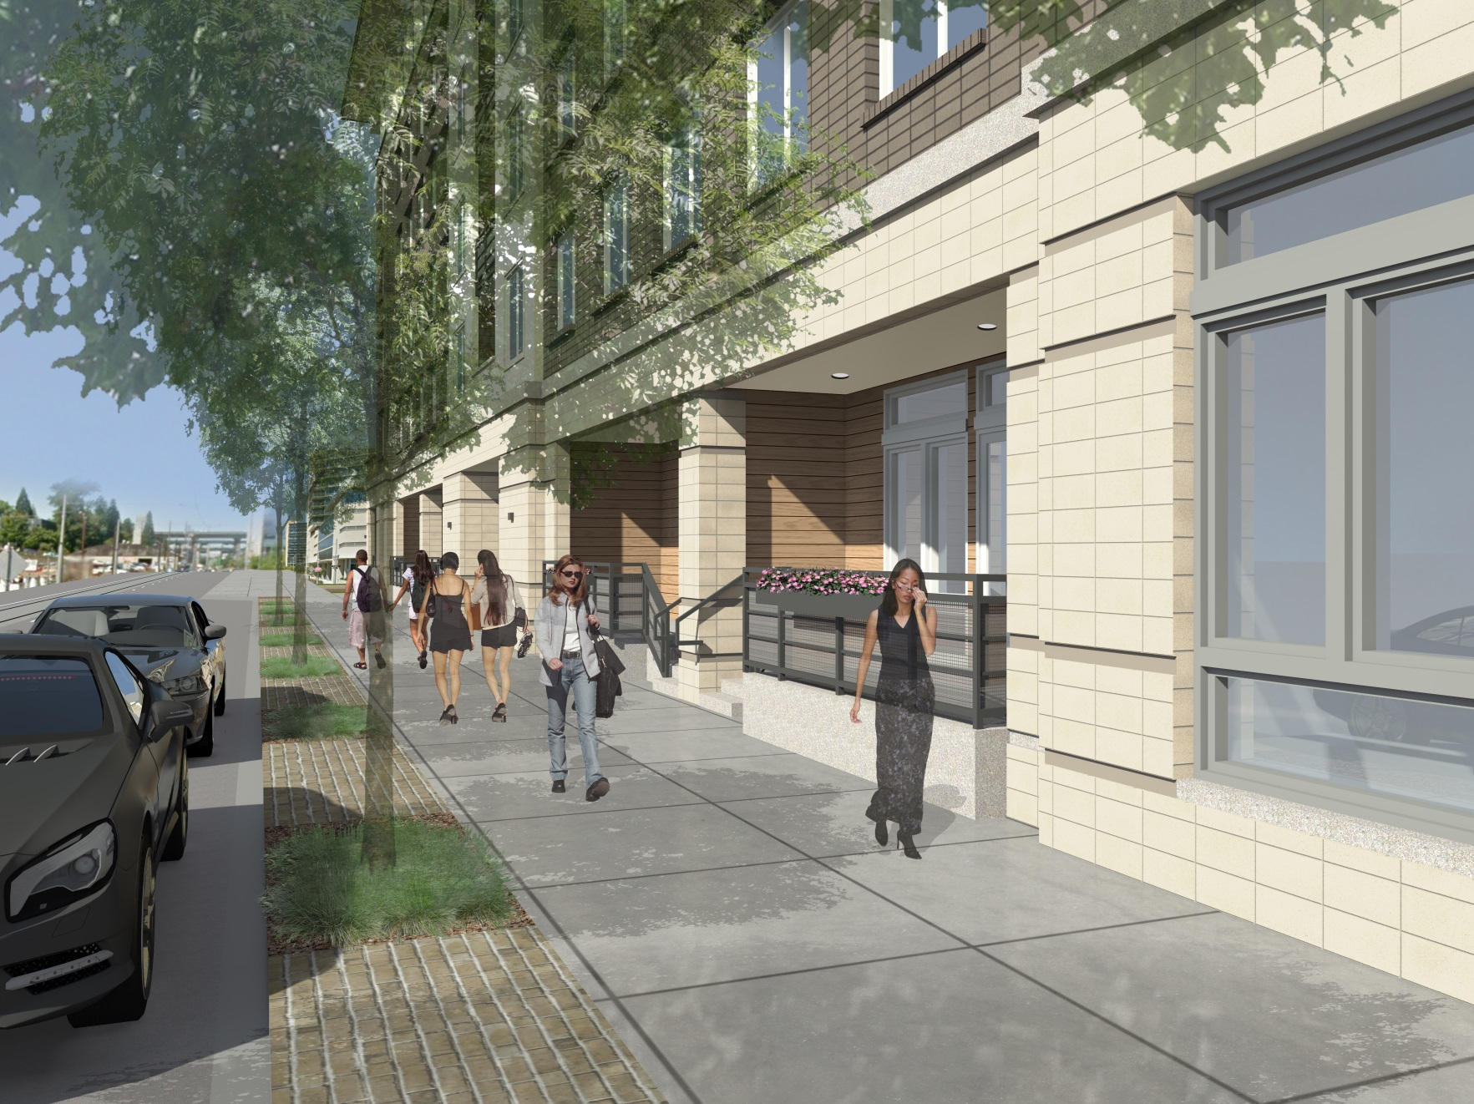
Current View – Street View Along Moody

Slide 10
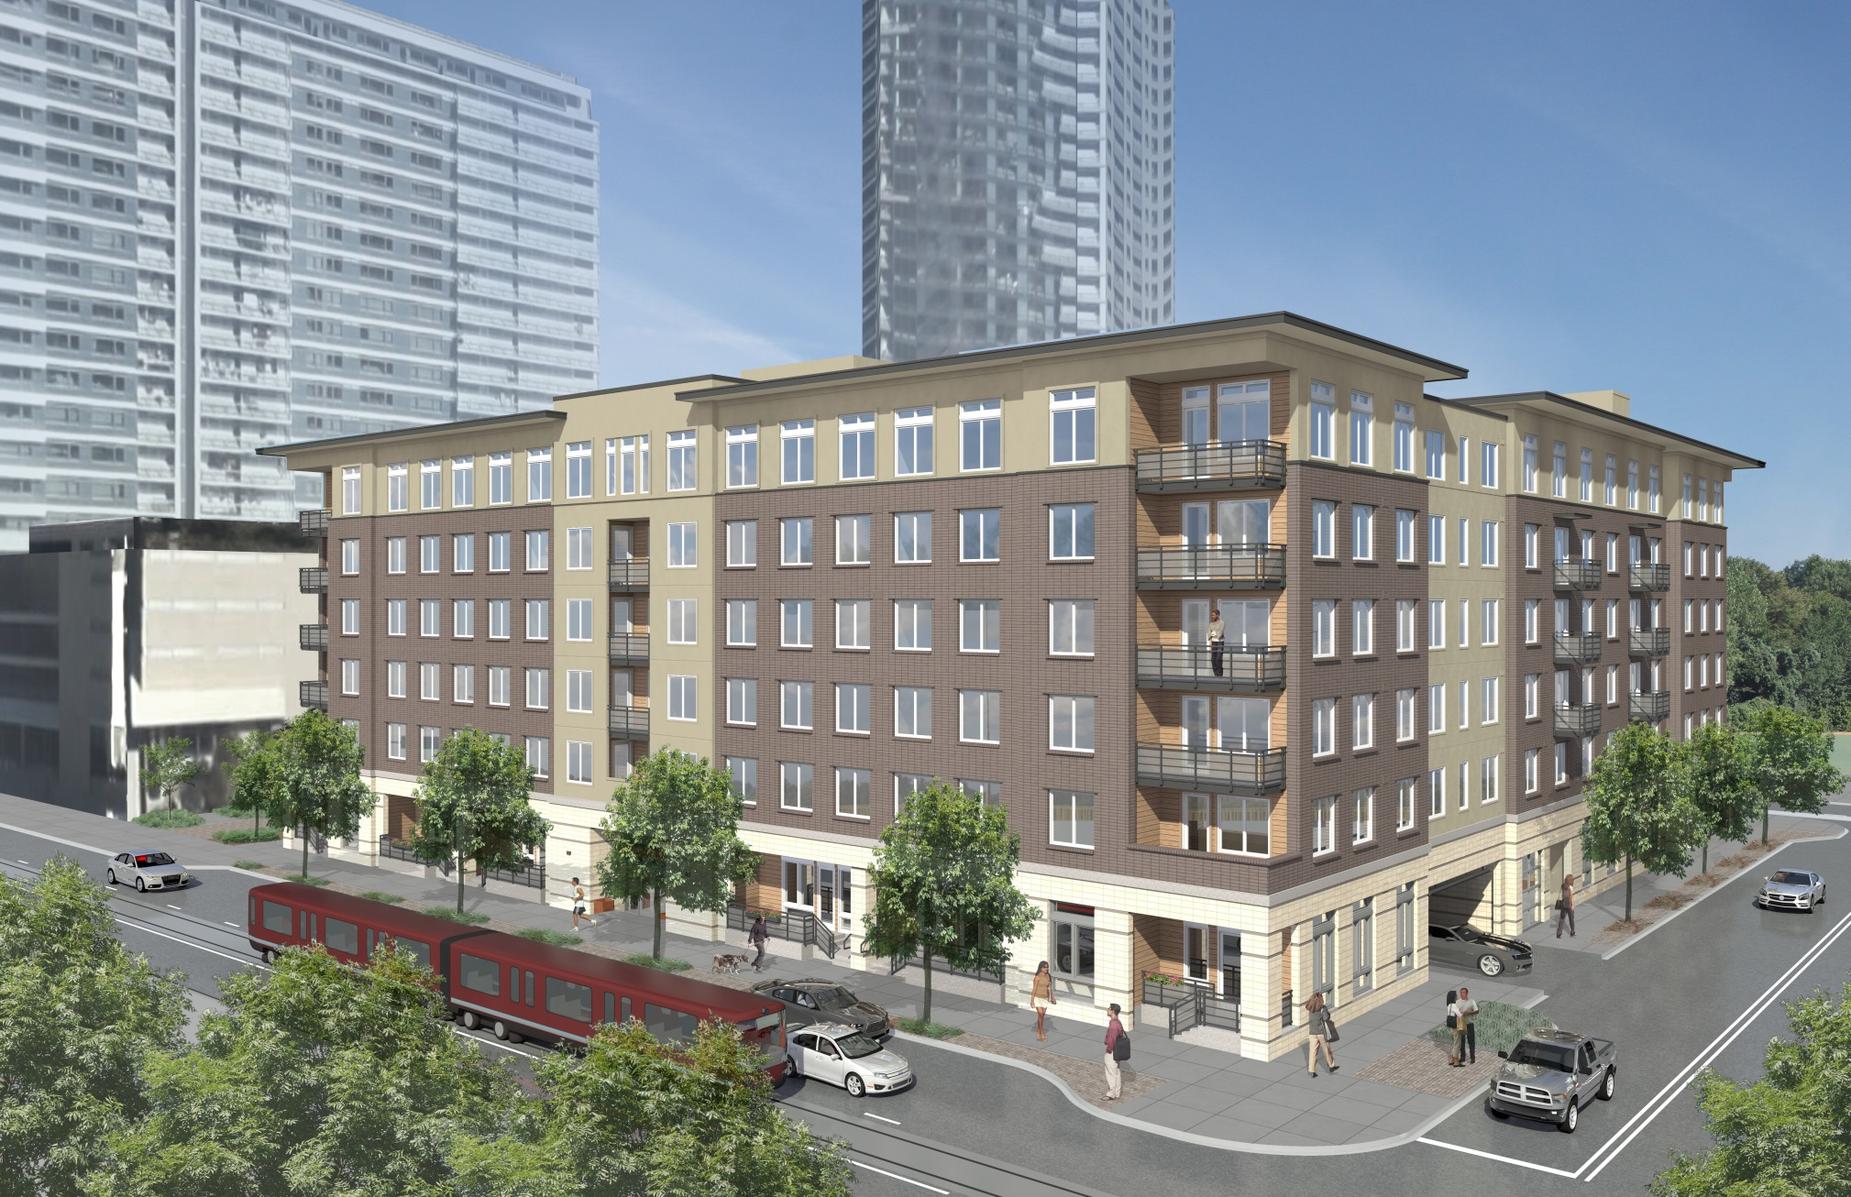
Current View – From SW Corner on Moody

Slide 11
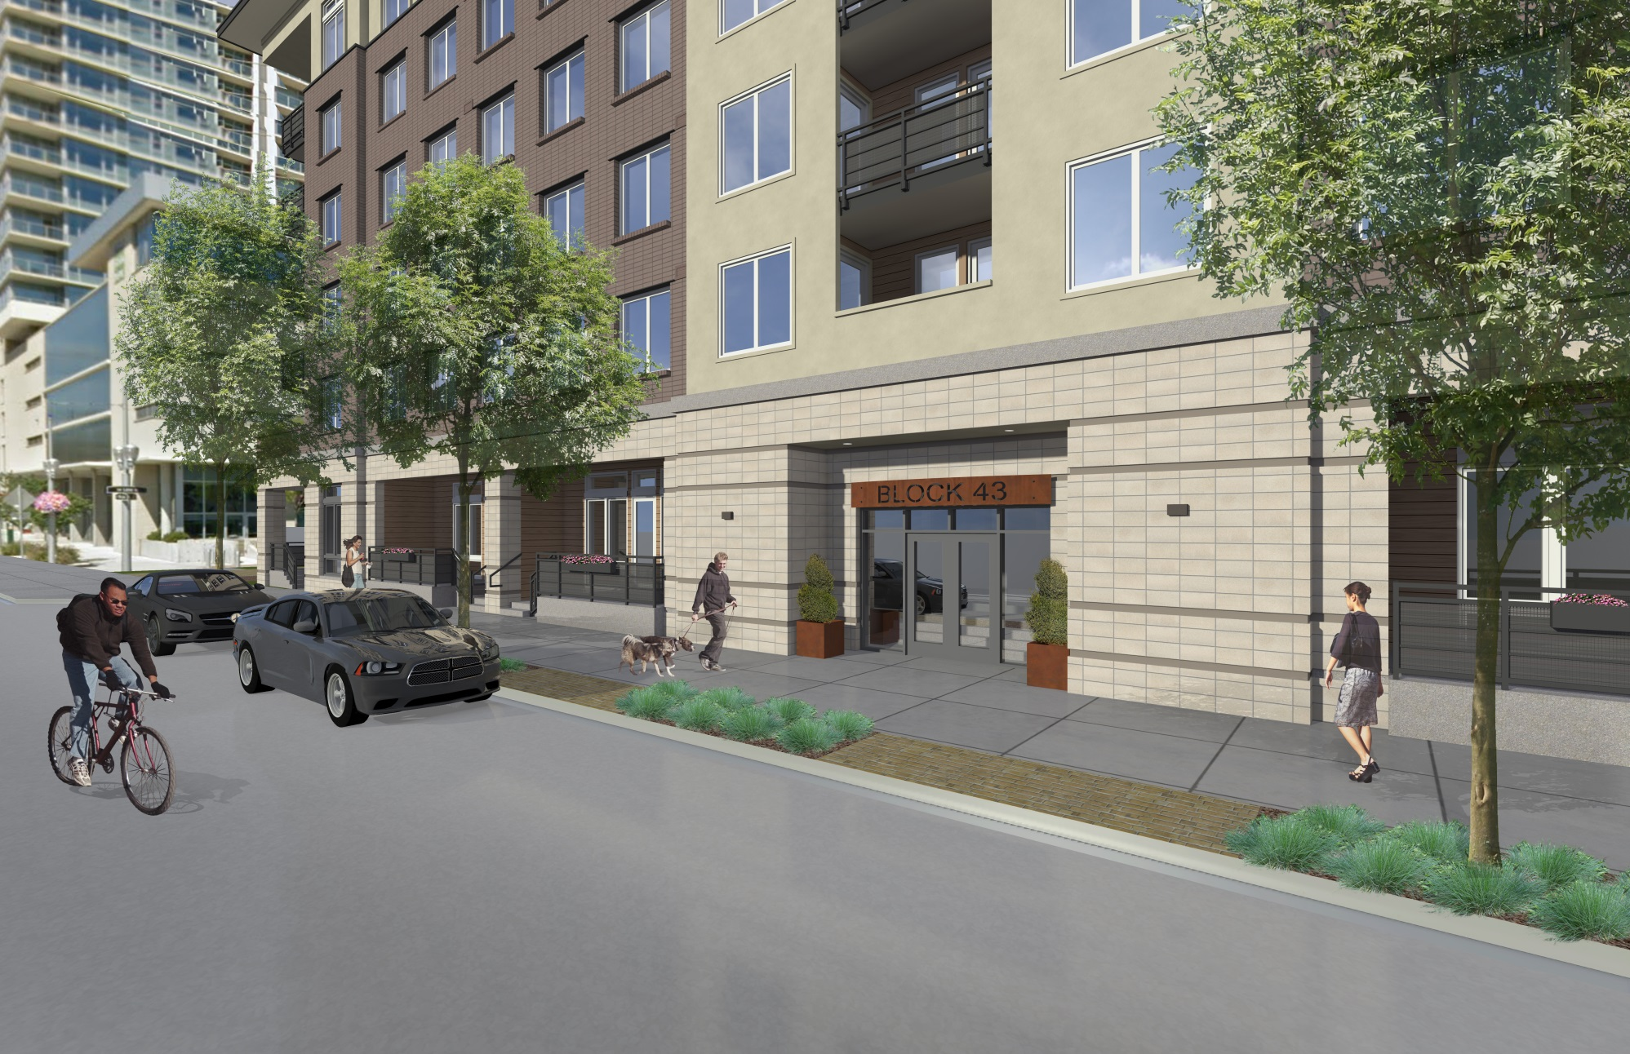
Current View – Street View Along Moody

Slide 12
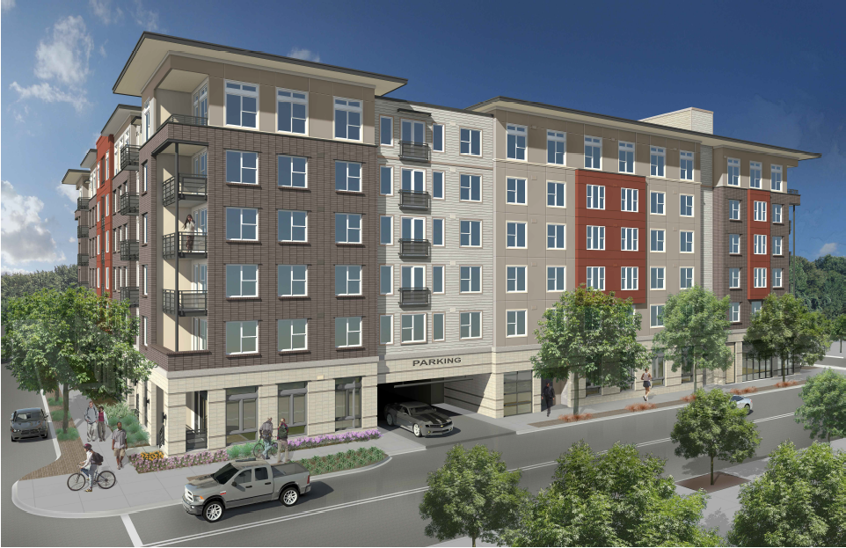
Former View – From SW Corner on Abernethy

Slide 13
Response
A more urban edge is preferred all around the building
Simplify the outside with a systematic material palette
Limit material palette to 3 materials; a 4th material is ok if the use is systematic
Remove structural column from corner balcony conditions
Incorporate lighting on all ground level facades, particularly at entry points
Relocate garage gate to face of building

Slide 14
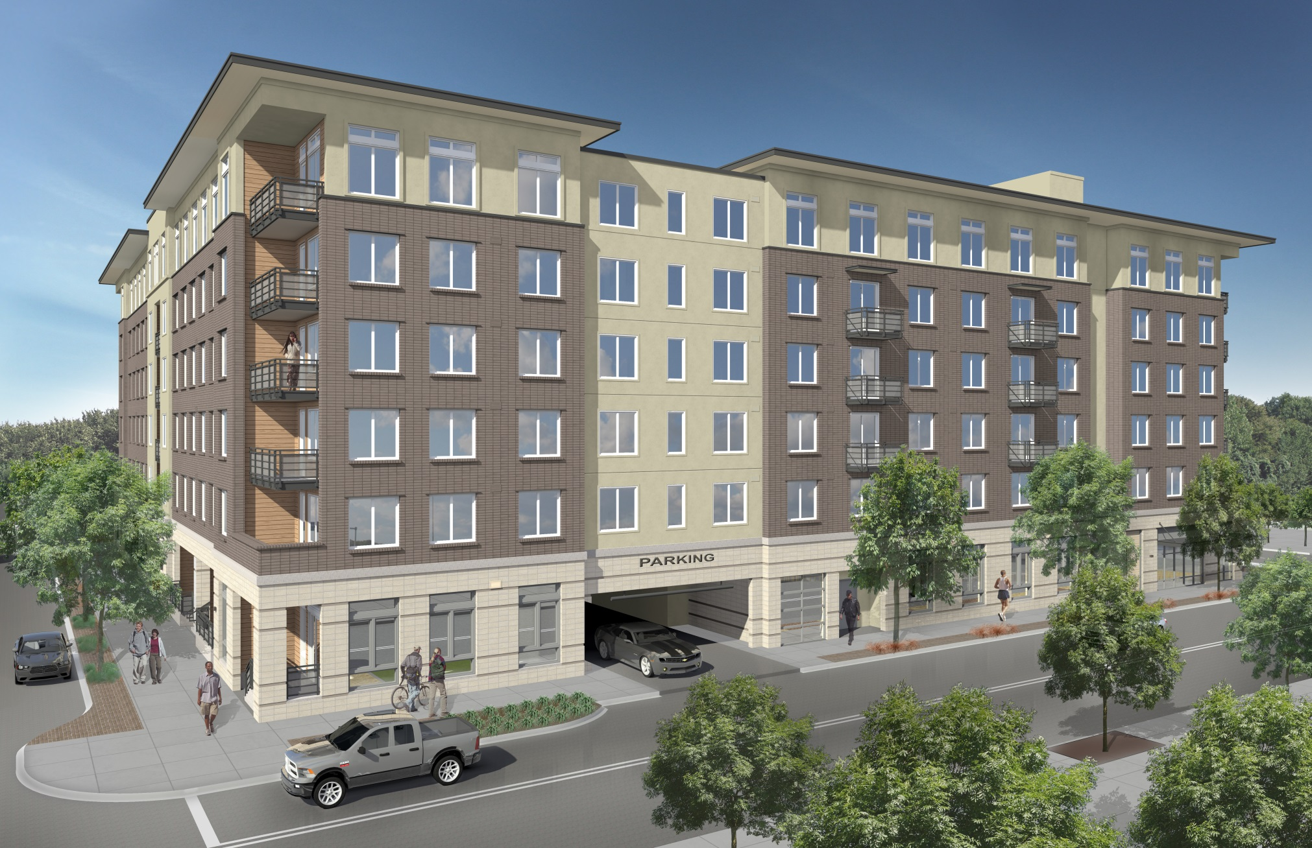
Current View – From SW Corner on Abernethy

Slide 15
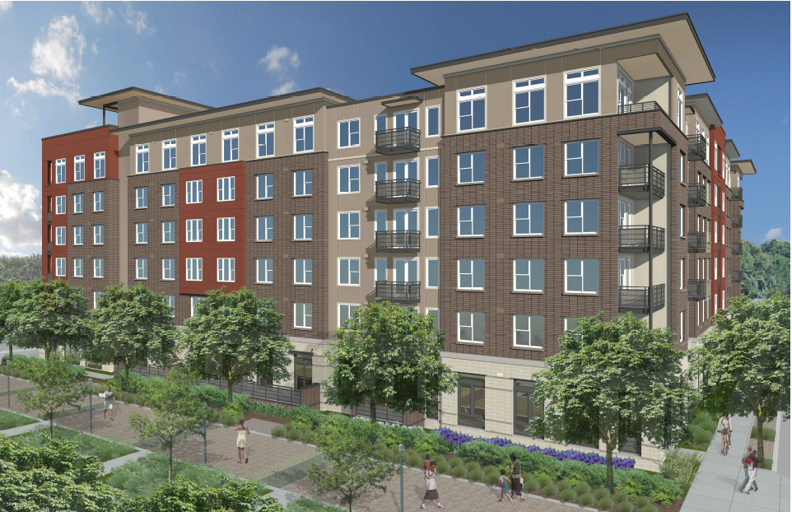
Former View – From NW on Lane

Slide 16
Response
Provide direct connections to SW Lane
Simplify the outside with a systematic material palette
Limit material palette to 3 materials; a 4th material is ok if the use is systematic
Remove structural column from corner balcony conditions
Incorporate lighting on all ground level facades, particularly at entry points

Slide 17
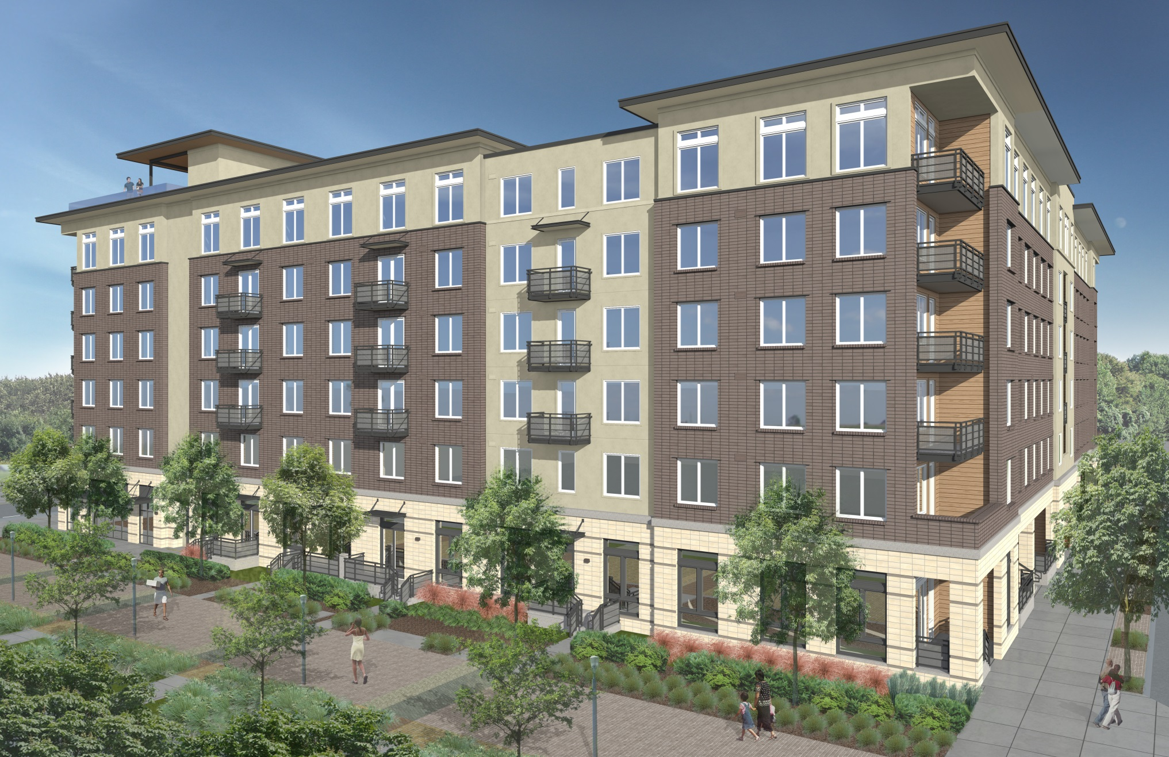
Current View – From NW on Lane

Slide 18
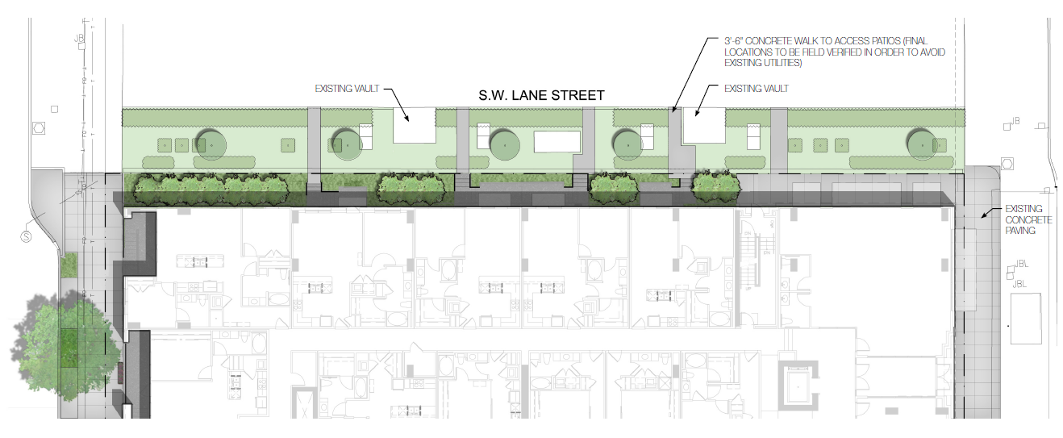
Current View – Connections to Lane

Slide 19
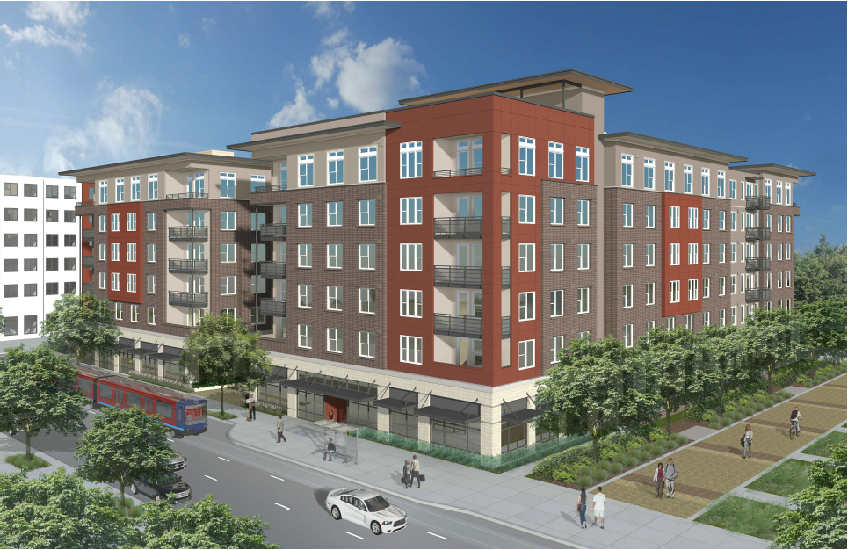
Former View – From NE Corner on Bond

Slide 20
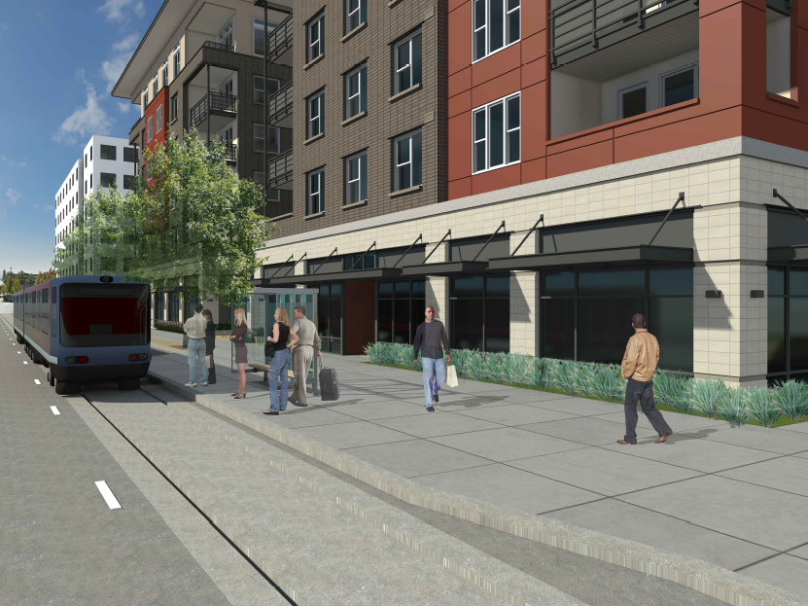
Former View – Street View of NE Corner From Bond

Slide 21
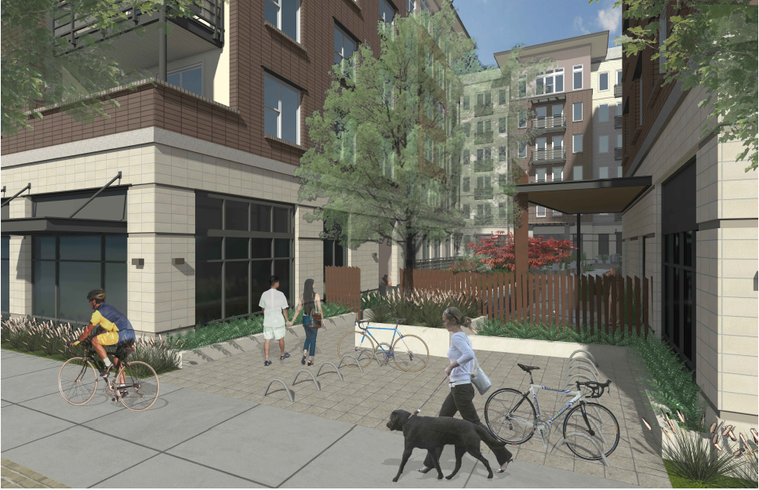
Former View – Street View of Courtyard Entry

Slide 22
Response
Establish a clear hierarchy of the entrances
A more urban edge is preferred all around the building
Simplify the outside with a systematic material palette
Remove structural column from corner balcony conditions
Incorporate lighting on all ground level facades, particularly at entry points
Rework courtyard entry to be oriented more for people than bike parking

Slide 23
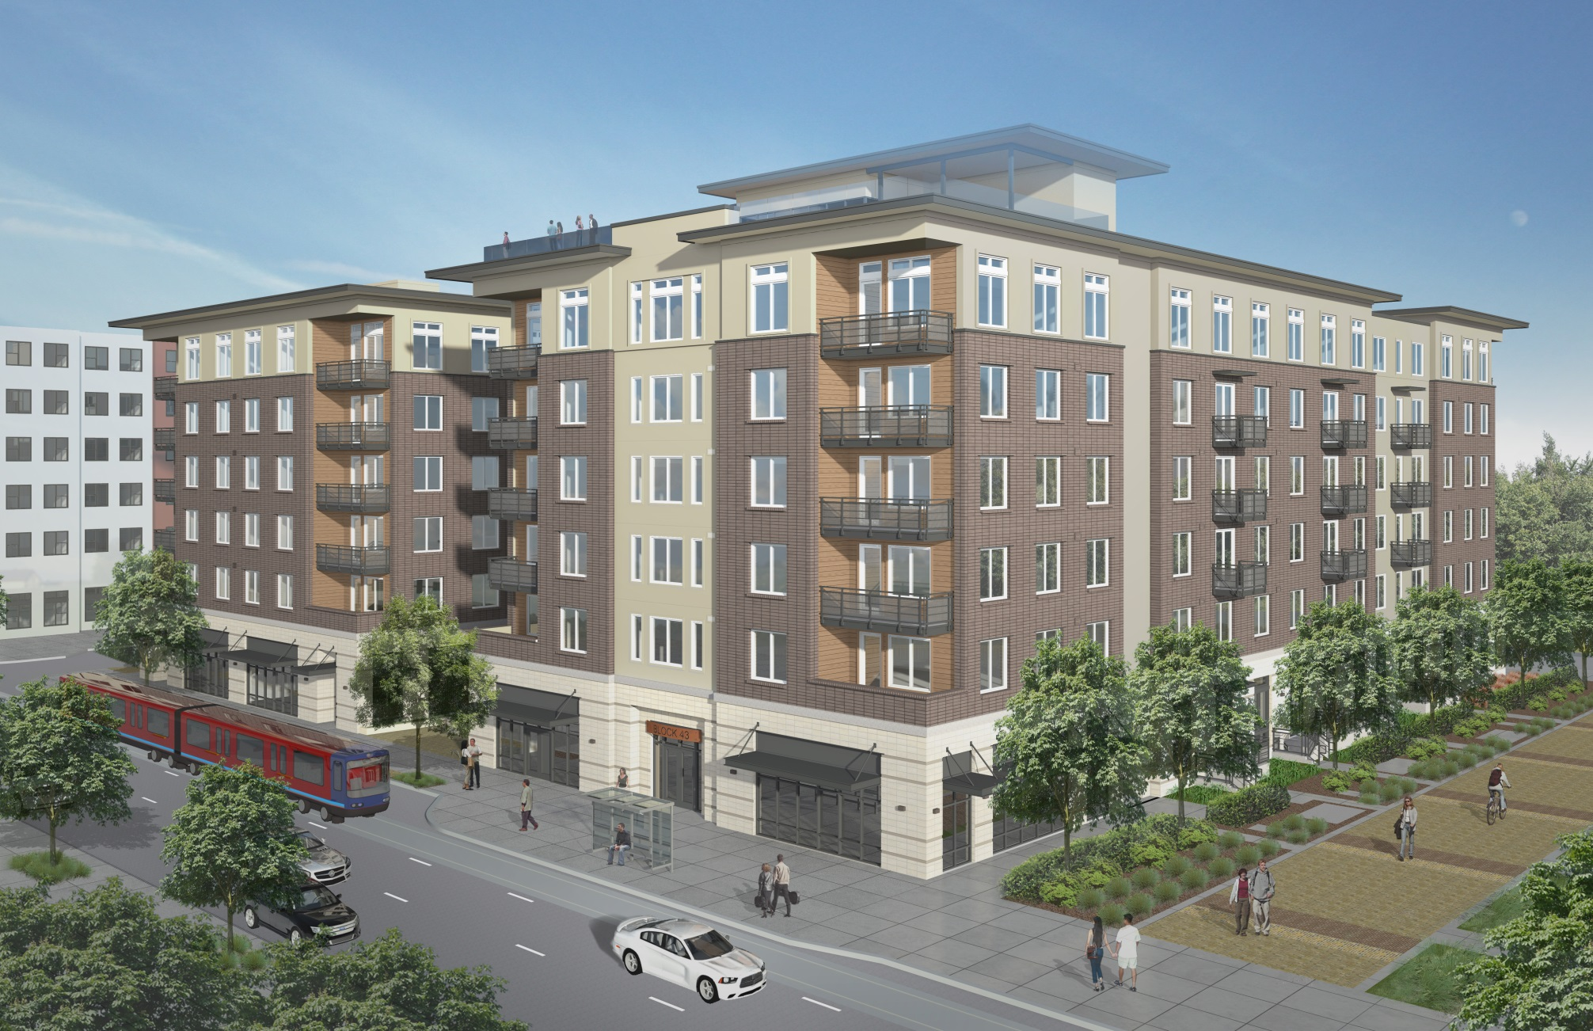
Current View – From NE Corner on Bond

Slide 24
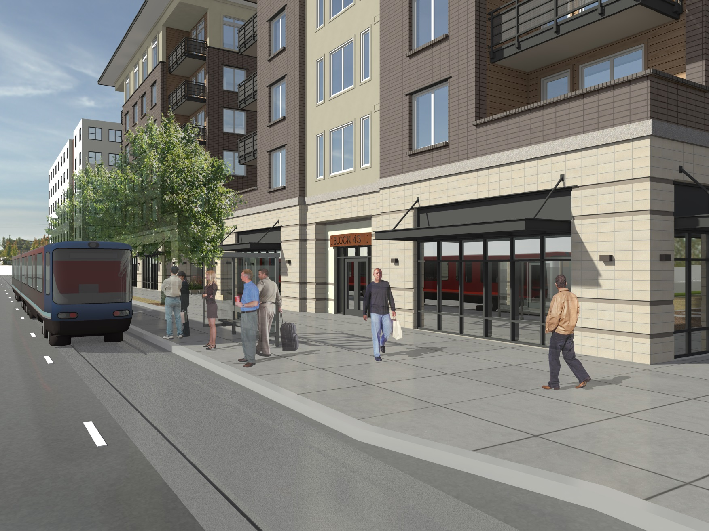
Current View – Street View of NE Corner From Bond

Slide 25
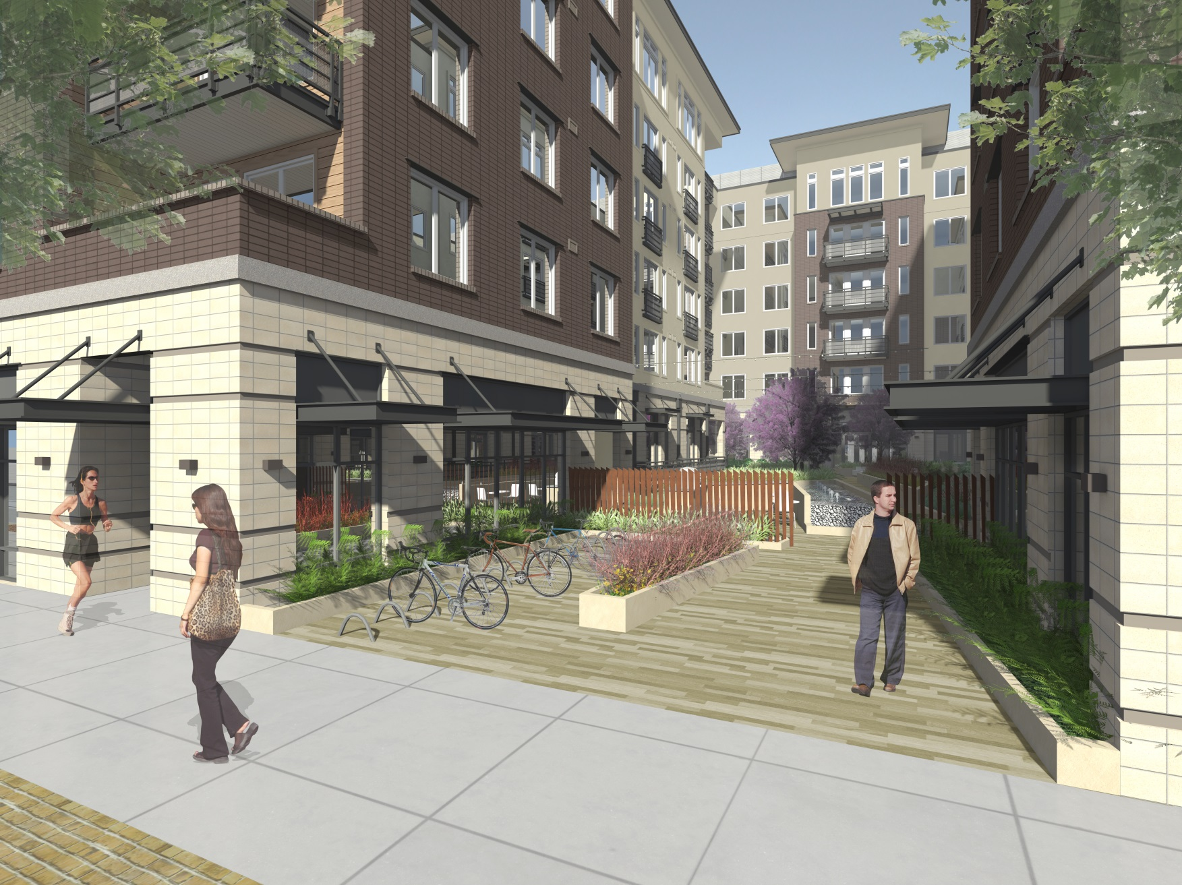
Current View – Street View of Courtyard Entry

Slide 26
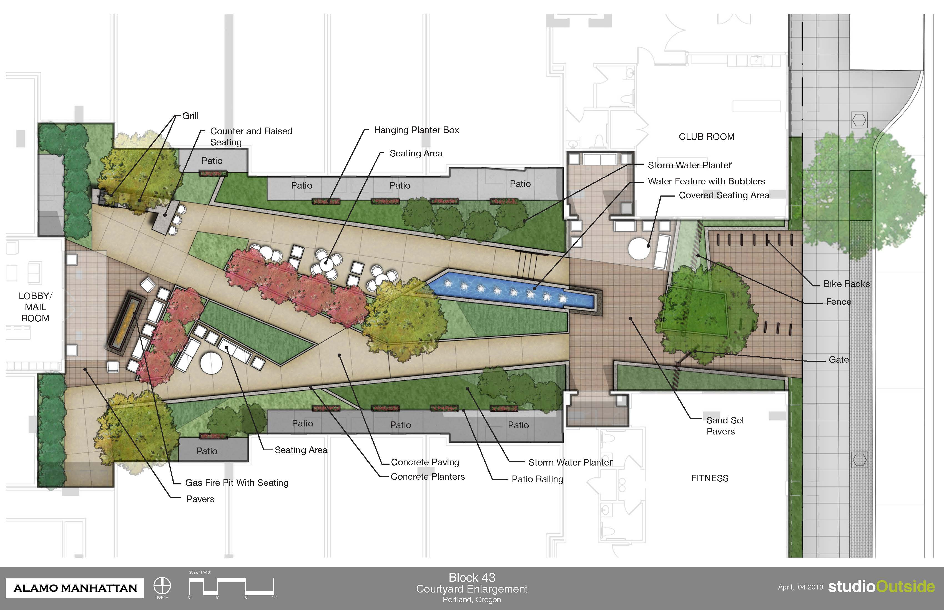
Former Courtyard Landscape Design

Slide 27
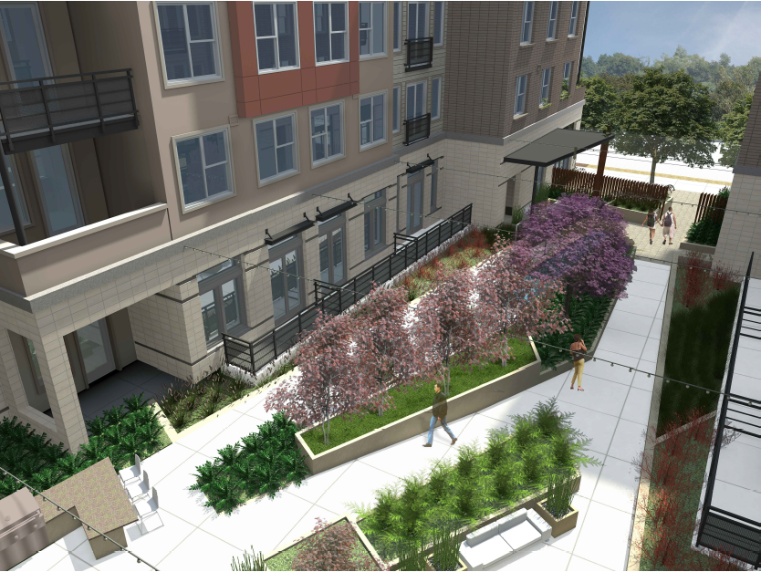
Former View – Elevated View of Courtyard

Slide 28
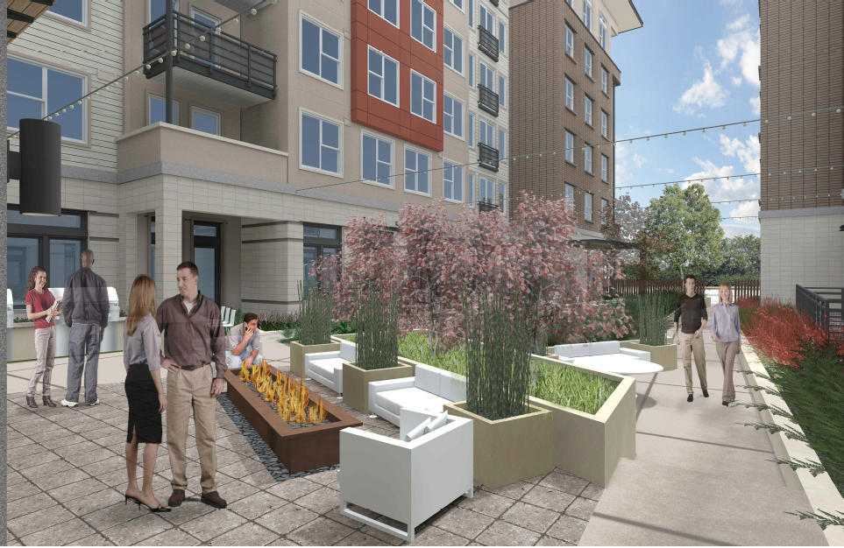
Former View – Courtyard View Toward Bond

Slide 29
Response
Rework courtyard entry to be oriented more for people than bike parking
Usability of the courtyard needs consideration; simplify
Create connection between building architecture and landscape design

Slide 30
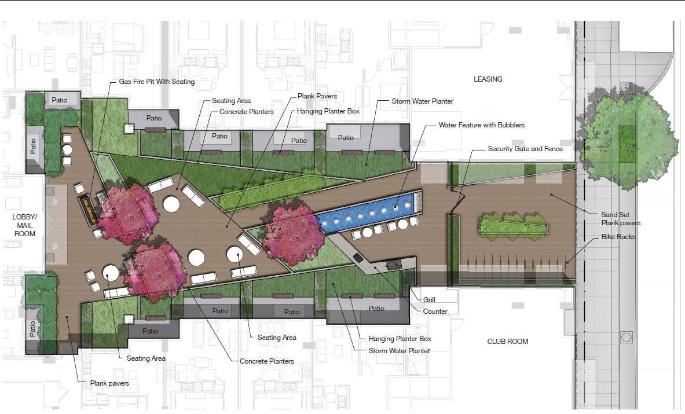
Current Courtyard Landscape Design

Slide 31
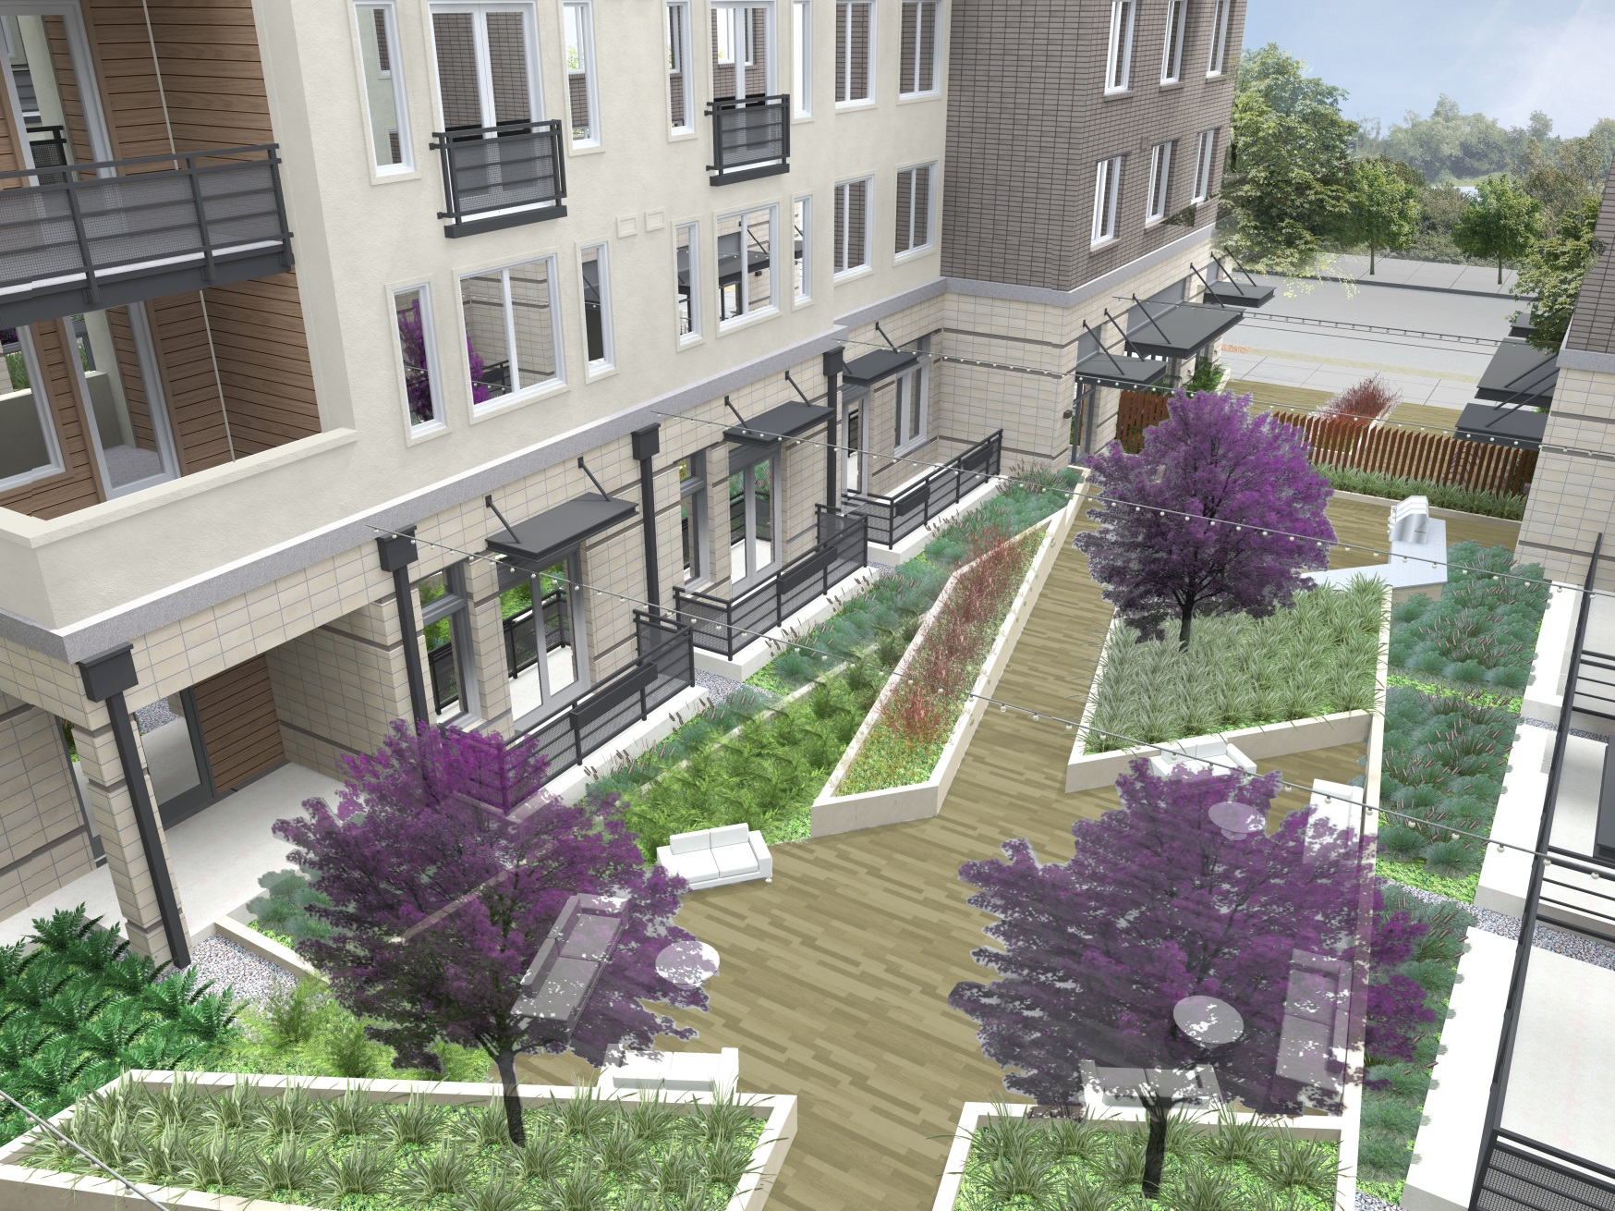
Current View – Elevated View of Courtyard

Slide 32
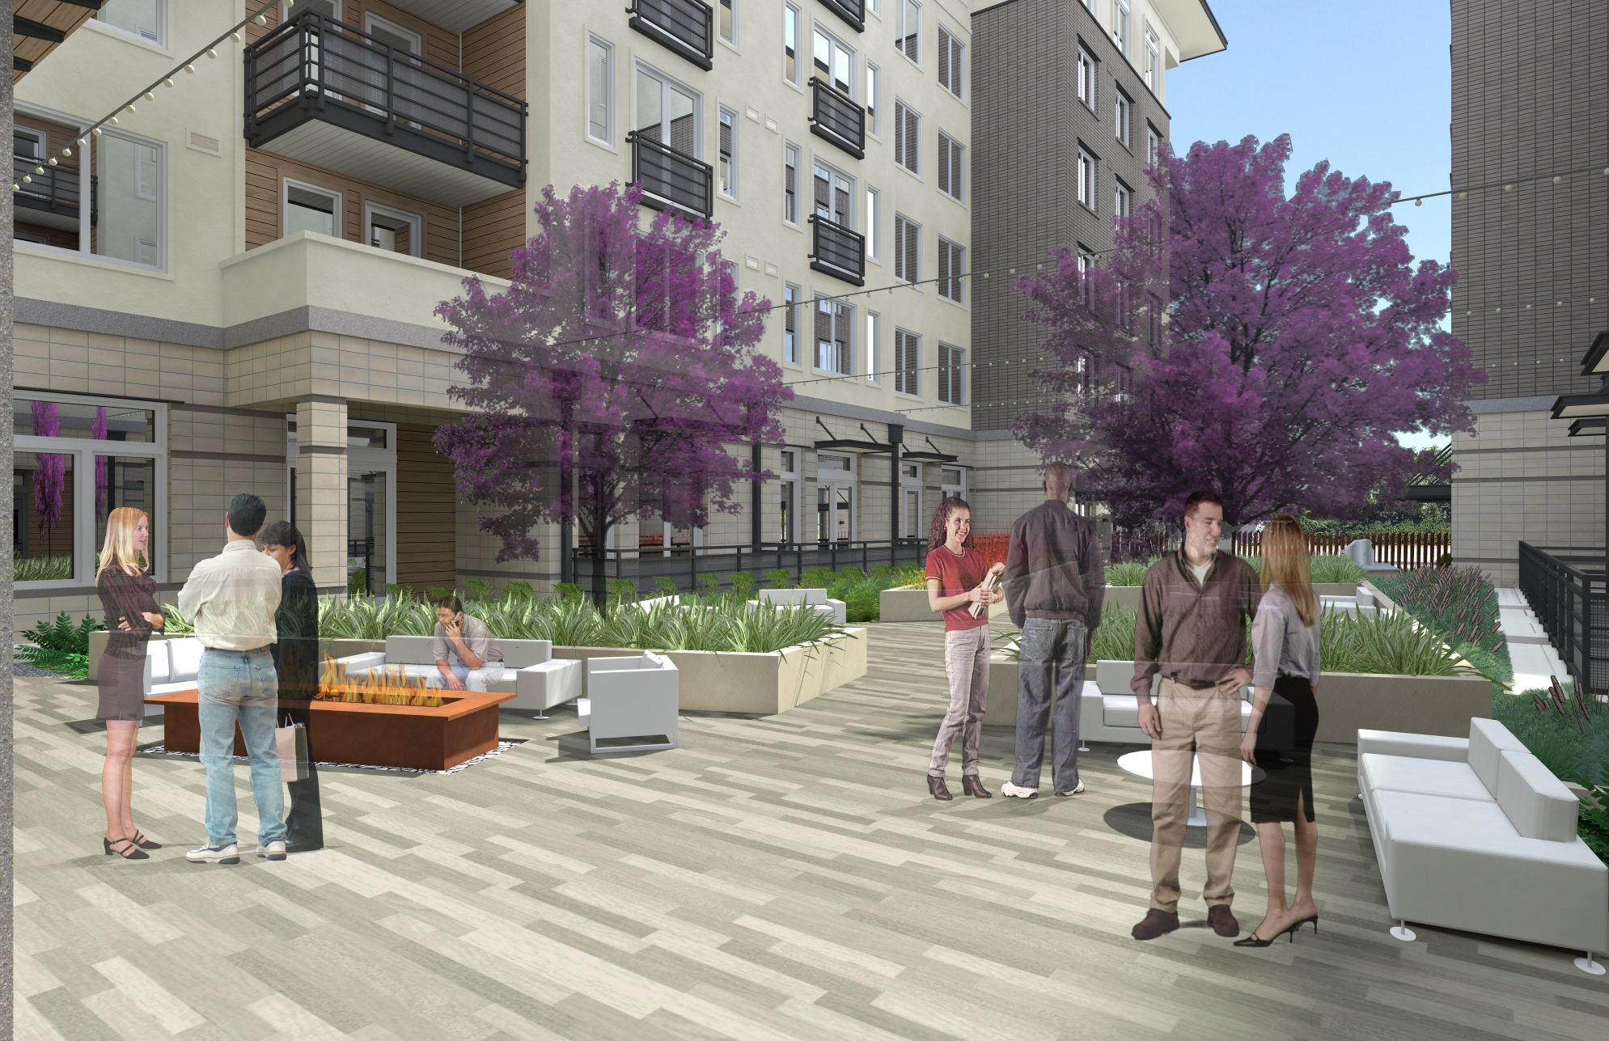
Current View – Courtyard View Toward Bond

Slide 33
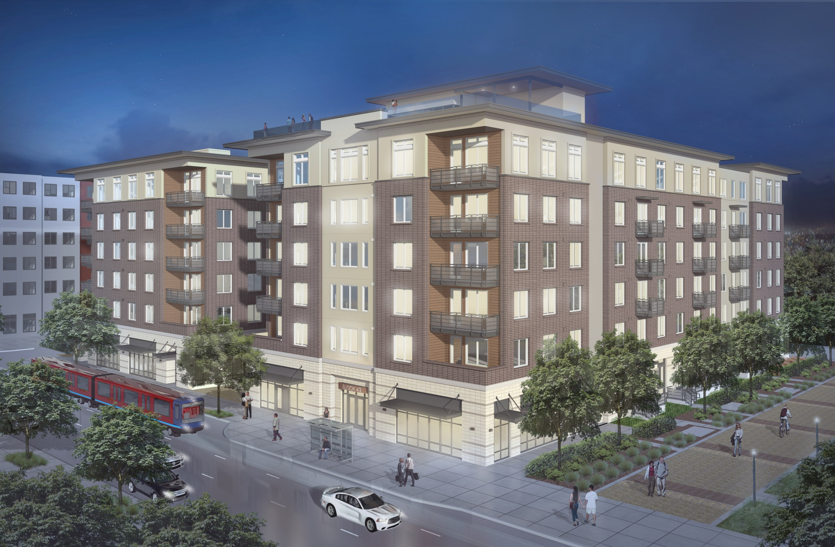
BLOCK 43 APARTMENTS
Block 43 Apartments

Slide 34
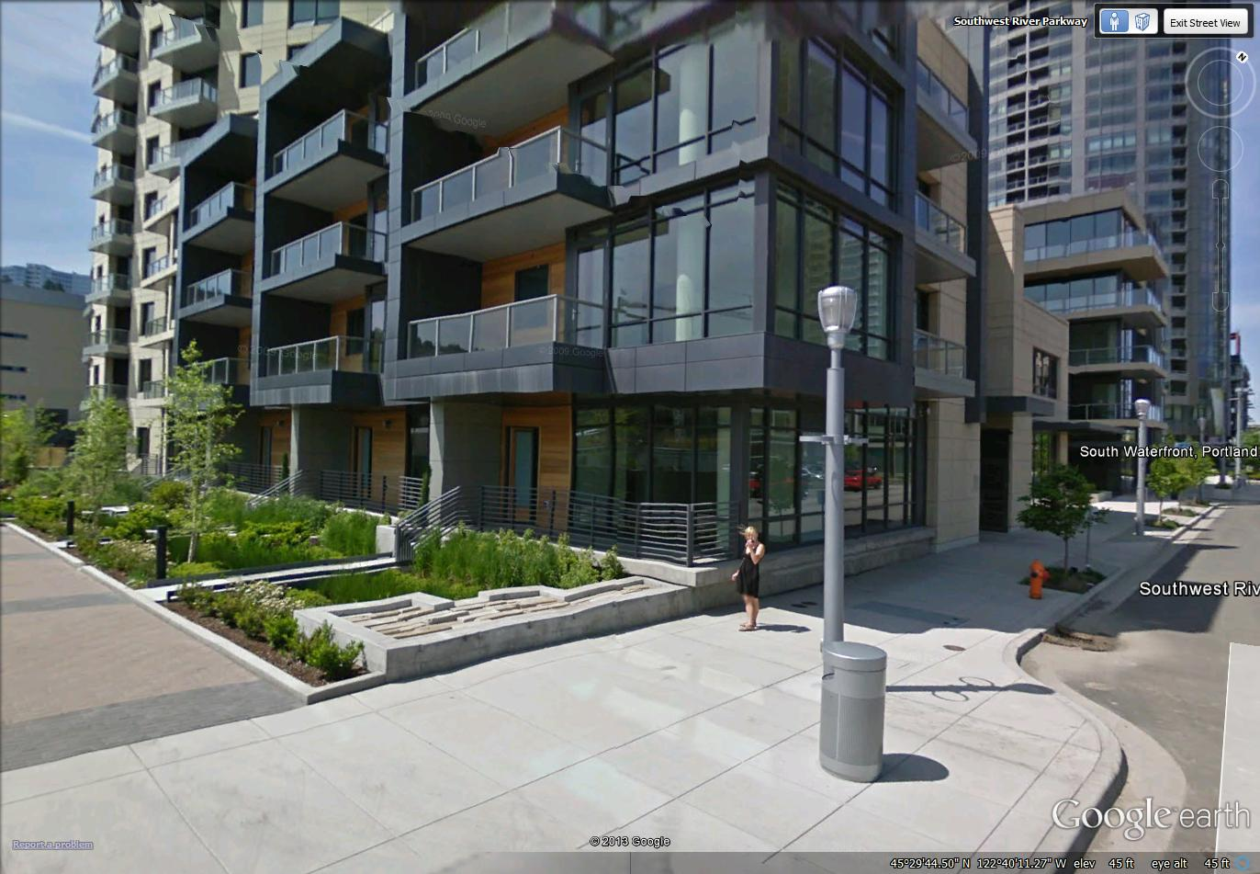
The Ardea

Slide 35
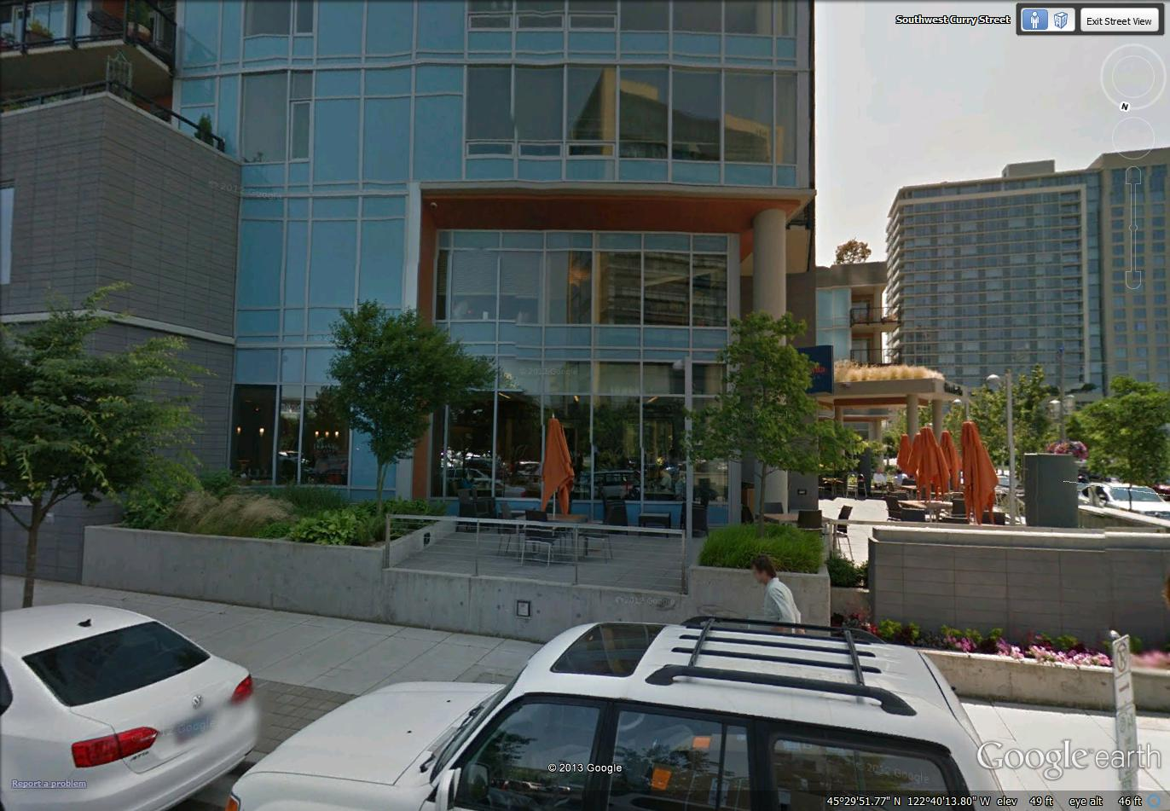
Mirabella

Slide 36
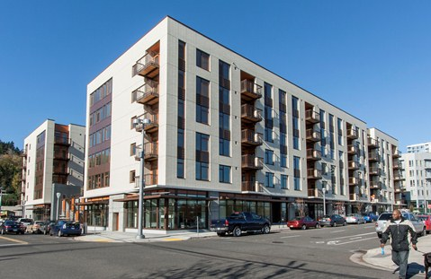
Gray’s Landing Apartments

Slide 37
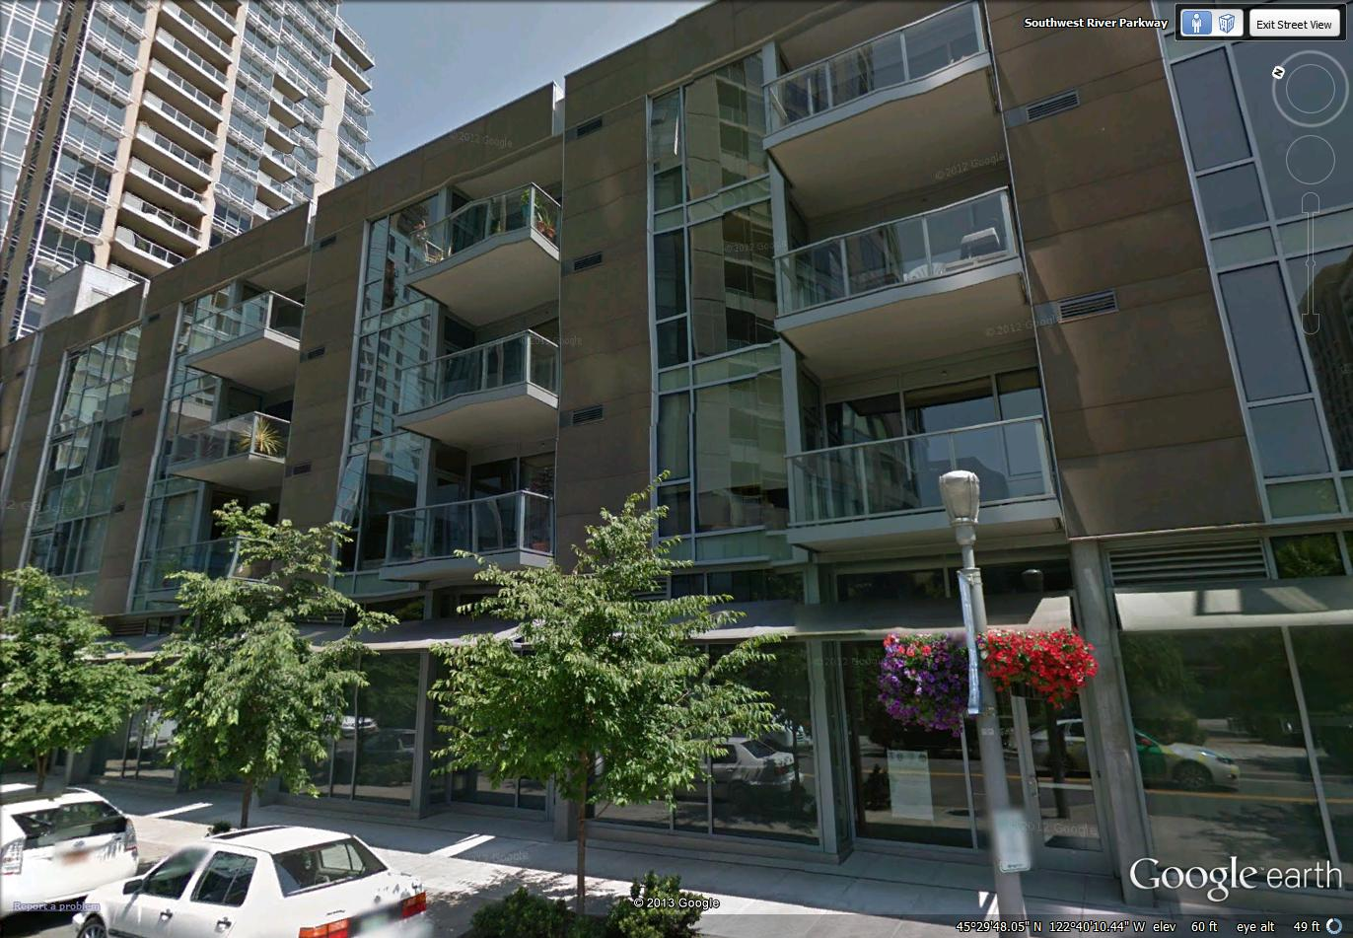
Atwater Place

Slide 38
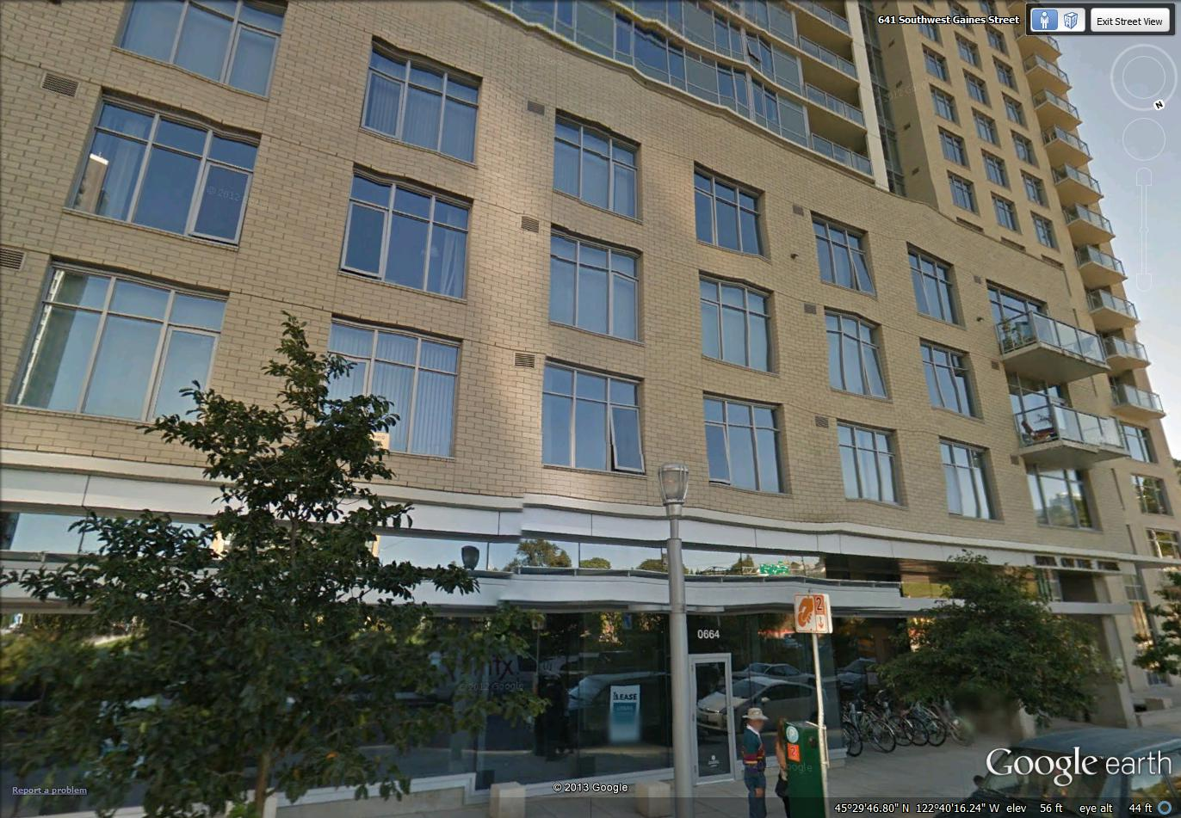
Riva on the Park

Slide 39
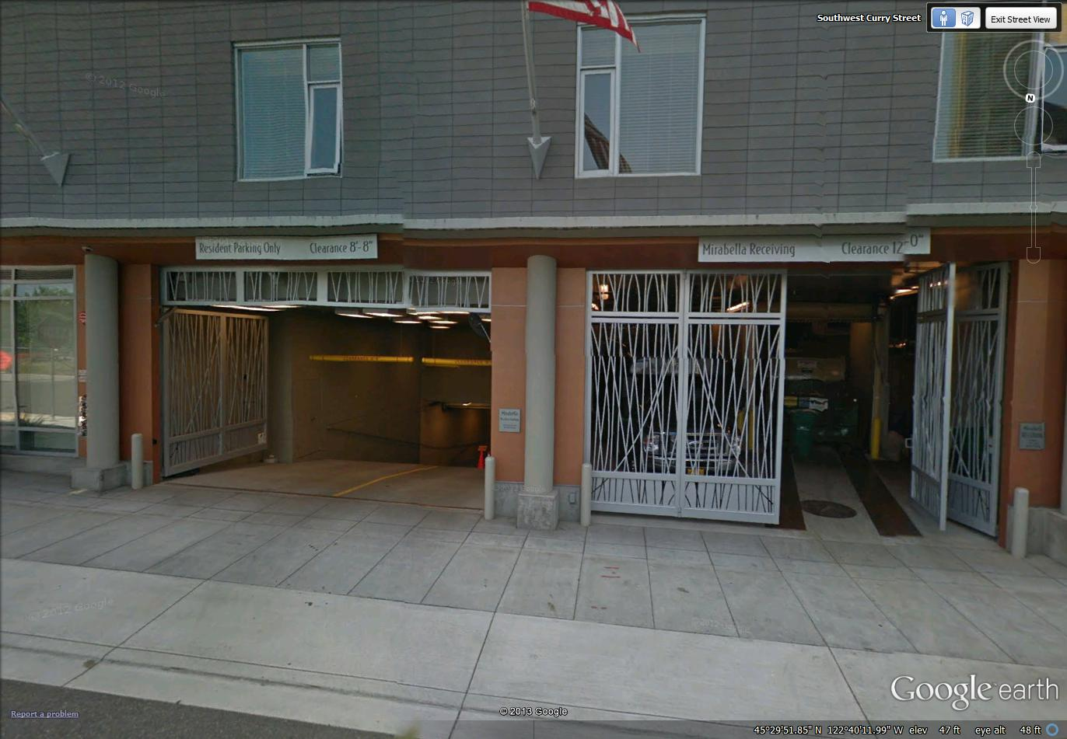
Mirabella

Slide 40
Thank you.
Questions?

