Slide 1
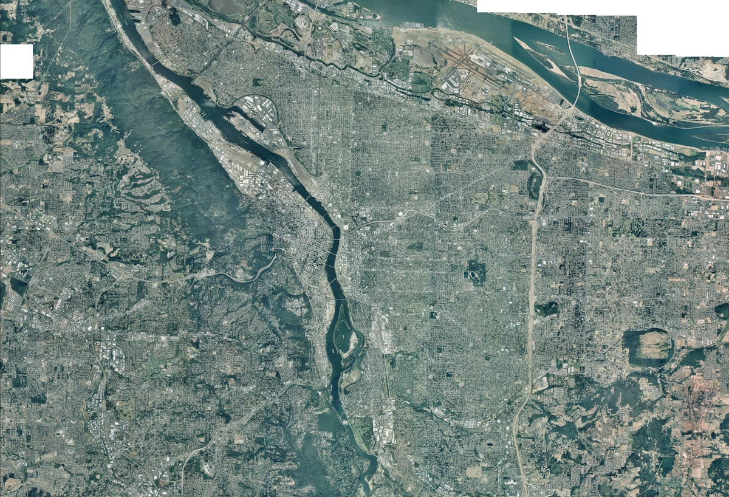
Comprehensive Plan Working Draft:
Urban Design Framework
Urban Design and Development Goals and Policies
Portland Design Commission
March 14, 2013

Slide 2
WHAT IS AN URBAN DESIGN FRAMEWORK?
A roadmap to the future physical form of the city, giving a spatial dimension to the goals and policies

Slide 3
What is the purpose of the framework?
Describe the city’s growth strategy and approach
Guide decision-making based on context
Convey intent behind zoning and implementation
Prioritize public investments
Comprehensive Plan Map

Slide 4
What does it build on?
Metro 2040
Notes:
Adopted by Metro in the mid-1990s
update with a Portland-specific framework that builds on the goals and policies of the Comp Plan

Slide 5
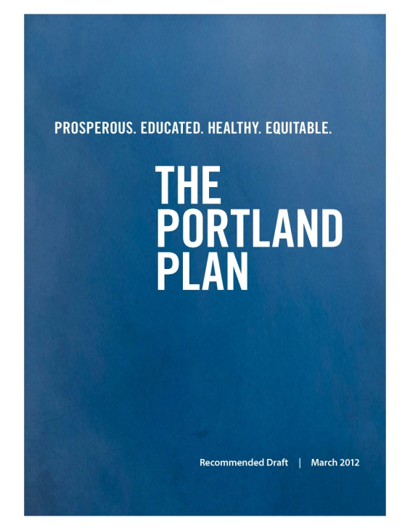
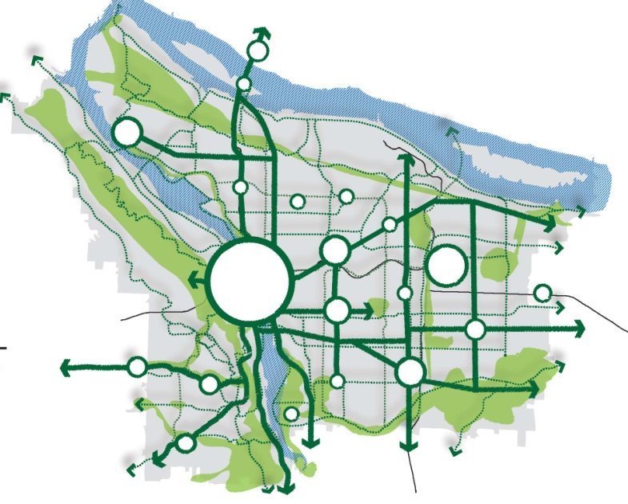
What does it build on?
Portland Plan’s
Healthy Connected City Strategy:
Focusing growth and change
Growing our natural resources
Linking a healthy city
Highlighting key places and features

Slide 6
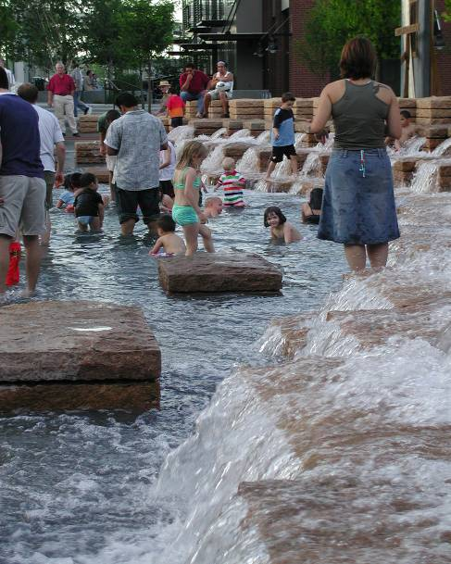
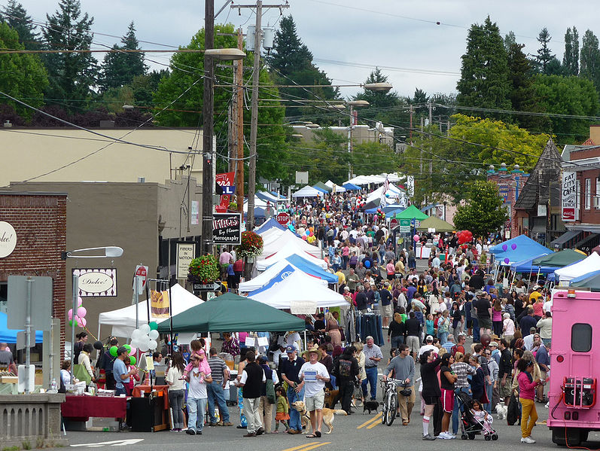
Design for People:
Places that support the lives of Portlanders

Slide 7
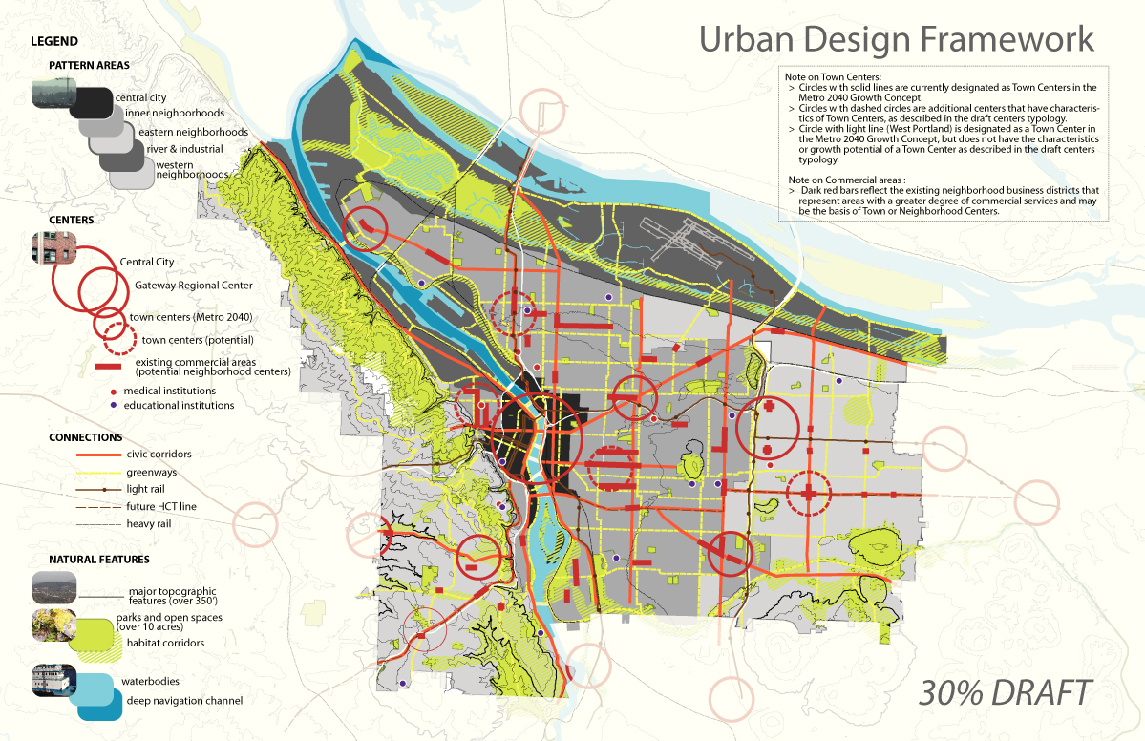
Focusing Growth and Change = Centers
Linking a Healthy City = Connections
Growing our Natural Resources = Natural Features
One Size Doesn’t Fit All = Pattern Areas

Slide 8
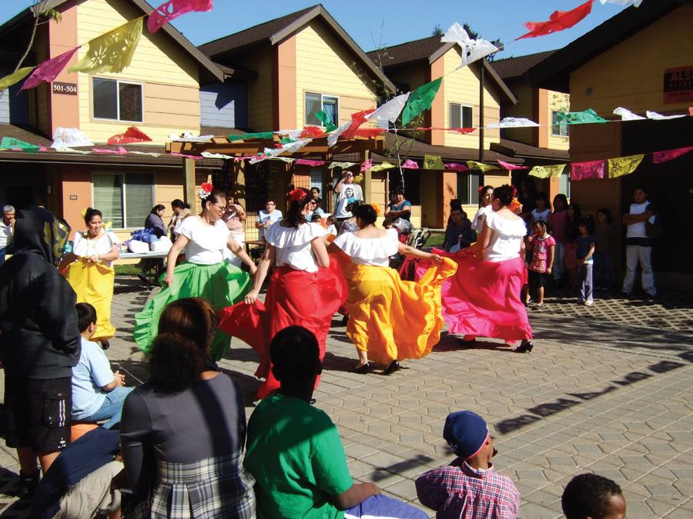
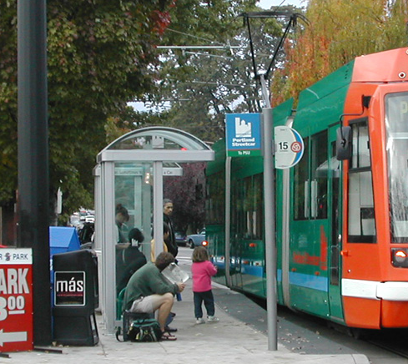
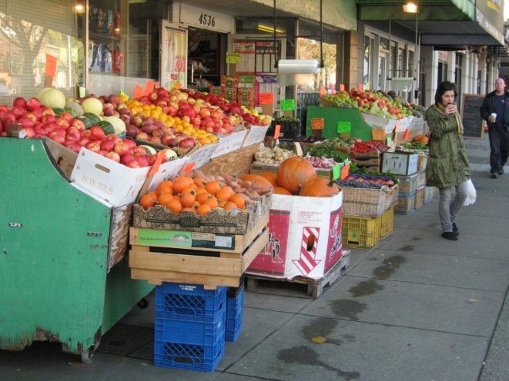
Centers
Local access to services, businesses and amenities
Range of housing and employment opportunities
Prioritized for public investments

Slide 9
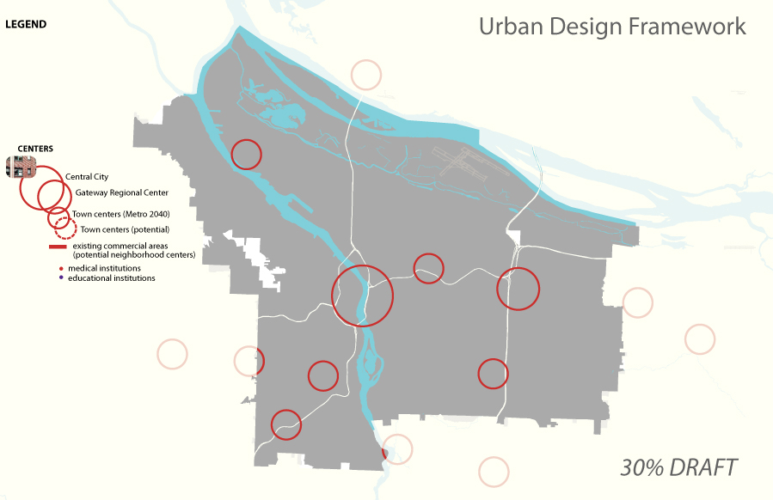

Centers

Slide 10
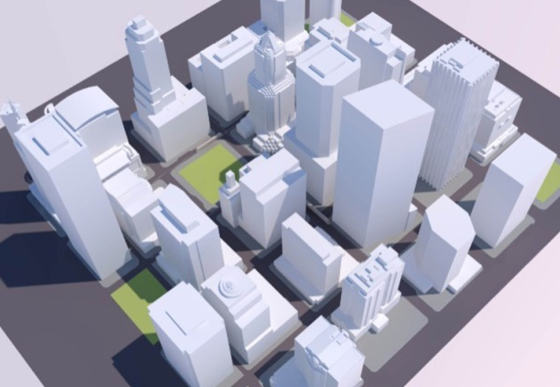
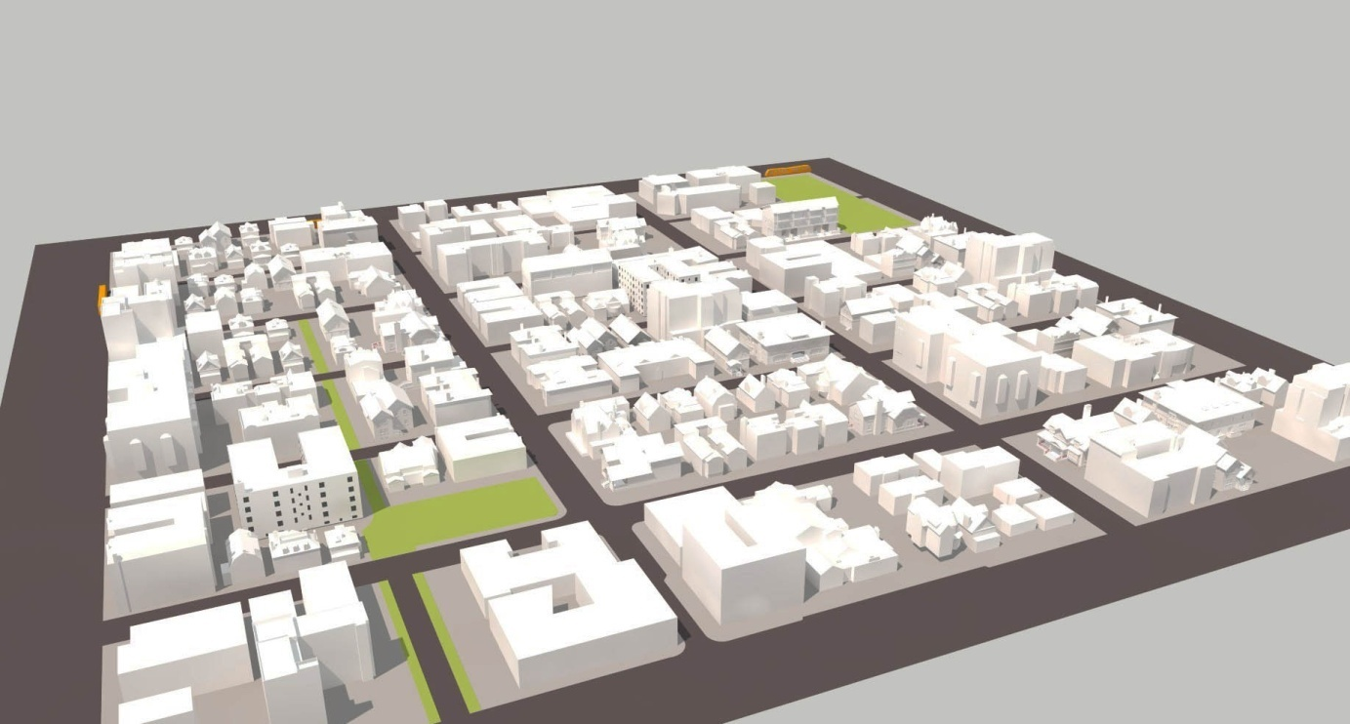
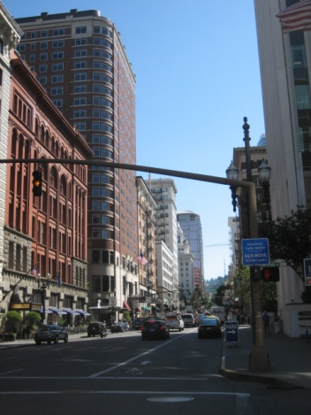
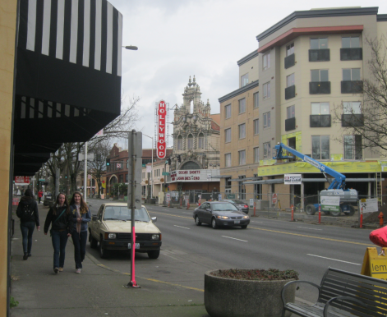
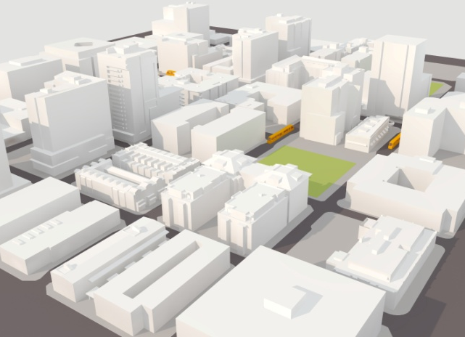
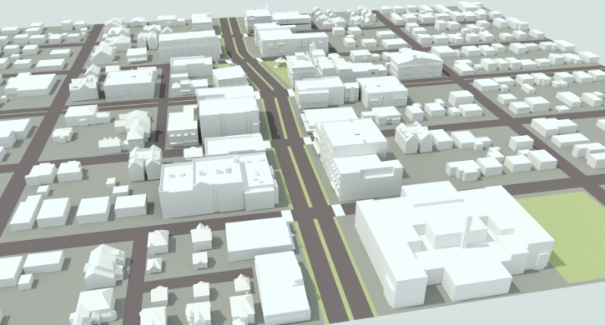
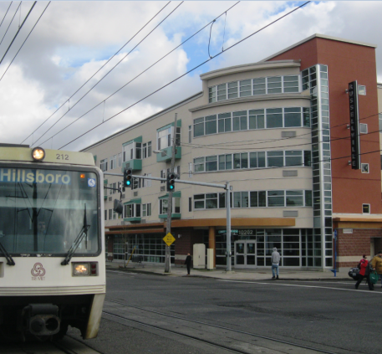
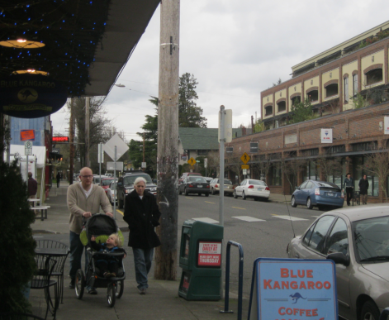
Centers: What are they?
Central City
Town Center
Gateway Regional Center
Neighborhood Center

Slide 11
Focusing Growth and Change = Centers
Linking a Healthy City = Connections
Growing our Natural Resources = Natural Features
One Size Doesn’t Fit All = Pattern Areas

Slide 12
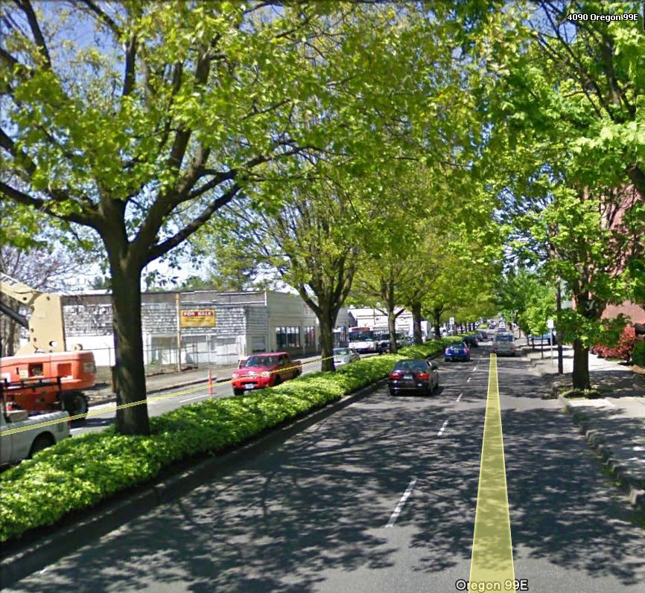
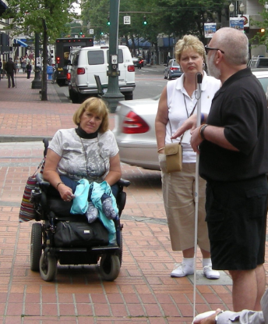
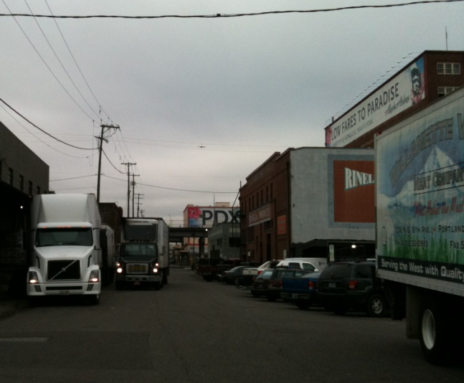
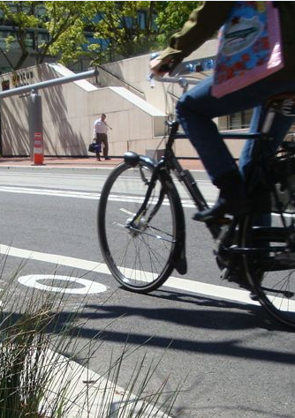
Connections
Improve safety, identity and placemaking
Increase choices for mobility, health
Link economic centers, civic amenities, parks

Slide 13
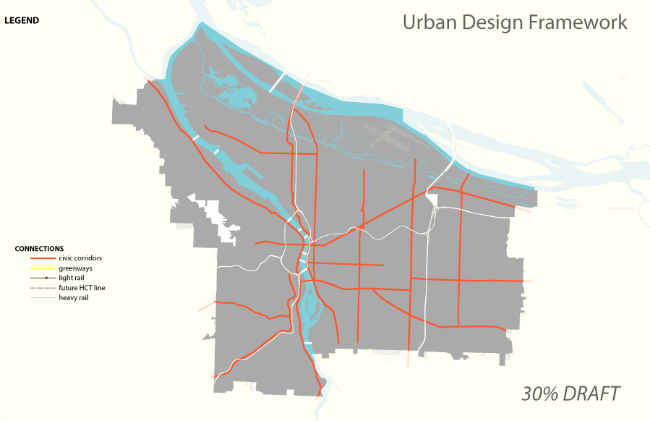
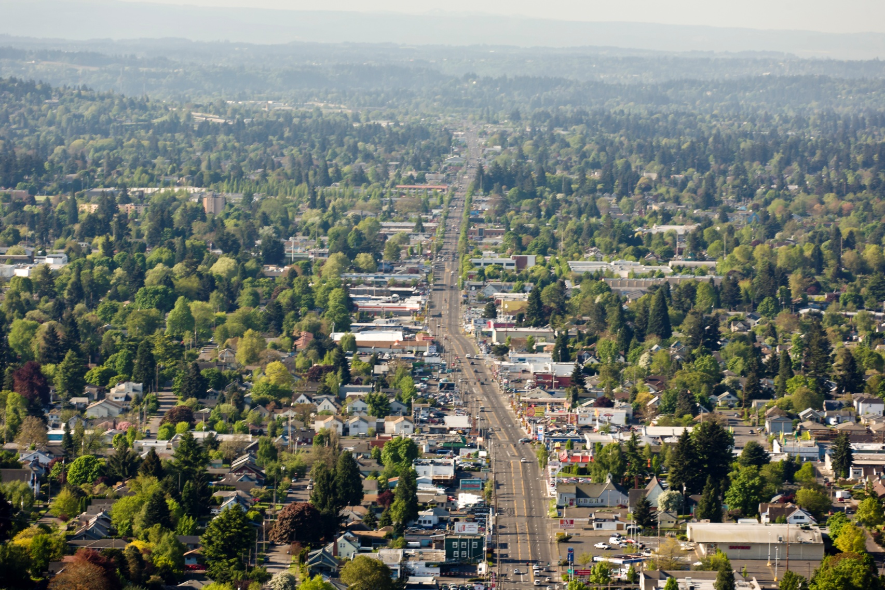
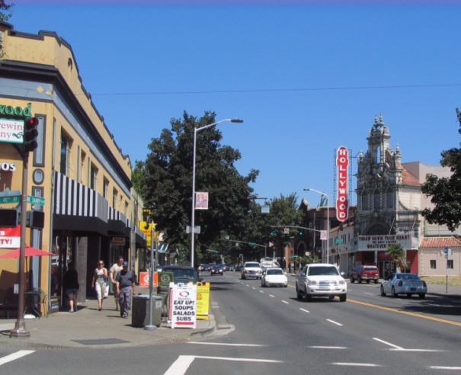
Connections
Civic Corridors

Slide 14
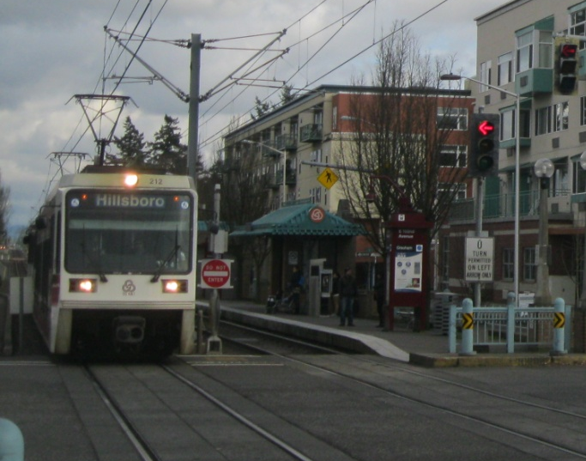
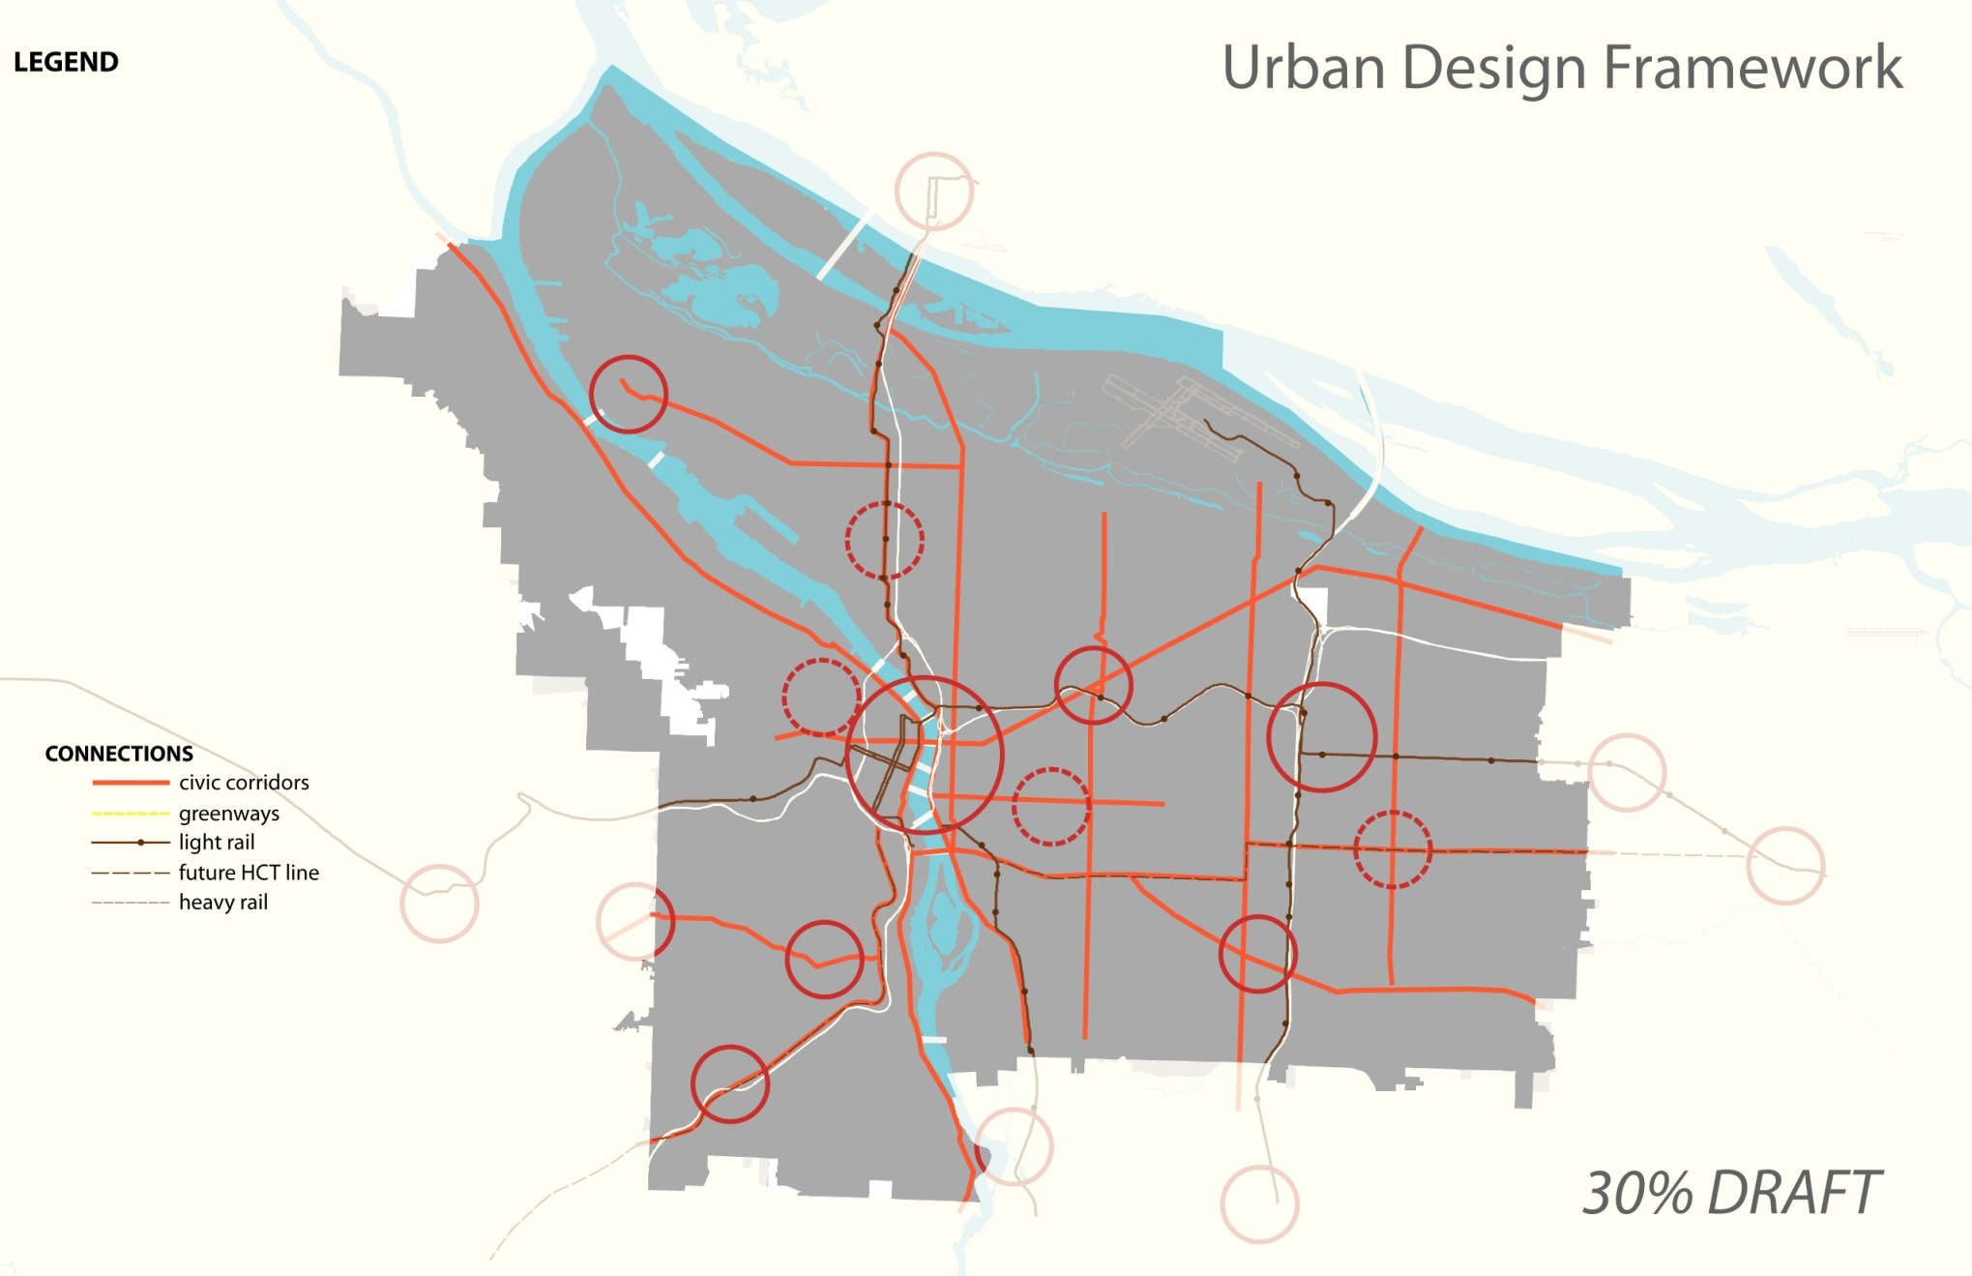
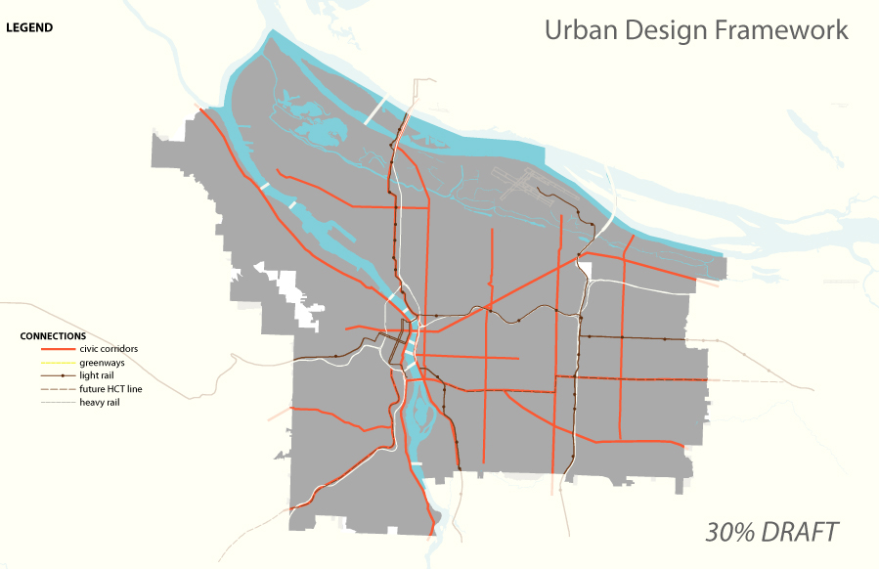
Connections
High-Capacity Transit Corridors

Slide 15
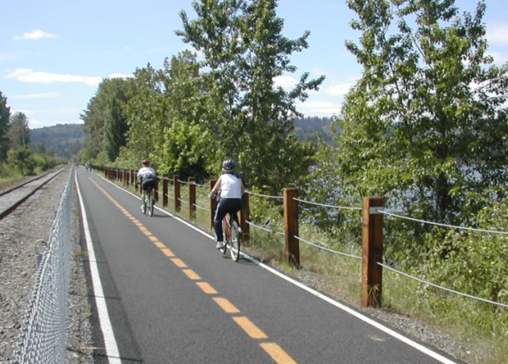
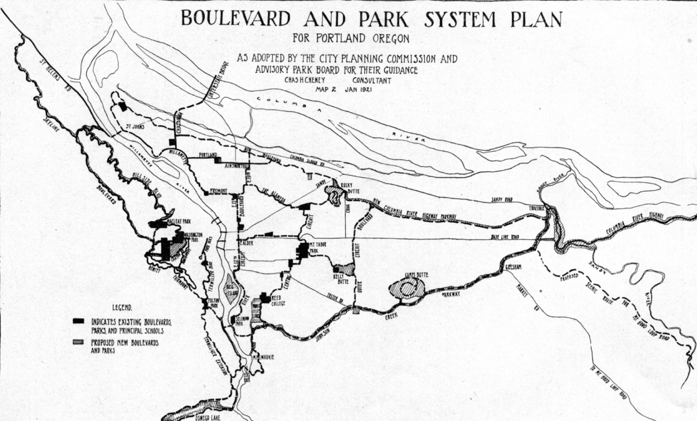
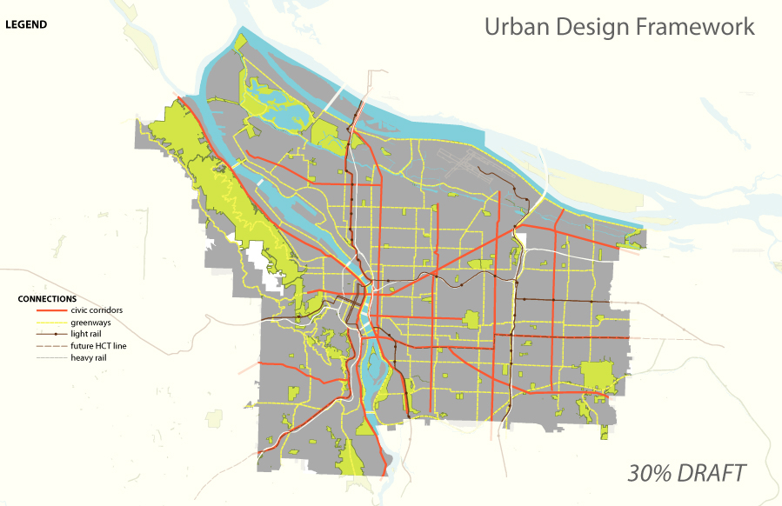
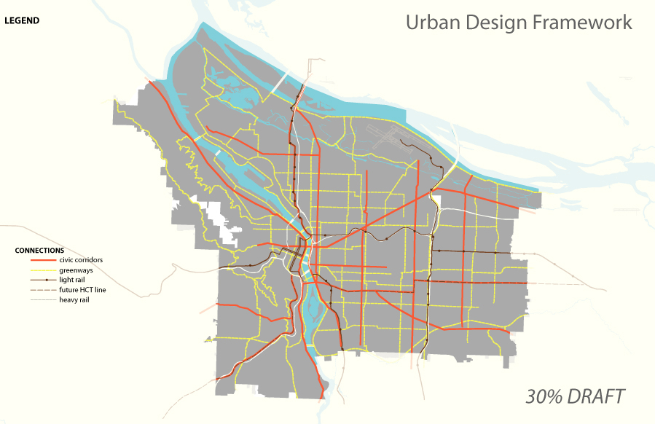
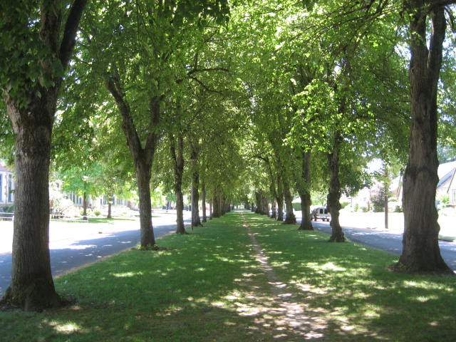
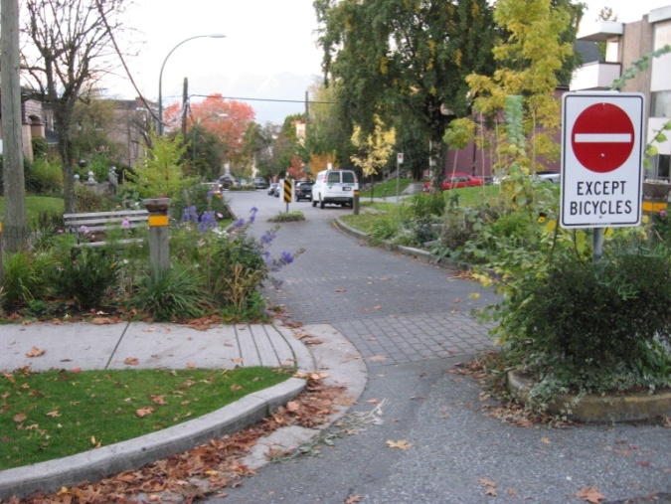
Connections
Greenways

Slide 16
Focusing Growth and Change = Centers
Linking a Healthy City = Connections
Growing our Natural Resources = Natural Features
One Size Doesn’t Fit All = Pattern Areas

Slide 17
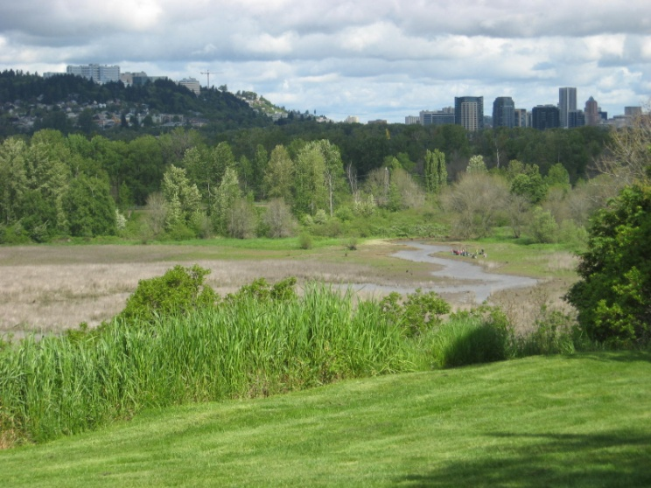
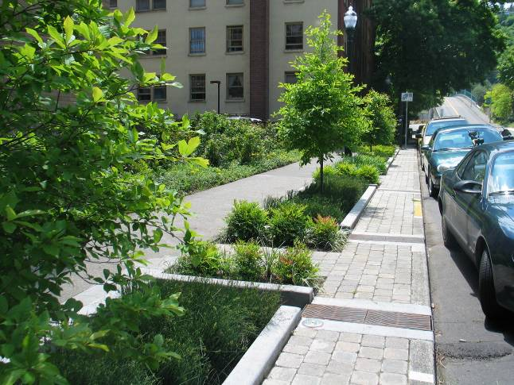
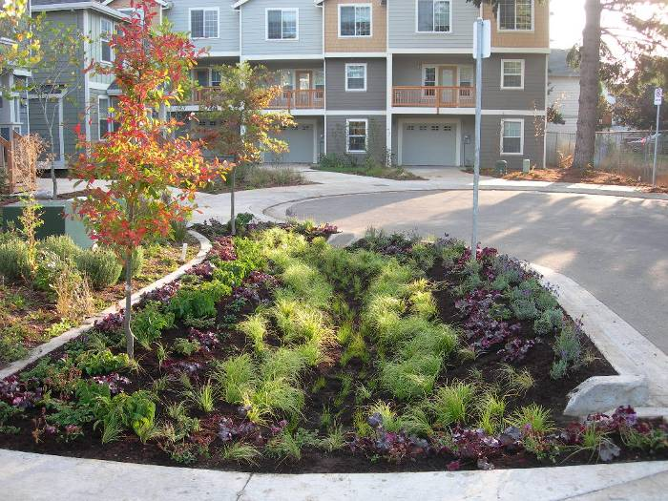
Natural Features
Expand natural resources, “grow the green”
Improve connections between habitat areas
Increase access from neighborhoods

Slide 18
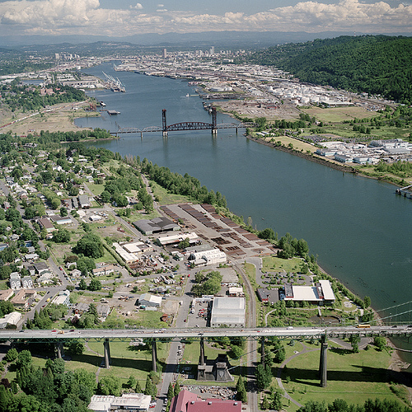
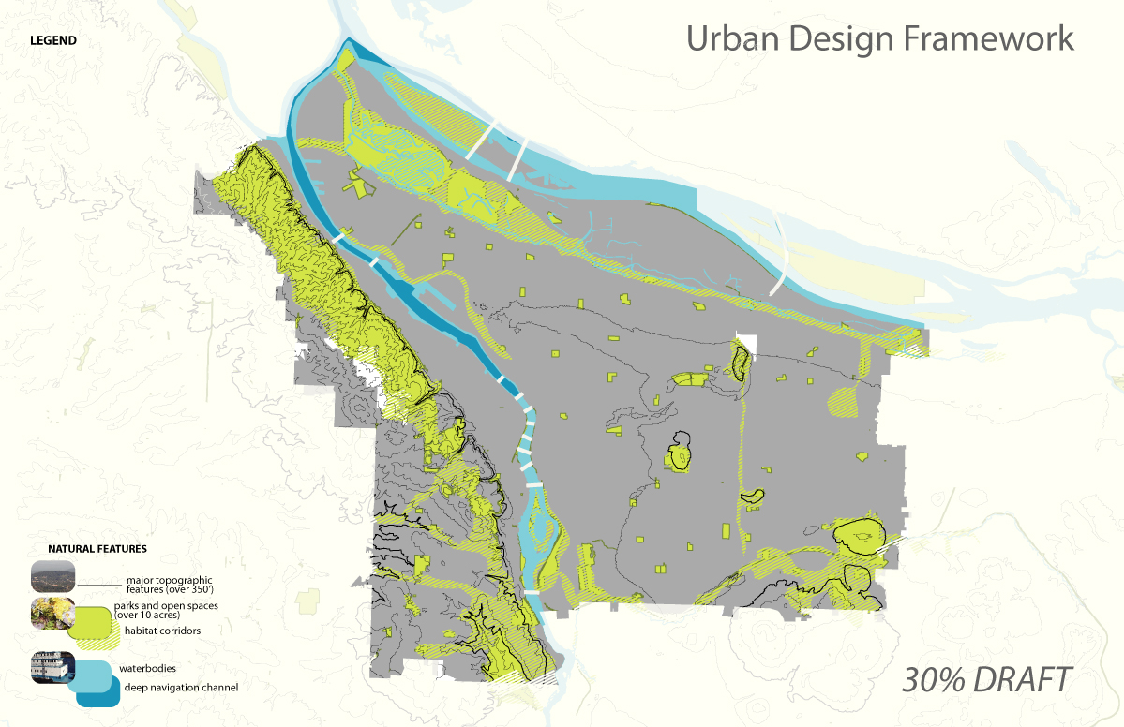
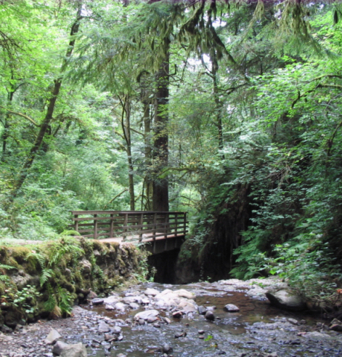
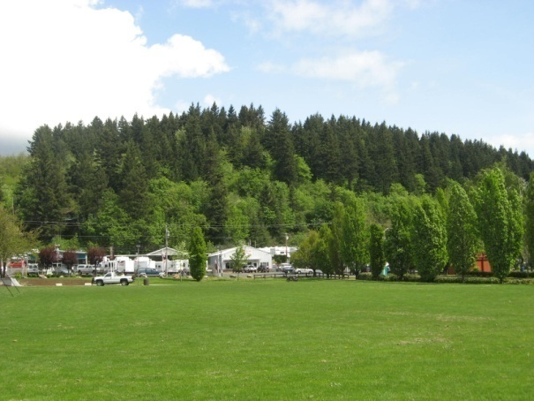
Natural Features
Rivers & Waterbodies
Habitat Corridors
Topographical Features
& Large Parks

Slide 19
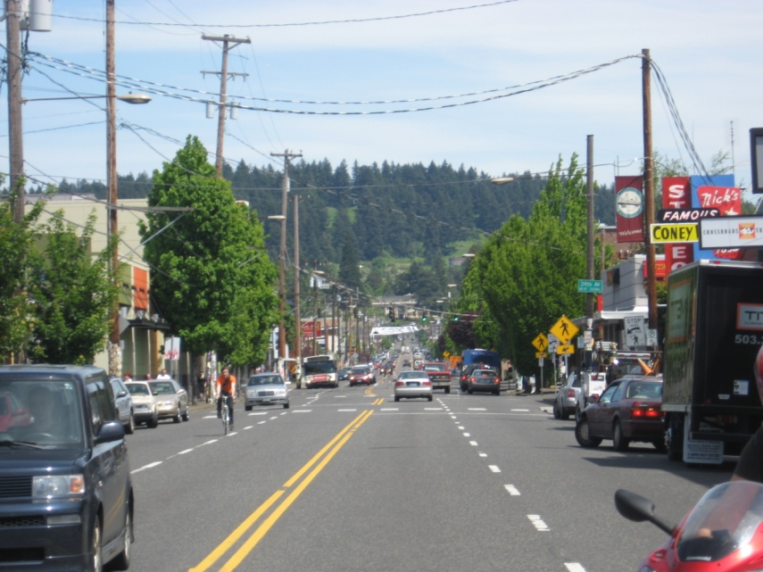
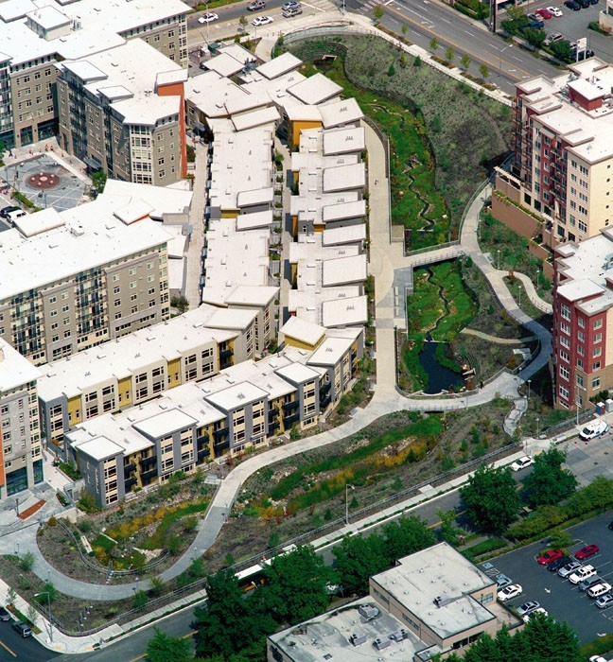
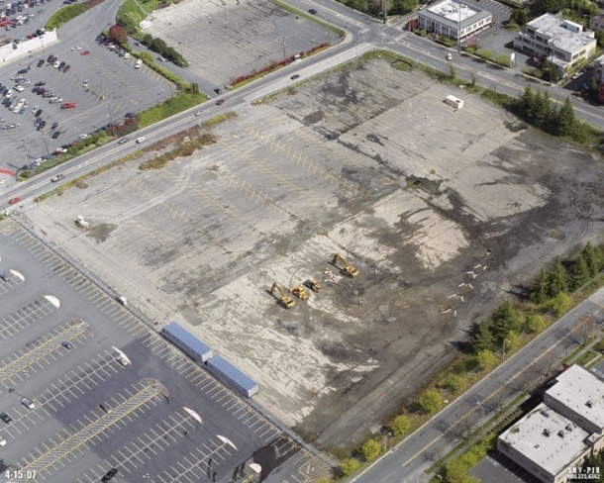
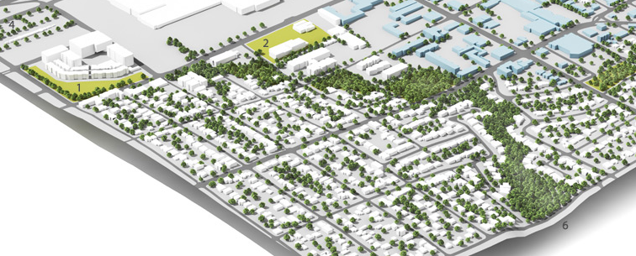

Slide 20
Focusing Growth and Change = Centers
Linking a Healthy City = Connections
Growing our Natural Resources = Natural Features
One Size Doesn’t Fit All = Pattern Areas

Slide 21
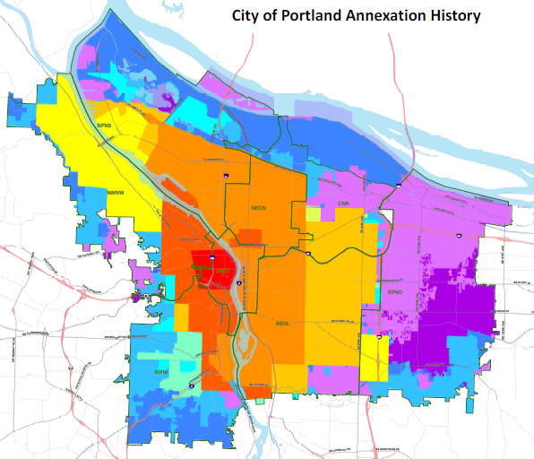
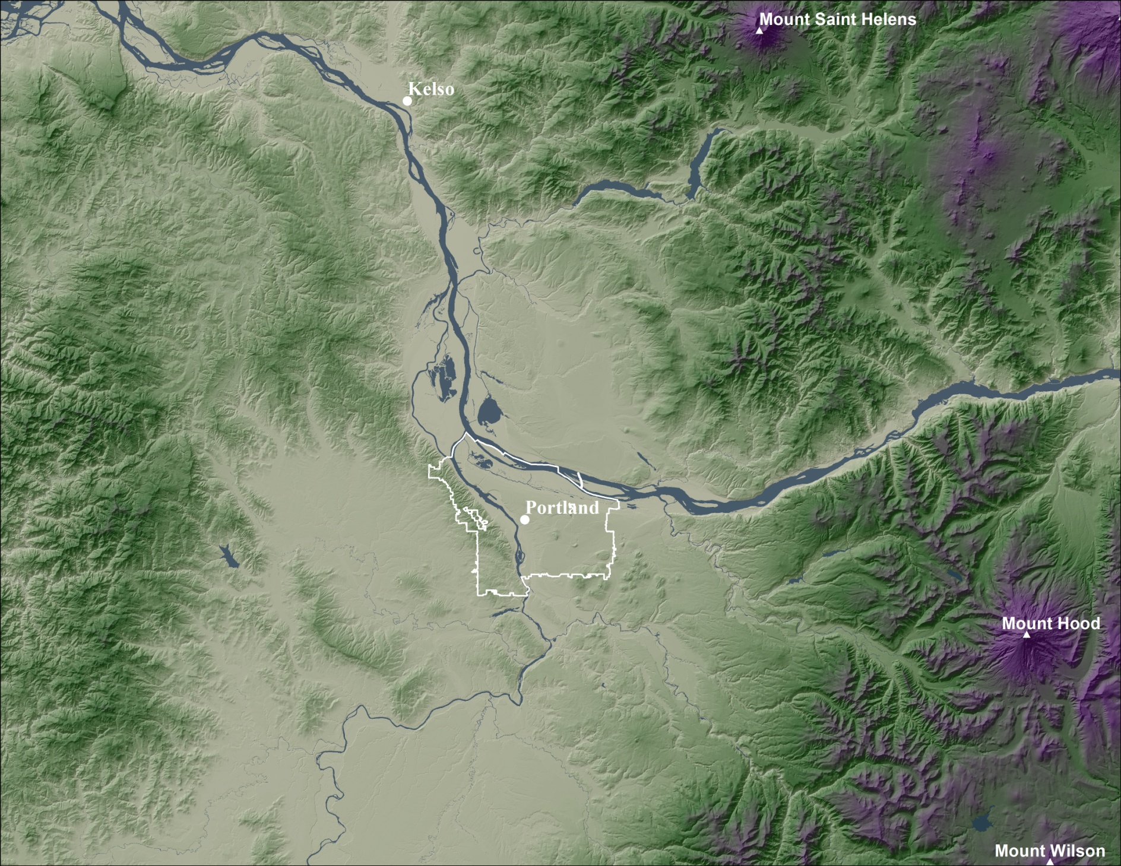
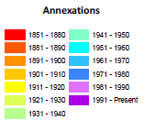
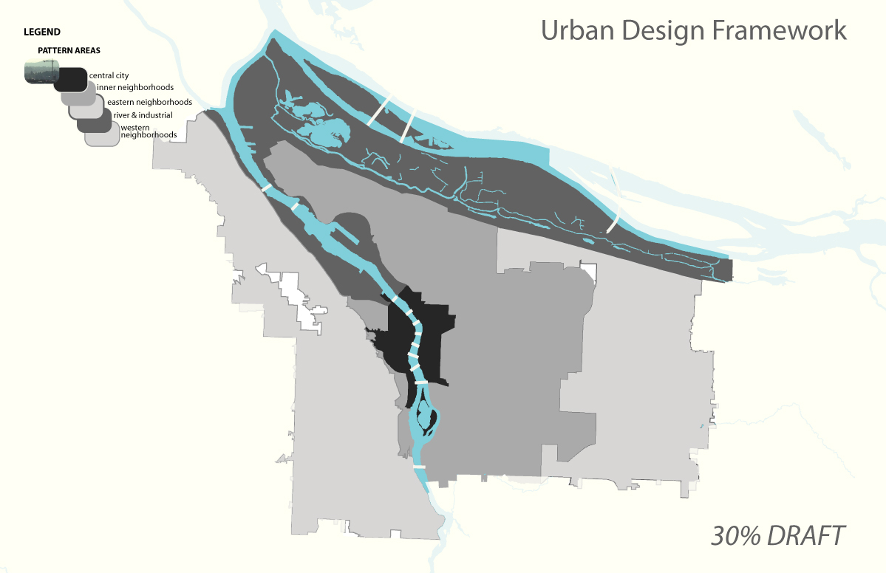

Slide 22
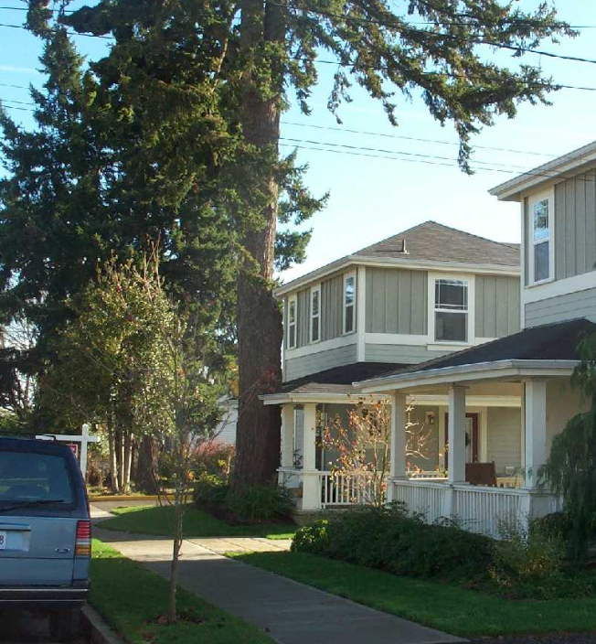




Inner Neighborhoods
Western Neighborhoods
Eastern Neighborhoods

Slide 23







Western Neighborhoods
Inner Neighborhoods
Eastern Neighborhoods

Slide 24



Slide 25



Slide 26



Slide 27
Design-Related Policy Sections
Design of Centers
Context-Sensitive Design and Development
Public Realm and the Street Environment
Transitions – scale and use
Historic and Cultural Resources

Slide 28
Design-Related Policy Sections
Sustainable Design and Development
Designing with Nature
Health and Safety
Housing
  Physically-accessible housing
  Healthful housing

Slide 29
Next Steps
May 1 Policy Comments Due
Summer 2013 Publish Part 2 Maps
Fall 2013 Public Workshops
Winter 2013-14 Proposed Draft Comp Plan (policies and maps)

Slide 32


Parks and Natural Landscape
Public
Realm
WATERBODIES
TOPOGRAPHY
NATURAL AREAS
MAJOR PARKS
EXISTING POLICY 12 LANGUAGE
“Enhance the sense Portlanders have that they are living close to nature”
“Preserve and enhance existing public viewpoints of….surrounding mountains and hills”
“Design new development to enhance the natural environment that is so much a part of Portland’s character”

Slide 33






Slide 34



Parks and Natural Landscape

Slide 35


Slide 36




Streets and Connections

Slide 37





Slide 38

Existing urban design policy
Need to integrate Portland Plan “Healthy, Connected City” strategy
  City Greenway system of connections
  5 Portland pattern areas
  Neighborhood centers and corridors
Lacks citywide concept map
Bigger picture direction missing

Slide 39
Bureau of Planning & Sustainability
Urban Design Studio
Mark Raggett, 503-823-6030
Lora Lillard, 503-823-7721
www.portlandoregon.gov/bps/urbandesign

Slide 40


Slide 41



Slide 42

Concept in the Comprehensive Plan
Introductory part of Comprehensive Plan update
Potentially paired with 25-year vision for City
Built on Vision PDX, Portland Plan strategies
Policies now, implementation later

Slide 43

Landscape: Unbuilt
“Preserve and enhance existing public viewpoints of….surrounding mountains and hills”
Celebrate Portland’s buttes, hills and ridges?
TOPOGRAPHY
Image

Slide 44

Landscape: Unbuilt
“Design new development to enhance the natural environment that is so much a part of Portland’s character”
More specificity?
NATURAL AREAS
Image

Slide 45

Landscape: Built
“Focus new development at locations where necessary services already exist, such as near transit stations and along transit streets”
Prioritize station locations and improve access to all?
HIGH CAPACITY TRANSIT
Image

Slide 46

Landscape: Built
“Enhance the environment occupied by Portland’s pedestrians”
Expand to include more place-making features, public art, intersection designs, landscaping?
ARTERIAL ROADS
Image

Slide 48


EMERGING DESIGN CONCEPT:
1. A CENTRAL RIVER
2. DISTINCT DISTRICTS
3. CONNECTED PUBLIC REALM

Slide 49






June – November 2010: interviews, presentations
November 2010 – March 2011: series of 3 workshops
CC2035 Advisory Group
Portland Design Commission
Portland Historic Landmarks Commission
Mayor’s Design Subcabinet
AIA
ASLA
Portland Development Commission
Bureau of Transportation
Bureau of Environmental Services
Portland Parks and Recreation
Bureau of Planning and Sustainability

Slide 51
Centers: What are they?
Town Center
Central City
Gateway Regional Center
Neighborhood Center

Slide 52
Purpose of the framework:
Describe the city’s growth strategy and approach
Guide decision-making based on context
Convey intent behind zoning and implementation
Prioritize public investments
Comprehensive Plan Map

Slide 53

Inner Neighborhoods
Western Neighborhoods
Eastern Neighborhoods

