Slide 1
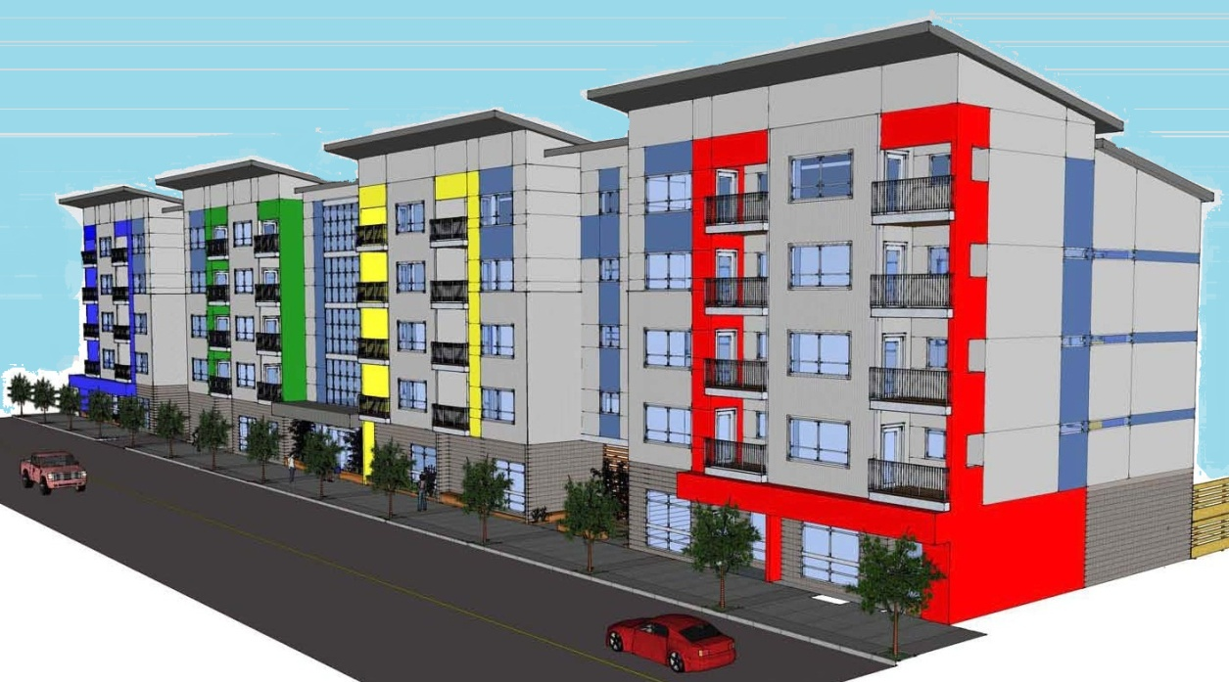
HAZELWOOD PLAZA 222 NE 102nd Ave. Portland, OR 61 RESIDENTIAL UNITS
ALBERTO RINKEVICH RICARDO BERDICHEVSKY
ARCHITECS QUAIL COURT MANAGEMENT
4810 SW LOWELL CT. PORTLAND, OR 97221 3570 RIVER PARKWAY PORTLAND, OR 9729
503-927-1758 FAX 503-922-2613 503-477-4587 FAX 503-954-2612

Slide 2
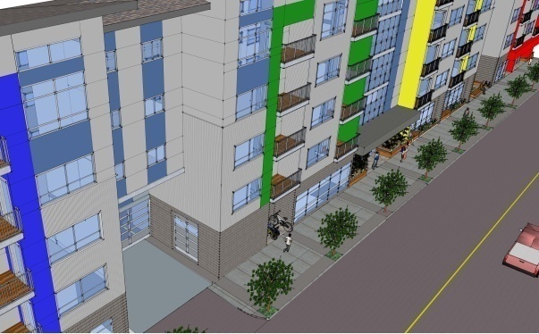
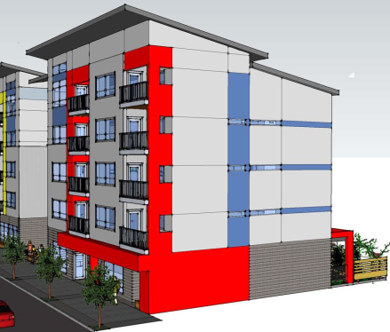
Project location: 222 NE 102nd. Ave. Portland, OR Neighborhood: Hazelwood Plan District: Gateway Plan district Design Guidelines: Gateway regional district Zoning: CMd, Mixed Residential/Commercial with design Overlay Maximum building height : 75 feet Floor area ratio (FAR): Max. 4:1 Min. 1:1 Parking: Not required, 53 provided Bicycle parking: Long term : 100 provided, 6 0 required Short term: 6 provided, 6 required

Slide 3
Design Strategy
Answer to the government's social housing demands
Rigorous formal and constructive order
To articulate and break the longitudinal dimension of the building defined by the urban parameters
Emphasize the facades composition utilizing materials colors and textures
To achieve budget objectives
Building to be easily identifiable by the end user

Slide 4
Project Description
Property Address
No. Residential Units
Net Rentable Area (NRSF)
Common Area
Gross Building Area
No. Buildings
No. of Floors
Site Area
Building Construction
Roof Type
Building Exterior
HVAC System
222 NE 102nd Avenue
60 , 2 live/work units, 35 1BR, 23 2BR
46,696 sq. ft.
12,322 sq. ft.
59,018 sq. ft.
1
5 residential floors with tuck under parking
24,338 sq. ft.
Wood frame
Composite / seamed metal
Painted corrugated metal panel and
Prefinished cement board siding,
Metal balcony
Split air conditioners

Slide 5
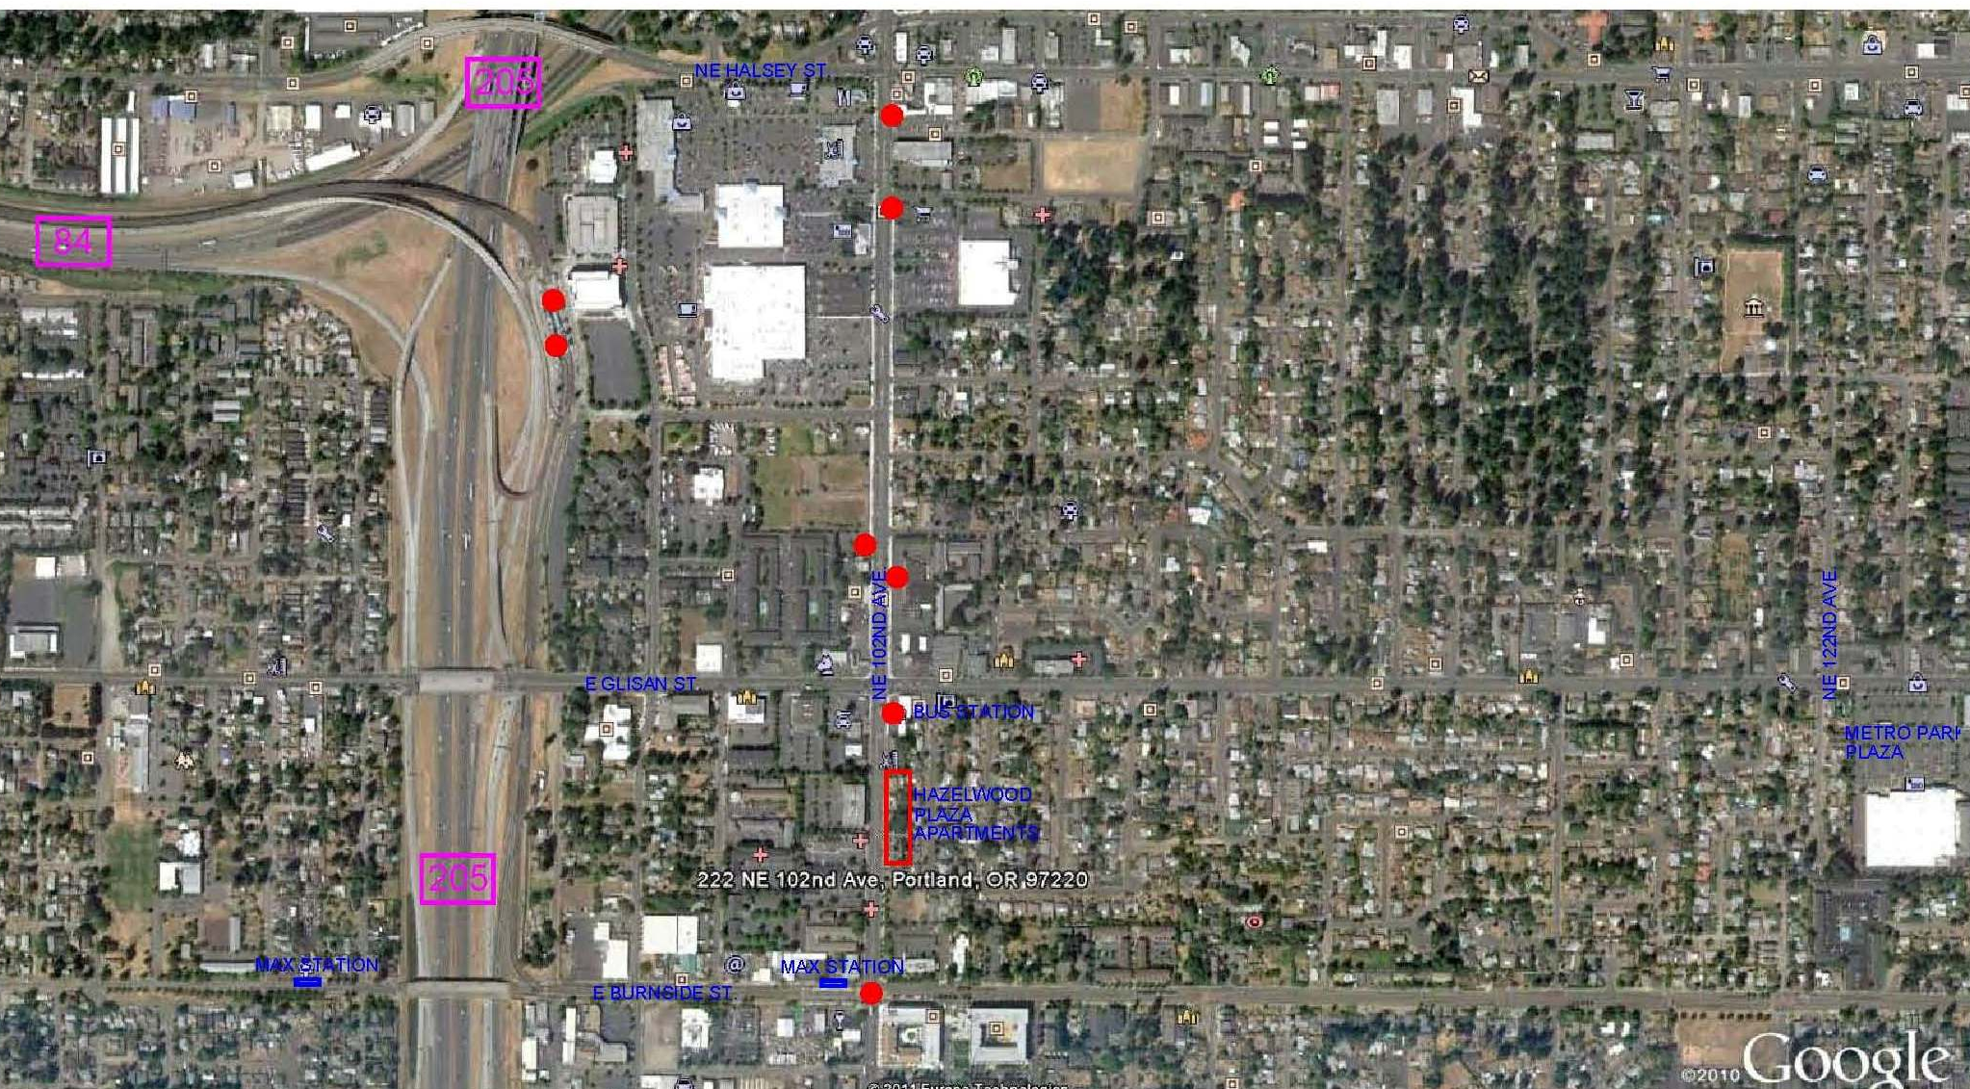
Vicinity
GATEWAY
TRANSIT CENTER
i-205 SHOPPING MALL
SE 102 ND / SE WASHINGTON ST.

Slide 6
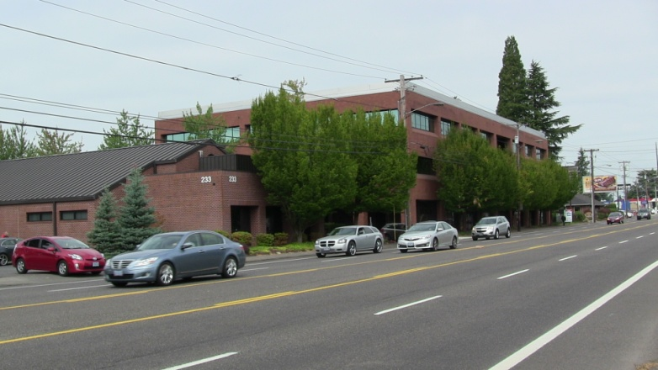
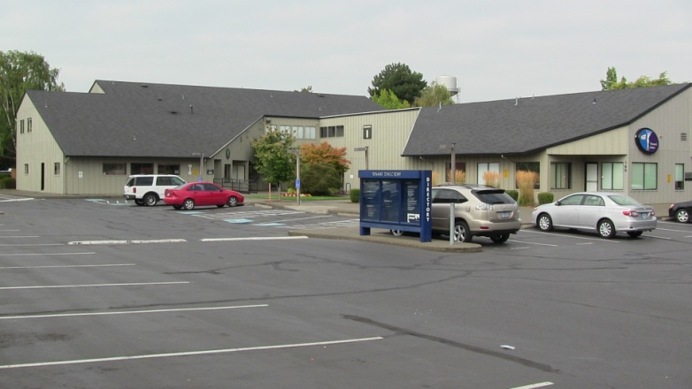
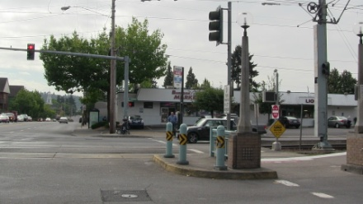
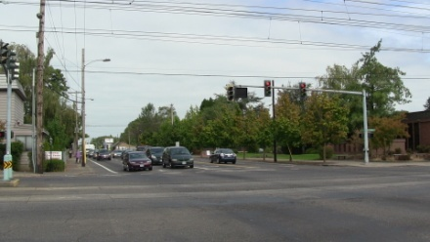
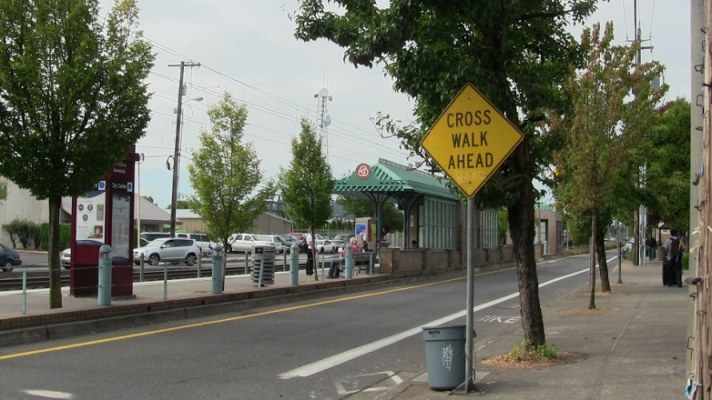
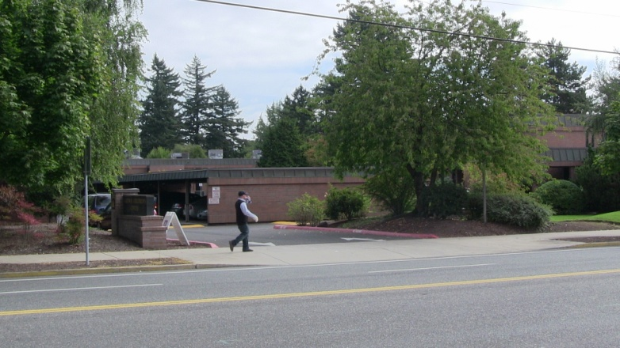
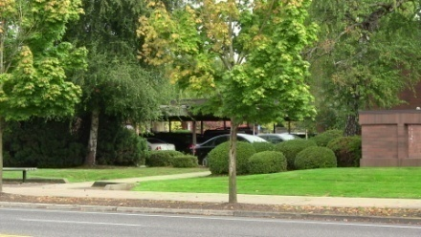
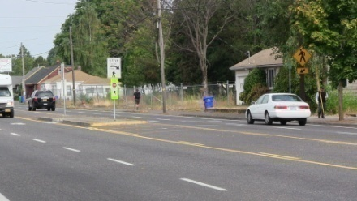
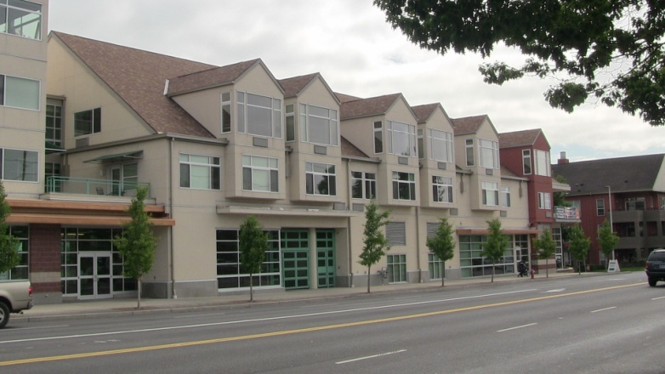
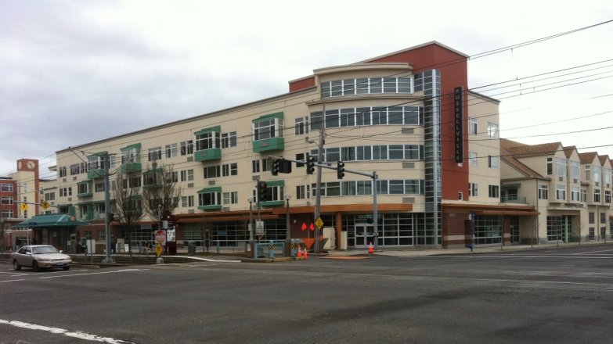
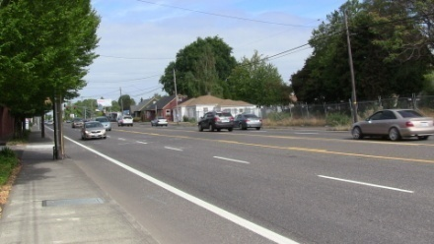
Vicinity photos

Slide 7
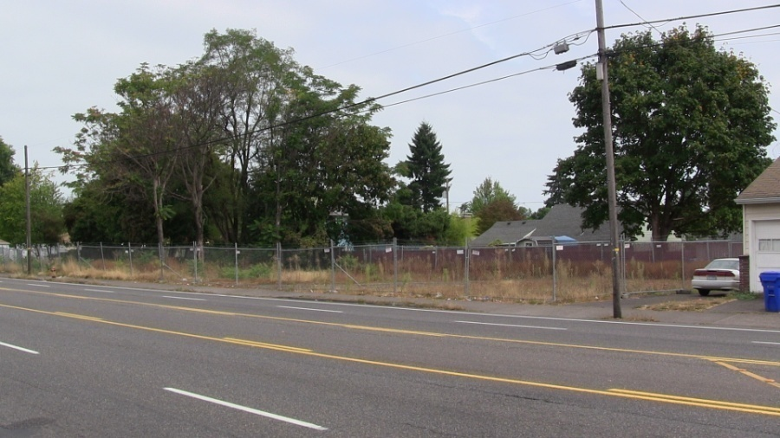
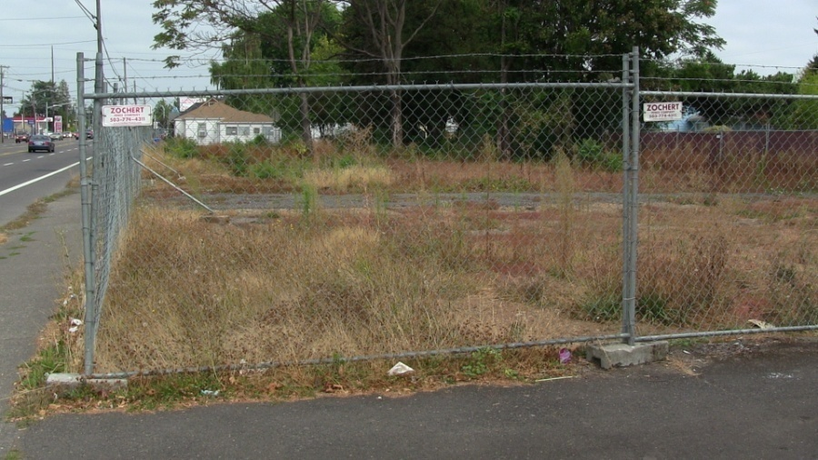
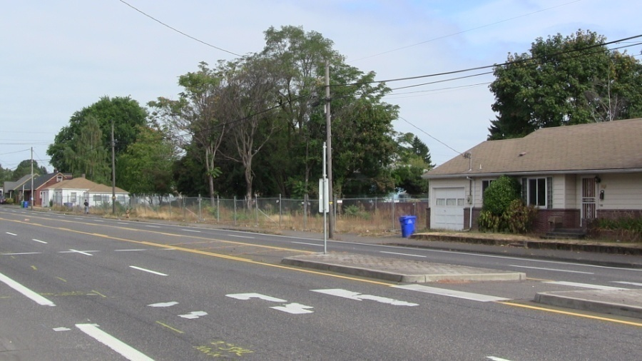
Site – current photos
the site is tapered, with one long side facing the street and one long side bounded by four small properties
the site was rezoned (consolidate 4 in 1 big lot) to replace four dilapidated townhouses with a 61-unit apartment building.

Slide 8
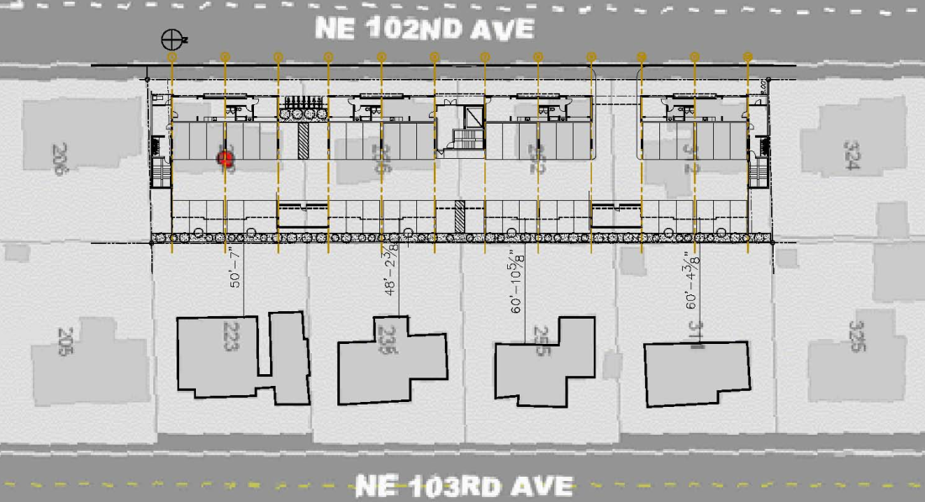
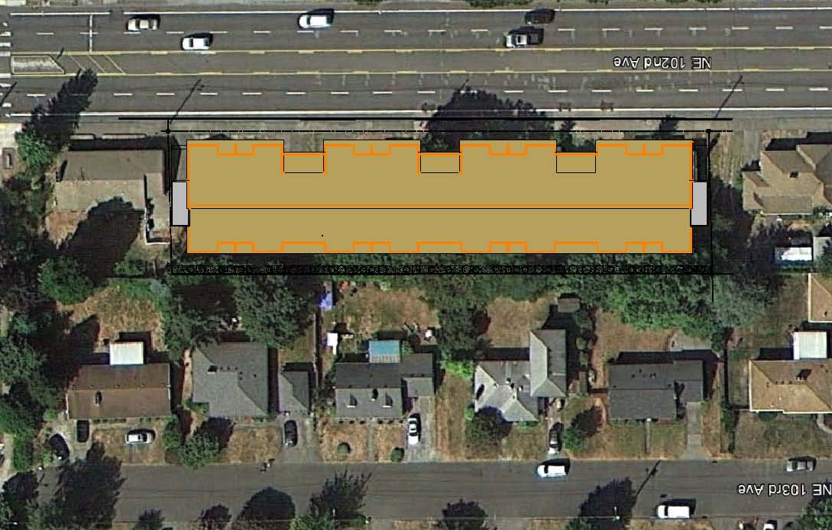
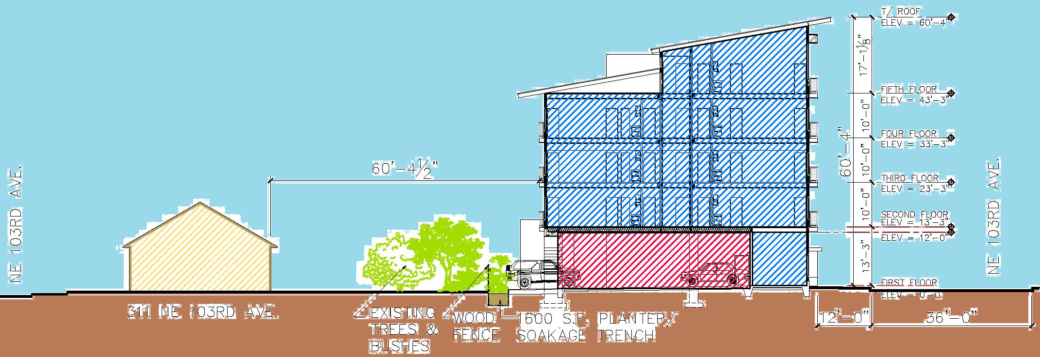
Site plans & section
Site Plan
Site + Roof Plan
Site Section
The building gently steps up in scale from the lower two story residences to the taller, denser 102nd. Avenue

Slide 9
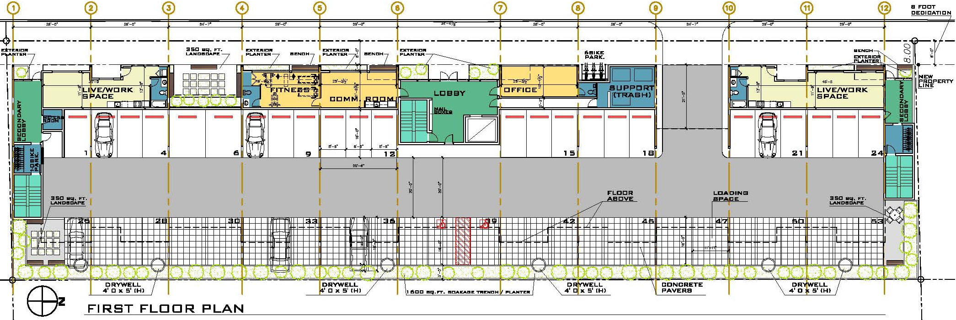
First Floor Plan
Need taller windows and more of them along the ground floor to really differentiate this from the upper floors and to anchor the building onto the site

Slide 10
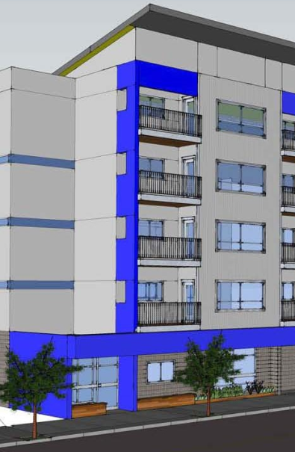
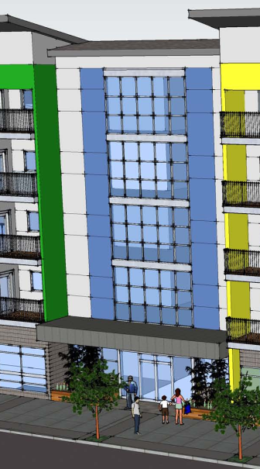
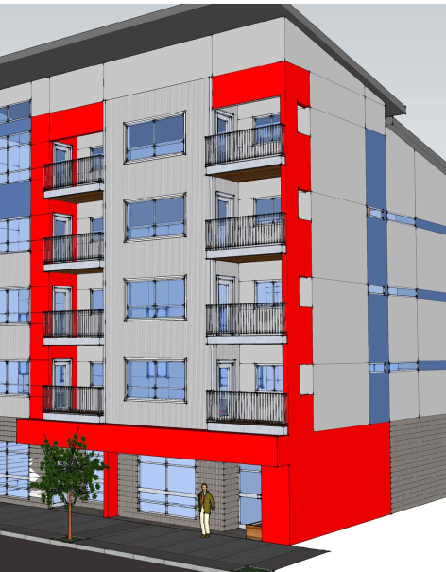
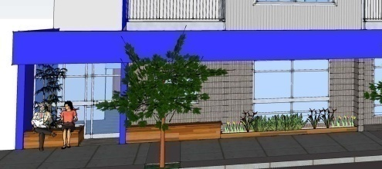
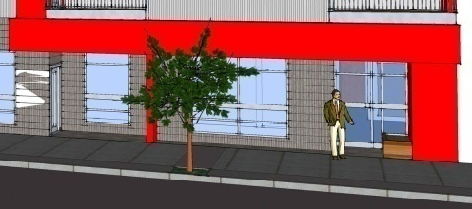
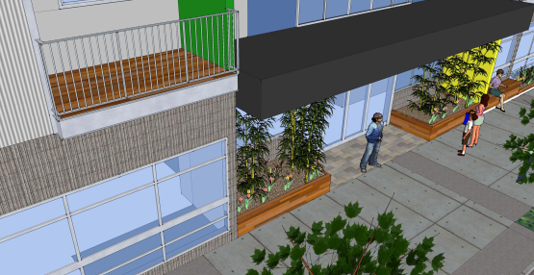
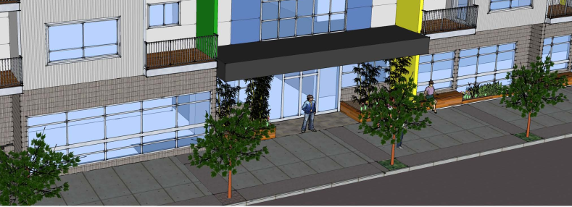
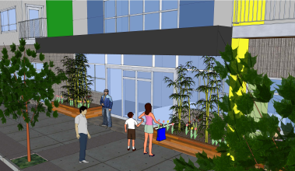
Building entries Is the main entrance significant enough?
Main entrance with curtain wall
2 secondary entrances at each end of the building

Slide 11
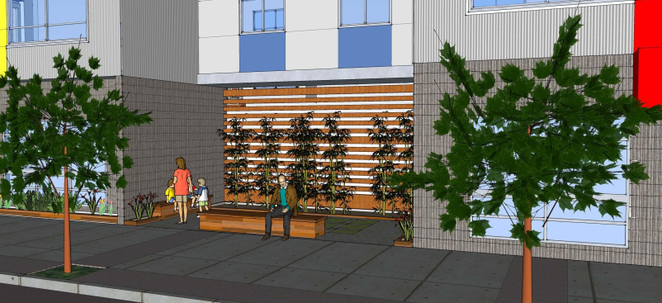
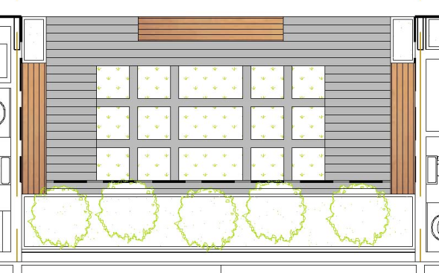
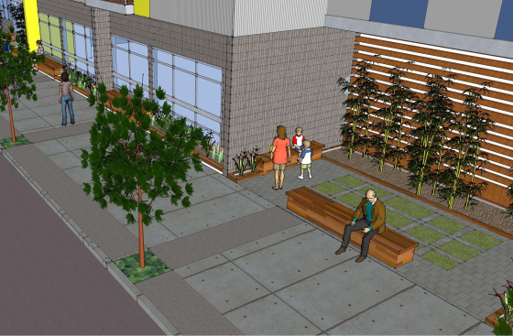
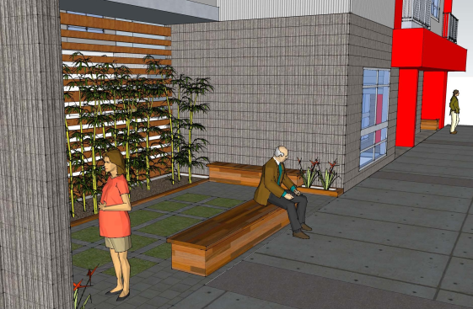
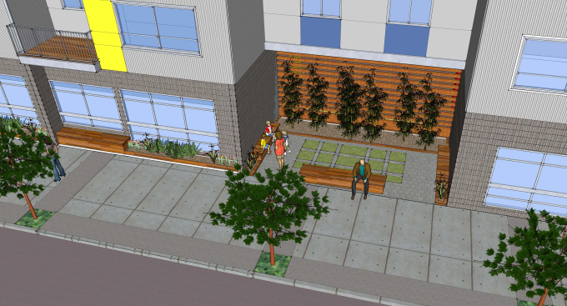
Exterior Landscape Areas
Offer something in order to get modifications
Provide some space for residents to do
something outside
Community piazza
Public / privet use
360 sq. ft.
24’-0”
15’-0”

Slide 12
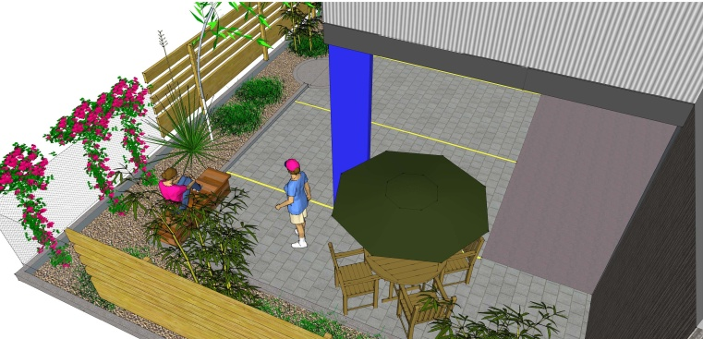
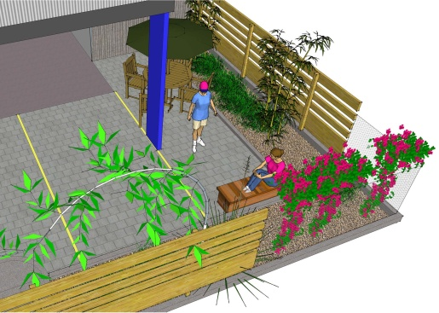
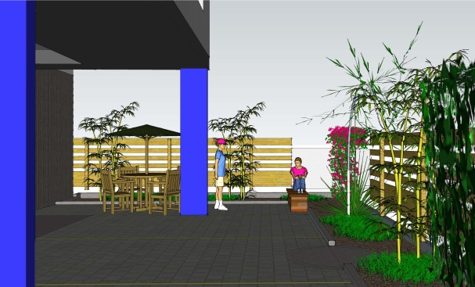
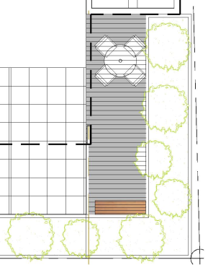
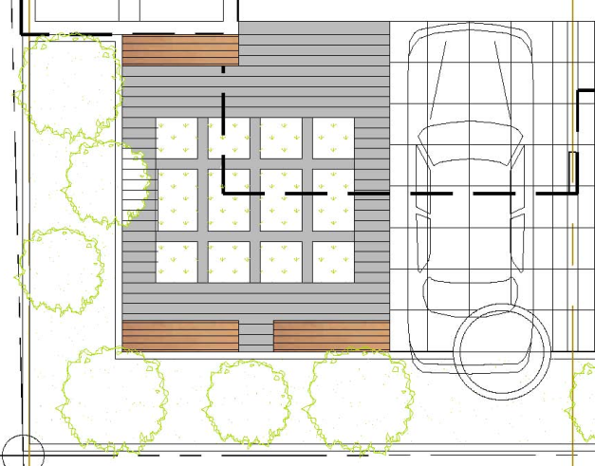
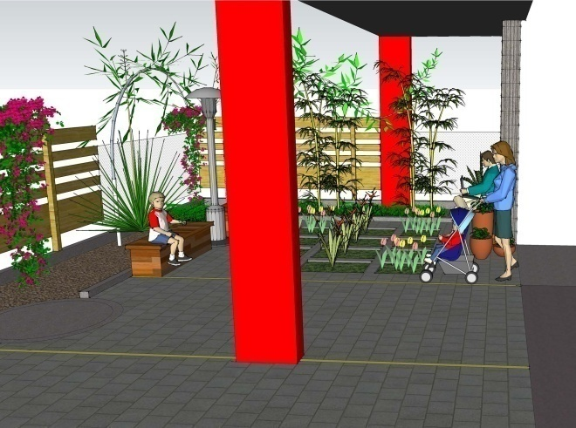
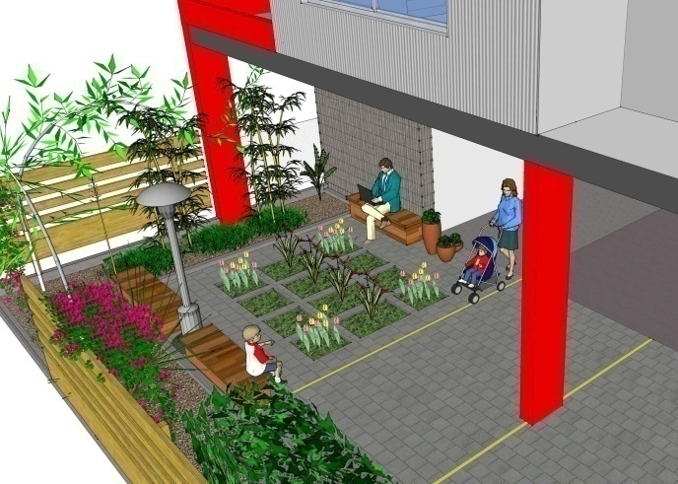
Interior Landscape Areas
Can’t be zero interior landscaping
2 interior landscape areas
privet use
350 sq. ft. each

Slide 13
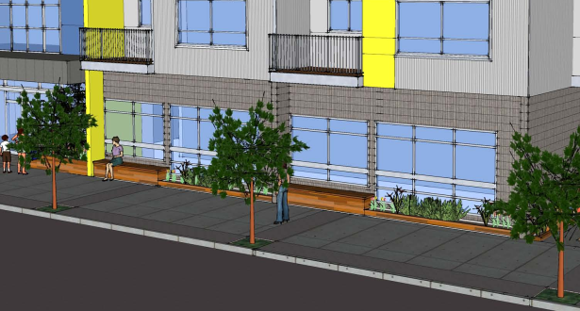
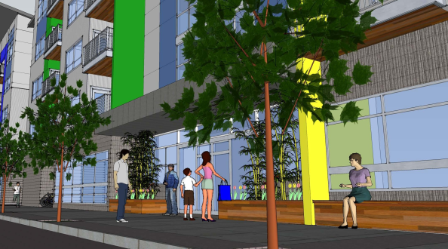
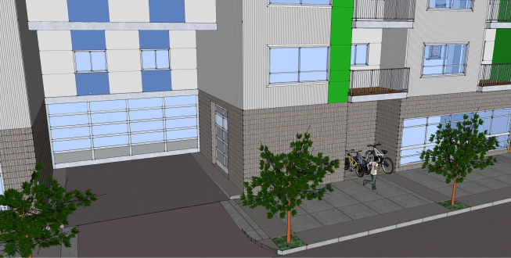
Active ground floor
An active ground floor is preferred

Slide 14
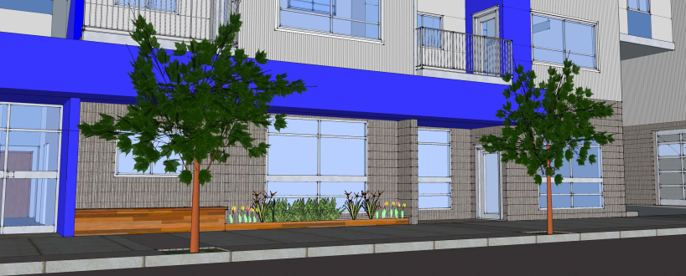
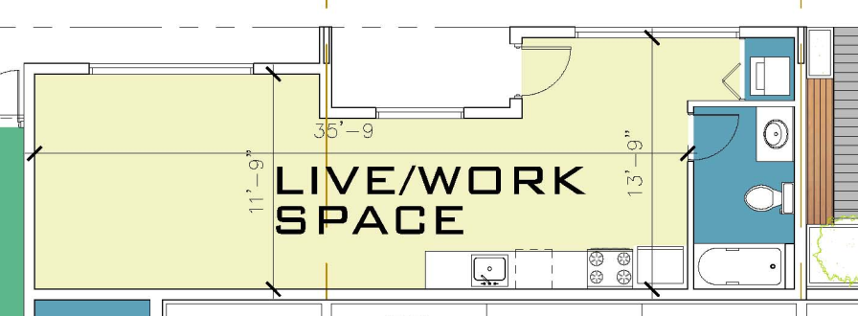
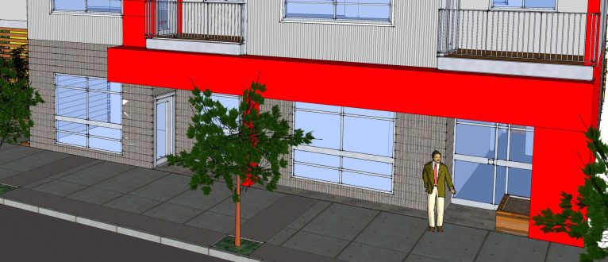
Live / work units
Consider making the units live / work units and having more storefront, commercial type windows
Pull the glass down
Ground floor units entry are difficult
700 sq.ft..
Covered entrance porch
Storefront windows
Open space adaptable to apartments or offices
600 sq.ft.

Slide 15
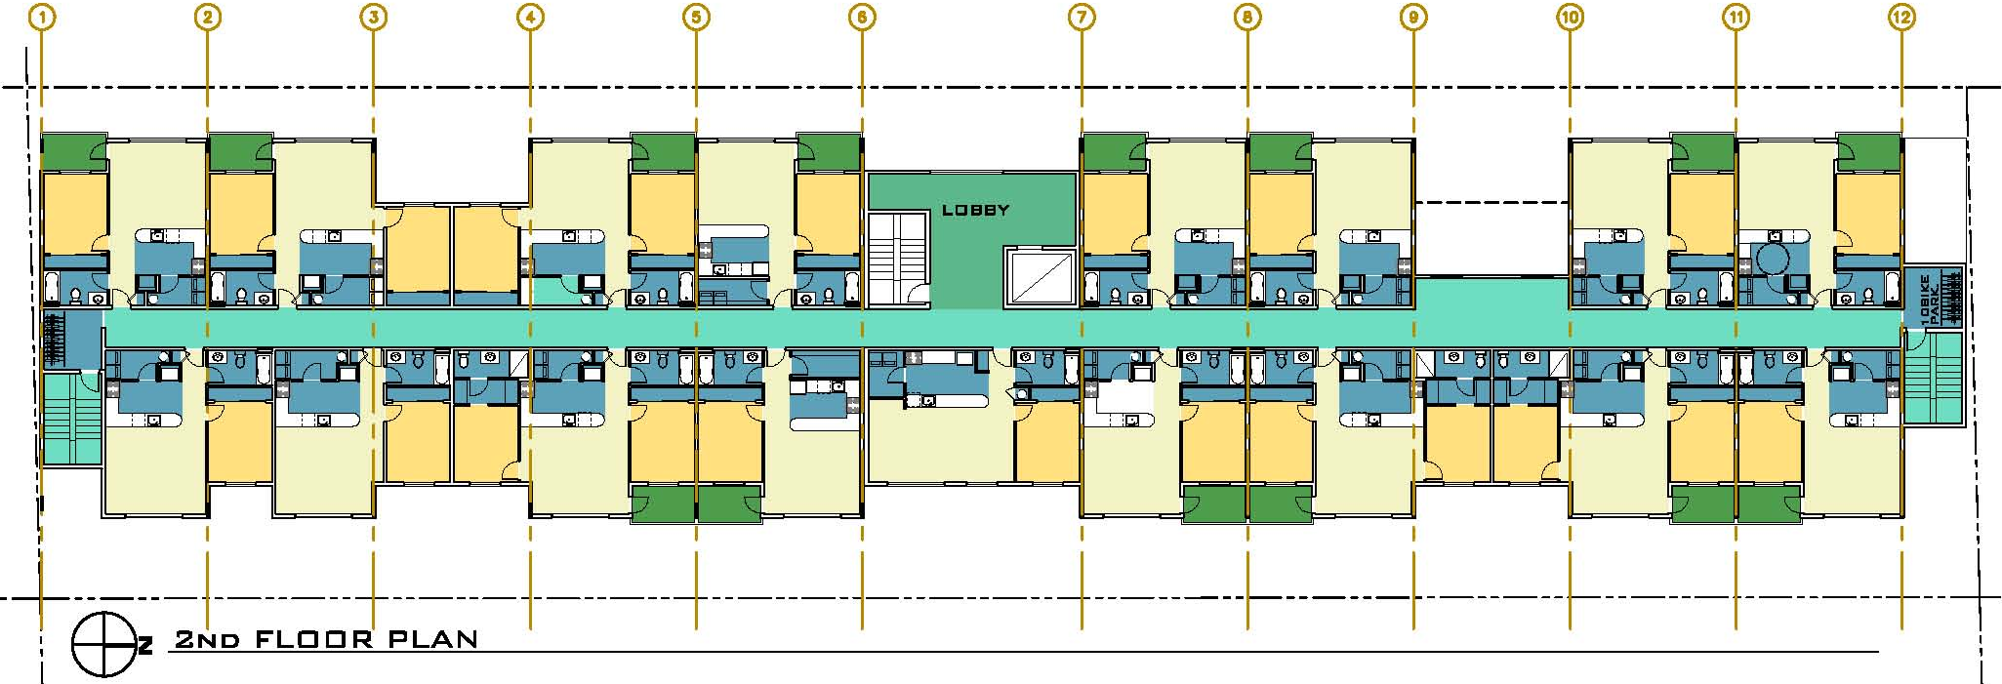
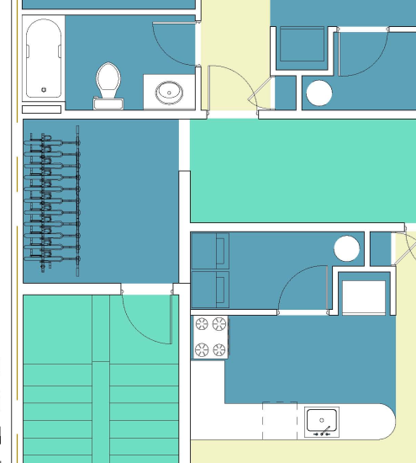
Second Floor Plan

Slide 16
Third Floor Plan

Slide 17
Fourth Floor Plan

Slide 18
Fifth Floor & Roof Plans

Slide 19
Elevations
CURTAIN WALL
COMPOSITE / METAL ROOF
METAL RAILING
PREFINISHED
CEMENT BOARD
GROUND FACE
BLOCK
PREFINISHED
CEMENT BOARD
PAINTEDCORRUGATED METAL PANEL
PREFINISHED
CEMENT BOARD

Slide 20
Elevations Option 2

Slide 21
Elevations
WALL SECTION

Slide 22
Elevations Comparison
The bold exterior colors reflect the design strategy of identification and composition, the long west façade engages in a fluent dialog with the surrounding and make a friendly pedestrian environment

Slide 23
Wall sections
PANEL INSTALL – SCREW LOCATION

Slide 24
Wall sections
METAL SILL
METAL TRIM
HEADER

Slide 25
Axonometric view & wall section
3
`
2
1

Slide 26
Wall section details + finishes
PAINTED CORRUGATED METAL PANEL
GROUND FACE CONCRETE
BLOCK
PREFINISHED
CEMENTBOARD

Slide 27
Modifications Request
You need to offer something in order to convince us that the modifications are justified
Ground Floor Active Use Requirement (33.526.280 D.2)
The Ground Floor Active Use areas requires 25'-0" deep in interior spaces that front onto a sidewalk.
Request: in order to allow a better screening of the parking garage from the 102nd. street and a more efficient design and operation of the parking garage we request to reduce to 13'-2" deep of the apartments located at the front of the building.
Loading Parking Standards (33.266319 D.b)
Size of loading spaces. Required loading spaces must meet the standards of this
subsection.
b. Standard B: The loading space must be at least 18 feet long, 9 feet wide, and have a clearance of 10 feet.
Request: A 16 foot deep loading space instead of the 18 feet required

Slide 28
Parking area setbacks and landscaping (33.266.130 G.3a)
Amount of interior landscaping required. In all zones, interior landscaping must be provided for sites where there are more than 10 parking spaces on the entire site. At least 45 square feet of interior
landscaped area must be provided for each parking space.
Request: 29 of the parking spots located in the back side of the parking lot are partially exposed. As a result of this situation the code demand 1,305 sq.ft. of interior landscape. We are providing three landscaped areas: one in the front of the building at the South of the main entrance (360 sq.ft.), a second one
on the SE corner of the site (350 sq.ft.) and the third one in the opposite corner of the site, NE (350 sq.ft.). These 1,060 sq.ft. in addition to 1,300 sq.ft planter
located on the East property line. Our request is to be exempted from fulfilling the required missing landscape.

Slide 29
Sormwater Management
The proposed stormwater management at this stage of the building design is based on the SWMM requirements. Is a mixed solution composed by the use of 6 drywells (4 feet diameter X 5 feet H as per Chapter 2 Exhibits 2.30 and 2.31) serving an impervious area of 3,000 sq,ft each one, combined with a 1,600 sqf. concrete planter (detail as per Appendix G, detail SW-130) located along the east property line, see first fl. plan. All the drywells are located five feet from the property line and at list 10 feet distance from any structural component.

Slide 30
General Images

Slide 31
General Images

Slide 32
Pedestrian Images

Slide 33
Color Examples

