Slide 1
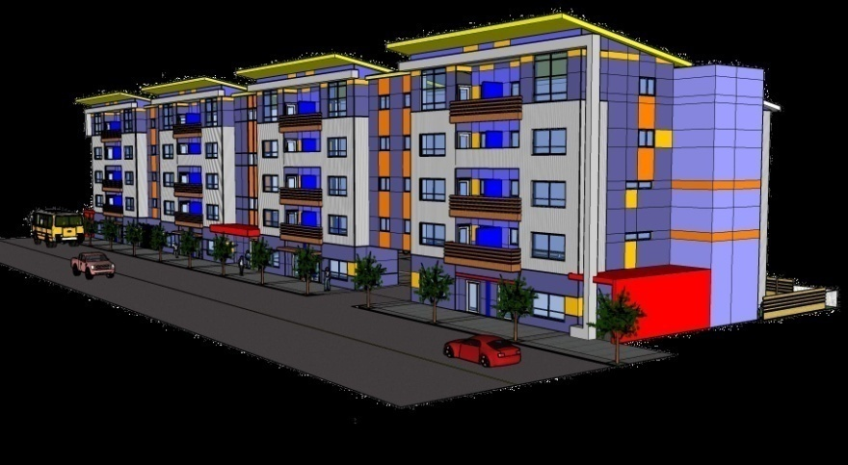
HAZELWOOD PLAZA 222 NE 102nd Ave. Portland, OR 61 RESIDENTIAL UNITS
ALBERTO RINKEVICH RICARDO BERDICHEVSKY
ARCHITECS QUAIL COURT MANAGEMENT
4810 SW LOWELL CT. PORTLAND, OR 97221 3570 RIVER PARKWAY PORTLAND, OR 9729
503-927-1758 FAX 503-922-2613 503-477-4587 FAX 503-954-2612

Slide 2
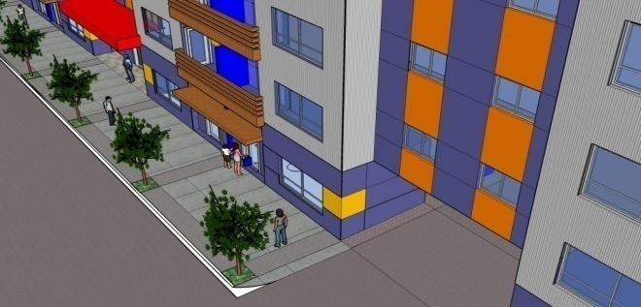
Project location: 222 NE 102nd. Ave. Portland, OR Neighborhood: Hazelwood Plan District: Gateway Plan district Design Guidelines: Gateway regional district Zoning: CMd, Mixed Residential/Commercial with design Overlay Maximum building height : 75 feet Floor area ratio (FAR): Max. 4:1 Min. 1:1 Parking: Not required, 52 provided Bicycle parking: Long term : 8 provided, 6 required Short term: 110 provided, 61 required

Slide 3
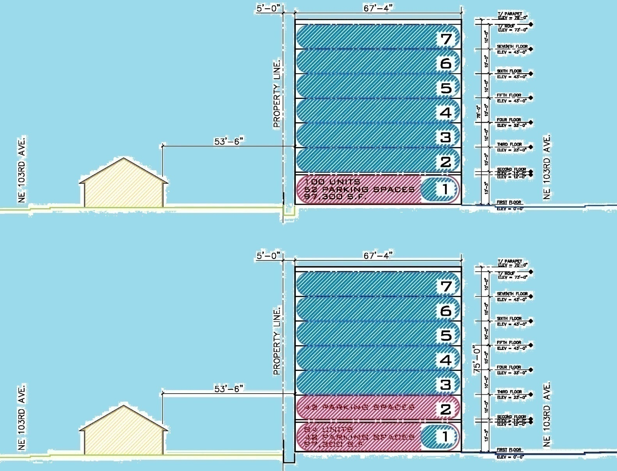
Site Analysis

Slide 4
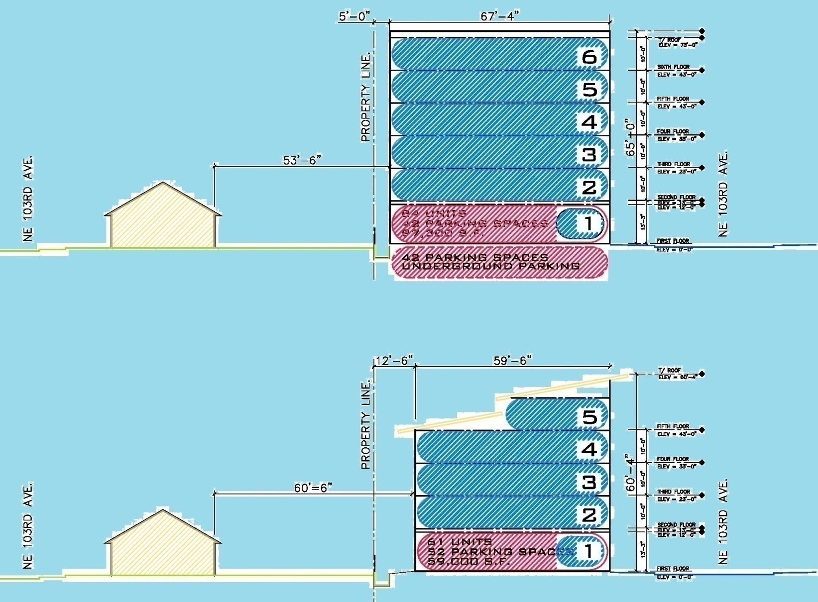
Site Analysis

Slide 5
Design Strategy
Answer to the government's social housing demands
Rigorous formal and constructive order
To articulate and break the longitudinal dimension of the building defined by the urban parameters
Emphasize the facades composition utilizing materials colors and textures
To achieve budget objectives
Building to be easily identifiable by the end user

Slide 6
Project Description
Property Address
No. Residential Units
Net Rentable Area (NRSF)
Common Area
Gross Building Area
No. Buildings
No. of Floors
Site Area
Building Construction
Roof Type
Building Exterior
HVAC System
Electrical Metering
Water Metering
222 NE 102nd Avenue
61
46,696 sq. ft.
12,322 sq. ft.
59,018 sq. ft.
1
5 residential floors with tuck under parking
24,338 sq. ft.
Wood frame
Green composite / seamed metal
Corrugated metal panel and prefinished
cement board siding, metal balcony
Split air conditioners
Individual
Individual

Slide 7
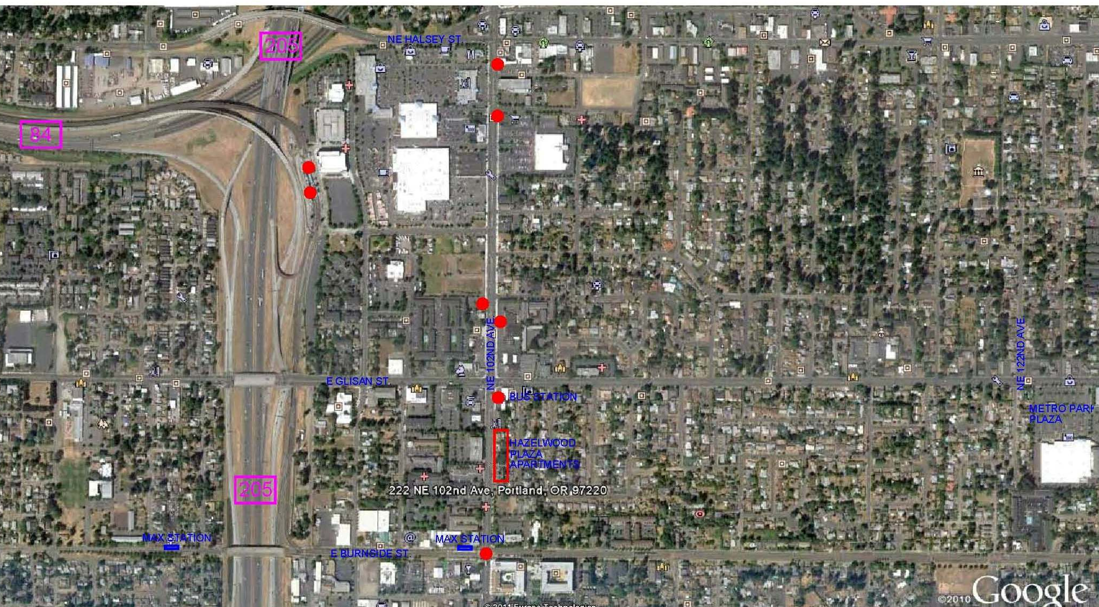
Vicinity
GATEWAY
TRANSIT CENTER
i-205 SHOPPING MALL
SE 102 ND / SE WASHINGTON ST.

Slide 8
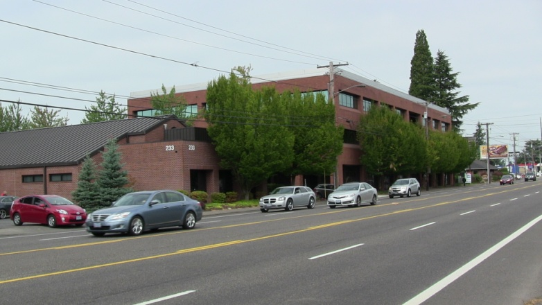
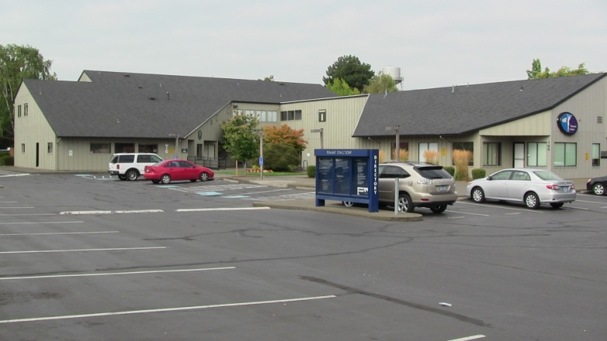
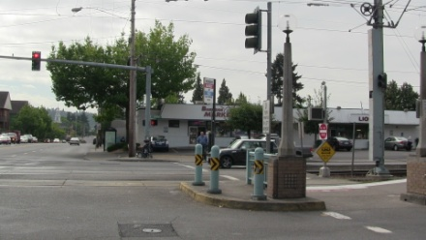
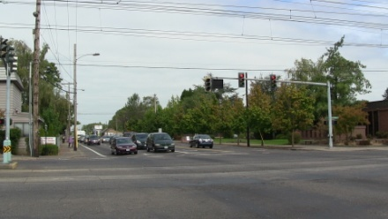
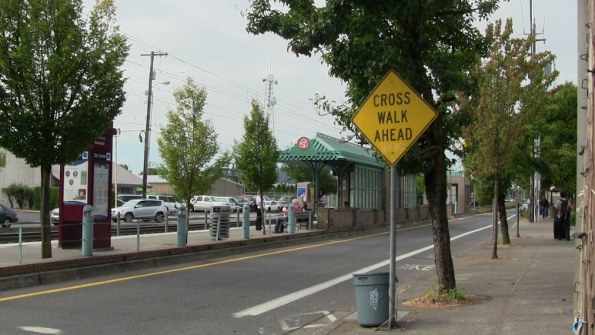
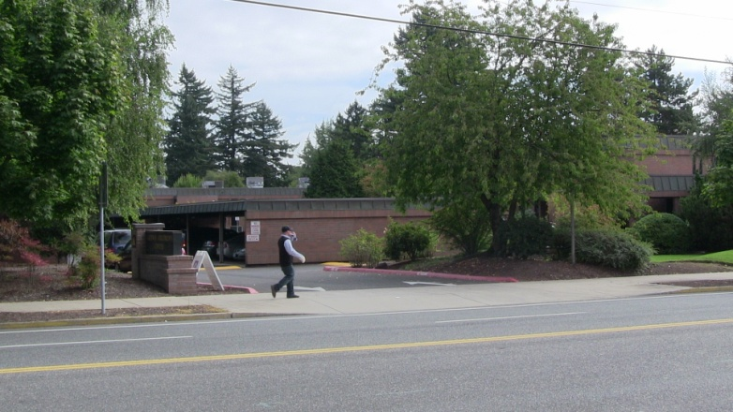
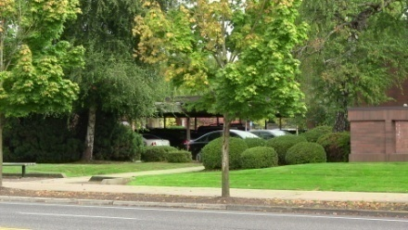
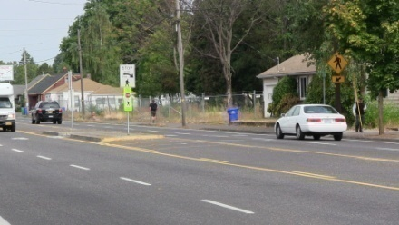
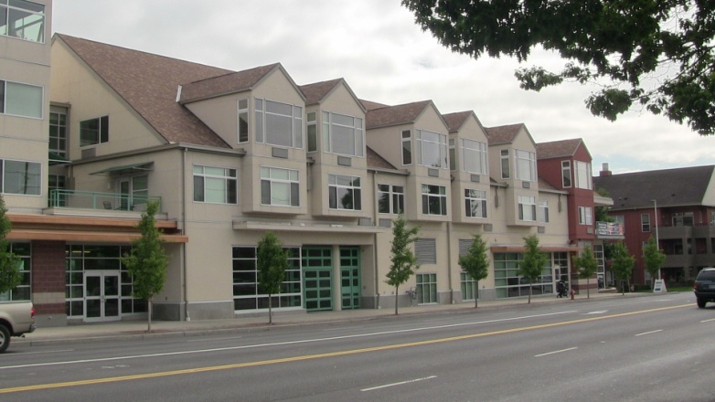
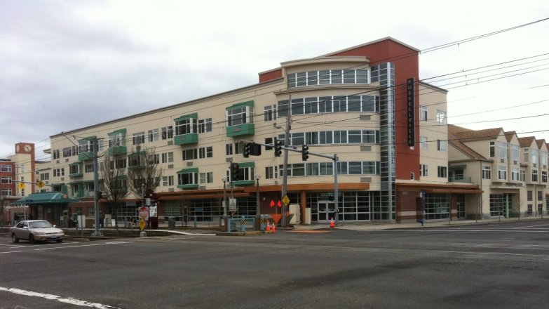
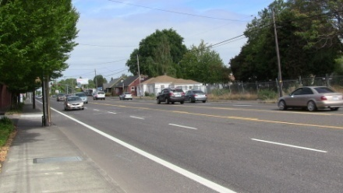
Vicinity photos

Slide 9
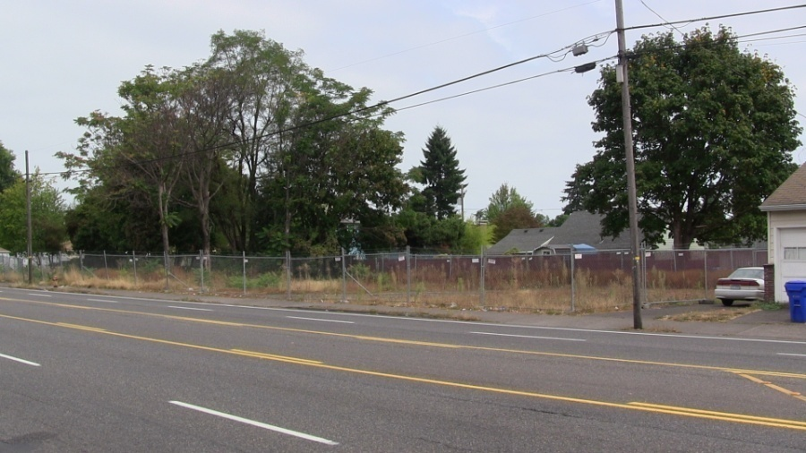
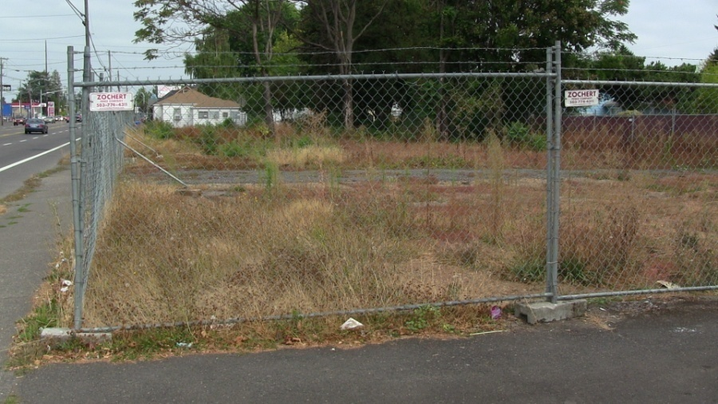
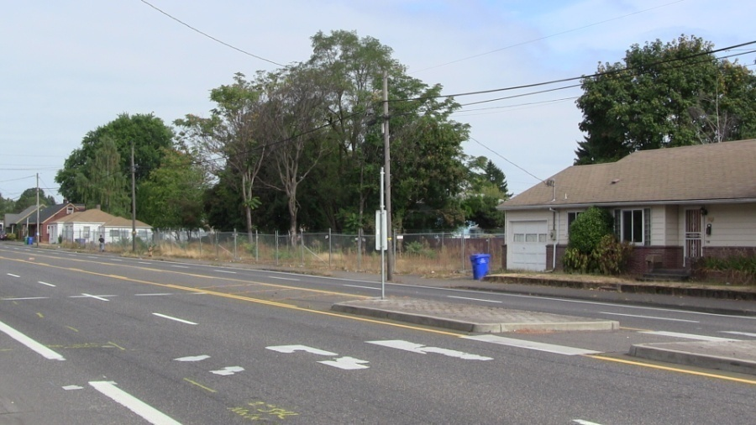
Site – current photos
the site is tapered, with one long side facing the street and one long side bounded by four small properties
the site was rezoned (consolidate 4 in 1 big lot) to replace four dilapidated townhouses with a 61-unit apartment building.

Slide 10
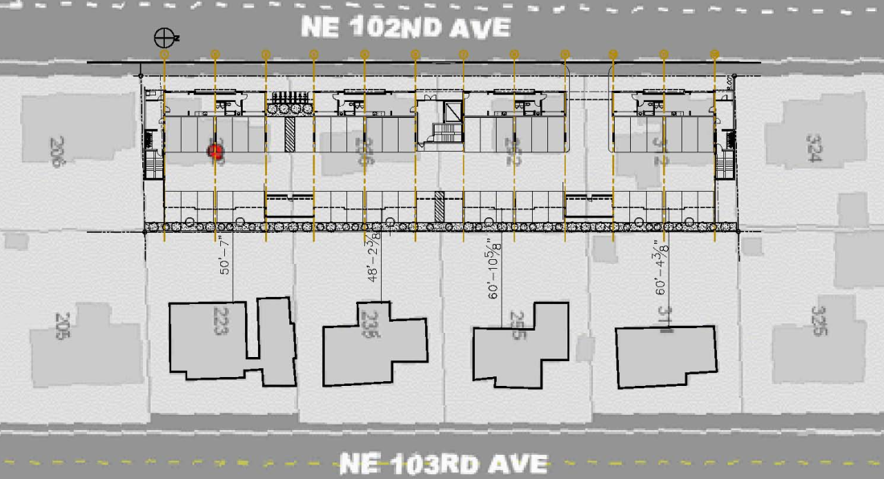
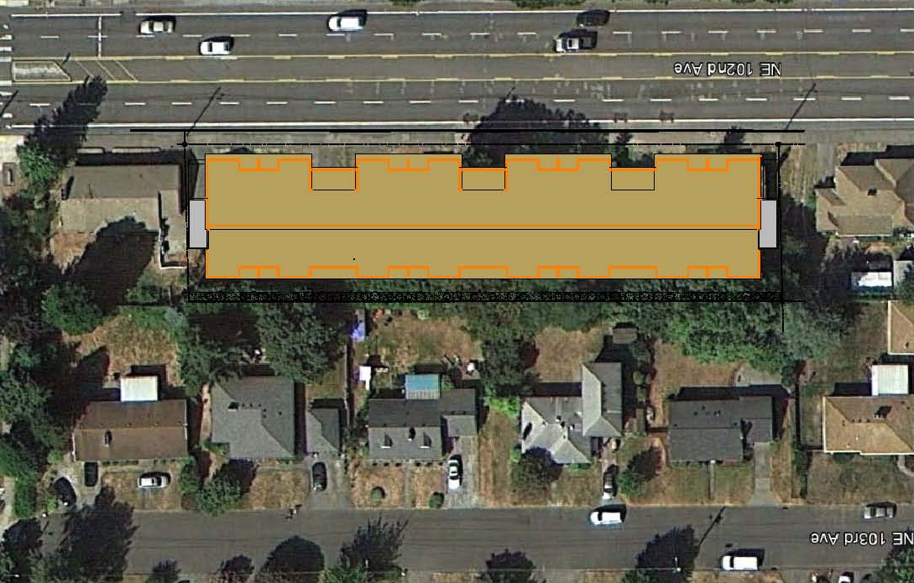
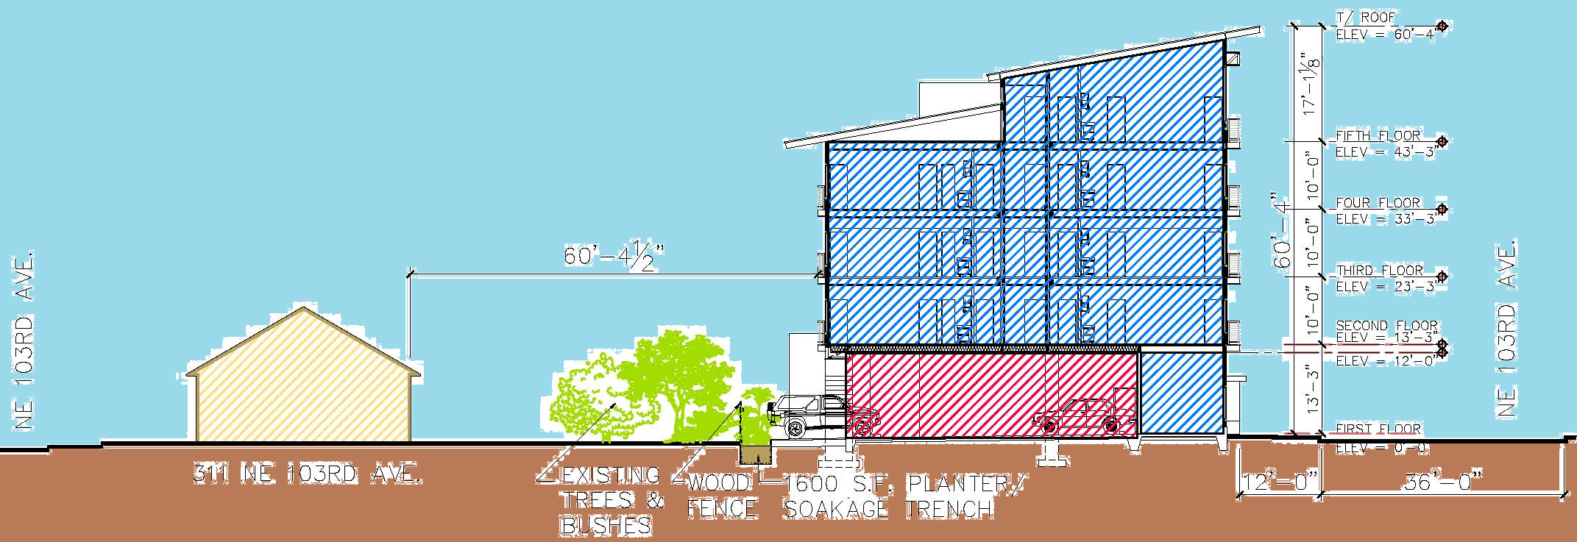
Site plans & section
Site Plan
Site + Roof Plan
Site Section
The building gently steps up in scale from the lower two story residences to the taller, denser 102nd. Avenue

Slide 11
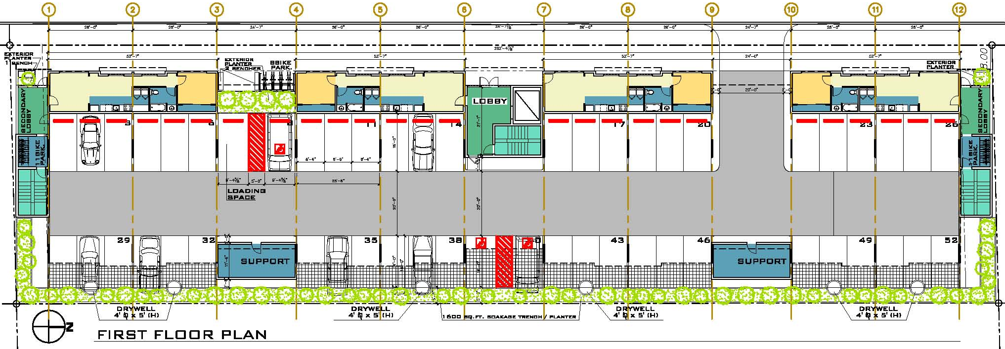
First Floor Plan

Slide 12
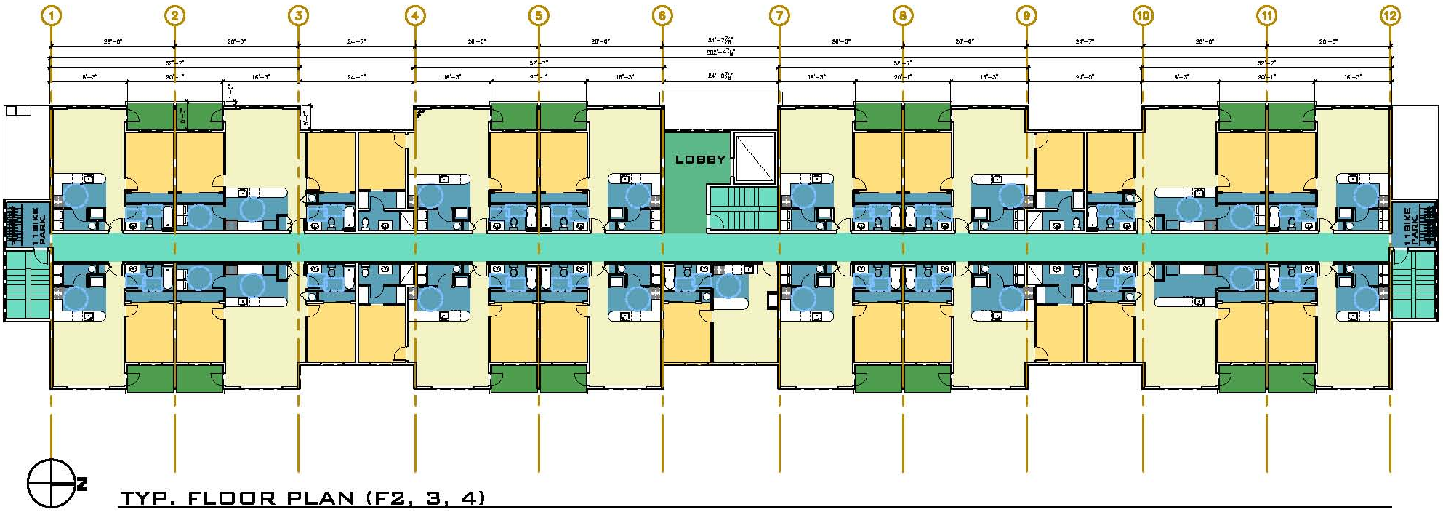
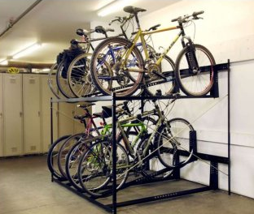
Type Floor Plan

Slide 13
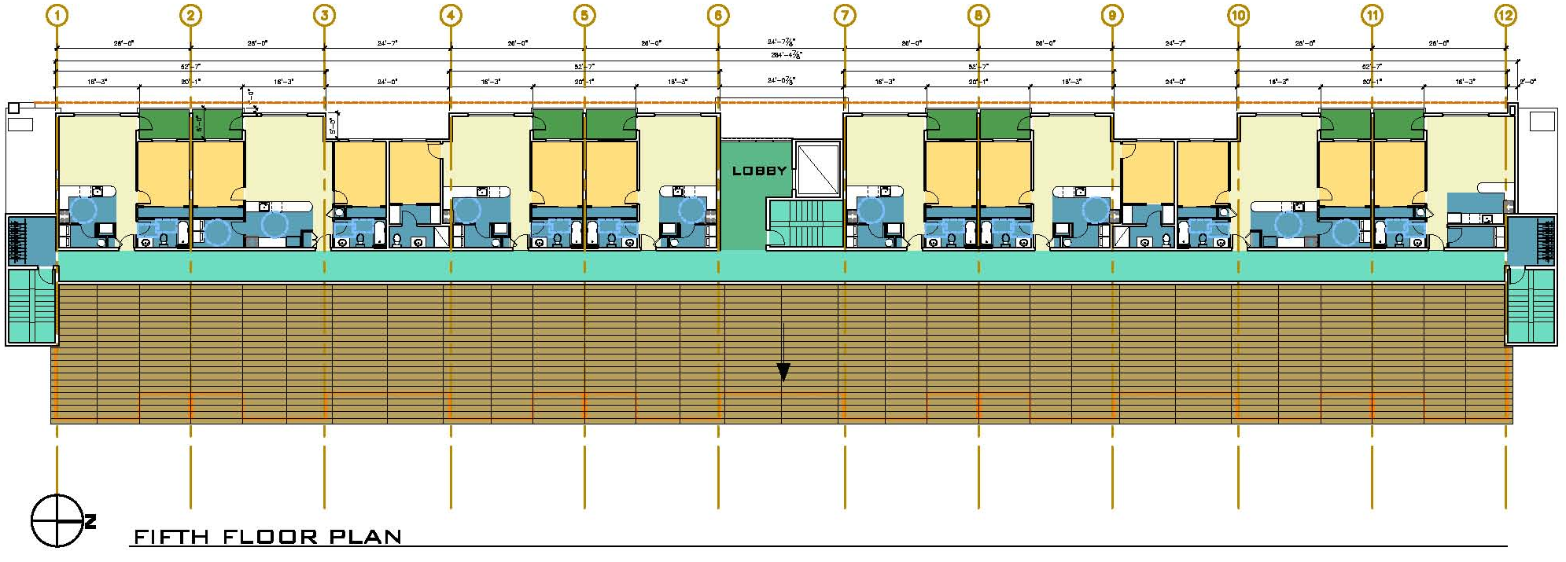
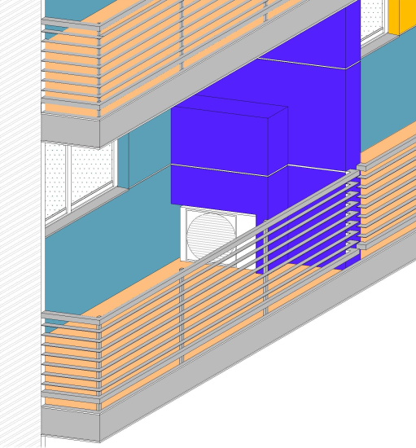
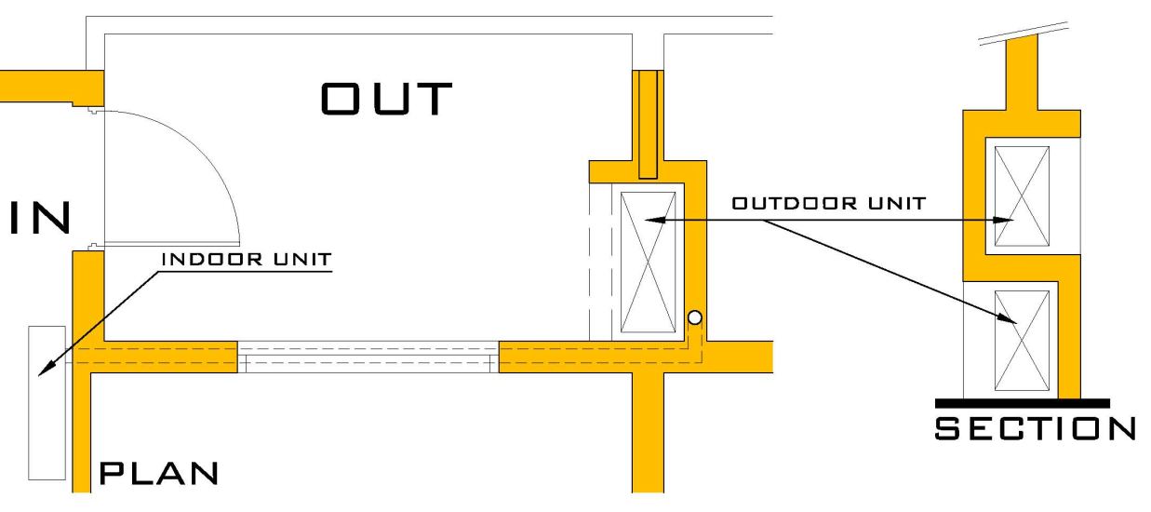
Fifth Floor Plan

Slide 14
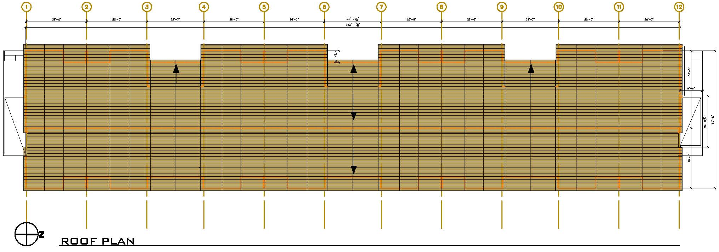
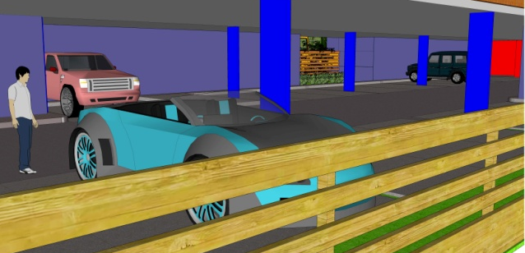
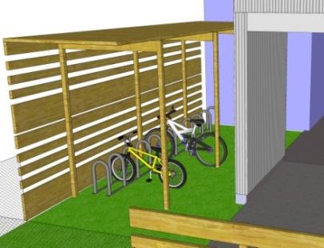
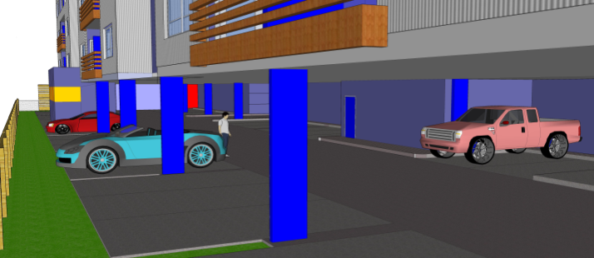
Roof Plan

Slide 15
Apartment Types
Unit Type Quantity Sq. Ft.
1 BR/1 BA 28 652
1 BR/1 BA 04 670
2 BR/1BA 12 985
2 BR/2 BA 16 985
1 BR/1BA 1 540

Slide 16
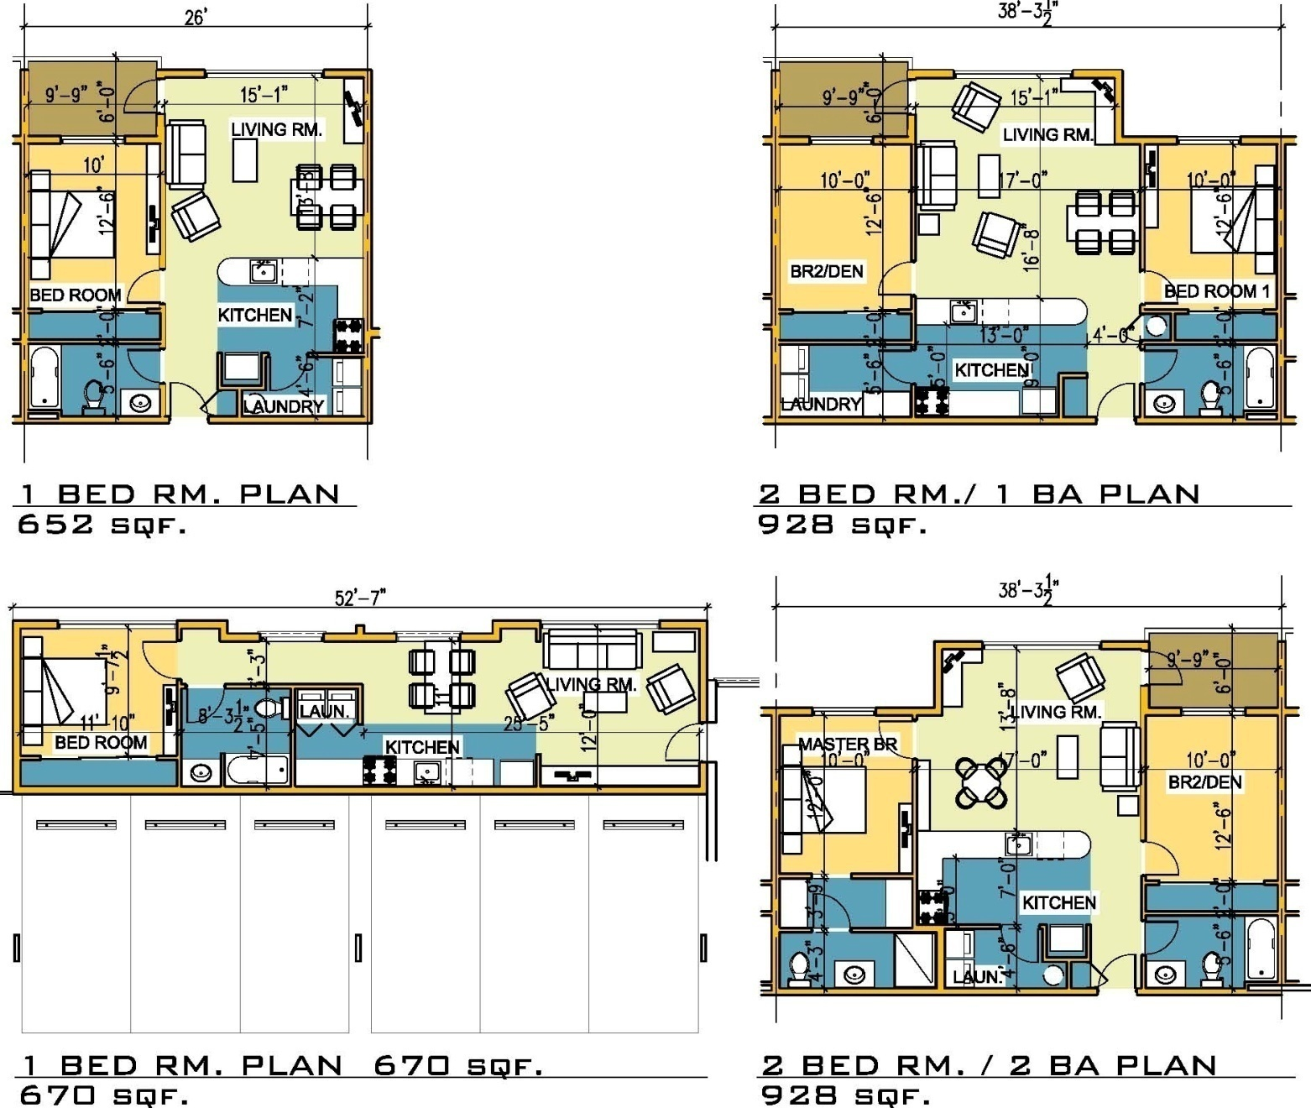
Apartment Types - Plans

Slide 17
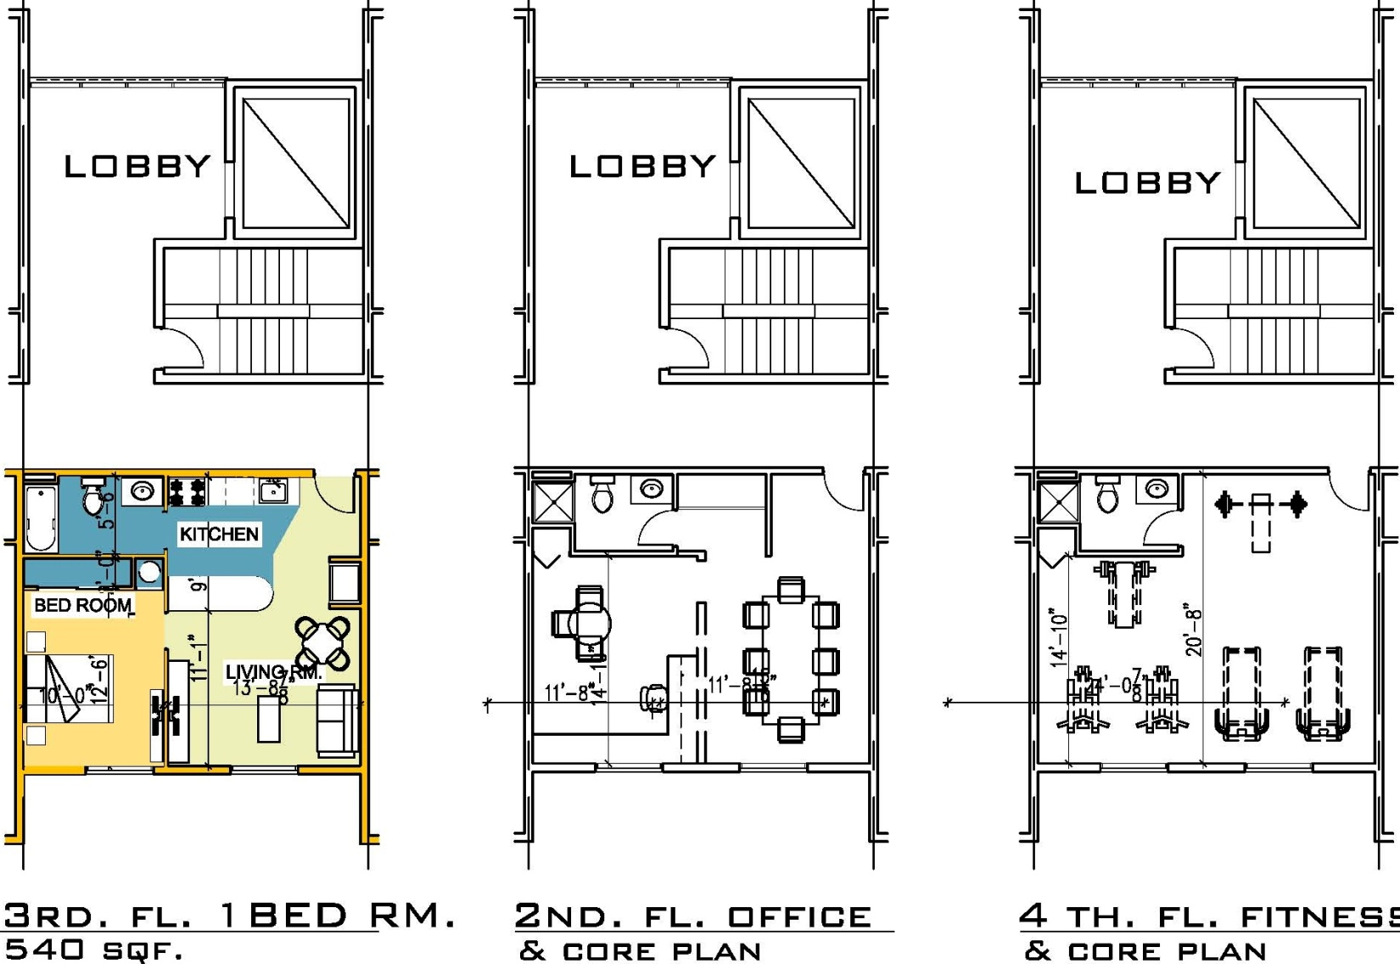
Special Units and Core

Slide 18
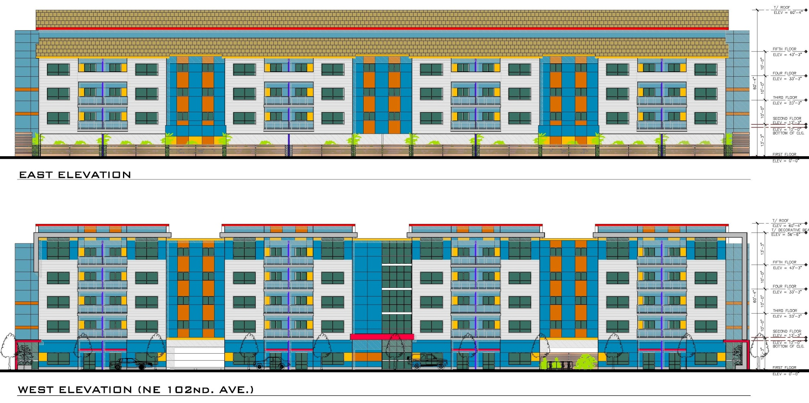
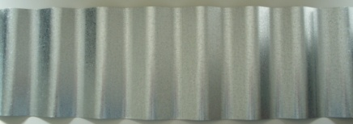
Elevations
CURTAIN WALL
COMPOSITE ROOF
METAL RAILING
PREFINISHED
CEMENT BOARD
PREFINISHED
CEMENT BOARD
PREFINISHED
CEMENT BOARD
CORRUGATED METAL PANEL
PREFINISHED
CEMENT BOARD

Slide 19
Elevations
The bold exterior colors reflect the design strategy of identification and composition, the long west façade engages in a fluent dialog with the surrounding and make a friendly pedestrian environment

Slide 20
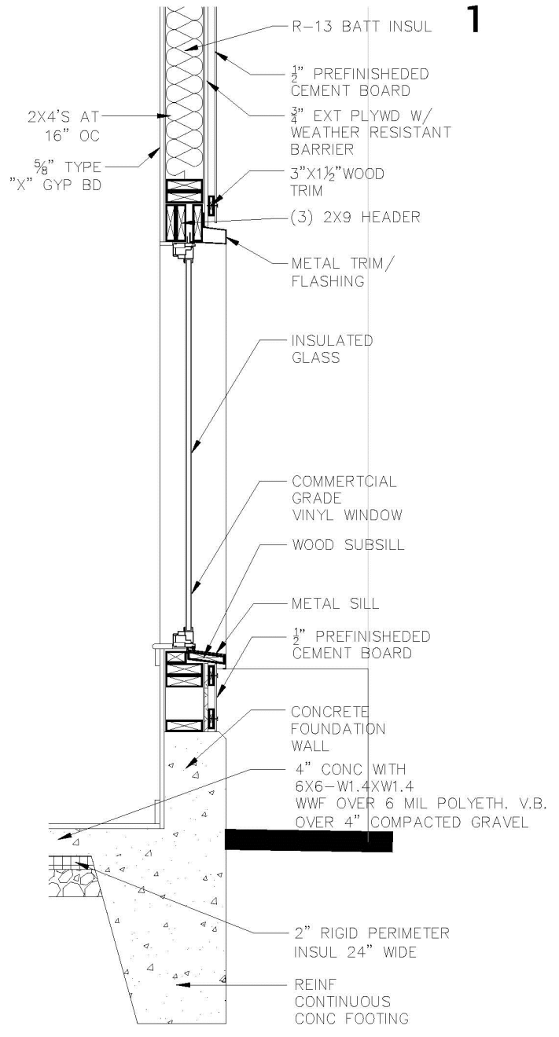
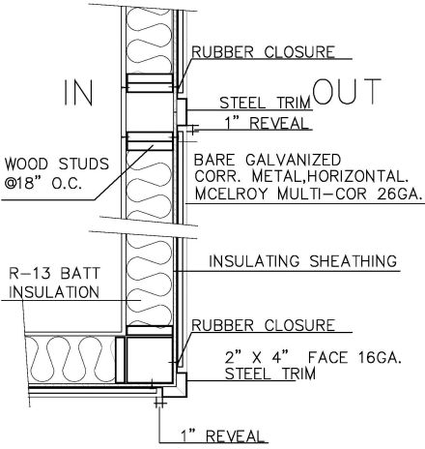
Wall section & plan details

Slide 21
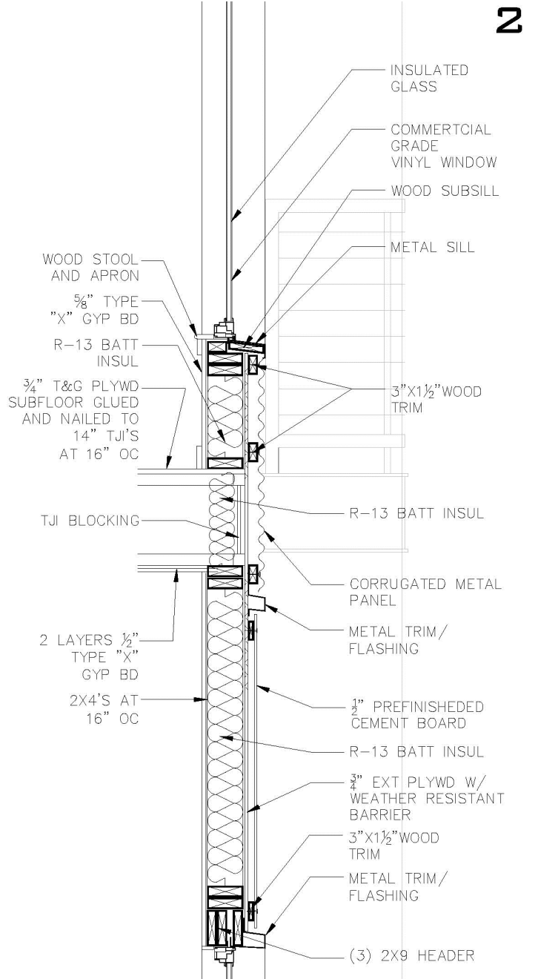
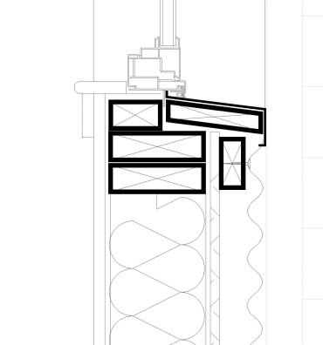
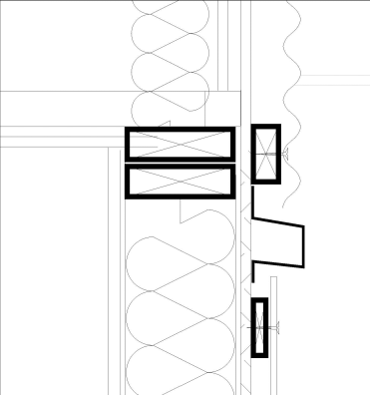
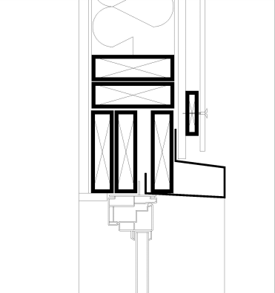
Wall section & plan details
METAL SILL
METAL TRIM
HEADER

Slide 22
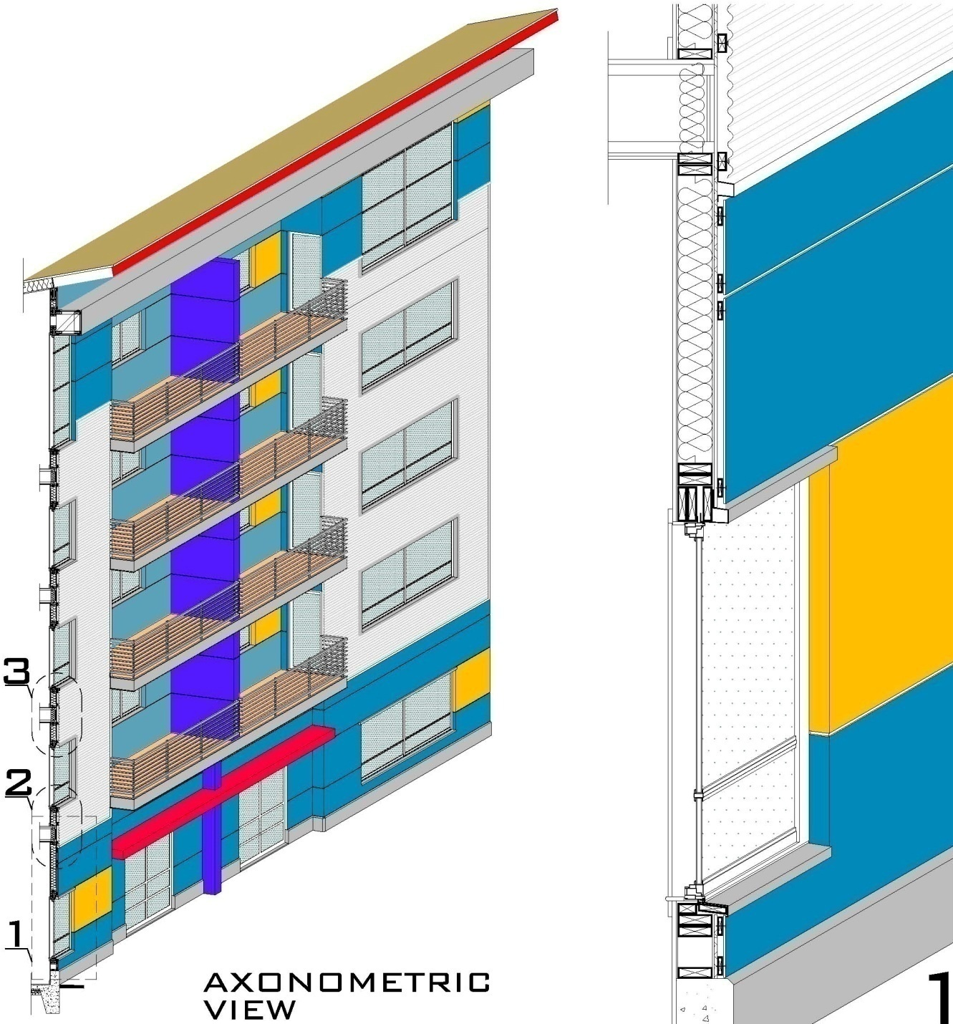
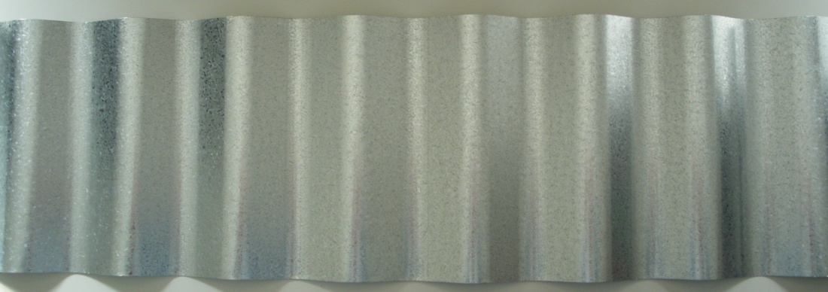
Axonometric view & wall section

Slide 23
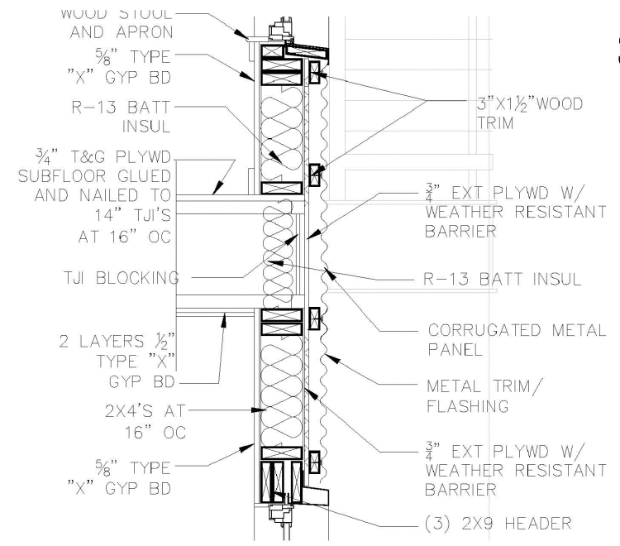
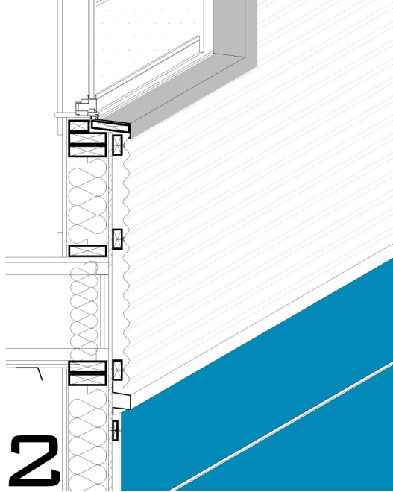
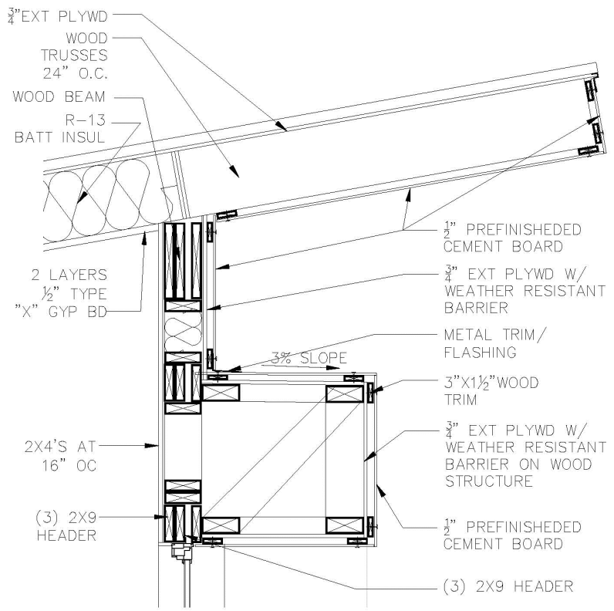
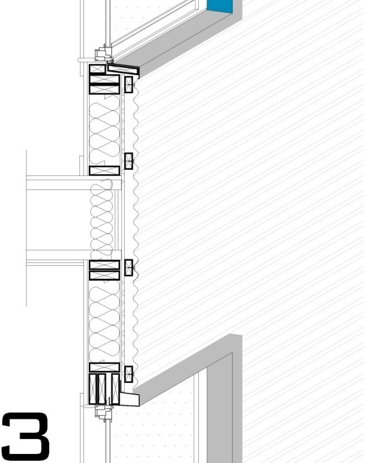
Wall section details + finishes

Slide 24
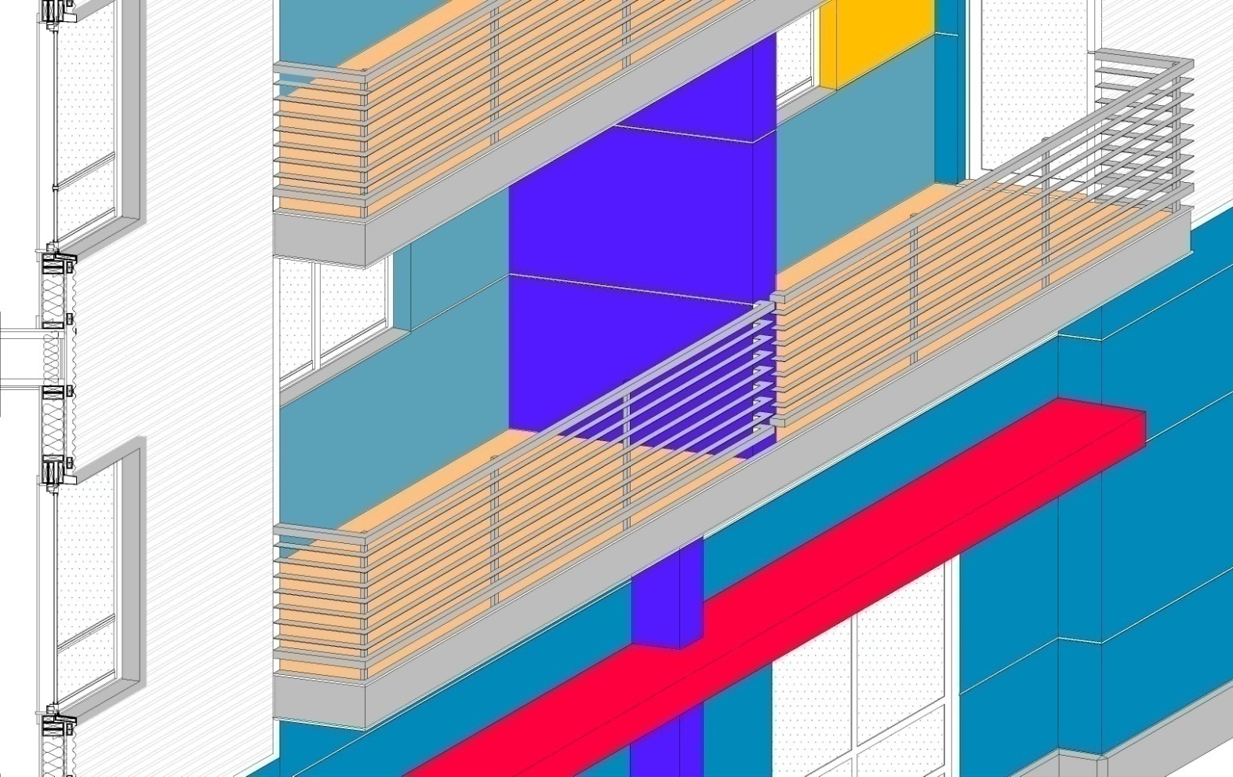
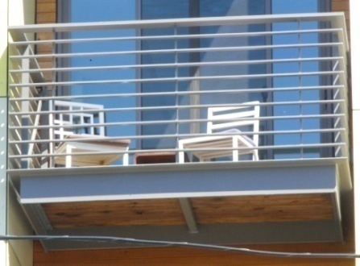
Axonometric view + finishes
Prefinished cement board
Corrugated metal panel

Slide 25
Modifications Request
Ground Floor Active Use Requirement (33.526.280 D.2)
The Ground Floor Active Use areas requires 25'-0" deep in interior spaces that front onto a sidewalk.
Request: in order to allow a better screening of the parking garage from the 102nd. street and a more efficient design and operation of the parking garage we request to reduce to 13'-2" deep of the apartments located at the front of the building.
Short-Term Bicycle Parking (33.266.220 A.2b(3))
Building with one main entrance. For a building with one main entrance, the bicycle parking must be within 50 feet of the main entrance to the building as measured along the most direct pedestrian access route .
Request: The short-term bicycle parking is located between two apartments in a public landscaped sitting area. This is one of the recessed areas along the 102nd. Ave. resulting from the intension to break the long front elevation to avoid an extended massive building. The distance between the main access to the bicycle parking is 58 feet instead of the 50 required.

Slide 26
Parking area setbacks and landscaping (33.266.130 G.3a)
Amount of interior landscaping required. In all zones, interior landscaping must be provided for sites where there are more than 10 parking spaces on the entire site. At least 45 square feet of interior
landscaped area must be provided for each parking space.
Request: 26 of the parking spots located in the back side of the parking lot are partially exposed. As a result of this situation the code demand 1,170 sq.ft. of interior landscape. Our request is to be exempted from this item.
.

Slide 27
Sormwater Management
The proposed stormwater management at this stage of the building design is based on the SWMM requirements. Is a mixed solution composed by the use of 6 drywells (4 feet diameter X 5 feet H as per Chapter 2 Exhibits 2.30 and 2.31) serving an impervious area of 3,000 sq,ft each one, combined with a 1,600 sqf. concrete planter (detail as per Appendix G, detail SW-130) located along the east property line, see first fl. plan. All the drywells are located five feet from the property line and at list 10 feet distance from any structural component.

Slide 28
General Images

Slide 29
Pedestrian Images

Slide 30
Same materials used in other buildings in Portland

Slide 33
Detailed examples

Slide 37
Composite Roof examples

