Slide 1
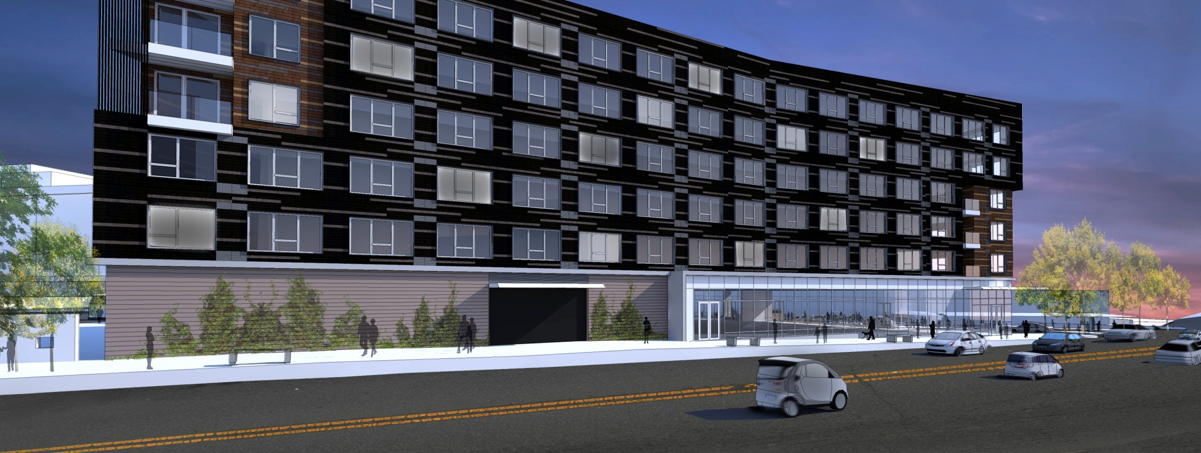
BLOCK A DESIGN ADVICE REVIEW SEPTEMBER 20, 2012 GBD ARCHITECTS Incorporated

Slide 2
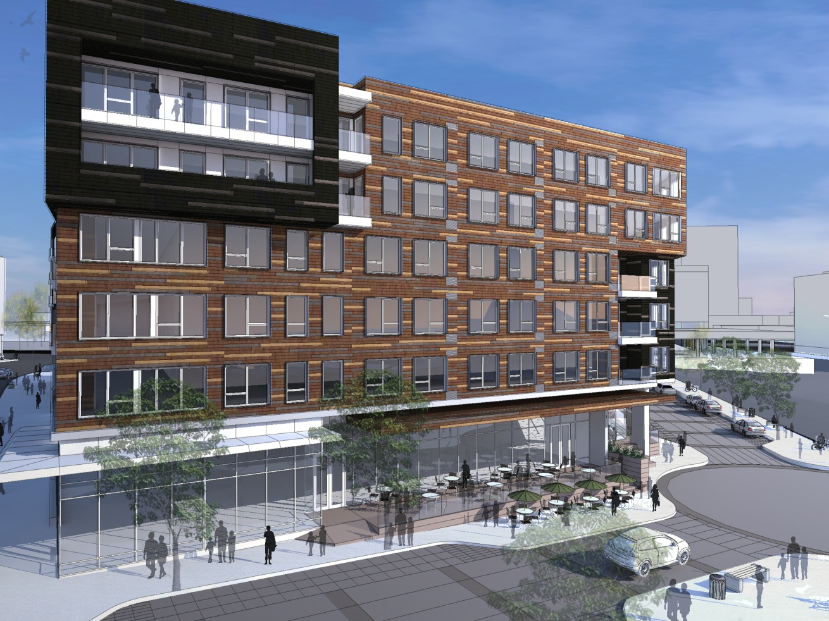
PRESENTATION OVERVIEW
DESIGN ADVICE REQUEST SUMMARY
SITE OVERVIEW
DEFINITION & PURPOSE OF SUPERBLOCK REGULATIONS
MULTIPLE OWNERSHIP & BLOCK A REQUIREMENTS
AREA REQUIREMENS
AREA PROVIDED
PLAZA REQUIREMENTS
MODIFICATION
TIME ALLOWING
PROJECT REVIEW
MASSING AND MATERIALS

Slide 3
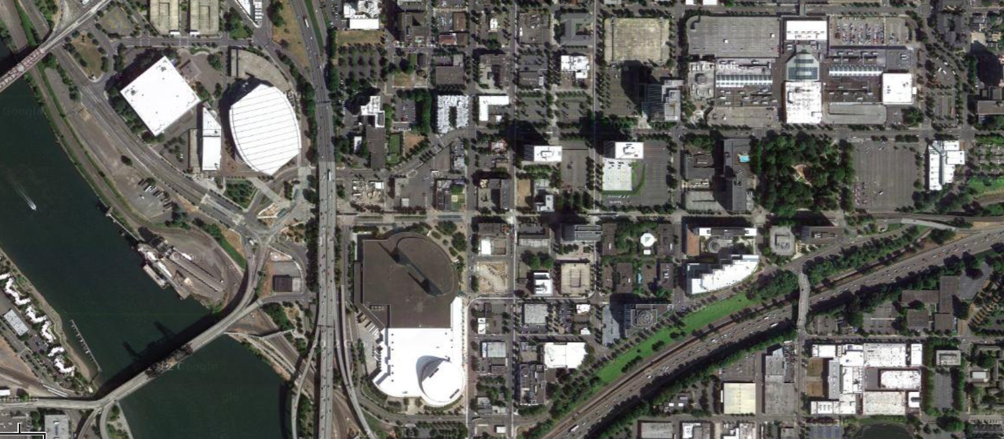
SITE OVERVIEW
1
CONTEXT: LOCATED NORTH OF THE CONVENTION CENTER

Slide 4
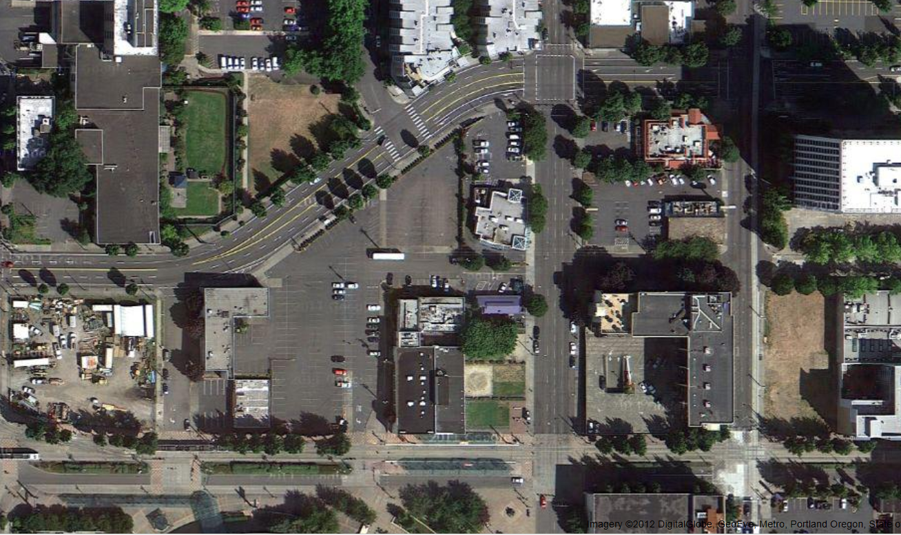
SITE OVERVIEW
1
BOUNDED BY MULTNOMAH AND MLK WITH HOLLDAY TO THE SOUTH & 2ND TO THE WEST
NE MULTNOMAH
NE 2ND
NE MLK BLVD
NE HOLLADAY

Slide 5
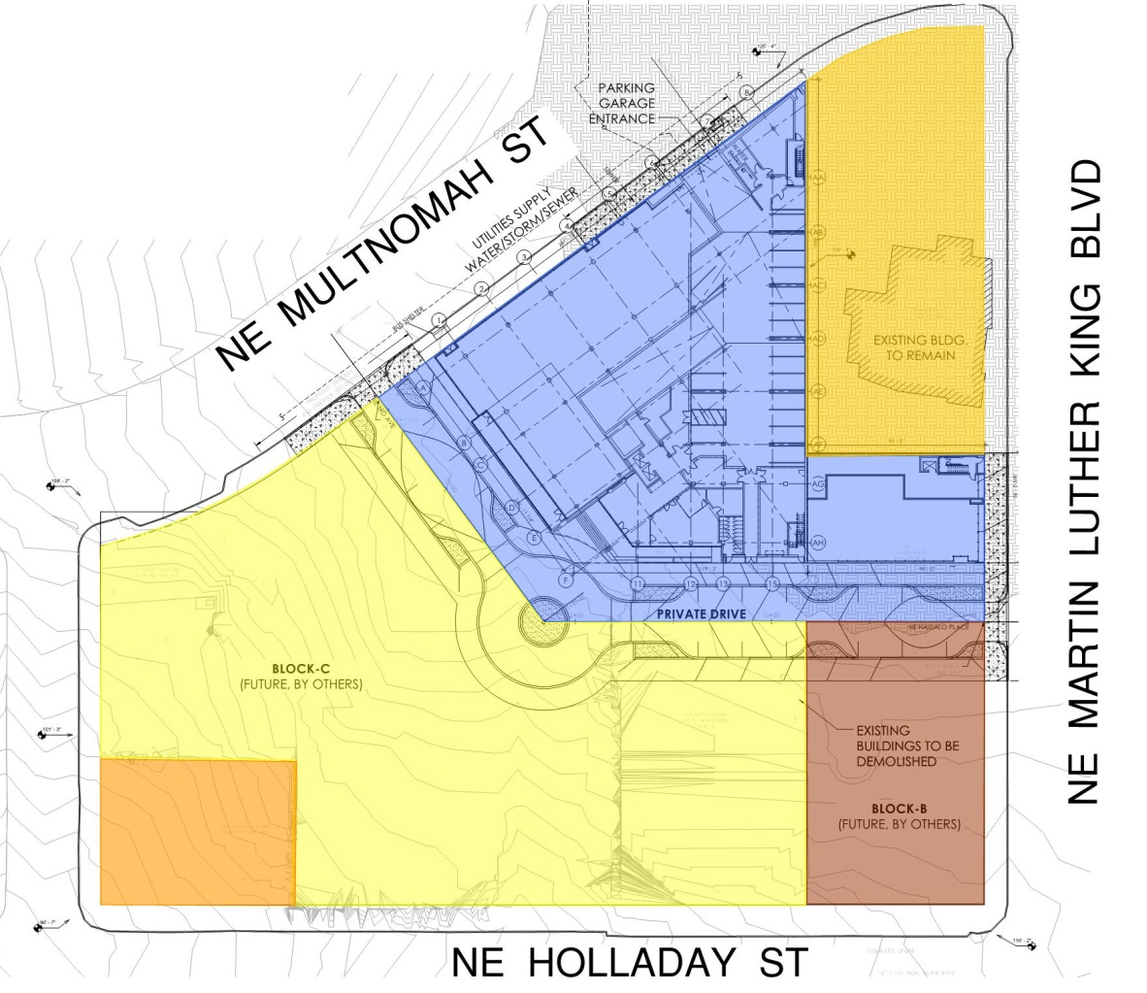
SITE OVERVIEW
1
MULTIPLE OWNERSHIPS
Powells
Rembold Companies
PDC
Starterra
Byrnes
POWELLS
POWELLS
REMBOLD COMPANIES
REMBOLD
PROPERTIES
STARTERRA
PDC
STARTERRA
PDC
BYRNES
BYRNES

Slide 6
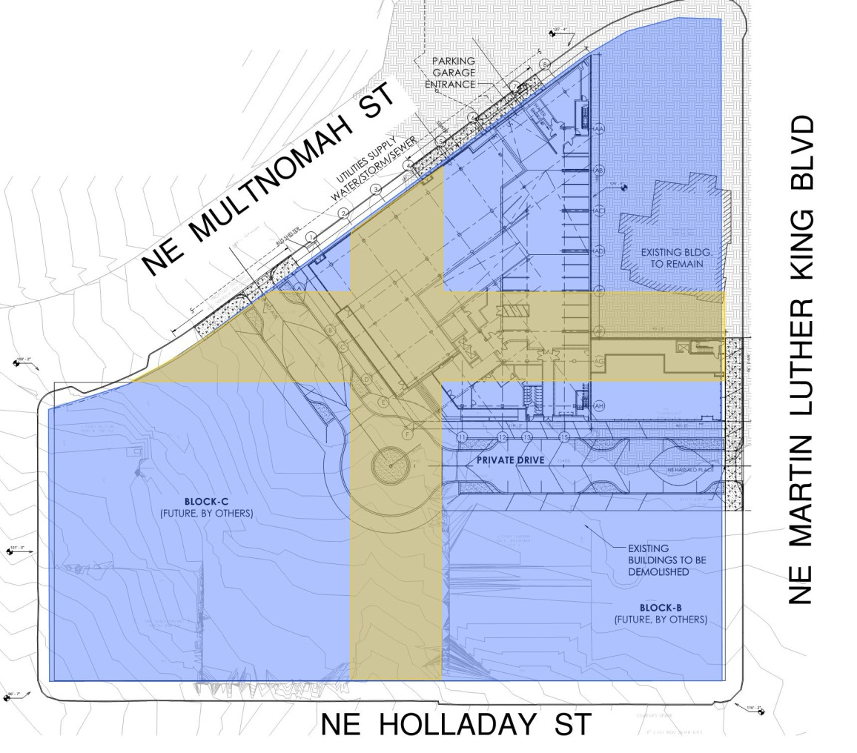
SUPERBLOCK DEFINITION
2
SUPERBLOCK CREATED WHEN THE CITY VACATED NE 3RD AND NE HASSALO
Superblock regulations apply to all new development on sites that include 5,000 sf or more of vacated streets.
Area of vacated streets
36,739 SF
Area of Superblock
185,405 SF
NE HASSALO
NE 3RD

Slide 7
SUPERBLOCK PURPOSE
2
PURPOSE & 33.293.010 REQUIREMENTS
The superblock chapter regulates the amount and location of open areas and walkways on large commercial sites where streets have been vacated.
The intent is to promote a pleasant and convenient walkway and open space system on the superblock that links to the adjacent buildings, to the public circulation system, and to any available public transit.
The requirement also promotes the maintenance of light, air and access that could be lost due to development on the vacated street.
Developments must provide walkways, landscaped areas and Public Plazas
(or Public Atriums)
NE HASSALO
NE 3RD

Slide 8
MULTIPLE OWNERSHIPS
3
DEFINITION & REQUIREMENTS OF MULTIPLE OWNERSHIPS
In cases where a superblock contains multiple ownerships and only one ownership is being developed:
Each ownership will provide walkways, landscaped areas and plazas based on that ownership’s percentage of the total vacated street area
The required walkways, landscaped areas and plazas for each ownership must be integrated into the previously required walkways, landscape areas & plazas of the other ownerships in the superblock
NE HASSALO
NE 3RD

Slide 9
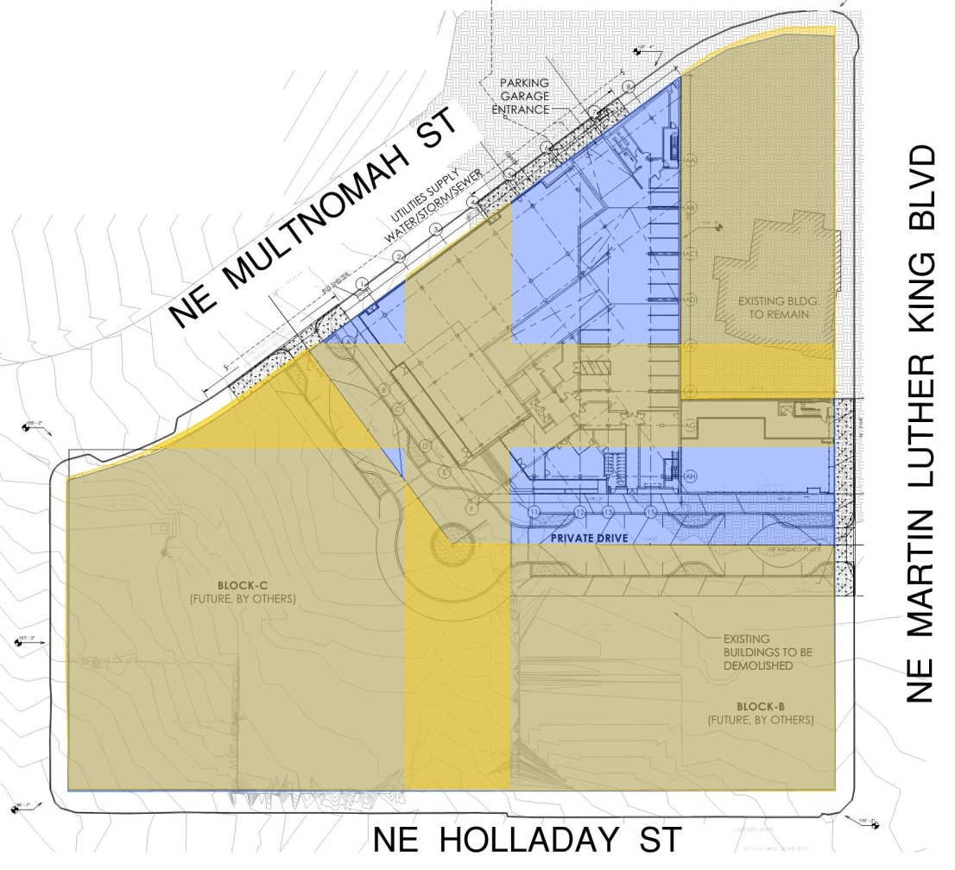
MULTIPLE OWNERSHIPS
3
BLOCK A PERCENT CALCULATION
Each ownership will provide walkways, landscaped areas and plazas based on that ownership’s percentage of the total vacated street area
Area of Vacated Streets on Entire Superblock
36,739 SF
Area of Vacated Streets on Block A
12,901 SF
Calculation:
12,901 SF / 36,739 SF = 35%
Block A’s Percentage of Total Vacated Streets
35%
NE HASSALO
Block A % of Superblock
24%
NE 3RD
35%

Slide 10
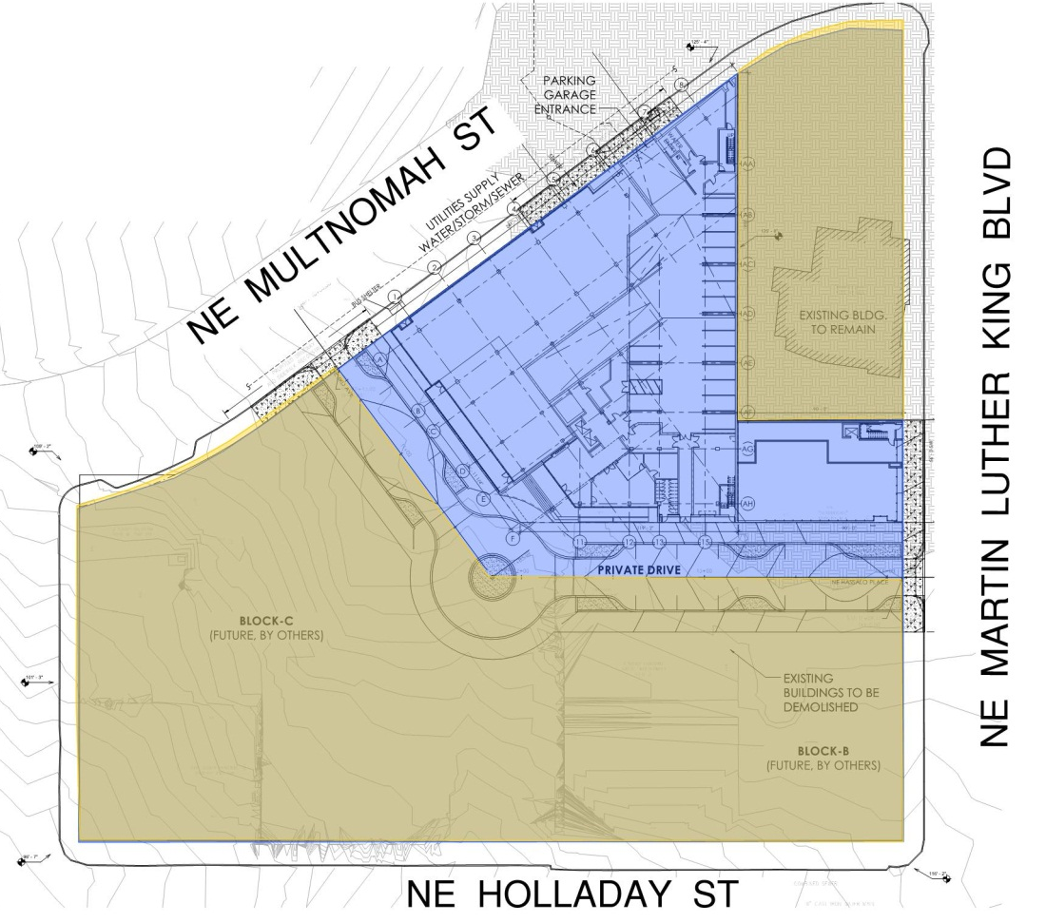
AREA REQUIREMENTS
4
BLOCK A – WALKWAYS, LANDSCAPE AREAS & PLAZA REQUIREMENTS
Walkway, Landscape Areas and Public Plazas must equal 50% of the total area of the vacated streets
Area of the Vacated Streets
36,739 SF
Walkway, Landscape and Public Plaza Area for the Entire Superblock
Calculation:
36,739 SF x 50% = 18,370 SF
Walkways, Landscape & Plaza Area Required for Block A
Calculation:
35% x 18,370 = 6,430 SF
6,430 SF
6,430 SF

Slide 11
AREA REQUIREMENTS
4
BLOCK A – PLAZA REQUIREMENTS
A public plaza must be provided with the superblock equal to 5% of the superblock land area
Plaza Area Required for the Entire Superblock
Calculation:
185,405 SF x 5% = 9,270 SF
9,270 SF
Plaza Area Required for
Block A
Calculation:
35% x 9,270 SF = 3,245 SF
3,245 SF
3,245 SF

Slide 12
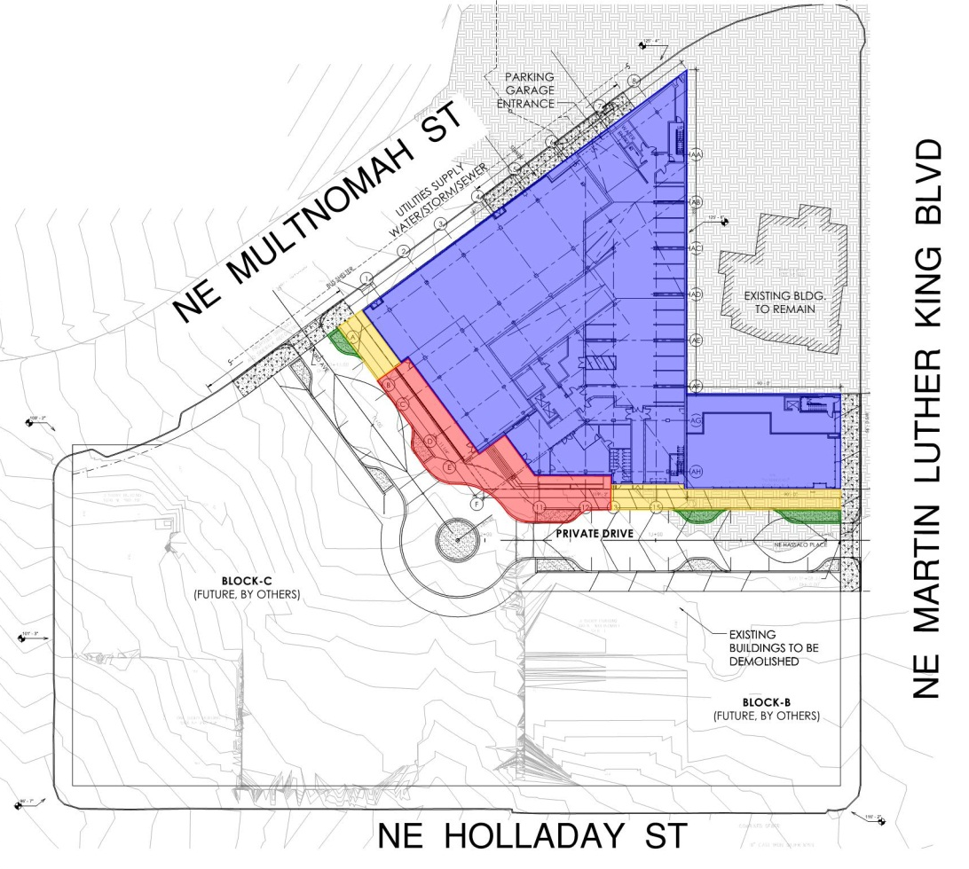
AREA PROVIDED
5
BLOCK A – WALKWAYS, LANDSCAPE & PLAZA PROVIDED
Block A - Walkway Area Provided
2,384 SF
Block A – Landscape Area Provided
400 SF
Block A – Plaza Area Provided
4,643 SF (+1,398)
Block A – Total Area Provided
Calculation:
2,384 SF + 400 SF + 4,643 SF =
7,427 SF
7,427 SF (+ 997 SF)
NE HASSALO
Block A Plaza
3,245 SF
NE 3RD

Slide 13
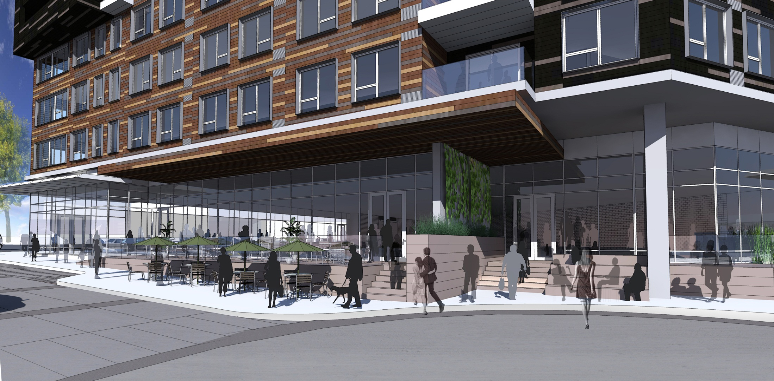
PLAZA REQUIREMENTS
6
PLAZA DEFINITION
PLAZA DEFINITION
An area generally open to the public on a controlled basis and used for passive recreational activities and relaxation. Plazas are paved areas typically provided with amenities, such as seating, drinking and ornamental fountains, art, trees, and landscaping, for use by pedestrians.
RATIO REQUIREMENT
The ratio of the length to the width of a plaza in a superblock may not exceed
3 to 1
NE HASSALO
NE 3RD

Slide 14
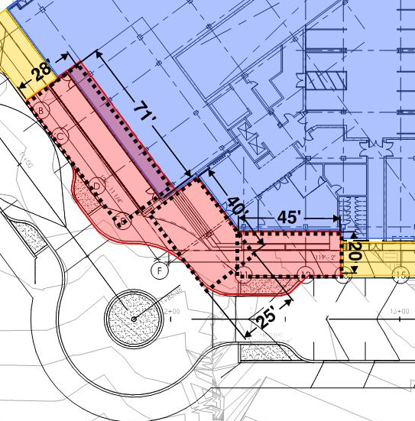
PLAZA REQUIREMENTS
6
PLAZA - RATIO REQUIREMENTS
Due to the odd shape, we looked at the plaza as a series of spaces
A: 1,988 SF
71’x28’
1:2.5
B: 1,000 SF
40’x25’
1:1.6
C: 900 SF
45’x20’
1:2.5
Note: The entire plaza area is not accounted for in these areas. An additional 755 SF is located in the triangle between A and B, and the triangle between B and C.
A
NE HASSALO
Block A Plaza
3,245 SF
NE 3RD
B
C
A
B
C

Slide 15
MODIFICATION
7
MODIFICATION OF PLAZA RATIO
DOES THE COMMISSION FEEL THAT A MODIFICATION ON THE PROPOSED MEASUREMENT METHODOLOGY FOR THE PLAZA RATIO IS APPROVABLE ?
Criteria for Modification Approval:
  The resulting development will better meet the applicable design guidelines; and on balance, the proposal will be consistent with the purpose of the standards for which a modification is requested
Purpose of Superblock
  The intent is to promote a pleasant and convenient walkway and open space system on the superblock that links to the adjacent buildings, to the public circulation system, and to any available public transit.
  The requirement also promotes the maintenance of light, air and access that could be lost due to development on the vacated street.
Justification:
  Providing private drives which will be built to meet Lloyd District Standards and for all intents an purposes will act and feel like a standard street in addition to meeting all of the walkway, landscape and plaza area requirements will not only meet the intent, but will provide better connections and more access to light and air than would otherwise be met meeting the standards alone.
NE HASSALO
Block A Plaza
3,245 SF
NE 3RD

Slide 16
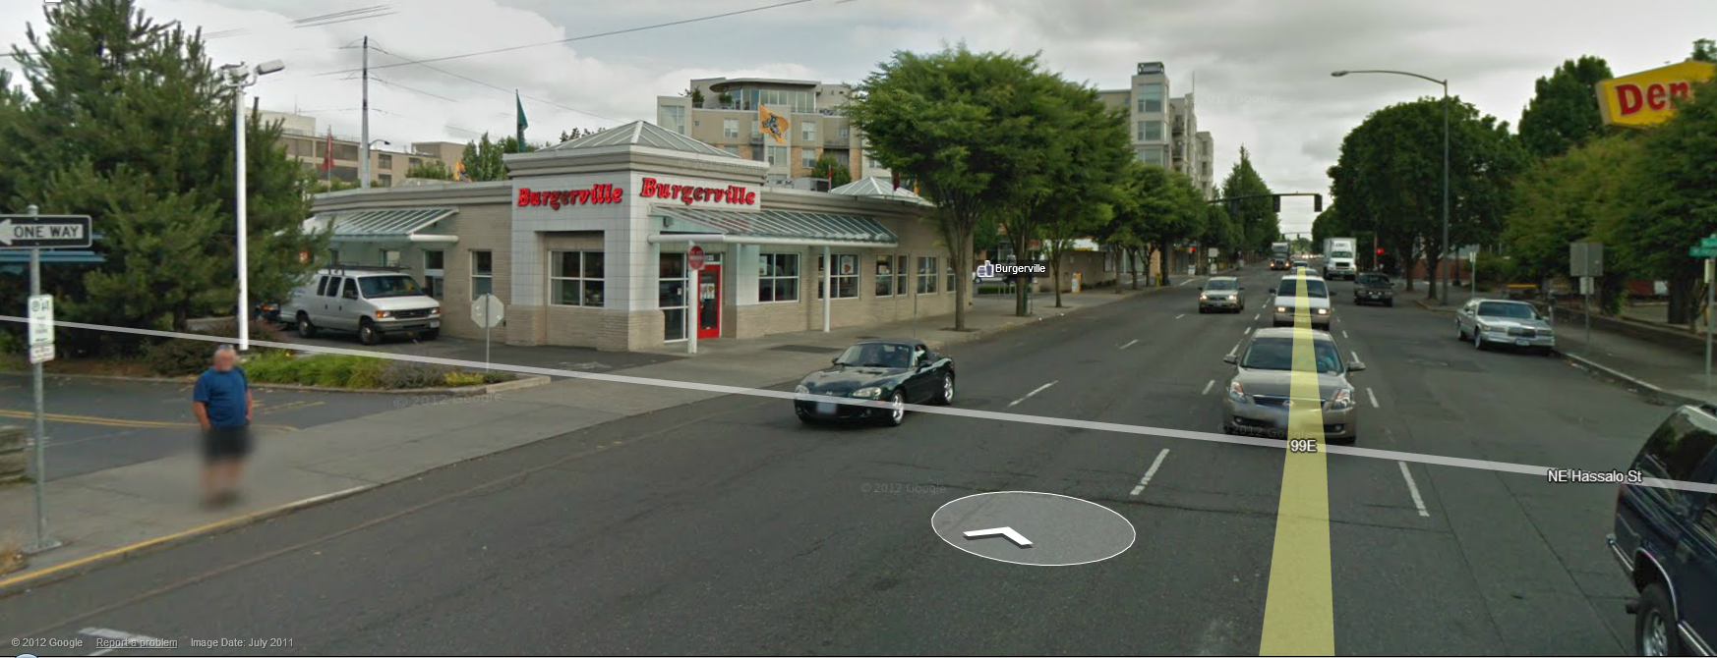
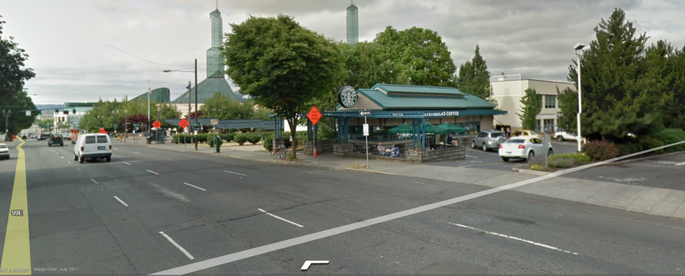
PROJECT REVIEW
8
CONTEXT
NE HASSALO
Block A Plaza
3,245 SF
NE 3RD

Slide 17
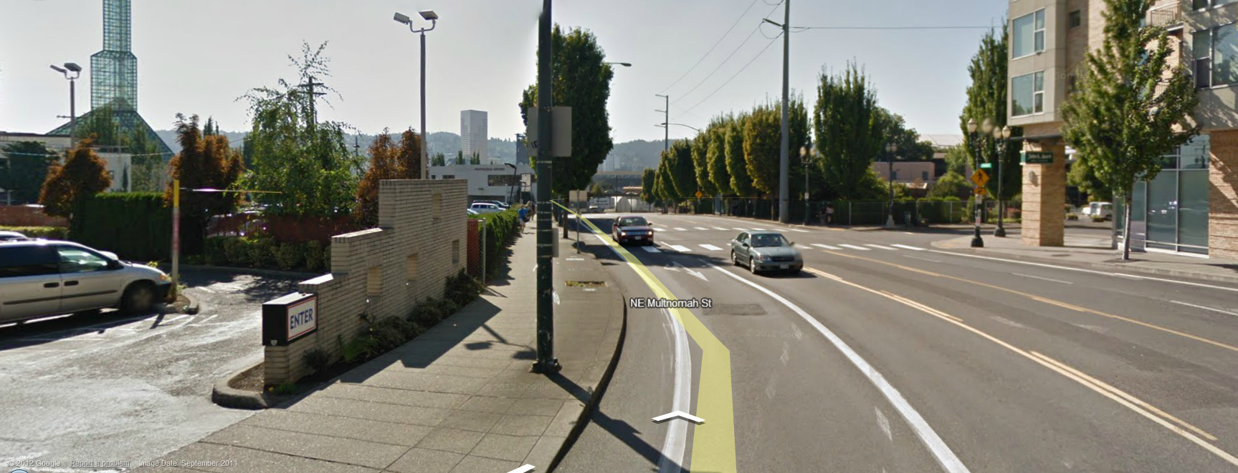
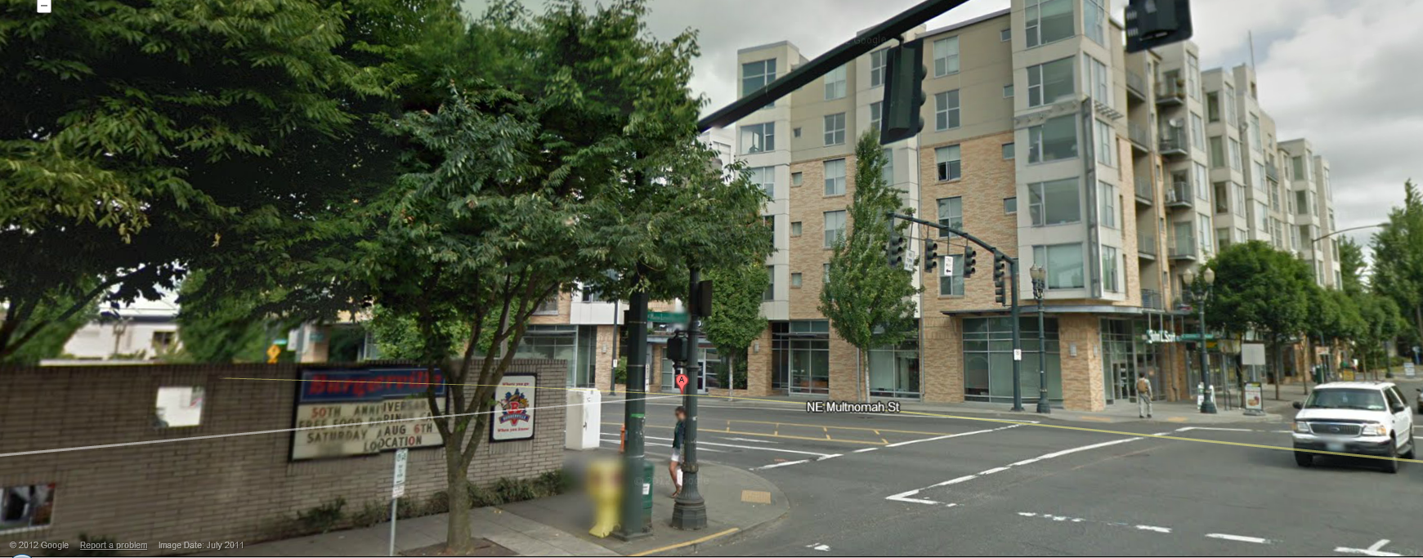
PROJECT REVIEW
8
CONTEXT
NE HASSALO
Block A Plaza
3,245 SF
NE 3RD

Slide 18
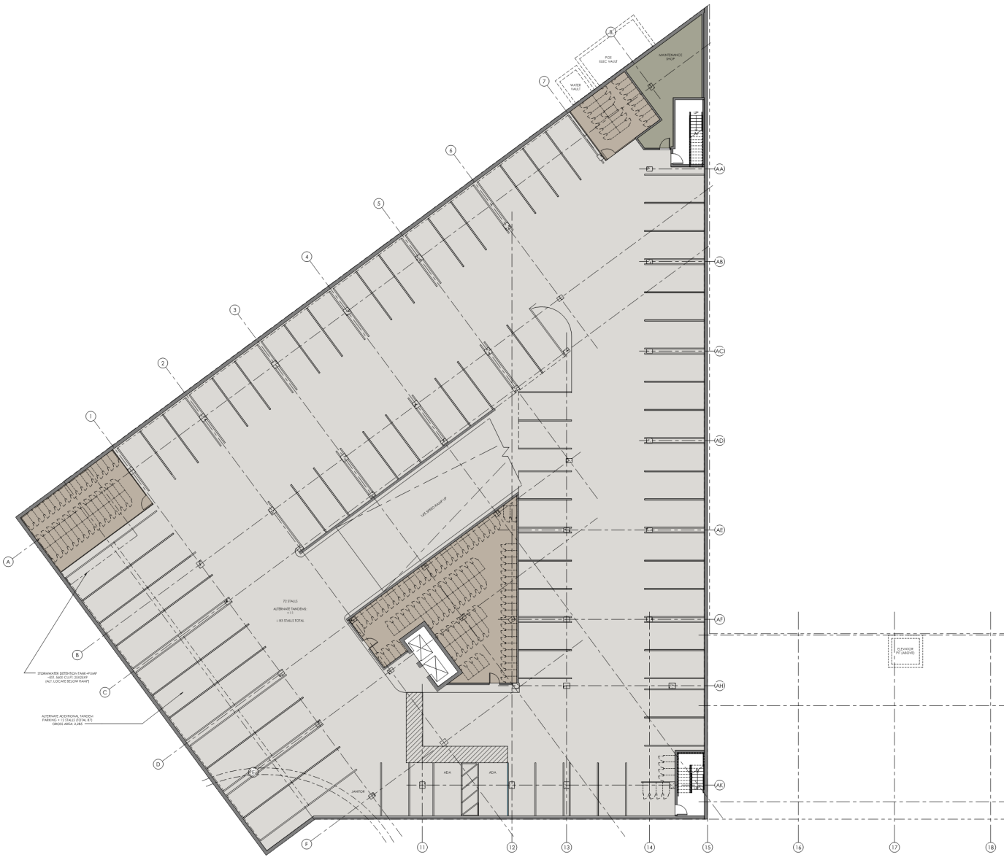
PROJECT REVIEW
8
BELOW GRADE PARKING PLAN
NE HASSALO
Block A Plaza
3,245 SF
NE 3RD

Slide 19
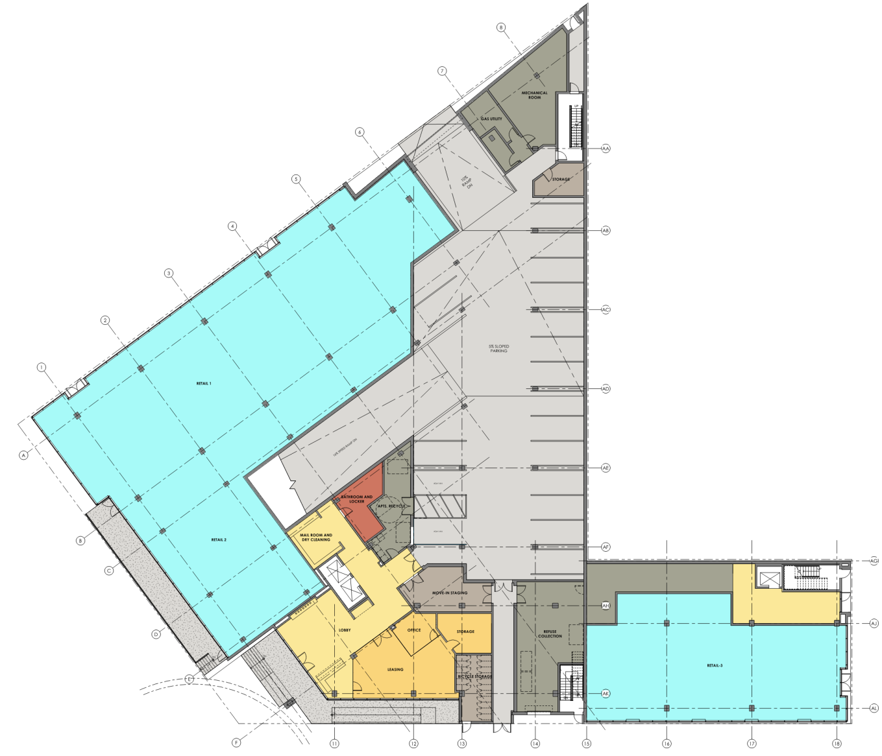
PROJECT REVIEW
8
GROUND FLOOR PLAN
NE HASSALO
Block A Plaza
3,245 SF
NE 3RD

Slide 20
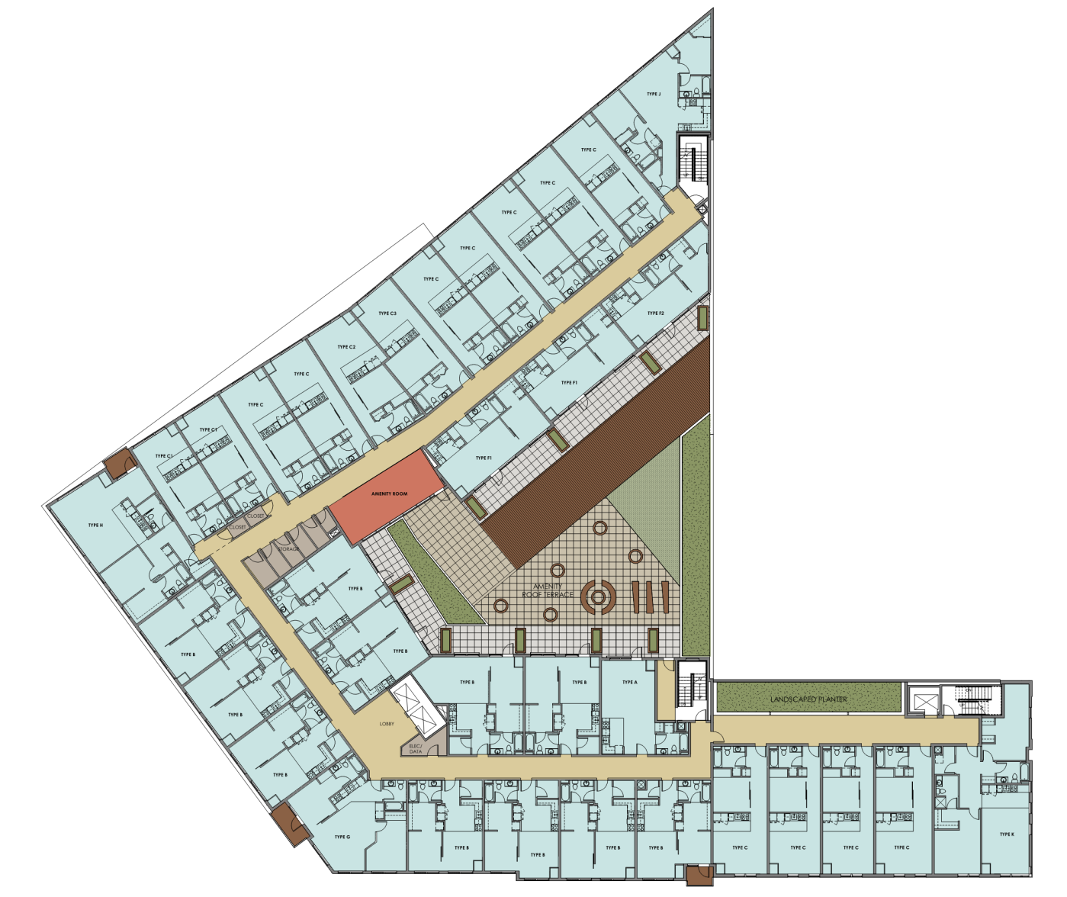
PROJECT REVIEW
8
TYPICAL FLOOR PLAN
NE HASSALO
Block A Plaza
3,245 SF
NE 3RD

Slide 21
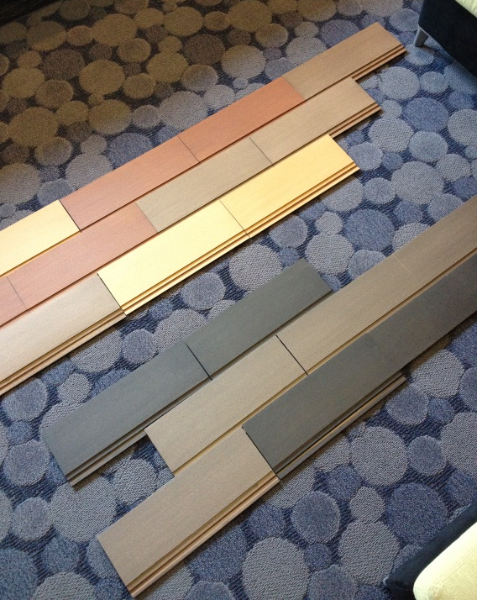

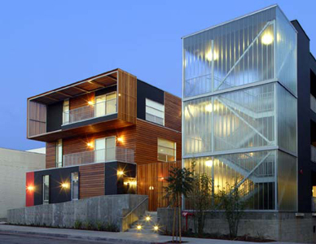
MATERIALS & MASSING
8
INTERSETION OF MULTNOMAH AND 3RD
NE HASSALO
Block A Plaza
3,245 SF
NE 3RD

Slide 22
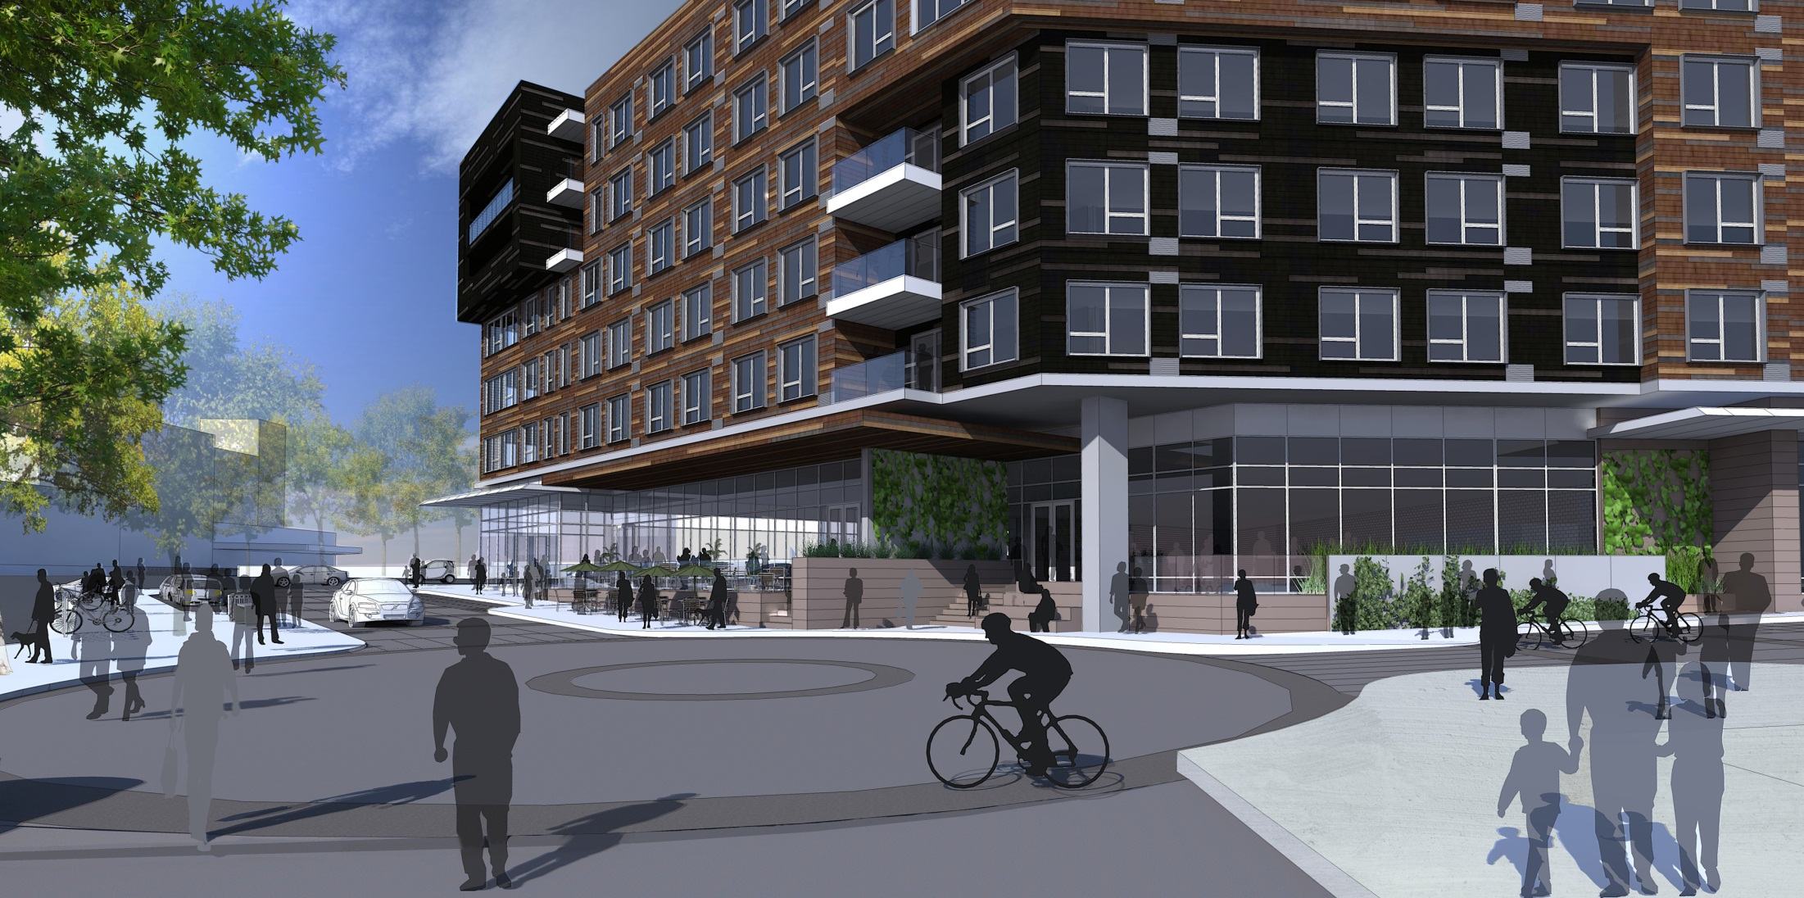
MATERIALS & MASSING
8
INTERSETION OF 3RD AND HASSALO
NE HASSALO
Block A Plaza
3,245 SF
NE 3RD

Slide 23
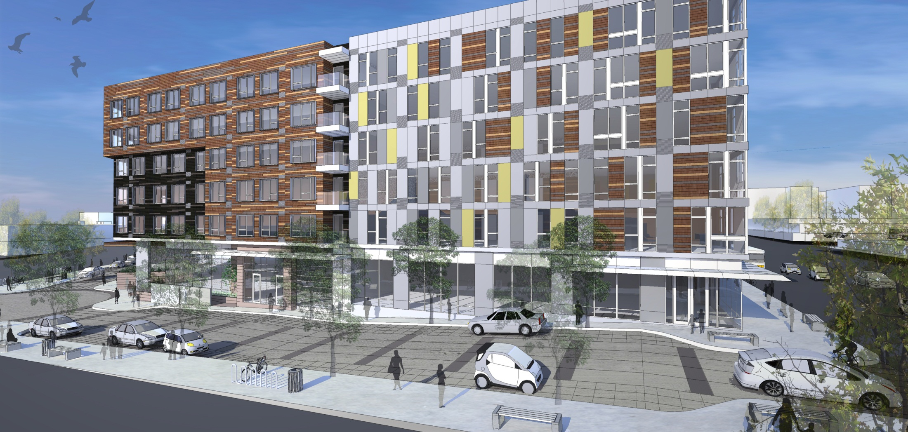
MATERIALS & MASSING
8
INTERSECTION HASSALO & MLK
NE HASSALO
Block A Plaza
3,245 SF
NE 3RD

Slide 24

SEPTEMBER 20, 2012
SITE OVERVIEW
BLOCK A – CONVENTION CENTER
300 NE MULTNOMAH
DESIGN ADVICE REQUEST

