Slide 1
Legacy
Holladay Park
Central Lab
Portland, OR
Proposal for a Two-Story, 65,000
Square Foot Clinical Laboratory
for Legacy Health
The project will consolidate laboratory facilities currently distributed among three campuses including current services at Holladay Park

Slide 2
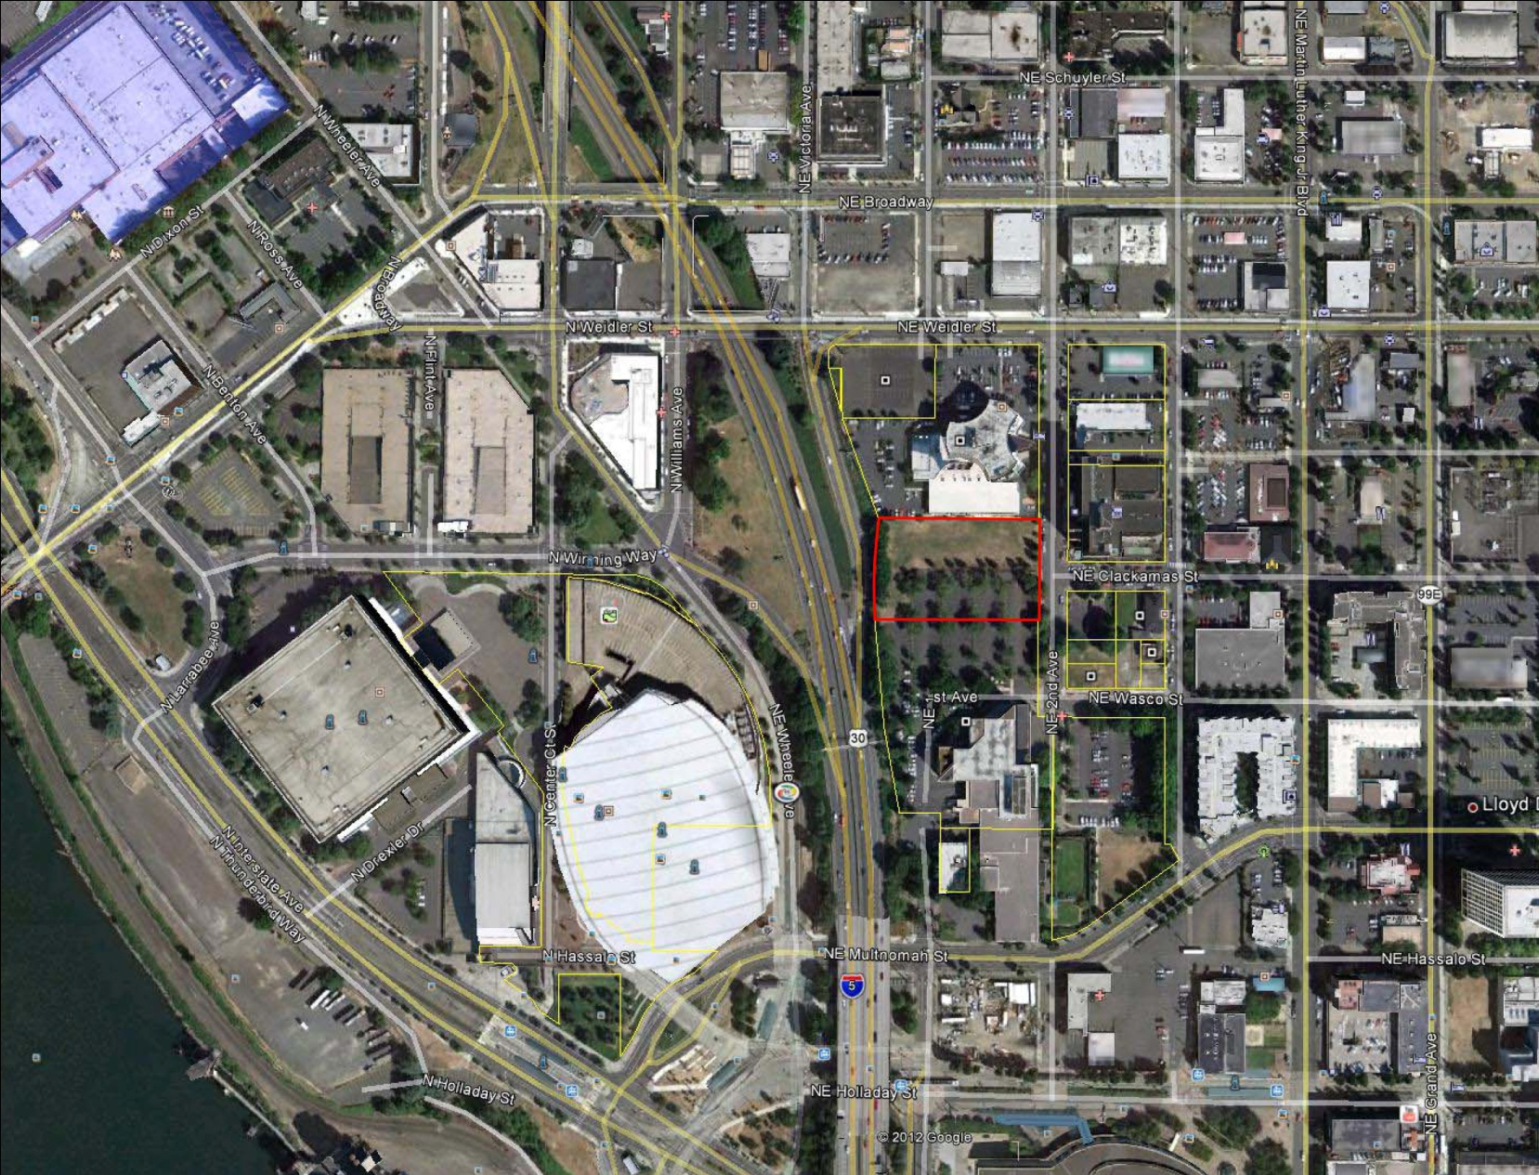
Crowne Plaza
Hotel
Project Site
Existing Legacy Lab
Memorial Coliseum
Rose Garden

Slide 3
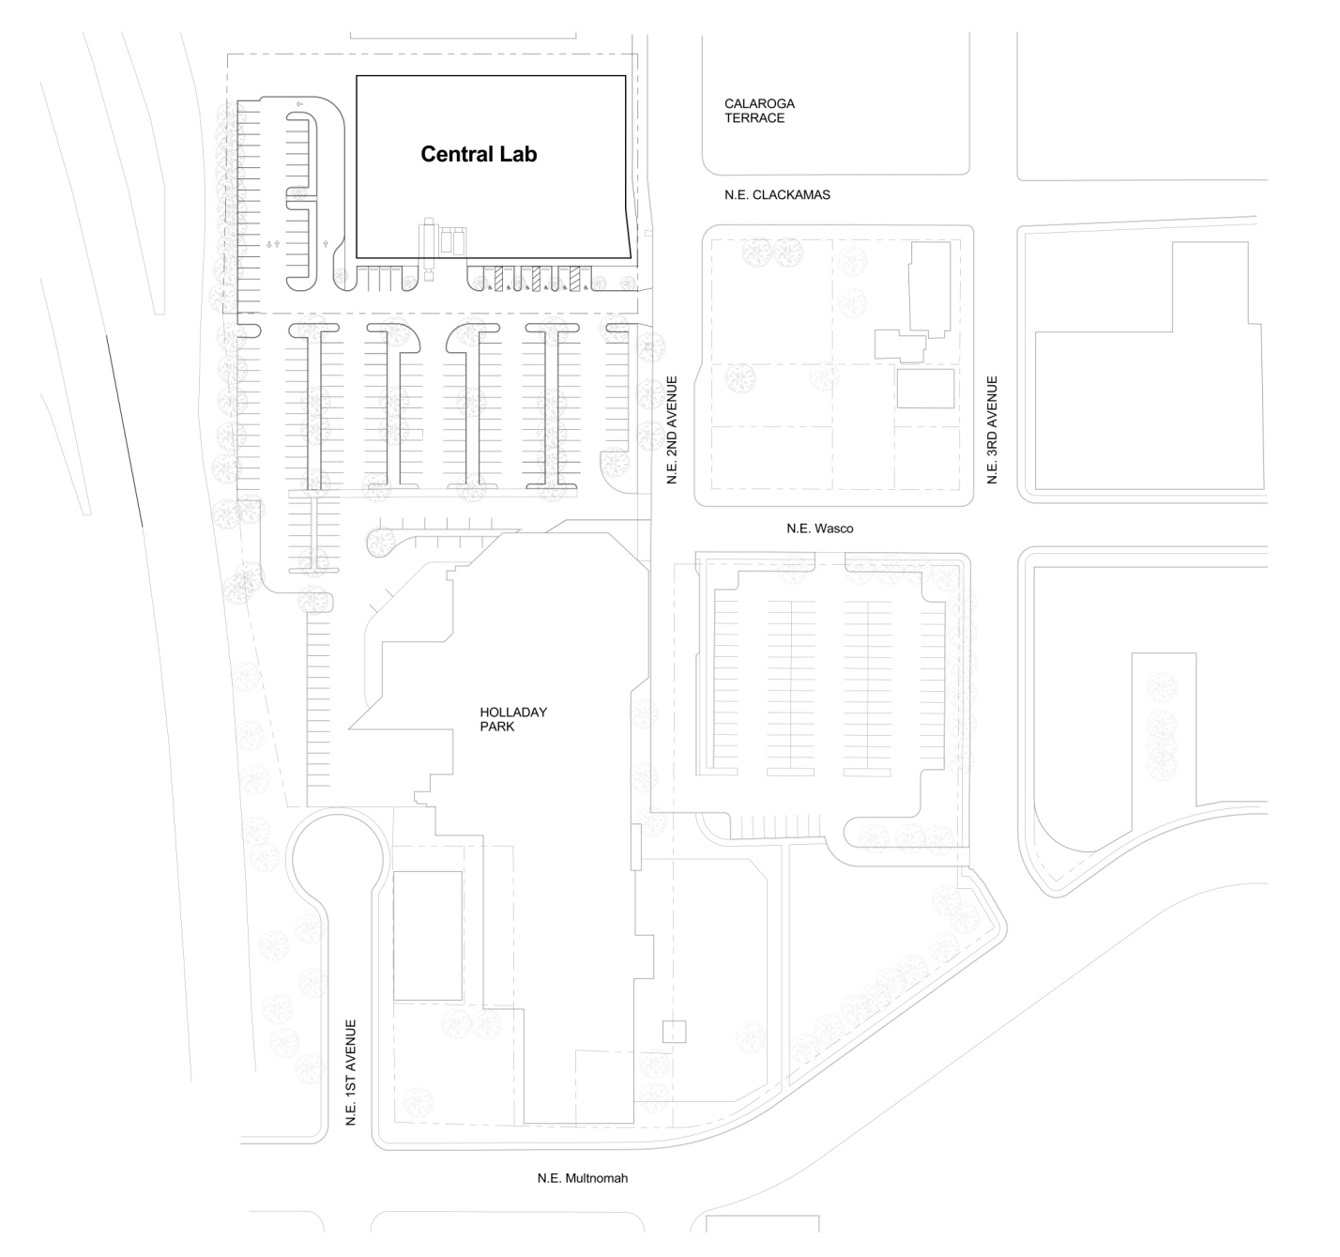

Slide 4
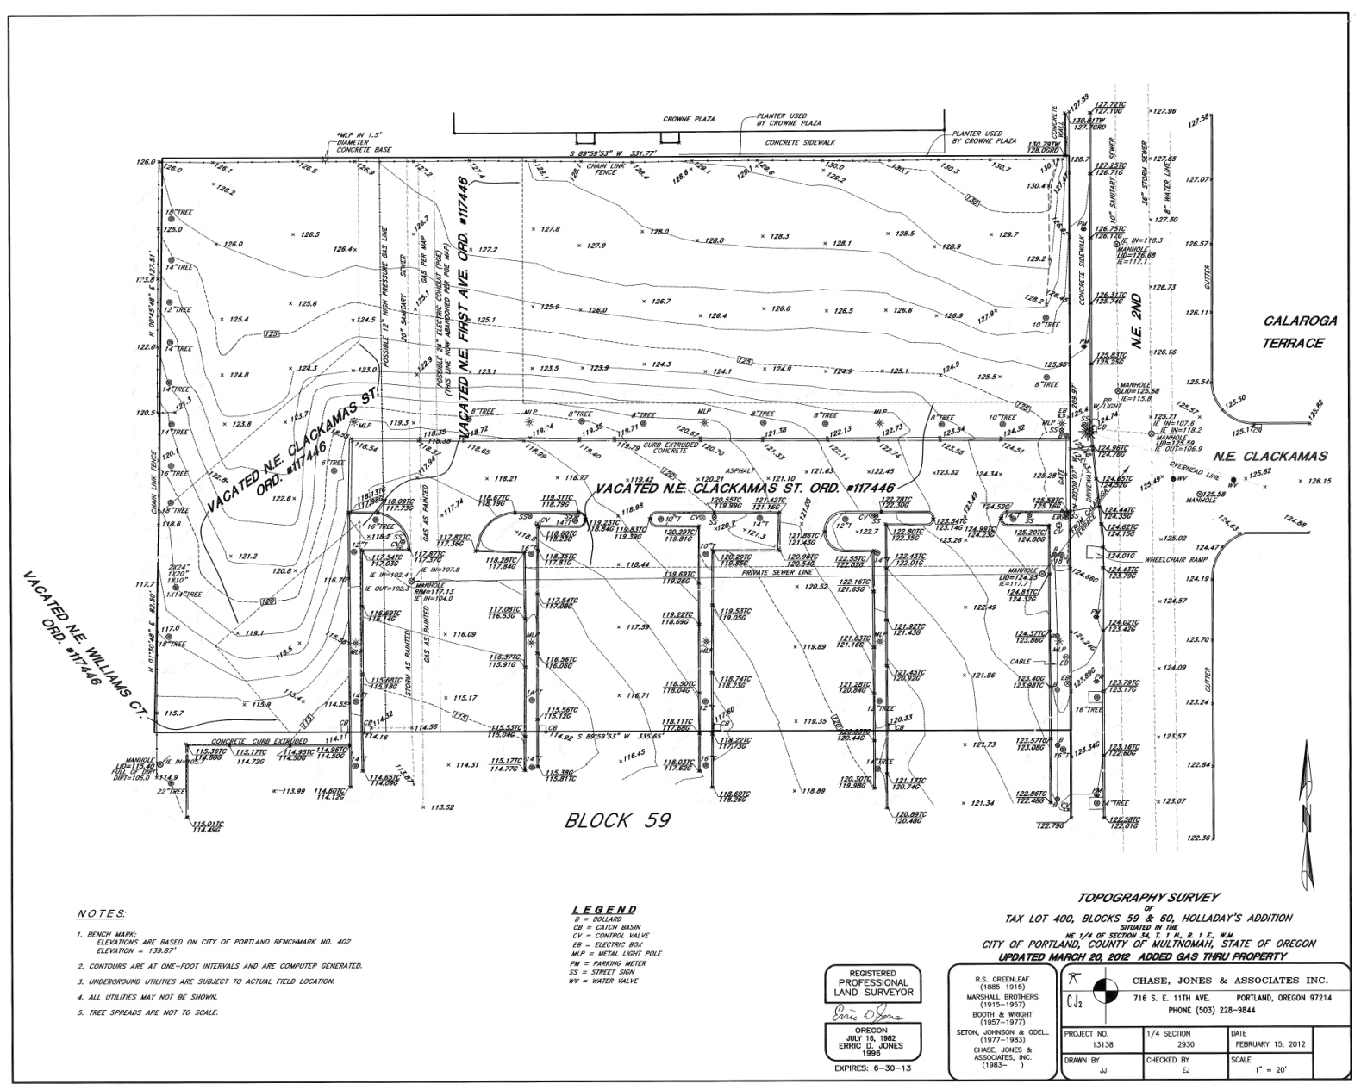

Slide 5
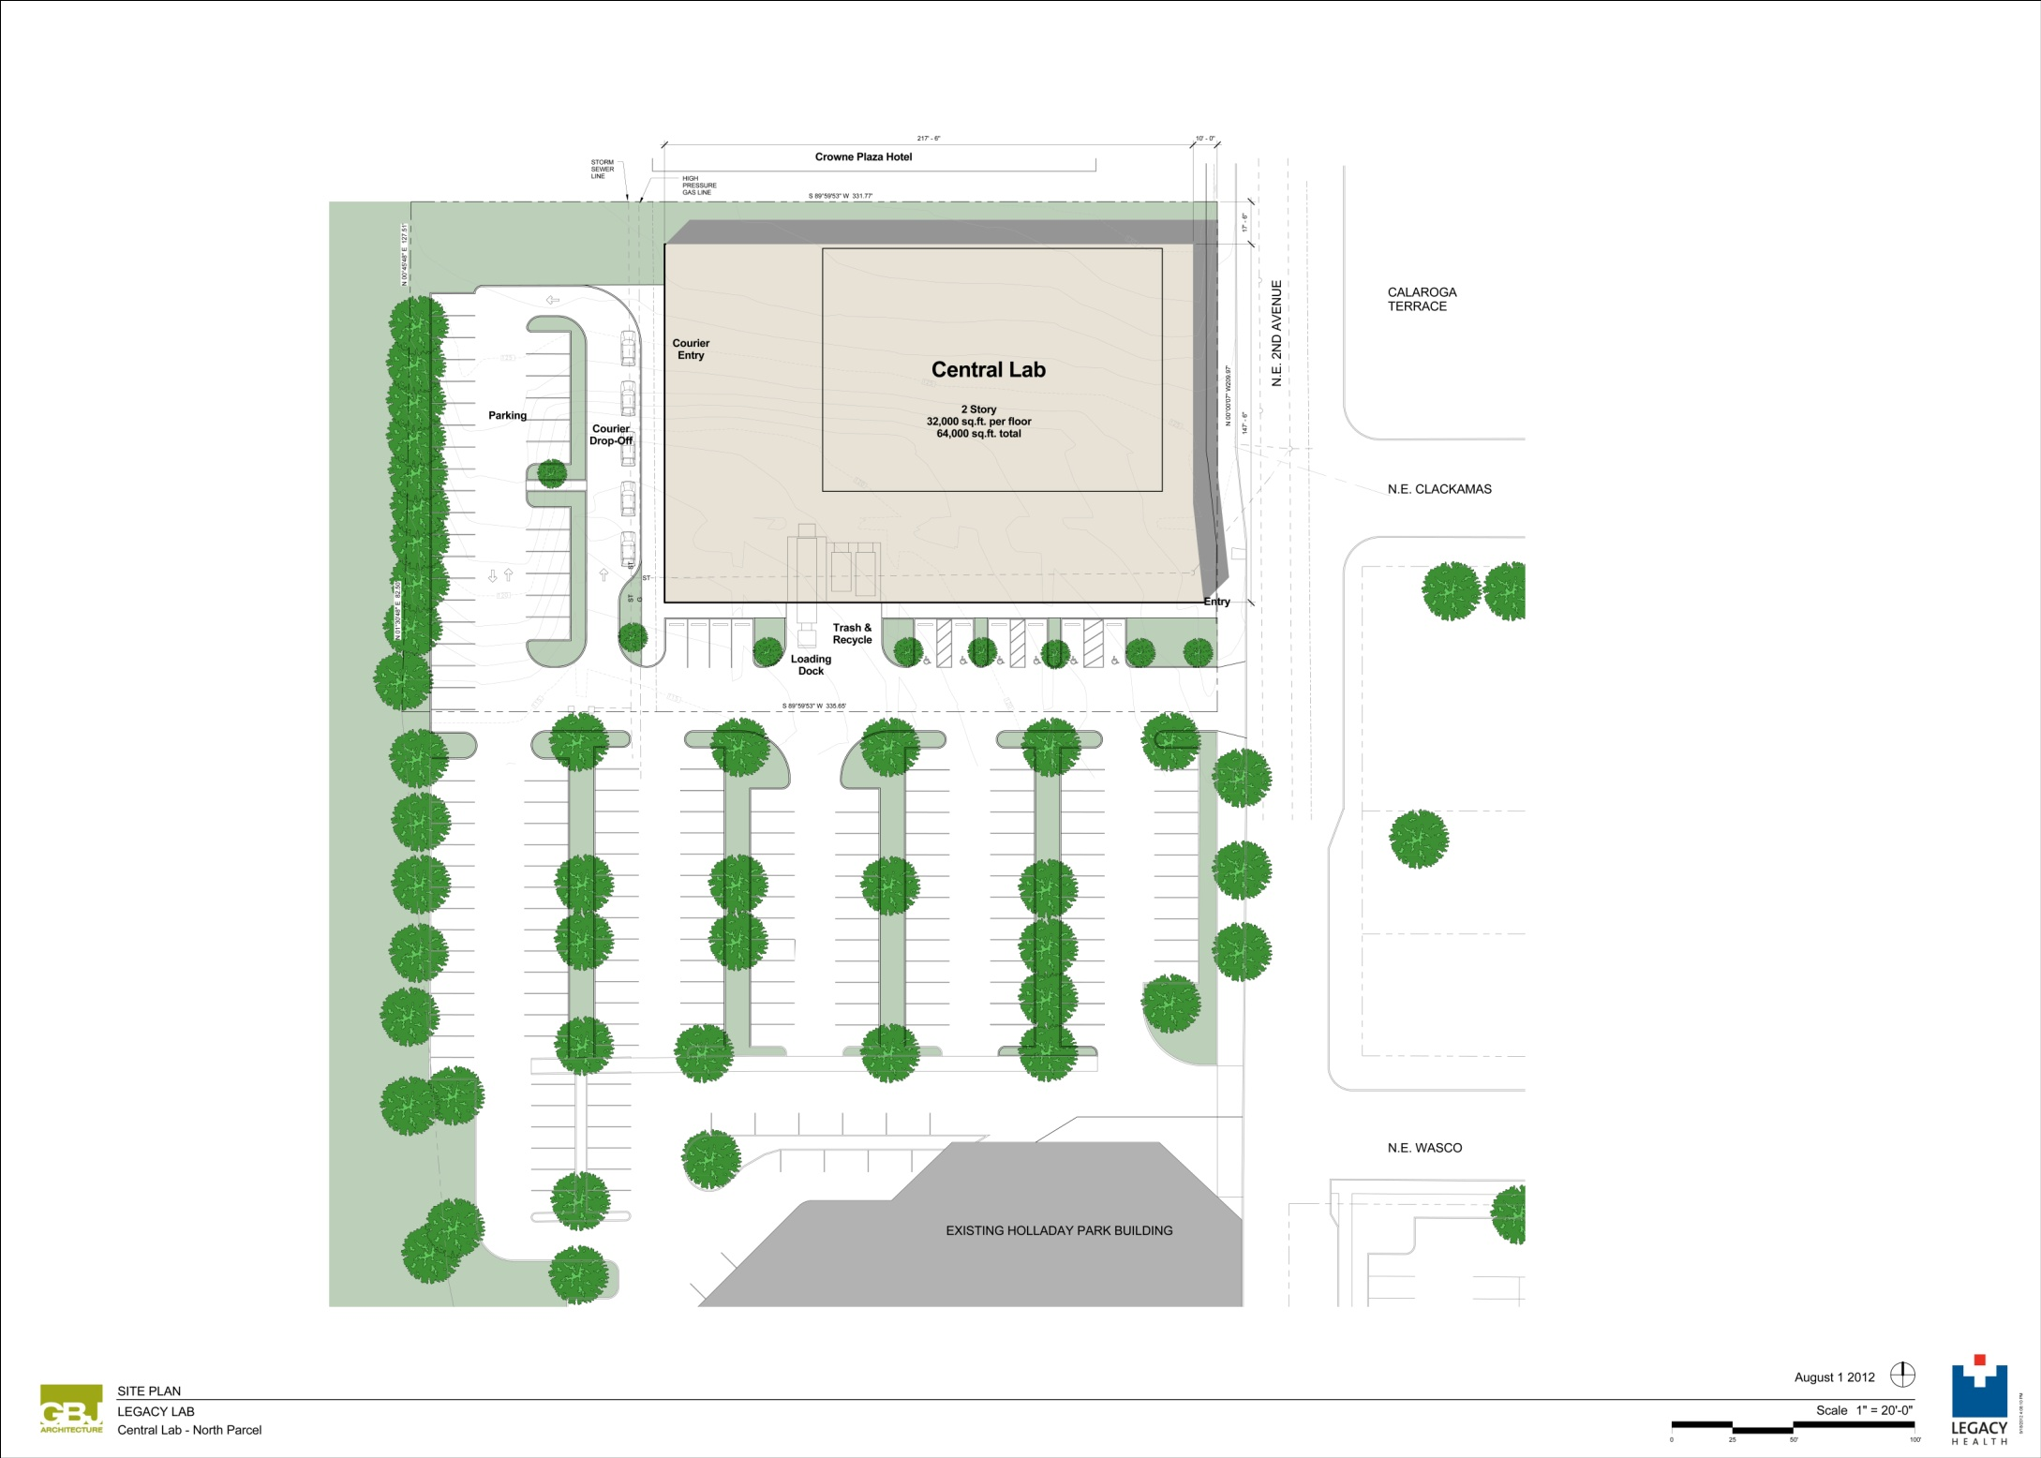

Slide 7
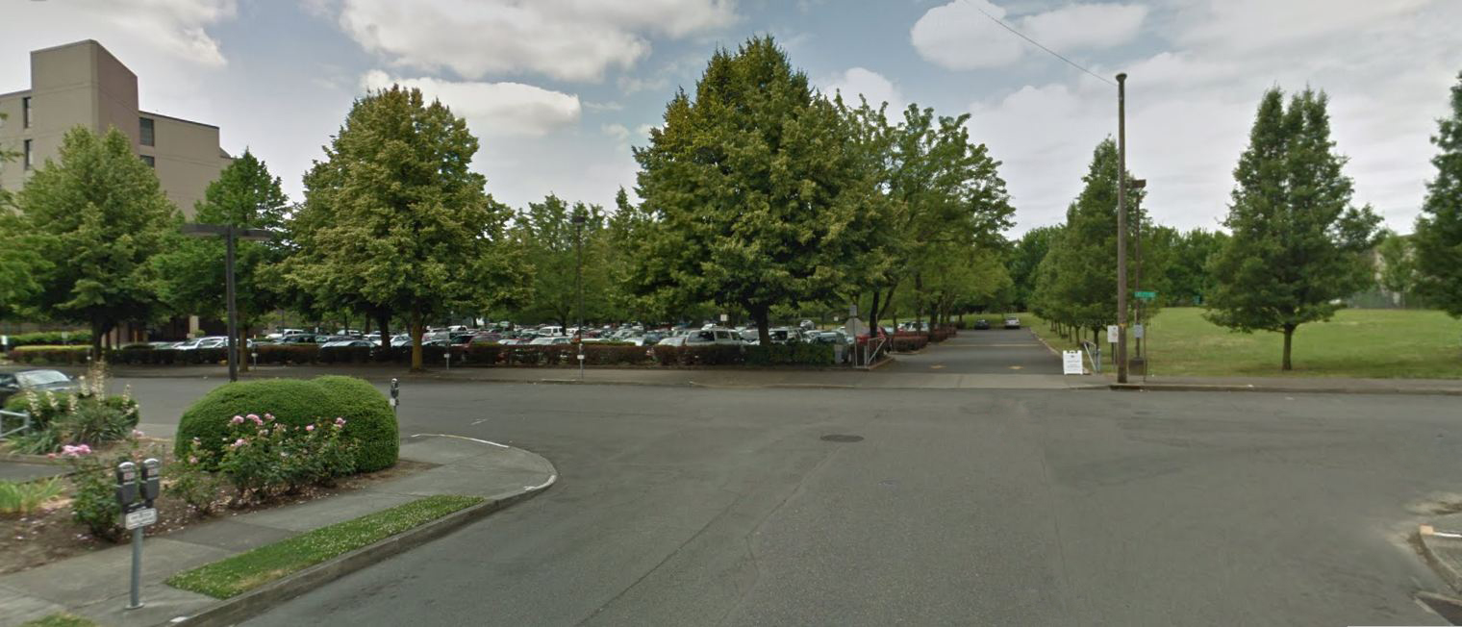
Adjacent Crowne Plaza Hotel
Existing Legacy Lab
Proposed Central Lab
NE 2nd Ave.
NE Clackamas St.

Slide 8
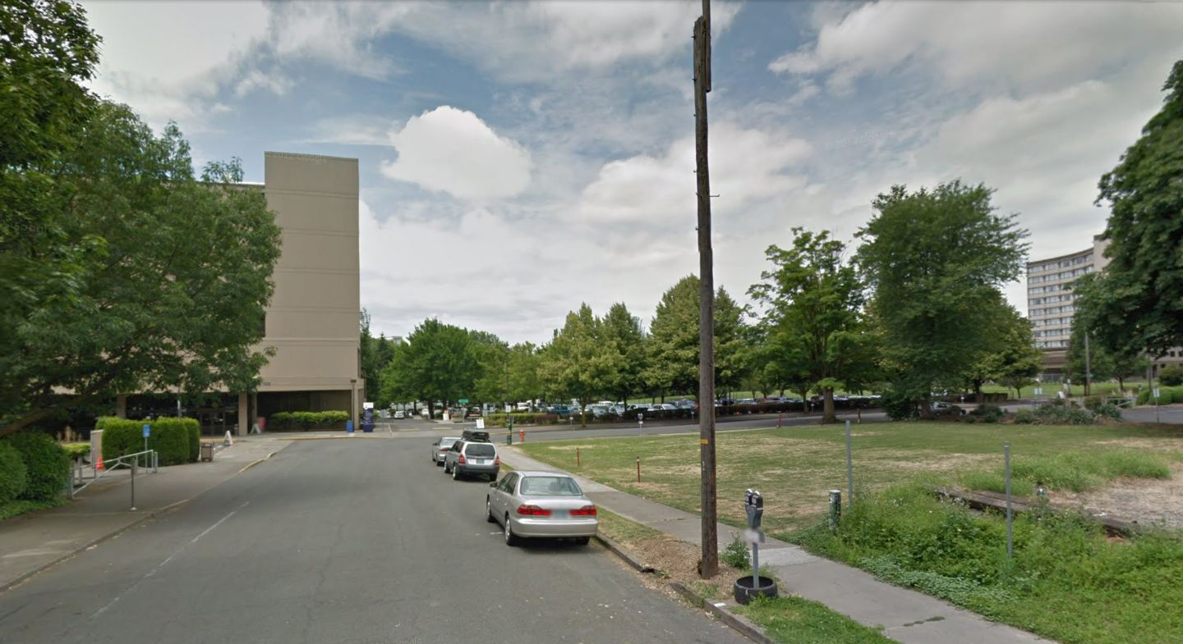
Existing Legacy Lab
Proposed Central Lab
Adjacent Crowne Plaza Hotel
NE 2nd Ave.
NE Wasco St.

Slide 9
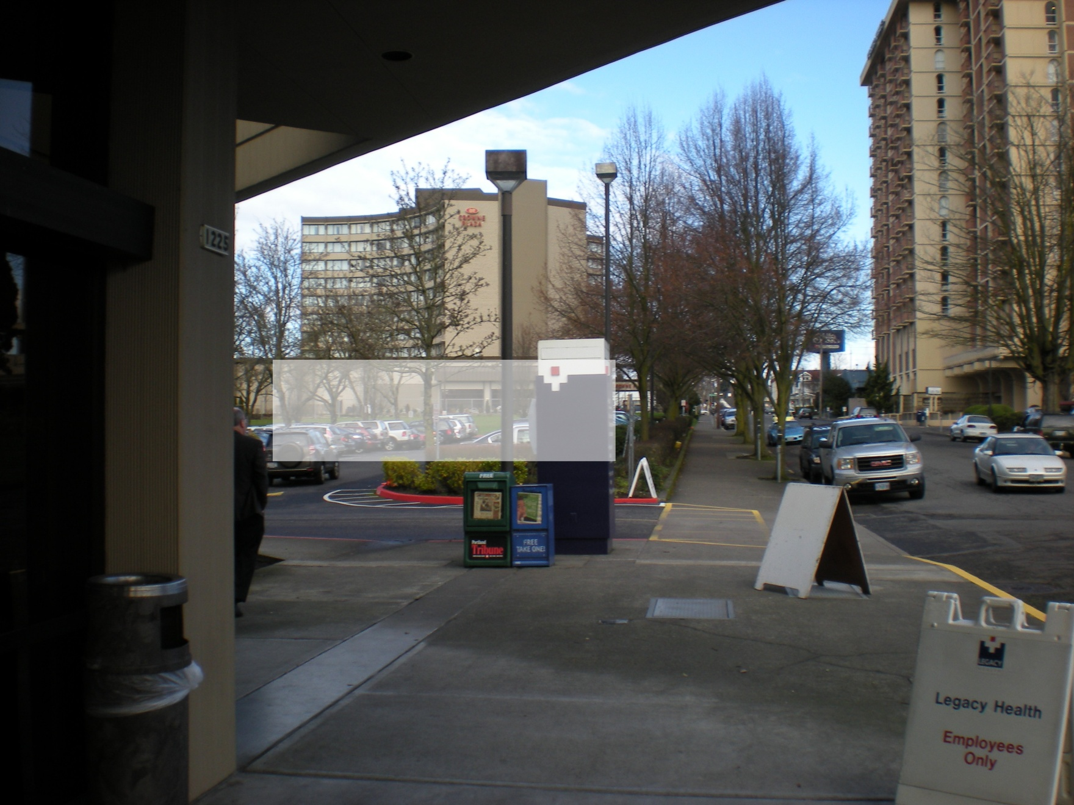
Calaroga Terrace
Adjacent Crowne Plaza Hotel
Proposed Central Lab
NE 2nd Ave
View looking North from existing Lab front entry

Slide 10
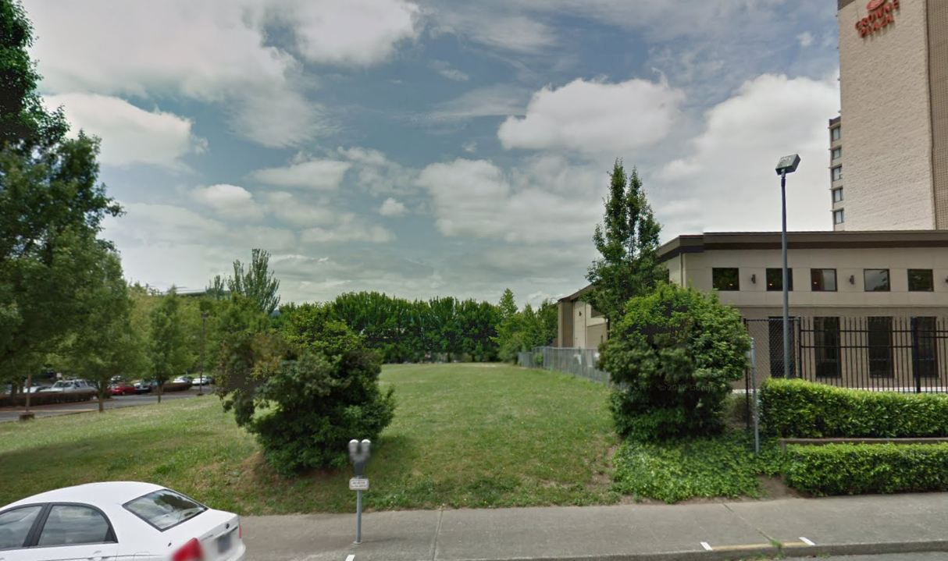
Proposed Central Lab
Adjacent Crowne Plaza Hotel
View looking East from NE 2nd Ave. near Intersection with NE Clackamas St.

Slide 11
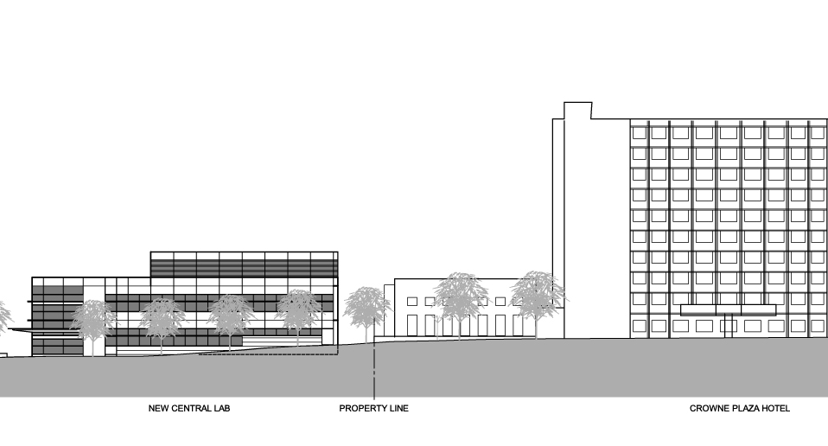

Slide 12


