Slide 1
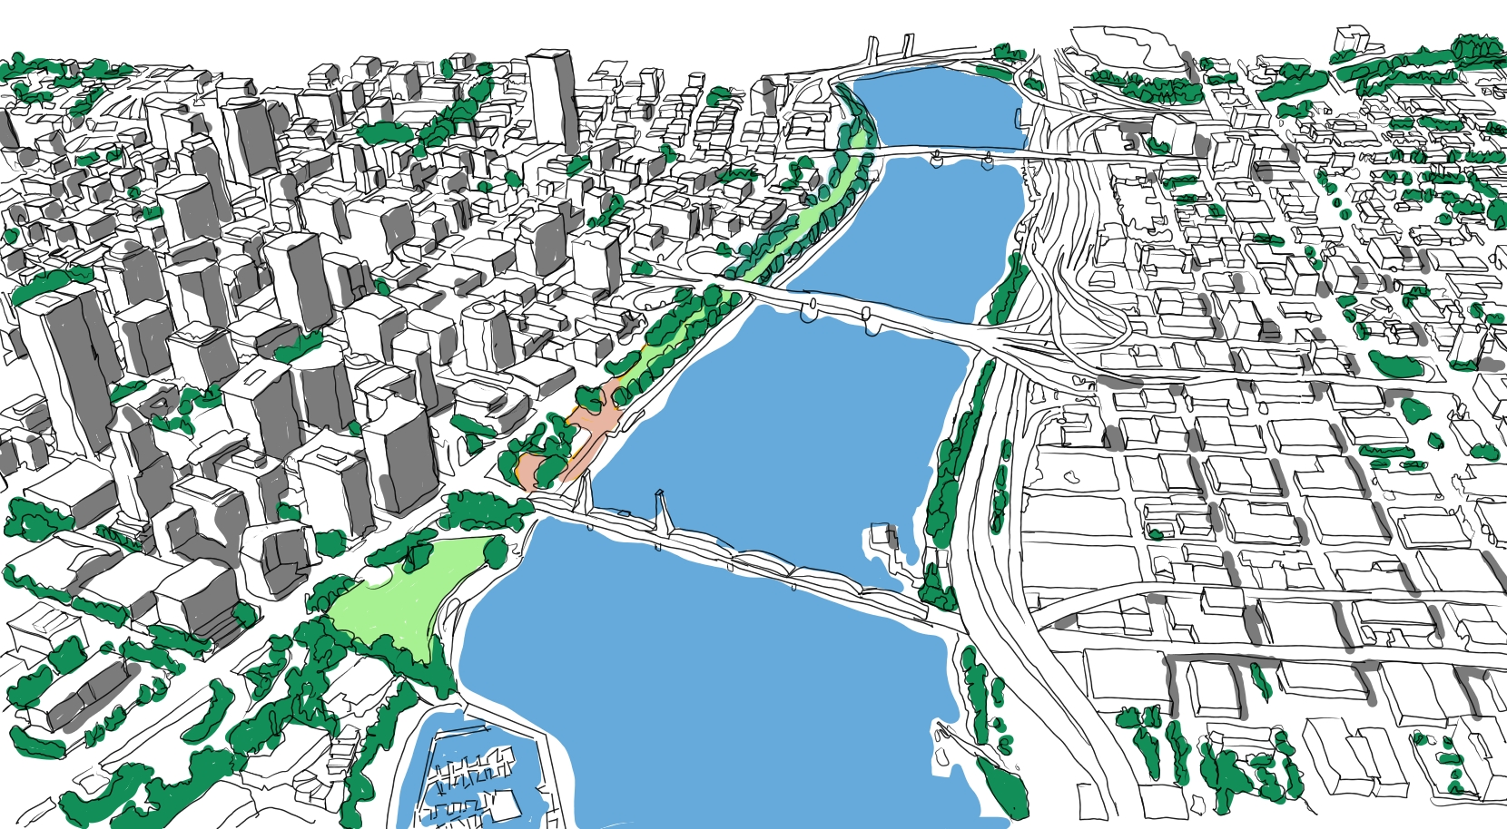
The Central City Waterfront Urban Design Study

Slide 2
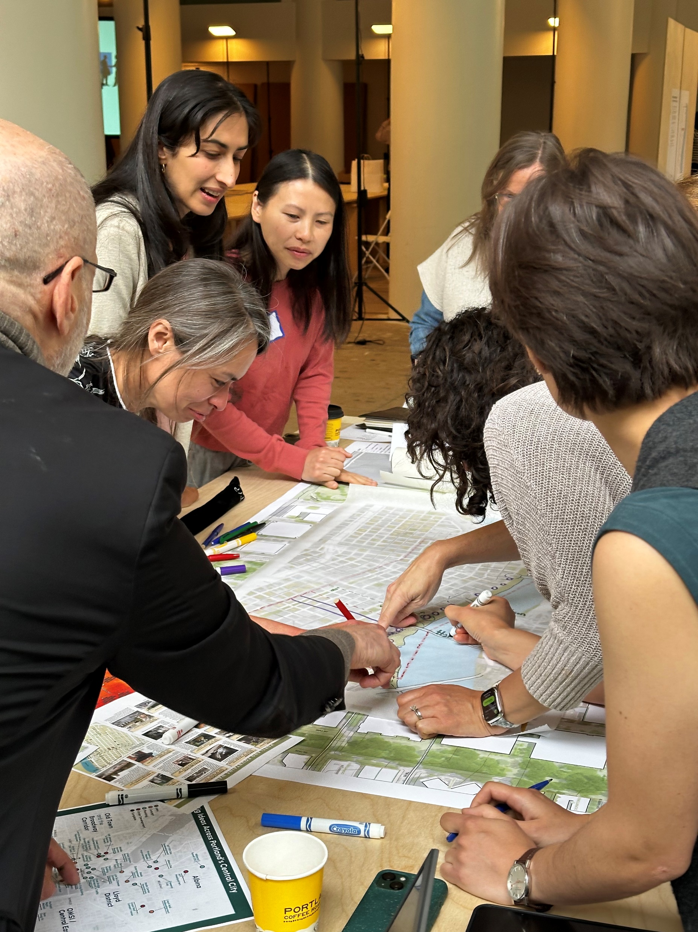
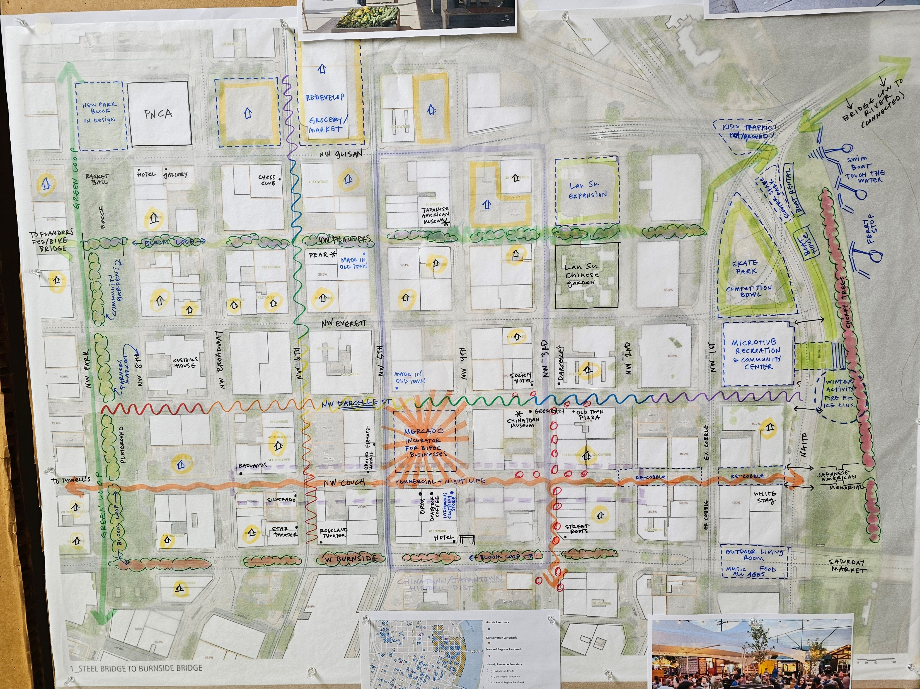
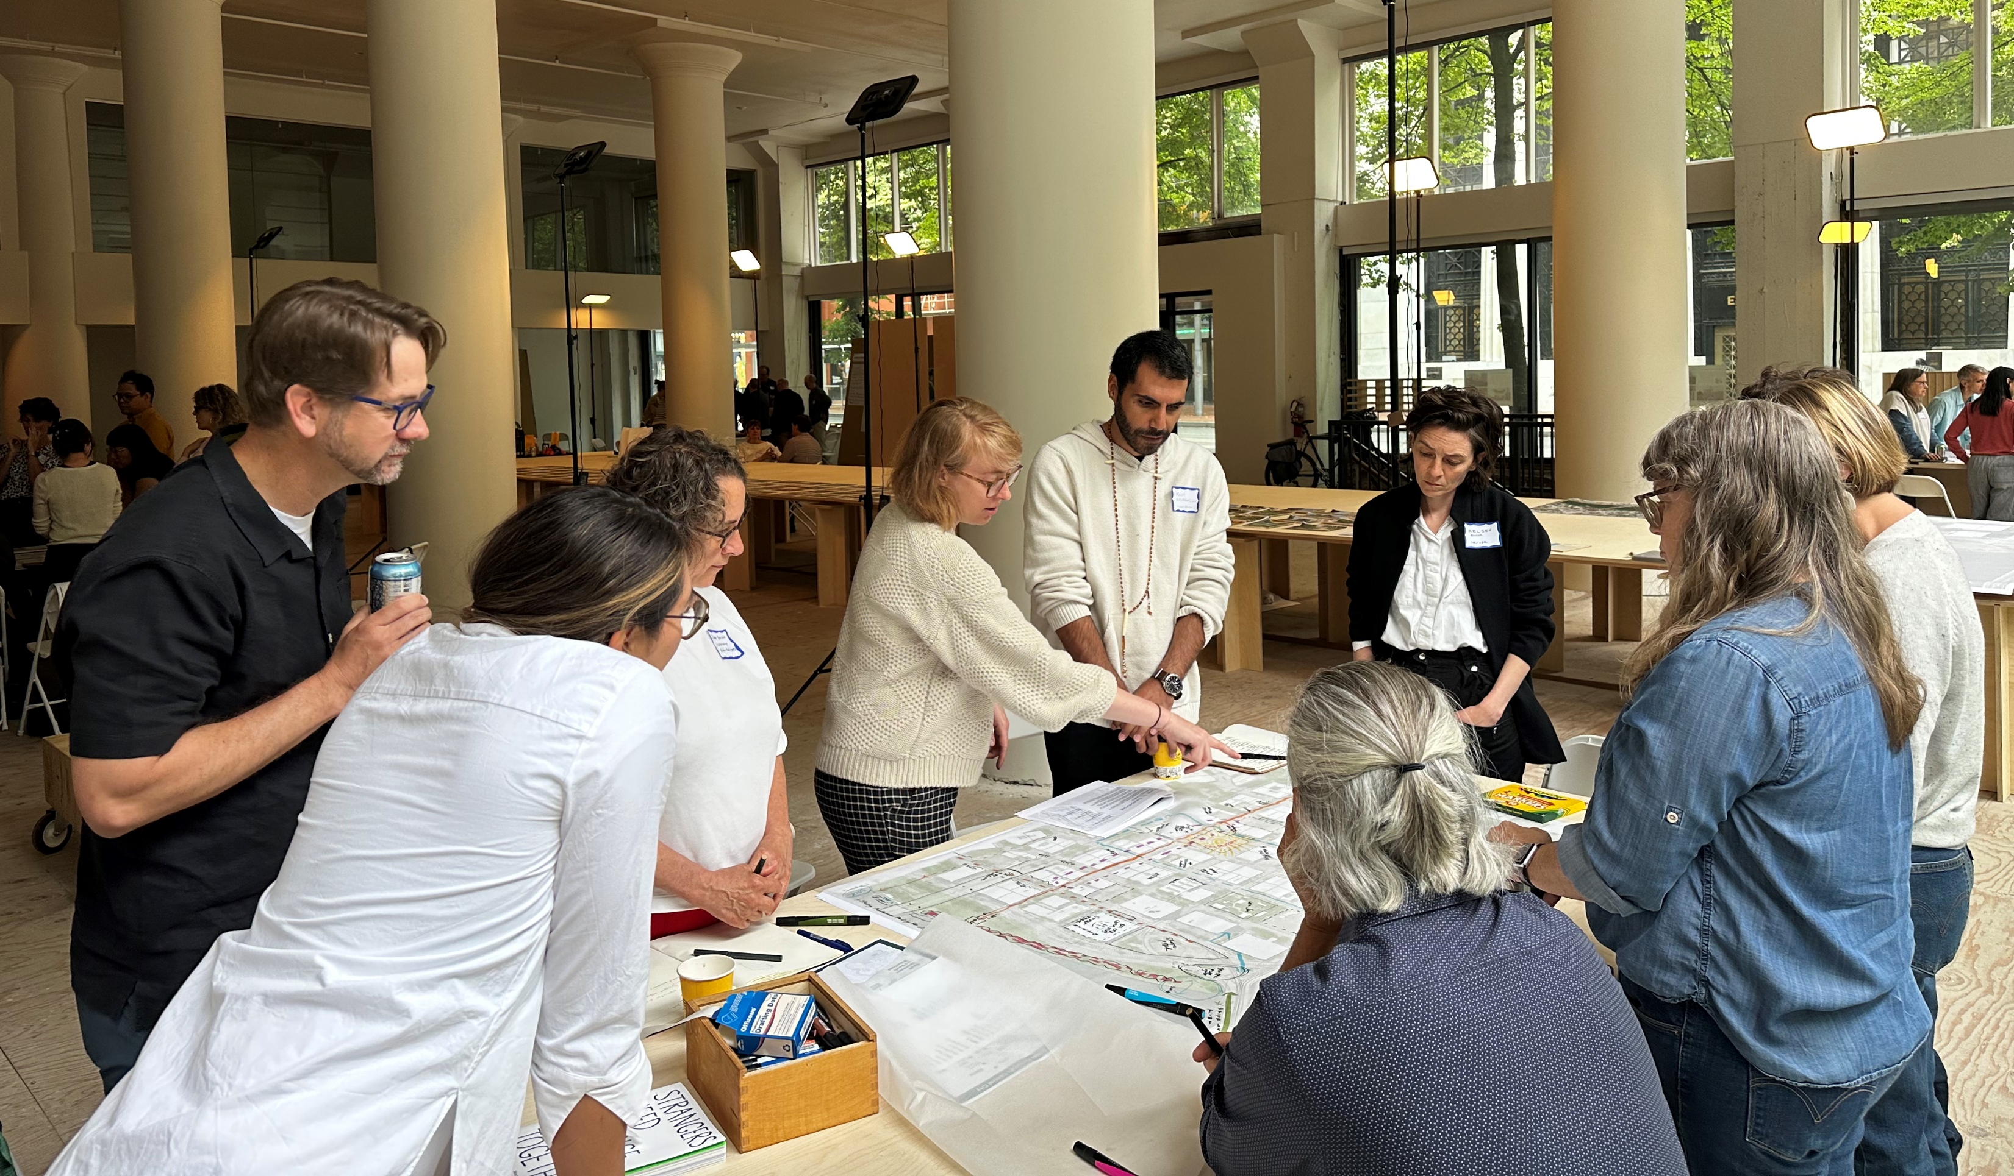
Ideas and Energy
City of Possibility Exhibit and Events
The City of Possibility Central City Waterfront Design Charrette
City Club/Architectural Heritage Foundation Central City Charrette
PP&R Metro2040 Grant for the Tom McCall Waterfront Park Bowl
U of O Architecture Design Studio

Slide 3
Focus on the Urban Fabric Around the Waterfront
Roughly Defined:
Steel Bridge and NW Glisan Street in the north
SE Grand Street to the east
405 Expressway, Marquam Bridge to the south
The Park Blocks and their prolongations to the west
A special focus on the area roughly three blocks from the waterfront
The area includes and connects to:
Light-rail lines, open spaces, the Green Loop, the Lower Albina Plan, Lloyd Mall Redevelopment, OMSI….

Slide 4
Corridors, Nodes, and Opportunities
Key corridors on which to focus streetscape improvements, activation, and future development.
Nodes of activity including retail, event spaces, open spaces, buildings, and uses that serve residents and draw visitors or generate pedestrian activity
Opportunities including publicly owned property, privately owned property, parks, and streets that could leverage proximity to a node of activity or other asset to enhance access to or connection with the waterfront.

Slide 5
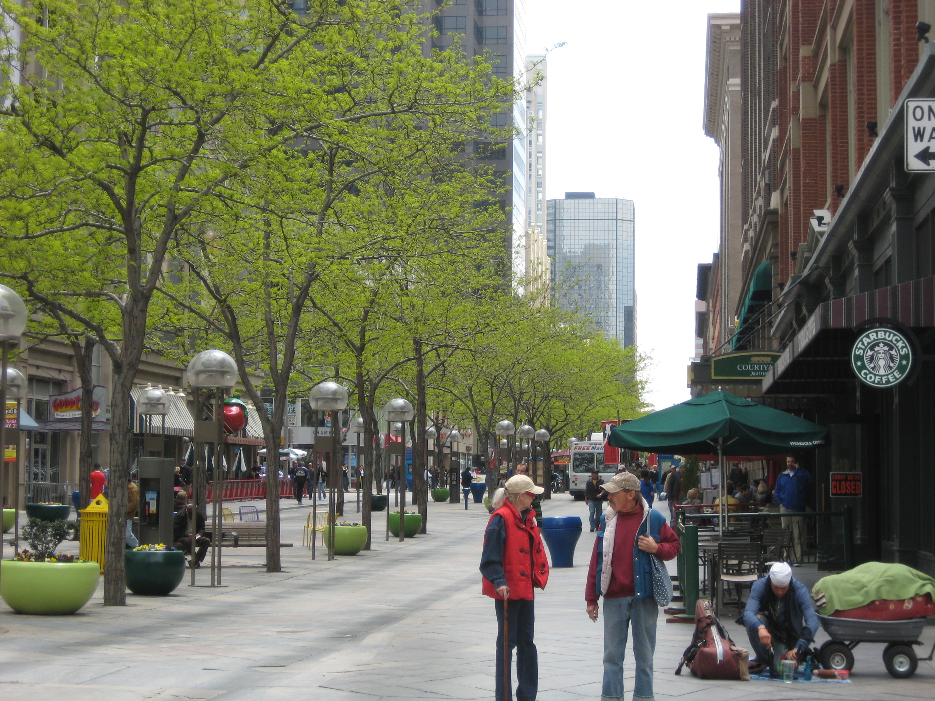
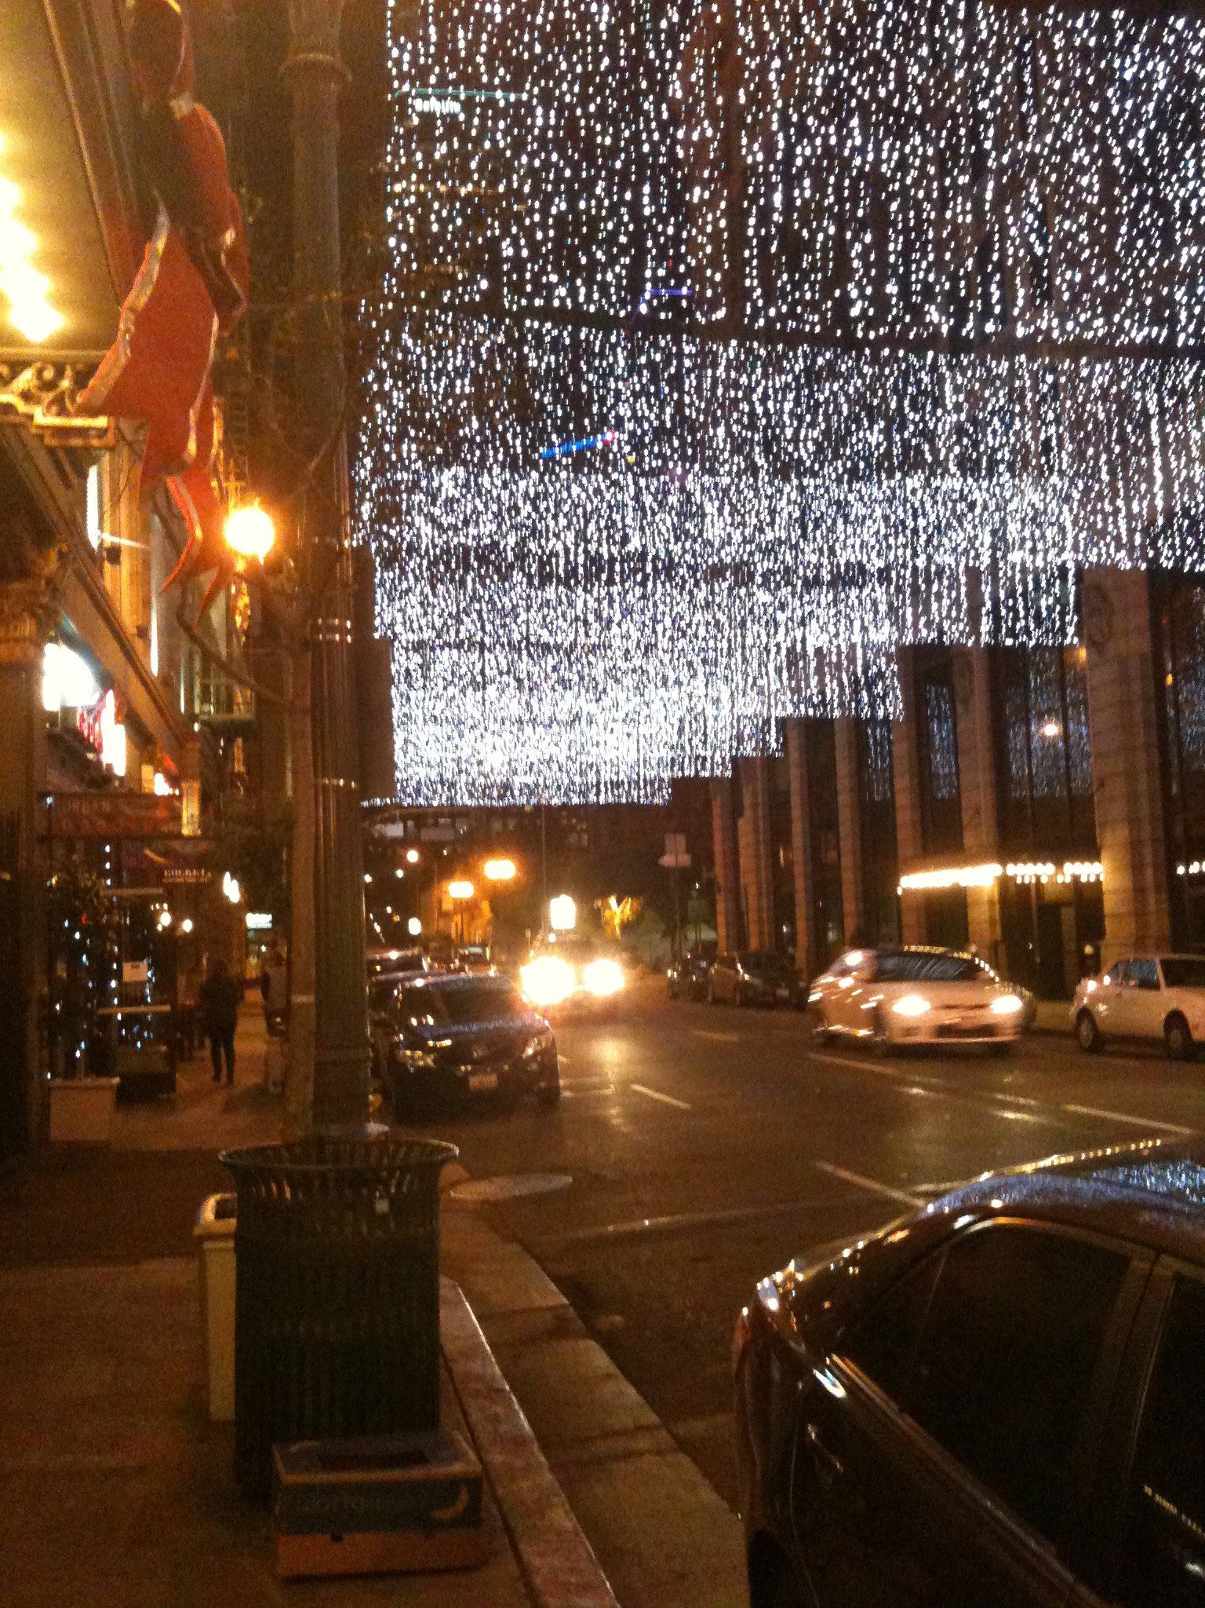
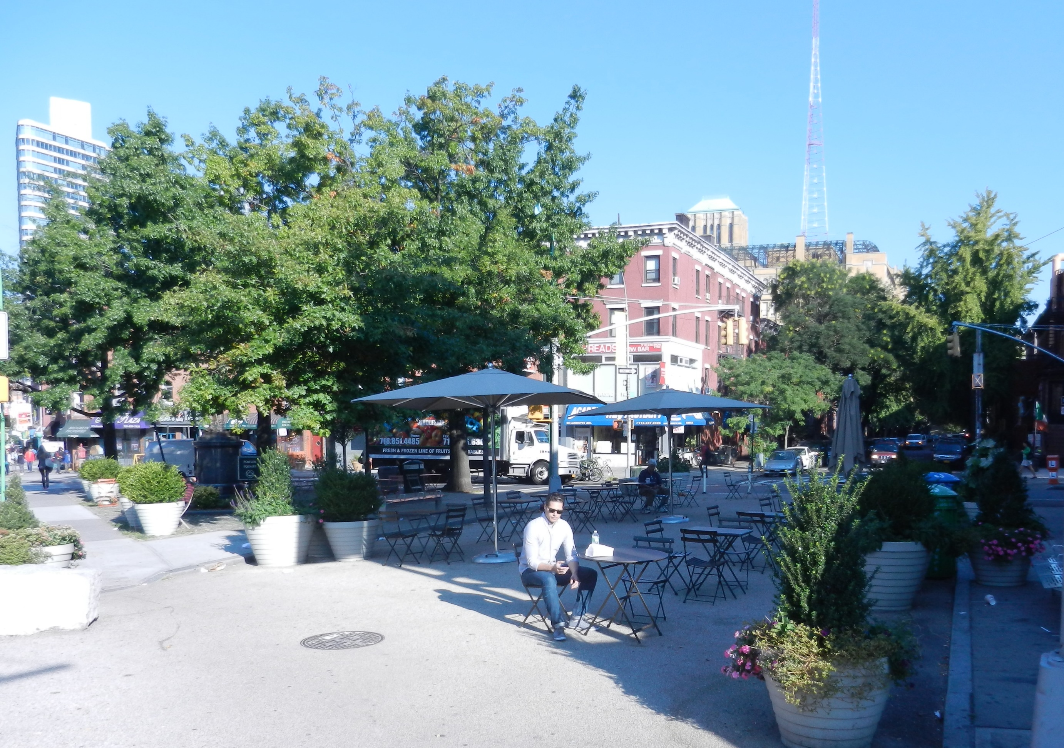
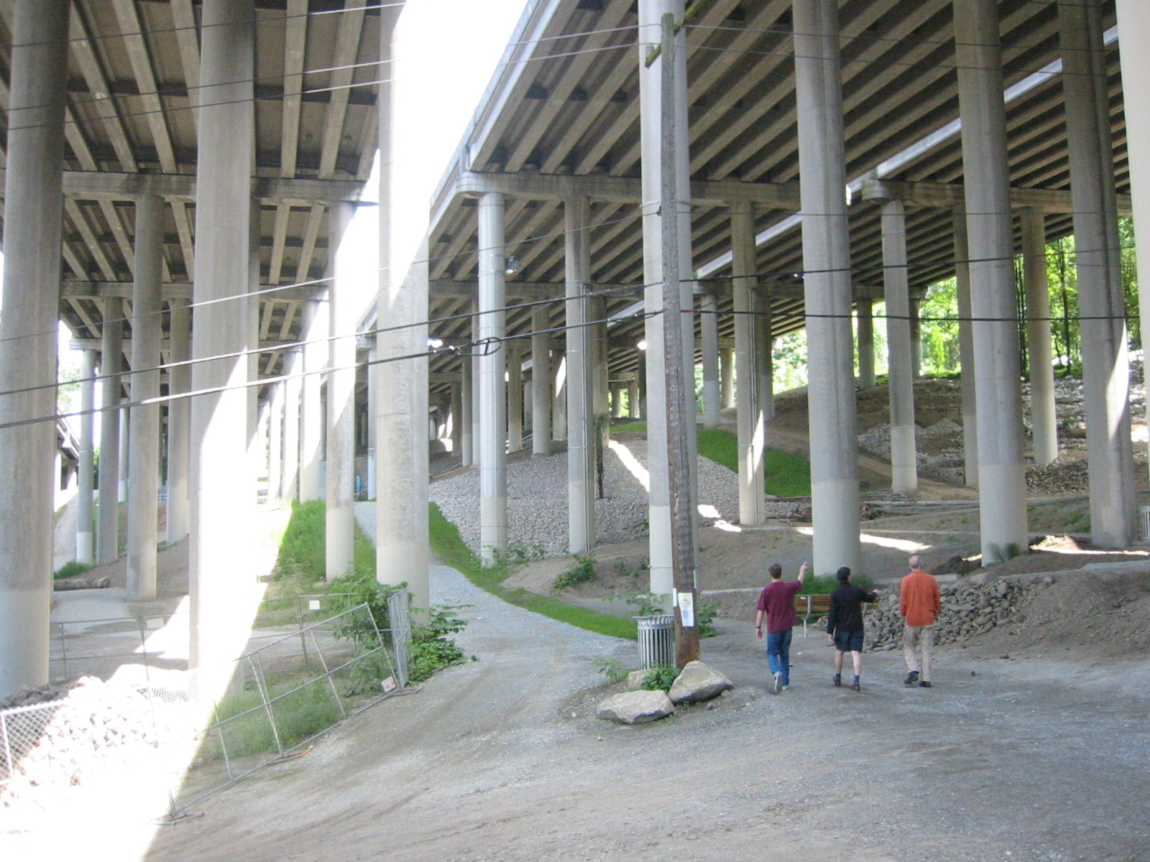
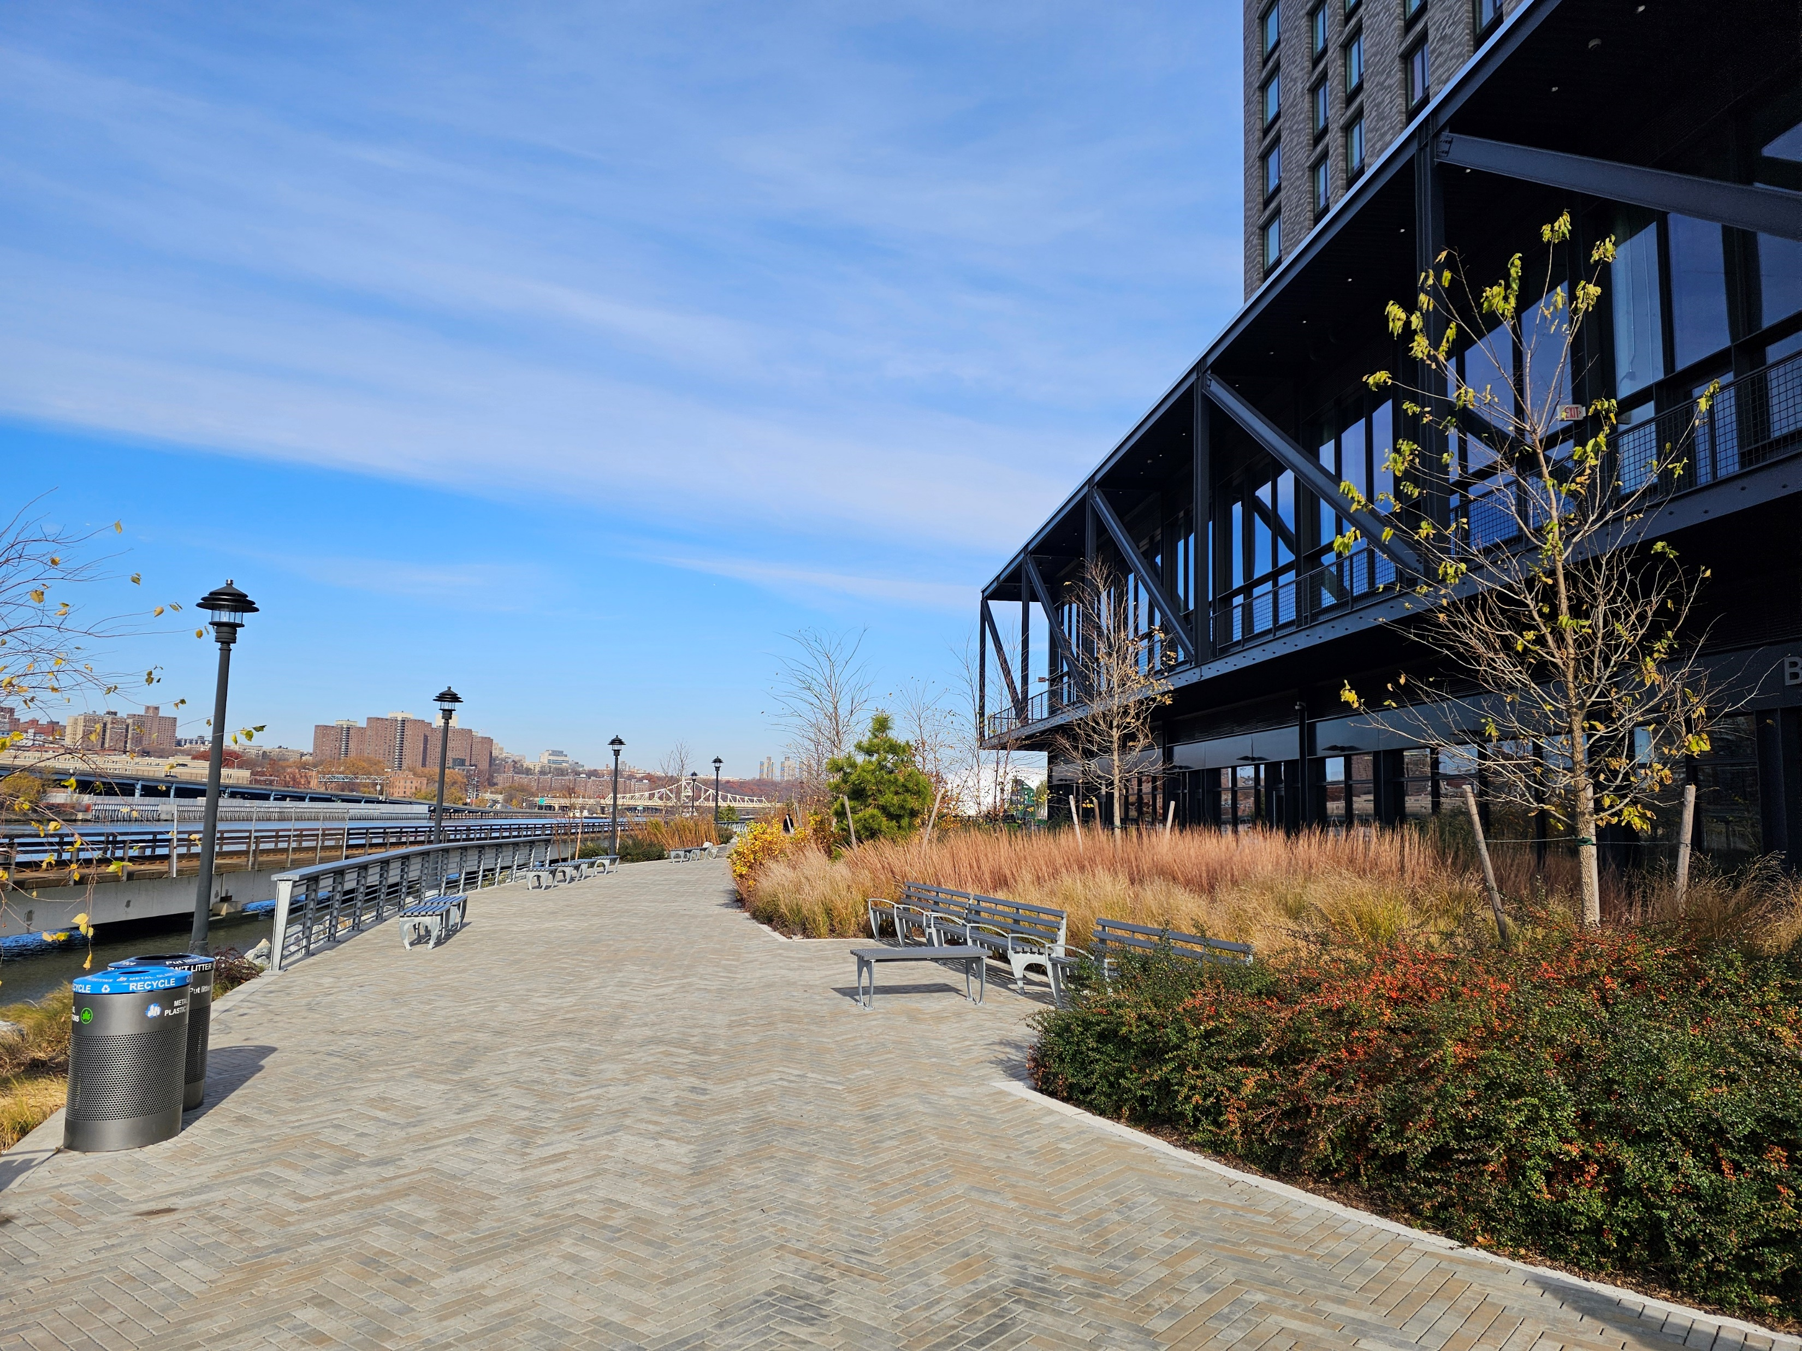
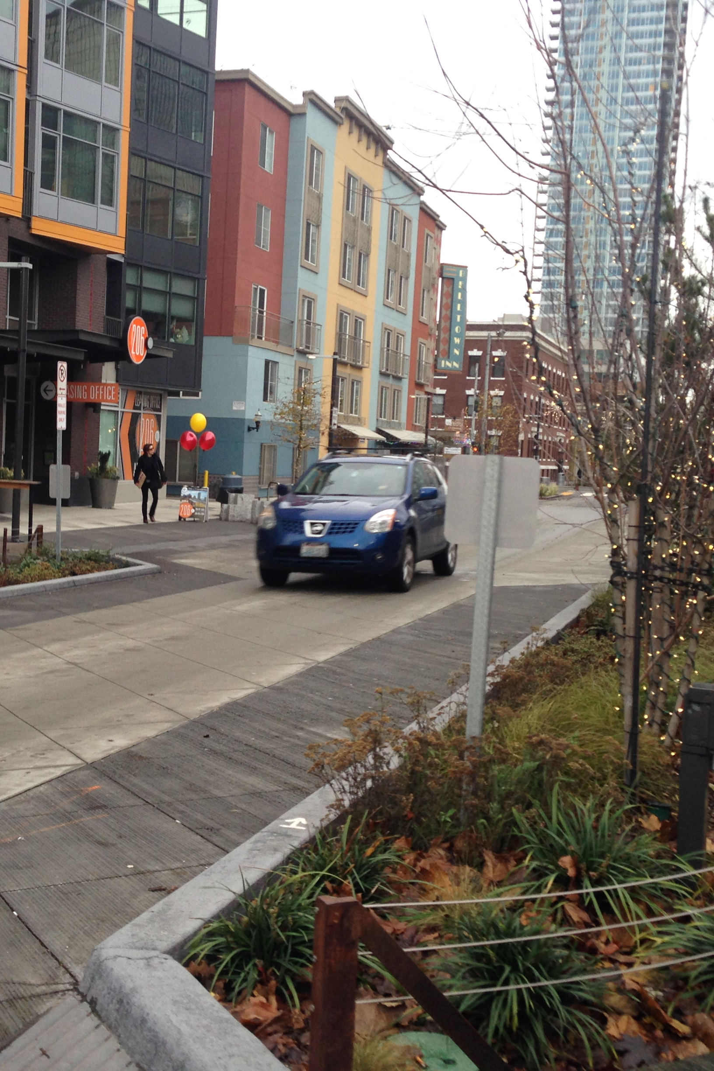
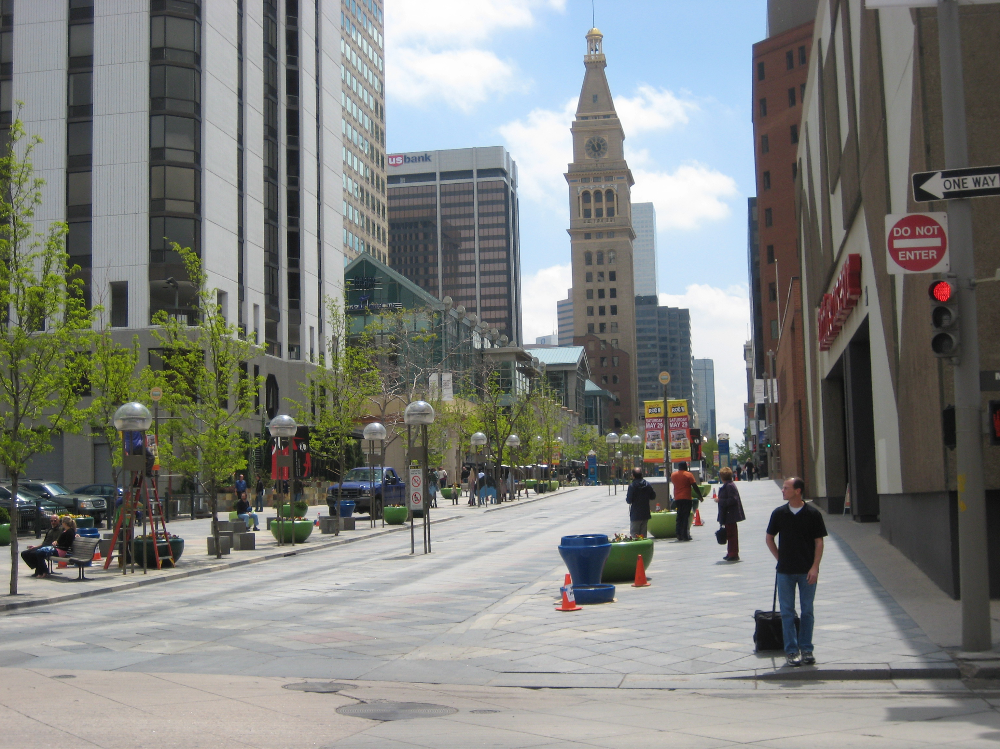
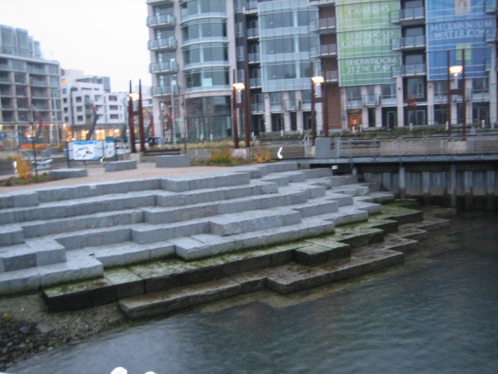
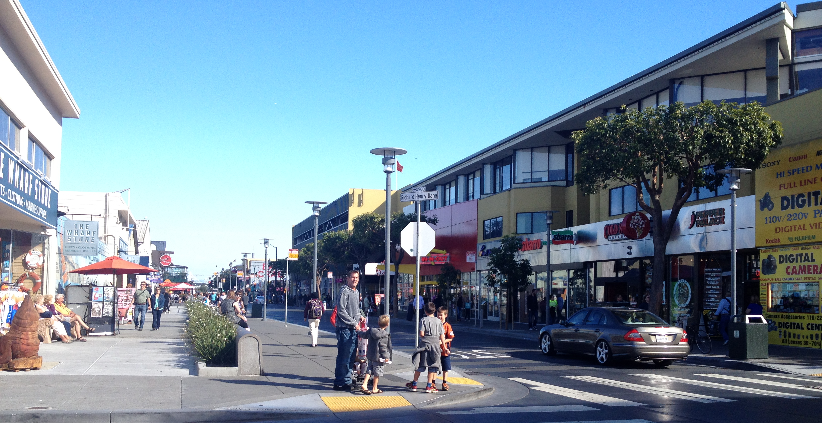
Urban Design Strategies

Slide 6
Timeline
June | July | August | September | October | November | December | January
Design Commission
AIA Urban Design Panel
Outreach and Public Conversation
Open House to Share Final Concepts and Visuals
Urban Design Analysis and Concepts
Prioritize and Refine Concepts. Develop Visuals
Open House
Web Feedback

