Slide 1
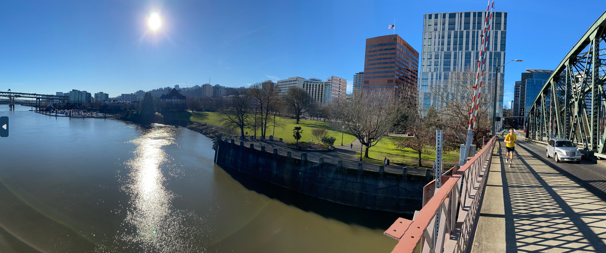
Tom McCall Waterfront Park – Bowl Redevelopment Project
Notes:
Lora

Slide 2
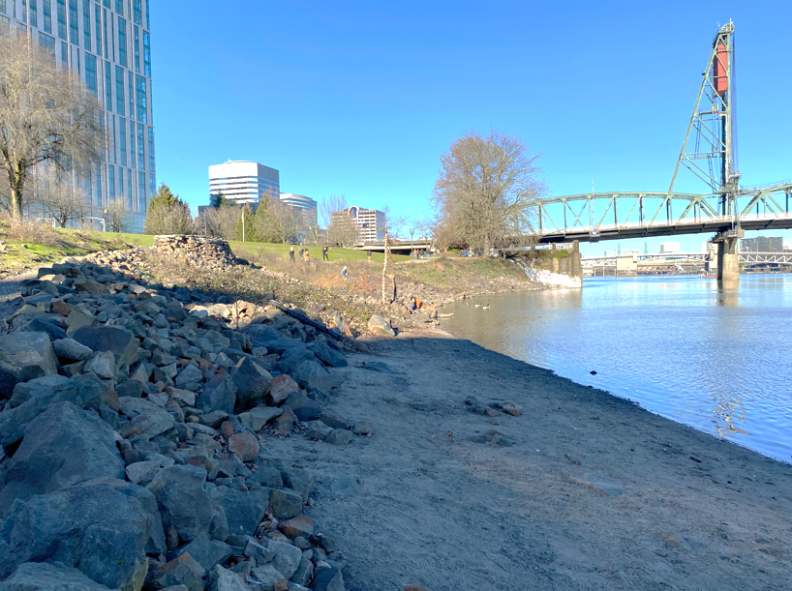
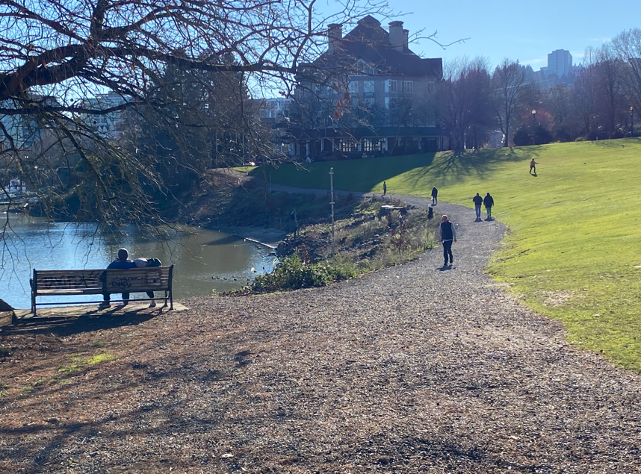
Metro 2040 Grant
Description: International design competition to create a new vision for the Bowl
Outcome: 30% Development Drawings, Cost Estimate, Funding and Implementation Strategies
Footprint: Portion of the ~31 acres
Funding: $750K Metro grant
Anticipated Timeline: Fall 2025 – Spring 2027
Partners: Human Access Project, Portland Waterfront Pavilion
Notes:
Lora
Metro awarded $750k to City of Portland
Our application was supported by partners Human Access Project and Portland Waterfront Pavilion
Application called for an international design competition for the Bowl itself; a portion of the 30-acre Governor Tom McCall Waterfront Park; Bowl shown in the photo on this slide
The outcome of the grant will be 30% development drawings, a cost estimate and funding and implementation strategies
It’s important to note that we are in the process of finalizing the IGA with Metro to receive the funds
With our new City rules, the IGA will require a signature from the City Administrator
This project will lay the groundwork for a second grant - the Metro Community Visioning Grant, which is an opportunity to apply for up to $10 million in construction funding
For that grant, there are requirements to be met that we are working towards:
demonstration of supporting housing and transportation,
increasing access to nature for people in urban areas
We need to demonstrate that these are all components of the future development at the Bowl.

Slide 3
Notes:
Lora
This diagram shows at the top the major STAGES of the DESIGN COMPETITION
First Phase: Preparation - Portland Parks will put out an RFP to hire a Design Competition Manager to run the competition
Once they are hired, they will be charged with facilitating the Project Advisory Committee Meetings and the Technical Advisory Committee meetings to advise on the design criteria for the competition
The Project Advisory will be 12-15 key stakeholders who will help advise on several deliverables of the project
Technical Advisory Committee will represent City and other agency staff who will advise on technical feasibility of the project and deliverables
Second Phase: Round 1
The DCM (with help from the committees) will post a Design Brief, which is essentially an invitation that launches the Design Competition, an open call for Round 1 of the Competition
Round 1 asks design teams for ideas for how the Bowl can be a catalyst for the park and downtown
The DCM will receive proposals and launch a public engagement process around the proposals
Broad public engagement both in-person and online
Focus groups
A jury, convened by the DCM will make a recommendation to the director, who will confirm three semi-finalists
Second Phase: Round 2 will be launched with specific instructions for the three semi-finalists and
Semi-finalists will develop 30% designs, cost estimate, and an implementation strategy
Again, public engagement
Jury will deliberate and recommend a finalist
Finalist will be confirmed by the director
The Design Competition Manager will compile the deliverables including the public process and outcomes and produce a final report
Per Metro’s IGA rules, this report will go to our City Leadership – City Council, to accept the report
We propose periodically briefing the Arts & Economy City Council Committee throughout the project, during the major milestones
There are potentially other partner bureau projects that will support this project with efforts beyond the Bowl
Early work:
There are several efforts conducted by other parties, shown in yellow, that we are participating in
These efforts are all engaged around ideas beyond the Bowl and are worth mentioning because there may be key takeaways that influence design criteria around the Bowl
We will host Listening Sessions – internal and external, to help give feedback before we put out the RFP for the Design Competition Manager

Slide 4
Design Competition Preparation
Organizations and Stakeholders, e.g.
Travel Oregon
Portland Metro Chamber
Willamette Riverkeeper
Wasabi Paddling Club
Japanese American Museum of Oregon
Portland Saturday Market
Frog Ferry
Black Swimming Initiative
Human Access Project (partner)
Portland Waterfront Pavilion (partner)
Events and Festivals, e.g.
Rose Festival
Blues Festival
Cinco de Mayo
Pride Portland
Committees/Commissions, e.g.
Arts and Economy City Council Committee
Parks Board Land Use and Infrastructure
Design Commission
Downtown Neighborhood Association
Willamette River Indigenous Groups
Center for Tribal Nations (OMSI)
Agencies, Institutions, e.g.
City of Portland bureaus
Mult Co Sheriff’s Office River Patrol
Oregon Department of State Lands, Fish & Wildlife
US Environmental Protection Agency
Portland State University
Notes:
We are working with our Community Engagement Team to set up various listening sessions;
This is not an exhaustive list of the groups we hope to engage; there will be others and they may be round-table style or interviews

Slide 5
Design Competition Preparation
Metro 2040 Key desired outcomes:
Public park for all
Iconic space, relatable to Portland, that transforms the waterfront.
Public river and swim access
Potential river and in-water structures
Ecological sustainability
Programming of public space for regional events, gatherings, cultural arts, and employment training
Outdoor entertainment stage location
Recreational and cultural opportunities
Central axis view from the downtown grid to the river
Extensive ADA accessibility upgrades and fluid north-south circulation.
Operations and maintenance
Questions & Discussion:
What is resonating?
Are there other desired outcomes for the Bowl?
Who else should we engage?
Design Competition lessons learned?
Notes:
Listening sessions – we hope to hear directly from people who have an interest in the Bowl development
We will give a concise overview of the project and share the desired outcomes listed in the Metro 2040 Grant
The list came from:
guiding documents
recent designs commissioned by our partners
Parks leadership, specifically around ADA accessibility goals as well as sustainable operations and maintenance
The questions in the green bubble are our open-ended questions about how these are resonating or not, what other desired outcomes for the Bowl are not listed, who else we should be engaging, and for design teams – are there lessons learned in design competitions that they have participated in
The sessions are intended to be open ended at this early stage and will go through winter

Slide 6
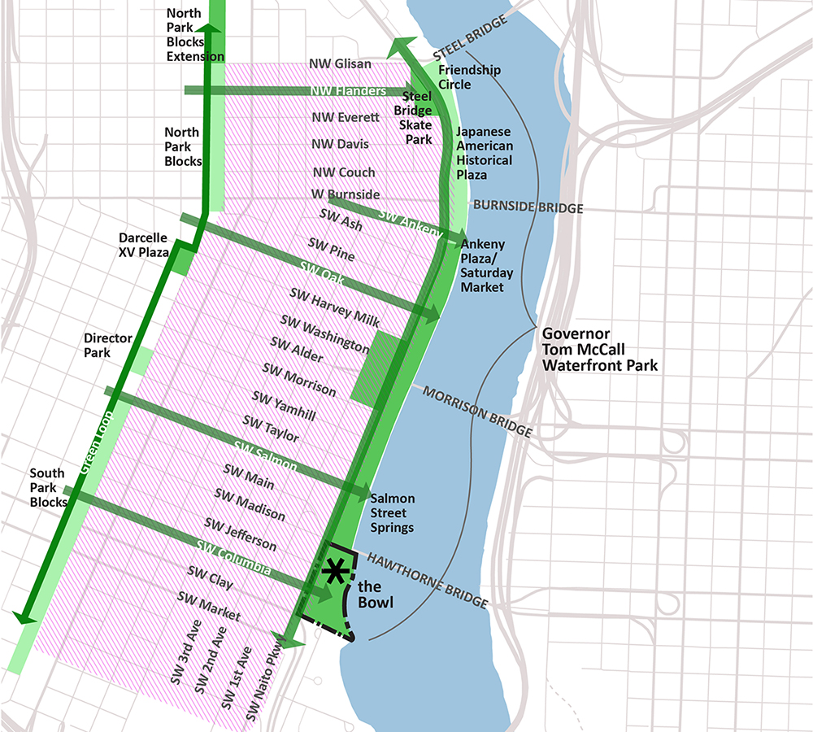
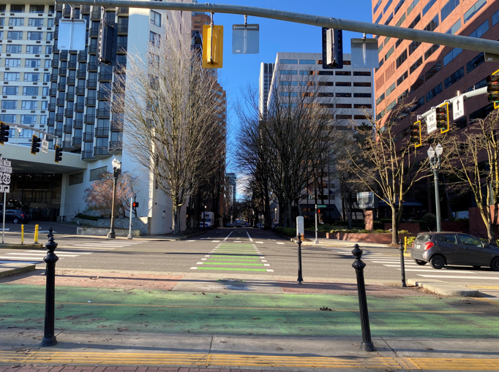
Design Competition Round 1
Notes:
Lora
The Bowl is seen as a catalytic project that can be supported by the larger park and:
Surrounding properties and uses adjacent to the Bowl and Park – especially housing
Potential transportation “big move” opportunities in Naito Parkway, Harbor Drive,
Some of the streets that act as “green fingers” which reach the river and don’t play a prominent transportation role (Columbia, Salmon, Oak, Ankeny, Flanders)
Development opportunities that can shepherd in housing and help boost a livable downtown neighborhood
We’ll be exploring this context in the first round of the design competition, but the Metro funding will have us focus on the design of the bowl.

Slide 7
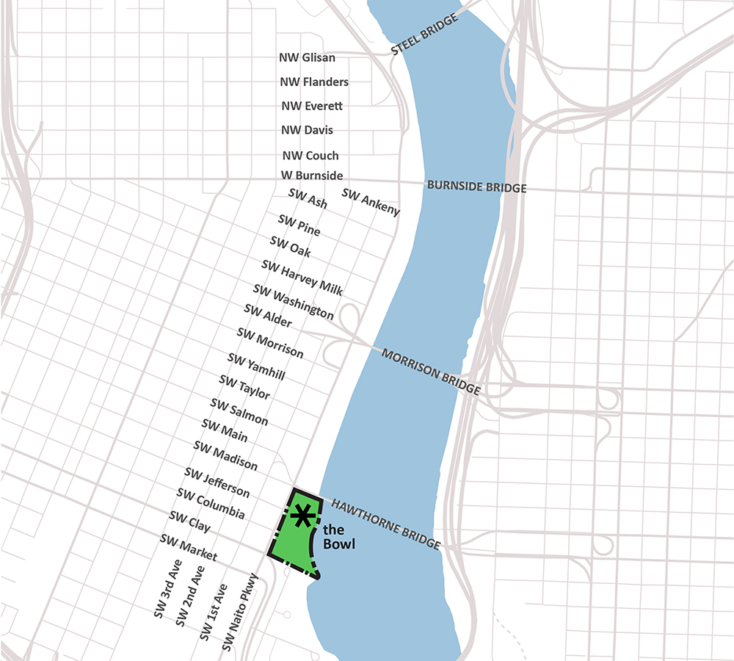
Design Competition Round 2
Notes:
Lora
The Bowl is located between Naito and the Willamette River, and bordered by the Hawthorne Bridge to SW Clay/Riverplace Hotel
This is the southern end of Tom McCall Waterfront Park and the only portion that is not bounded by seawall.
Opportunity to touch the water and could be a site for in-water recreation access, swimming, and habitat restoration.

