Slide 1
Cully TIF District Community Leadership Committee
May 28, 2025
Notes:
Co-chairs

Slide 2
Agenda
Guiding Agreements, Roll Call
Icebreaker, Items of Interest
Refresher from Last Time
NPN Presentation (Edy Martinez)
Action Plan 101, Vision
BREAK
Economic & Urban Development Priorities: to the Muralboard!!
Public Comment
Feedback Loop & Next Steps
Notes:
Co-chairs

Slide 3
Guiding Agreements
Roll Call
Open Conversation
Keep within Scope
Hold Equity Lens
Be Goal-oriented
Minimize Interruptions
be mindful of interpretation
Notes:
Co-chairs

Slide 4
Icebreaker
CLC Member’s
Items of Interest
Choose 1:
Which business in Cully to do you miss that no longer exists here?
Is there a type of business you would like to see in Cully in the future?
! ?
Notes:
Co-chairs

Slide 5
Refresher from Last Time
We reviewed commercial and market data that Prosper Portland provided. Additional information was included in a follow up email to the committee.
We discussed a public engagement approach for Action Planning that included funding for the CLC, Living Cully, and other community-based organizations interested in hosting events.
Notes:
Co-chairs and/or Kathryn

Slide 6
Tentative Meeting Sequence
CLC Meeting Topics | Public Engagement
Action Planning 101 | Relationship-building, Education
Public Engagement Planning
Community Context: Data, Other Projects | Priorities, Needs, Barriers
Community Context: Data, cont’d; public engagement approach
Economic Development, Part 1: Priorities, Allocations
Affordable Housing, Part 1: Priorities, Allocations
Affordable Housing & EcDev: Allocations, Tools, 10% flexible | Draft Action Plan
Draft Plan, Public Engagement Summary
Draft Plan Discussion, cont’d
Jan
Feb
Mar
Apr
May
June
July
Aug
Sept
Notes:
Jessi/Kathryn
This is tentative and shifts based on meeting outcomes.

Slide 7
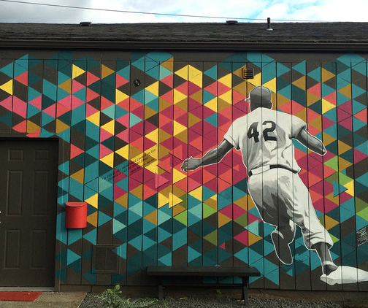
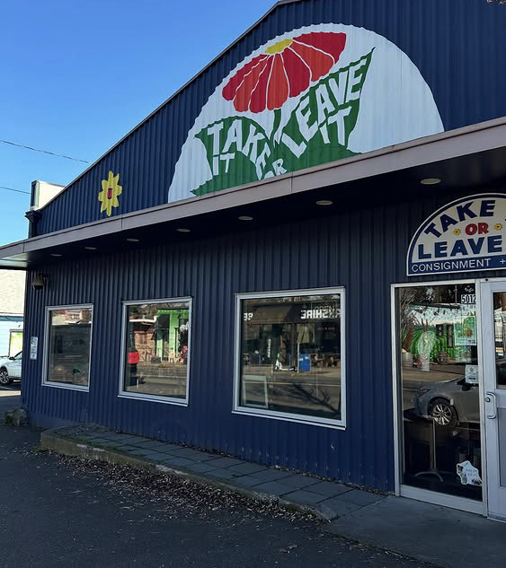
Our 42 Ave
Helping Cully grow since 2012

Slide 8
Master Leases: Demographics [2015-2025]
Businesses & Non-Profits | BIPOC & women owned businesses | Helped purchase land/building
17 & 4 | 77% | 3 (1-Black 1-POC 1-Spanish Speaking)
Black/African American | Asian-American | Spanish Speaking | POC identifying | Woman Owned
3 | 3 | 1 | 3 | 11 (65%)

Slide 9
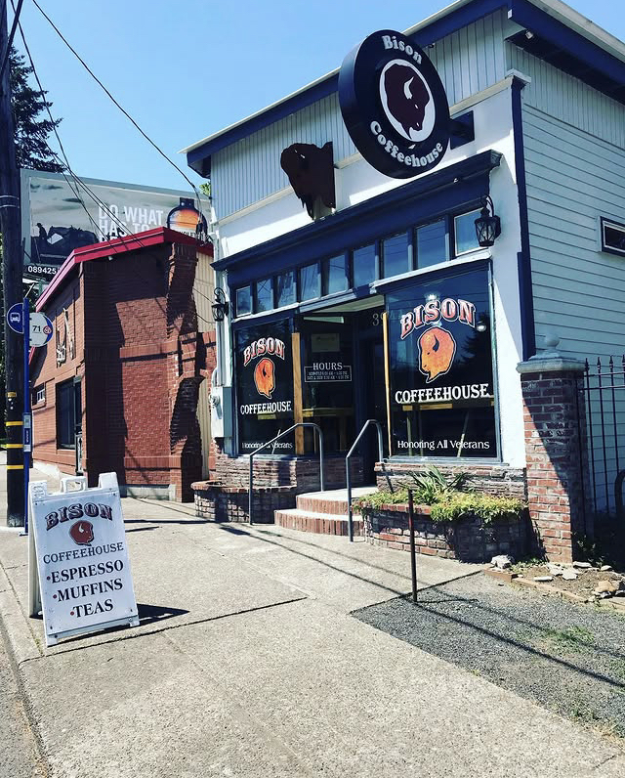
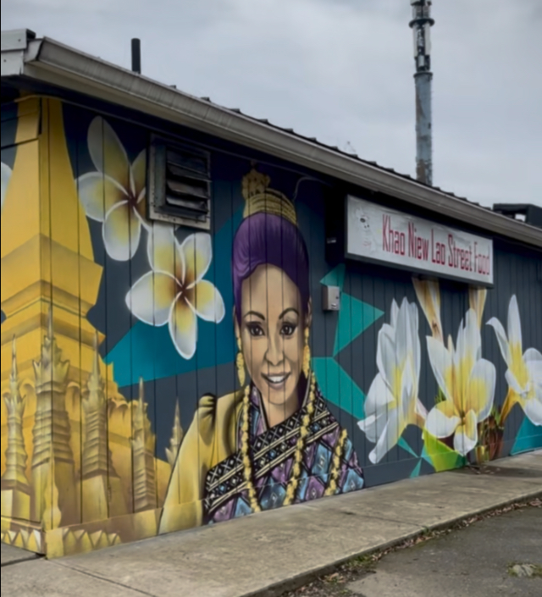
Cully Blvd Alliance

Slide 10
Store Front Improvement Grants: Demographics [2012-2025]
Total dollars | Number of grants to businesses | Stand-alone investments |  | BIPOC & women owned businesses
$457,000 | 37 | 6 (affordable housing and others) |  | 84%

Slide 11
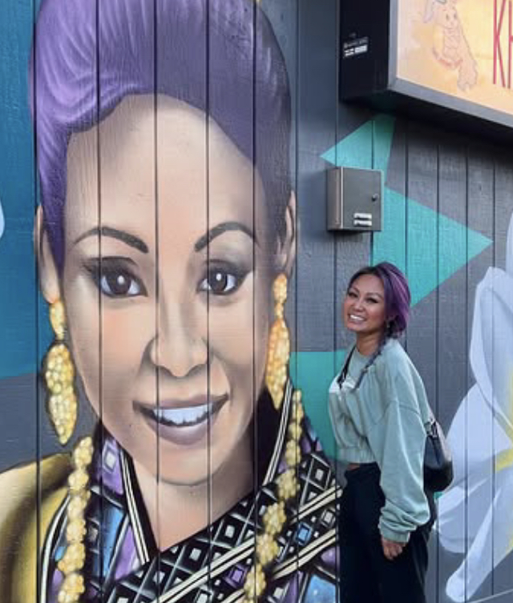
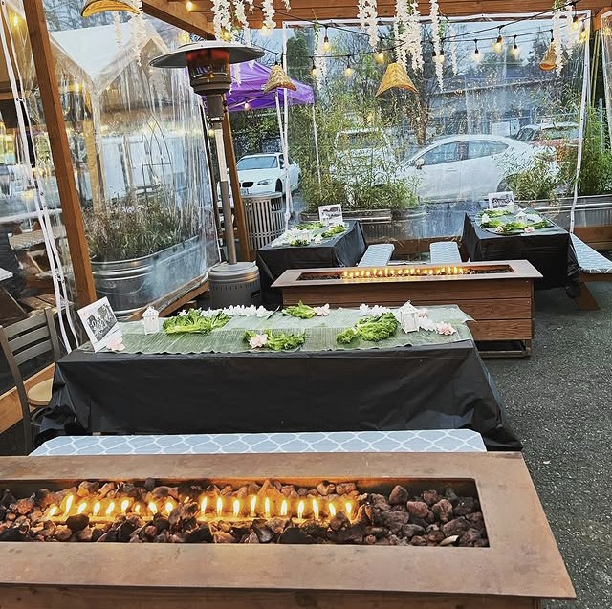
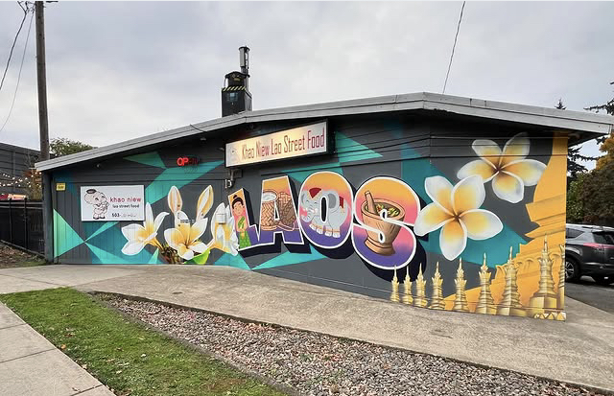
Ae from Khao Niew – Lao street food
aka Cully Central

Slide 13
Action Planning Refresh
Notes:
Co-chairs introduce, hand off to Kathryn

Slide 14
What’s in an Action Plan?
Background / Introduction
Types of info: History, context, demographics & district data, vision
II. Community Engagement
Types of info: activities, input received
III. Investments & Outcomes
Types of info: priorities, budget amount, timeline, measures of success
IV. Practices and Policies
Types of info: accountability mechanisms, implementation guidelines
Notes:
Jessi/Kathryn
Action Plans don’t look like District Plans.
They’re shorter and tighter…Rather than 200 pages, our Action Plan will likely be closer to 20 or 25.
These are the major headings in the North/Northeast Community Development Initiative Action Plan.
It’s a great framework for us. We can add to it if we feel anything is missing, but it’s a template for us to start from.

Slide 15
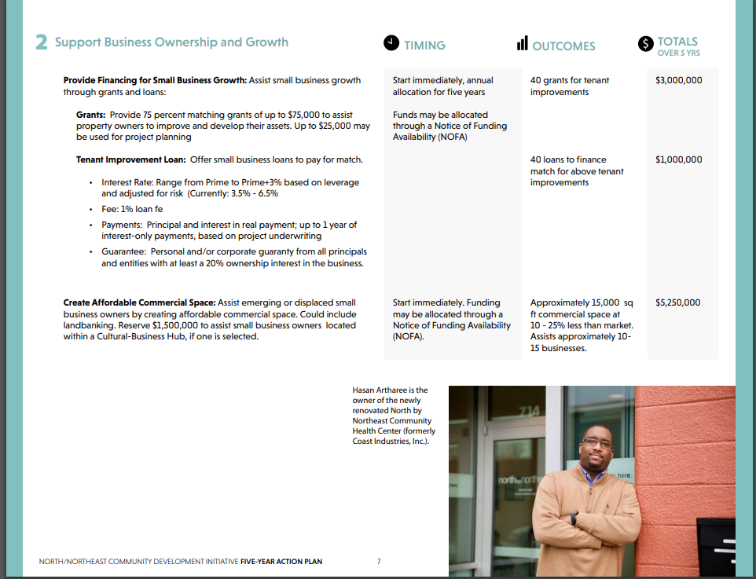
III. Investments & Outcomes
Timing
Projected Outcomes &
Dollar Allocation
Priority/Strategy to meet District Plan Goals
Action
Must be on District Plan Eligible Projects List
Tools
Notes:
Kathryn

Slide 16
Priorities in Context
Vision & Goals
Governance
Eligible Projects List
Implementation Principles
DISTRICT PLAN
5-Year Priorities
Actions
Tools/ Programs
Timing
$$ Allocation
Projected Outcomes
ACTION PLAN
Notes:
Kathryn
These priorities sit within a broader context.
They need to align with what’s in the district plan – and they sit with other components of the Action Plan – so they don’t have to do EVERYTHING.

Slide 17
District Plan Vision (sample language)
The community’s long-term vison is to transform Cully into a place that provides a sense of belonging for its residents, and particularly for Priority Communities. This means Cully will have plentiful safe, affordable housing, thriving BIPOC businesses, rewarding employment opportunities, safe and accessible transportation options, parks and open spaces, a clean and healthy environment, climate resiliency, with places and programs that reflect the cultural diversity of BIPOC individuals.
What language most resonates with you?
Is there anything missing?
New investment and development creates stability and opportunity for low-income people
Cully residents have access to meaningful, living-wage employment and economic opportunities
Cully based small business are stable and growing.
Cully is resilient in the face of climate change and related impacts to health and environment
Notes:
District Plan Vision – note colors

Slide 18
Implementation Principles (sample language)
Action Plans will thoughtfully and strategically prioritize and sequence activities in alignment with the Plan. In general, investments will be prioritized in the following order over time:
Projects that prevent displacement and stabilize current businesses and community institutions
New development to expand opportunities for economic prosperity
Quality of life investments whose primary purpose is neither affordable housing or economic prosperity
Real estate acquisition to remove property from the market – protect current leaseholders from displacement, and for future development
Notes:
Implementation Principles – intended to be used both WITHIN Action Plan implementation, but also over the life of the district

Slide 19
District Plan Goals (sample language)
Prevent the displacement of vulnerable people, communities, businesses and community-based institutions.
Preserve existing opportunities for …economic prosperity activities and create new opportunities for vulnerable people and communities, especially Priority Communities, to live, work, and thrive in Cully, including those previously displaced.
Ensure that current residents benefit from investments and neighborhood change, and that opportunity for economic prosperity activities will be preserved and expanded for future generations
What language most resonates with you?
Is there anything missing?
Notes:
EcDev-related Goals in the District Plan

Slide 20
Economic & Urban Development Priorities Exercise
Notes:
Kathryn

Slide 21
Cully TIF Plan Goals & Eligible Project List
GOALS
Prevent displacement
Preserve existing opportunities for affordable housing and economic prosperity, and create new opportunities
Ensure that current resident benefit from investments
Ensure that those most affected will play lead roles
Develop and inspire a new model for TIF
Actively work to remove access barriers
Spur innovation of environment and climate change
ELIGIBLE PROJECT LIST
Affordable housing, homeownership and home repairs
Business support, property acquisition, development and renovation
Arts, culture and signage
Land acquisition and land banking
Recreational improvements
Infrastructure improvements
Notes:
MOLLY
Thanks Kimberly – my name is Molly Rogers and I’m the Interim Director of the Portland Housing Bureau. I’m going to provide some additional information about the Plan itself.
The District Goals are very people focused, as you see
Preventing displacement of vulnerable people, communities, businesses and community-based institutions from Cully.
Preserve existing opportunities for affordable housing and economic prosperity activities and create new opportunities for Priority Communities
Ensure that current residents benefit from investments and neighborhood change, and that opportunities for housing and economic prosperity activities will be preserved and expanded for future generations.
Ensure that Priority Communities, those often most affected by market and displacement pressure, play lead roles in guiding decisions about investments and policies that affect them and their communities.
Develop and inspire a new model for the creation of future TIF districts in Portland and beyond.
Actively work to remove barriers that could preclude community members from accessing TIF-funded projects and opportunities, including barriers such as immigration status, credit history, legal history, rental history, eviction history, and experience of domestic violence.
Spur innovation to be a part of solution to combat climate change initiatives in TIF projects.

Slide 22
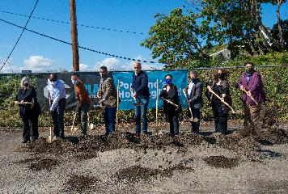
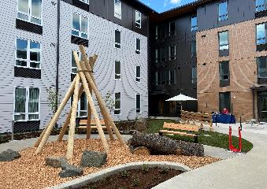
Sample Phasing and Type/Scale of Investments Years 1 - 15
 |  |  |  | Potential Investments & Sequencing​
District​ Timeline​ | Affordable Housing​ | Economic Development​ | Total​ | Stabilizing grants and loans | Land acquisition | Predev/Dev of acquired properties | Significant investment in new development
Years 1-5​ | $11M​ | $14M | $25M*​
Years 6-10 ​ | $14M​ | $16M​ | $30M​
Years 11-15​ | $22M​ | $27M​ | $49M​
1
2
3
4
Photo Credit: Chere Nichole
* Includes bonding issued at year five.​
Notes:
KIMBERLY
We’ve talked about phasing and how the amount of increment available increases over time, so we wanted to bring those pieces together.
The slide shows roughly how much money will be available for affordable housing and economic development during the first three 5-year Action Plan cycles.
In the first cycle, we’re looking mostly at smaller, stabilizing grants and loans for Priority Community residents and businesses at risk of displacement. There’s also an interest in opportunistic land acquisition for later development.
In the second cycle, we’d continue with stabilizing efforts and land acquisition, and might begin predevelopment or development work on acquired properties.
In the third cycle, we’d continue prior work, and begin to look at significant investments in new development.
Specific recommendations and priorities for each Action Plan will be developed in co-creation with a new Community Leadership Committee, which Oscar will describe later in the presentation.
The photos here show different types of TIF-funded work:
IMAGE 1: Home Repair Client
IMAGE 2: Prosperity Investment Program (PIP) grant recipient - Hair Unlimited by Chere Nichole, a salon and training facility
IMAGE 3. A Shovel Ceremony
IMAGE 4: Lents Commons.– a collaboration between Prosper Portland and the Portland Housing Bureau, which is a mixed-use, mixed-income project with 54 units of housing and retail spaces on the ground floor, including affordable commercial space.

Slide 23
Muralboard Exercise
Can we identify 2-4 Economic Development Priorities for the next five years?
Notes:
I’m going to give some context – and then we’re going to jump to an online tool called a MuralBoard. Will exp

Slide 24
Cully TIF District Budget
Line Item | FY 2025-26 | FY 2026-27 | FY 2027-28* | FY 2028-29 | FY 2029-30*
Action Plan Investments (e.g. ec dev & housing direct investments) | $1.9M | $2.0M | $19.4M | $2.0M | $10.4M
Economic Development (>45%)
~16M
Affordable Housing (>45%)
~$16M
Flexible
~$4M
Notes:
Kathryn
Allocations are minimum 45/45 ecdev/affordable housing – with 10% intended to swing.
Let’s start with a 50/50 split – and when we have this more refined, we can move money between the two categories if the CLC wants to do that.

Slide 25
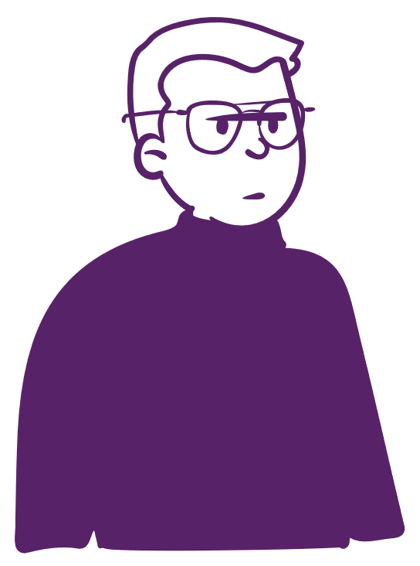
N/NE CDI Action Plan Priority Examples
Promote property ownership and redevelopment
(Financing and support for land acquisition, property improvements and redevelopment)
Support business ownership and growth
(Grants and loans for small business growth; create affordable commercial space)
Advance community livability projects
(Build community, support growth, development and sustainability of key community-based orgs that drive outcomes and serve Priority Communities)
Catalyze Cultural-Business Hubs
(Foster multigenerational wealth creation by investing 1-2 large-scale projects that will provide commercial space for small businesses owned by Priority Communities, examples: Portland Mercado, Vanport Square, Goden West Hotel)
Notes:
Priority Examples from N/NE Community Development Initiative Action Plan

Slide 26
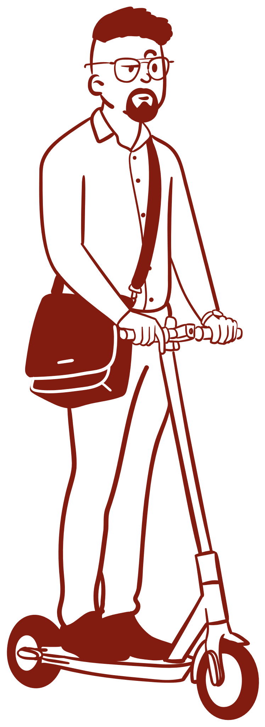
Gateway Action Plan Priority Examples
Inclusive Economic Growth & Celebrating our Diverse Business Community
(Financing and support for small business; aggressive marketing to Priority Communities)
Activate a Livable Gateway
(Invest in community anchors; artistic façade improvmenets; property activations; public infrastructure)
Notes:
EcDev related Priorities from 2024 Gateway Action Plan

Slide 27
BREAK! …then Muralboard Exercise
Can we identify THREE Economic Development Priorities for the next five years?
Notes:
https://app.mural.co/t/cullyclcactionplanning9614/m/cullyclcactionplanning9614/1747423305505/416da220432993fa0311b2ef6f173cf10ac459fc?sender=u4eff3c27cbb007878c2e1040

Slide 28
Public Comment
Notes:
Co-chairs

Slide 29
Next Steps Feedback Loop Next Meeting is Wednesday, June 25
Notes:
Kathryn/Jessi – next step – review the Eligible Projects List section of the District Plan before the next meeting – many of the already identified community priorities live in this section. Reviewing this will help you understand what’s been said and what questions you might still have…
Feedback Loop. How did this go?

