Slide 1
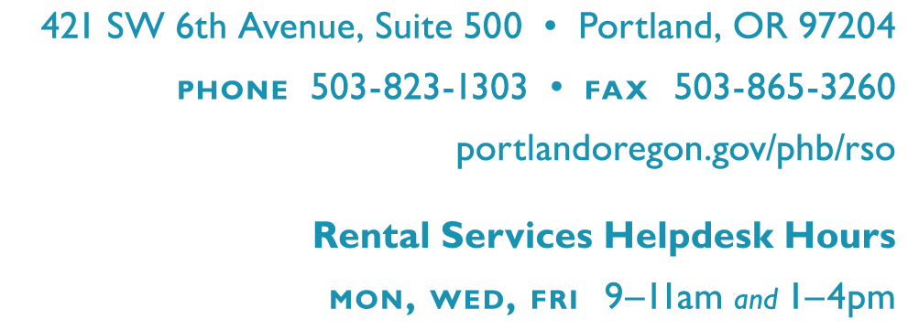
2035 Comprehensive Plan
Policy 5.54 Renter Protections
Enhance renter health, safety, and stability through education, expansion of enhanced inspections, and support of regulations and incentives that protect tenants and prevent involuntary displacement.
Andrés Oswill

Slide 2
Overview of Local Landlord-Tenant Law

Slide 3
The information in this notice is for educational purposes only. You should review appropriate state statute, city code, and administrative rule as necessary. If you need legal guidance, or are considering taking legal action, you should contact an attorney.

Slide 4
Owning Rentals
Owner Must Register the Rental Unit Annually and Pay Fee
Leasing
Units
Landlord Must Follow Local Application and Screening Rules and Security Deposit Rules
Modify/End
Tenancy
Landlord Might
Have to Pay Mandatory Relocation Assistance to Renter
City of Portland, Portland Housing Bureau, November 2019

Slide 5
Owning Rentals
Owner Must Register the Rental Unit Annually and Pay Fee
Leasing
Units
Landlord Must Follow Local Application and Screening Rules and Security Deposit Rules
Modify/End
Tenancy
Landlord Might
Have to Pay Mandatory Relocation Assistance to Renter
City of Portland, Portland Housing Bureau, November 2019

Slide 6
FAIR Administrative Rules
Timeline
Jun 2019
FAIR Ordinances Approved
Oct 2019
Proposed Administrative Rules
Mar 2020
FAIR in effect
City of Portland, Portland Housing Bureau, November 2019

Slide 7
FAIR Administrative Rules
Application and Screening
Administrative Rules
Advertising multiple units
Repeated Rental Violations
Statement of Applicant Rights Notice
Right to Request a Modification or Accommodation
City of Portland, Portland Housing Bureau, November 2019

Slide 8
FAIR Administrative Rules
Security Deposits
Administrative Rules
Disputed Condition Reports
Updating Condition Reports
Items not subject to depreciation schedule
Depreciation Schedule
Rental History Form
City of Portland, Portland Housing Bureau, November 2019

Slide 9
Questions?
Andrés Oswill
andres.oswill@portlandoregon.gov
Testimony:
Rental Services Office
rentalservices@portlandoregon.gov

