Slide 1
Vacate NE 24th Ave south of NE Columbia Blvd subject to certain conditions and reservations (Hearing; Ordinance, VAC-10136)
Street Vacation Process
December 13, 2023 – Agenda Item #___
Staff presenting: Kevin Balak, Right-of-Way Program Supervisor

Slide 2
Area Proposed for Vacation

Slide 3
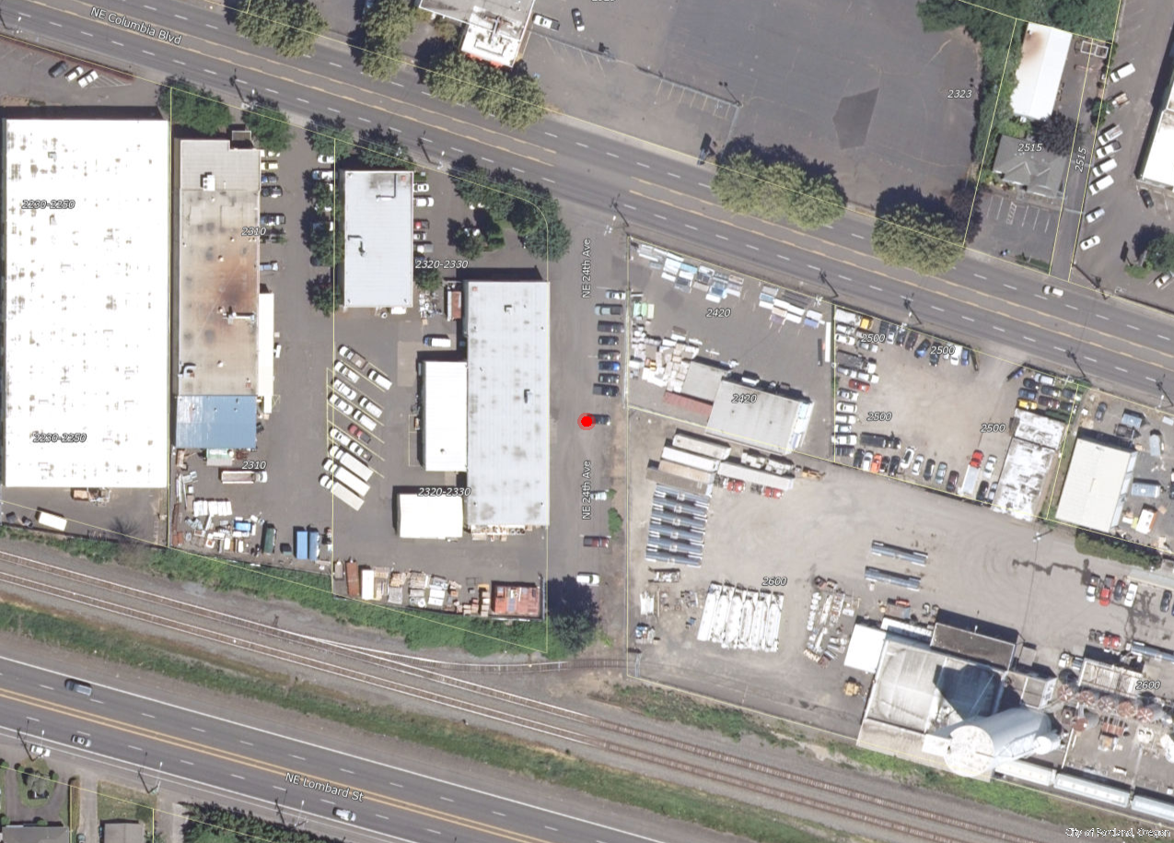
Current Conditions
Area zoned IG2 (General Industrial 2) and currently has a mix of industrial uses.
No north/south connectivity due to elevation changes and the Union Pacific Railroad to the south.

Slide 4
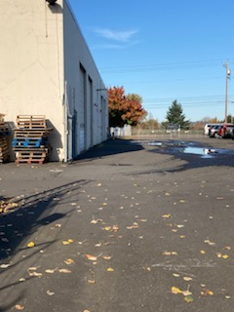
Current Conditions
Within NE 24th Ave. Facing North

Slide 5
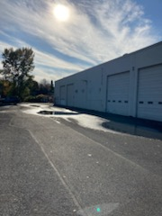
Current Conditions
Within NE 24th Ave. Facing South

Slide 6
PBOT Conditions of Approval
PBOT Transportation Planning and Development Review – NE 24th Ave Vacation area has been reduced in size to accommodate frontage improvements along NE Columbia Blvd.
PBOT Permit Engineering - Concept Review phase of Public Works process (30%) and a bonding/contract must be in place for future construction of 12 foot wide pedestrian corridor and driveway along NE Columbia Blvd prior to recording of Ordinance.

Slide 7
PBOT Conditions of Approval
PBOT Transportation Systems Management – Petitioner will install eastbound white dotted line markings and two-way left turn pavement markings on NE Columbia Blvd to connect the markings across the vacated NE 24th Ave intersection. In addition, Petitioner will remove all existing street name signs, dead-end signs, and post at the vacated NE 24th Ave intersection
PBOT Right-of-Way Management and Permitting – Owners of 2310, 2320-2330, 2420 and 2600 NE Columbia Blvd are required to dedicate approx. 5 feet along the frontage for future sidewalk improvements in order to establish a 12 foot wide pedestrian corridor.

Slide 8
Other Conditions of Approval
Bureau of Environmental Services – Petitioners will grant a 20-foot-wide public sewer easement over the existing 8-inch sanitary sewer facility running down the middle of NE 24th Ave. No parking signs and striping will also be required over the existing maintenance hole for future access.
Union Pacific Railroad – Property owners will grant an access easement to Union Pacific within NE 24th Ave. to access the existing spur track that serves the Amalgamated Sugar property. Douglas E. McQuown will also grant an access easement to Amalgamated Sugar for the spur track that runs across the southwestern portion of NE 24th Ave.

Slide 9


