Slide 1
Declare property located near the intersection of NE 90th Ave and NE Glisan St as surplus property (Hearing; Ordinance)
Surplus Property Process
December 20, 2023 – Agenda Item #___
Staff presenting: Kevin Balak, Right-of-Way Program Supervisor

Slide 2
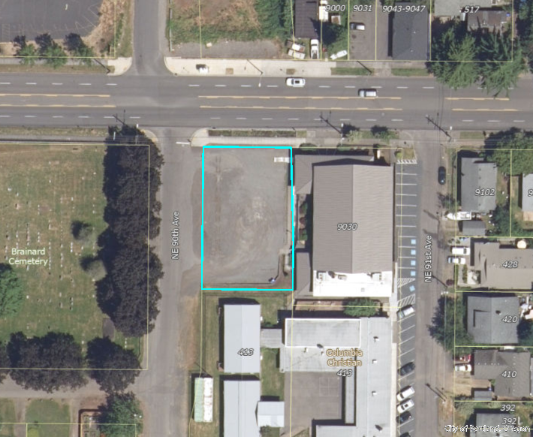
Proposed Surplus Area
NE Glisan St
10,442
sq.ft
NE 90th Ave

Slide 3
Current Conditions
Property zoned RM1 (Residential Mult-Dwelling 1)
Gravel parking lot currently leased to Eastside Church of Christ, the adjacent property owner
BES sewer pipe along frontage of property
NE Glisan St
NE 90th Ave

Slide 4
Background
City purchased the property from the Columbia Bible College in 1951.
Property served as the bus turnaround location for the now defunct Glisan Bus line.
As condition of the 1951 sale, Columbia Bible College reserved the first option to purchase back the property.
The Columbia Christian School (formerly the Columbia Bible College) assigned that Right of First Refusal to the Eastside Church of Christ in 2016.

Slide 5
Surplus Process
Upon Council action to declare property excess, City will initiate an independent appraisal and offer fair market value to the Eastside Church of Christ.
If City cannot come to terms with the Eastside Church of Christ, City will make an offer to the Columbia Christian School.
If City cannot come to terms with Columbia Christian School, place property on a 60 day public comment period.
After 60 day public comment period, sell the property on the open market.

