Slide 1
Sheridan Trunk – WZ 03 Project E11008
Lisa Huntington, P.E. | Engineering Manager | Bureau of Environmental Services
Daniel Boatman, P.E. | Project Manager | Bureau of Environmental Services
November 1, 2023
MINGUS MAPPS, COMMISSIONER
MICHAEL JORDAN, DIRECTOR

Slide 2
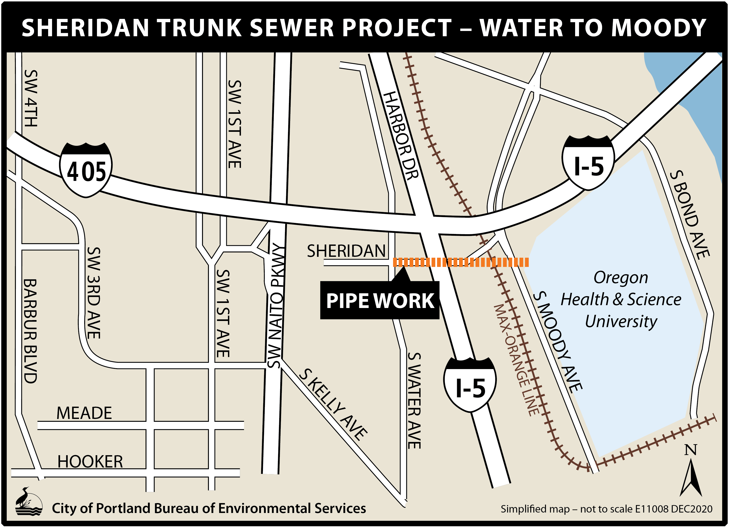
Project Overview
Sheridan Trunk – Work Zone 03
Approx. 510 feet of 66” diameter pipe
Has provided over 135 years of service
4 service laterals
Notes:
This project will: Increase sewer system capacity and reliability, and Protect public health, property, and the environment by reducing the risk of sewage releases and sewer backups.

Slide 3
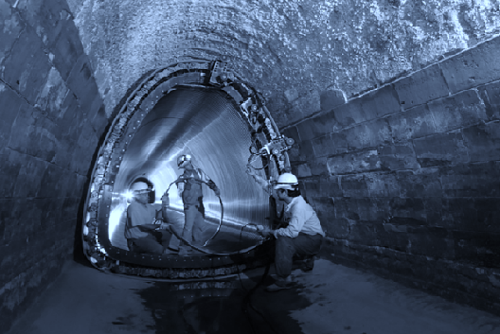
Construction Methods and Scope
Trenchless rehabilitation
Notes:
Trenchless to reduce impacts and restoration.
Method ft %
CIPP 1893 17%
Spot Repairs 42 0.6% (35’ on CIPP mains)
PB 1580 22%
Sect-CIPP 6 0.1%
Auger Boring 94 1.4%
OC 3345 49%
---------------------------------------
Abandon 1794 -
TOTAL 12439
NCS 1368
TOTAL REHAB 11071

Slide 4
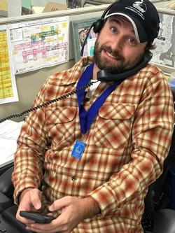
Public Outreach & Impacts
Project Notifications
Sent to a 2-block area to 4,475 neighbors on April 25, 2023.
GovDelivery email bulletin to 231 recipients on April 25, 2023.
Project website.
No responses or concerns received.
Extended Work Hours
Work will be performed during the day, but some activities may need to extend into the evening or even over night.
BES has applied for a noise variance for up to 10 nights.
Notes:
Working with outreach firms to assist in public involvement.

Slide 5
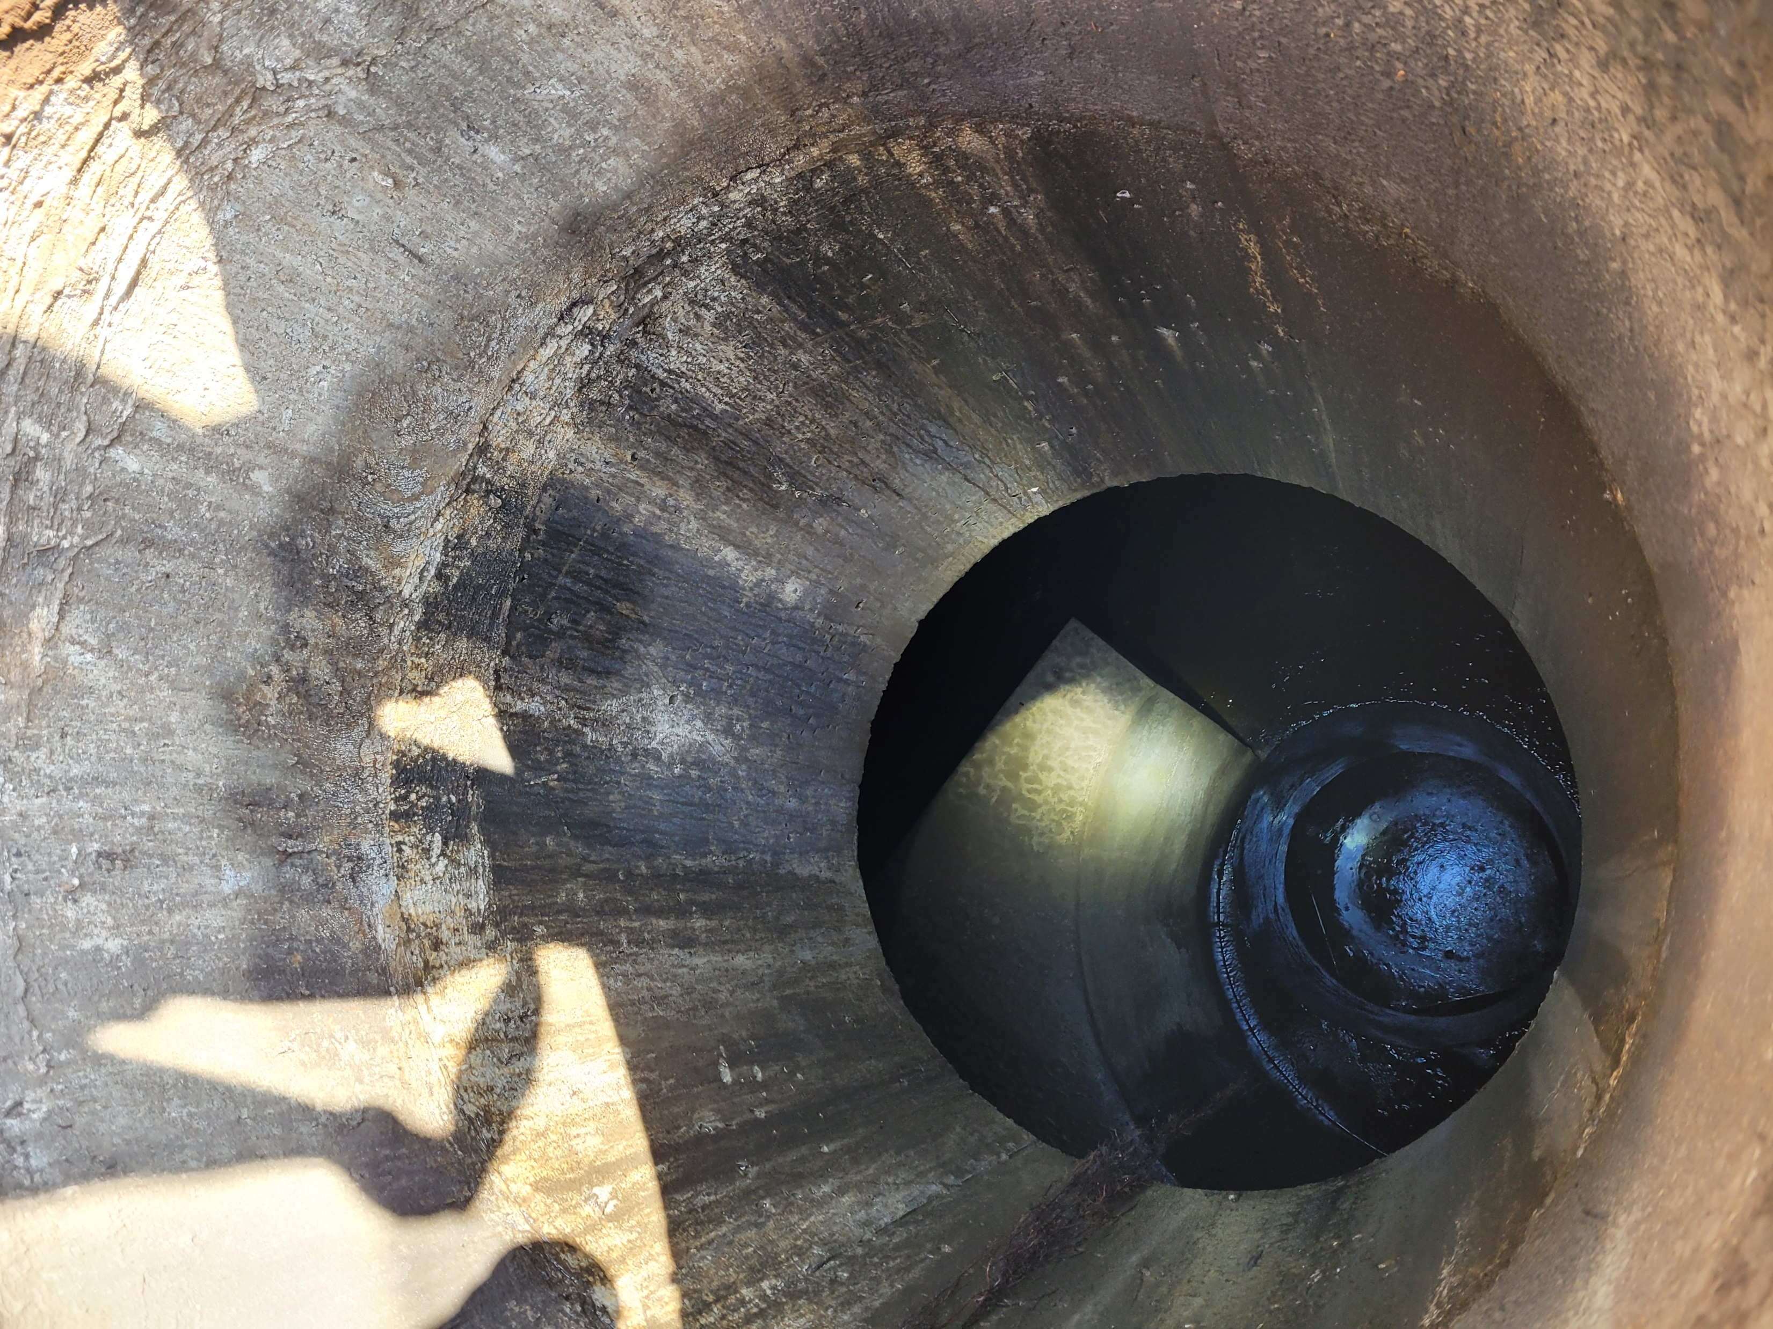
Engineer’s Estimate & Schedule
Engineer’s Estimate:
$1,652,000
Medium confidence level
Advertise Project:
December 2023
Begin Construction:
May 2024
Construction Duration:
365 calendar days

Slide 6
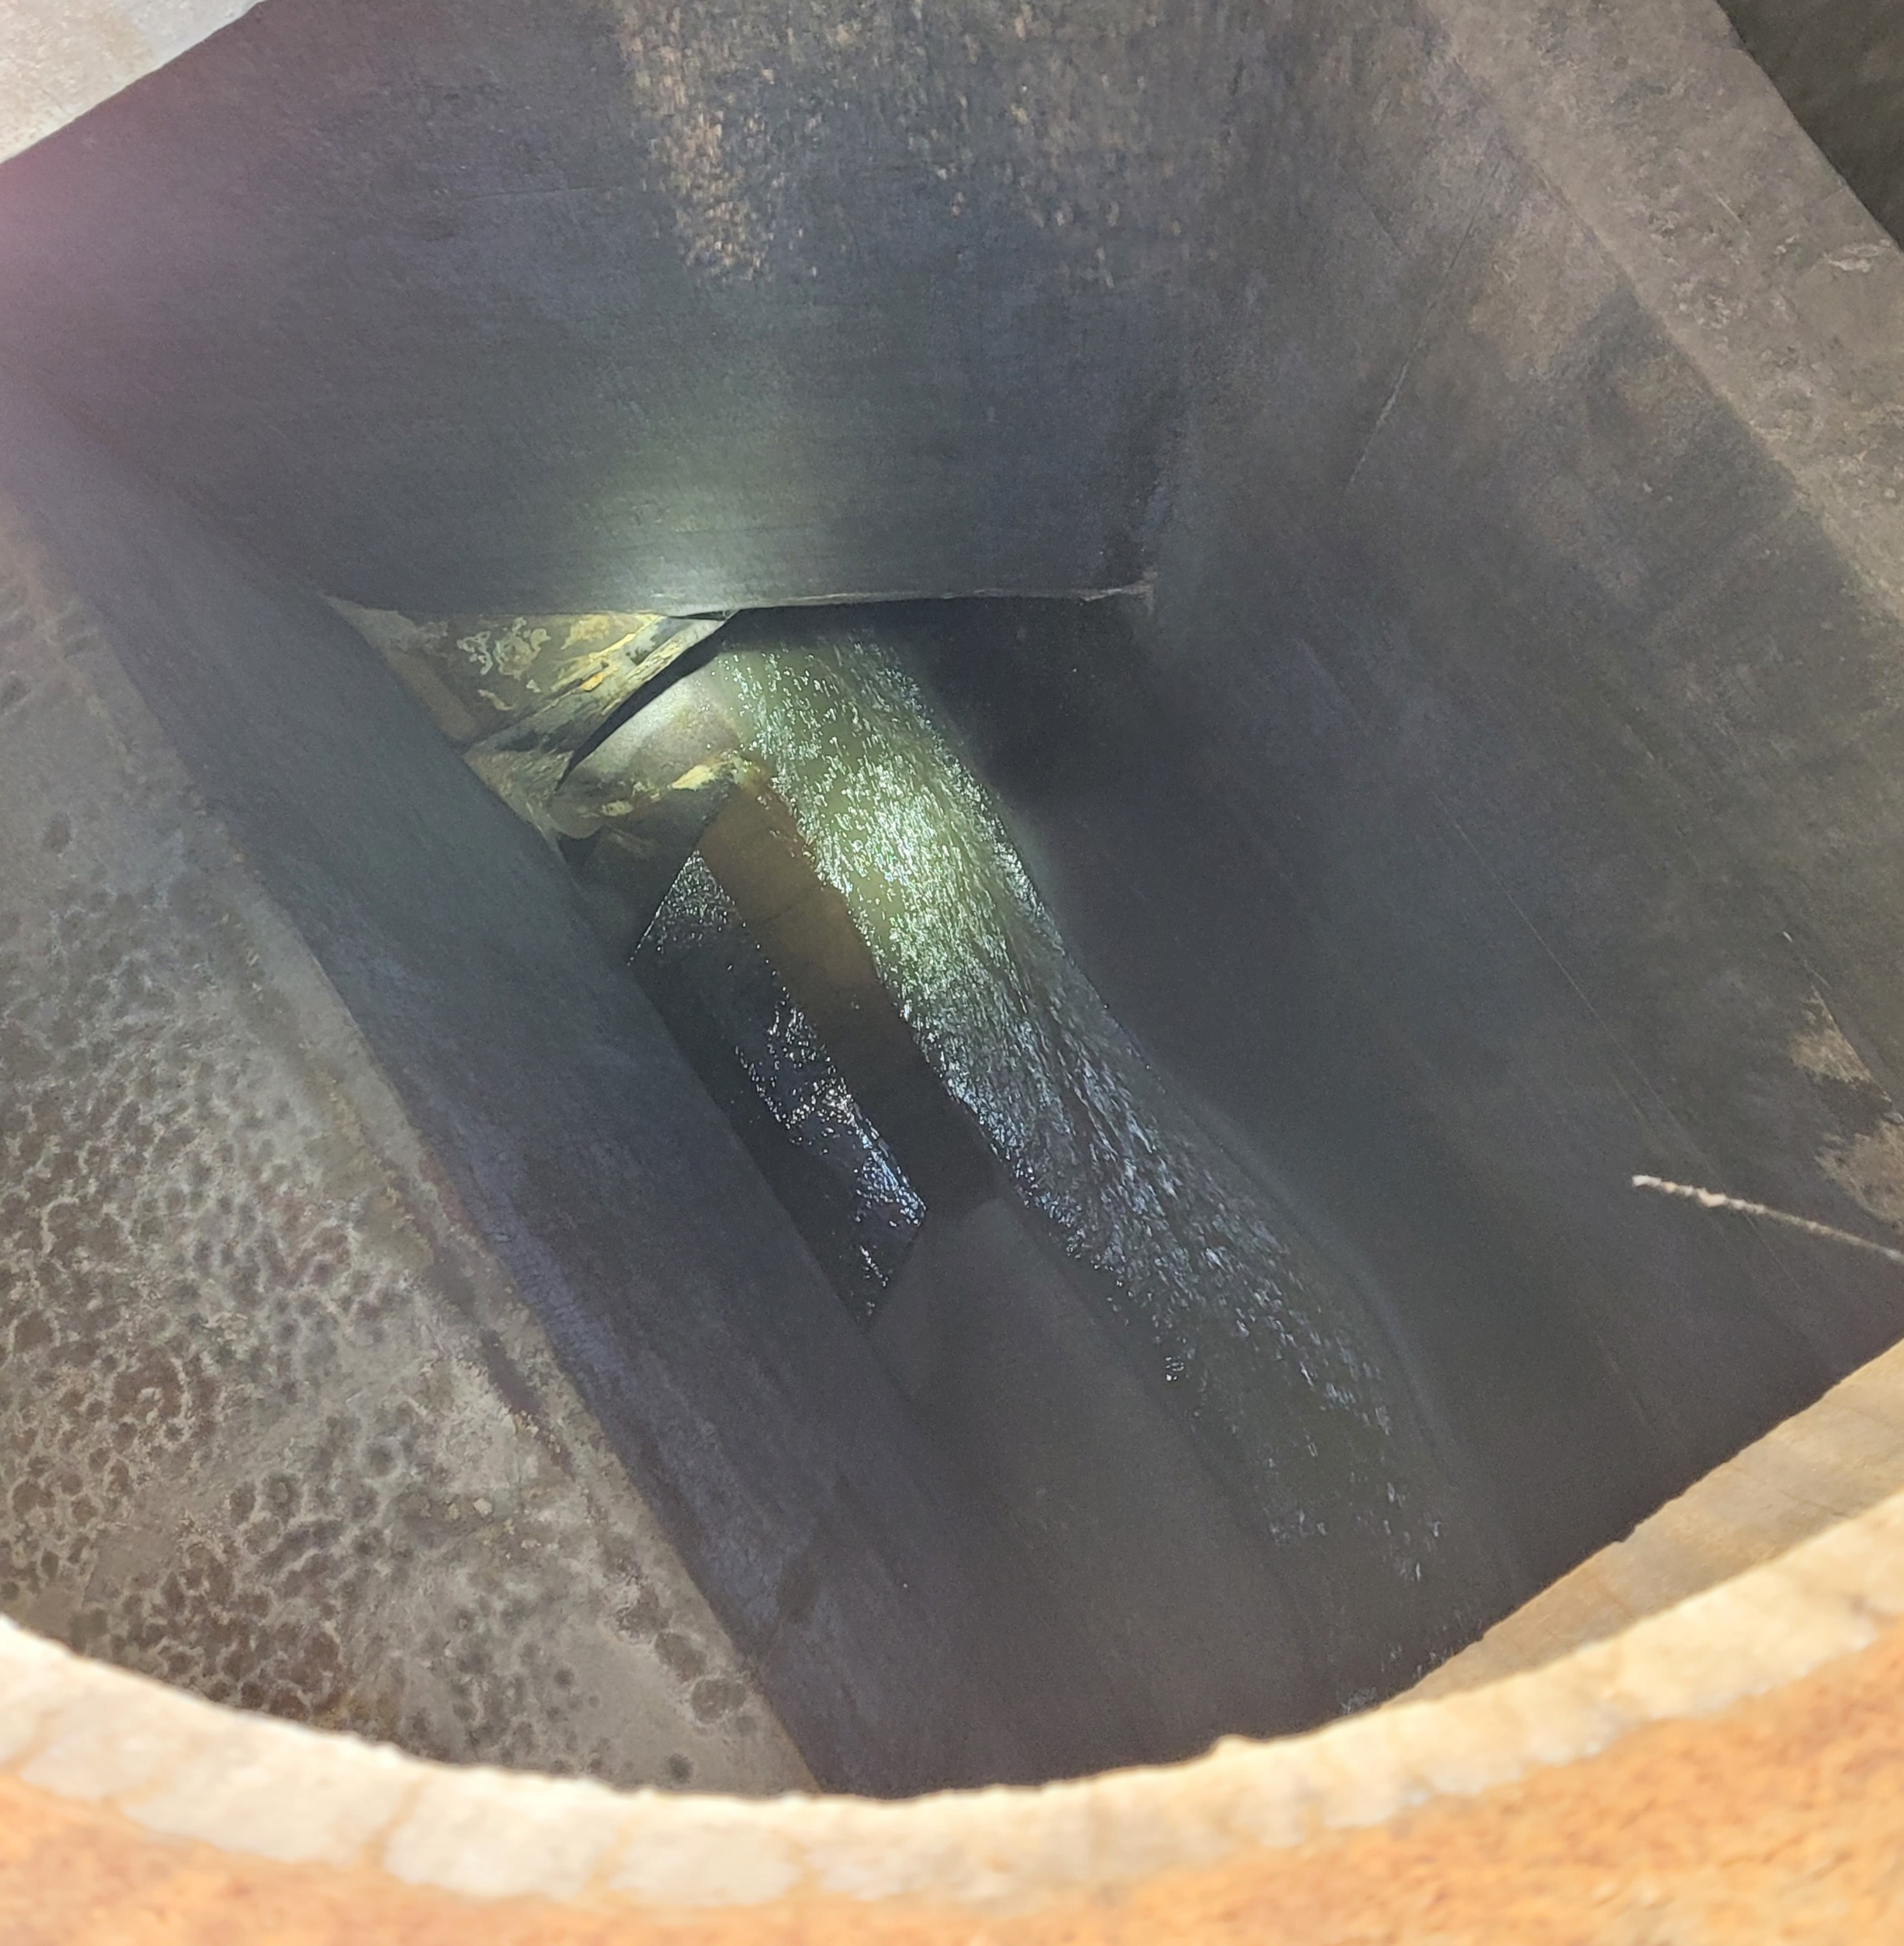
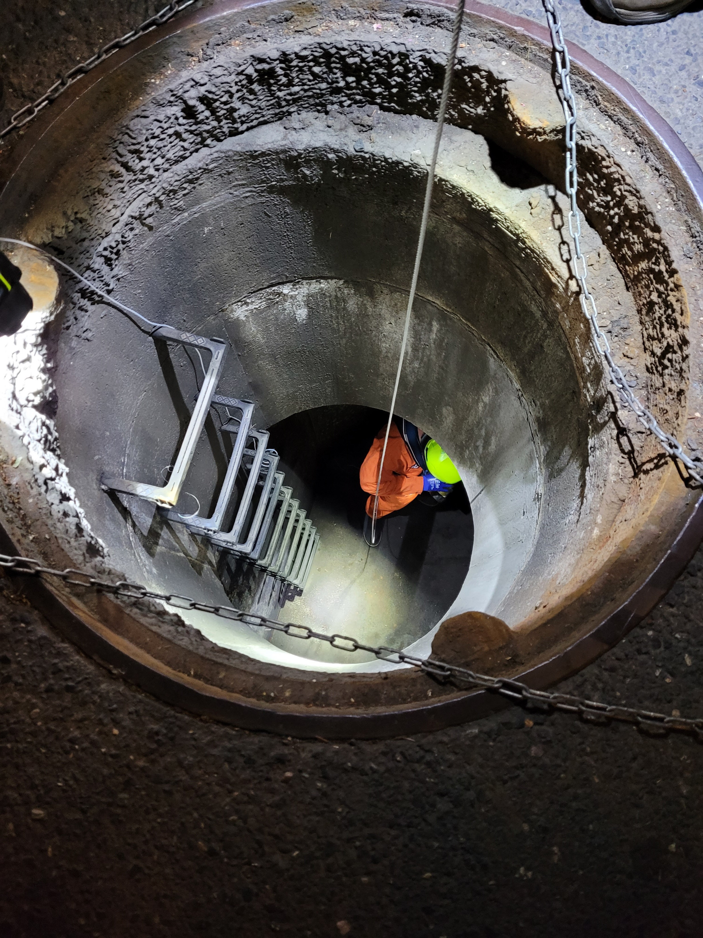
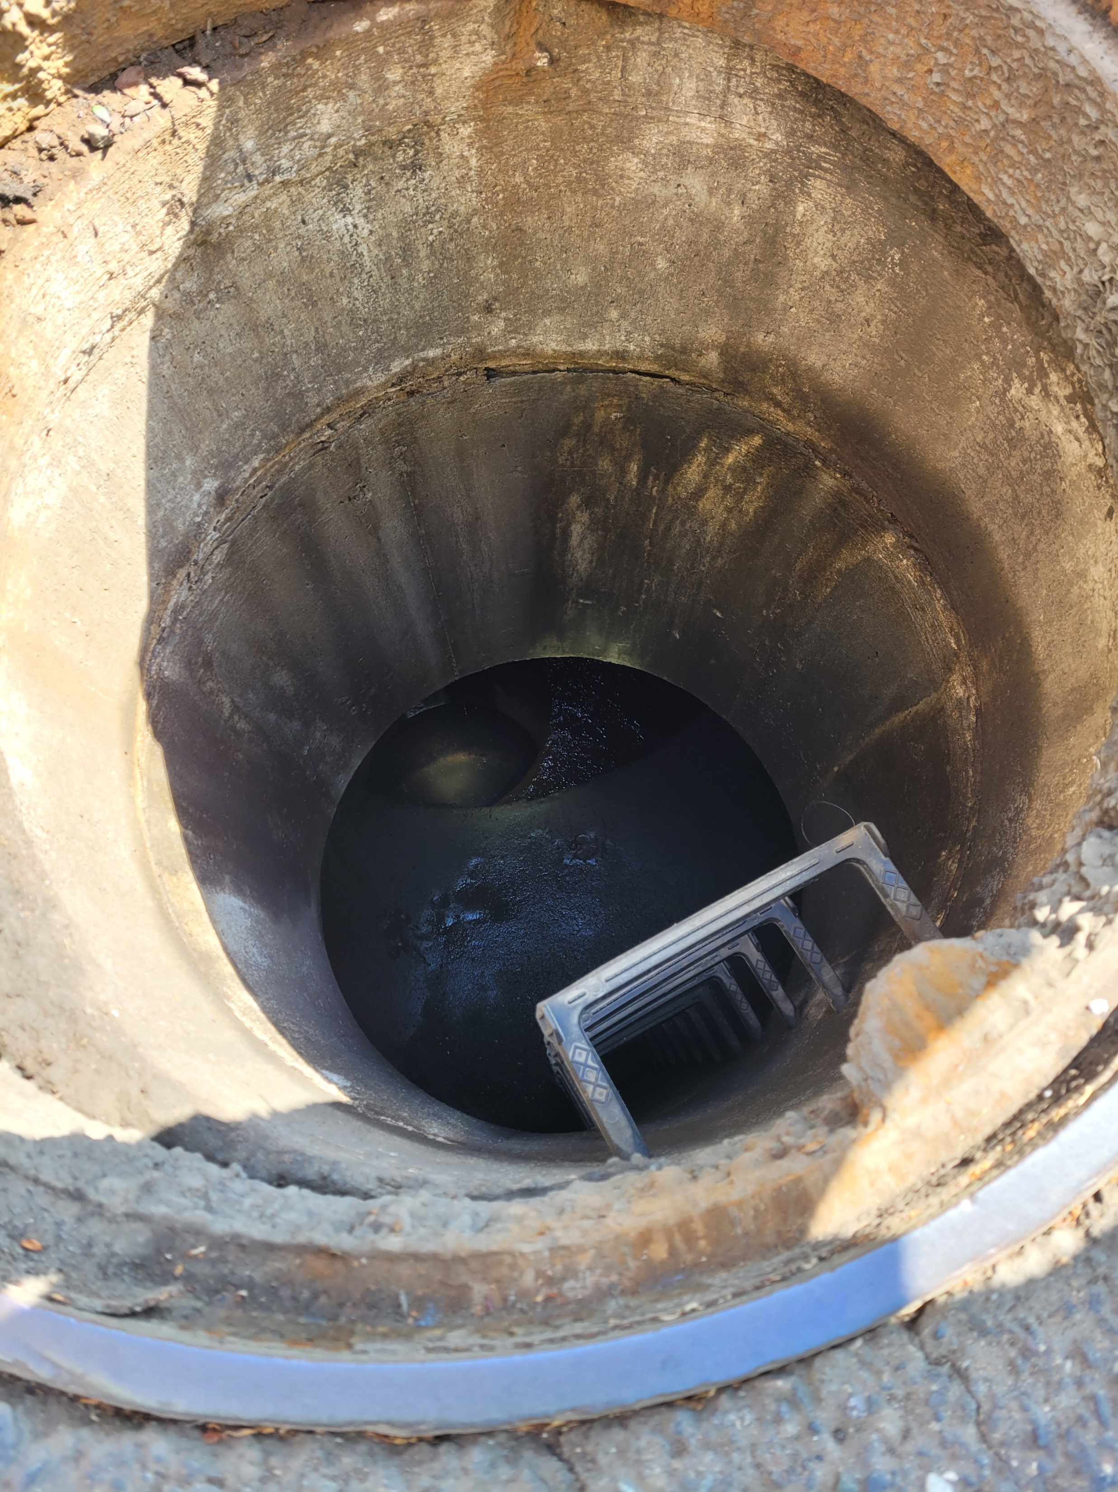
Questions?

