Slide 1

CBWTP WWCL and Hypochlorite Modifications
E11485
Tressie Word| Project Manager | Bureau of Environmental Services
Muriel Gueissaz-Teufel| Engineering Manager
11/1/2023
Mingus Mapps, Commissioner
Dawn Uchiyama, Director

Slide 2
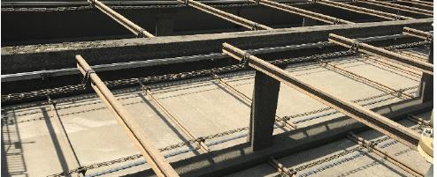
Brief Summary
Overview
Requirements
Objectives
Budget
Schedule
Questions

Slide 3
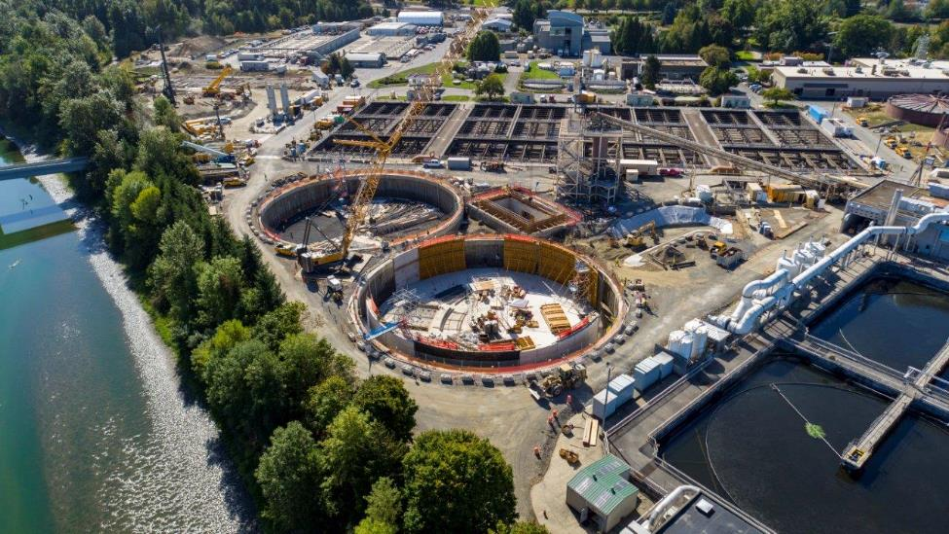
Overview
Columbia Boulevard Wastewater Treatment Plant
  Wet Weather Clarifiers
  Disinfection System
Notes:
Over $100M for the project…

Slide 4
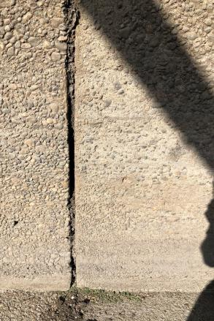
Objectives
Reduce asset failure risk
Increase system resilience and extend service life
Support operation and maintenance

Slide 5
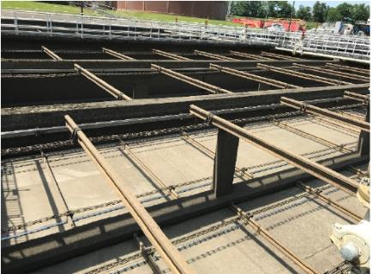
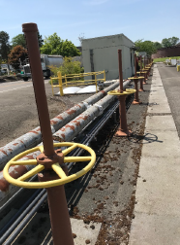
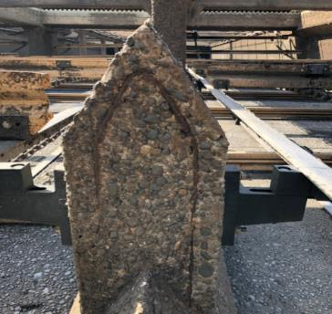
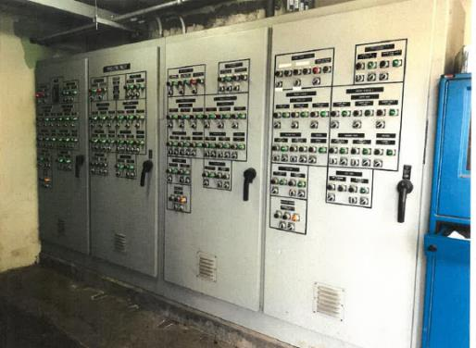
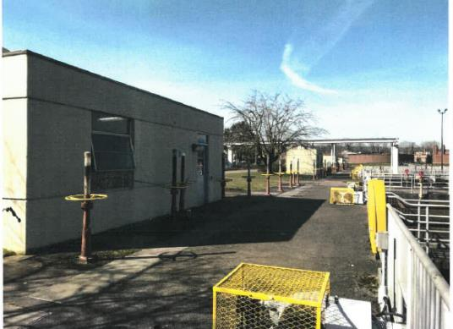
Requirements
Aged systems present a greater risk of failure
Notes:
These systems built were built in the 50s and 70s, no major reinvestment since, you can see from the photos the systems are degraded. Getting harder to operate these systems effectively.

Slide 6
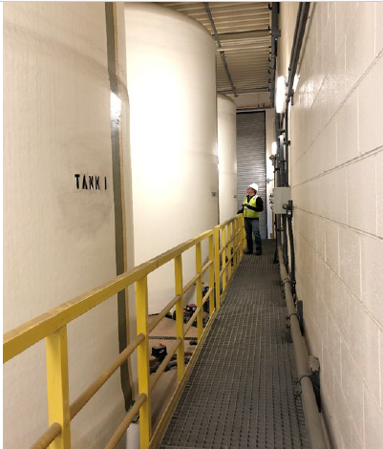
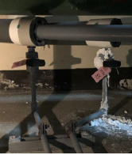
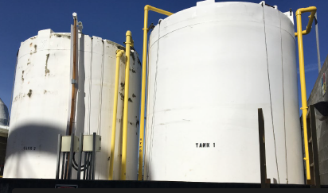
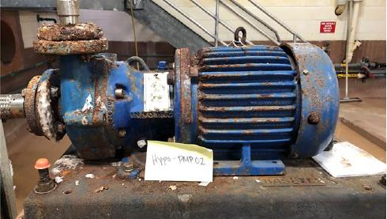
Requirements
Existing Sodium Hypochlorite System
Notes:
Hypo: Decentralized system, corrosive, chemical, consolidate it for safer for operations

Slide 7
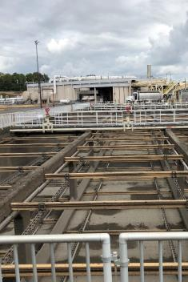
Budget - Ordinance
Low-Bid Exemption: $63M (-50%, +100%) CM/GC
  Perform complex, large wastewater treatment facility construction
  Maintain continuous, safety focused plant operations
  Deliver contractor input during the design process
    Constructability
    Sequencing
    Packaging
  Reduce project risks and scheduling delays
  Advance goals of equity and inclusion in the construction industry
Notes:
Core services, building on experience from the Secondary Treatment Program

Slide 8
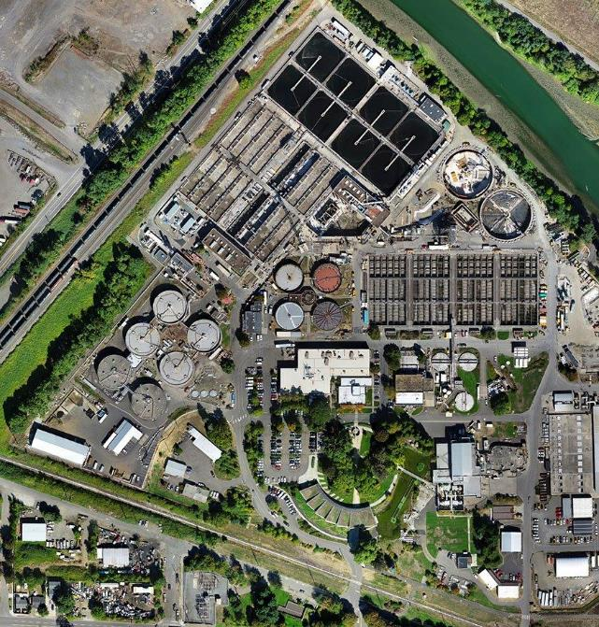
Next Steps
Report to Council on Guaranteed Maximum Price
~ Summer 2026
Construction
~ Fall 2026

Slide 9

Questions
Thank you!

