Slide 1
CBWTP WWCL and Hypochlorite Modifications E11485
Tressie Word| Project Manager | Bureau of Environmental Services
Muriel Gueissaz-Teufel| Engineering Manager
10/18/2023
Mingus Mapps, Commissioner
Dawn Uchiyama, Director

Slide 2
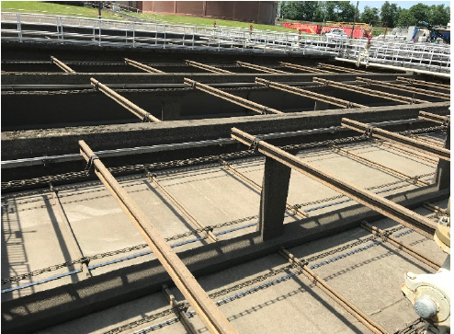
Brief Summary
Overview
Objectives
Requirements
Budget
Next Steps
Questions

Slide 3
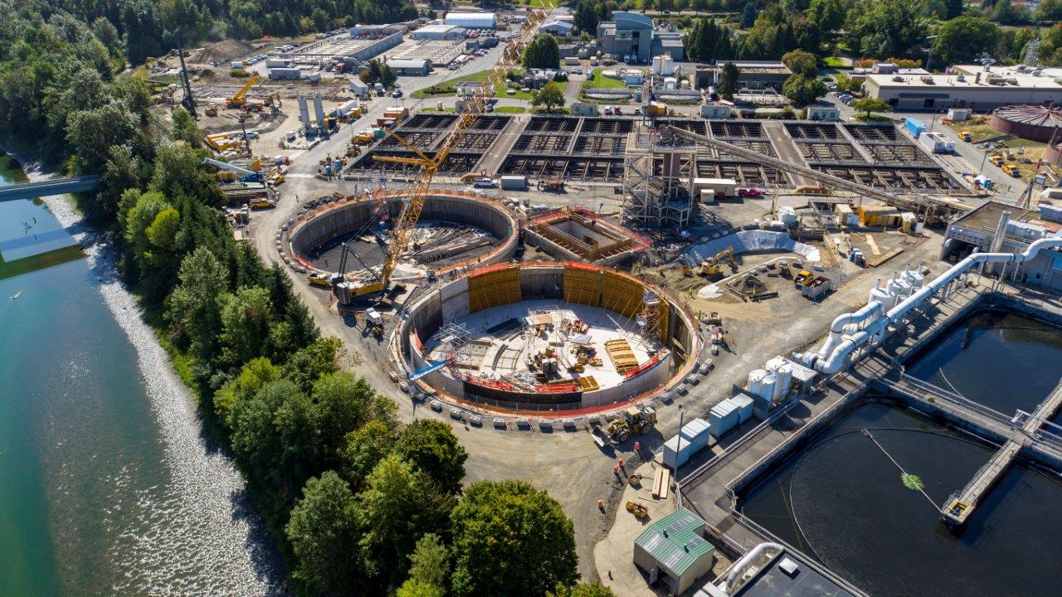
Overview
Columbia Boulevard Wastewater Treatment Plant
Wet Weather Clarifiers
Disinfection System

Slide 4
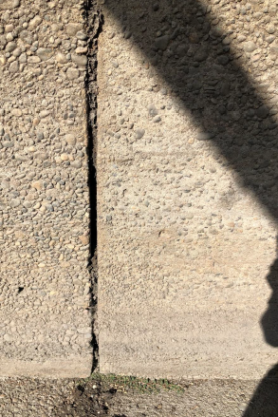
Objectives
Reduce asset failure risk
Increase system resilience and extend service life
Support operation and maintenance

Slide 5
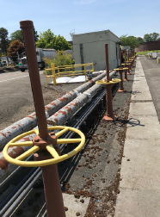
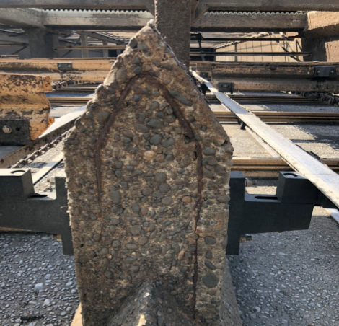
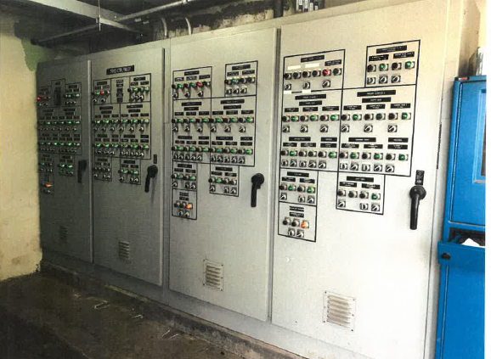
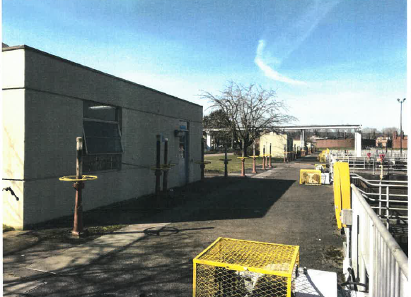
Requirements
Aged systems present a greater risk of failure
Wet Weather Clarifier Systems

Slide 6
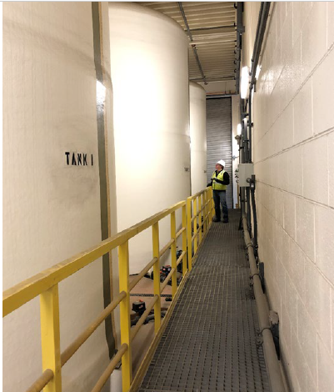
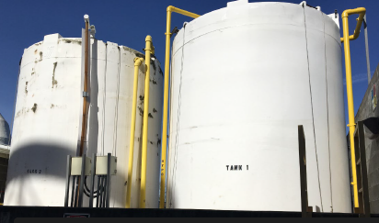
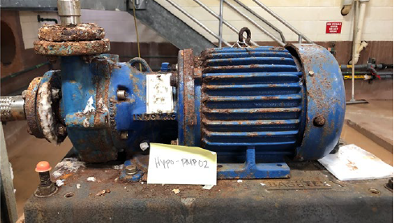
Requirements
Deteriorating Sodium Hypochlorite Disinfection Systems

Slide 7
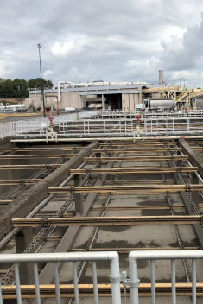
Budget
Professional Technical Services: $15.8M
Project development
Design
Engineering services during construction
30% Business Inclusion and Diversity Goal
Structural and Seismic Resiliency
Mechanical and HVAC
Electrical
Instrumentation and Controls
Civil
Architecture and Sustainability
Demolition

Slide 8
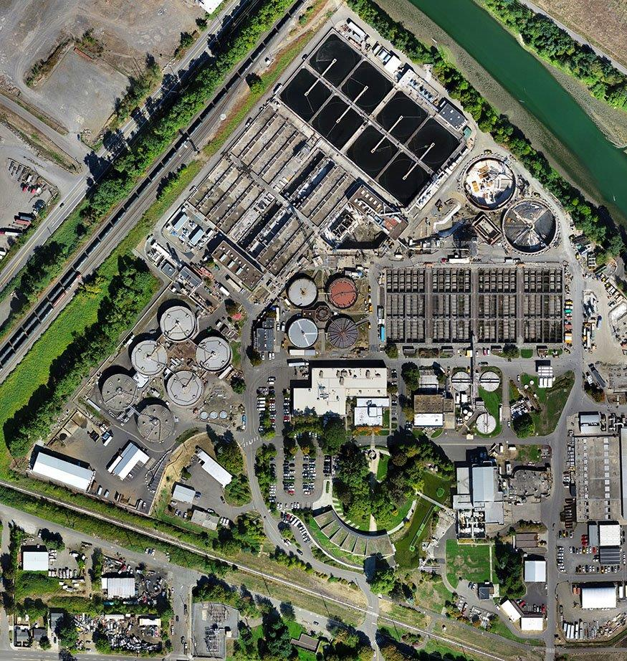
Next Steps
Low bid exemption ordinance
~ November 2023
Report to Council on Guaranteed Maximum Price
~ Summer 2026
Construction
~ Fall 2026

Slide 9
Questions
Thank you!

