Slide 1
MAP Evaluation Results
Status Reports of Actions for Mitigation Action Plan (MAP) 2023
Rachit Nerwal,
Interim Planning Manager
Notes:
Agenda
Introduction
Hazard mitigation plan describes the natural hazards that pose a risk to the City of Portland and outlines the steps the City of Portland is taking to mitigate the harmful impacts of those hazards.
A lot of what you all see during emergency response are emergency response or preparedness plans .
It’s a 5 year plan. The 2021 Mitigation Action Plan is the third comprehensive update to the City of Portland Natural Hazard Mitigation Plan (NHMP), which was first developed in 2004. This update identifies resources, information, and strategies for reducing risk from natural hazards.
Why do we update it: To report on any changes in the built environment since the prior MAP was approved that would increase or decrease vulnerability, especially in hazard-prone areas.
How does it help to have a plan?
The federal Disaster Mitigation Act (DMA) of 2000 requires state and local governments to develop hazard mitigation plans as a condition for Federal disaster grant assistance. The City’s Mitigation Action Plan (MAP) fulfills the requirement for a local Natural Hazard Mitigation Plan (NHMP) and meets certain requirements for the City of Portland’s participation in the Federal Emergency Management Agency’s (FEMA) Community Rating System (CRS).
Disaster Recovery and Resilience Action Group (DRRAG)

Slide 2
Community Rating System (CRS)
Communities are rated Class 1-10 (with 1 being the highest) based on an accounting of activities that reduce FEMA's risk. Our current Class 5 rating provides a 25% discount on flood insurance for property owners.
Portland's rating is higher than 90% of the 570 communities enrolled in FEMA's CRS Program. Portland's Class 5 rating saves the community about $300K in insurance premiums every year. About 60% of those receiving the discount are located in lower income neighborhoods.
As part of the CRS implementation, the City receives credit for the Mitigation Action Plan. To continue receiving this credit, the City reports annually to FEMA on the implementation of the Plan.
Notes:
The CRS is a voluntary program under the National Flood Insurance Program that rewards participating communities (provides incentives) for exceeding the minimum requirements of the National Flood Insurance Program and completing activities that reduce flood hazard risk.
The annual progress report for 2023 is attached to this memo for City Council consideration and acceptance. These reports are prepared by BES - the CRS Coordinator for the City - and submitted to FEMA as part of the CRS Recertification process.

Slide 3
Mitigation projects fall into the following categories:
Planning and regulations
Structural and infrastructure projects to make the built environment more resilient
Natural systems protections that minimize harm to people and the built environment and restore the functions of natural systems
Education and awareness programs that inform the public about natural hazards and ways to mitigate their impacts.

Slide 4
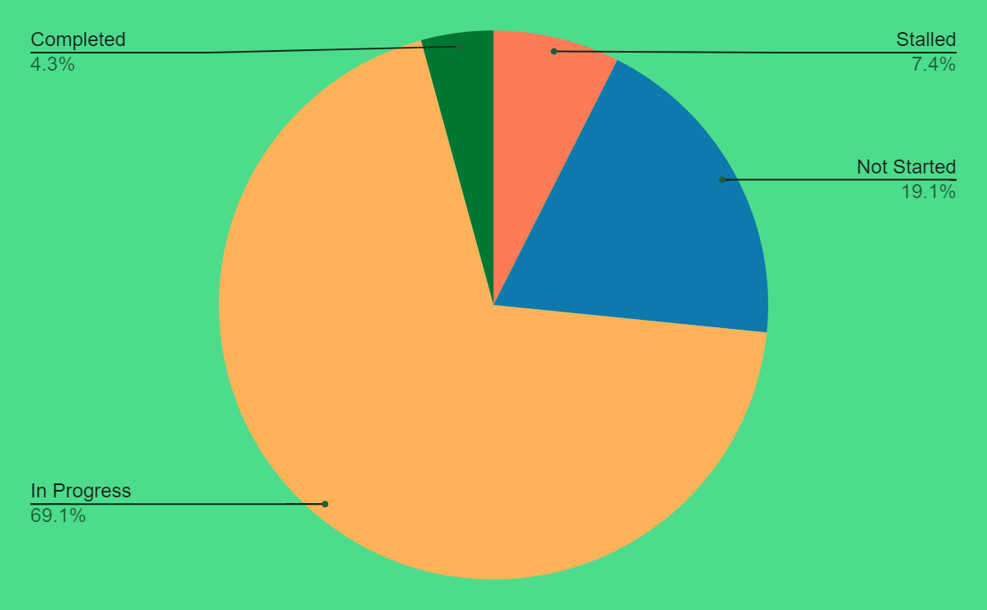
Breakdown of MAP Actions
4 actions completed
66 actions in progress
18 actions not started
6 actions stalled
Notes:
There are total of 117 projects/strategies identified under this plan with several bureaus

Slide 5
In Progress Actions
What has been accomplished?
BES-5: Planted 700-800 trees and receive 4 years of maintenance; also installed 53,560 native plants throughout city owned natural areas
BES-7: Partnered with multiple watershed councils to ensure community participation, education, and stewardship
BES-15: STEP program–significant excavation and ground improvement work to add secondary treatment clarifier capacity; work will conclude or be close to completion in FY 24/25
BES-19: Lower Columbia River Basin Peak Stage Frequency Report completed in 2022 and released in 2023 through a collaboration with US Army Corps of Engineers

Slide 6
In Progress Actions
What has been accomplished?
BPS-3: Developing neighborhood scale energy resilience through solar+battery systems; shifted from policy and planning to more investment as the Portland Clean Energy Fund has taken shape, which has funded 3 community based solar plus storage projects
BPS-4: BPS replaced the 2015 Climate Action Plan with the 2022-2025 Climate Emergency Workplan in August 2022
BPS-15: Developing an urban heat island strategy for east portland; collaborating with 8 city bureaus to implement the city wide flood management update work plan (Floodplain resilience plan)
BPS-7: Fix it fairs are resource events for personal and community resiliency and sustainability, 1,300 people have attended fix-it fairs in 2023; long range planning often raises the awareness of climate resiliency

Slide 7
In Progress Actions
What has been accomplished?
BDS-1: BDS worked on the regional aspects of updating their building damage assessment plan but since BDAP+ did not get funding, this limits their outreach capabilities, developed a strong collection of educational materials translated into 10+ languages
PBOT-1: Reassigned PBOT Senior Planner to focus on operations resiliency at Maintenance Operations
PBOT-2: Received a federal bridge infrastructure program grant to replace the N Burgard Street Viaduct, ranks highest in seismic priority index; completing bridge replacement feasibility study for NE 33rd Ave Bridge
PPR-1: Improved awareness of natural hazards and risks among staff

Slide 8
In Progress Actions
What has been accomplished?
PBEM-7: Signed a contract with AIM-4-Access to support disability specific emergency preparedness materials and work in partnership with the disability community
PBEM-8: Provide response packs to NET volunteers who cannot afford it, cultivated a full spanish speaking NET team in partnership, continue to prioritize neighborhoods that have been underserved by government
PWB: Mitigation projects against extreme weather, wildfire, and earthquakes involving the Bull Run Dam are ongoing and efforts are underway. Most of these projects are in the initial stages of progress and planning.

Slide 9
In Progress Actions
Obstacles or Barriers to Progress
Need for more training and improved awareness of natural hazards and their risks.
Inadequate funding
Bureau capacity, lack of personnel
Delays in the planning and design process
Coordination with other bureaus, agencies, and community partners
Lack of accurate/trusted information needed to pursue expensive projects
COVID-19 and weather emergencies
Safety concerns for field personnel
Translation and Interpretation for non-english speaking communities

Slide 10
In Progress Actions
Factors to Success
Collaborative working relationships with partnering agencies
Staff with excellent and relevant technical ability were leading the way
Success of ongoing items is dependent on long-term relationship building, collaboration, and trust
PCEF has helped provide the resources for implementation for solar and storage through its community driven prioritization

Slide 11
Completed Actions
PWB-11 | Mitigate Impacts from Power Loss - Continuity of Electric Service: Establish cooperative agreements with local power suppliers to prioritize and provide emergency repairs and continuity of service to the Bureau facilities and Columbia South Shore Well Field during power outages.
BES-16 | Design and build stormwater improvements along SW Capitol Hwy and local side streets to address drainage and conveyance deficiencies and recurring nuisance flooding.
PWB-31 | Mitigate Against Dam Failure in the Bull Run: Replace Bull Run Dam 2 Spillway Subdrain System Pipe to reduce likelihood of dam failure
BDS-2 | 2008 Erosion and Sediment Control Manual Update: Update the manual so that it reflects recommendations from an EPA audit around "simple sites" and sites under construction.

Slide 12
Stalled
Actions
BPS-2 | Assess and Restart Garbage and Recycling Collection Services. Develop continuity of operations plans for services to residences and businesses post-disaster. Implement requirements for garbage and recycling service providers to prepare and maintain emergency operations and continuity of operations plans.
PWB-22 | All Hazards Mitigation - Staging Locations for Emergency Repairs: Develop and establish a West-side emergency operations, staging facility for field crews, and staging plan for stockpiling water system repair materials in strategic locations.
BPS-13 | Seismic upgrades to Central City Buildings: develop seismic requirements for Central City development that uses public funds and develop a plan for seismic upgrades in Old Town/Chinatown that reflect equity considerations and allow for incremental improvements
PPR-5 | Seismically retrofit or upgrade Parks & Recreation facilities, prioritizing unreinforced masonry (URM) buildings.
PWB-3 | Seismic Mitigation - Replace Existing Vulnerable Pipes by Burying New Water Pipes Under Rivers: - Plan, design and construct new underground river crossings to reduce earthquake damage to pipes: > Willamette River - 2 crossings > Sandy River (Conduit 3)
BDS-3 | Amend Chapter 24.85 (Seismic Regulations) to adopt new seismic upgrade triggers and limit the requirements for seismic upgrades for conversions of single dwelling homes to multi-dwelling homes.
Staff Capacity
Lack of Funding
Delays in planning and political processes

Slide 13
Not Started Actions/Need Significant Support
Seismic mitigation: Infrastructure improvements, fuel plan, risk assessments and resiliency planning, elevating funding for retrofitting
Coordination and partnerships with communities, bureaus, and regional partners
Updating plans, data, and policies
Actions where long term funding might be required for mitigation: Ex. Mitigate wildfire danger on PP&R-managed property
Reasons: Lack of funding, out of data/inaccurate data, need for more research and deeper analysis, staff capacity, changes or delays to the planning process, coordination with multiple actors

Slide 14
Thank you.
Any questions?

