Slide 1
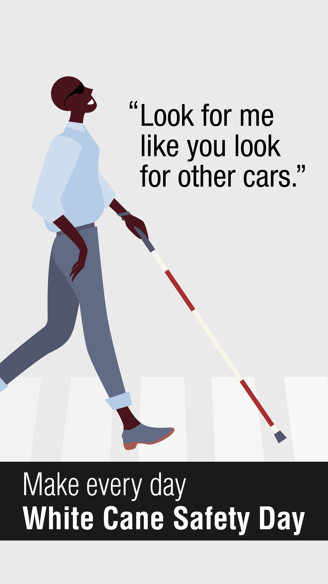
White Cane Safety Day Proclamation
Portland City Council
11 October 2023

Slide 2
Disability in Oregon
May 2023 Data https://www.cdc.gov/ncbddd/disabilityandhealth/impacts/oregon.html

Slide 3
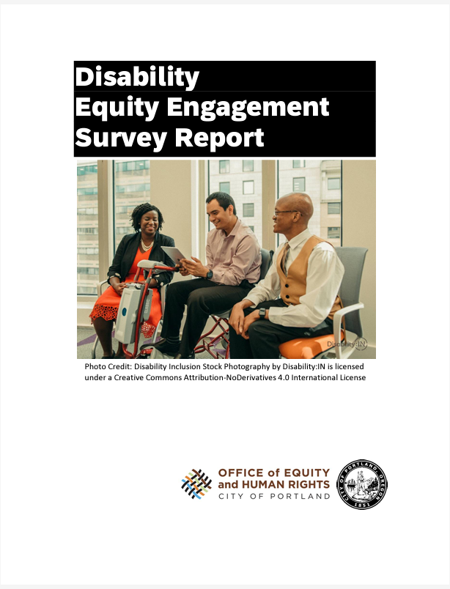
OEHR survey of people with disabilities in Portland just closed. Of the 3800 respondents, 20% of them identified that they experience a vision disability.

Slide 4
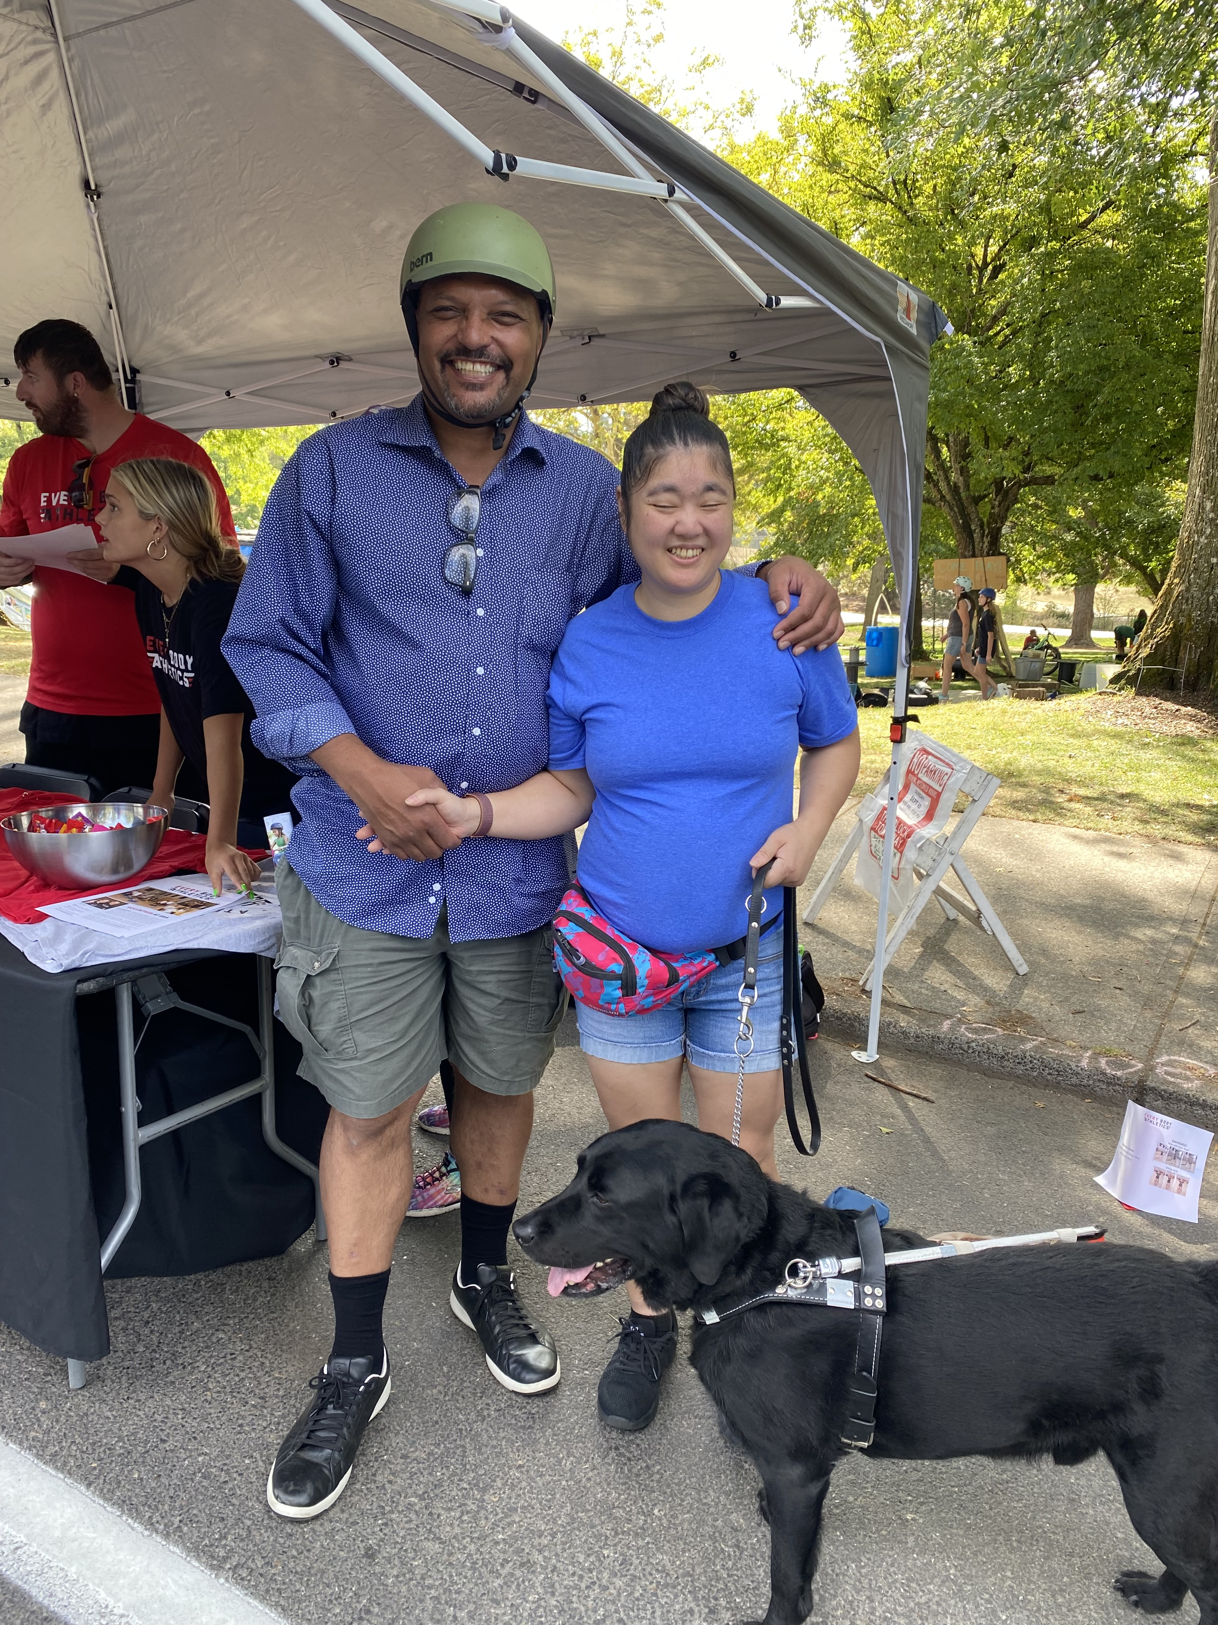
Proclamation is for White Cane Safety Day.
Community members who are visually diverse might also be guide dog users.
Pedestrian Safety Action Coalition (PSAC) promotes transportation safety for white cane AND guide dog users.
Here today with PSAC co-chairs.

Slide 5
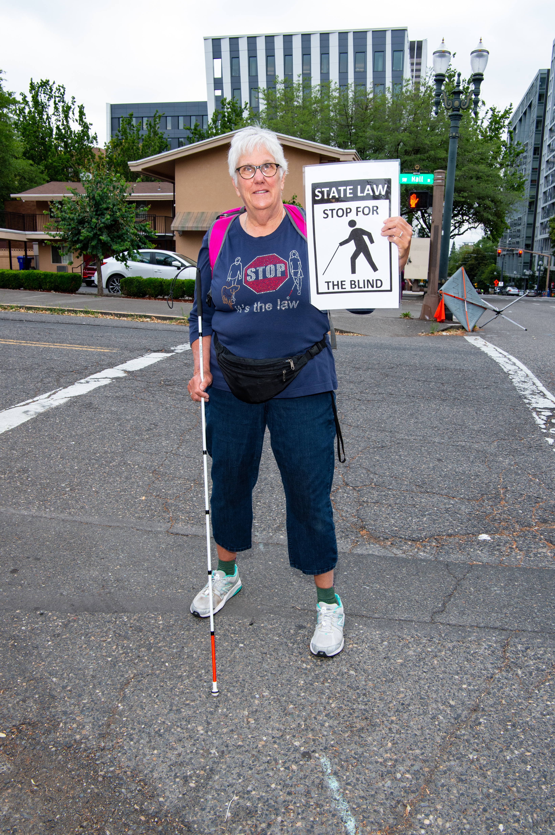
Continue educating drivers of all vehicles and all ages
Pedestrian safety is dependent on both drivers and pedestrians
To move to zero injuries and fatalities takes all to be alert & aware all year.

Slide 6
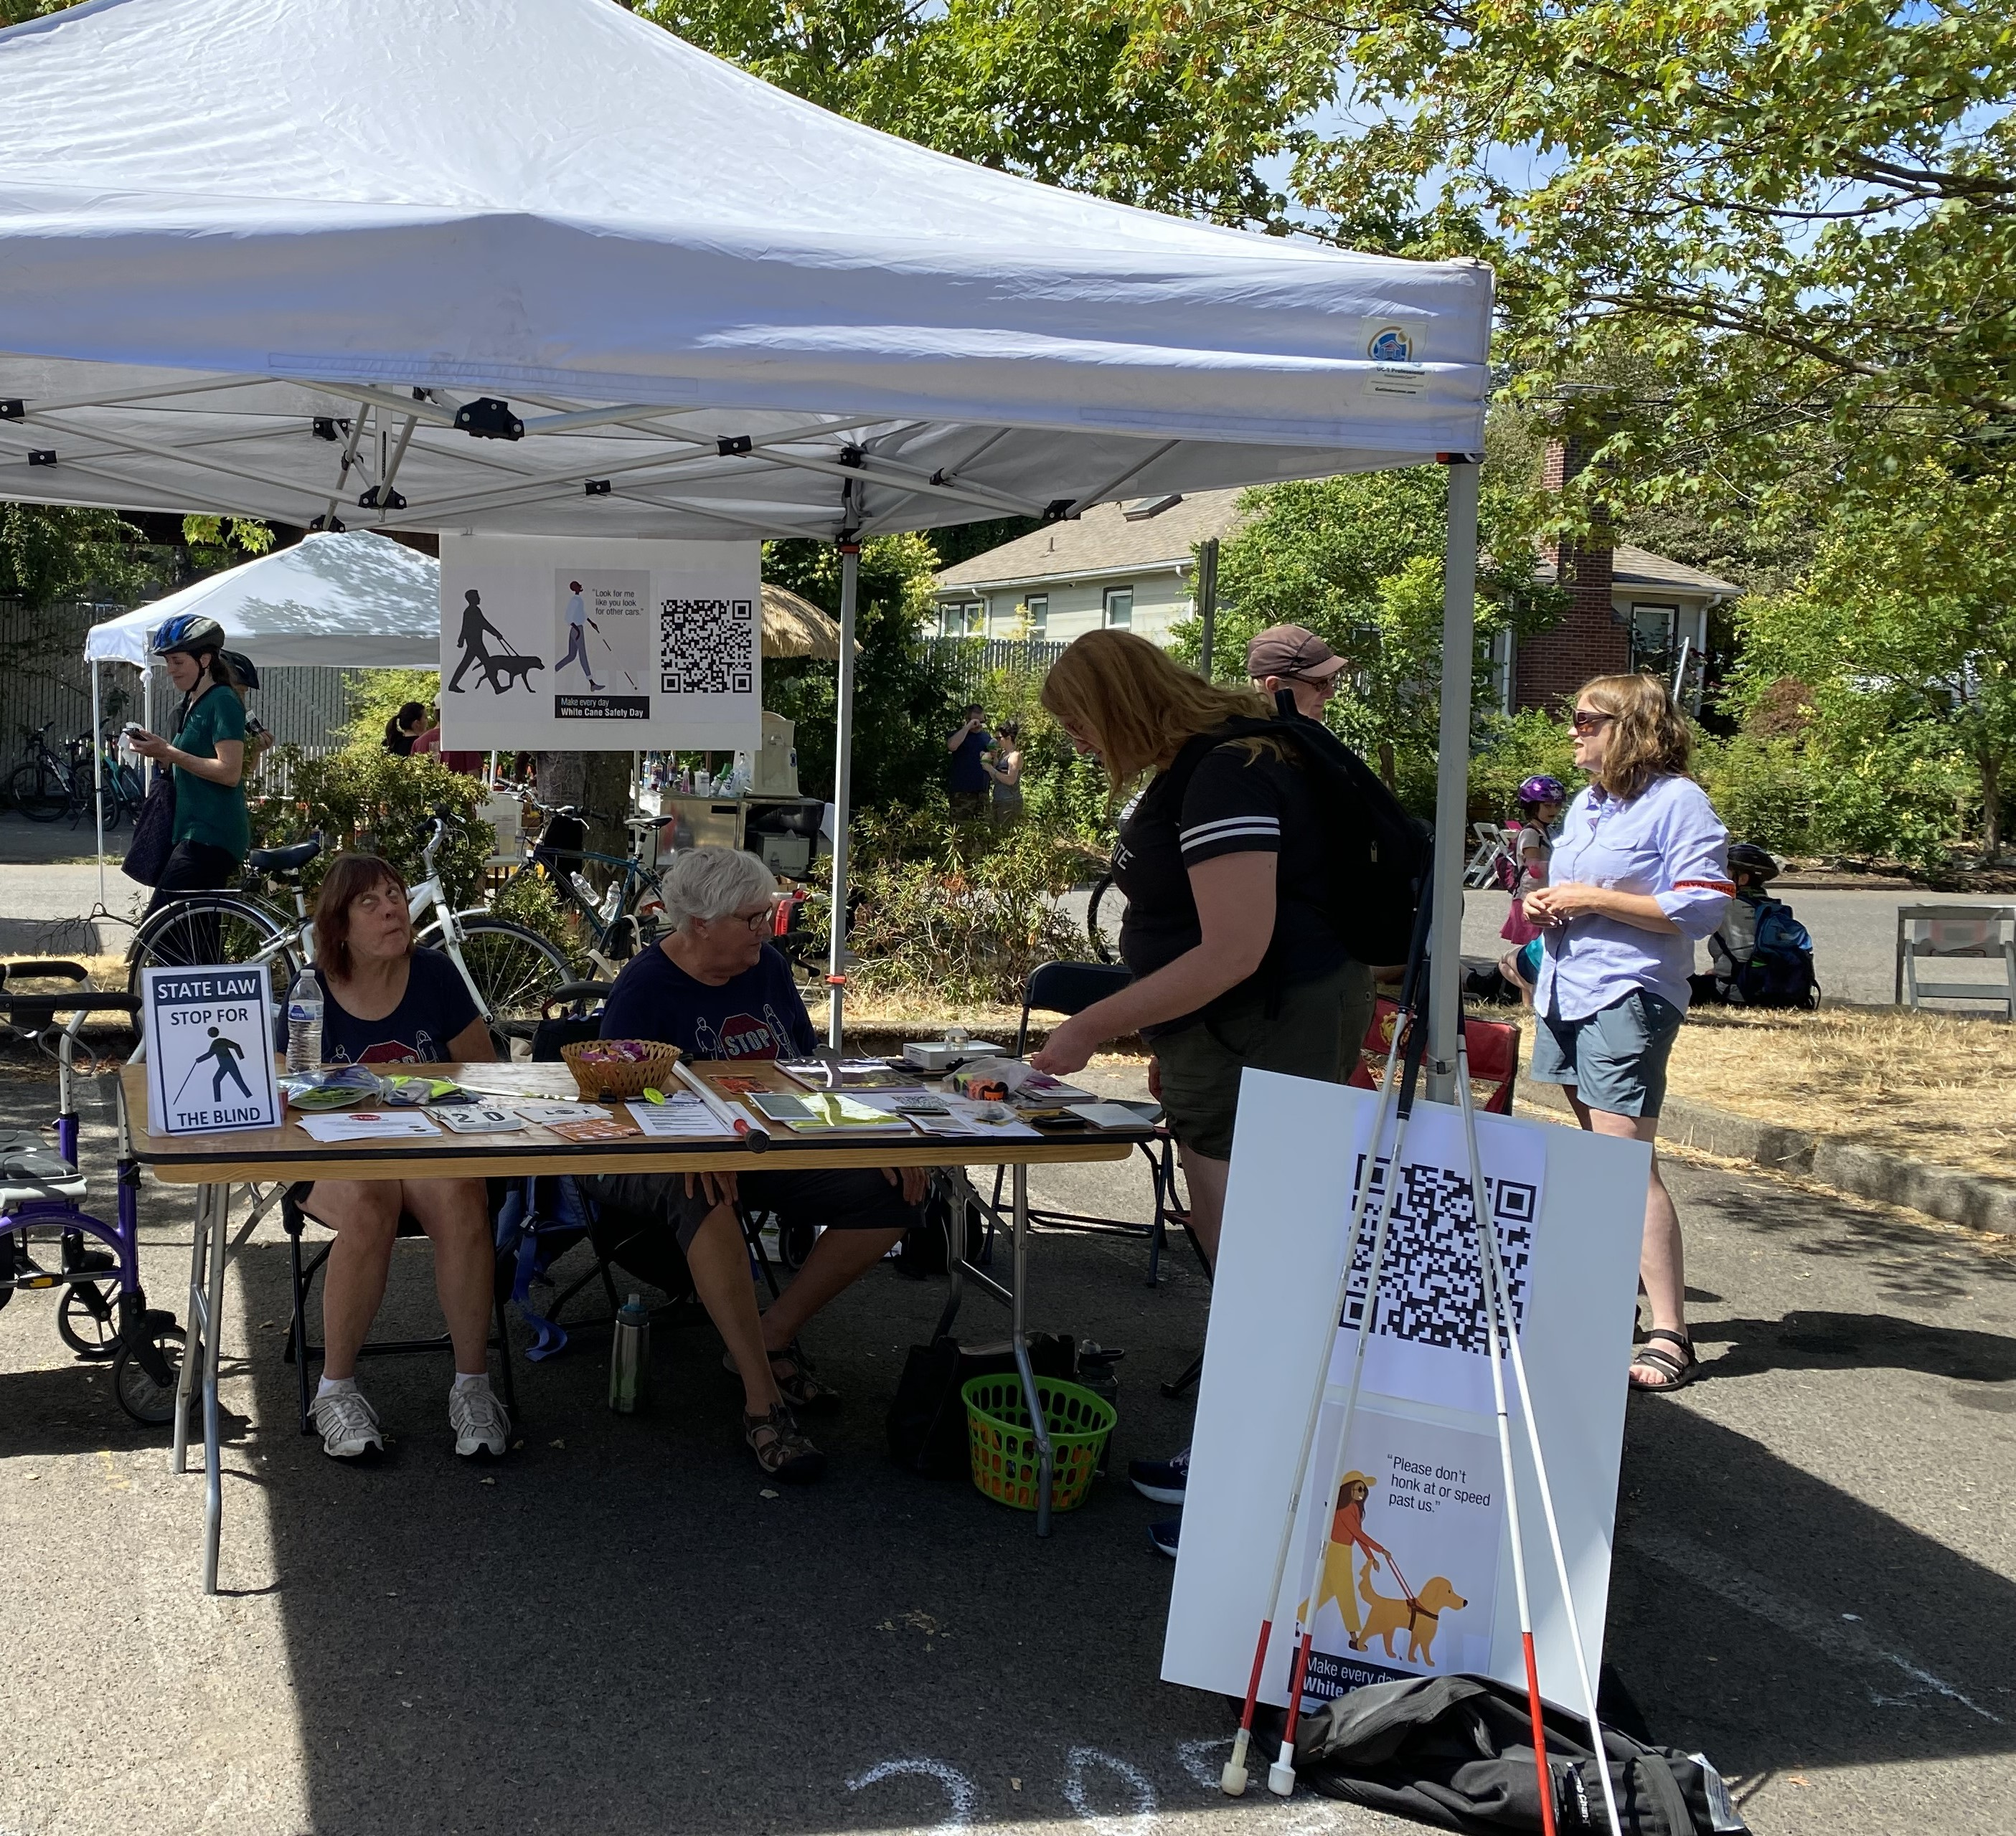
Many people still don’t understand what a white cane means.
Many white cane & guide dog users have been hit.
A designated day is important, but need white cane safety everyday.
Notes:
LBS – Should this also say Pop Quiz?

Slide 7
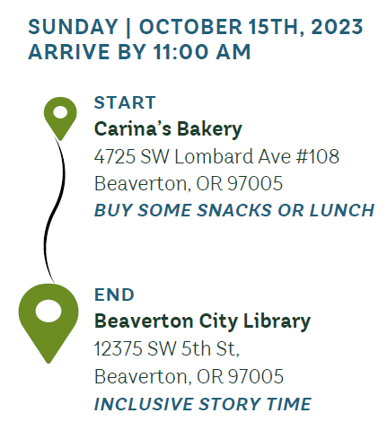
White Cane Safety Walk

Slide 8
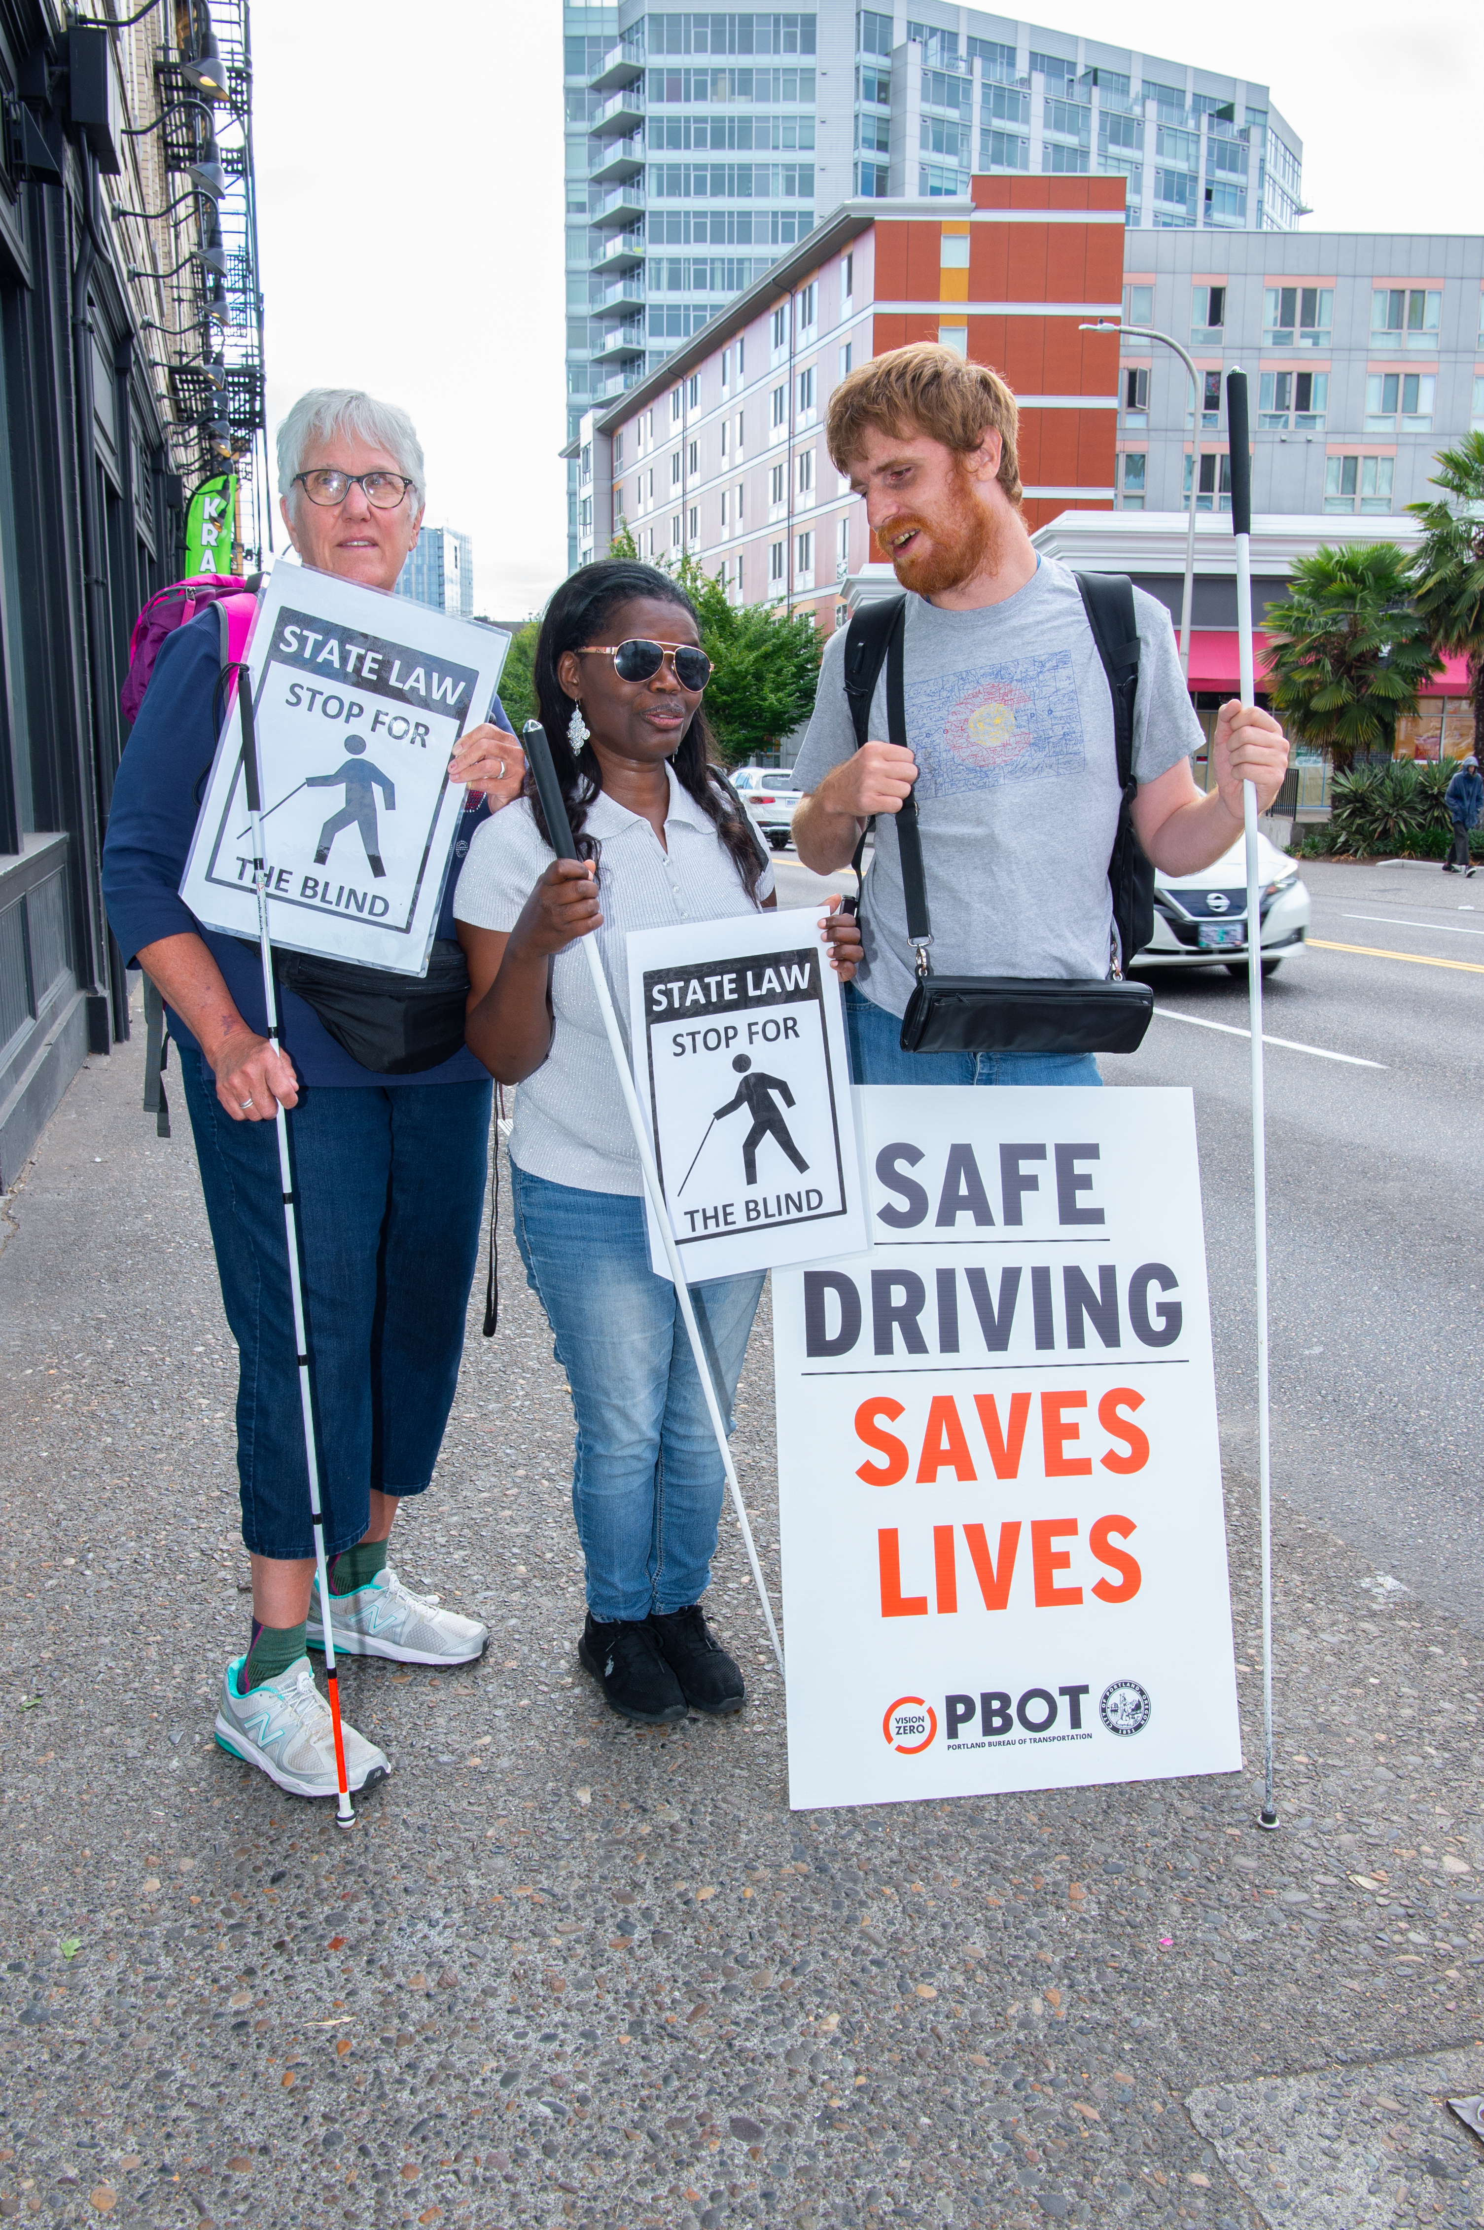
Thank You

