Slide 1
The Handling of the 2020 Protests and Riots in Portland, Oregon: An Independent Review
August 23, 2023
Nicholas E. Mitchell, Principal
Independent Monitor LLC

Slide 2
Scope of Work
The effectiveness of PPB's crowd management training
The City's response to the protests of 2020
The effectiveness of the Incident Command System, including criteria for unlawful assemblies or riots, authorizing munitions, and communication
Evaluating strategies used and not used
Evaluating communication and leadership
Other factors that impacted the City's response

Slide 3
Methodology
Reviewed PPB directives, standard operating procedures, and training materials
Honed in on 43 operational periods and analyzed operational plans, activity logs, force reports, arrest records, and after-action reports
Examined materials associated with administrative investigations into complaints about PPB officers
Analyzed extensive video of PPB officer conduct
Interviewed dozens of officers, command staff, community members, other Portland employees, elected officials, and regional partners

Slide 4
Key Facts
Protests in Portland from May 29 through mid-November
Large, generally peaceful crowds during the day, smaller crowds at night, with some engaging in violence or destructive behavior
The federal government sent more than 700 federal officers to Portland, which escalated street conflict
Police response largely Rapid Response Team ("RRT") though also Mobile Field Forces ("MFF")
More than 1,000 arrests, mostly for public order crimes

Slide 5
Key Facts
Protesters and officers experienced significant injuries
More than $15 million damage to public and private property
The City's response caused it to fall out of compliance with the DOJ consent decree
In June 2021, the members of the RRT resigned en masse after a member was criminally charged

Slide 6
Key Facts
PPB documented more than 6,000 estimated uses of force
Early uses of force led to restrictions imposed both by Mayor Wheeler and a federal judge
Other restrictions limited cooperation within Portland municipal government and with federal agencies

Slide 7
City Leadership and PPB Command
The City was not transparent with the public about its strategies, tactics, and munitions for public order policing, which set the stage for a loss of public trust
There was insufficient internal oversight of RRT by PPB executives
PPB executives did not visit the field or debrief with officers often enough in 2020
PPB leaders did not consistently prime officers with the rules of engagement before deployments
PPB leaders did not enforce consistent rules of engagement with protest crowds
The City did not do enough to preserve its network of mutual aid partners, despite warnings that the network was in danger of failing

Slide 8
The First Amendment and Use of Force
PPB relied too often upon civil disturbance declarations and riot control agents (“RCAs”)
PPB would have been better able to reduce its use of RCAs with crowd observation tools and methods that were not available in 2020
  Portland’s downtown video blackout
  Lack of plainclothes officers making crowd observations – need for stringent safeguards

Slide 9
PPB’s Use of the Incident Command System
The National Incident Management System (“ICS”) provides a unified approach for government organizations to collaborate in responding to domestic incidents
PPB benefited from significant in-house ICS expertise in running its command post, and the incident management team was structured according to ICS guidance
PPB did not prepare a sufficient number of command personnel to handle a long-lasting civil disturbance
The incident management team was not consistently effective as a learning organization throughout the Review Period

Slide 10
The First Amendment and Use of Force
PPB’s dispersal order warnings were often insufficient and not properly documented
PPB failed to implement key internal controls on the force used by officers
  PPB’s tracking of less-lethal munitions was insufficient
  PPB’s force reporting and review practices during the Review Period were inconsistent with its policies

Slide 11
The First Amendment and Use of Force
Key policy guidance authorizing certain types of force was inappropriate or imprecise
  PPB policy did not address dynamics, bull rushes, and baton pushes
  PPB’s threshold for use of area impact munitions, or rubber-ball grenades, was too low
  PPB directives authorized officers to use FN303 and 40mm projectiles to “avoid the use of a higher level of force”
  Officers were authorized to use OC spray when a person “indicate[d] the intent to engage in physical resistance”

Slide 12
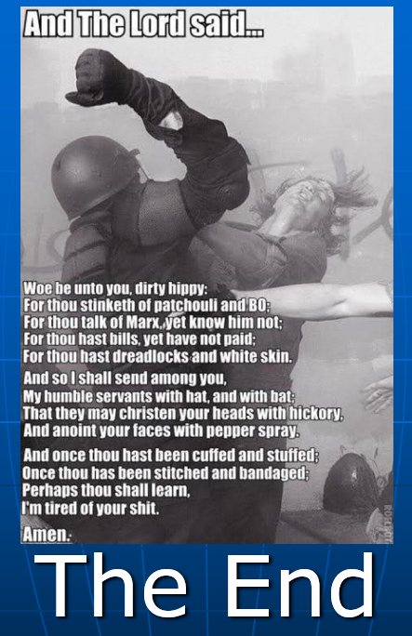
The Effectiveness of PPB’s
Public Order Training
The City did not provide sufficient oversight of PPB’s public order training
PPB provided insufficient guidance in RRT training about when force was authorized and prohibited
PPB did not adequately train Mobile Field Forces officers
PPB did not sufficiently address de-escalation and procedural justice in its training

Slide 13
Recommendations
The City must rebuild its mutual aid network
PPB must dramatically reduce its reliance on crowd dispersals with RCAs, like CS gas, at public order events
PPB must strengthen and clarify its public order and use of force directives
The City must ensure that PPB directives related to internal controls during public order events are followed
The City must create a new specialized public order team consistent with emerging standards for advanced public order units

Slide 14
Recommendations
The new public order team must be rigorously scrutinized by PPB executives, overseen by Portland’s new oversight agency, and transparently introduced to the public
The City must continue to improve its public order training program consistent with recent National Tactical Officers Association standards
PPB policy should require chiefs to be engaged with and visible to officers in the field during public order deployments, when possible

Slide 15
Recommendations
PPB should prepare a deep bench of leaders to serve as incident commanders and operations section chiefs
PPB should develop a pre-operational briefing checklist and hold supervisors accountable for providing comprehensive briefings to officers before public order deployments
PPB should formalize the debriefing process for public order deployments
The City should produce a detailed self-assessment in 180 days reflecting the steps it took to implement these recommendations

