Slide 1
S Macadam Ave
Ken Ackerman, P.E.
Design Principal
August 2, 2023

Slide 2
Distribution Main Program
Approximately 2,250 miles of water main
Over one million linear feet of distribution pipe recommended for replacement by 2040
Main replacement goal of 50,000 ft/yr
Main replaced by crews and contract projects
Contractor Mains Projects will:
increase footage replaced to meet asset management goal
provide different size contract opportunities to the community

Slide 3
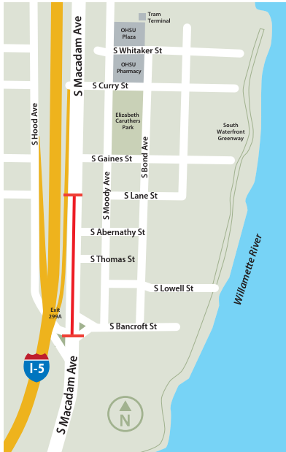
Why this project
Main is 130 years old and has been repaired 3 times in last 10 years
High consequence of failure
Project will:
Replace 1,000 feet of 24-inch cast iron main
Install 2 fire hydrants improving fire coverage
Some night work to limit traffic impacts
The new pipe will mitigate risk and help make sure water is safe and reliable for generations to come.

Slide 4
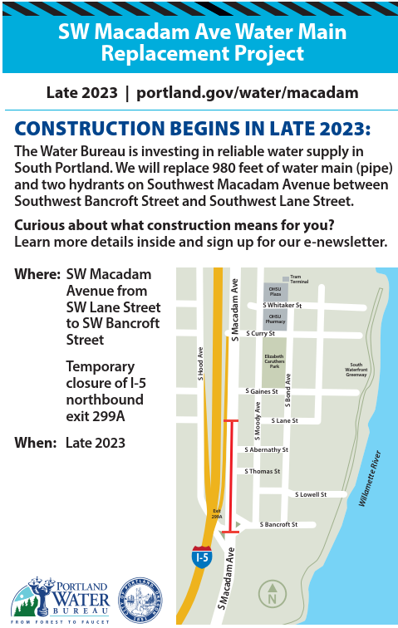
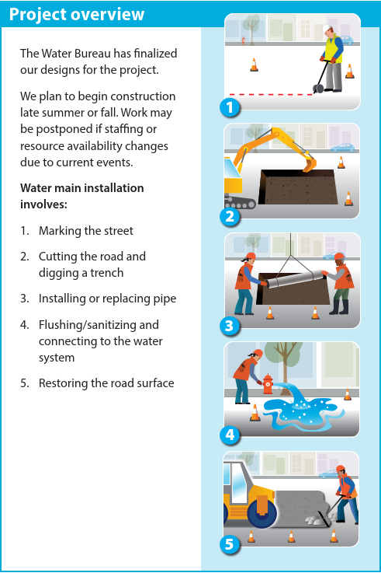
Outreach
Began at project initiation
Established webpage
Sent mailers, notification letters and postcards
Published on social media
Distributed project flyer to business and community

Slide 5
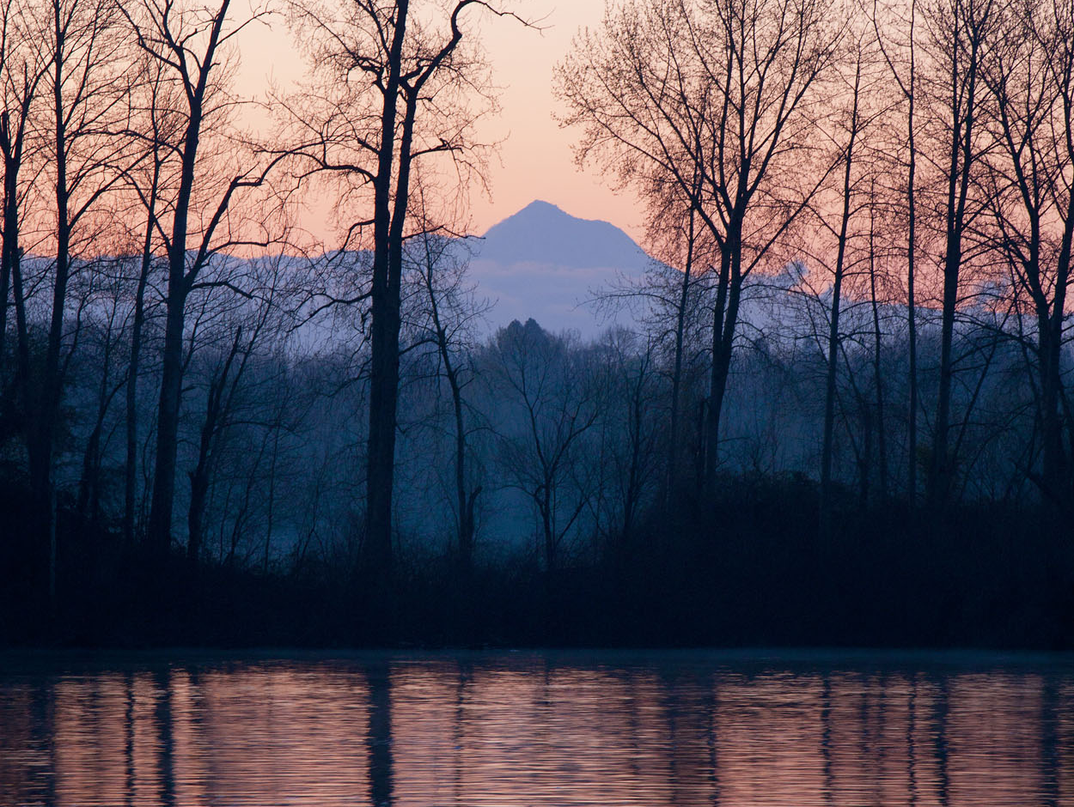
Questions
For more information, contact:
Ken Ackerman
503 865-6738
Website: www.portland.gov/water/Macadam

