Slide 1

Springwater Wetlands and Floodplain Ordinances
E07383
Tressie Word| Project Manager | Bureau of Environmental Services
Muriel Gueissaz-Teufel| Engineering Manager 8/2/2023
Mingus Mapps, Commissioner
Dawn Uchiyama, Director

Slide 2
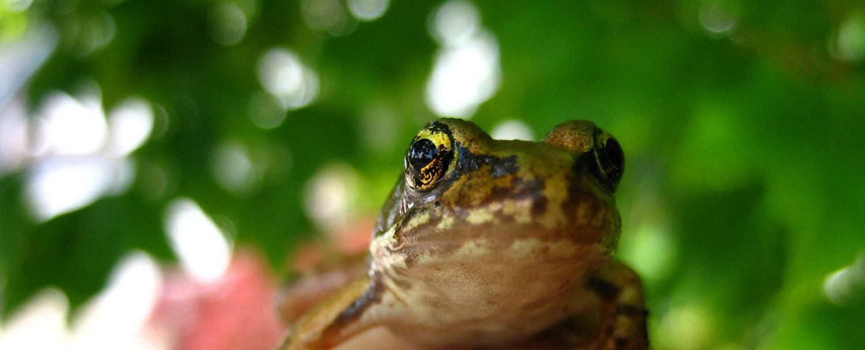
Brief Summary
Project Requirements
Project Objectives
Project Overview
Project Budget
  Grant
  Design
  Construction
Project Schedule
Discussion

Slide 3
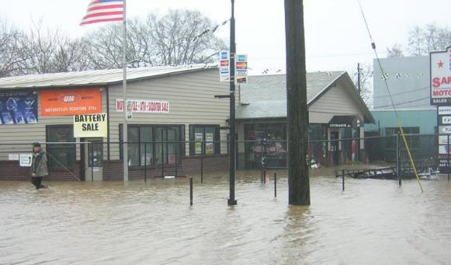
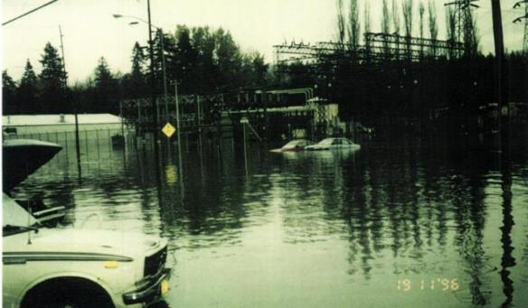
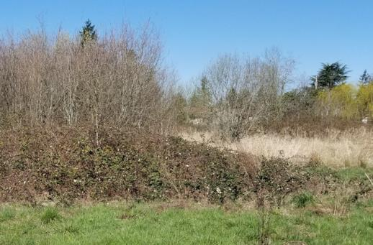
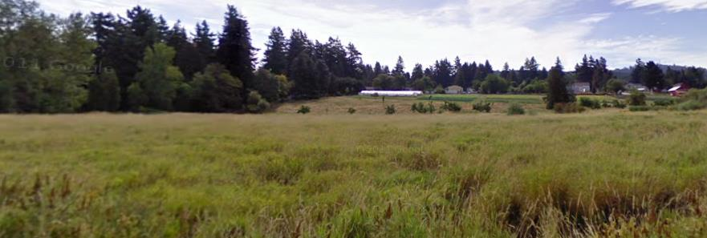
Project Requirements
Flooding
Contaminated, non-native fill
Limited access to nature and nearby centers
Invasive plants in and around the wetlands

Slide 4
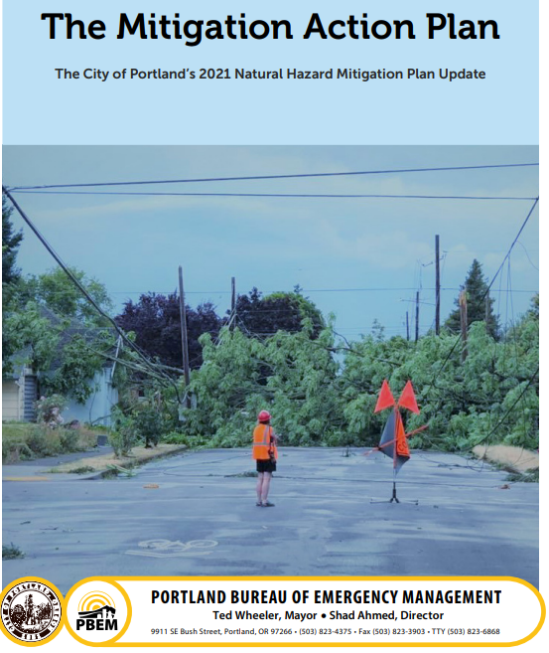
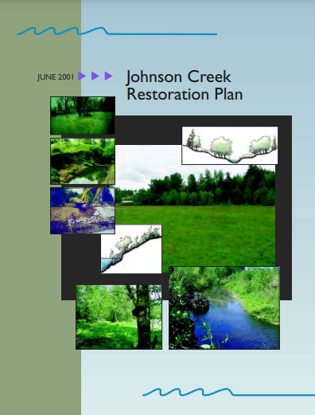
Project Requirements
Flood Risk Reduction
Johnson Creek Restoration Plan
City of Portland 2021 Natural Hazard Mitigation Plan
  $7.1M Federal Emergency Management Agency Grant (in-progress)
Lents Collaborative Declaration of Cooperation
Neighborhood Connections
2035 Comprehensive Plan​
Transportation System Plan​
Portland Bicycle Plan​
Safe Routes to School​
PedPDX

Slide 5
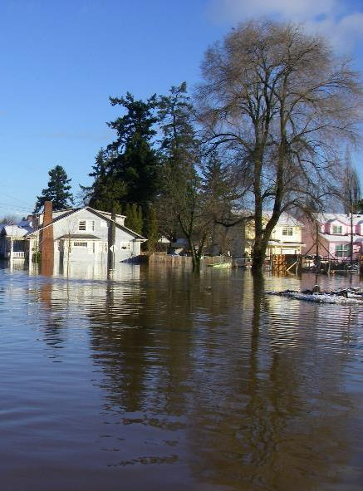
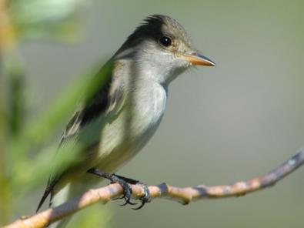
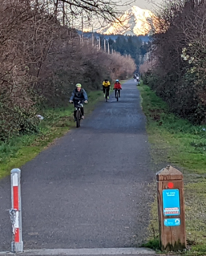
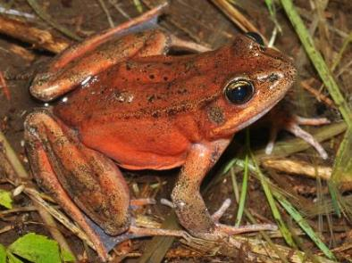
Project Objectives
Relieve local flooding
Enhance habitat, water quality and watershed health
Improve community access to nature
and nearby centers
Emergent

Slide 6
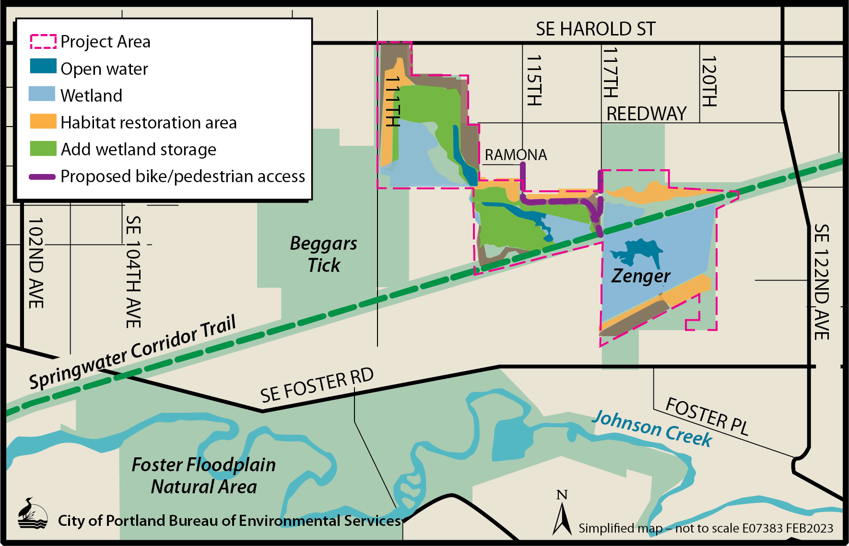
Project Overview

Slide 7
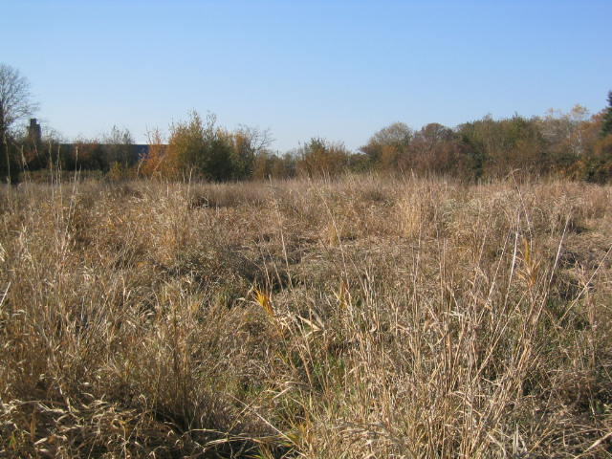
Project Overview
Lents and Powellhurst-Gilbert neighborhoods
  High social vulnerability index
  Racially and ethnically diverse
  Large numbers of households
    English not spoken as a first language
    Low-income families
    Children
  Outreach focus
    Multiple languages
    Flood map changes

Slide 8
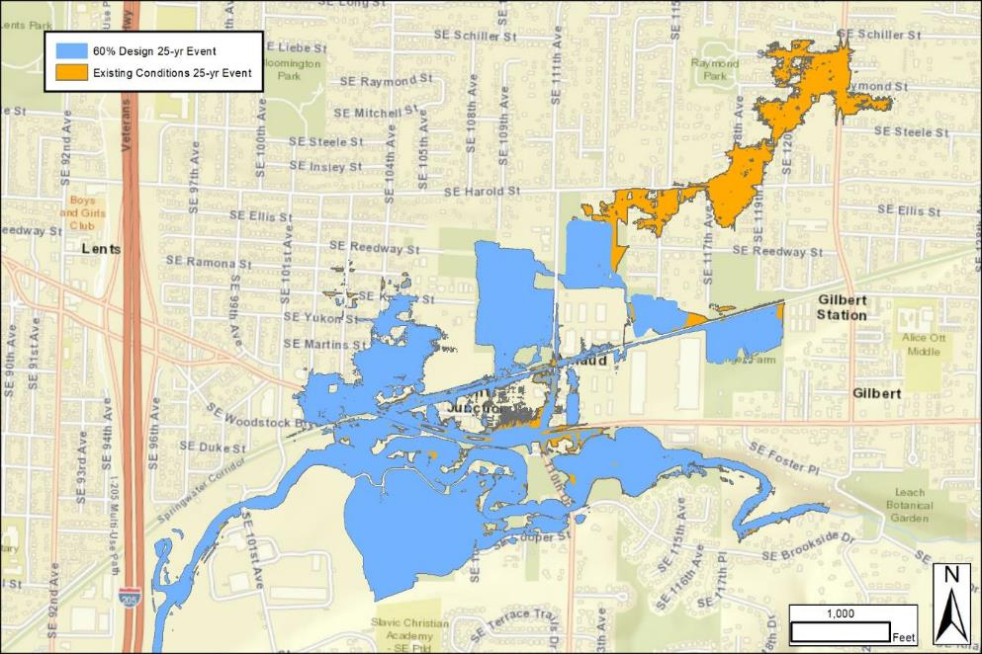

Project Overview
Existing and future local floods
Project hydraulics:
Reduce flood risk in underserved communities
  Climate change may increase flood frequency
  Contains flood water on City property
Expand wetlands
Improve water quality
Future Conditions 25-Year Event
Existing Conditions 25-Year Event
^{Future}

Slide 9
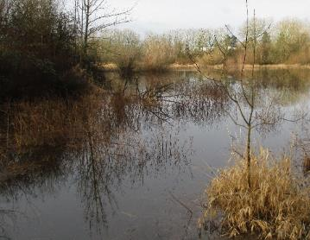
Project Budget - Ordinances
Grant: Increase potential FEMA award to $7.1M
  Federal cost share increased from 75% to 90%
  Approval at second reading last week
Construction: $6,028,000 Special Prequal Invitation to Bid
  Wetland restoration: 30 acres
  Handling and disposal of contaminated soil: 12K CY
  Bike and pedestrian trail: 500 FT
  Educational areas with WPA features: 4 EA
Design: Add $206K to contract, $1.44M total,
44% increase, 24.78% DMWESB
  Include newly acquired low-lying property to maximize flood benefit
  Extend permit support
  Add community outreach regarding flood map changes
  Incorporate cost escalation

Slide 10
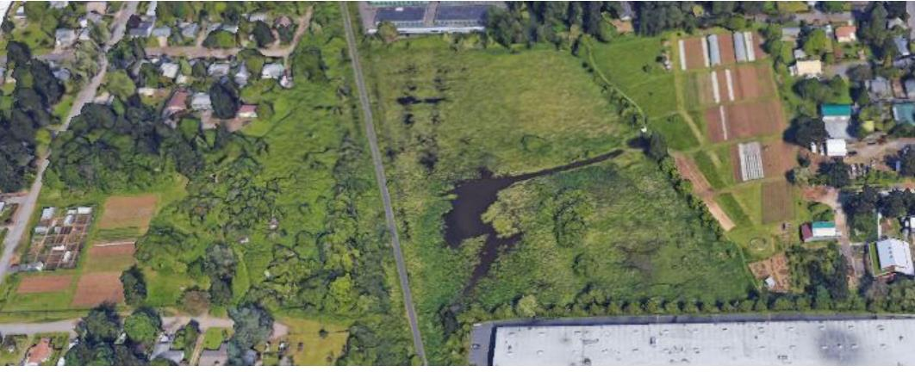
Project Schedule
Source: zengerfarm.org
Advertise: August 2023
FEMA Grant Decision Anticipated: January 2024
Construction: March 2024

Slide 11

Questions
Thank you!

