Slide 1
Springwater Wetlands Restoration Grant E07383
Muriel Gueissaz-Teufel | Engineering Manager | Bureau of Environmental Services
7/19/2023
Mingus Mapps, Commissioner
Dawn Uchiyama, Director

Slide 2
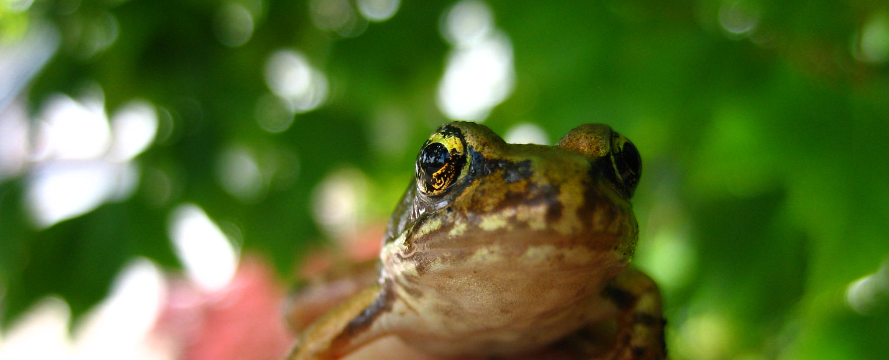
Brief Summary
Project Requirements
Project Objectives
Project Overview
Project Grant Budget
Project Schedule
Discussion

Slide 3
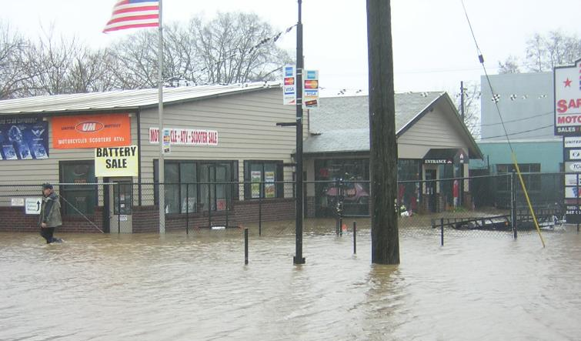
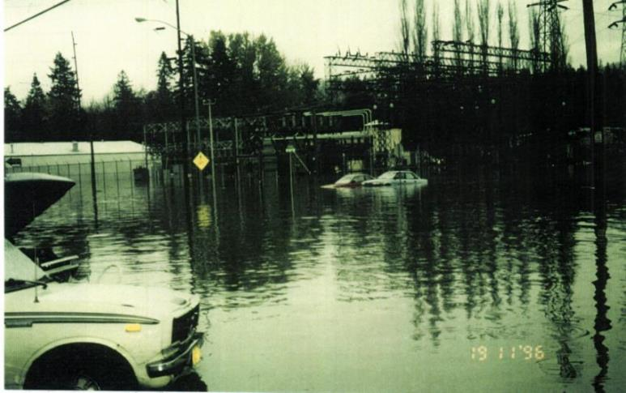
Project Requirements
Flooding
Contaminated, non-native fill
Limited access to nature and nearby centers
Invasive Plants in and around the wetlands

Slide 4
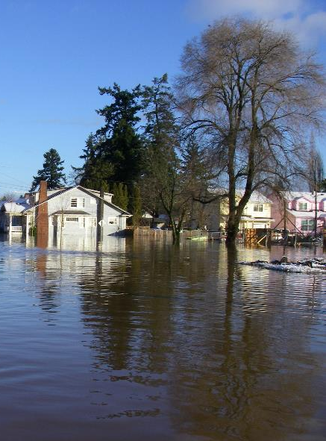
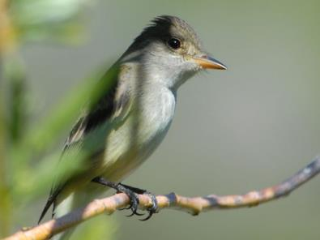
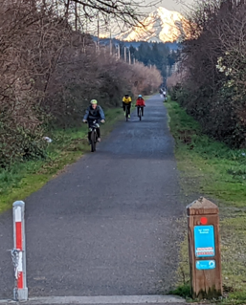
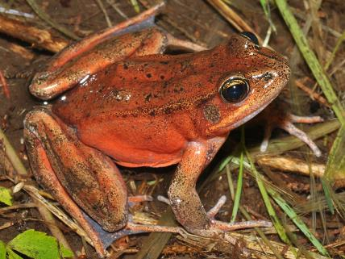
Project Objectives
Relieve local flooding
Enhance habitat and watershed health
Improve community access to nature
and nearby centers
Emergent

Slide 5
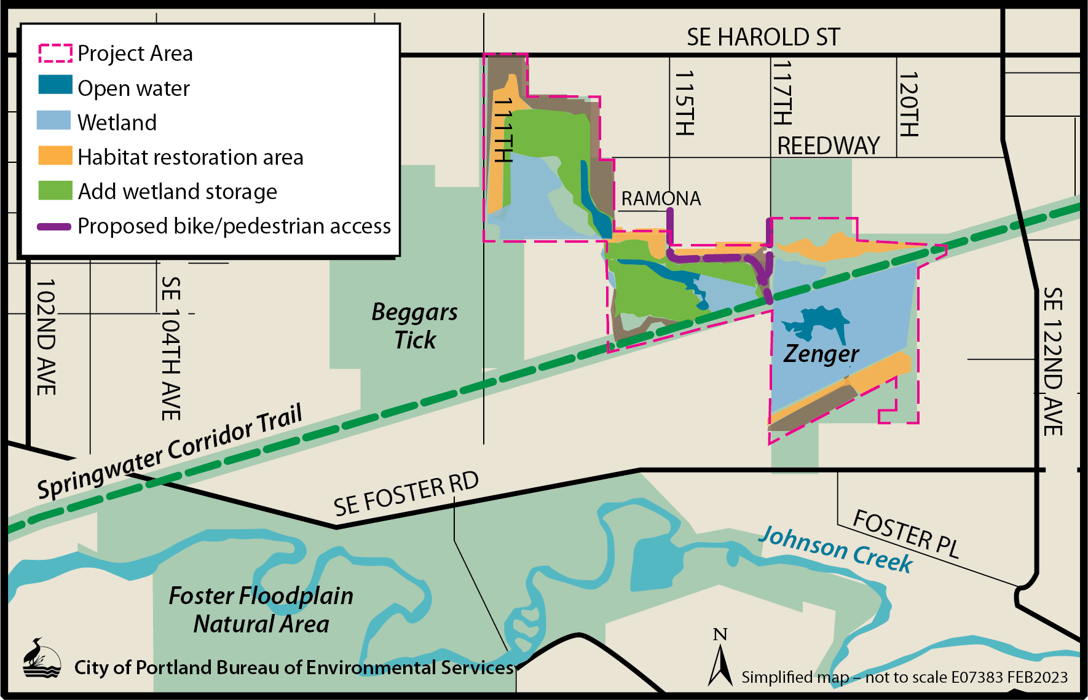
Project Overview

Slide 6
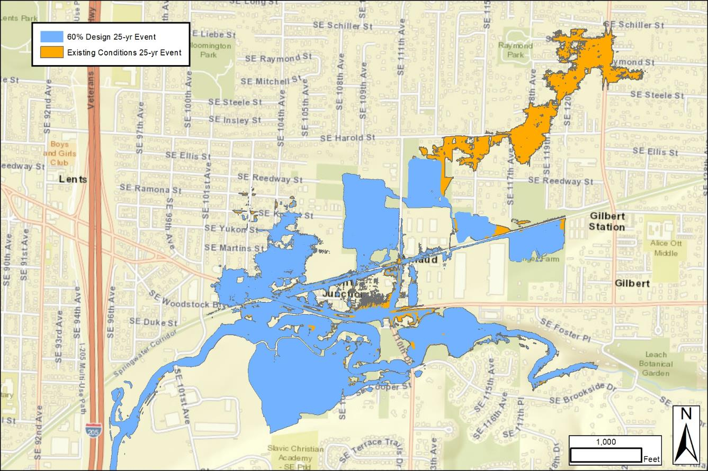
Project Overview
Existing and future local floods
Future Conditions 25-Year Event
Existing Conditions 25-Year Event
^{Future}

Slide 7
Project Grant Budget
Increase potential Federal Emergency Management Agency Hazard Mitigation Grant Program award to $7.1M
Council already authorized up to $5.6M
Federal cost share increased from 75% to 90%
Per the March 2022 Consolidated Appropriations Act

Slide 8
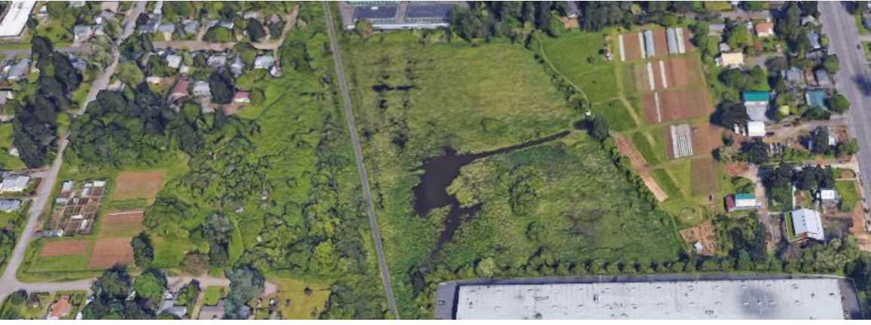
Project Schedule
Source: zengerfarm.org
Advertise: August 2023
FEMA Grant Decision Anticipated: January 2024
Construction: March 2024

Slide 9
Upcoming Council Actions
Professional Services Amendment
Authorization for competitive solicitation for construction

Slide 10
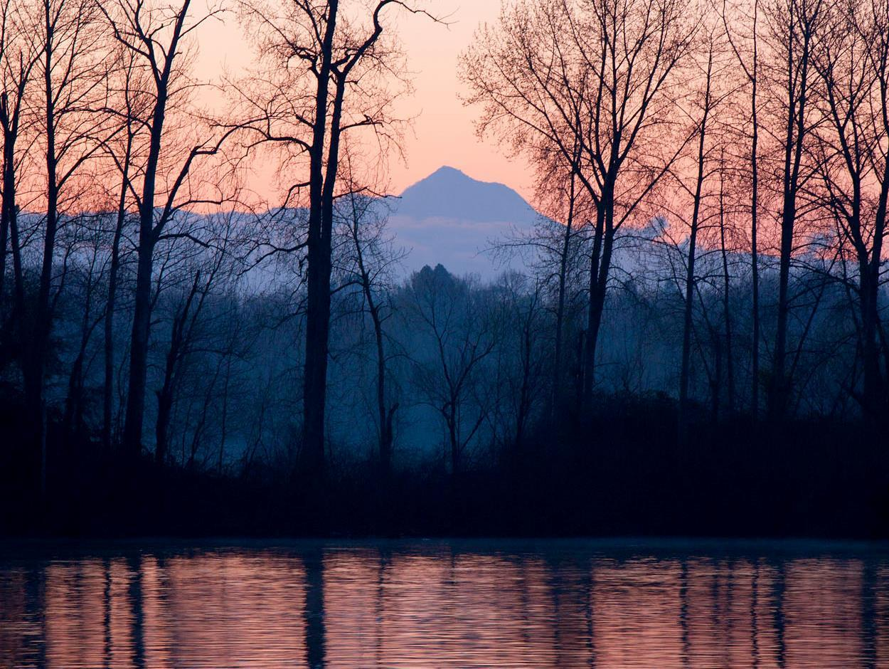
Questions
Thank you!

