Slide 1
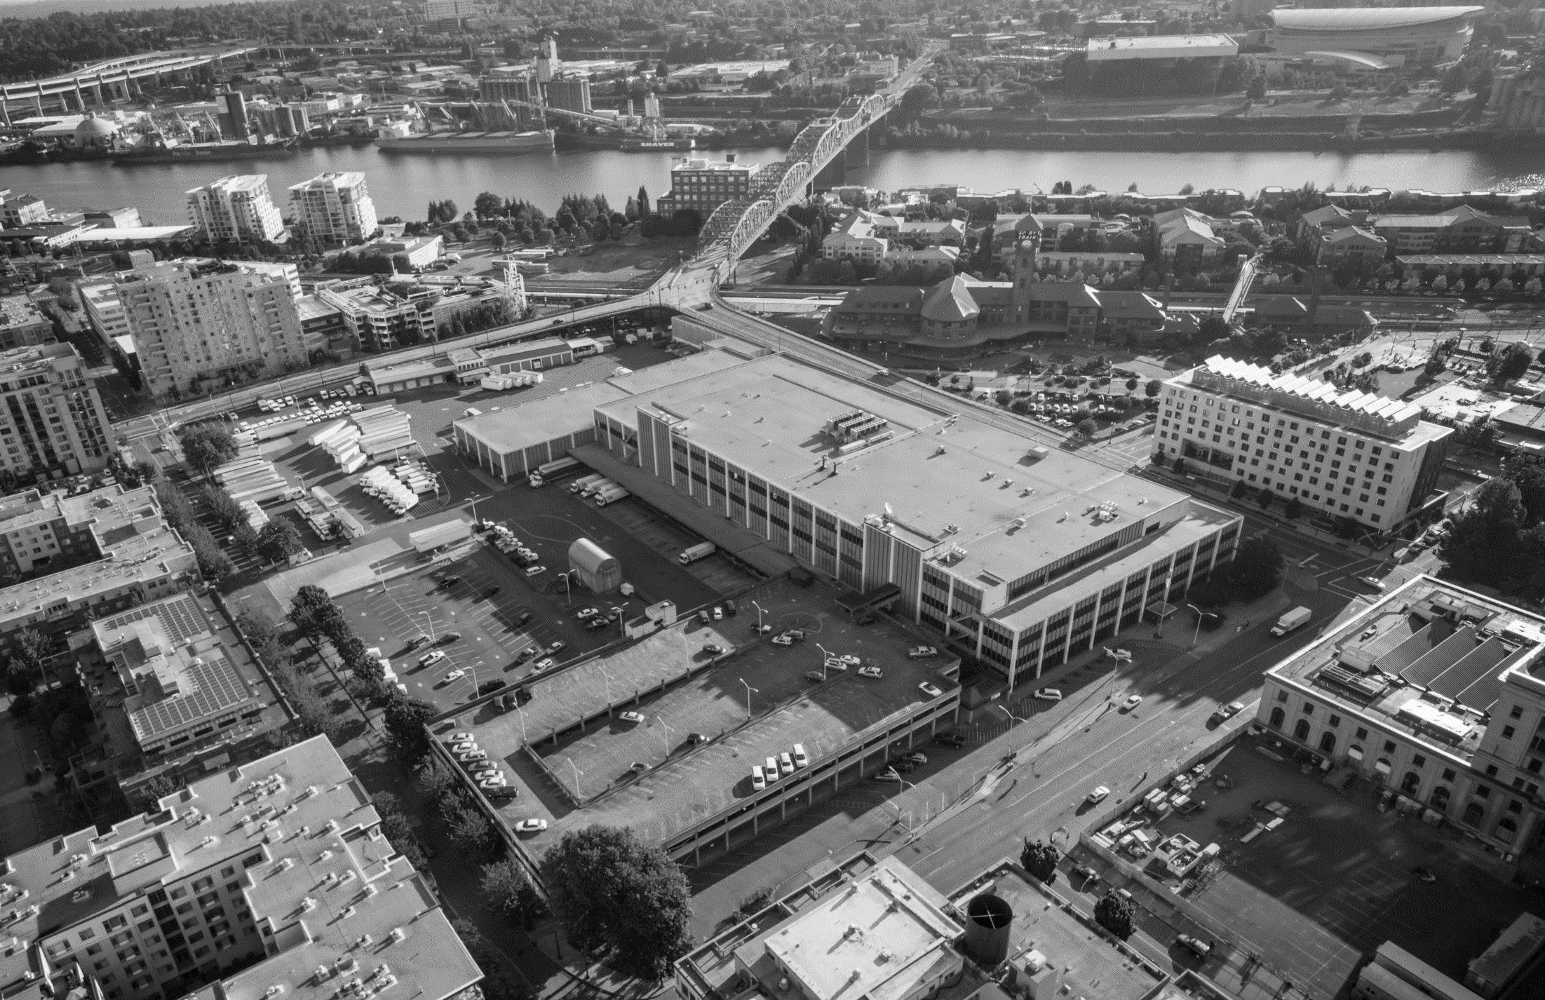



Authorization of Intergovernmental Agreements
July 19, 2023
Notes:
Good afternoon, Mayor Wheeler and Commissioners.
I'm Kimberly Branam, Executive Director of Prosper Portland.
I'm joined by Molly Rogers, Interim Director of Portland Housing Bureau, Matt Gierach, City of Portland Debt Manager and Sarah Harpole, Prosper Portland’s senior project manager for Broadway Corridor.
We are pleased to be back with you today to seek your approval of two critical agreements that move forward the development of the Broadway Corridor.

Slide 2
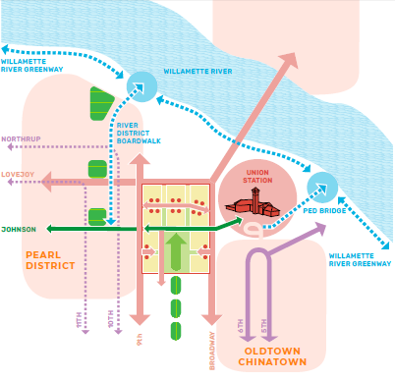
Action
Authorize two Intergovernmental Agreements (IGAs) necessary to further the redevelopment of the Broadway Corridor:
OMF/Prosper Portland: restructuring and repayment of debt incurred by the City in support of the acquisition of the USPS Property and construction of new streets
PHB/Prosper Portland: utilization of development rights for the purpose of delivering affordable housing units
Notes:
Our presentation addresses both actions before you today – so I’ll provide some background context on the over all project and then dig into the elements of the IGA between OMF and Prosper Portland to restructure the repayment of debt incurred by the City related to this project – and then Molly will speak to the IGA between Portland Housing Bureau and Prosper Portland to articulate how our joint ownership will move into PHB’s specific development rights in order to deliver affordable housing units.
Sarah and Matt are also prepared to responding to any questions you might have as we walk through the presentation – and have been key authors of the IGAs, along with:
Thank you:
PHB: Molly Rogers, Tanya Wolfersperger, Kate Piper (and many former PHB staff)
Prosper: Tony Barnes, Hope Whitney, Sarah Harpole
OMF: Matt Gierach, Brigid O’Callaghan, Patti Tigue
City Atty: Wendy Hain,

Slide 3
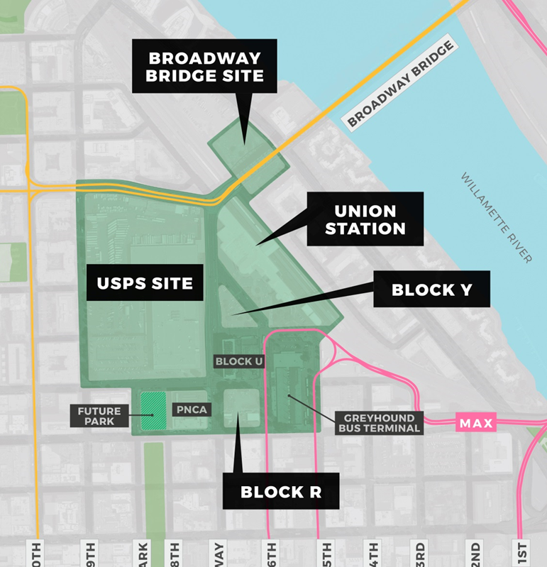
Context & Background
Notes:
Let’s start with a reminder of what we mean when we talk about “Broadway Corridor”
The Broadway Corridor is a 34-acre district – in green on the slide – that includes:
The 14-acre USPS site – jointly owned by Prosper Portland the Portland Housing bureau
As well as Prosper Portland owned development opportunity on Block R and the Broadway Bridge Site, where the Oregon Harbor of Hope is currently located
It also includes Union Station – owned by Prosper Portland
The former Greyhound Bus Terminal, PNCA and
The adjacent future park block owned by Portland Parks & Recreation.
So, this is an area with a lot of development potential – in the heart of our city. We’ll do our best to differentiate between the Broadway corridor development area and the agreements that are specific to the USPS site.

Slide 4
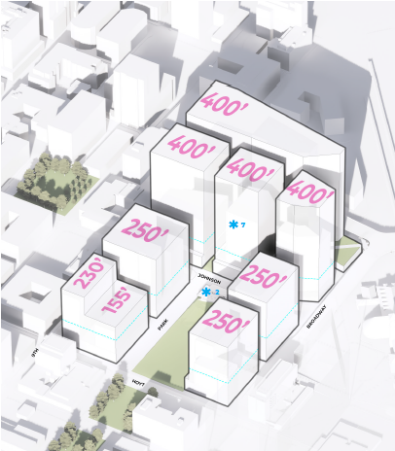
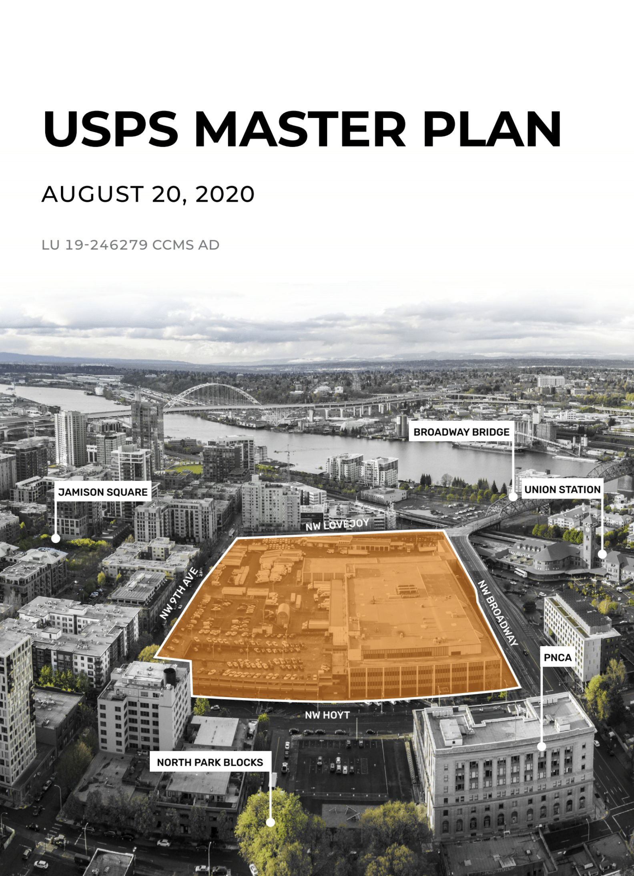
Where We’ve Been
Framework Plan
Developer RFQ & Selection
Agreement Negotiations
Acquisition
STEERING COMMITTEE
2015
COMMUNITY ENGAGEMENT
2022+
Preferred Concept Selection
Project Vision
Development Planning
Council authorized increased zoning entitlements
Approved Master Plan
Notes:
Redeveloping the Post Office site has long been a goal of the City of Portland – going back to at least the 1988 central city plan. In the Central City 2035 plans the site was identified as perhaps the most significant opportunity within Portland’s Central City.
In October of 2015, City Council approved the Broadway Corridor Framework Plan, authorized a line of credit of up to $40M to acquire the site, and established high-level expectations for the site – including that 30% of the residential units would be affordable.
In partnership with Portland Housing Bureau, Prosper Portland then acquired the site in 2016 for an acquisition price of $88M, which was used by USPS for relocation to Collwood Industrial Park
With the aim of applying lessons learned from our past large-scale public/private partnership and ensuring equity and inclusion were at the core of this development planning processes, we convened the Broadway Corridor Steering Committee.
Comprised of 37 people representing a diversity of community, private and non-profit organizations, geographies and lived experiences, the Steering Committee advised on goals for the project including selection of a development partner, the physical concept for the site, and priorities for mix of uses, equitable engagement, and community benefits.
The Master Plan for the USPS site that resulted from this process reimagine to central portion of Broadway Corridor into a welcoming 21st century, mixed use urban district for new Portlanders and those whose families and communities have long ties to the district .
Connecting the Pearl and Old Town/Chinatown, development of the USPS Property could house between 1,800 to 2,400 new households and support between upwards of 4,000 new jobs.
If this growth needed to be absorbed into other locations in our region, it could take 400 acres of land and hundreds of millions of dollars of infrastructure investments to serve this same number of jobs and families with greater climate and transportation impacts for our region.

Slide 5



Implementation Authorizations
Master Plan Land Use Approval
Established required infrastructure, open space, min/max development density
Approved by
Design Commission
August 2020
Funding & Finance Plan
  Established public funding and finance for extraordinary site conditions and community benefits
Funding & Finance Plan approved by City Council September 2020
LID approved by City Council October 2020
Infrastructure IGAs approved by City Council May 2022
  Directed restructuring debt with General Fund support up to $15M
Disposition & Development Agreement + Community Benefits Agreement
Establish terms and conditions for private development and delivery of community benefits
Negotiations Pending Development Partner(s)*
*Maintaining commitments on public demo and infrastructure projects
Notes:
In 2020, following this extensive planning and community engagement process, two key approvals were reached:
Design Commission approved the Master Plan setting forth infrastructure and development requirements; and
City Council approved the Funding & Finance Plan establishing the public investment commitments to carry out this vision.
Subsequently, City Council has also authorized the Local Improvement District (2020) and Infrastructure IGAs (2022) flowing from this public investment and financing commitment.
City Council’s approval of the Funding & Finance Plan in 2020 also directed the use of up to $15M in General Fund resources in the restricting of debt used for the initial acquisition of the property, which is captured in the Prosper Portland/OMF IGA before you today.
Future approval milestones will include authorization of the terms for the sale and redevelopment of development parcels within the USPS site and the delivery of community benefits in partnership with this private development.

Slide 6
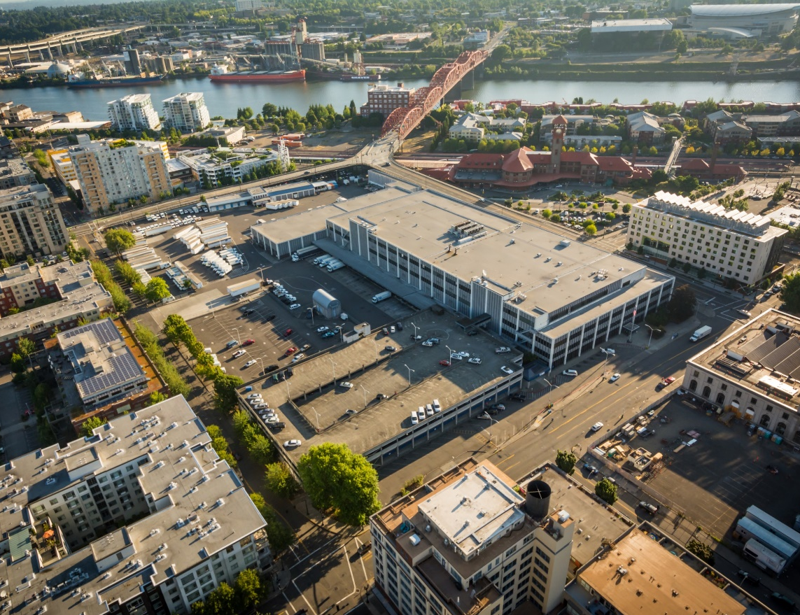
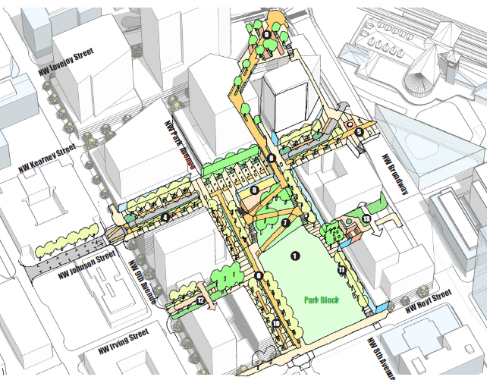
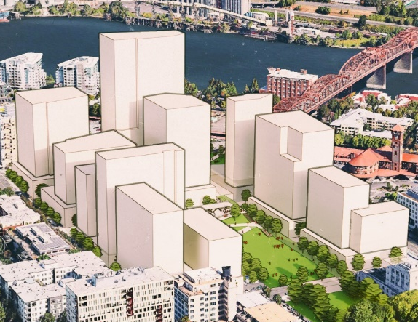
Public-Private Partnership
Prosper Portland
Site Acquisition & Preparation
Vision & Master Plan
Infrastructure Investment
Community Benefit Negotiations & Delivery
Private Development Transactions
City of Portland
Master Plan Approval
Infrastructure Investment, Contracting & Ownership; Community Benefit Delivery
Debt Financing
Affordable Housing Development Rights & Investment
Vertical Developers
Market-rate Development (Prosper)
  Inclusionary Housing
  Infrastructure Investment
  Community Benefits Delivery
Affordable Housing Development (PHB)
  Infrastructure Investment
  Community Benefits Delivery
Notes:
A vision this large truly requires a public-private partnership.
Prosper Portland has led site acquisition, planning, and site preparation – and will negotiate the terms of private development and community benefits looking forward.
The City has informed and approved infrastructure and open space requirements; provided investment of SDCs and debt financing; established affordable housing metrics and secured affordable housing development rights
Success will also be dependent on future partnerships with market-rate and affordable housing development partners.

Slide 7
Current
Status
Notes:
So where are we today?

Slide 8
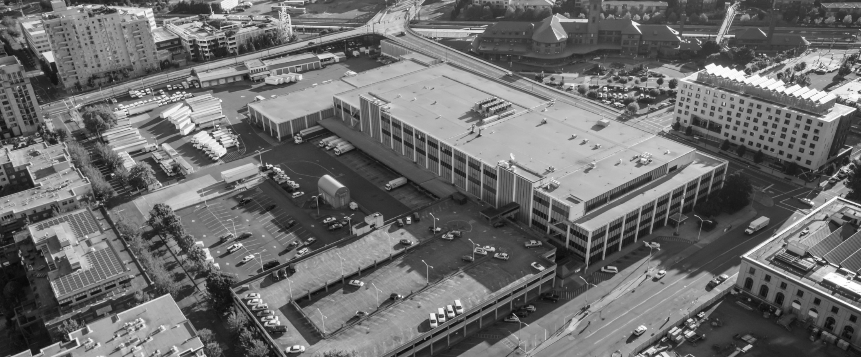
Demolition & Sitework (2020-2023)
Project Components
Scope 1.
Vehicle Maintenance Facility Demolition & Hot Spot Soils Remediation (COMPLETED)
Scope 4.
P&DC Demolition (UNDERWAY)
Scope 3.
Soils Remediation & USPS Truck Access (COMPLETED)
Scope 2.
Interim USPS Retail
(COMPLETED)
Completed Projects (Scopes 1-3):
58% construction dollars have been earned by certified MBEs; Total Contract Value = $5.8M
50% of hours were worked by BIPOC individuals
Demolition Project Underway (Scope 4)
97% construction dollars are contracted to certified MBEs; Contract Value = $30.4M
Workforce hours ongoing
Access RFPs here:
https://bidlocker.us/a/prosperportland/BidLocker
Notes:
Once complete at the end of this year, Prosper will have invested an estimated $42M in site preparation (hard + soft costs). True to our vision, this investment has benefited and helped to create wealth within our diverse community. (see stats on slide)
Completed projects include:
Vehicle Maintenance Facility Demo (Not covered by the CBA/RWEA)
McDonald Excavating (MBE)
$983,703
Interim USPS Retail (Not covered by the CBA/RWEA)
O'Neill Walsh Community Builders (Not Certified)
$4,020,285
Soils Remediation & USPS Truck Access
Northwest Infrastructure (MBE)
$677,000
Underway: P&DC Demolition = $30.4M
Northwest Demolition & Dismantling (MBE) / Raimore (MBE)
Business Equity = ~97% proposed
Workforce Equity & Apprenticeship = TBD but seeing impressive performance to-date

Slide 9
Critical Path to Site Readiness
Ph 2. Development (2030+)
  Affordable Housing Ph. 2
  Remainder of Private Development
Site Prep
(2021-2023)
  Demolition
  Soils Remediation
Ph. 1 Development
(2024+)
  Affordable Housing Ph. 1
  Private Development
  Relocation of USPS Retail
Infrastructure
(2023-2024)
  NW Johnson & NW Kearney
  Off-Site Utilities
Site Prep & Infrastructure Ph. 2 (~2030)
  Garage Demolition
  NW Park Avenue
  Park
  Complete Green Loop
Notes:
Site preparation work will be immediately followed by construction of new streets starting next spring – both of which are the critical path to both market rate and affordable housing development
We anticipate the site will build out over the next 15-20 years and will include a future second phase of demolition and infrastructure work.

Slide 10
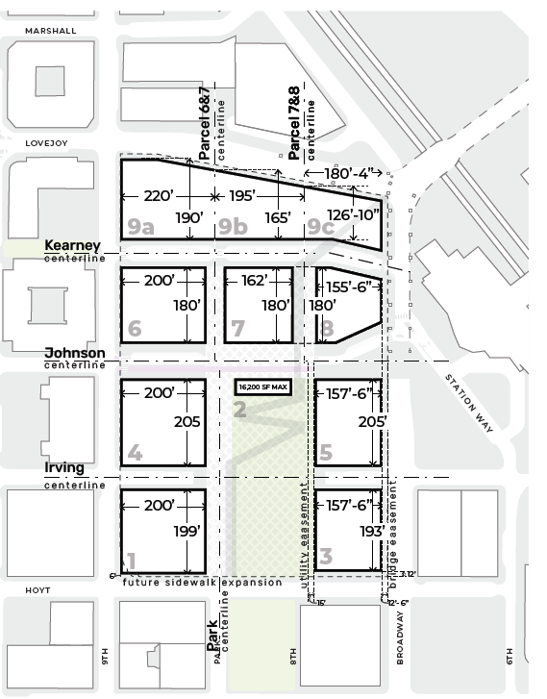
Related / Melvin Mark
12-month Exclusive Negotiation Agreement
Prosper Portland
  Contribute $50k match for certain predevelopment work
  Continued economic & market analysis and support for downtown, including Broadway Corridor
Related / Melvin Mark
  Commercial and residential development pro formas
  Assessment of CBA terms, including feasibility & financial concerns and impacts
  Participation in Open Space & Green Loop design and operations planning
  Phase 1 development proposal
PHB
Notes:
Prosper Portland is currently in an Exclusive Negotiation Agreement with Related, Inc and Melvin Mark to explore the feasibility of market rate development. The agreement concludes in January 2024, at which time we will evaluate the potential to negotiate the terms of a development agreement and community benefits agreement for one or more phases of development.
This agreement does not include the parcel 4 (shown in orange) which will be owned by PHB. PHB will separately issue a NOFA to seek an affordable housing developer.

Slide 11
Item No. 596
Notes:
With that background, we will turn to the terms of the agreements before you today:

Slide 12
OMF Agreement: Background
2015 | OMF-Prosper Line of Credit to support Prosper in USPS Property Acquisition (City Council Ordinance No. 187434)
2020 | Funding & Finance Plan Approval (City Council Ordinance No. 190146) Outlines financial contributions of the City and Prosper Portland to the construction of public infrastructure and open space required pursuant to the Master Plan
 | Infrastructure Local Improvement District Approval (City Council Ordinance No. 190180) Funds construction of street, sidewalk, stormwater, sanitary sewer, water main, and off-site signal and intersection improvements
2021 | City refinances the 2015 Line of Credit by issuing 2021 Limited Tax Revenue Bonds (providing for the RD Indebtedness)
2023 | Amended & Restated Intergovernmental Agreement with OMF Outlines roles and responsibilities between OMF and Prosper Portland with respect to the RD Indebtedness and Prosper Portland’s share of the LID Debt City Authorization and Issuance of NW Johnston and NW Kearney LID Debt Financing (Winter 2023)
Notes:
As I previously mentioned, the IGA between Prosper Portland and OMF follows and reflects a number of prior City Council approvals, including the financing used for the acquisition of the property; the public investment strategy or ‘funding and finance plan’; and the approval of a Local Improvement District to finance the construction of the streets through the site.
The IGA outlines the roles and responsibilities between OMF and Prosper Portland for the repayment of the debt used for the acquisition of the property (referred to as the River District (RD) Indebtedness) and the certain unique aspects of the LID.

Slide 13

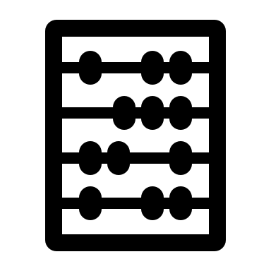

OMF Agreement: Key Terms
  RD Indebtedness ($22.8M)
  Repayment from Prosper to City on the payment schedule set in the IGA
  Reduced repayment plan reflects $15M of General Fund support as directed by City Council in Ordinance No. 190146
  Any land sales proceeds derived from the sale of properties acquired with proceeds of the original Line of Credit must be used in accordance with the applicable laws and regulations
  Prosper to continue updating OMF with funding plan and project developments
  LID Debt (LID Interim Financing & Bonds)
  Final LID amount will be determined based on the final infrastructure and financing costs for NW Johnson /Kearney and NW Park Avenue
  Prosper Portland will cover construction interest payments for the entire LID Debt
  Prosper Portland will receive a credit against its Final Assessment for interest paid on behalf of properties not owned by Prosper
  Prosper Portland and other assessed property owners will make semi-annual payments on long-term LID bonds once issued, consistent with City's LID Program
  Primary repayment source will be proceeds from the sale of properties within the Broadway Corridor and program income
  All legally available resources of Prosper serve as a secondary source of repayment
Notes:
As directed by City Council in 2020, the IGA memorializes the use of $15M of General Fund for the repayment of the debt used for the acquisition of the property. The balance will be paid by Prosper Portland in accordance with the schedule set forth in the IGA.
The LID financing is unique due to the phasing of construction occurring in two phases and over approximately 10 years. As with standard LIDs, the final assessment and annual payments will come due at the completion of the infrastructure. And responsibility for these payments will run with the land, meaning Prosper Portland and PHB will transfer this obligation with the sale of individual parcels to development partners.
However, unique to this LID and per the terms of the IGA, Prosper Portland will be responsible for making the interim interest payments for the financing used for the first phase until the final assessment occurs. At this time, Prosper Portland will receive credit for any interest payments made on behalf of any other assesses. This cost will be further defined later this year as we have updated construction costs and City Council authorizes the interim debt financing. Current best estimates indicate this may be approximately $6M.
The primary repayment source will be proceeds from the sale of properties within the Broadway Corridor and program income.

Slide 14
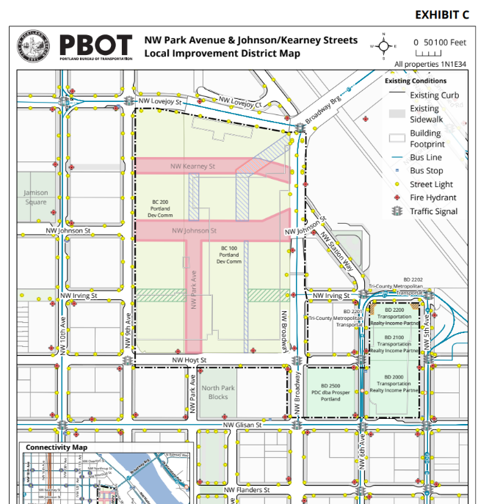
Local Improvement District
Notes:
LID includes the USPS property, Block R (owned by Prosper) and the former Greyhound property (privately owned)

Slide 15
Item No. 597
Notes:
Transition to Molly

Slide 16
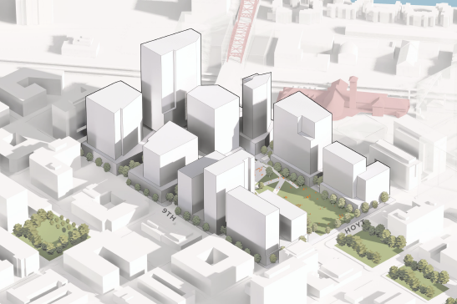
PHB Agreement: Background
PHB contributed 16% of the USPS purchase price
Contribution was based on the amount of floor area ratio (“FAR”) for affordable units
16% = 650,277 sq. ft. of FAR available under the USPS Master Plan
Notes:
Good morning Mayor Wheeler and Commissioners, for the record I am Molly Rogers, Interim Director of the Portland Housing Bureau. I use she/her pronouns.
When Prosper Portland initially purchased the USPS site, PHB contributed $14.5M in River District Tax Increment Financing Housing Set-aside funds to acquire 16% of development rights for future affordable housing. This was important for a number of reasons:
First, the City must make early commitments and investments in affordable housing to ensure we are creating inclusive, diverse and balanced communities. Locking in land was the surest way for PHB to hedge any risks that future parcels could be used for other uses.
Second, it is a more cost-effective as this approach benefits from lower land values than when the broader site is fully built out. We've learned from past TIF districts that lining up early construction projects can catalyze other investment for the rest of the district.
This investment will result in the acquisition of land for PHB to directly finance income restricted affordable housing, and the deployment or transfer of Floor Area Ratio (or FAR) to other developers to build affordable housing within their market rate projects. This is similar to how Inclusionary Housing works, and necessary within the Master Plan context.

Slide 17
PHB Agreement: Key Terms
Affordable Housing Metric = 720 units within Broadway Corridor via PHB’s direct delivery + Inclusionary Housing via private development
PHB to control 390,200 sf on Parcels 4 A&B (subject to modification)
PHB to contribute 260,077 sf FAR to IH Bonus requirements; Prosper to provide all additional IH Bonus FAR required
Prosper to provide 1Waterfront Property for the purpose of meeting requirement of 720 units as needed
Notes:
The key terms of the IGA are related to the shared goal between Prosper Portland and PHB of creating a mixed-income community whereby approximately 30% of future residents will be earning at or below 60 percent of the area median income. This was based on the current demographics of the City. Preliminary estimates translated this goal into 720 new affordable housing units within Broadway Corridor.
Prosper Portland and PHB will deliver on this goal through direct investments by PHB on parcels 4A and 4B as well as contributing FAR to a private developers to place affordable housing within market rate housing, consistent with the FAR bonus required in Inclusionary Housing policy.
Once all of PHB's FAR is fully allocated, Prosper Portland will be required to allocate any FAR necessary to meet the Inclusionary Housing FAR Bonus requirements.
If we run short of our 720 unit goal after a substantial portion of the corridor is built out, Prosper Portland and PHB have negotiated an additional parcel for PHB to control and subsidize a future affordable housing community.

Slide 18
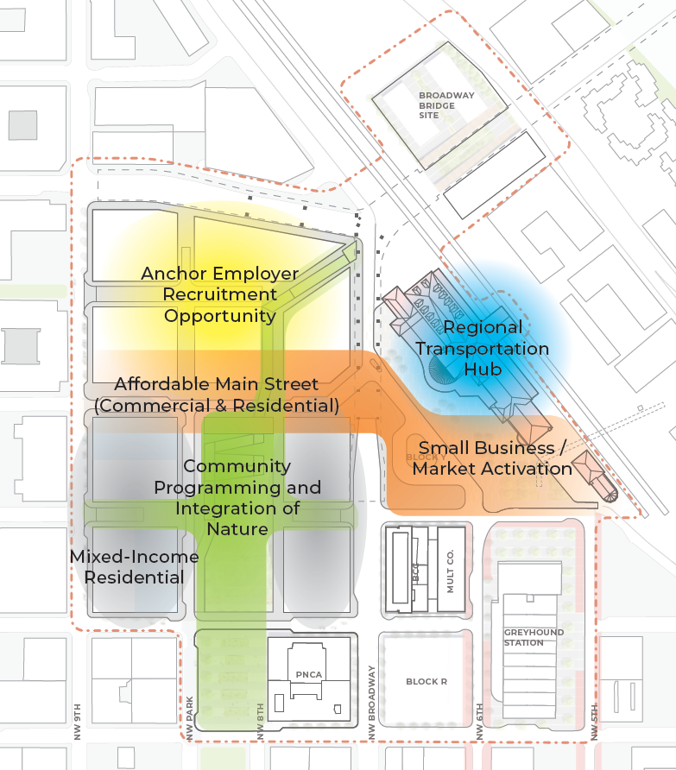
PHB Parcel Selection
Full Block 4 (2 Half Blocks) + 1 Waterfront Site
Values & Goals
Meets shared goal of 720 affordable housing units
Allows a range of household types (family-sized units, senior living)
Maximize connectivity and proximity to site amenities and public spaces
Ability to lead with Phase 1 development
Site Control – Top to Bottom
Constructability and Development Feasibility
PHB / PROSPER
PHB
PHB
Notes:
Vetted by the original Steering Committee, PHB’s parcel selection process was guided by the community's core values including:
•Can we meet the 720 affordable housing unit goal
•would the parcel allow for a range of household types and needs
•Does this location maximize connectivity and proximity to site amenities and public spaces
•Would the development be cost effective and feasible
•Can it support future Residents' livability and quality of life
PHB reviewed about a dozen options across the entire site and identified a full block located along the ‘main street’ and the park frontage shown in yellow highlights called parcel 4. This parcel is located between NW Irving and Johnson and between NW 9th and Park. It was important to the Steering Committee and PHB leadership that future affordable housing residents get to benefit from the new park amenities. It was also important that our parcel selection was considered within the context of where existing affordable housing projects are located so that we are creating a balanced future community.
The other block in yellow highlight is the alternative parcel I previously referenced that Prosper Portland can make available as our safety net in case we are not on track to meeting the 720 unit goal.

Slide 19
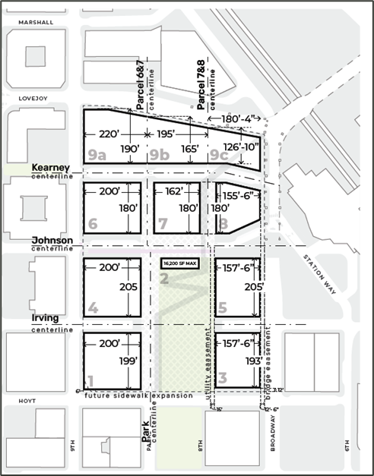
PHB Development Parcel
PHB to secure Parcel 4A for an initial phase of affordable housing development
PHB to secure Parcel 4B in a future phase – after demolition of existing parking garage
Potential for additional/alternative sites:
  PHB securing resources for a second phase of affordable housing prior to the demolition of the existing parking garage (Parcel TBD)
  Mutual re-evaluation of site selection (Portion of Parcel 1)
  Insufficient delivery of affordable units on USPS site (1WF)
1WF
4A
4B
1
Notes:
The parcel build out of the PHB directly financed projects will occur in three phases.
The first is the north portion of the block 4, as a Phase I project. To be clear, PHB has identified city resources for this first phase only. We hope to go vertical by 2026 or sooner if other financing can be lined up and the infrastructure needed is complete.
The second phase is the south portion of that block once Prosper no longer needs it for the demolition of an existing parking garage.
The third will be triggered if we are not making sufficient progress towards the 720 unit goal. Prosper Portland and PHB have agreed to come back to the table to explore an additional parcel at that time.

Slide 20
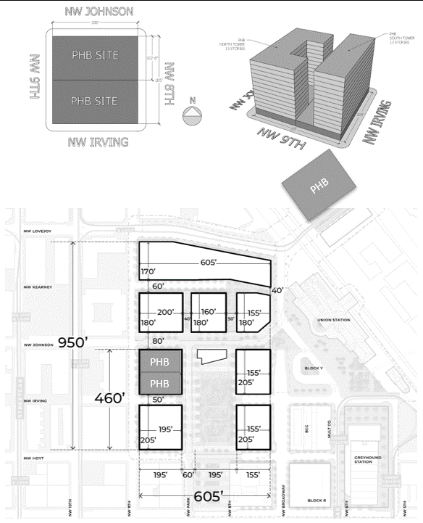
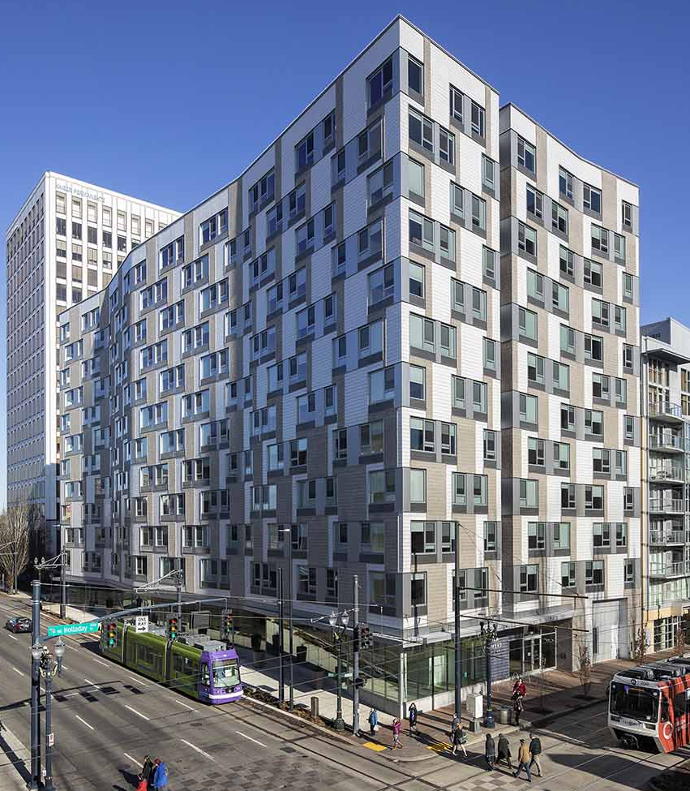
PHB Parcel Selection
Full Block 4 (2 Half Blocks)
Each tower ~12-15 stories
2x
Picture courtesy of Jeremy Bitterman
Development Example: Louisa Flowers project
12 story building, including ground floor retail/support services
240 units (mostly studio, plus some 1 and 2-bedroom units)
Notes:
By way of illustration, future development on Parcel 4 could result in two 12-15 story buildings that will be income restricted to households earning 60 percent of AMI or below. Final building size and unit counts will depend on the goals and priorities of each funding source used to finance development. The funding sources identified for the Phase I building are Metro Housing Bonds and River District TIF funds. Metro bond funds come with additional goals for family-size units and units serving households earning 30% AMI or below.

Slide 21
Next Steps
Summer 2023​ | Commence Open Space 30% Concept Design (Parks Bureau)​ ​
Fall 2023 | Construct “off site” Water and Sewer Infrastructure to Serve the District (BES) City Council Authorization of LID Interim Debt Financing (OMF/PBOT)
Winter 2023​ | Complete Demolition (Prosper Portland)​ ​ Assess Development Feasibility & Partnership (Prosper Portland/Related)​ ​ Issue Phase 1 Affordable Housing NOFA (PHB)​ ​
Spring 2024​ | Commence Street Construction (PBOT)​ ​
Notes:
Looking forward:
Parks will be kicking off the concept design for the open space with the site, as well as the design and construction of the park block immediately to the south
BES is commencing work on critical sewer and water infrastructure necessary to serve the district this fall
PBOT and OMF will be back before City Council late this year to authorize the interim LID financing prior to the start of construction of new streets beginning in Spring 2024. Construction of the new streets and utilities is critical to getting the site ready for vertical development, and is anticipated to start next Spring.
Prosper Portland will be completing demolition work by the end of this year – as well as conferring with Related on market-rate development feasibility and potential next steps to negotiate the terms of development for the Prosper Portland controlled parcels.
The next step for PHB is to issue a Solicitation this winter to select a development team to start the early work for an affordable housing project. PHB anticipates using Metro Bonds for the first phase of affordable housing development within the Corridor. Metro Bond resources are required to be used within a certain timeframe pursuant to the Metro bond requirements. Therefore, any significant delays in this project could adversely impact the city's ability to deliver on the commitment of 720 units of affordable housing on the site.

Slide 22
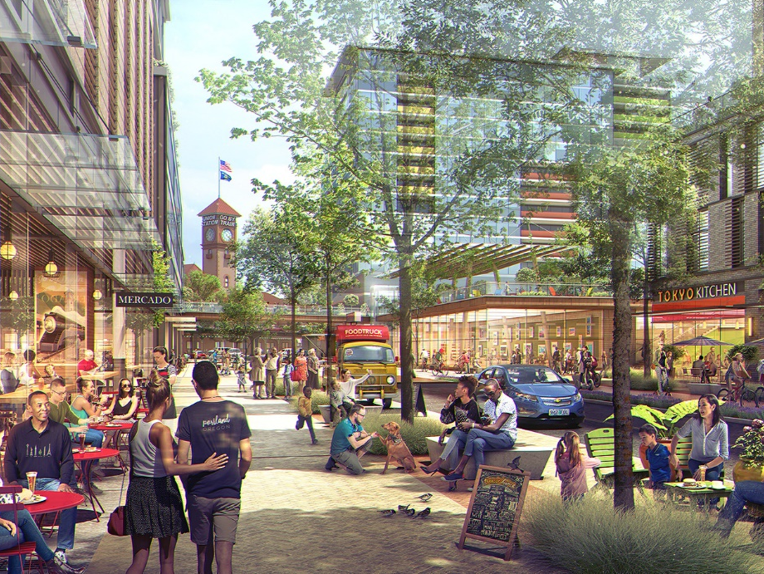
Discussion

