Slide 1
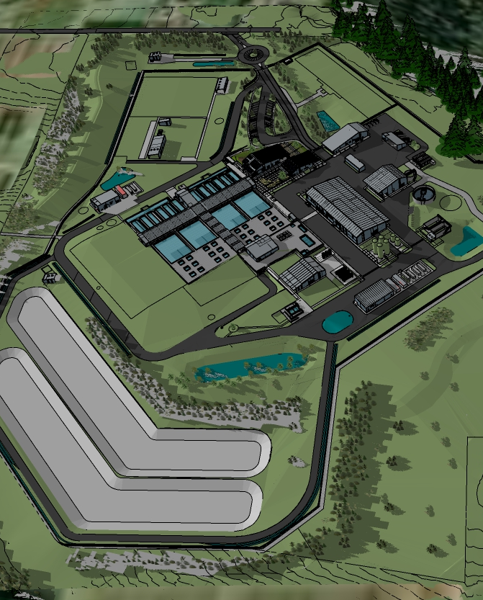
Bull Run Treatment Projects
City Council
June 28, 2023

Slide 2
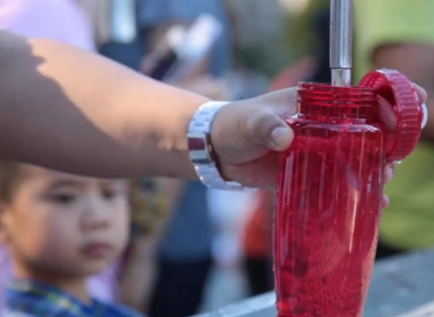
Agenda
Intro and background
Cost and how to address
Moving into construction
Six Council Items

Slide 3
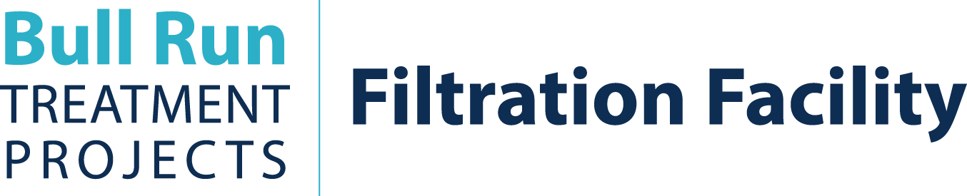

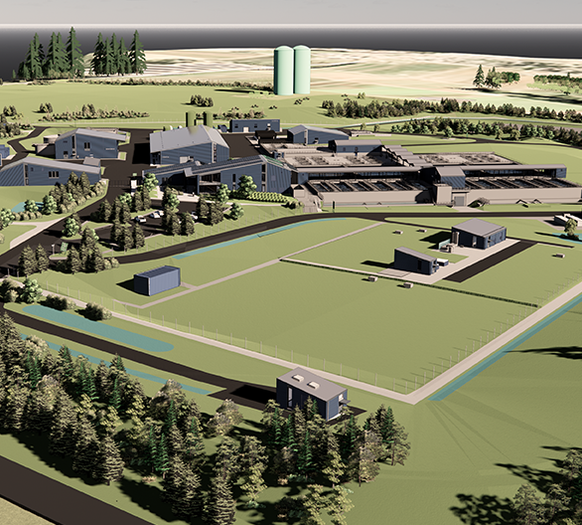
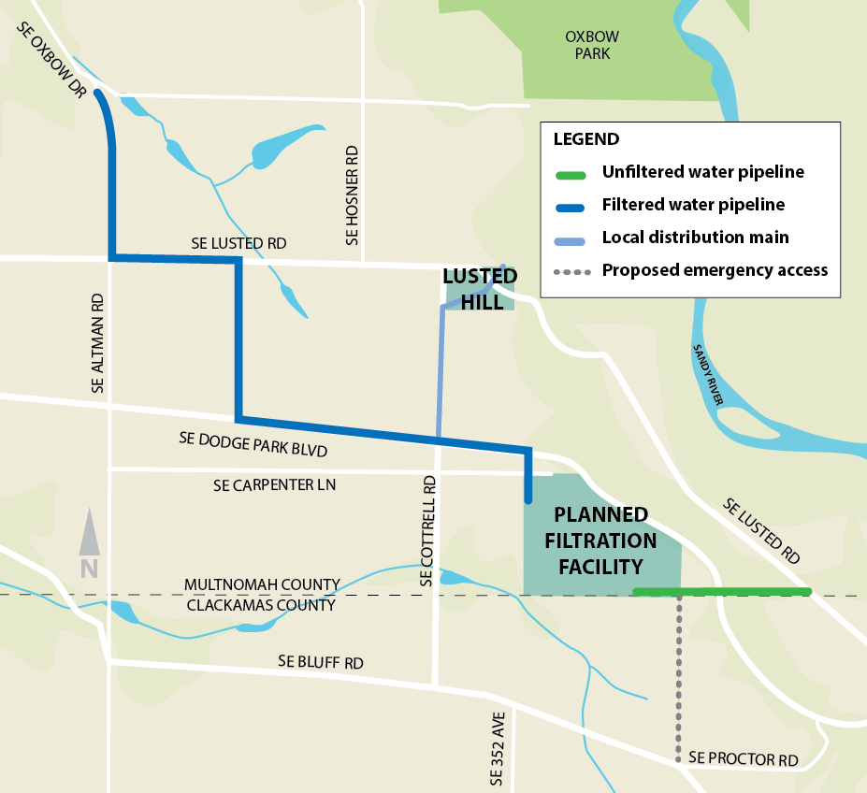
135 mgd conventional filtration facility
Met 2nd compliance deadline for Oregon Health Authority
Completed 100 percent design
Land Use submitted to both Clackamas and Multnomah County
Facility looking southeast from main entry

Slide 4
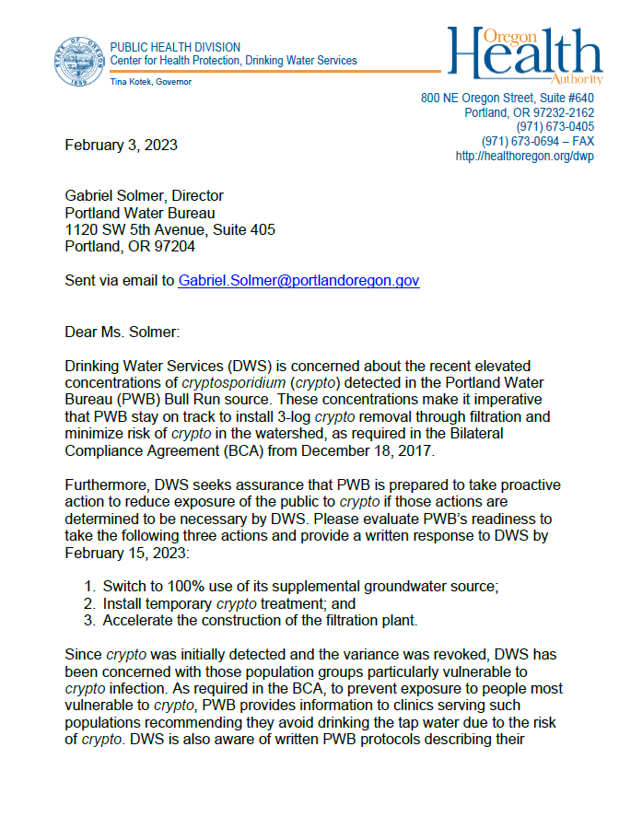
Brief History
2006
2009 - 2016
January 2017
August 2017
December 2017
February 2023
EPA passes regulation to protect against crypto, because it is so resistant to chlorine
Portland develops unique compliance approach to regulations - program is successful for 5 years
Low level detections show
Cryptosporidium is present in the watershed at levels sufficient to require treatment
Portland City Council passes resolution to build filtration
Bilateral Compliance Agreement signed with Oregon Health Authority
Increased crypto detections prompt schedule compliance letter from Oregon Health Authority

Slide 5
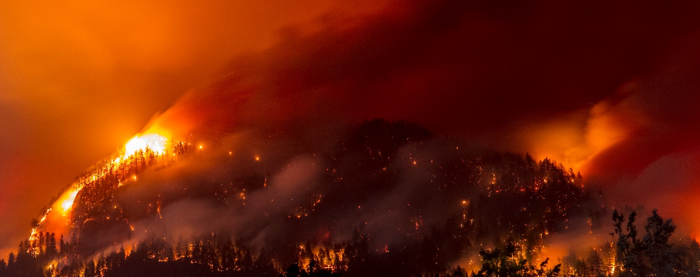
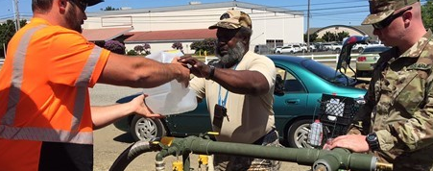
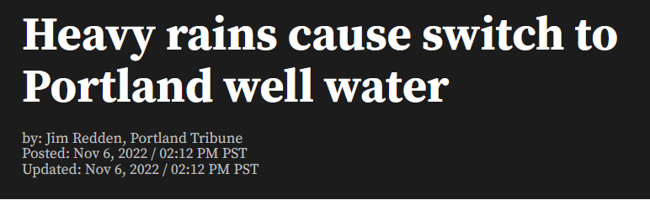
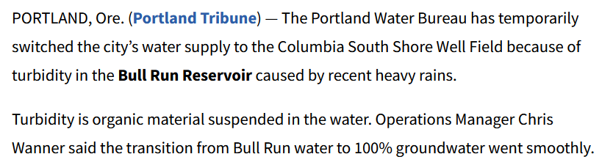
Resiliency & Benefit
Helps adapt to climate change
  Fires
  Algal blooms
  Turbidity
Seismically resilient
  Earthquakes
Emerging contaminants
  Aging infrastructure
  Replacing poor condition conduits
Resiliency for most vulnerable
Eagle Creek Fire
Salem Algal Toxins

Slide 6


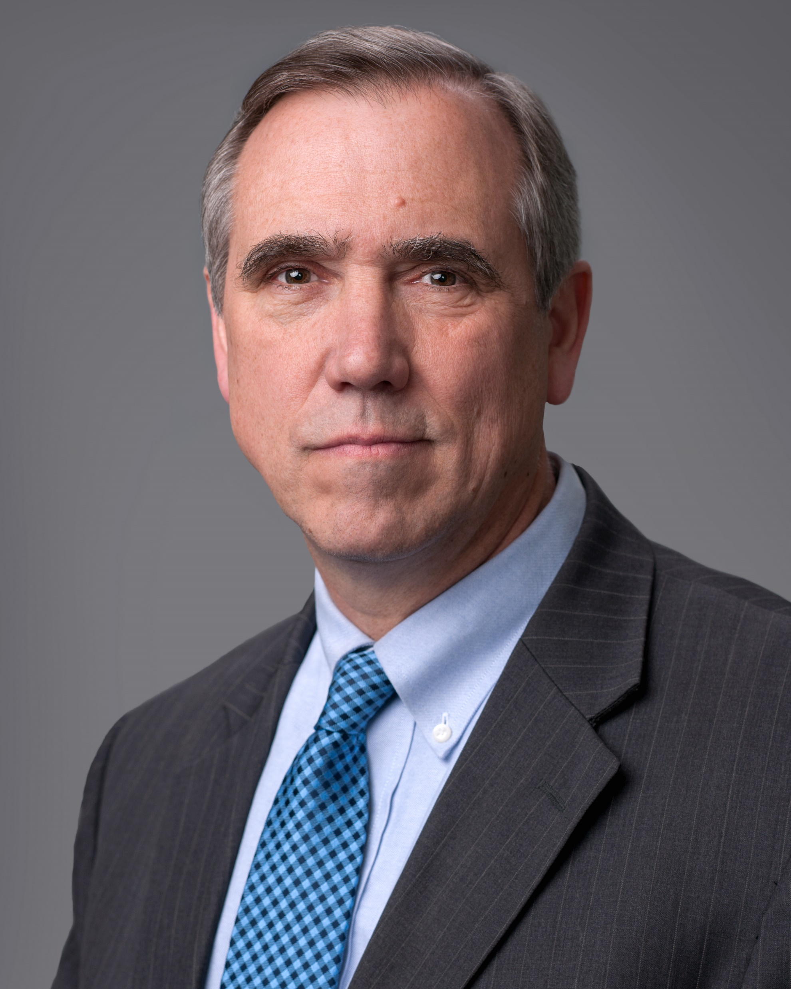

Funding support
EPA WIFIA Loan
  Saves ratepayers $247M
  Championed by Senator Merkley for projects of this scale
  Largest WIFIA loan to date
  WIFIA has invited application for 2nd loan
Anticipating over $500,000 in Energy Trust of Oregon incentives
Going forward
  Hiring consultant to seek non-rate revenues with private, federal, and state funding opportunities
  Continuing collaborations with federal, state, and local governments to secure additional resources in consultation with the Office of Government Relations
Very low 1.89% interest rate
Flexible repayment

Slide 7
Current estimated program costs
​ | WIFIA Application​ & Funding Plan | 2022 Estimated Costs | Current Estimated Costs
Capital Costs​ | $967M ​ | $1,249M | $1,578M
Other WIFIA-eligible Costs (financing costs, overhead, and interest)​ | $106M ​ | $106M | $106M
Available Contingency​ | $410M ​ | $128M ​ | $150M ​
TOTAL PROGRAM FUNDING | $1,483M ​ | $1,483M | $1,834M

Slide 8

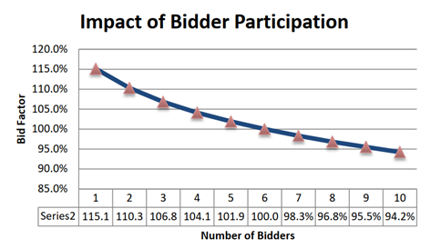
Key drivers for increase in estimated costs
  Regional Case Study
Design progression
  New 60 MGD water treatment plant
  46% cost increase in 2 months
Schedule compression
High escalation in construction economy
Limited market and competition

Slide 9
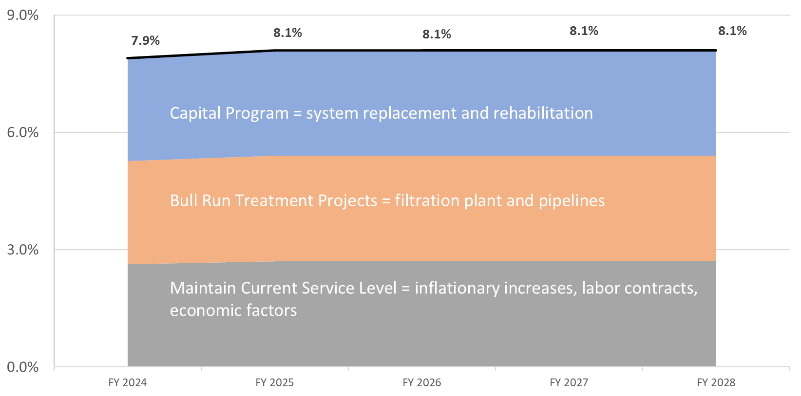
Rate Forecast

Slide 10
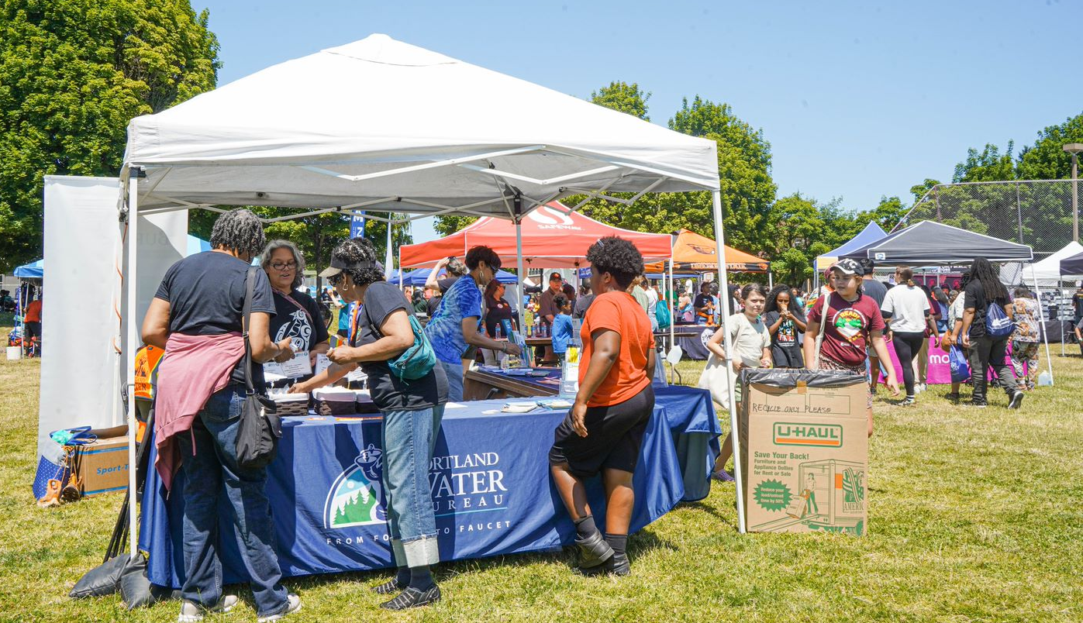
Centering water rate affordability
Maintaining current forecasted rates
Applying for second WIFIA Loan
  49% WIFIA - $172 M
  Defer payment until projected rates are lower
Reviewing Capital Improvement Plan
  Deferring projects
  Slowing Seismic Implementation Plan
  Maintaining core asset work
  Less able to fund emergency or new interagency projects, federal mandates (FERC), or react to failure increases of an asset class
Financial assistance programs
  A dedicated financial assistance service team
  Discounts available for customers in a variety of financial situations

Slide 11
Bull Run Filtration critical path to compliance
 | 2017 | 2018 | 2019 | 2020 | 2021 | 2022 | 2023 | 2024 | 2025 | 2026 | 2027 | 2028
Compliance agreement
Facility planning
Pilot study
Pipeline planning
Facility design
Construction plans
Pipeline design
Facility construction
Pipeline construction
Filtered Bull Run water
Dec.
Nov.
Early works GMP 1 authorization request
Oct.
Sep.
Oregon Health Authority deadline
Filtration facility
Pipelines

Slide 12


Multi-step land use permitting process
Type III conditional use review
Over 25 individual land use and permit applications
Over 2,700 pages of applications, narratives and supporting documentation
Public hearing scheduled for June 30
Required for secondary access
Currently in review
Preliminary process direction expected June 30

Slide 13
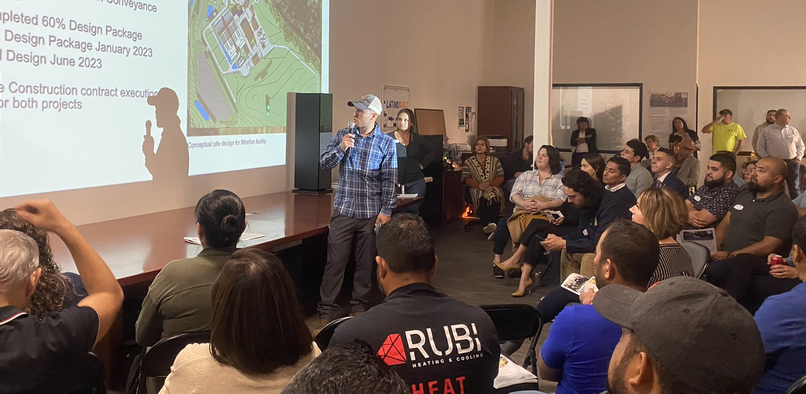
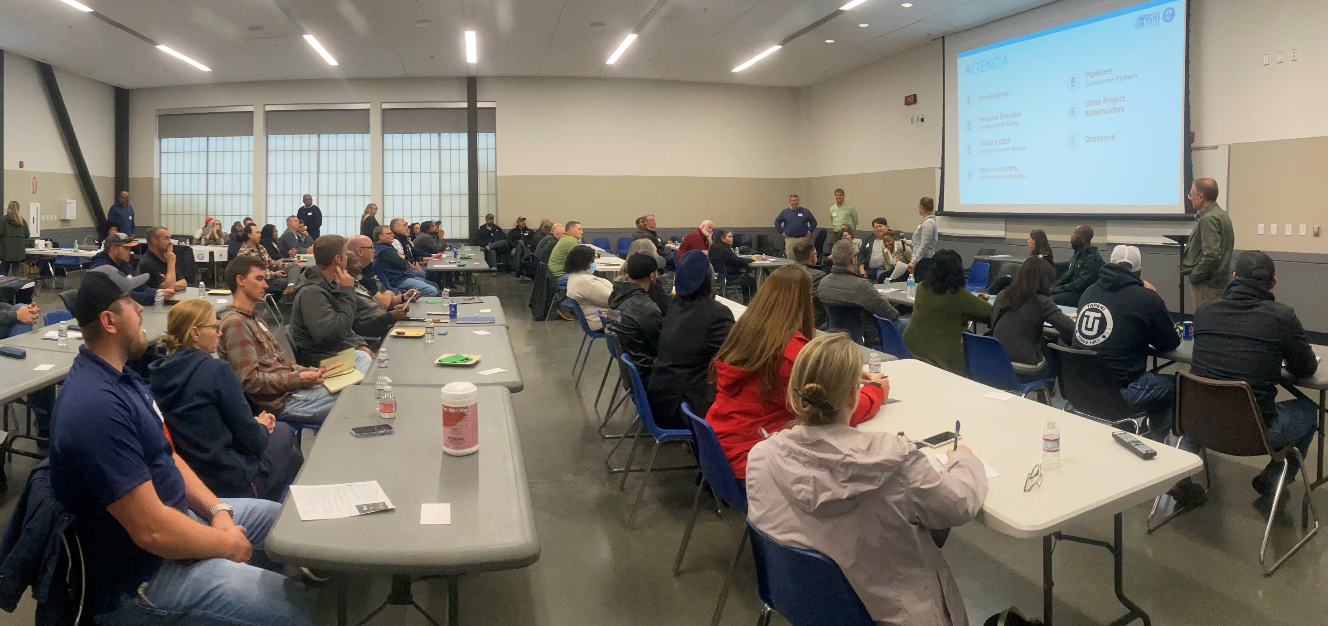
Equity contracting and workforce
Partnership
  City Procurement Office, Project Team, and the contracting community working together
  Commitment to maximizing participation
Preparing the community
  Engagement over the last year
  Presentations at over 16 organizations for both workforce and contracting
Workforce
  Largest project yet to implement the new Regional Workforce Equity Agreement
  Goals for apprenticeship and Safe from Hate workplace

Slide 14
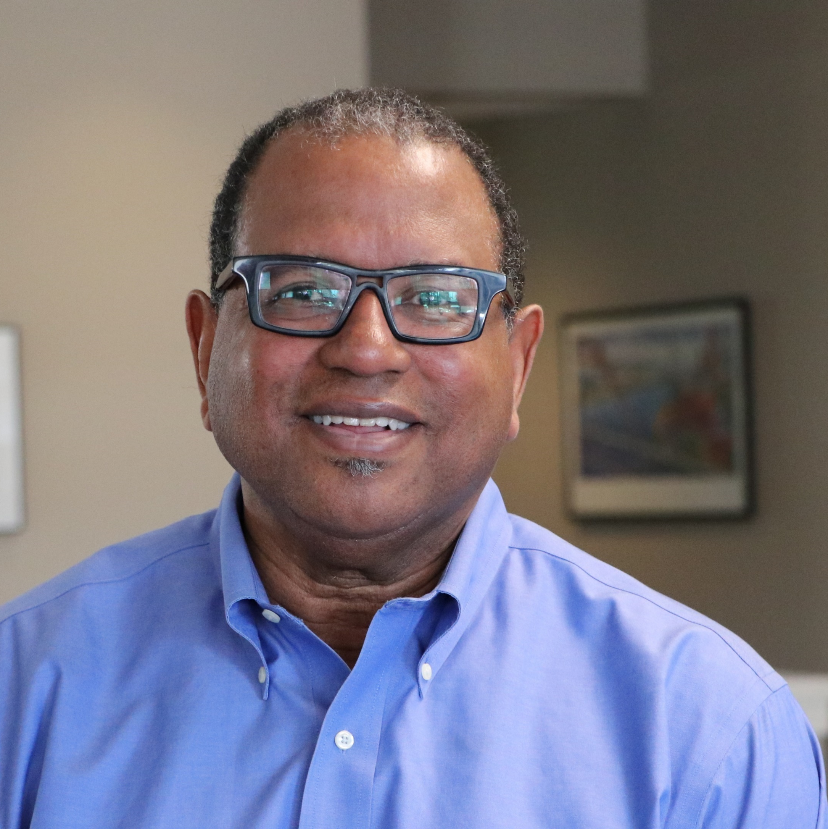
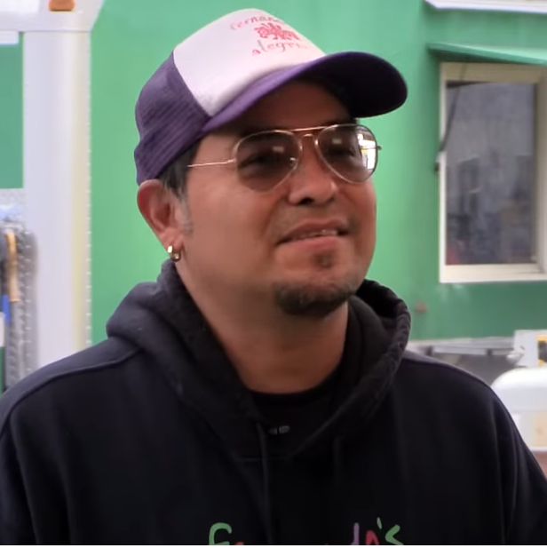
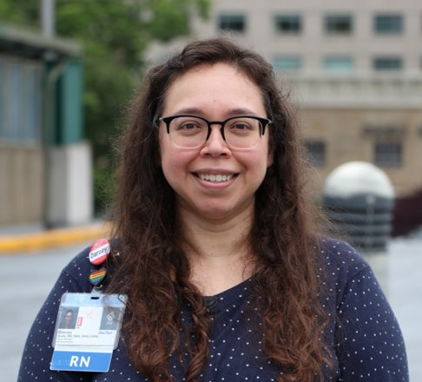
Building vital infrastructure that will serve local industry and businesses
“[These projects] pay well and give people economic independence. If you have that experience, that gives you an opportunity to start your own company and hire other people and grow.” -- Andre Baugh, principal at Group AGB
“For us water is super important. We use water in everything we do. Put it simple… without water we couldn’t have a business.” -- Fernando Rodriguez, Fernando’s Alegria
4,700 construction jobs +
25% hard construction costs
to equity contractors
$1.59B economic activity through construction +
$14.9M annually when complete
“One of the things that’s really beneficial is having assurance from the City that an item such as Cryptosporidium is not in the water. This will help us ensure that the care we provide our patients does not inadvertently cause them any harm.” -- Darcey Ayala, Oregon Health & Science University

Slide 15
Council Actions – Reports to Council
561: Accept the Bull Run Treatment Projects 2023 Annual Report (Report)
  Annual update on the status of the Bull Run Treatment Projects (no Council action required)
562: Extend the Contract with Brown and Caldwell for Program Management and Support Services for the Bull Run Filtration Projects (Report)
  No-cost extension to duration due to City 5-yr original contract length requirement (Council vote to accept the report)

Slide 16
Council Actions – Guaranteed Maximum Prices
563 Authorize the Bull Run Filtration Facility Project construction in two phases with two guaranteed maximum prices and update estimated total cost of construction to $1,069,000,000 (Ordinance)
564 Authorize the Bull Run Filtration Pipelines Project construction in two phases with two guaranteed maximum prices and update estimated total cost of construction to $404,000,000 (Ordinance)
565 Accept Guaranteed Maximum Price of $286,245,376 from MWH-Kiewit JV for construction of the first phase of the Bull Run Filtration Facility Project (Procurement Report - 00001428) (Report)
566 Accept Guaranteed Maximum Price of $51,792,077 from Bull Run Conveyance Partners for construction of the first phase of the Bull Run Filtration Pipelines Project (Procurement Report - RFP 00001634) (Report)
Key to staying on track and managing costs

Slide 17
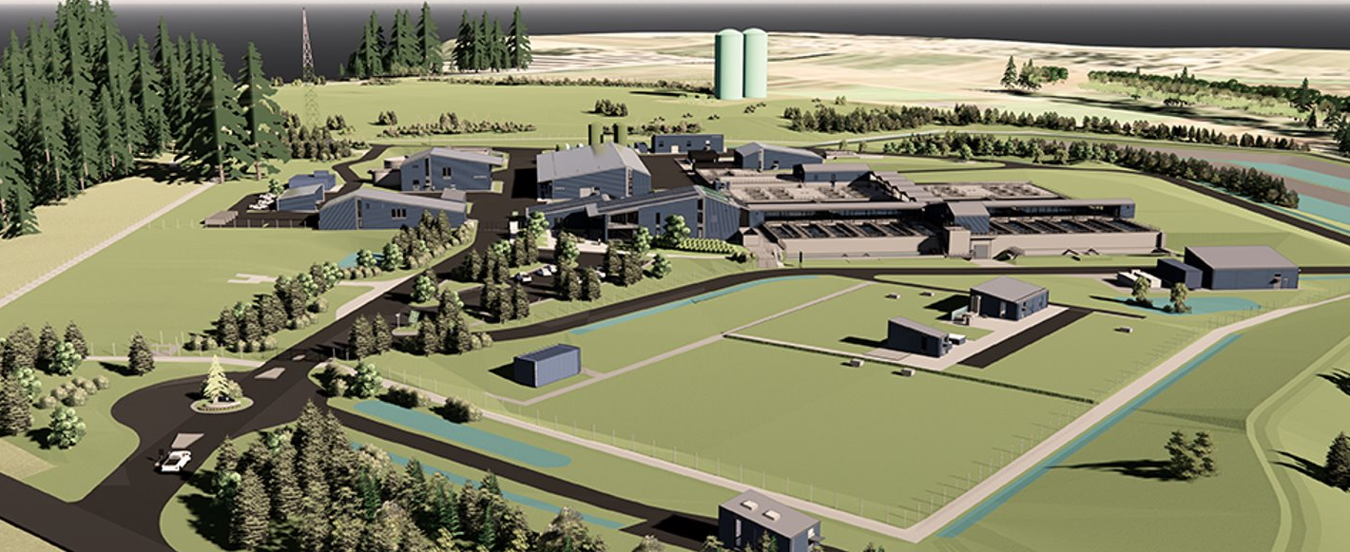
Thank you!

