Slide 1
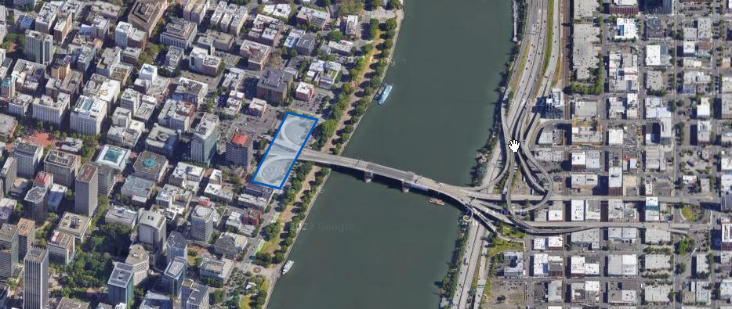
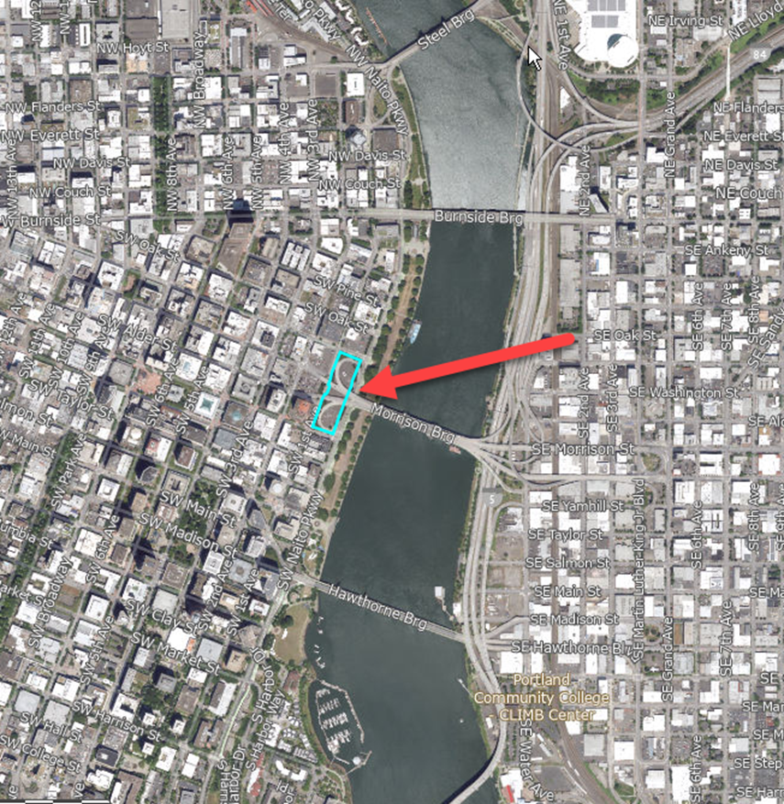
Morrison Bridgehead Property – Acquisition Presenter: Dylan Paul
Click to update the date or subtitle – January 1, 2018
Click to update the date or subtitle – January 1, 2018
Click to update the date or subtitle – January 1, 2018
Presenter Name, Title
Presenter Name, Title
Presenter Name, Title

Slide 2
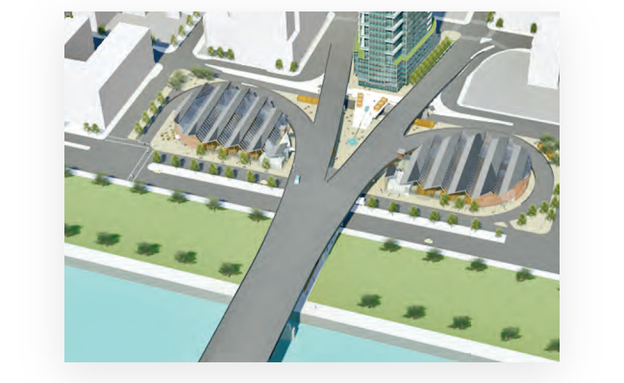
Prior Ownership
There has been a consistent conceptual design theme for this site going back to 2014 that has always included public events, marketplaces, and year-round activation.
In line with this consistent theme, Parks & Recreation is intending to use the site pretty much “as-is” for capacity increasing purposes and to support year-round events, markets, fairs, and overflow parking for Waterfront Park.

Slide 3
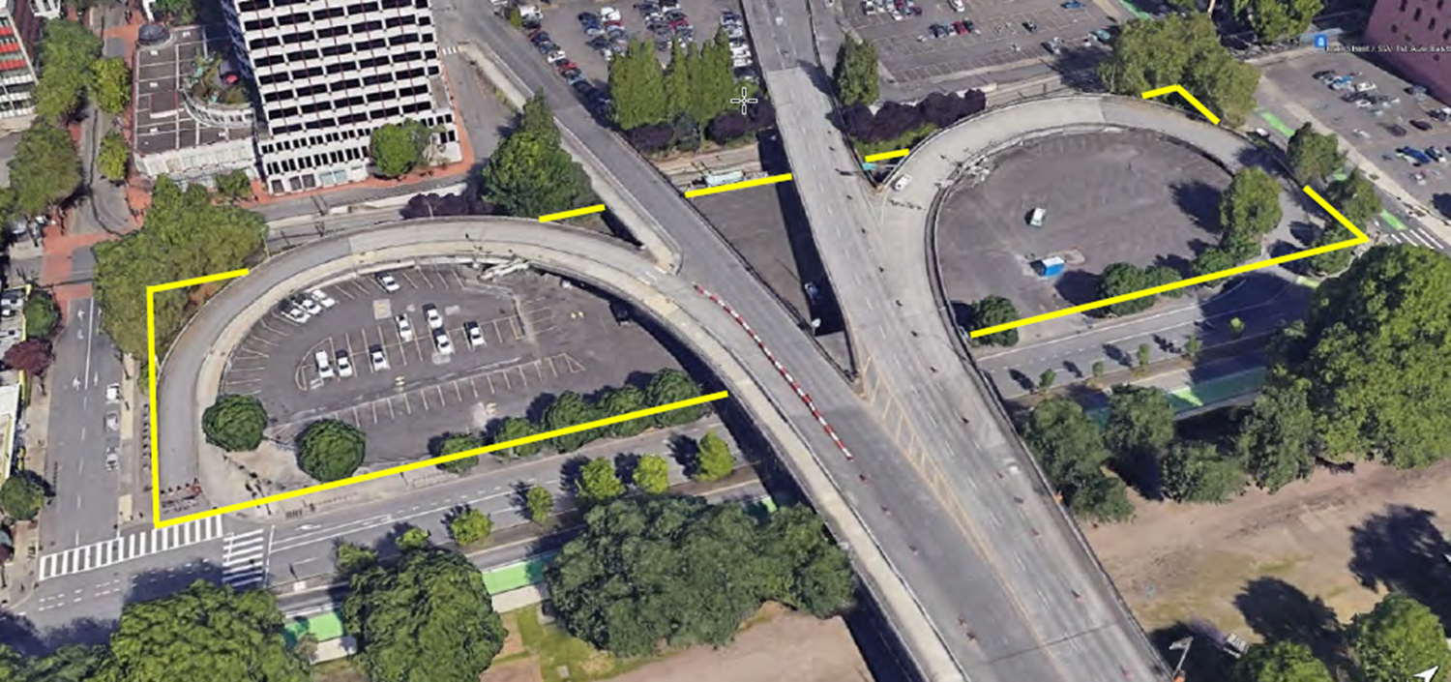
Site Details
Gross Land Area is 142,110 SF or 3.26 Acres
Number of Surface Parking Spaces is 300
Multnomah County Assessed Value $8,620,920
City Purchase Price $8,000,000
Capitalization Rate Approximately 7.5%
(Capitalization Rate = Net Operating Income / Purchase Price)

Slide 4
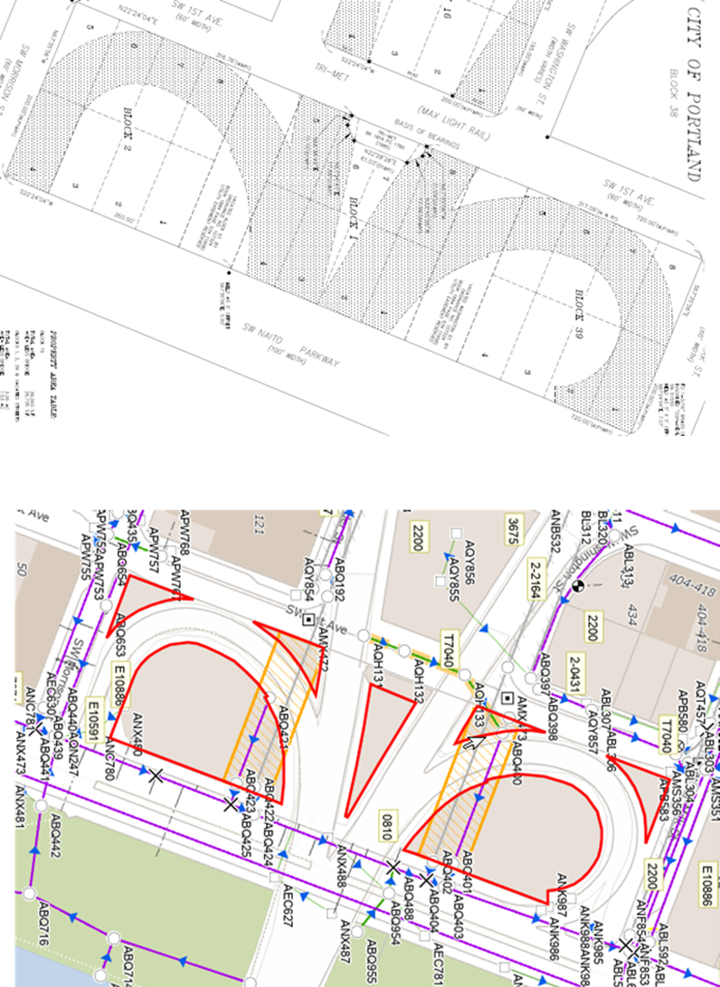
Site Encumberments
City Sewer Easement Area in Gold
Multnomah County Right of Way Shared Use Agreement (Shaded Area)

Slide 5
Questions

