Slide 1
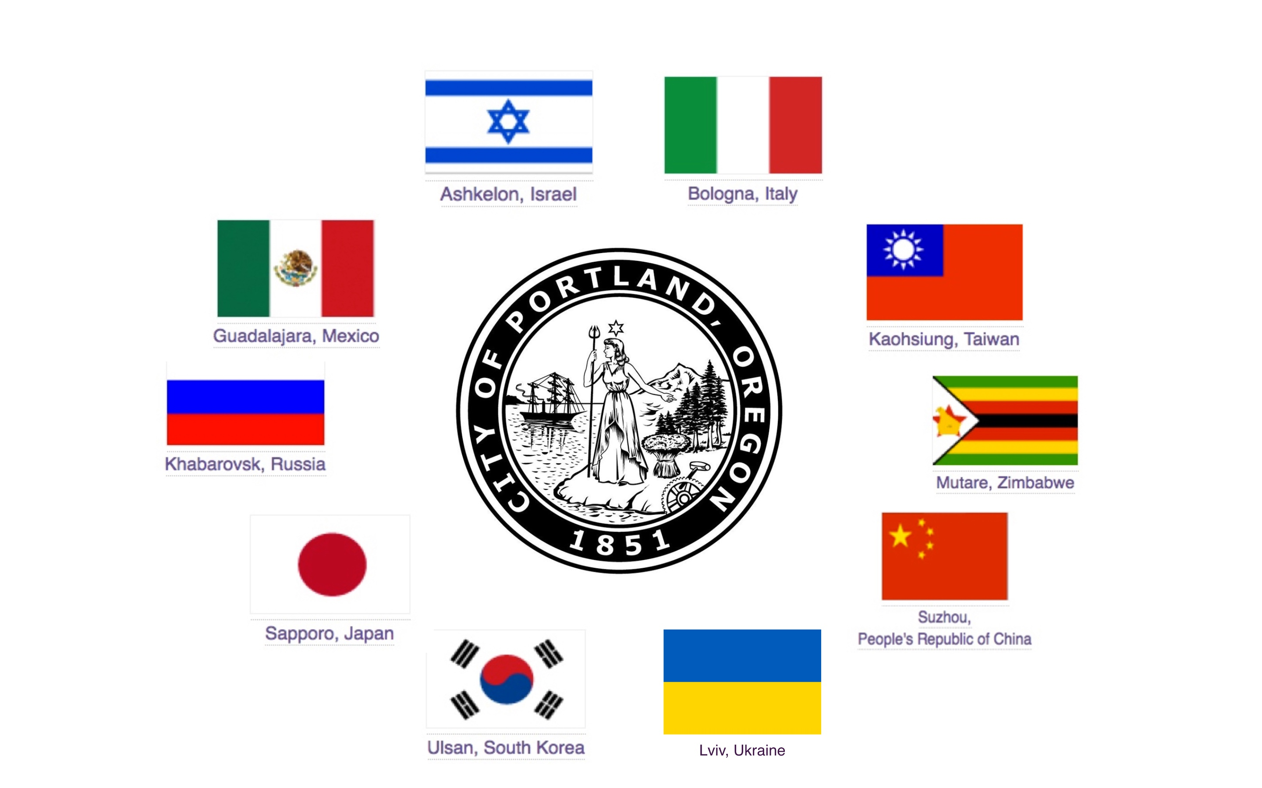

Slide 4
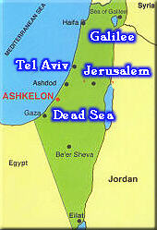
Ashkelon has been a Portland Sister City for 36 years
Ashkelon is a growing Israeli city of 149,000 citizens
Ashkelon is home to the world's largest water desalination plant, the Israeli Beer Breweries & some of finest most creative young entrepreneurs.

Slide 5
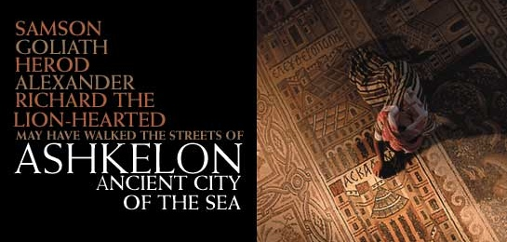
Ashkelon is an ancient 5,000+ year old “Philistine” garden city located on the Israel’s west coast, the beautiful Mediterranean Sea, rich in world history, the arts & recently added to the Rockefeller Foundation 100 Resilience Cities

Slide 6
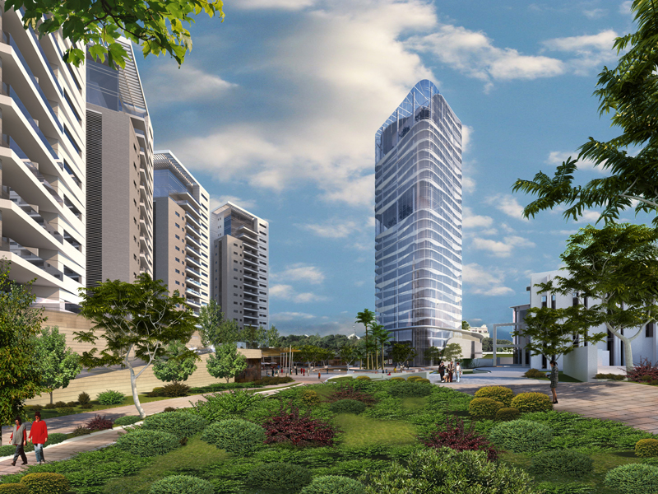
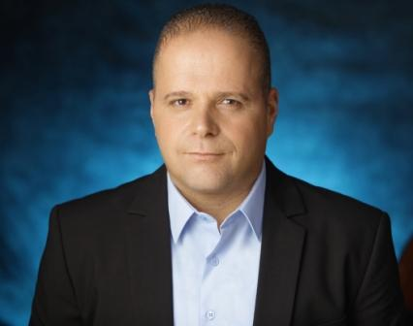
Ashkelon is a modern Israeli city led by Mayor Tomer Glam and is the bedroom community for Jews & Arabs that work in Israel’s Silicon Forest, inventors of Intel’s Pentium 4 Chip, modern voicemail, smart phones, medical breakthroughs & cutting edge environmental technologies.

Slide 7
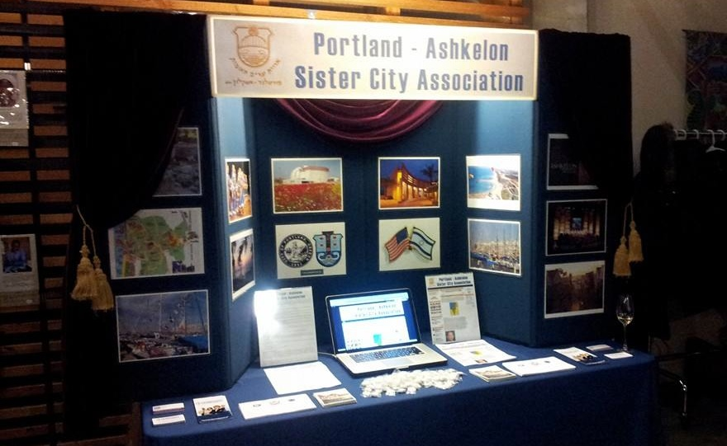
PASCA has been working to rebuild our leadership, planning a tour in March 2024 and helping other Sister City Associations with our new website & Facebook page, as well as our annual Rose Festival Reception & Grand Floral Parade entry.

Slide 11
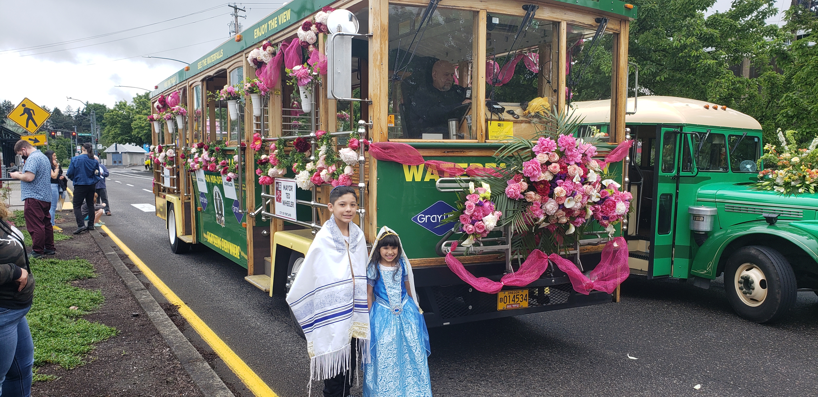

Slide 12
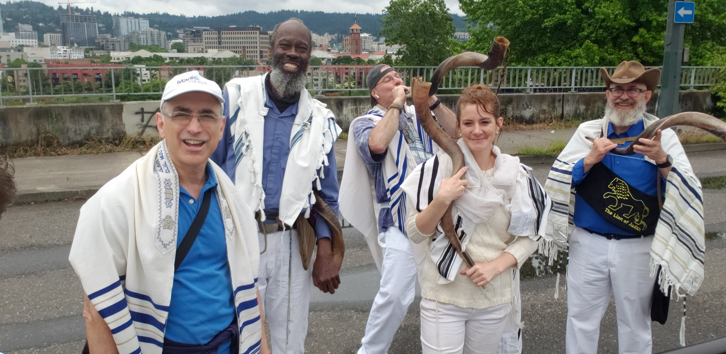

Slide 13
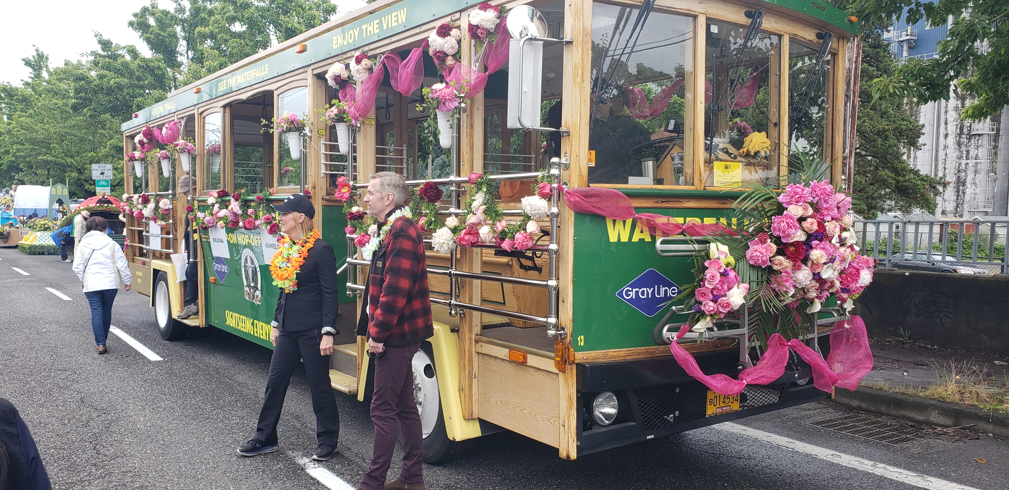

Slide 16
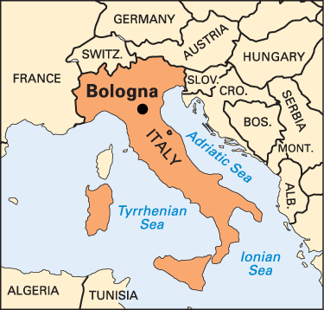
Bologna has been a Portland Sister City for 19 years
Bologna has three nicknames:
Bologna la Rossa (the red) for its red rooftops and the leaning of its politics
Bologna la Grassa (the fat) for its world-famous cuisine and food products
Bologna la Dotta (the learned) for its incredible university

Slide 17
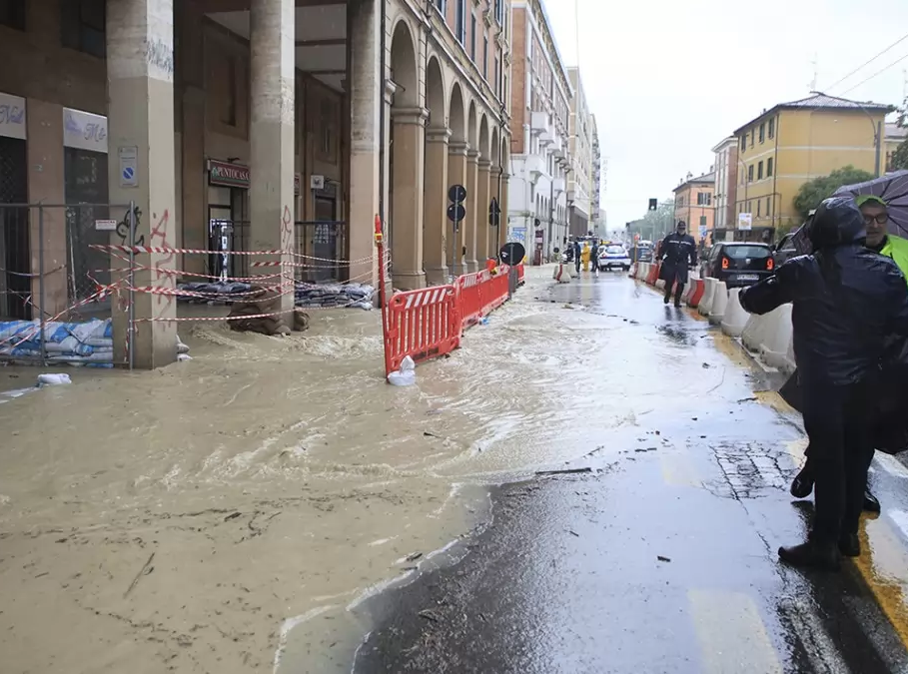
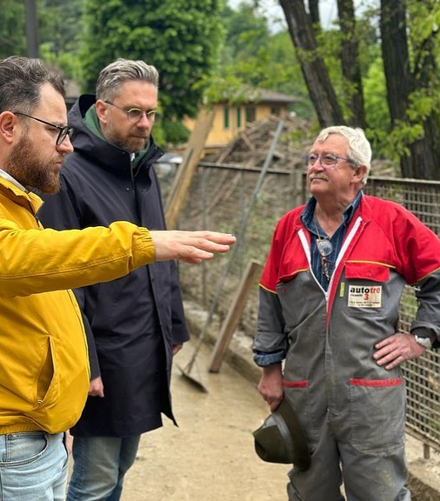
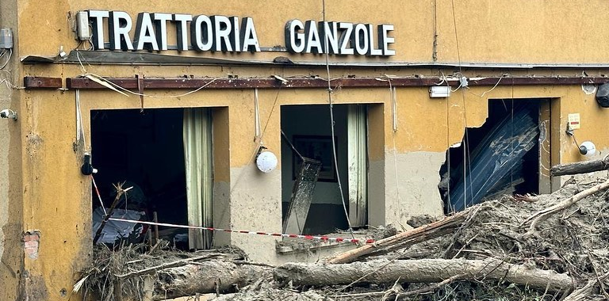
Emilia-Romagna Floods

Slide 18
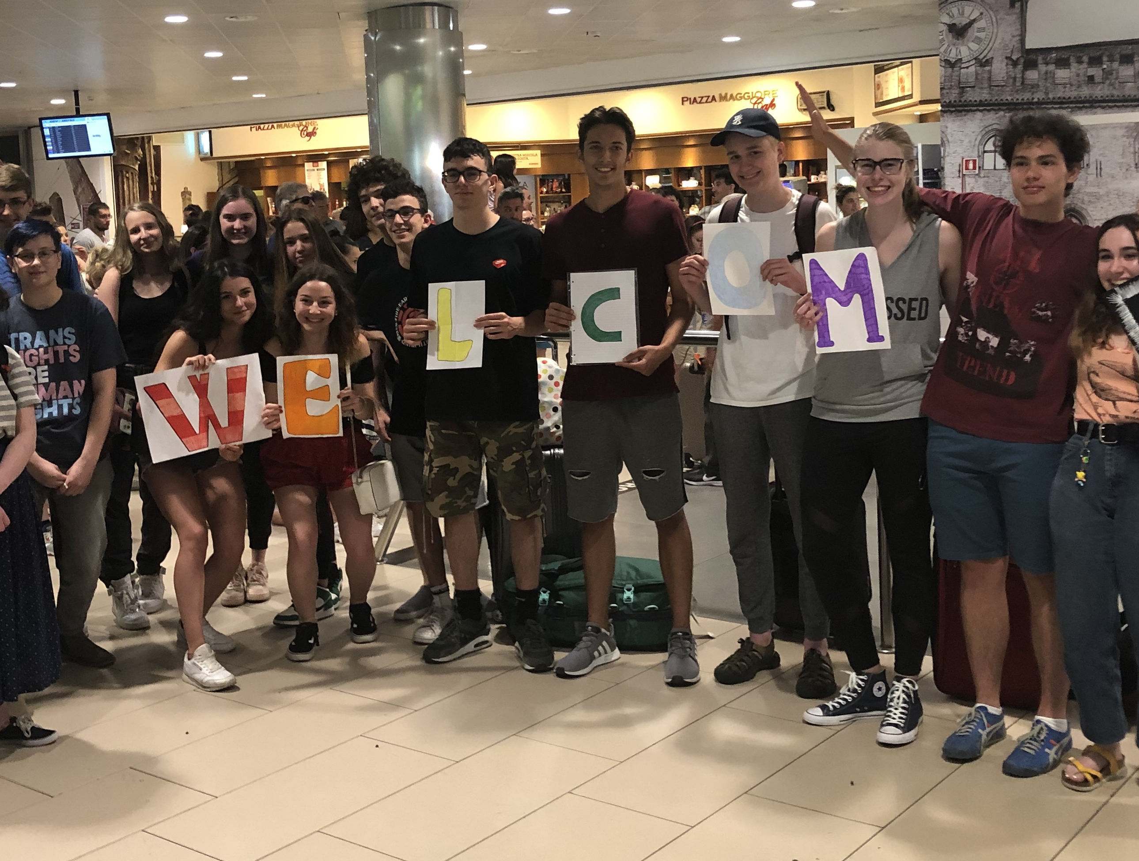
Portland-Bologna Scambio Youth Exchange
High school students from Bologna will be hosted by Portland families this summer for the first post-pandemic youth exchange. Students from Portland will travel to Bologna next year.

Slide 19
2023 Events
Zoom Cooking Class with chef Giorgia Lambertini - April
Sip & Share Wine Event - May
Annual Amici Dinner - June
Youth Exchange - June/July
Fast Cars and Fine Wine (fundraiser for flooding relief) - August
Ferragosto (Aperol & gelato in the park free event) - August
Annual Sagra Dinner - October
Italian Wine and Art Event - November
Learn more at: https://www.portland-bologna.org/events

Slide 21
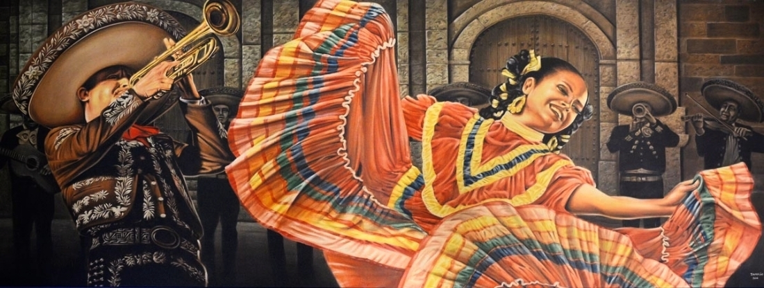
Established in 1983-Celebrating 40 years!

Slide 22
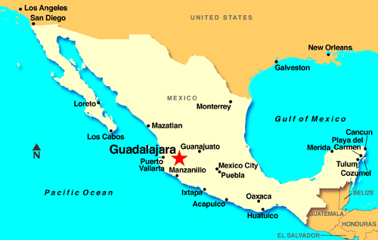
Guadalajara has been a Portland Sister City since 1983.
Guadalajara is Mexico’s third most populous metro area with 5 million citizens & Latin America’s 10th largest city
Guadalajara is also a city of roses and the cultural center of Mexico.
Guadalajara hosts a number of large-scale cultural events such as an International Film Festival and International Book Fair.

Slide 23
Established at Waterfront Park in 1984

Slide 24
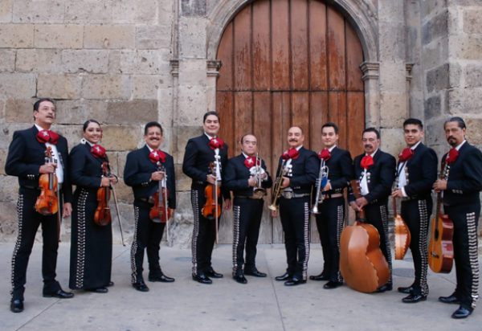
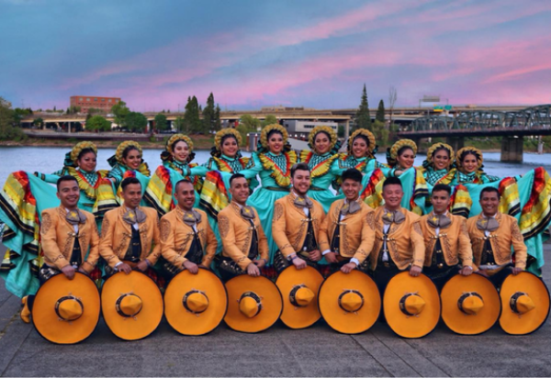
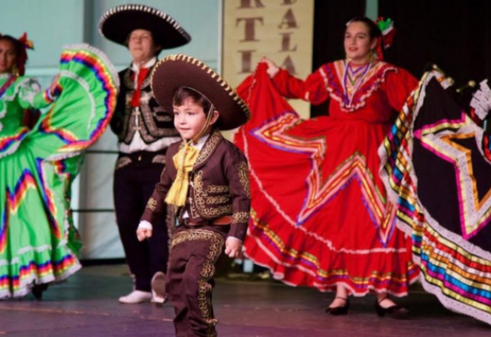
Featuring music and dancing from Guadalajara and Portland.

Slide 25
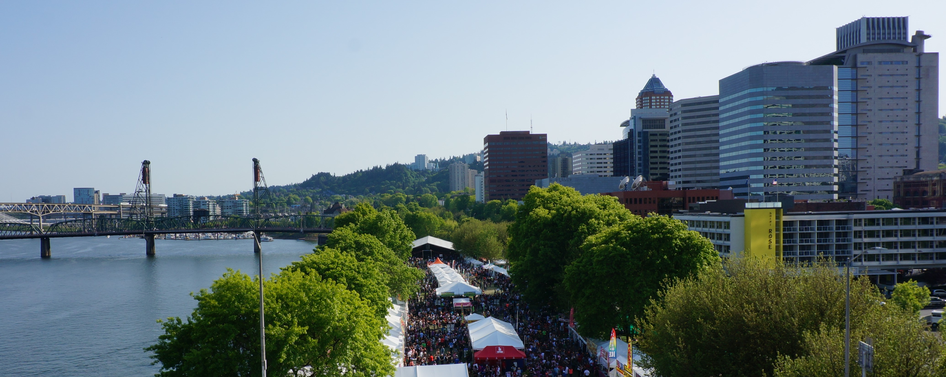
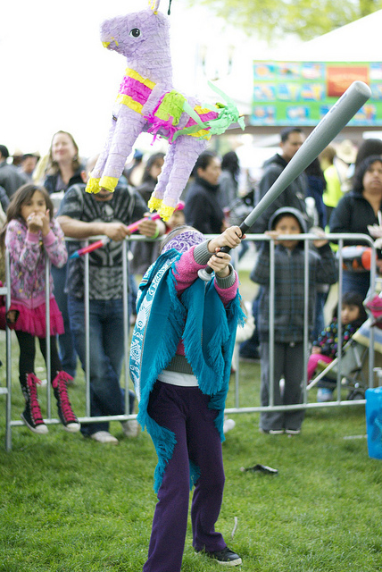
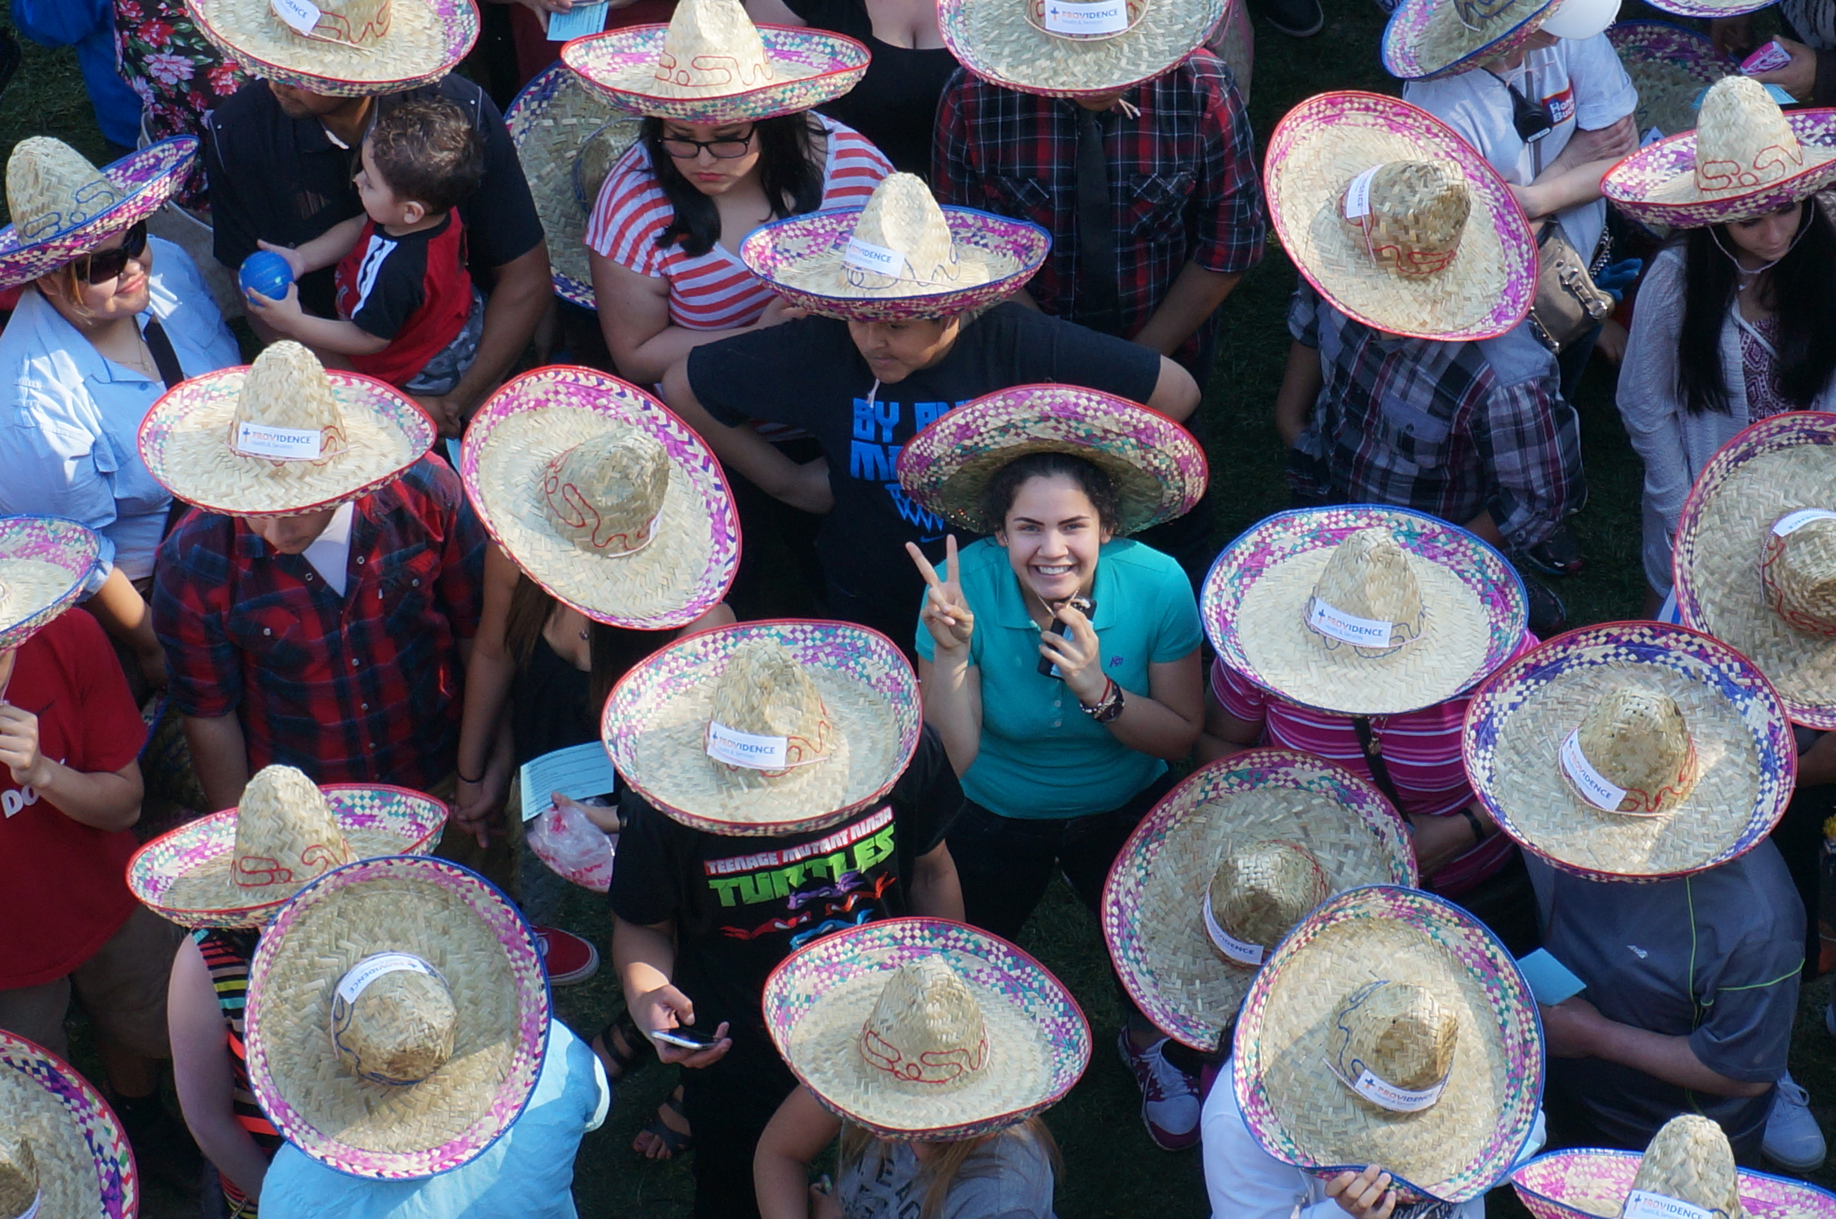
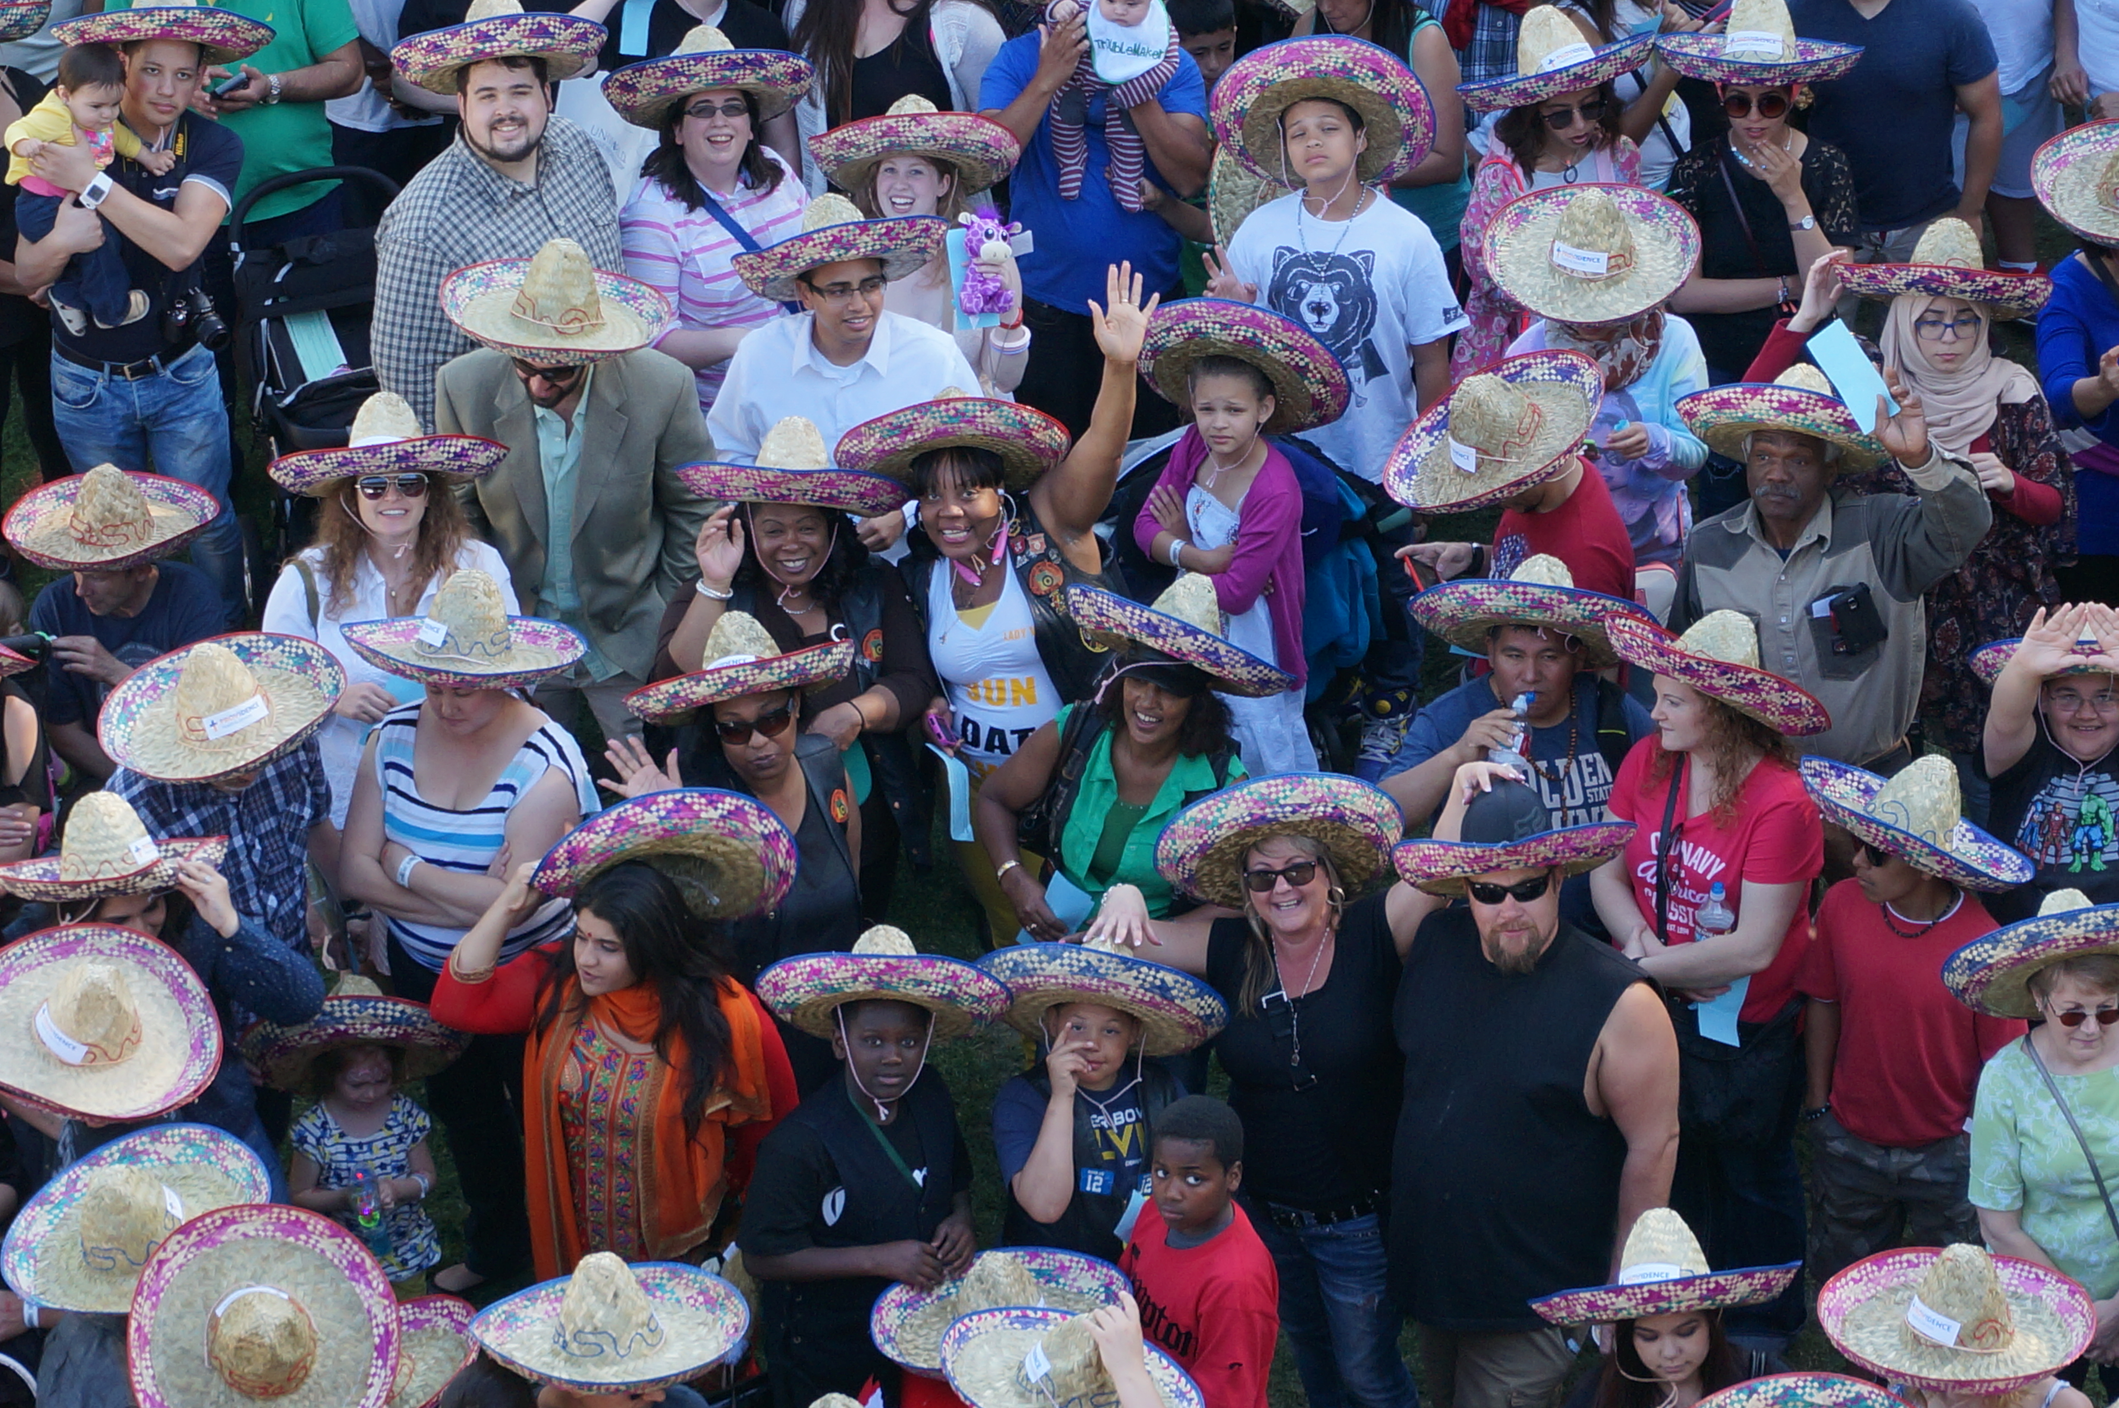
Guinness Book of ---
---World Records fun!

Slide 26
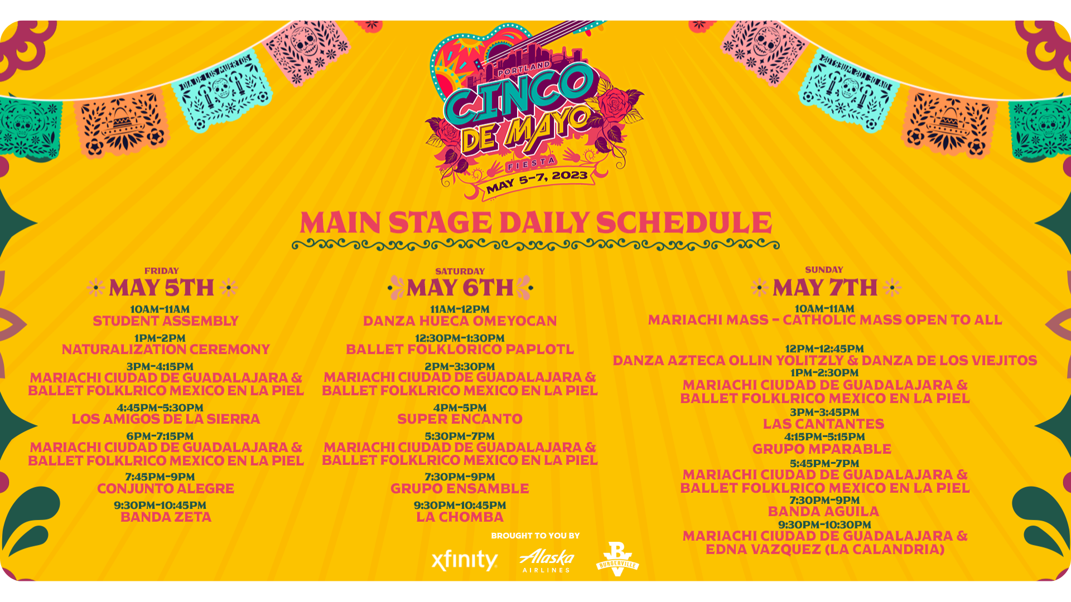

Slide 27
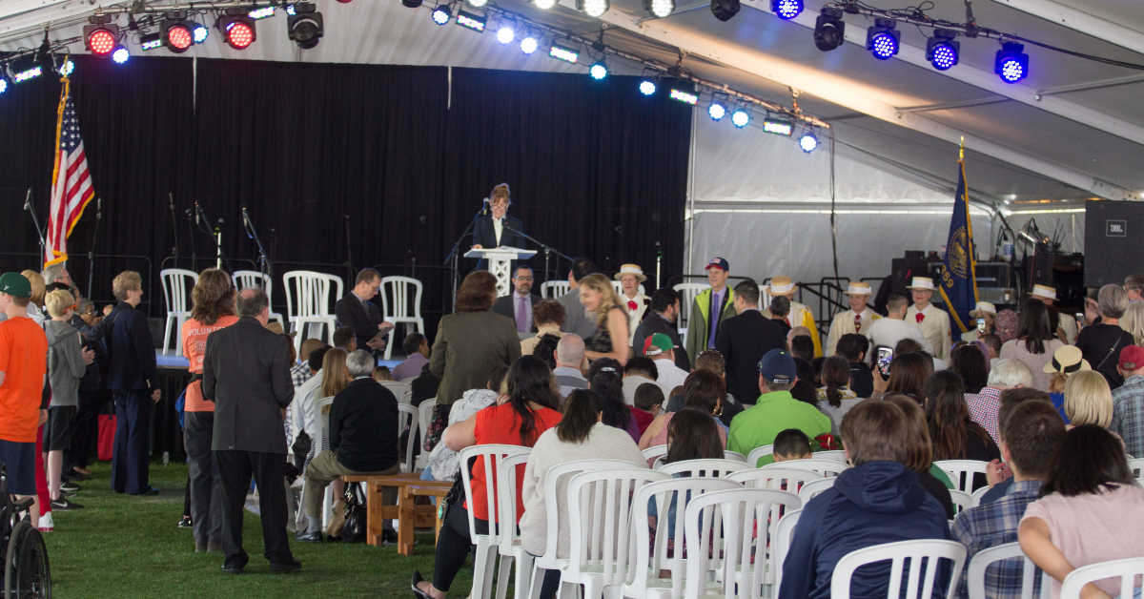
NATURALIZATION CEREMONY
48 People from 36 Countries became citizens this day

Slide 28
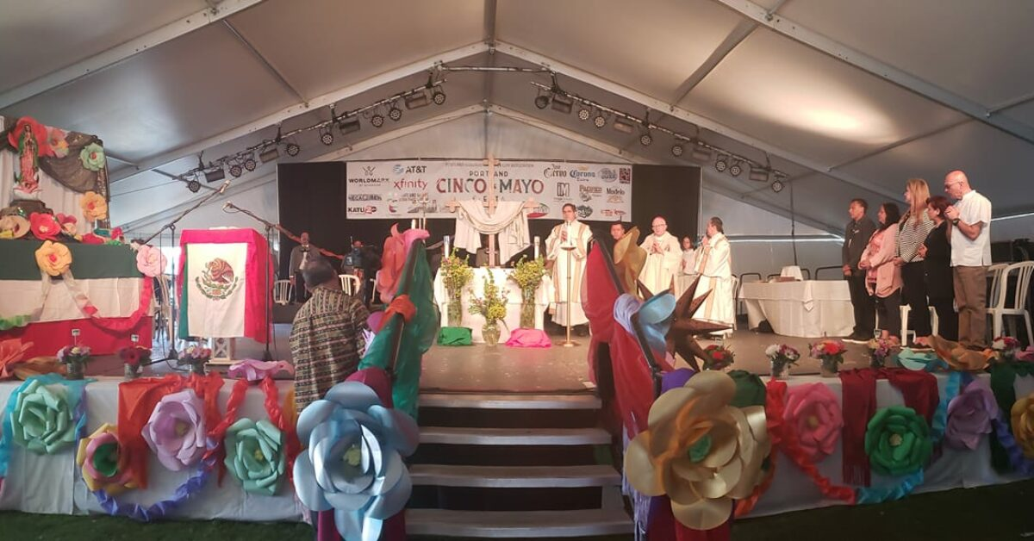
CATHOLIC MASS WITH MARIACHI CITY OF GUADALAJARA
The Mariachi Mass provides a spiritual and cultural aspect to PGSCA ‘s Cinco de Mayo festival, where positive family values ​​are emphasized and shared by the Hispanic community.
Everyone is welcome to attend the Mass, regardless of religious affiliation.

Slide 29
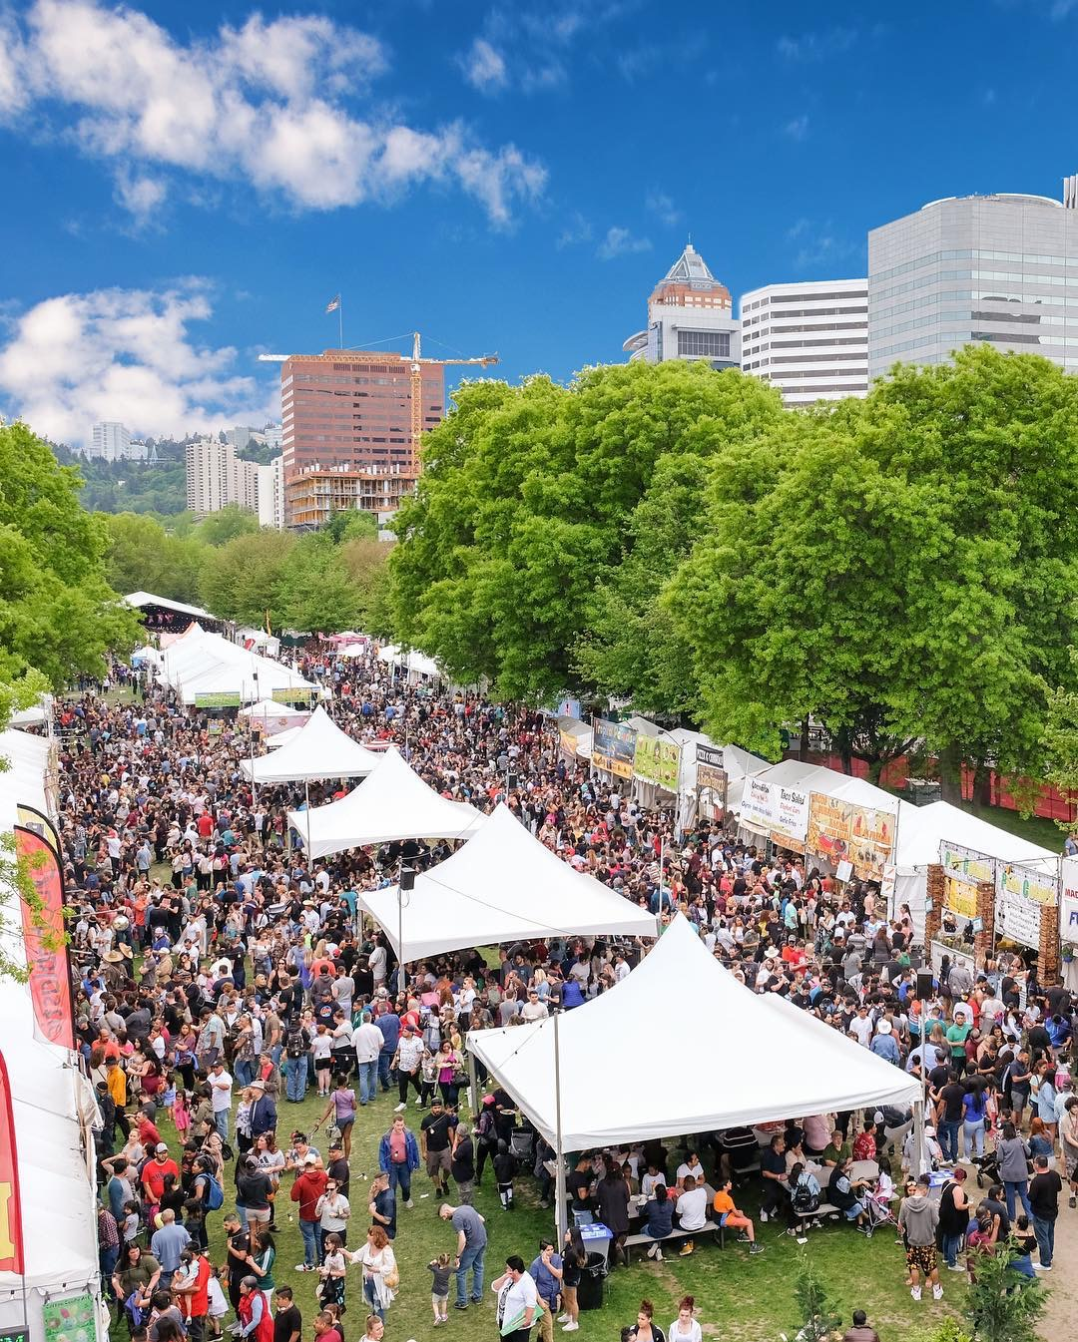
Sharing business, education, culture and love between the citizens of Portland and Guadalajara since 1983.

Slide 30
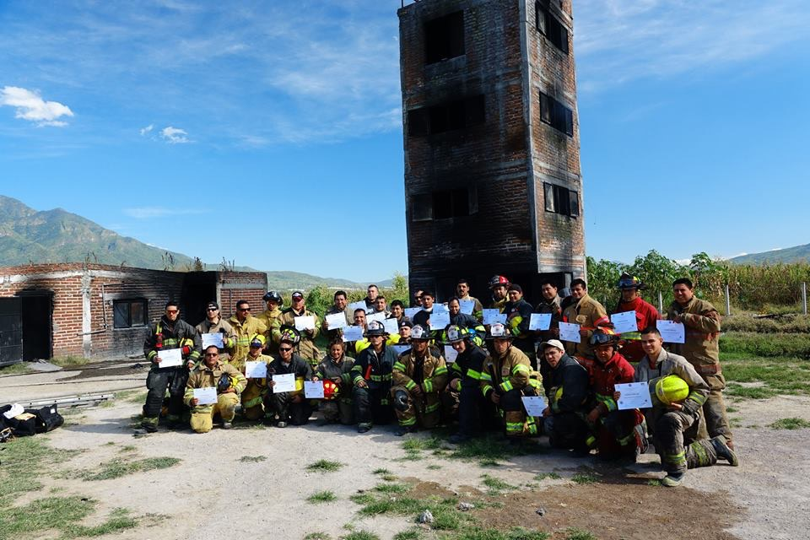
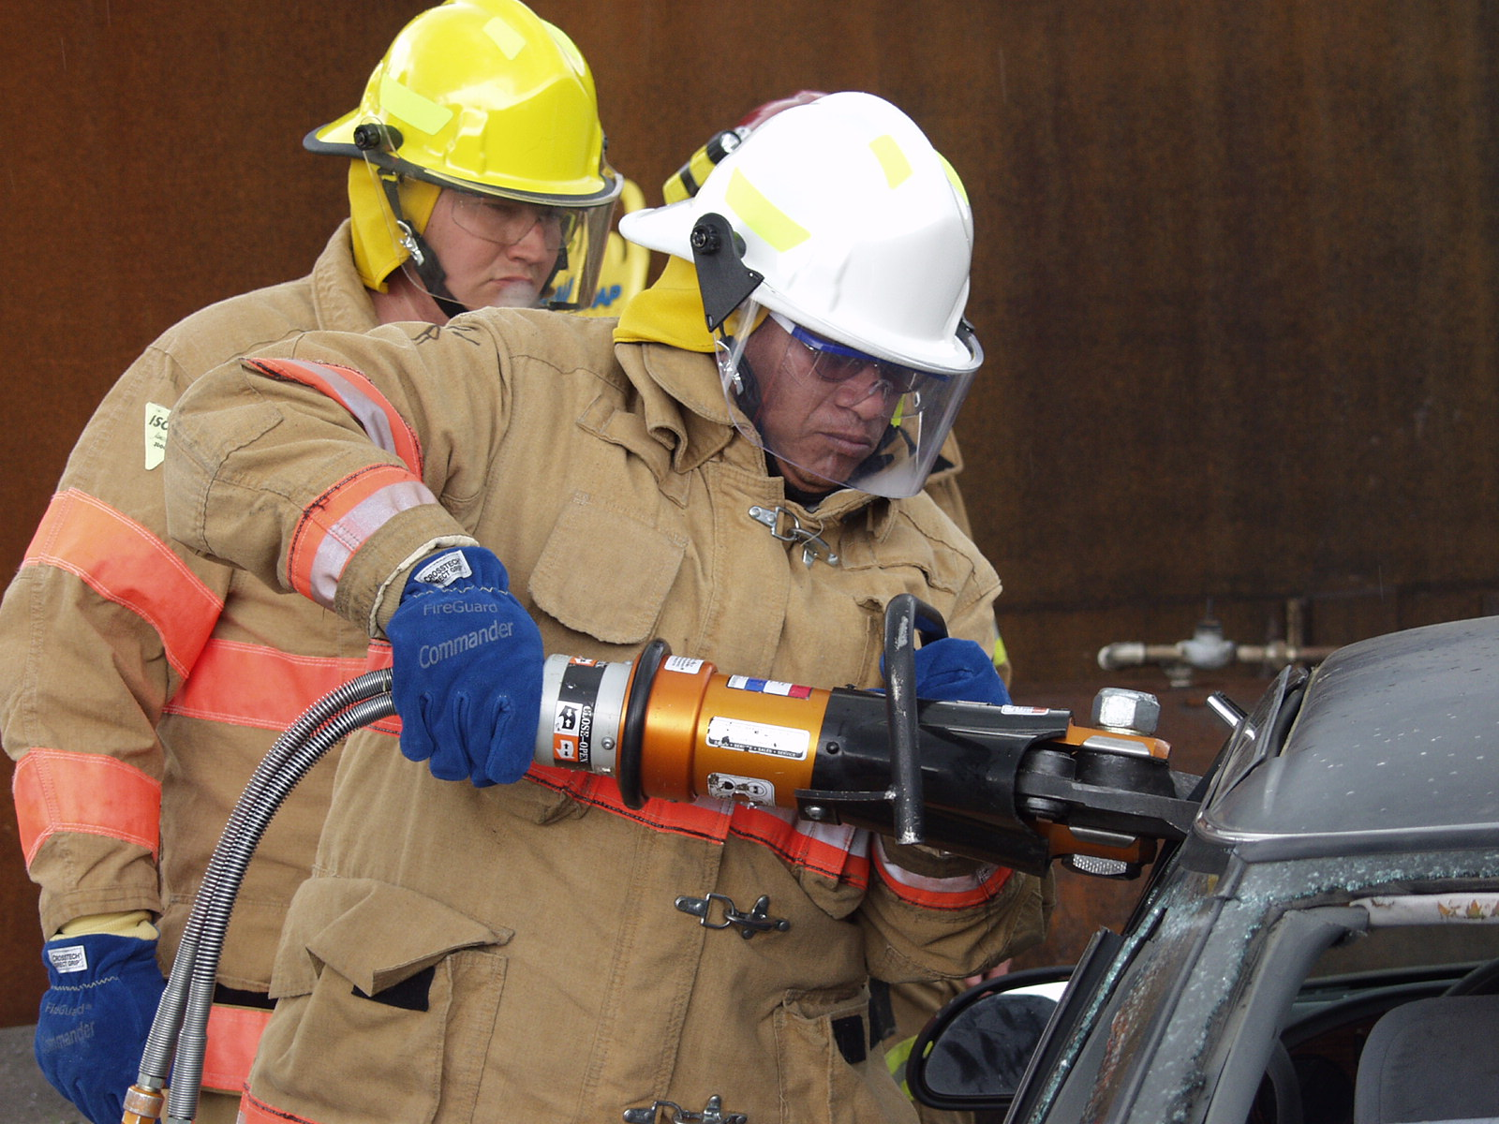
Portland Guadalajara Sister City Community Giving Program Continues
Bombero Program…
Portland firefighter and PGSCA board member Jose Troncoso trains firefighters from around central America in Guadalajara, Mexico.
PGSCA financially supports this effort to save lives.
Lifesaving techniques shared with firefighters from around the world in Guadalajara and in Portland.

Slide 31
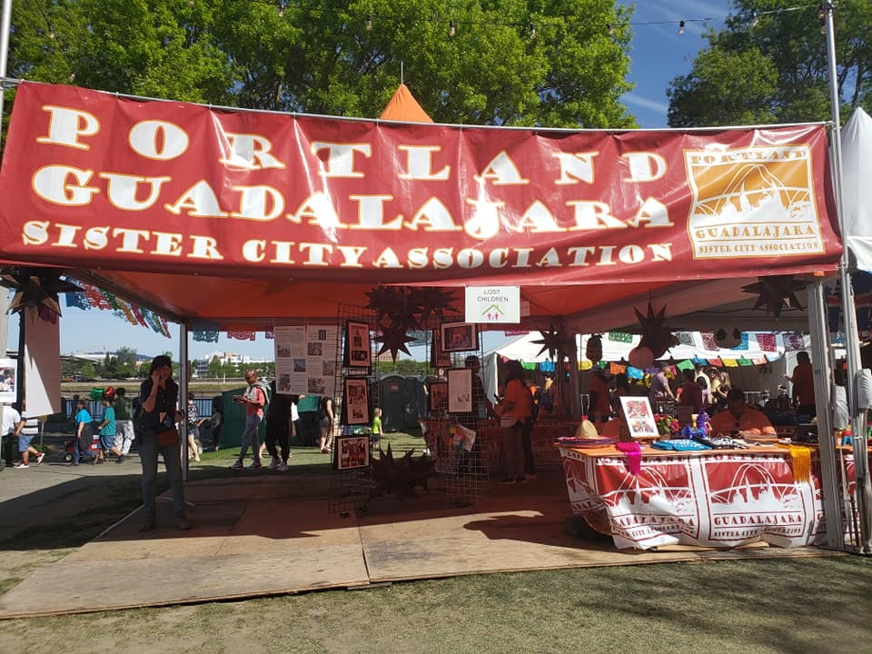
Community giving for 2023 will include donations to education, the arts and business to business collaborations. A big thanks for the effort put forth by the Mayor, commissioners, Portland Police, Portland Parks and everyone who helped to bring this event back to Portland!

Slide 36
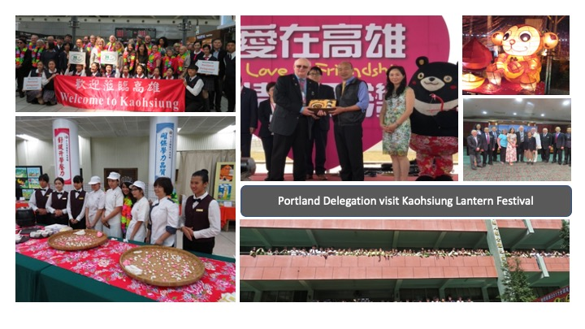

Slide 38
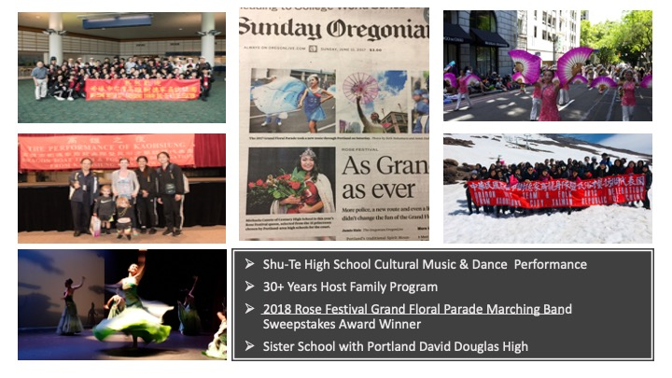

Slide 40
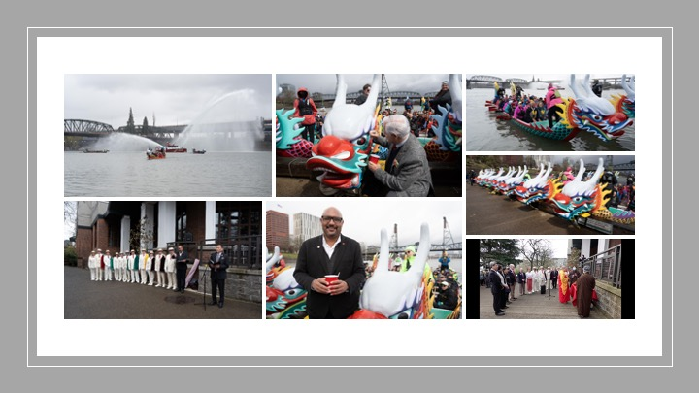

Slide 41
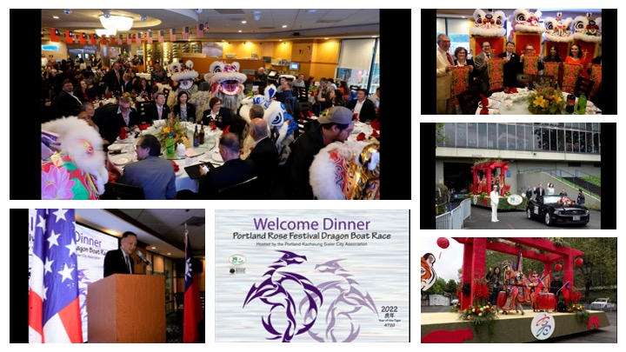

Slide 43
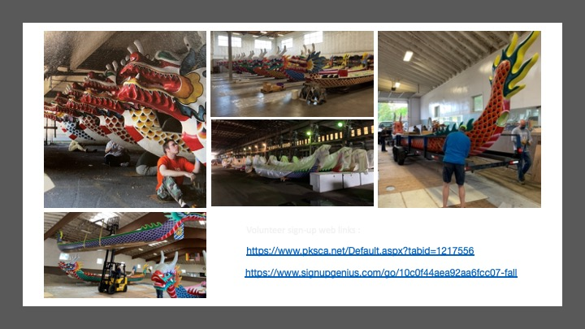

Slide 53
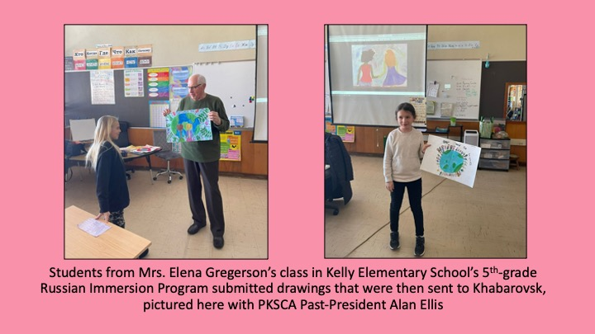

Slide 54
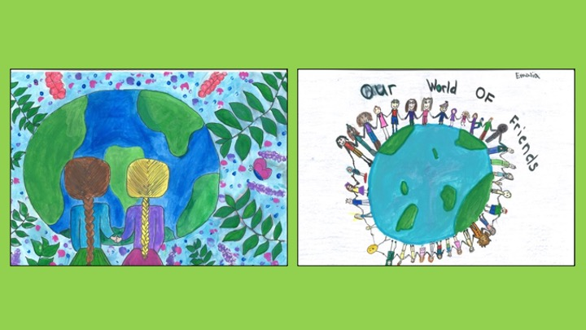

Slide 55
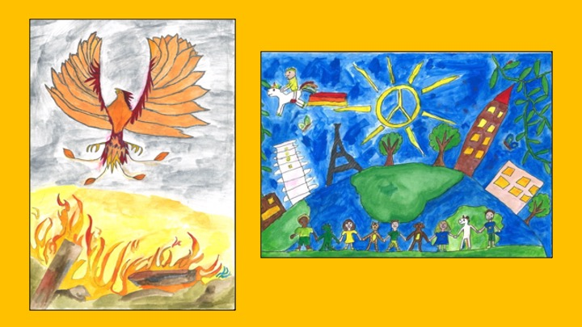

Slide 56
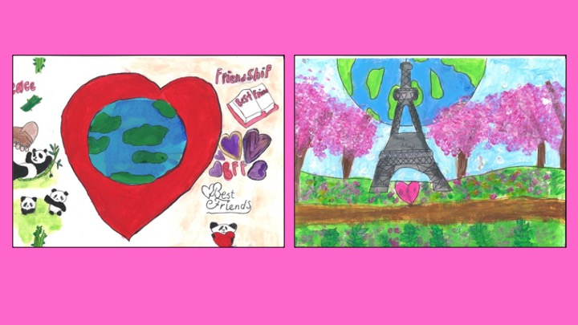

Slide 57
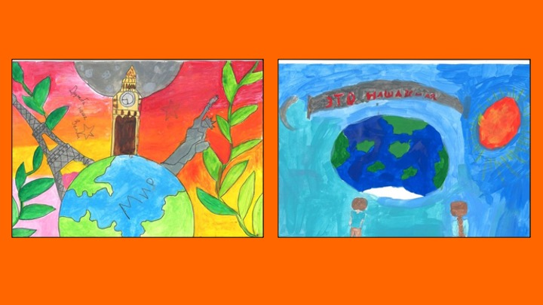

Slide 58
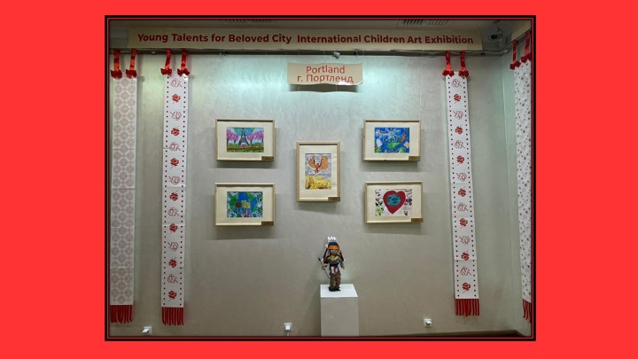

Slide 71
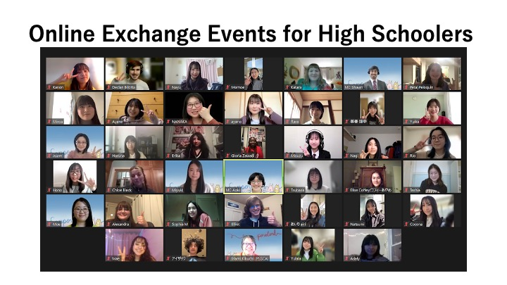

Slide 73
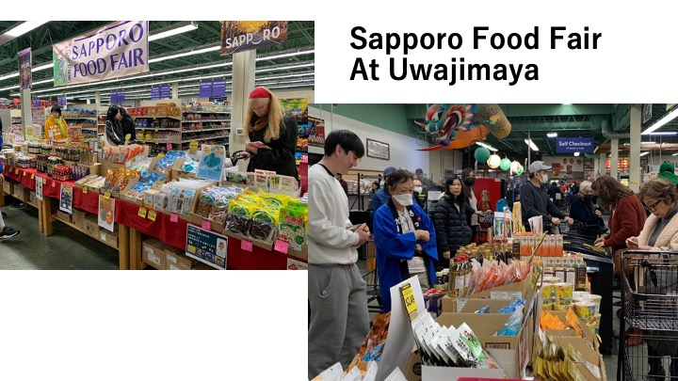

Slide 74
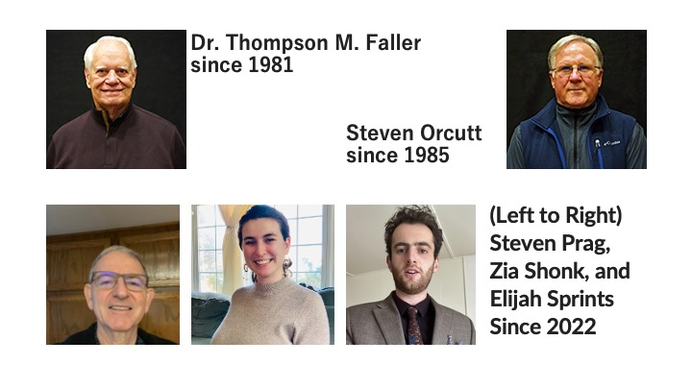

Slide 88
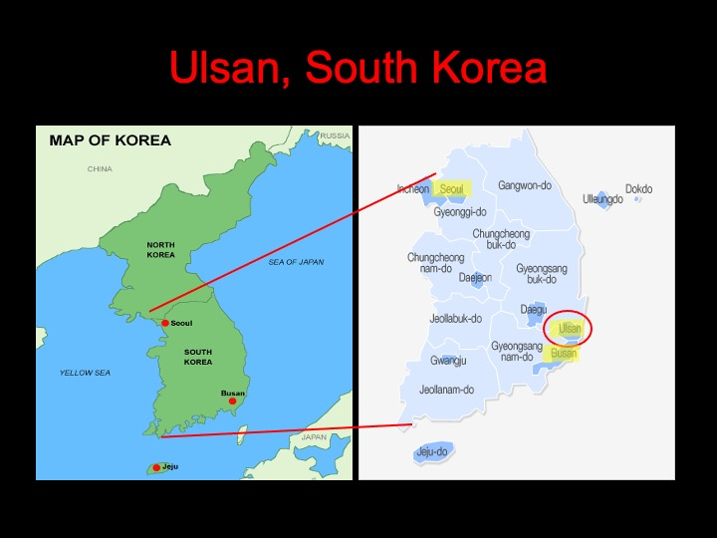

Slide 91
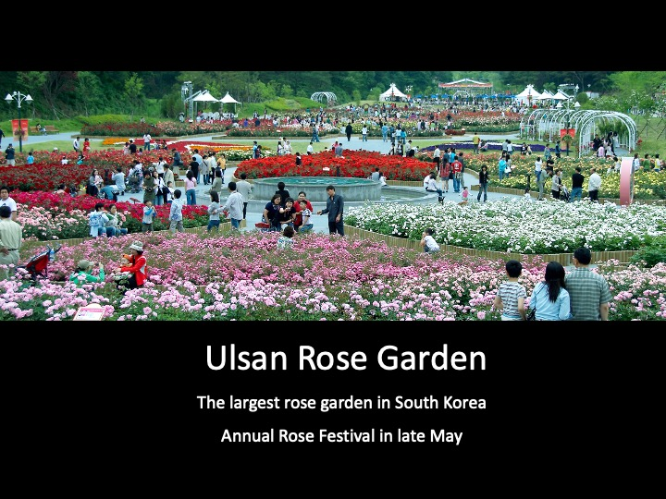

Slide 92
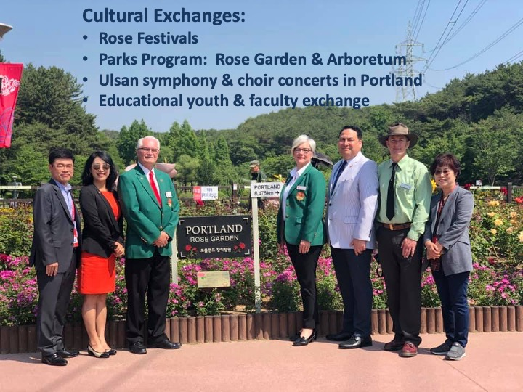

Slide 98
