Slide 1
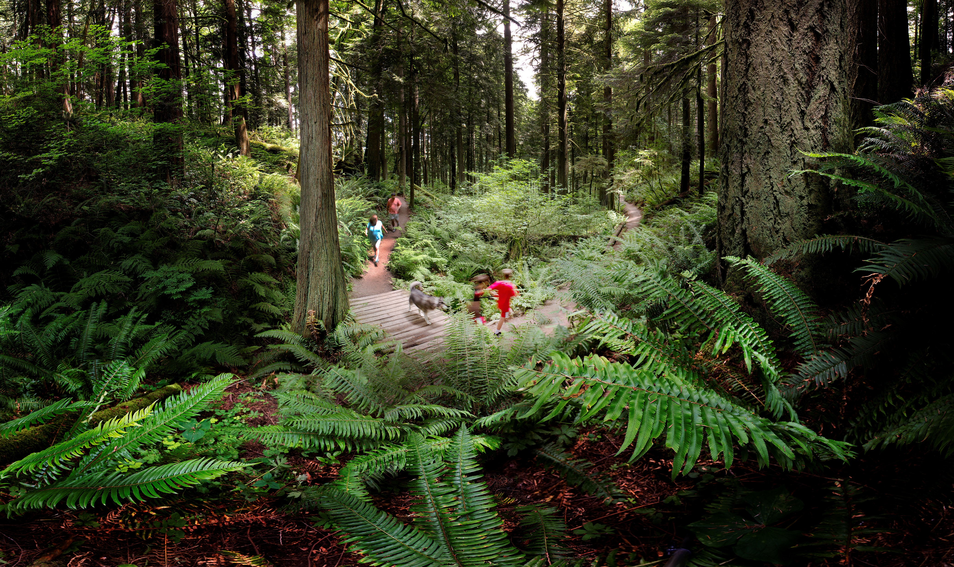
Proposed ordinance: Authorize Portland Parks & Recreation to receive fee in lieu of mitigation funds to implement restoration in natural areas
May 31st, 2023
Presenter:
Kendra Petersen-Morgan, Natural Areas Supervisor, City Nature West
Click to update the date or subtitle – January 1, 2018
Click to update the date or subtitle – January 1, 2018
Click to update the date or subtitle – January 1, 2018
Presenter Name, Title
Presenter Name, Title
Presenter Name, Title

Slide 2
Current system:
Third party proposes a project in Forest Park or other natural area;
Under zoning code and necessary permits, mitigation is required for negative resource impacts;
Applicants design and implement mitigation plans; and
Portland Parks & Recreation (PP&R) and Bureau of Development Services (BDS) provide extensive technical assistance throughout the process.

Slide 3
This burdens the City and applicants because:
Considerable communication and coordination between the parties is required;
It offers many opportunities for miscommunication and/or non-compliance;
Applicants can only perform certain types of mitigation; and
Applicants lack the technical expertise to carry out nuanced mitigation work.

Slide 4
The proposed ordinance would:
Authorize PP&R to accept mitigation fees from applicants, in lieu of applicants conducting mitigation;
Fees would be calculated based on existing fees for tree planting and removal under Title 11, the City’s tree code;
PP&R would use the fees to design and implement the mitigation in natural areas, instead of the applicant.

Slide 5
Proposed ordinance would help:
A more efficient approach: PP&R would use applicant funds to design and implement mitigation.
Reduces communication and coordination between all parties.
Reduces friction and results in more efficient use of City resources.
Better ecological outcomes on the ground: PP&R has technical expertise to implement appropriate mitigation.
Speeds restoration projects.
Enhances efforts to meet overarching stewardship objectives.

Slide 6
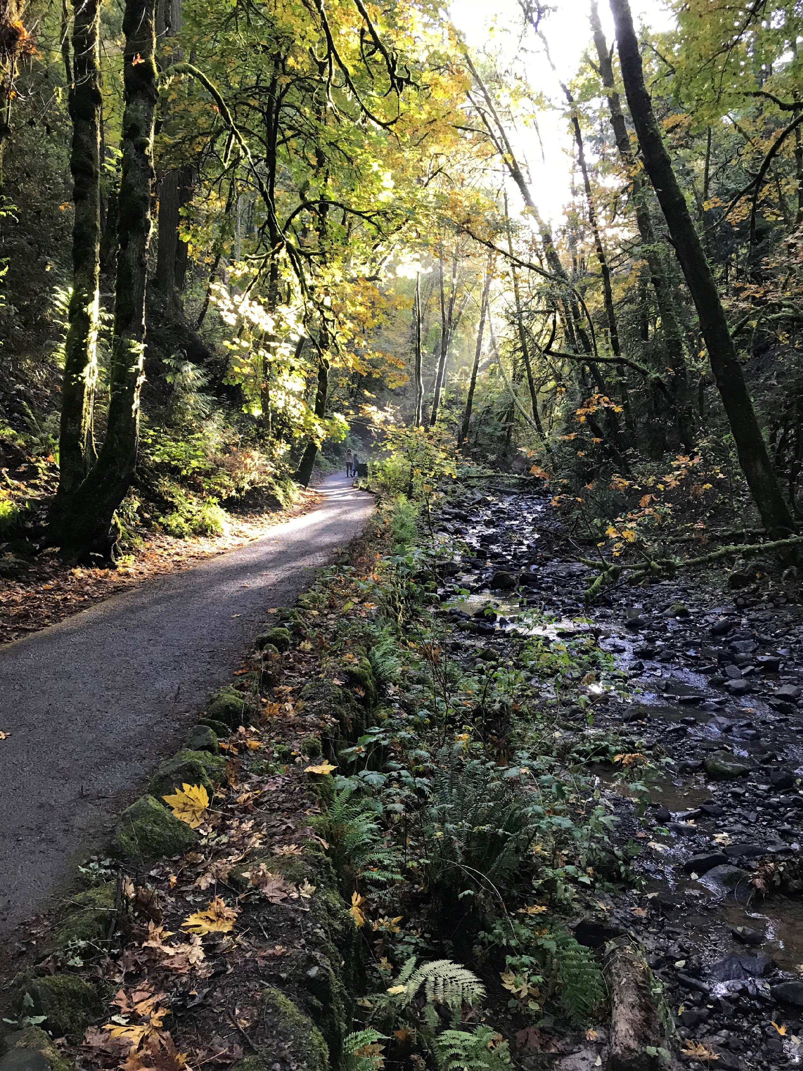
Questions and discussion

