Slide 1
RESIDENTIAL WASTE COLLECTION rateS and COMMERCIAL Waste TONNAGE FEE
City Council Utility Rate Hearing
May 24, 2023
Donnie Oliveira and Eben Polk

Slide 2
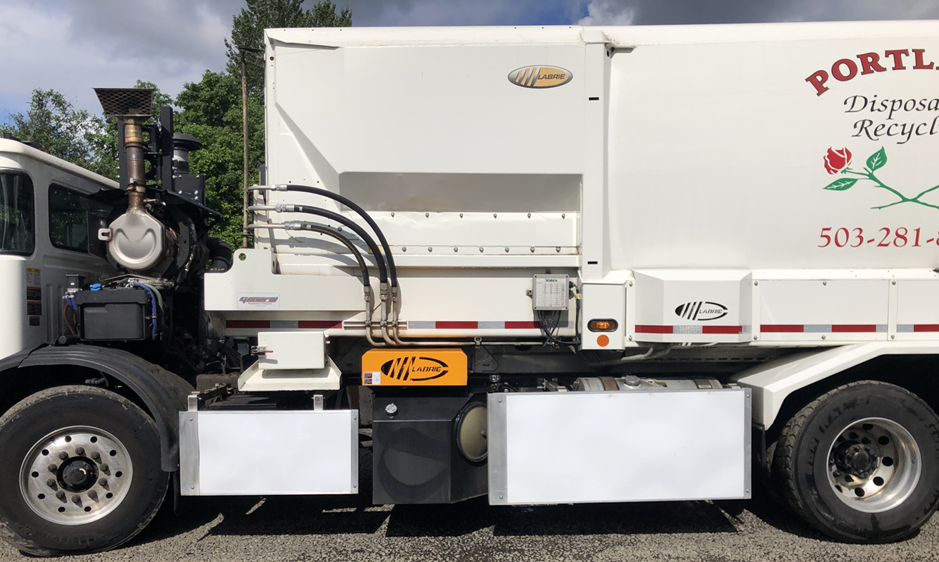
Topics
Waste collection systems and rate-setting overview
Residential rates recommendation
Commercial tonnage fee recommendation

Slide 3
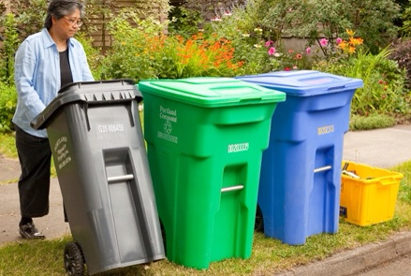
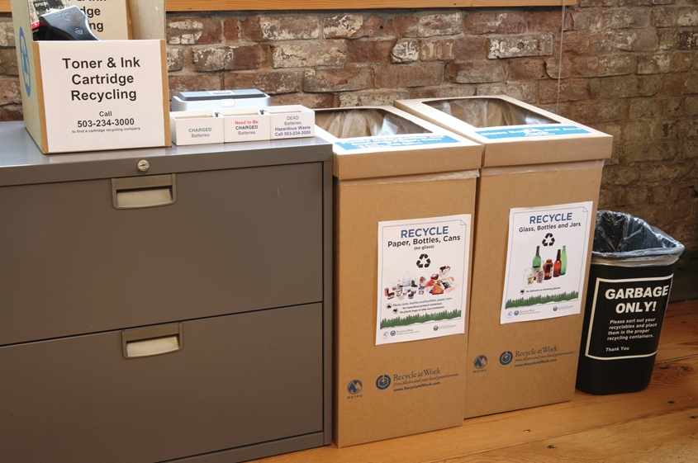
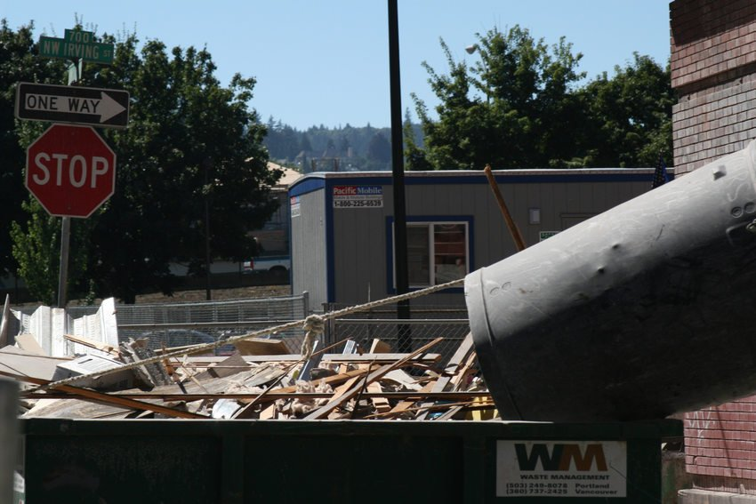
Where does Portland’s waste come from?
Residential
(single-family
thru 4-plexes)
Commercial
business
multifamily
construction and demolition
Notes:
Franchise covers single family, duplex, triplex, fourplex. Not multifamily (the part of Portland that is growing fastest) or business, or construction and demolition.
Residential accounts for under 1/3 of the waste generated in Portland.

Slide 4
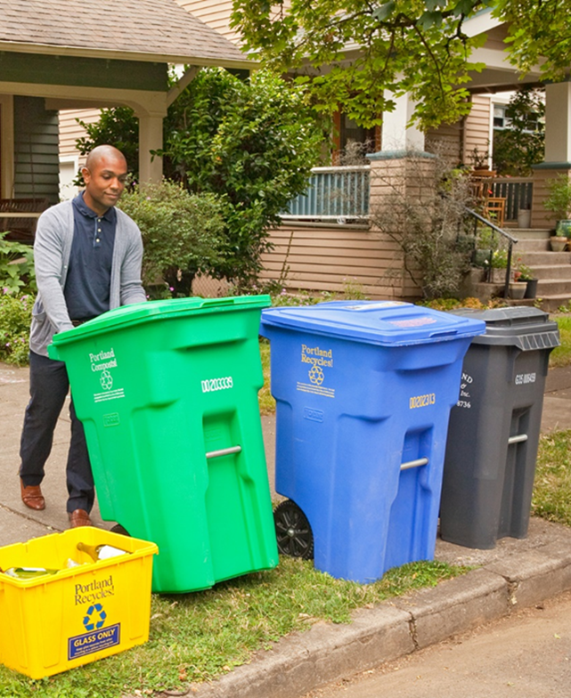
Background
We manage the residential collection system to:
Support recycling and waste reduction
Reduce environmental / climate footprint
Deliver financially sustainable collection service with good jobs
Maintain a reliable system

Slide 5
Residential Rate Review Process
Portland Ordinance 189242 (Franchise Agreement) Governs the Rate-Setting Process
This ordinance requires annual review and requires City Council to adjust rates to cover overall cost of service, target operating margin, plus the franchise fee.
The franchise system incentivizes haulers to deliver service in a cost-effective and efficient way because each hauler is not guaranteed a specific profit.

Slide 6
Rate Review Process
Jan.
March
Early April
Late April
May
30 day period
July 1
Jul-Aug
Haulers receive detailed cost report (DCR) template. | City receives DCRs. Contracted Certified Public Accountant reviews them and vets costs. | City receives adjusted DCRs and contracted economist prepares rate model using these costs. | City vets preliminary findings with economist and the Portland Haulers’ Association. Briefing for a public advisory body. | Hearing with proposed rates with a public advisory body and then two hearings before City Council. |  | New rates effective concurrently with City budget. | Customer notifications

Slide 7
Residential Rate Components
Rates cover:
cost of collection and disposal services for garbage, recycling, food scraps and yard debris
target operating margin
franchise fee
Collection service costs are based on actual prior year costs reviewed in detailed cost reports, plus known coming increases such as disposal costs or wages

Slide 8
Key Cost Factors for FY 2023-24
Increasing costs:
Overall inflation
Recycling processing costs (+100%)
Hauler staff wages
Metro disposal fees (+11.2%)
BPS franchise fee (5% to 8%)
Expanded public trash collection
Operational costs
Expanded regional goals and expectations for waste programs
Declining costs:
Fuel
Depreciation

Slide 9
Recommended Residential Garbage and Recycling Collection Rates
Primary Garbage Service Levels | Current Monthly Rate | Proposed Monthly Rate FY22-23 | Increase | Share of Customers
Every 4 Weeks | $27.35 | $33.25 | $5.95 | 4%
20-Gallon | $30.15 | $33.95 | $3.85 | 5%
35-Gallon | $34.90 | $39.00 | $4.10 | 41%
60-Gallon | $39.45 | $43.55 | $4.10 | 34%
90-Gallon | $45.70 | $49.90 | $4.20 | 7%
Terrain Fee: $0.70 increase to $5.55

Slide 10
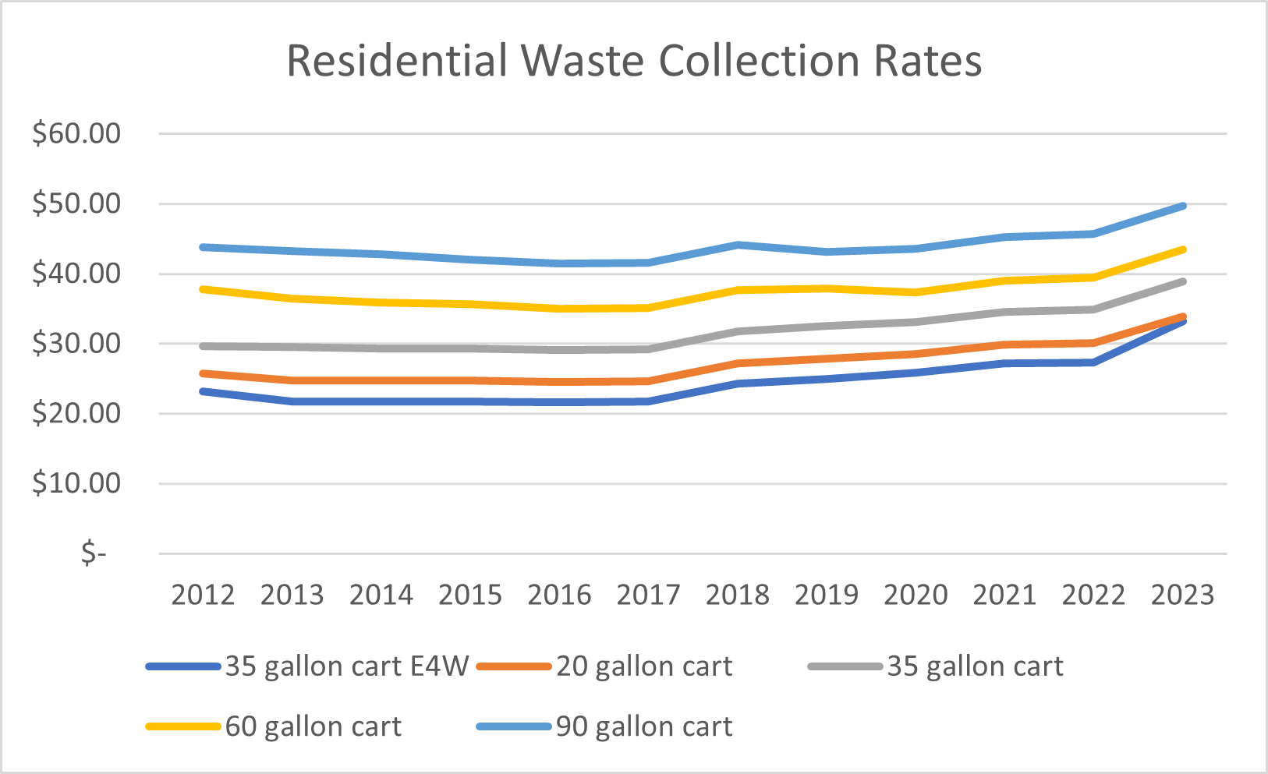
Rate History 2012 - 2023

Slide 11
Proposed rates remain lower than in 2012, adjusting for inflation
Recommended fees effective July 1
90
60
35
20
E4W

Slide 12
Comparable Cities: Monthly Cost for 32-35 Gallon Service
City
Services Included
Similar, bi-weekly Yard Debris
Similar
Garbage, Yard Debris, Food Waste, Comingled Recycling, Glass
Similar
Garbage, Recycling
Similar
Similar
Similar + Bulky Waste

Slide 13
Planning Commission Hearing
Planning Commission (PC) held a hearing on May 9 for the city's rate review, an interim public advisory step in lieu of the former Planning & Sustainability Commission
PC members suggested that other funding sources should be considered for public trash collection and thus the PC recommended adopting proposed rate increases with the exception of the franchise fee
The PC's subsequent recommendation letter (submitted to Council) supports public trash collection and recognizes alternative funding sources may not exist
Staff recommendation for solid waste fee increases remains unchanged:
public trash collection expansion is well underway
Council expectation set in 2021 was to fund public collection through the solid waste system
solid waste funds are also supporting the Impact Reduction Program
consistent with approved city budget
BPS does not have purview over funding alternatives

Slide 14
Commercial Tonnage Fee
Recommend $1.00 per ton increase to bring fee to $15.60 per ton for commercial garbage
Commercial tonnage fee supports services and programs related to or driven by commercial sector including contributions to the Impact Reduction Program ($1.07M in FY 22-23)

Slide 15
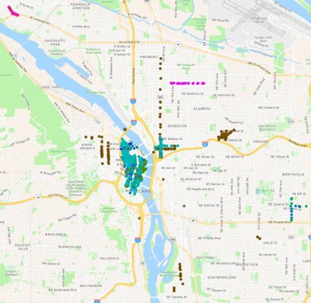
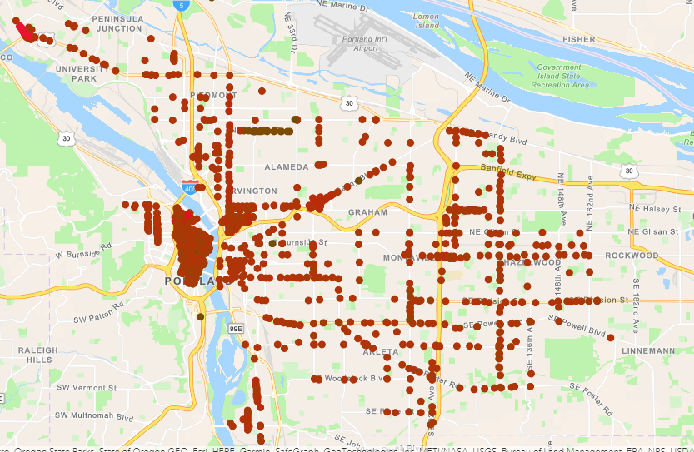
Public Trash Can Program Expansion
2019 - $1.2 million in expenses
700 trash cans in limited business districts.
2023 - $2.6M in expenses
1400+ trash cans covering large parts of the City. Projected to reach $3.6M

Slide 16
Next Step
July 1, 2023: Adopted residential rates and commercial tonnage fee take effect

Slide 17
Questions?

