Slide 1
North/Northeast Neighborhood Housing Strategy Oversight Committee
Annual Report to Portland City Council
Wednesday May 31st

Slide 2
Oversight Committee Members
Dr. Steven Holt, Committee Chair
Gabrielle Mercedes Bolivar
Triston Dallas, Attorney
Jilian Saurage Felton
Felicia Tripp Folsom
Sheila Holden
Virgie Ruiz-Houston
Aquiles Montas
John Washington
Adrian Mashia Sr,
Estelle Love,
Saelee Winters,
Ta’neisha Renee’

Slide 3
2022 Accomplishments
$409,477 in Rent assistance was provided to all 6 NE Housing Strategy buildings, assisting 117 Residents
2 PHB owned properties (Strong and Carey) and the Kaiser donated site were awarded in the Fall MBOS
5020 N. Interstate rental project broke ground and is scheduled for completion in late 2023/early 2024
PHB reached the 2022 goal of 110 new homeowners utilizing PHB subsidy, another 11 preference policy families purchased without subsidy

Slide 4
Total Interstate TIF Expenditures
2015-2022
Notes:
$ 95,590,053 TIF expenditures
Plus $2,000,000 STR
$1,000,000 CET for home ownership

Slide 5
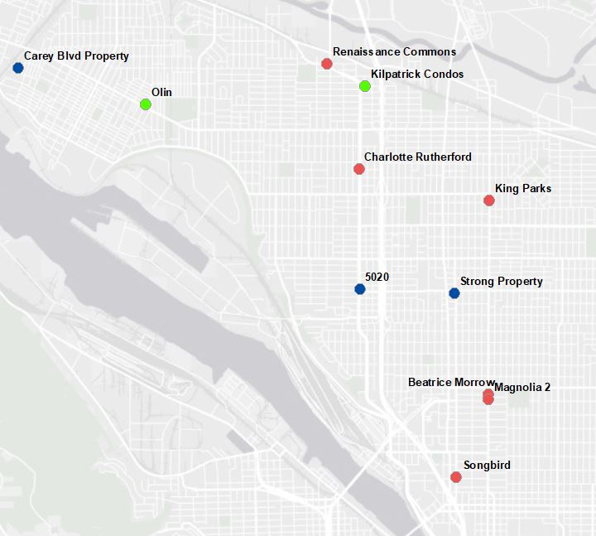
PHB N/NE Investments

Slide 6
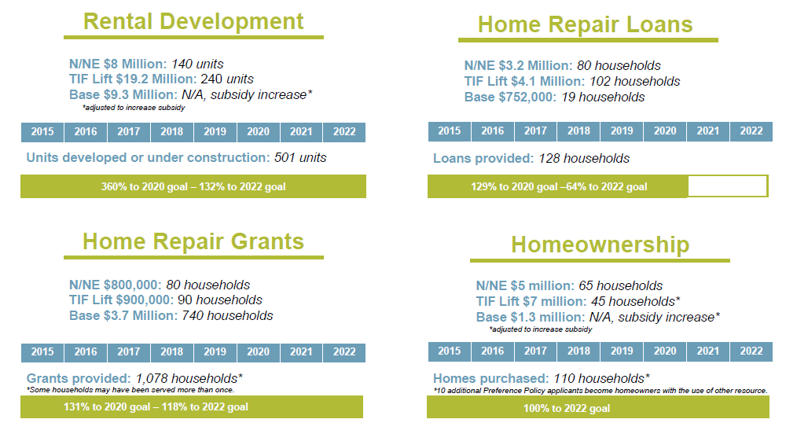

Slide 7
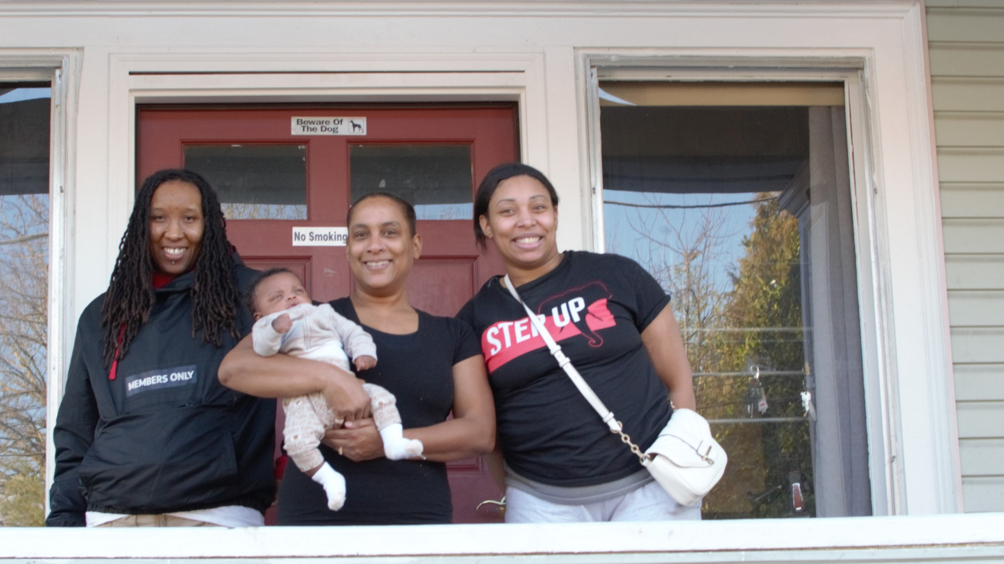
Strategy 1: Preventing Displacement
Notes:
DaLessa Miller (center) still recalls the exact date she and her parents moved into their North Portland home more than 30 years ago. It was January 7, 1990 – she was a senior at Jefferson high school—and closing on their home was an exciting time for the entire family.
In 2018, after her mother passed away, DaLessa inherited the house from her parents, but with the home in disrepair, and four children to care for, times were tough, and she had to rely on credit cards to make ends meet. In 2020, she participated in a workshop offered by the African American Alliance for Homeownership (AAAH), where she learned about home retention programs offered by the Portland Housing Bureau (PHB) for longtime residents of N/NE Portland.
“I found out about the lead grant program, but it was the housing program grant that I looked into first. It’s to help us stay in our homes, and if you stay for 15 years, it is forgivable. And we're not going anywhere.” DaLeesa was relieved to learn that she qualified for a Home Repair Loan from PHB, which allowed her to replace 20 wood windows with new vinyl windows, provided new interior and exterior paint, plus the repair and re-painting of doors, cabinets, and stairs throughout the home. Gutters were replaced, and a roof leak was repaired that was contributing to paint deterioration.
In addition, the house had high lead dust levels, which is a risk to children under 6, especially those that are crawling. As part of her home repair loan, she also received lead paint remediation through PHB’s Lead Paint Hazard Control Program.

Slide 8
Strategy 1: Preventing Displacement

Slide 9
Strategy 1: Preventing Displacement

Slide 10
Strategy 1: Preventing Displacement – HAPP
Notes:
80 PBS8 units
17 PSH units
67 at 30% AMI
57 studios
182 one bedroom
189 2 bedroom
70 3 bedroom

Slide 11
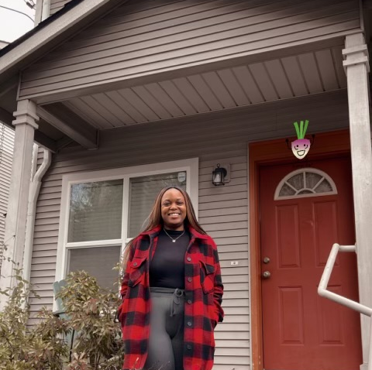
Strategy 2: Creating New Homeowners
Notes:
For the next two years she worked on building her credit, attending the African American Home Buyers’ club offered by Portland Housing Center (PHC). The sessions were motivating and engaging, and were held conveniently on Wednesday nights, offering different types of ethnic foods and a welcoming atmosphere. “It was a really good way to get more African Americans excited about homeownership,” she stated.
“Lenders and realtors would come and talk, and recent homebuyers came to share their stories. It felt great to be in class with others who were closing on their first home. That's what got me interested.”
Connecting with other motivated home buyers and receiving supportive guidance really inspired Sheriah, and in 2012 she was ready to buy. Sadly, she discovered the neighborhood where she grew up was outside of her financial reach, so she searched for homes in and around the outer SE Powell neighborhood. Initially, she explored a short sale, however that proved futile. Appreciating the experience, she remained determined.
Then, in 2013, working with a realtor she met at the club, she placed an offer on a cute townhome in the Concordia neighborhood of NE Portland. Finally, her offer was accepted! Her dream was beginning to be realized, yet, again, the sale fell through, and this time it was because of her student loans.
“After going through the whole process, it defeated me a little bit. I had plans of returning to school soon, but at that time the home loan stipulated that student loans had to have been deferred for a full year. After this, I ended up taking several years off from searching—and I didn't know if I wanted to buy a house anymore.”
Then in September of 2021 a friend bought a house and reminded Sheriah homeownership was her dream as well. Sheriah immediately began searching for a home, working with the African American Alliance for Homeownership (AAAH) and PHC. Just one month later, in October 2021, she found a home in outer SE Portland and was considering making an offer when her counselor informed her that she qualified for the DPAL program, which would aid her in purchasing a home in N/NE Portland! Shortly after, she found a townhome and closed on December 31st!
Today, Sheriah lives in the neighborhood where she grew up, just 10 minutes from her parent’s home. “I feel accomplished! I always wanted to move back, but it felt like an impossible goal to reach. I live minutes from the freeway, and close to downtown. It is possible! I am still pinching myself; it just feels like a dream.”

Slide 12
Strategy 2: Creating New Homeowners

Slide 13
Strategy 2: Creating New Homeowners

Slide 14
Strategy 2: Creating New Homeowners
83% of homes purchased had 3+ bedrooms
71% of homes purchased had 1.5+ bathrooms
Average sales price of market rate homes = $313,187
Market rate sales ranged from $176K to $522K

Slide 15
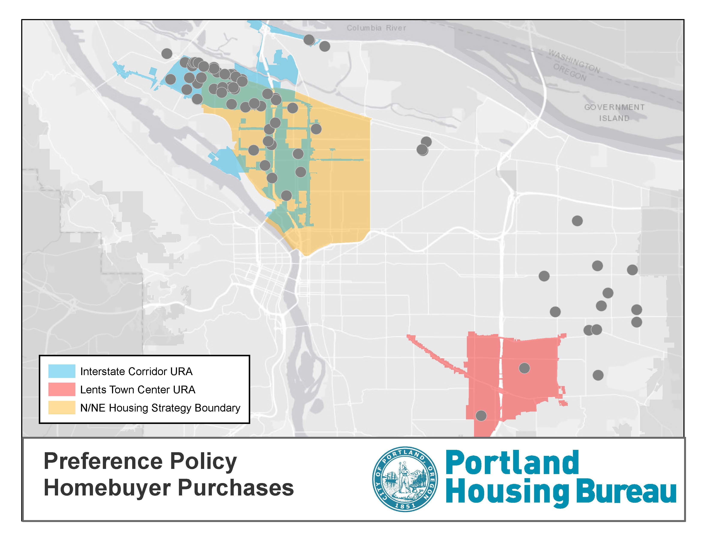
Strategy 2: Creating New Homeowners

Slide 16
Strategy 2: Creating New Homeowners - Development
Sponsor | Site | # of PP | Funding Sources
SEI/CDP | Strong/Abbey site | 7-8 | Metro/TIF CDP owned land
Habitat for Humanity/Proud Ground | Carey Blvd Site | 52 | Metro Bond/TIF & PHB Land
Williams & Russell CDC/ Adre/PHC | Williams & Russell | 20 | TIF DPALs & Legacy land

Slide 17
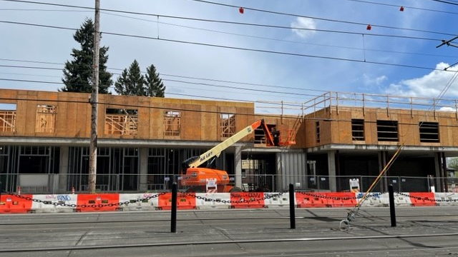
Strategy 3: Creating New Rental Homes
Notes:
5020 N Interstate broke ground on _______________________, due for completion in late 2023

Slide 18
Strategy 3: Creating Rental Homes
Sponsor | Rental Project | #PP Units | Total # Units | % BIPOC | Status
PCRI | Beatrice Morrow | 59 | 70 | 87% | Occupied
PCRI | King+Parks | 49 | 70 | 93% | Occupied
CCC | Charlotte B Rutherford | 51 | 51 | 94% | Occupied
IHI | Magnolia II | 49 | 50 | 87% | Occupied
Reach CDC | Renaissance Commons | 185 | 189 | 79% | Occupied
Bridge | Songbird | 20 | 60 | 83% | Occupied

Slide 19
Strategy 3: Creating Rental Homes
Sponsor | Rental Project | #PP Units | Total # Units | Funding Source
SEI/CDP | 5020 N. Interstate | 64 | 64 | Metro Bond & PHB Land
AVT/Edlen & Co | Albina One | 78 | 94 | Metro Bond
SEI/CDP | Strong | 75 | 75 | Metro Bond/TIF & PHB Land
NHA/ULPDX | Kaiser Site/Margaret Carter | 51 | 62 | Metro Bond/TIF and Kaiser land
PCRI & HDC | Williams & Russell | 80 | 80 | Interstate TIF & Legacy Land

Slide 20
Policy Goal: DMWESB Participation Home Repair

Slide 21
Policy Goal: DMWESB Participation Rental Construction

Slide 22
Policy Goal: DMWESB Participation Rental Construction

Slide 23
Policy Goal: Preference Policy
Notes:
Unduplicated Applicants to date:
Home Ownership – 1,622
Rental – 3,782
Eminent Domain Applicants – 612 (

Slide 24
Summary
2022 was a full year of continued activity for the oversight committee. Several goals were achieved in that align with the overall strategy, including home repair grants, and creating new homeowners.
Continues to be active participation by PHB’s non-profit partners in working with the NE OC.
PHB released the Metro Bond Solicitation which included three NE properties, ICURA funds and Metro funding. Development teams were selected for all three projects: Carey Blvd – Habitat for Humanity/Proud Ground; Strong property – Self Enhancement Inc/Community Development Partners; Kaiser donated property – Urban League/Northwest Housing Alternatives.
The 5020 project that was originally slated to be a home ownership development, broke ground in 2022 as a rental project utilizing the plans originally created for the condo development. These units are on track to be completed in late 2023/early 2024. PHB is working with them on leasing utilizing the preference policy.
PHB worked with Commissioner Ryan’s office and the OC on placement of one of the Safe Rest Villages on property purchased for the NE Housing strategy, Carey Blvd.

Slide 25
Summary
Notable accomplishment is the achievement of the home ownership goal of 110 new homeowners with PHB subsidy, with an additional 11 preference policy families became homeowners after receiving homeownership counseling services through our community partners
PHB Down Payment Assistance seems to be the most used subsidy to create new homeownership for preference policy home buyers.
The data is clear that the Housing Strategy and Preference Policy work.
How will the Preference Policy continue to serve its purpose and generate these results into the future?
Completed a recruitment for new OC members in the fall of 2022, which resulted in 4 new members coming onto the committee in early 2023.
Evaluation of the preference policy being completed by Portland State University as part of a Robert Wood Johnson grant. A memo outlining issues in the preference policy buildings was sent to PHB and the NE OC, issues including building safety, rent checks not being cashed, lack of safe package delivery, poor communication, and failure to follow ADA regulations.
As a result of those findings, PHB and OC held a series of meetings to look at mitigation strategies. PHB and the OC will continue to work through these issues in 2023.
Identified that there are funding gaps for security in the PP buildings, but also as a systemwide issue.
PHB required the 6 PP buildings to submit quarterly updates explaining steps they’ve taken to address issues raised in the memo.

Slide 26
Opportunities
Home retention strategy utilizing home repair loans/grants, we’d encourage PHB to increase engagement with community to ensure that they are reaching the intended population, specifically for home repair loans. The small number of loans in 2022, could be a signal that this is not the appropriate tool to serve the targeted community in the ICURA. The OC suggests, PHB evaluate the effectiveness of this program, and consider reallocating loan funds to the grant program, and increasing the grant award amounts.
The OC is concerned that we continue to see small numbers of Black/African American trades/construction workers participating in all levels of construction for rental development and home repair. What steps are being taken to increase Black/African American participation in projects in NE Portland, the committee has discussed over its tenure the necessity of providing living wage jobs as part of the strategy, not just affordable rental units.
The OC would like to see increased partnership and communication between themselves, PHB and the partners. While there have been no significant issues, the memo from PSU created some reluctance to participate in conversations.
New developments create opportunities to ensure that the values of the NE Housing Strategy continue. The development teams will be presenting their plans to the OC early summer, the OC will provide feedback with the expectation that development teams benefit from the lessons learned from previous projects. That the development teams are clear on the objectives that have been set forth within the strategy and by the NE OC, working collaboratively as partners.
Ensure that the Safe Rest Village transitions as promised, without any significant delays, to ensure timely construction of a new home ownership community on that property. The OC wants to relay the importance or prioritizing home ownership, given the significant disparity in Black Home ownership in Portland.

Slide 27
Opportunities
A significant issue in the creation of new homeowners, particularly in the Interstate URA is rising home prices and interest rates. The OC appreciates PHB’s recognition of this and the allocation of citywide funds for preference policy applicants. We recommend that PHB continue to prioritize additional citywide funding either CET or STR to support these efforts.
To optimize investment opportunities for home ownership, we suggest PHB collaborate with Home Forward to utilize the waiver which allows housing choice voucher holders to apply their voucher towards a mortgage. One of our 121 homeowners was able to purchase their home using their voucher as income. we would love to see this applied to as many of our marginalized and displaced community members as possible.
PSU report – highlights several consideration and concerns.
Considerations – how resident services is calculated into the pro forma, does there need to be a different way to account for higher needs populations aside from PSH?
Communication gaps for residents, how can we assist with improving communication between property management and residents?
Delivery of packages, groceries and/or other goods lack of secure location. Suggest all buildings work with Amazon to have a locker placed in the lobby.
City Council appropriate additional funds to support additional security to patrol areas where there are multiple affordable housing developments
Concerns- Residents being fearful to report issues in buildings that they will be retaliated against by staff.
Building safety, issues with calling the police, fire department, or any first responders.
Absence of security, doors not being secured and non-residents having access to building common areas
Presence of violence
Cleanliness, pet waste not being cleaned timely, lack of weekend janitorial service
No availability of staff on weekends for urgent issues, or slow response of those that are on-call
Need to ensure that tenant’s rent payments are processed in a timely fashion, so that they are not given eviction notices for failure to pay…
PHB consider evaluating whether a similar strategy could work in other areas of the city experiencing or likely to experience gentrification (eg along the proposed new SW MAX line).

Slide 28
QUESTIONS?

