Slide 1
Community Watershed Stewardship Program
May 2023
Kathy Dang & Daryl Houtman – Environmental Services, Community Watershed Stewardship Program
Judy BlueHorse Skelton - Professor, Indigenous Nations Studies Dept., Portland State University
Bear Cunningham-Goodell – Student, Portland State University
Mingus Mapps, Commissioner
Dawn Uchiyama, Director

Slide 2
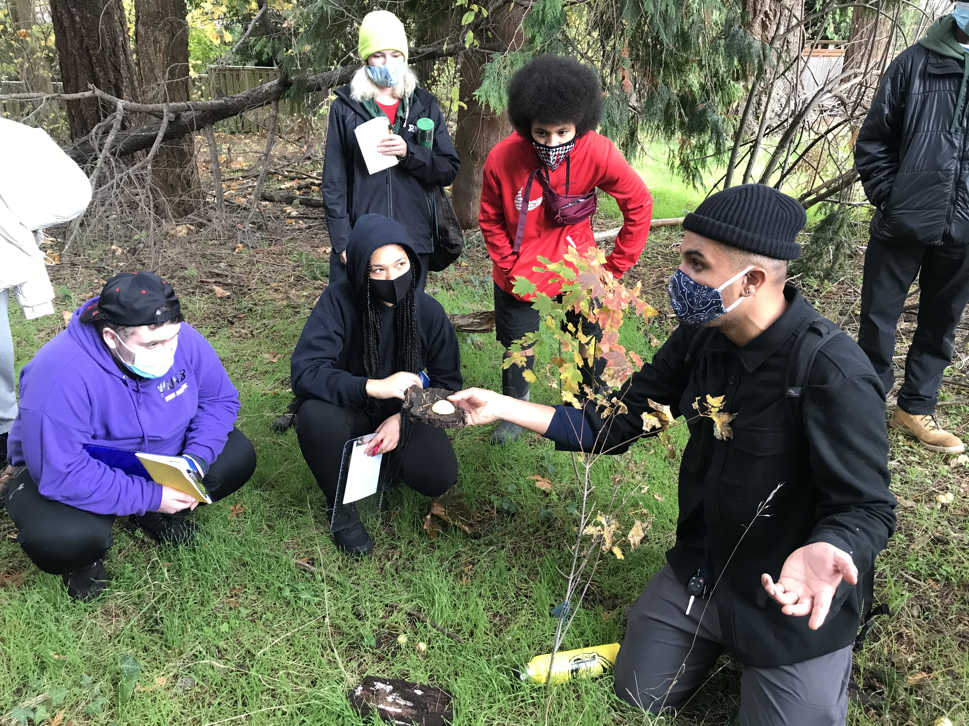
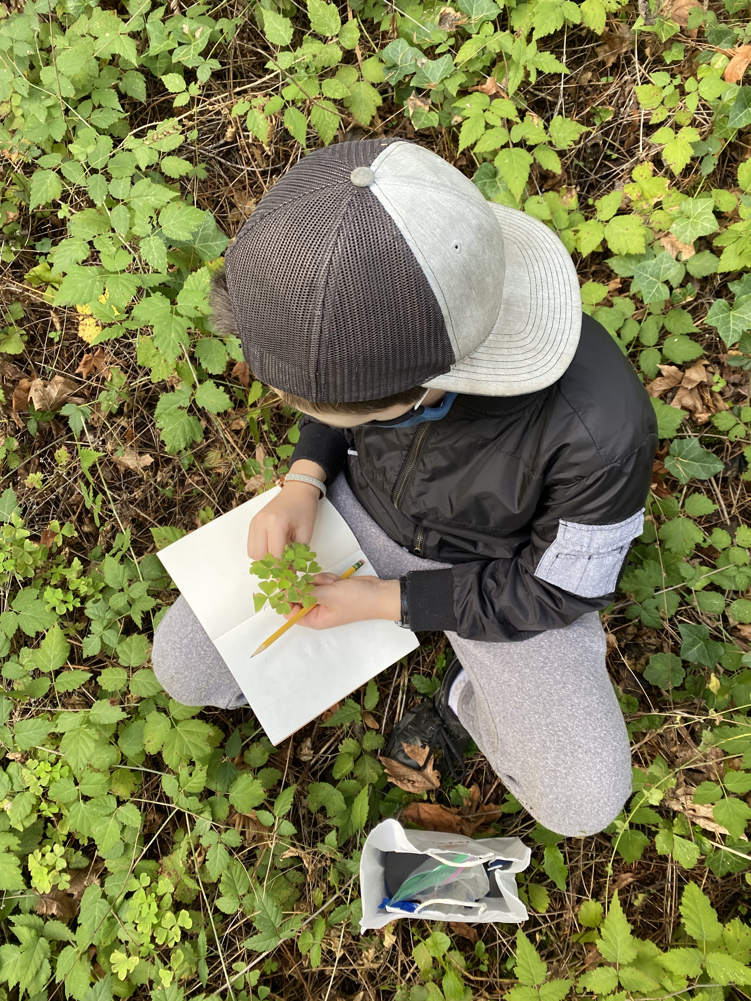
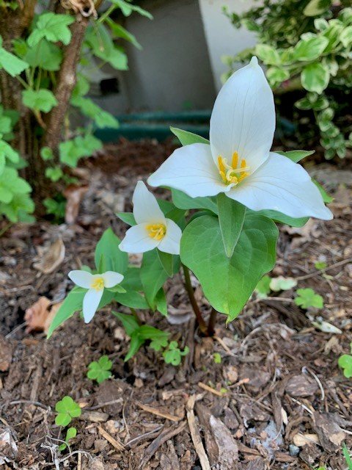
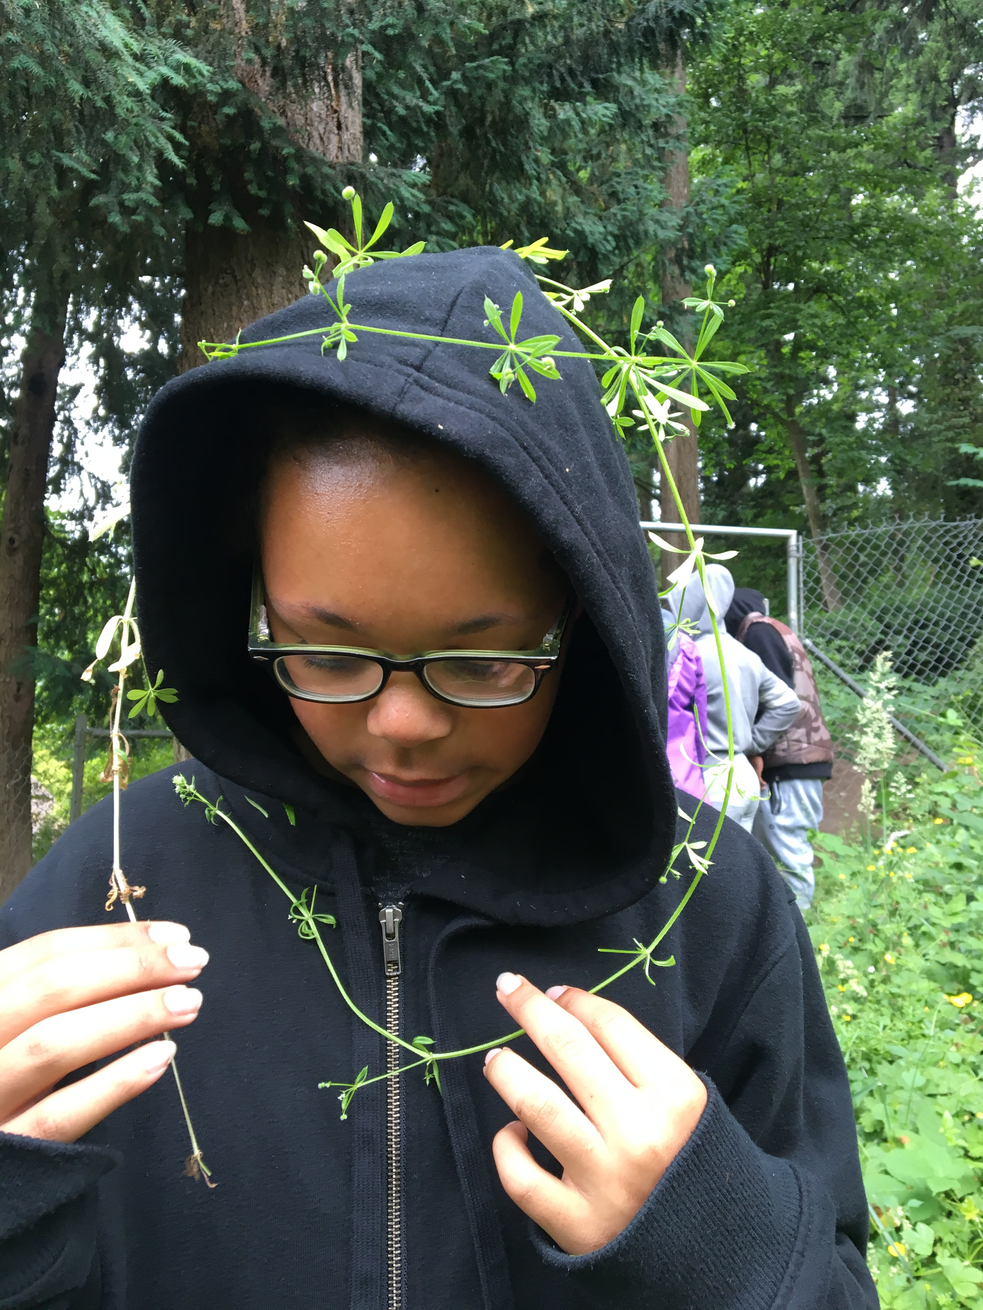
CWSP by the Numbers
CWSP began in 1995
341 projects have been awarded funds
Over $2.1 million in Community Investments

Slide 3
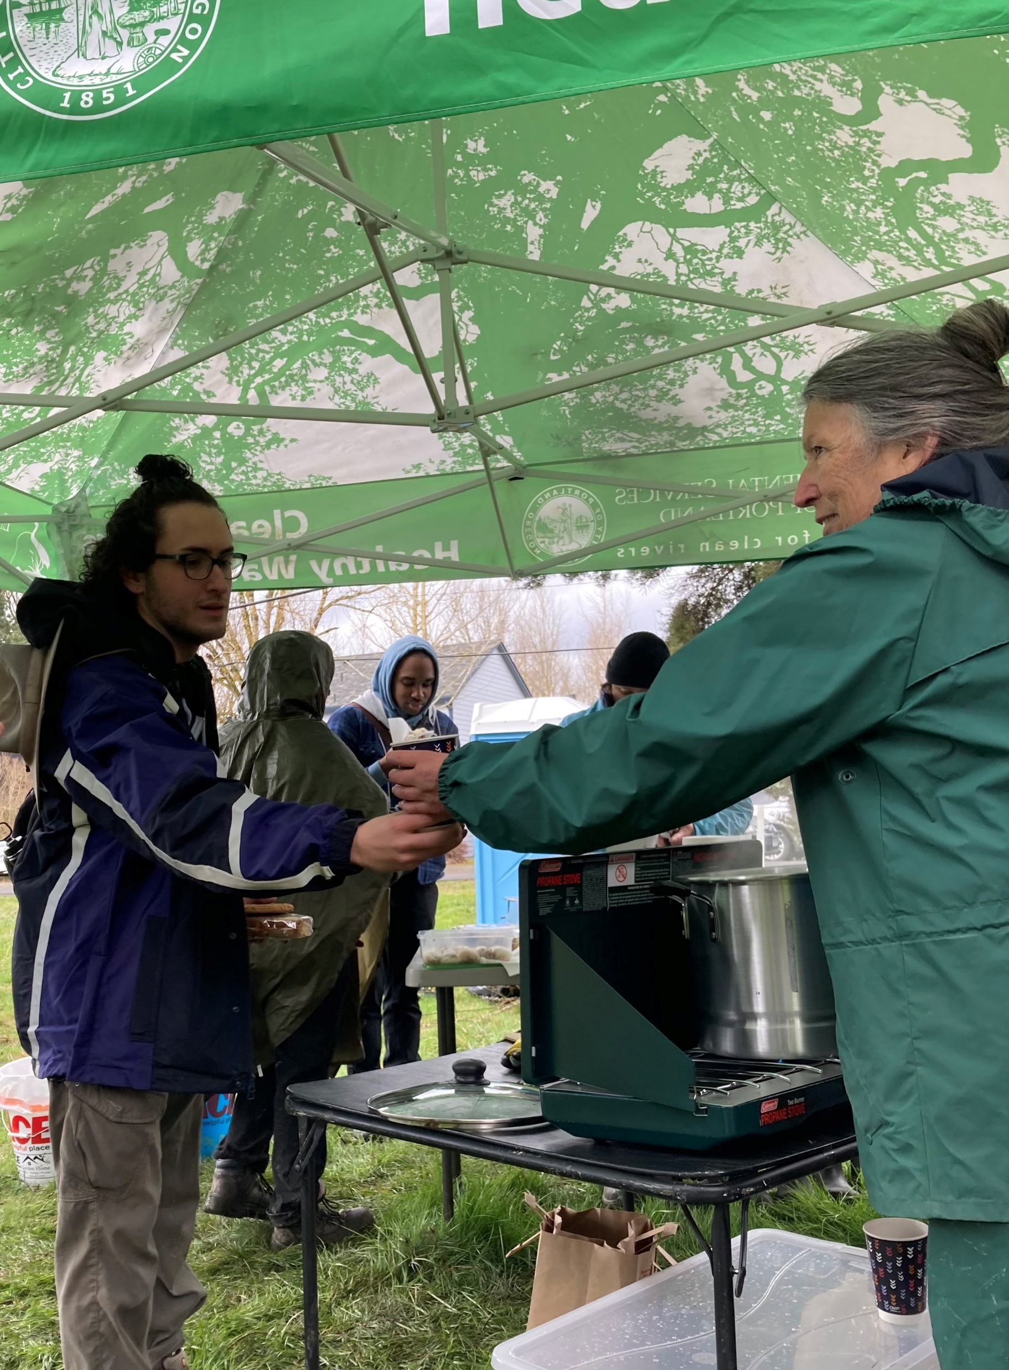
Partnership with Portland State University
Partnership with Indigenous Nations Studies Dept. at PSU
CWSP interns are selected from the INST Indigenous Traditional Ecological & Cultural Knowledge (ITECK) program
Students serve an overlapping 2-year internship
Community Engagement and Education with BIPOC, and underserved communities
Fostering Career Pathways
Notes:
Judy's slide

Slide 4
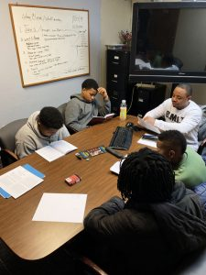
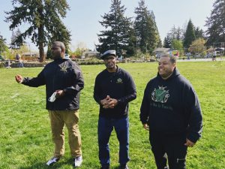
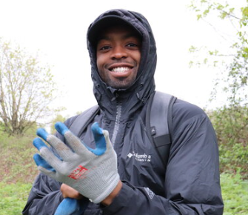
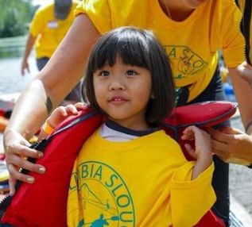
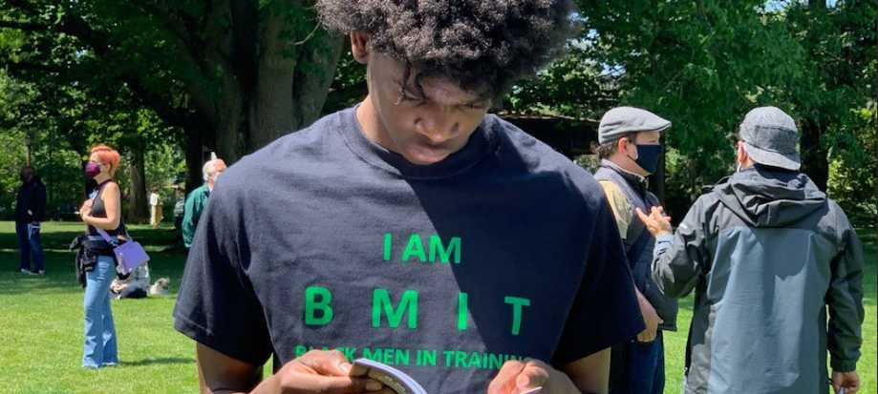
CWSP Grantees FY24
Black Men In Training (BMIT)
$12,000
Columbia Slough Watershed Council (CSWC)
$12,000
Notes:
Black Men in Training (BMIT) ($12,000) will provide environmental education that prepares older Black teens to lead and share knowledge with younger youth. BMIT staff will accompany a culturally specific naturalist as youth learn about their natural world, and watershed health.
Columbia Slough Watershed Council (CSWC) ($12,000) will work with community members to restore a boat launch area to preserve tree canopy and improve freshwater resources along Columbia Slough. This project includes youth workforce development with interns from Parkrose Highschool.

Slide 5
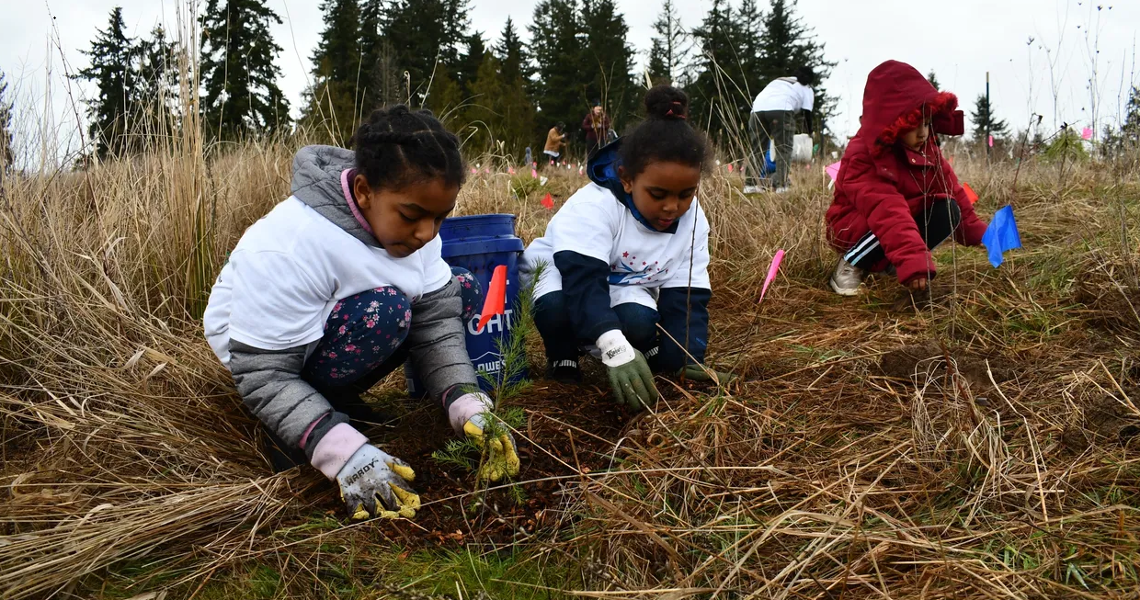
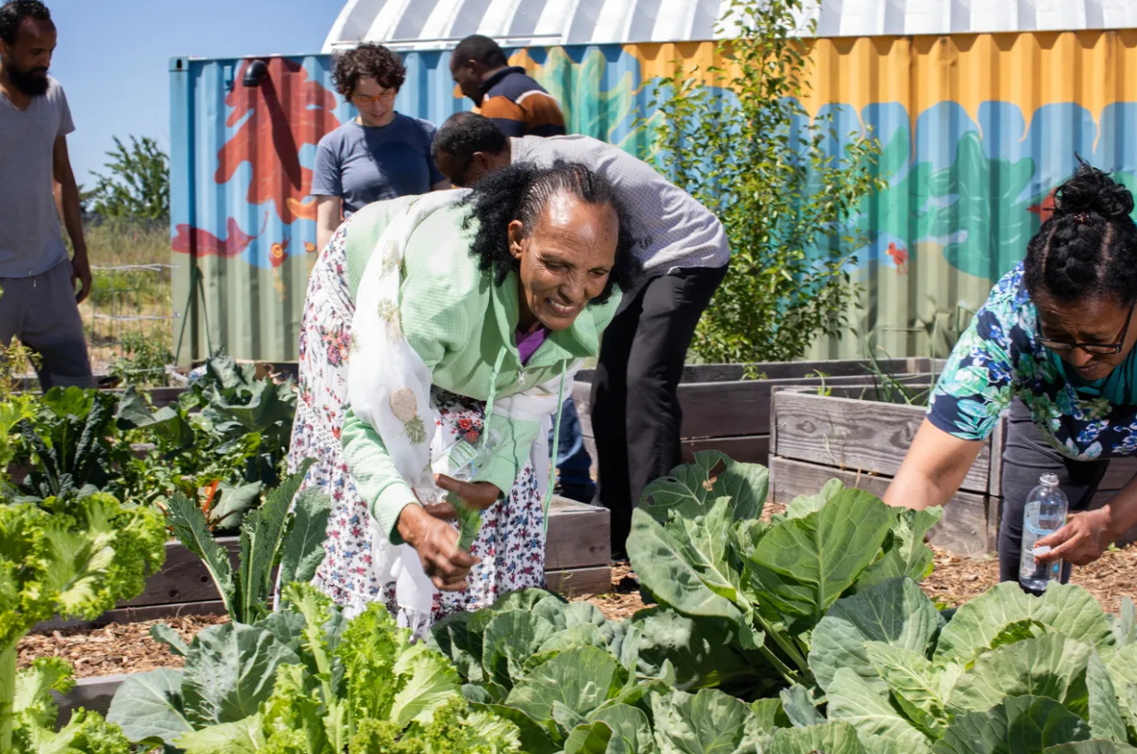
CWSP Grantees FY24
Division Midway Alliance (DMA) $12,000
Ethiopian and Eritrean
Cultural and Resource Center (EECRC)
$11,995
Notes:
Division Midway Alliance ($12,000) will build on an existing youth environmental leadership program to involve East Portland refugee youth in learning and sharing about watershed concepts with culturally relevant instruction. Youth will visit Leach Botanical Garden, create a mural, and coordinate a neighborhood clean-up day.
Ethiopian and Eritrean Cultural and Resource Center (EECRC) ($11,995) will recruit and train ambassadors to provide environmental knowledge to the community. Participants will include youth, mothers, and seniors with special focus on youth engagement and environmental responsibility.

Slide 6
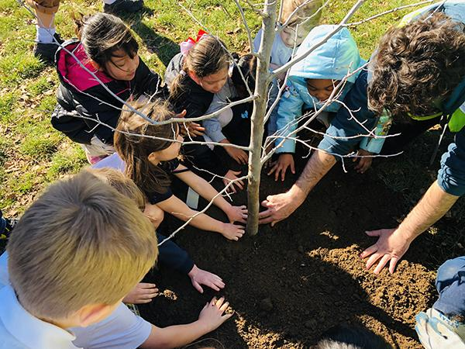
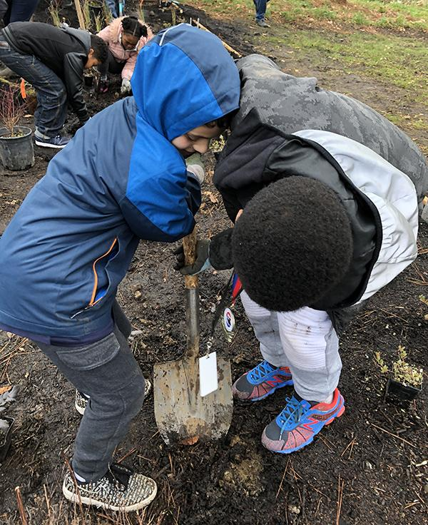
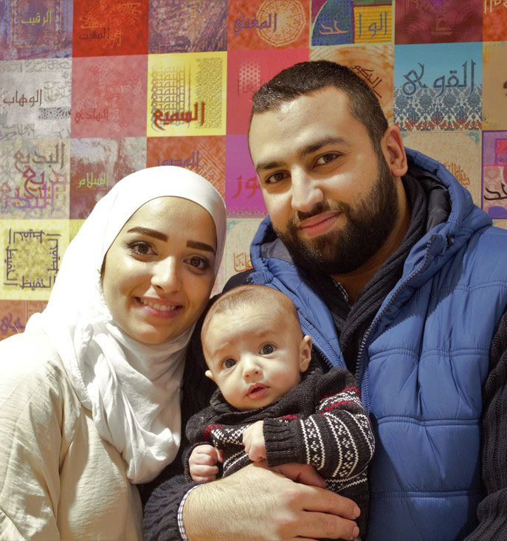
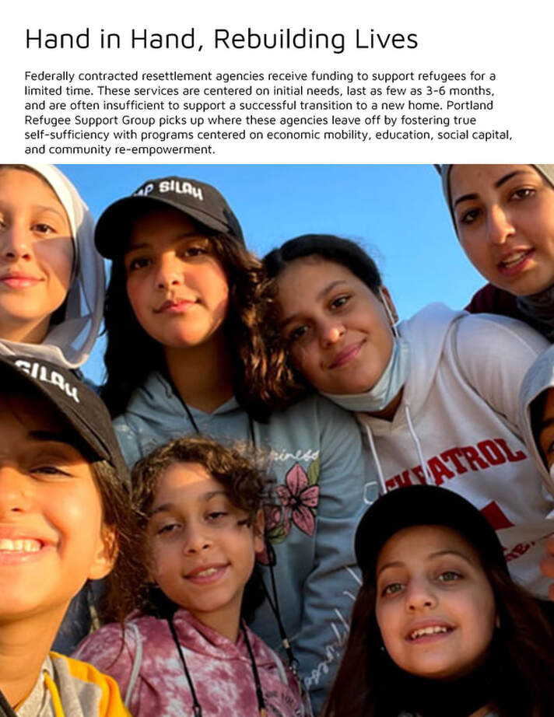
CWSP Grantees FY24
Lower Columbia Estuary Partnership (LCEP)
$11,950
Portland Refugee Support Group
$12,000
Notes:
Lower Columbia Estuary Partnership ($11,950) will provide the Connecting Students with Science curriculum to elementary schools. Enironmental educators and school teachers will work together to deliver local ecology lessons in class, followed by a field trip and hands-on restoration project in Forest Park.
Portland Refugee Support Group ($12,000) will educate refugee youth about their new environment, offer tools for environmental responsibility, and share this knowledge with their communities. Activities include workshops, visits to Tryon Creek watershed, and native planting projects at Leach Botanical Garden.

Slide 7
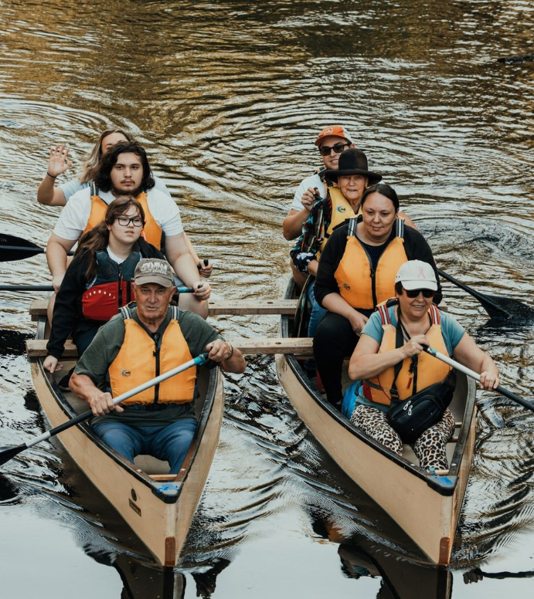
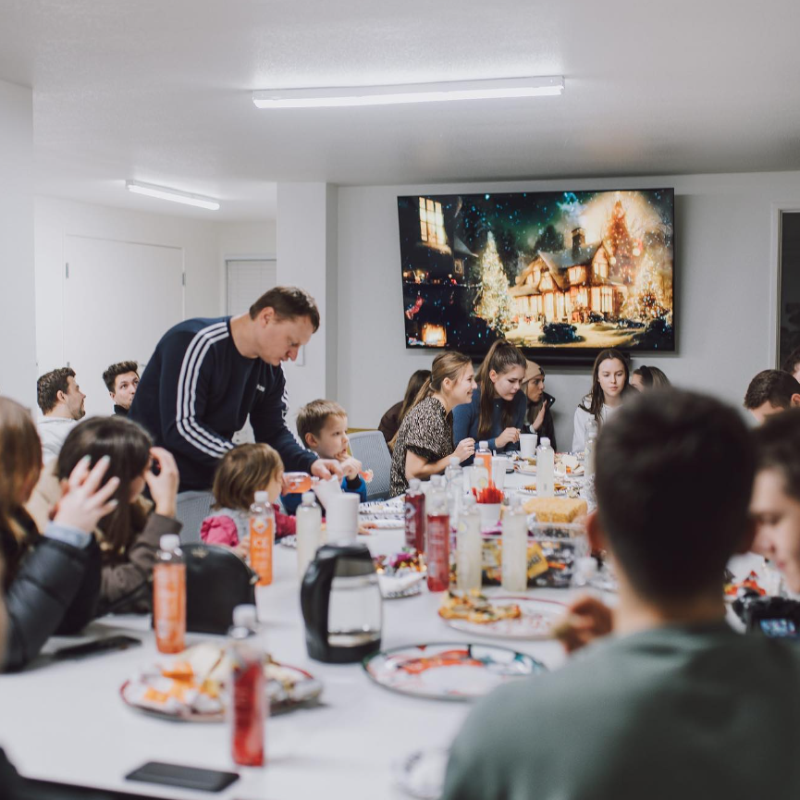
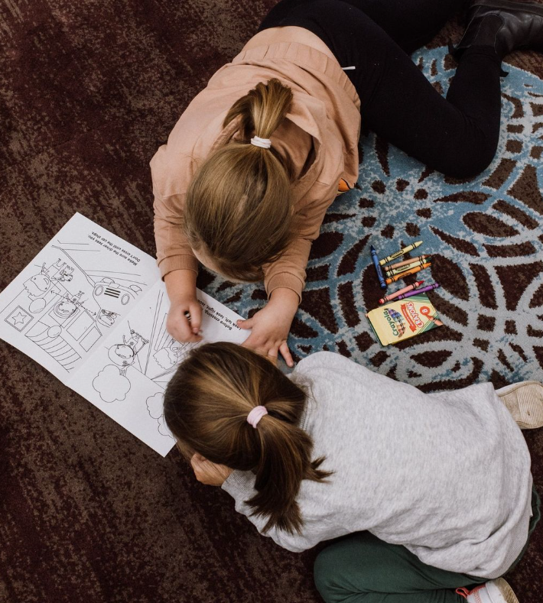
CWSP Grantees FY24
Slavic Community Center of the Northwest
$9,890
SOLVE
$11,491
Notes:
Slavic Community Center of the Northwest ($9,890) Will create a gathering garden for community healing, planting viburnum, a native plant to Portland and a symbol of the courage of the Ukrainian people. Participants will work with the Columbia Slough Watershed Council to clean up a boat launch area on the slough and create a welcoming space for all.
SOLVE ($11,491) will partner with Dignity Village to plan and implement two litter clean ups near waterways of the Columbia Slough. Dignity Village will help communicate with people living in the area about the events and provide outreach support and services during events.

