Slide 1
Francis + Clare Place funded by the Portland Housing Bond
Molly Rogers, Interim Director
May 17, 2023

Slide 2
Francis + Clare Place
Notes:
The Portland Housing Bureau has made significant progress on implementing the City’s goals for the Portland Housing Bond.
In total, 1,859 units will be funded, exceeding our commitment to Portlanders by 43%.
Nine-hundred (900) units are open and over 900 are under construction or in predevelopment.
Notably, 399 units will house some of our community’s most vulnerable homeless households, like at Francis + Clare Place.

Slide 3
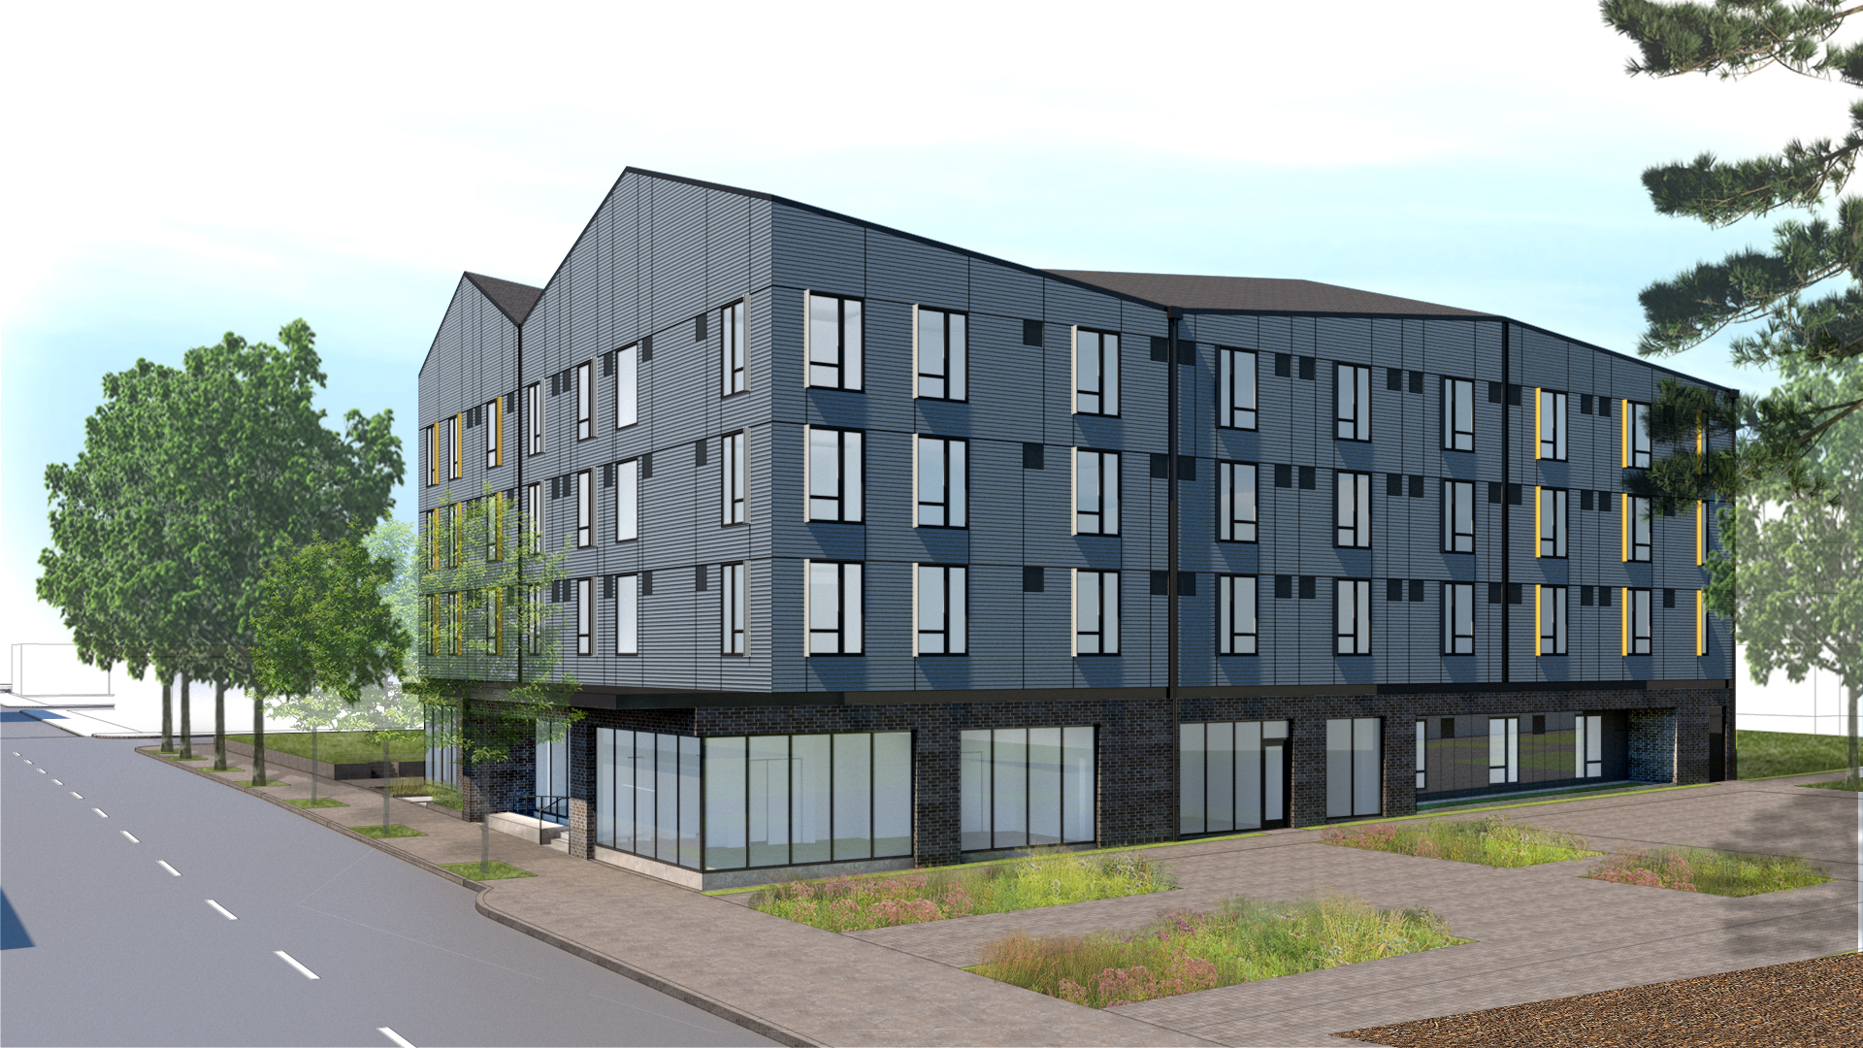
Francis + Clare Place
Notes:
Francis + Clare Place is a multifamily affordable rental project with 61 rent-regulated units located at 1131 SE Oak Street in the Buckman neighborhood.
We thank the St. Francis of Assisi parish for welcoming this project and for their willingness to sell a portion of the church’s land to facilitate its development.

Slide 4
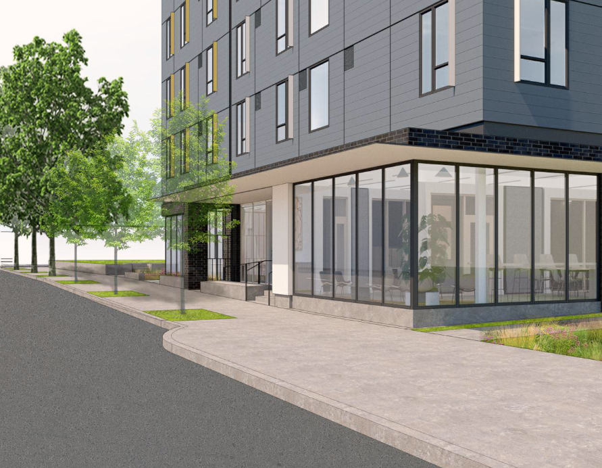
Project Highlights
61 new deeply affordable units
Land agreement with St. Francis of Assisi Catholic Church
100% permanent supportive housing (PSH) with rental subsidy
Intensive services supported by Joint Office of Homeless Services funding
Buckman neighborhood
99-year affordability period
Notes:
The project will be 100% PSH targeted to individuals and couples exiting chronic homelessness
with rental assistance and supportive services
The Borrower will enter into regulatory agreements with PHB in accordance with City policies to maintain affordability for 99 years.

Slide 5
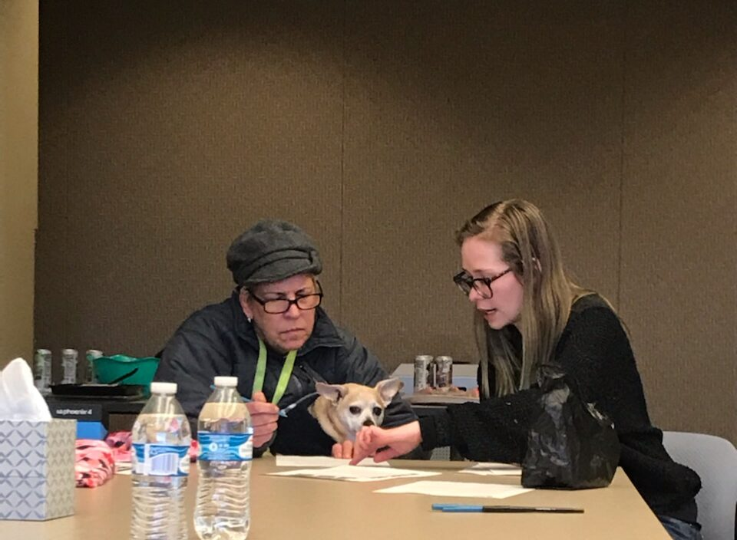
Unit Mix
61 units of PSH
54 studios
7 1-BRs
All units at 30% AMI or below
All units have rental subsidy from Project Based Vouchers
Notes:
The project is comprised of 54 studios and 7 one-bedroom units.
All units will be affordable to households earning up to 30% of area median income, with many expected to have no income
and rents will be supported by Project Based Section 8 Vouchers.

Slide 6
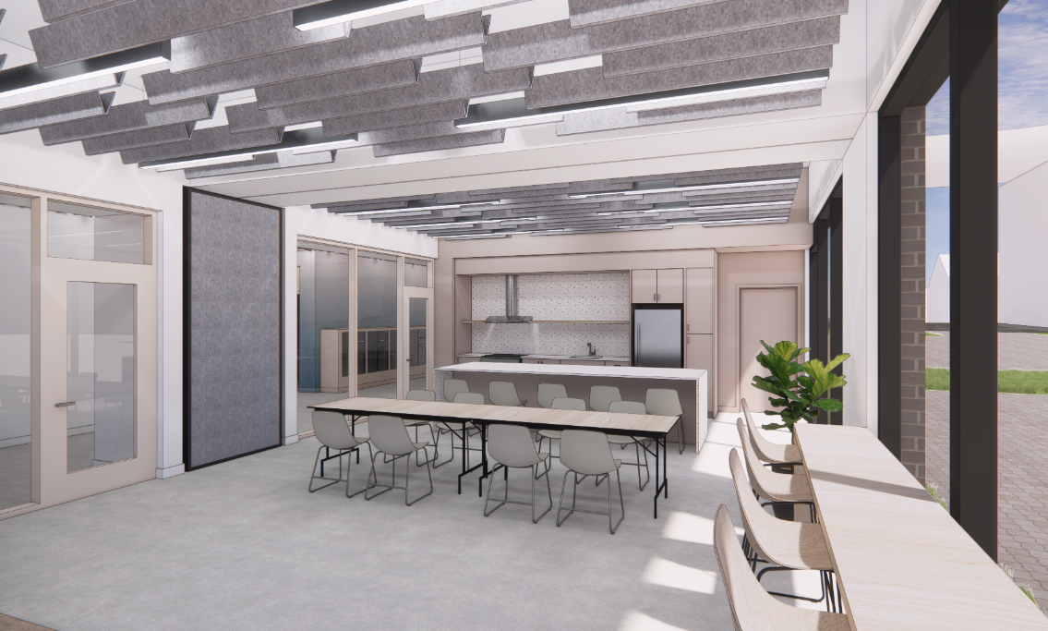
Amenities & Contracting
Laundry, quiet room, flexible classroom/community space with kitchen, offices for service delivery
24/7 front desk coverage
Adjacent to Francis and Clare Commons green street
Earth Advantage Gold
30% DMWESB contracting goal
Construction: June 2023 through Spring 2024
Francis and Clare Commons
Notes:
Amenities include a quiet room, flexible classroom/community space with kitchen, offices for delivery of resident and PSH services, laundry, bike storage, and 24/7 front desk coverage. Residents will have access to Francis + Clare Commons, a pedestrian green street adjacent to the project.
The project is on track to earn Earth Advantage Multifamily Gold certification with features that include low-flow fixtures, Energy Star appliances and lighting, an electric water heater, and durable/sustainable materials. Francis + Clare Place is designed as solar ready; financing for the solar installation is anticipated through a partnership between PHB and the Portland Clean Energy Fund.
The project team expects to meet or exceed PHB’s equity in contracting goals of 30% DMWESB (Disadvantaged, Minority, Women, Emerging Small Business firms) utilization for hard costs and 20% utilization for professional services. Current projections are 30% for hard costs and 86% for soft costs.
Construction will start in June 2023 and is expected to be completed in Spring of 2024.

Slide 7
Permanent Supportive Housing
Services Operating Support
Wrap-around service support for homeless households is $10,000 per PSH unit per year
Rental Subsidy
All units supported by Project Based Vouchers
Service Providers
Trauma-informed care model, with case management and peer support focused on housing retention and stability
Notes:
The 61 permanent supportive housing units will receive funding for wrap-around services provided by the Joint Office of Homeless Services (JOHS) totaling up to $10,000 per unit per year.
PSH units are intended to serve the chronically homeless or those at risk of homelessness.
All units will have rental support from Project Based Section 8 Vouchers awarded by Home Forward.

Slide 8
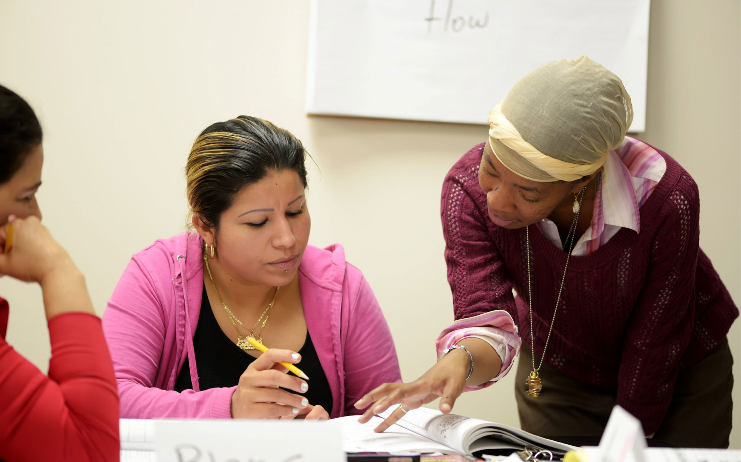
Resident & PSH Services
Catholic Charities and Native American Rehabilitation Association of the Northwest (NARA)
Case management and peer support
Access to primary care, counseling and mental health services, food programs
New resident orientation and resources
Income support including accessing benefits, Individual Development Accounts, and financial coaching
Referrals and assistance navigating social services
Community building events and activities
Replace this photo
Notes:
Catholic Charities, in partnership with the Native American Rehabilitation Association of the Northwest, will provide resident and PSH services
These will be focused on housing stability and retention, including case management, peer support, resource navigation, and community building activities.

Slide 9
Funding Sources
Other City Sources
PHB Funds
Other Sources
PHB resources leveraged 1.9x other
private & public sources
Notes:
The proposed City funding is leveraged 1.9x raising over $18 million of other public and private financing from Enterprise Community Partners, Heritage Bank, Oregon Housing and Community Services, Metro, City System Development Charge exemptions, and Portland Clean Energy Fund.

Slide 10
City Council Request
Authorize funding of up to $9,421,891 to Francis + Clare Place Limited Partnership or an affiliate of Catholic Charities of Oregon
Authorize the Interim Director of PHB to approve amendments and execute any related documents necessary to advance the project within the maximum approved amounts

