Slide 1
Authorize Contract Amendment for Infor Public Sector Implementation Services
May 17, 2023
PWB – Gabe Solmer & Devin Sanders
BES – Baron Howe & Mia Sabanovic

Slide 2
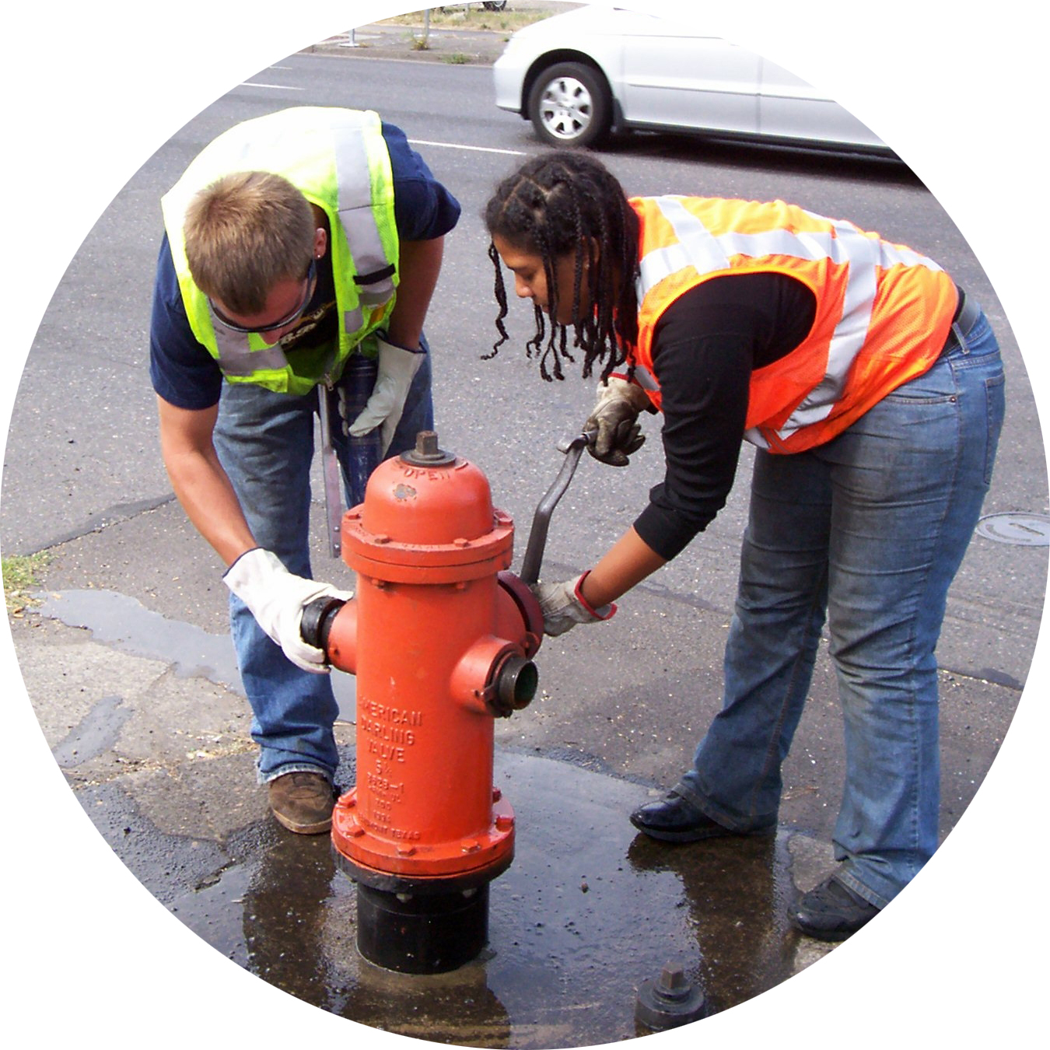
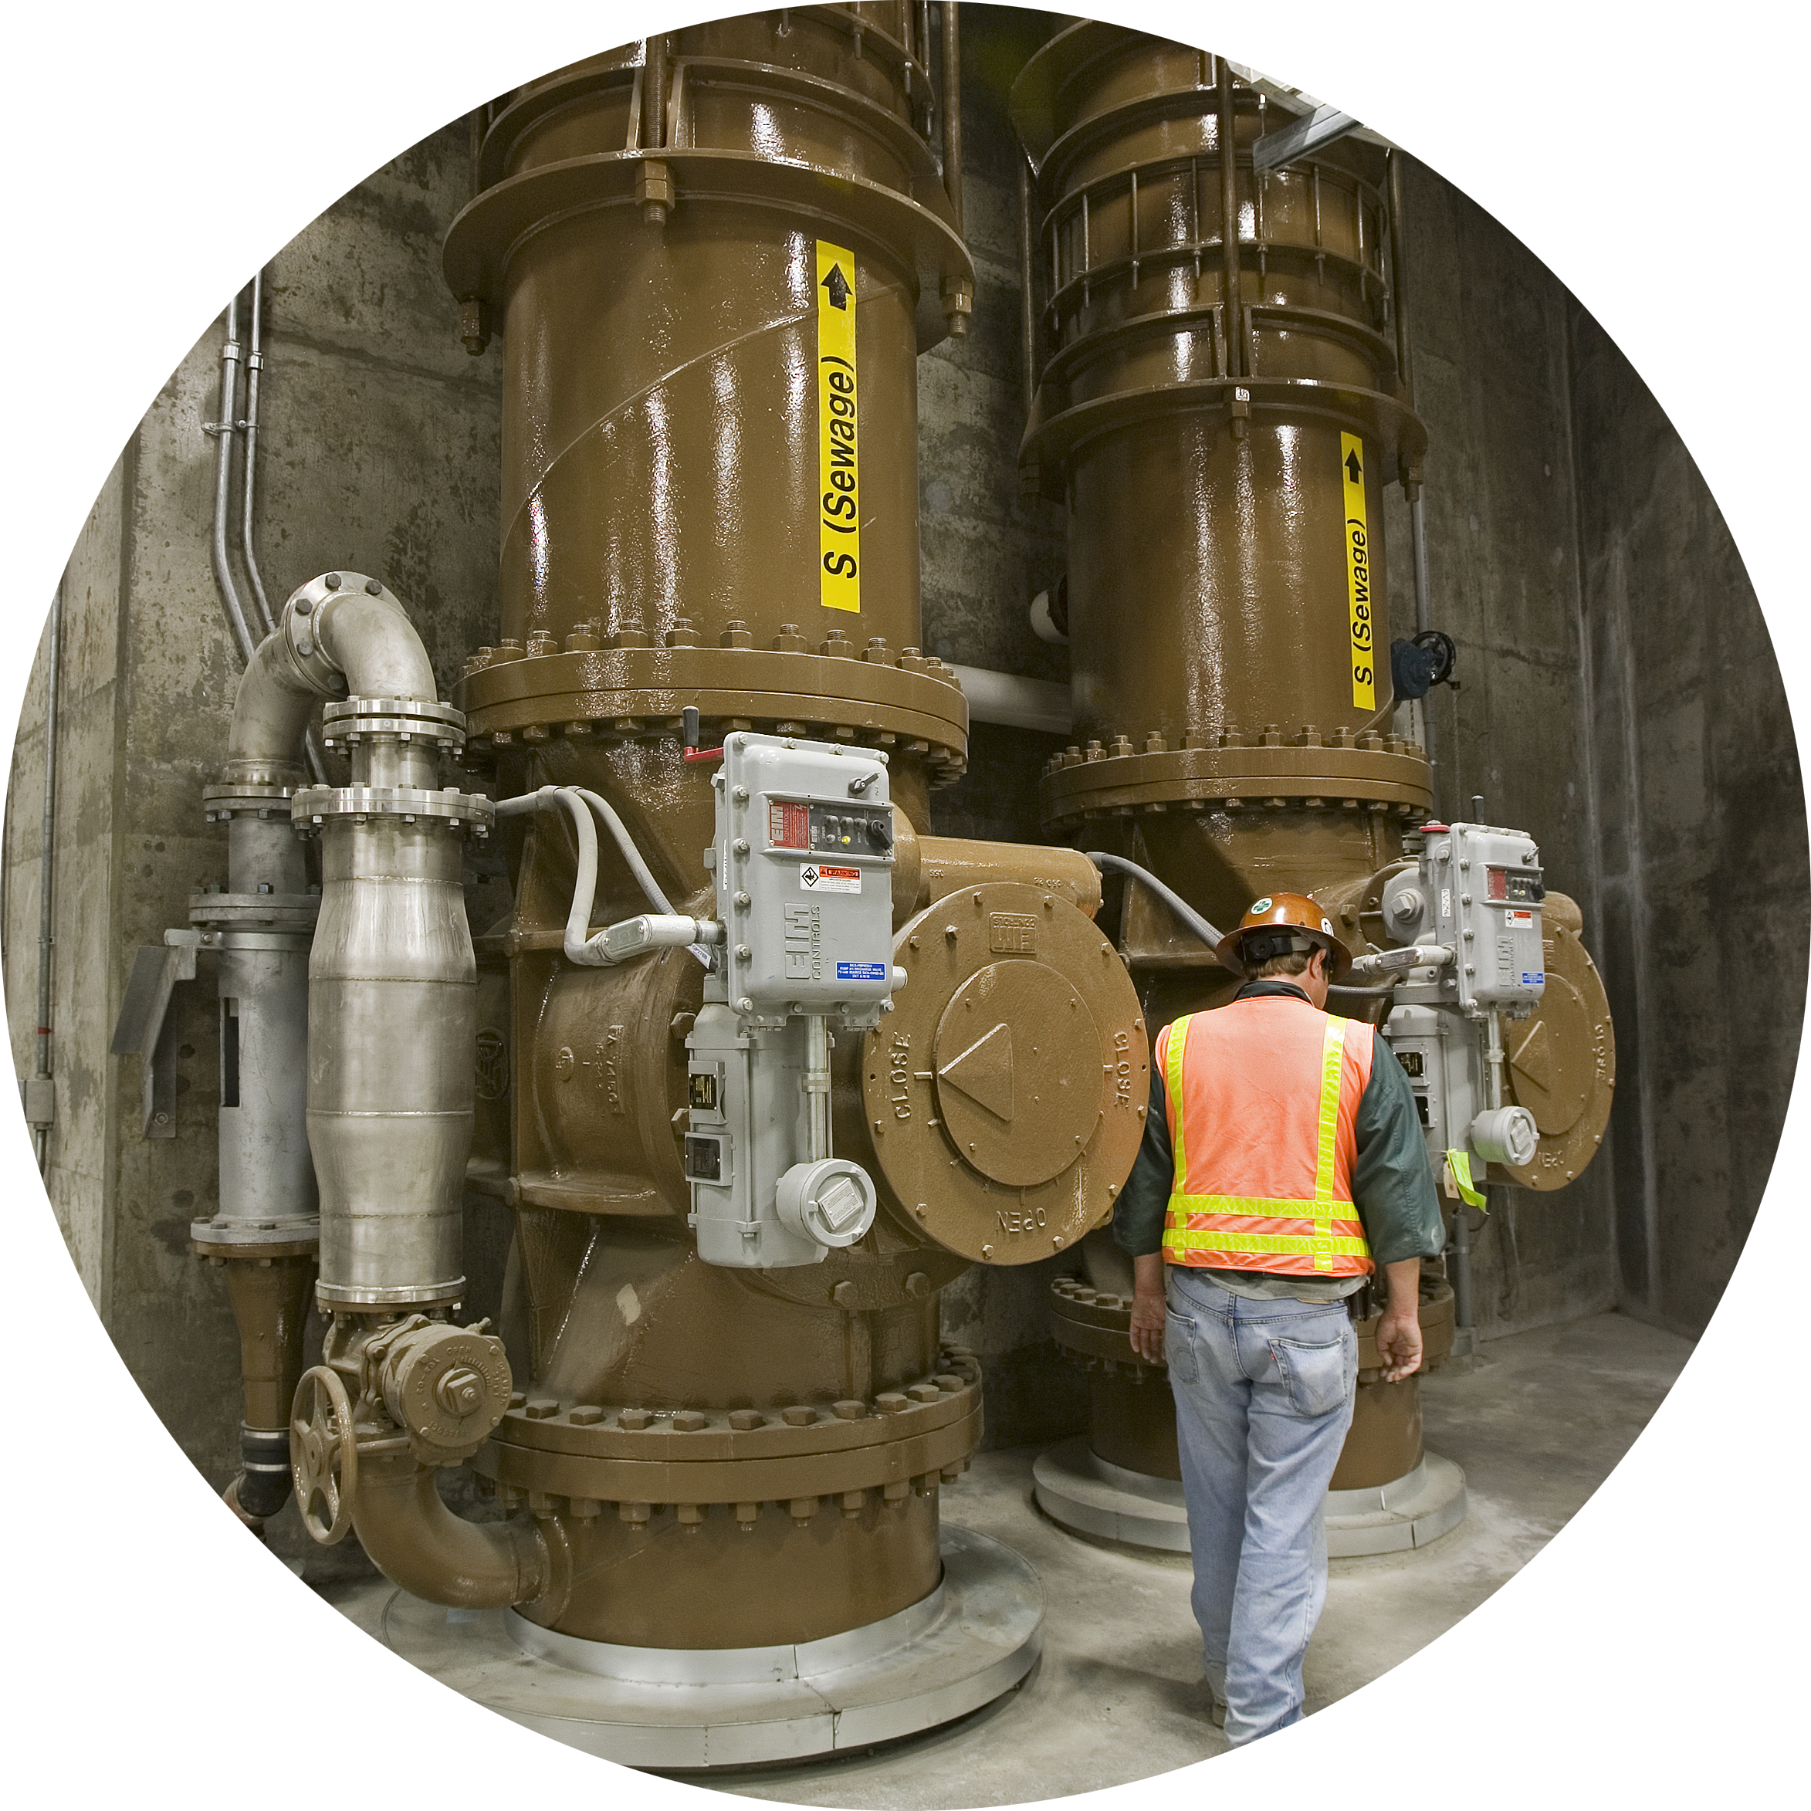
Ordinance Summary
Authorize the City of Portland to Amend Price Agreement No 31001571 to fund software implementation services for BES and PWB Asset Management System.
This is a 5-year agreement for both bureaus software Implementation and future services costs and sets a not to exceed cost of $9,163,708 for the 5-year period.
This cost is included in each bureaus existing capital budgets.
Why is this an emergency ordinance action?
The Oracle Work & Asset Management System both bureaus use has been out of support since August 2021
This system has known information security vulnerabilities

Slide 3
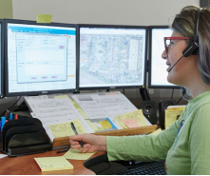
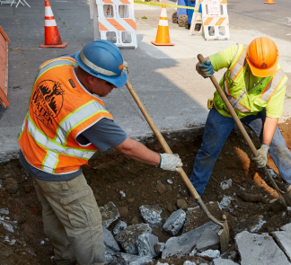
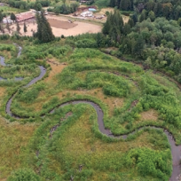
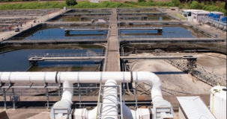
What is an Asset Management System?
A system of processes, tools, and technology used to manage wide variety of traditional utility infrastructure and green infrastructure.
Facilitates the management of the assets life-cycle: design, construction, commissioning, operating, maintaining, repairing, modifying, replacing and decommissioning of assets.

Slide 4
Key Asset Management Drivers
The Bureau of Environmental Services and the Water Bureau collectively manage assets valued at over 39 billion dollars.
A key asset management system in use by both bureaus has been out of support since August of 2021.
In 2019 the bureaus partnered on a Request for Information process to assess the marketplace for systems that would meet bureau needs.
The Infor Public Sector product was selected. The Bureau of Environmental Services has successfully used Infor software for over a decade to manage the collection system assets.

Slide 5
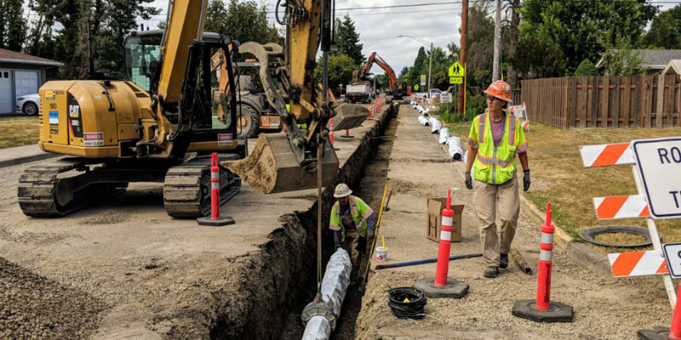
Key Asset Management Drivers
In a unique opportunity both bureaus have agreed to strategically align on a shared platform for asset management.
Greater ability to support Equitable service delivery and City Core Values of Anti-Racism, Equity, Transparency, Communication, Collaboration and Fiscal Responsibility.
A shared platform presents new collaboration opportunities and efficiencies in operations, maintenance, support and data sharing.

Slide 6
Phases of Work
First Council Action
We are here
Vendor Selection
Software Acquisition
Pre-implementation Planning
Software Implementation
Evolve
2019 – RFI results in
selection of Infor Public Sector by both bureaus.
Cooperative Agreement to purchase software licensing.
Workshops to define implementation requirements, scope, schedule & cost.
Configure system and processes to meet business needs. Prepare the bureaus for the change.
Iterative process to add value and improve business processes to meet future needs.

Slide 7
Questions
May 17, 2023
PWB - W02364
BES - E11337
Thank you!

