Slide 1
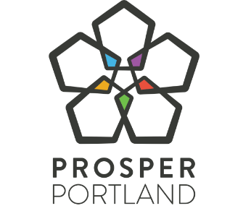
East Portland Enterprise Zone Program 10-Year Reauthorization

Slide 2
Summary
Review East Portland Enterprise Zone Program (2012-2023)
Enterprise Zone State Statute overview
Enterprise Zone Program Impact
Proposed East Portland Enterprise Zone boundary map
Discussion and feedback
Notes:
Shea

Slide 3
Enterprise Zone Overview
E-Zone is a property tax abatement program of the State of Oregon
Companies receive abatement on increased property taxes on new investment in construction or equipment to property for five years
Average Tax Liability for new Capital Investments is around 1.5%/year
Example: $20M investment would create new tax liability of 300k/year. After 5 years, and $1.5M exempted, and the total asset re-enters the tax rolls.
Must be creating new or additional living wage jobs, $15/hour minimum or $20/hour total compensation.
Companies agree to public benefits when applying to the program.
Additionally, 15% of their exempted taxes go towards public benefit agreement activities or other economic opportunity programming.
Notes:
Shea

Slide 4
Oregon State Statute/Administrative Overview
1985
70+
10 years
Enacted by legislature, continuously supported by nearly all legislators, both urban & rural, for decades
Enterprise Zones across the state; nearly every medium/ large city in Oregon has a zone
10-year designations must be approved by local zone sponsor, port, and state
Allows for local conditions/community benefits, but not required for 3-year exemptions
Notes:
Shea

Slide 5
Adaptation and Evolution
Portland Enterprise Zone established, 10-year designation
New Enterprise Zone policy established for Portland and East Portland Enterprise Zones
Requesting East Portland E-Zone Reauthorization
Policy Assessment & Program Reorganization
Policy updates w/ Public Benefit Agreements
Reauthorized Portland E-Zone for 10 years
East Portland Enterprise Zone established
10+ Public Benefit Agreements signed
2008
2010
2012
2015
2017
2018
2019
2023
Notes:
. Shea

Slide 6
Four Objectives
Advance Portland
OBJECTIVE 2
Promote Equitable Wealth Creation
OBJECTIVE 1
Propel Inclusive Economic Growth & Innovation
OBJECTIVE 3
Foster a Vibrant Central City & Neighborhood Commercial Districts
Goal:
Advance inclusive growth in Portland
OBJECTIVE 4
Connect Portlanders to High-Quality Jobs in Future-Ready Sectors
Notes:
Shea The program intersects Objectives 1, 2, and 4 of our new Advance Portland Strategy. Key tool for BRE
Small businesses have been able to leverage the tool to grow, including companies like Nossa Familia and COR
Job creation

Slide 7
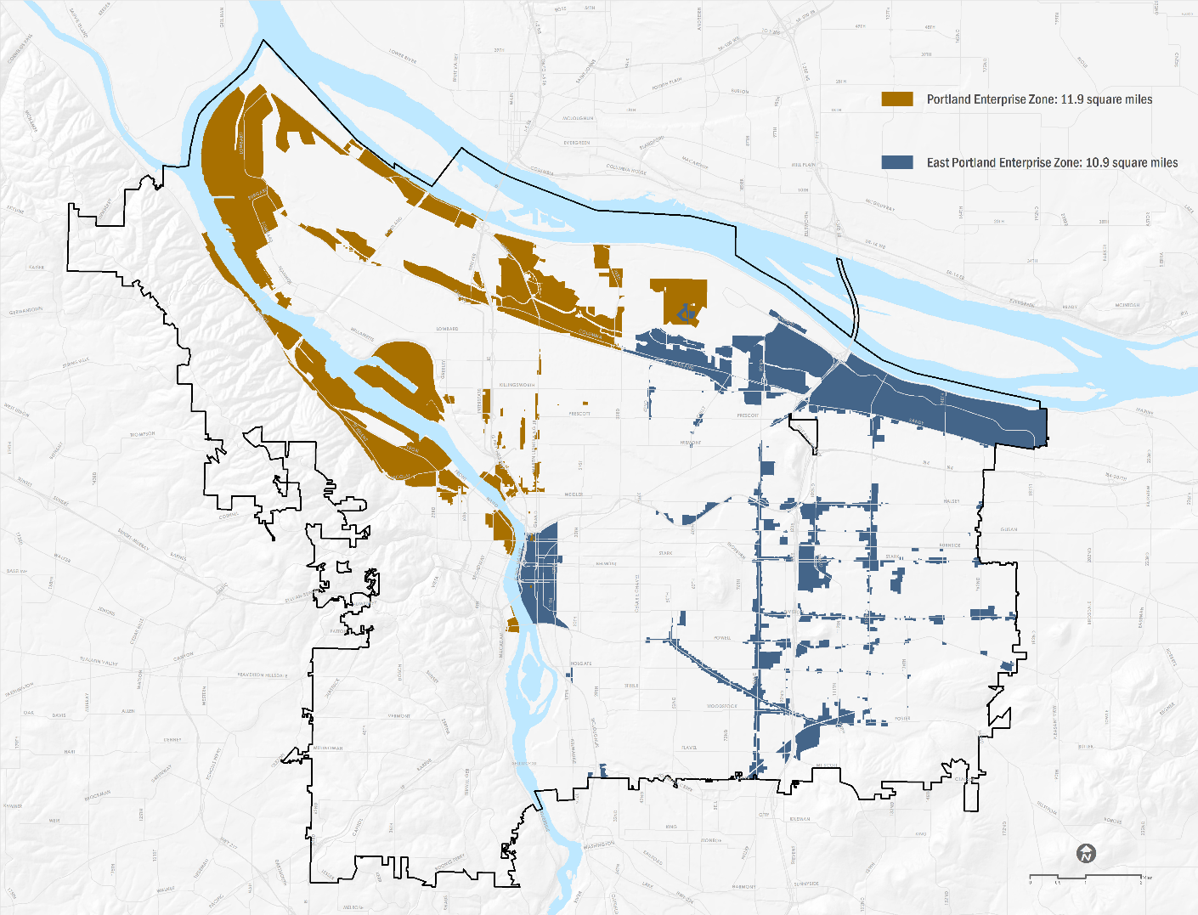
Current Enterprise Zones
Portland Enterprise Zone (2019)
East Portland Enterprise Zone (2012)
Notes:
Shea

Slide 8
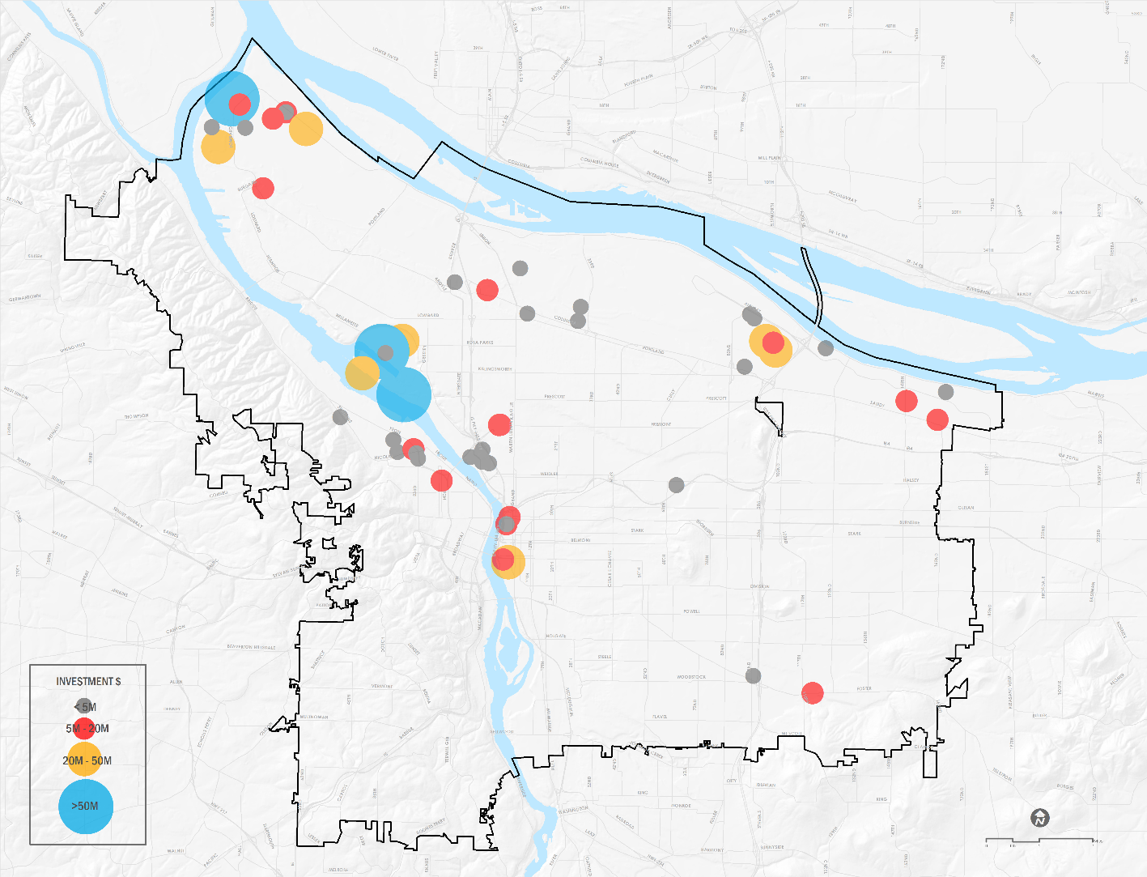
Portland Enterprise Zones Activity Map
Notes:
Shea

Slide 9
Enterprise Zones Program Activity
97
45
29%
of active projects are small businesses
Total projects
Active projects
10
YEARS
Notes:
Shea

Slide 10
Active Companies in Portland & East Portland Enterprise Zones
A & K Designs | Fedex Ground | Revant Optics
Adpearance Inc. | FXI Inc. | Salt & Straw
Ajinomoto Toyo Frozen Noodles | Harder Mechanical | TEC Equipment
Amazon | Instrument Marketing Inc. | The Good Group
Bob's Metals | KeHe Distributors | The Home Depot
Bridge City Steel | Leatherman | TOAST
Bridgetown Natural Foods | Morel Ink | United Parcel Service
City of Roses Disposal | Nossa Familia Coffee Roasters | Urban Gypsum
Cook Security | Olympia Meats | Viewpoint Software
Cummins | PAE Consulting Engineers | Young's Market
Daimler Trucks North America | Portland Bulk Terminals | Z Haus LLC
Notes:
Shea
Bolded companies in black here are the ones in the east portland zone

Slide 11
Impact | Investments in Portland
$1,813,680,775
Total Capital and Procurement Investment, 2015-2022
$974 M
$940 M
Notes:
Andy
13M dollars is what we've exempted, for nearly 2 Billion in investment, doesn't include the fact that these improvements are back in the tax rolls, Daimler trucks just expired.

Slide 12
Impact | Jobs, wages & compensation
$41.95
$41.38
$38.18
$37.28
$36.34
$33.98
$35.86
Benefits
$30.86
$29.21
$29.48
$30.16
$27.98
$28.84
Wages
$25.14
2015
2016
2017
2018
2019
2020
2021
AVERAGE TOTAL COMPENSATION
Notes:
Andy

Slide 13
Public Benefit Agreements
In addition to new jobs and investing, companies agree to the following:
* Workforce Training and Business Development Fund Contributions
* Child care and transit support (if more than $1M in Tax Savings)
* Equity Training
* Yearly compliance and outcome tracking: Department of Revenue and public benefit compliance with both quantitative and qualitative data on performance
* Career ladder opportunities
* First Source Hiring Agreements
* Local procurement
* 2-6 additional public benefits from our menu
Notes:
Andy

Slide 14
Economic Development Value Proposition
7-year average forgone Property Tax Revenue: $1.9 million City General Fund (Total= $13.6M)
Cost Per Job: $1,513
Return over 7 years:
3,600
New living wage full time jobs;
(10% increase required,
30% increase realized)
2.2%
Business Tax on applicable revenue
$80.6M
Income tax to the State of Oregon
$7.8M
Workforce Training & Business Development Fund
$960M
Procurement w/in City of Portland
19 Public benefit agreements with 100+ engagements each year
Estimated ‘payback’ of forgone revenue = 5 years after abatement expires
Notes:
Andy

Slide 15
Action Proposed: 10-year Extension of East Portland E-Zone
Enterprise Zone must:
Meet state income/poverty standards for qualifying
Stay within statutory limits on total square miles and point-to-point distances
Be located in or near low-income areas
Be authorized by Portland City Council and Port of Portland Commission by resolution (COMPLETED)
Today’s Actions
Consideration by City Council
Notes:
Talking Points: Andy
Mapping Criteria:
We us a combination of American Community Survey modeling software to allow us to report on non-conforming census geographies.
unemployment rate, two percentage points or more above the statewide rate,
income level of 80 percent or less of the equivalent income level for the state in terms of per capita, median household or comparable figures,
percentage of persons or families below the federal poverty level that is at least five percentage points higher than the statewide poverty incidence rate, or
ten-year change in population that is at least 15 percentage points below the state’s corresponding population change.
Our E-Zones are located in or near many of our high poverty areas of the city.
Max combined E-Zone acreage allowed = 24 sq. mi.; current = 21.43 sq mi.

Slide 16
Enterprise Zones Proposed 2023-2033
Portland Enterprise Zone (2019-2029)
East Portland Enterprise Zone (pending 2023)
Notes:
Andy Calling back to Advance Portland actions to revitalize the central city, we're exploring Expanding the Portland Enterprize Zone Boundary to Include Downtown. We'd have to look at statutory limits and square mile limitations, so given that downtown is a relatively small area, we should be able to make those modificaitons with limited changes to the existing boundary.

Slide 17
Discussion & Questions

Slide 18
Impact | Jobs, wages & compensation
3,424
3,604
3,303
2,834
2,899
1,810
1,346
2015
2016
2017
2018
2019
2020
2021
NEW JOBS (from baseline)

Slide 19
Economic Development Programs
TOTAL | Years 2012-2022
$1,681,177 | Traded Sector
$1,152,071 | COVID Emergency Response
$891,763 | Neighborhood Prosperity Network
$ 2,038,628 | Inclusive Business Resource Network
$ 2,101,994 | Workforce Development Programming

