Slide 1

Garden Park Estates funded by the Metro Housing Bond
Molly C. Rogers, Interim Director
May 3, 2023
Notes:
MOLLY TALKING POINTS:

Slide 2
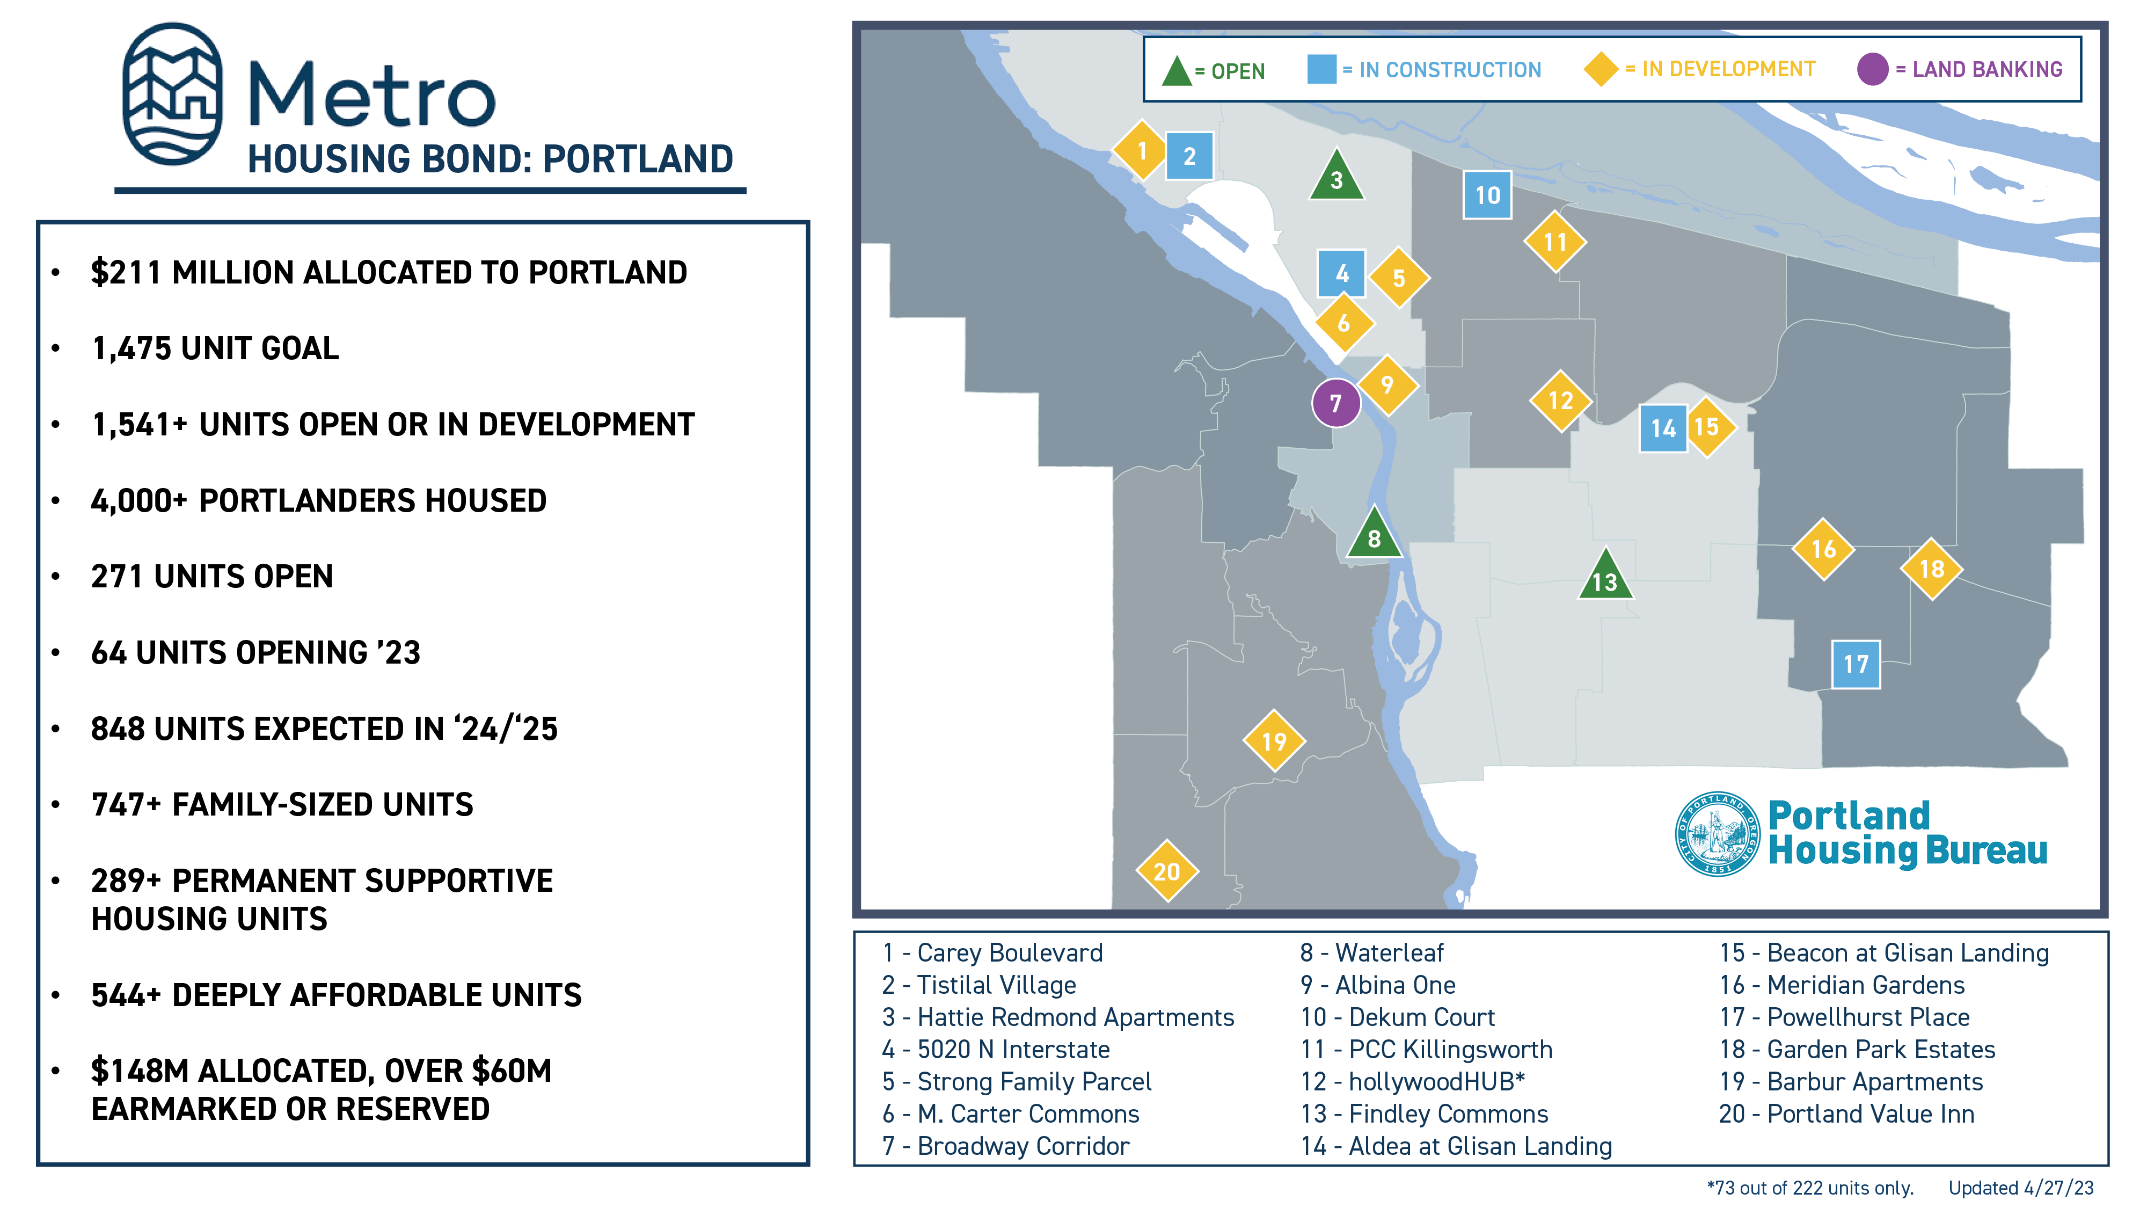
Notes:
MOLLY TALKING POINTS:
The Metro Housing Bond (Metro Bond) Measure 26-199 was approved by voters in the Metro region in 2018 authorizing Metro to distribute the Bond funds to local jurisdictions to fund affordable housing.
Garden Park Estates includes Metro Bond funds. PHB is well on its way to implementing the City’s goals for its eligible share of the Metro Bonds, with 570 affordable, Metro Bond funded units already open or under construction throughout the City (not counting Garden Park’s 54 units), and nearly 1,000 more in pre-development.

Slide 3
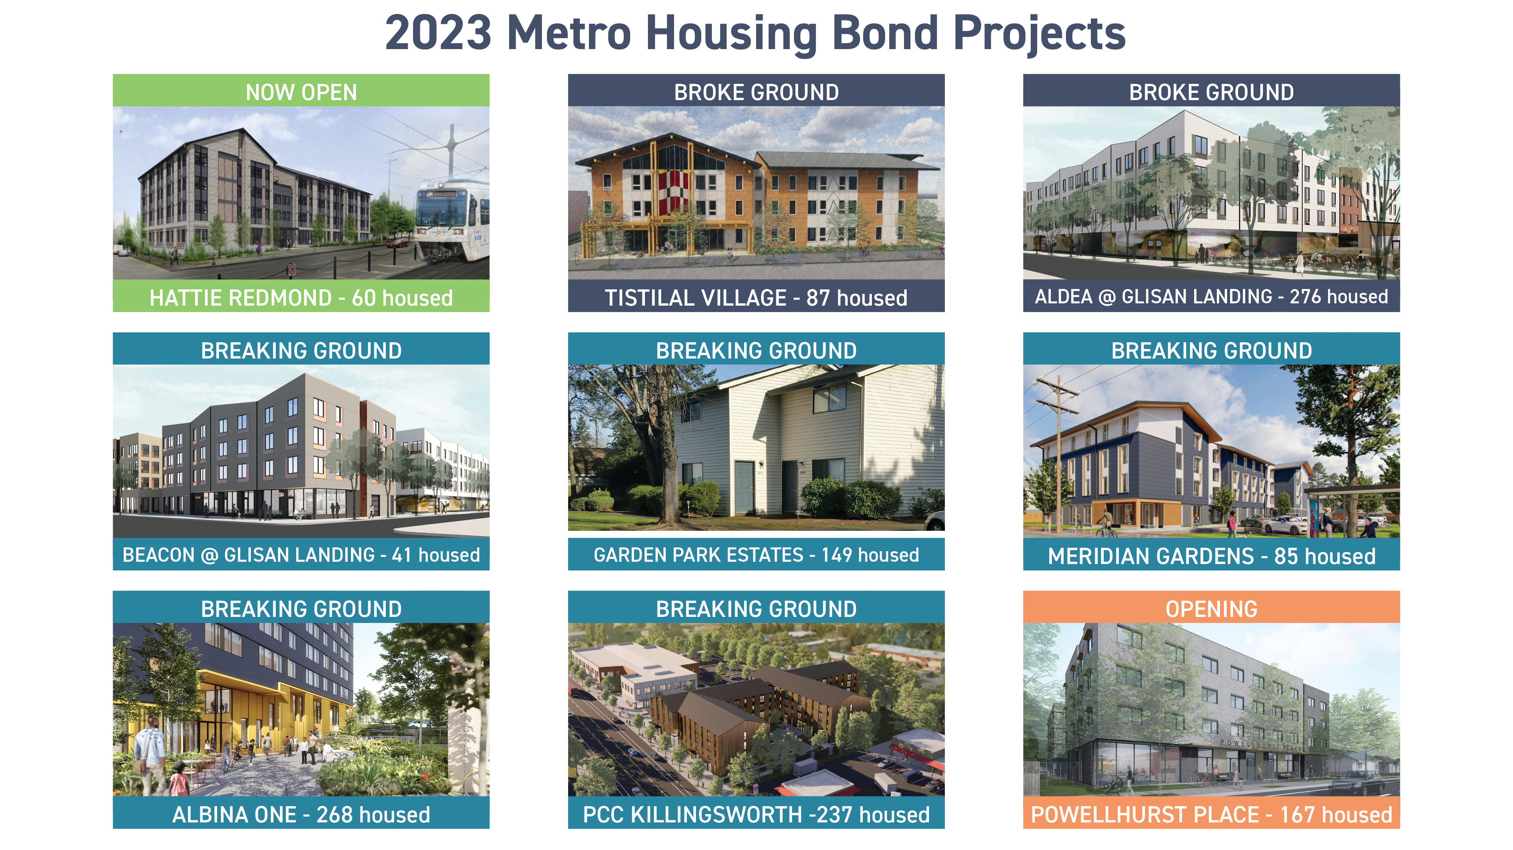
Notes:
MOLLY TALKING POINTS:
Here is a snapshot of Metro-Bond funded projects that are already open, will be completed, or are breaking ground this year.

Slide 4
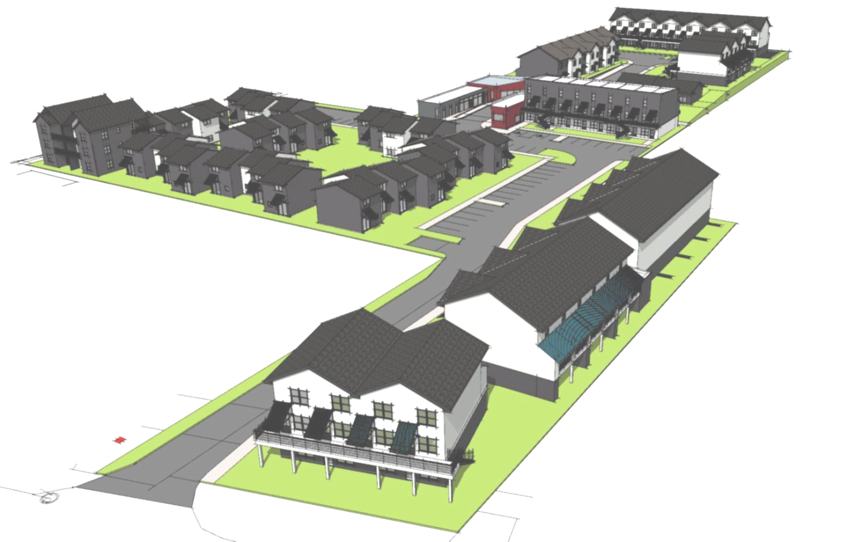
Rehabilitation & New Construction
4.13-acre site with 2 access points
Delayed maintenance, major systems replacement needed
Many 2-bedroom units, 2-story townhomes with small backyards
Regulated affordable by OHCS until 2033
Notes:
MOLLY TALKING POINTS:
Existing conditions:
Garden Park is located at SE 136th Avenue and SE Powell Boulevard.
Garden Park Estates, located at SE 136th and Powell Boulevard, is a single 4.13 acre tax lot. The 63 walk-up, garden-style units, were built in 1978 and have reached their useful lives with major systems failures, even though all are regulated affordable at 60% AMI until 2033. These will be either replaced or rehabbed completely; however, notably none of the residents will be displaced.
Site plan shows the project after when completed, looking northward from SE Powell Boulevard.

Slide 5
Project Highlights
117 Total Units:
  63 rehab/replacement
  54 new
Powellhurst-Gilbert neighborhood
103 family-sized units
25 Permanent Supportive Housing units
99-year affordability period
Notes:
MOLLY TALKING POINTS:
34 of the existing 63 garden-style units will be rehabilitated, and 29 will be demolished and rebuilt. The PHB award will support the construction of 54 new affordable units.
The 54 units to be added to the site will enable the site to serve more households of different sizes, and at a deeper affordability level. The new units range in size from studios to three bedrooms, and twenty-five of these units will be permanent supportive housing, affordable to households earning up to 30% of the area median income (AMI).
The Borrower will enter into regulatory agreements with PHB in accordance with City policies to maintain the affordability of the Project for 99 years and comply with federal HOME requirements for 20 years.

Slide 6

Unit Mix
117 Units
  8 studios
  6 1-BRs
  96 2-BRs
  7 3-BRs
25 units at 30% AMI or below
92 units at 60% AMI or below
25 supportive housing units
Notes:
MOLLY TALKING POINTS:
When completed, the Project will have 8 studios, 6 1-bedrooms, 96 2-bedroom, and 7 3-bedroom units..
Twenty-five (25) units in the Project will be affordable to households earning up to 30% of area median income (which is slightly less than $32,000 for a family of four)
Ninety-two units (92) units will be affordable to households earning up to 60% of AMI.

Slide 7

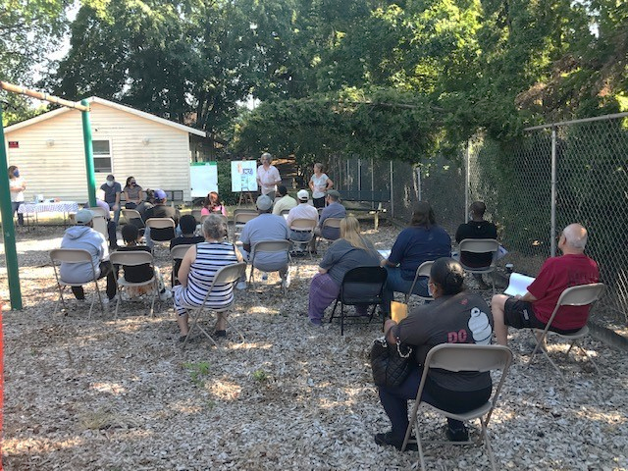
Amenities & Contracting
Two additional laundry facilities
New playground equipment
Outdoor amphitheater
New community room and office space
Earth Advantage Gold
30% DMWESB contracting goal
Construction: June 2023 - Oct 2025
Notes:
MOLLY TALKING POINTS:
Livability on the site will be enhanced by the addition of two laundry facilities, an outdoor community space (amphitheater), new modern playground equipment, and the addition of several single-level units to accommodate residents with restricted mobility or disabilities.
The Project is on track to earn Earth Advantage Multifamily Gold certification. It has many environmentally friendly components including LED lighting, Energy Star appliances, heat pump hot water heaters, and mini-split heating and cooling systems in each unit.
The project team strives to meet PHB’s equity in contracting goals of 30% DMWESB (Disadvantaged, Minority, Women, Emerging Small Business firms) utilization for hard costs and 20% utilization for professional services (The project is currently tracking 24% hard cost and 13% of professional services, though final participation rates will be determined at project completion. Highly competitive market conditions (all contractors are experiencing shortages and higher bids), and the relatively few firms that are certified, impact DMWESB participation rates of all projects approaching construction).
Construction will start in early June and is expected to take 28 months. The work will be done in three phases to minimize impact to residents, and most residents will be able to remain on site while the work is completed.

Slide 8



Permanent Supportive Housing
Rental Subsidy
PSH units supported by project-based rental assistance from OHCS
Service Provider
A program manager, housing specialists, and a wellness specialist provide case management and other supports for PSH households
Services Operating Support
Wrap-around service support for homeless households is $10,000 per PSH unit, per year
Notes:
MOLLY TALKING POINTS:
All twenty-five (25) of the PSH units will have rental support awarded by OHCS.
Innovative Housing, Inc will provide supportive services to PSH residents including mental health case management, peer support, and access to culturally specific and supportive programming. IHI will hire both a full-time Housing Support Specialist (HSS) and a Peer Support Specialist (PSS) to work with PSH households.
The twenty-five (25) Permanent Supportive Housing (PSH) units in the Project will receive funding for wraparound service support provided by Oregon Housing and Community Services totaling up to $10,000 per unit, per year.

Slide 9


Resident Services
Innovative Housing, Inc.
Resident Services includes a youth/family program with after-school activities and academic support, along with core services such as eviction prevention, information and resource referrals, access to an emergency fund, and workshops and education.
Replace this photo
Notes:
MOLLY TALKING POINTS:
The project will have Resident services provided by Innovative Housing.
They will provide onsite services to all residents, such as
* housing stability support,
* after-school activities for youth, inc. academic support
* eviction prevention counseling
* information and resource referrals,
* workshops and educational opportunities

Slide 10





Funding Sources
PHB Funds
Other City Funds
Other Sources
PHB resources leveraged 5x other
private & public sources
Notes:
MOLLY TALKING POINTS:
The proposed PHB funding is leveraged 5x raising over $47 million of other public and private financing for the renovation and expansion of the affordable housing complex.
On April 6, 2023, the PHB Housing Investment Committee recommended approval of the use of Metro Housing Bonds and federal HOME Investments Partnership Program funds. Total PHB direct funding support is proposed at $9,649,712.
Other City Funds consist of PCEF funding and SDC waivers.
Private funding is contributed by investor Enterprise Housing Credit Investments and lender Umpqua bank, with public support from Metro and the Oregon Housing and Community Services Department.

Slide 11
City Council Request
Authorize funding of up to $9,649,712 to Garden Park Limited Partnership or an affiliate of Innovative Housing, Inc
Authorize the Interim Director of PHB to approve amendments and execute any related documents necessary to advance the project within the maximum approved amounts
Notes:
MOLLY TALKING POINTS:
In conclusion, we are asking City Council to:
Authorize funding of up to $9,649,712 to the project
Authorize the Interim Director of PHB to approve amendments and execute any related documentation as needed to complete the project within the maximum approved amounts

