Slide 1
The Ellington
3000 SE Powell
10506 E Burnside St
5827 NE Prescott
NW 6th Ave (Westwind)
SW 11th Ave. (Joyce Hotel)
8

Slide 2
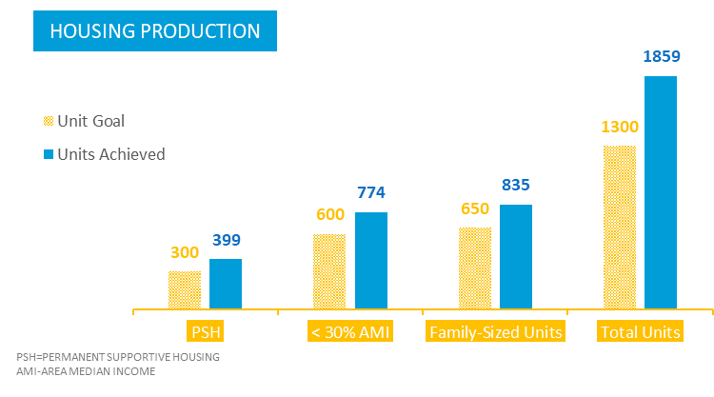
Adherence to the Bond Policy Framework
2022 Production Goals and Progress

Slide 3
The Ellington
3000 SE Powell
10506 E Burnside St
5827 NE Prescott
NW 6th Ave (Westwind)
SW 11th Ave. (Joyce Hotel)
8

Slide 4
Equity in Contracting Goals
Hard Costs
30%
Soft Costs
20%
Apprentice & Workforce Diversity
20%

Slide 5
Culturally Specific and Service Partnerships

Slide 6
Creating Community Feedback and Transparency
Public Testimony
Stakeholder and Resident Engagement
Quarterly and Annual Progress Reports

Slide 7
Who Lives in the Two Open Communities
314
total Units
763
RESIDENTS
149
Units with
Children
105
Seniors and/or Disabled
*Tenant data for remaining five open projects not available until after date of presentation.

Slide 8
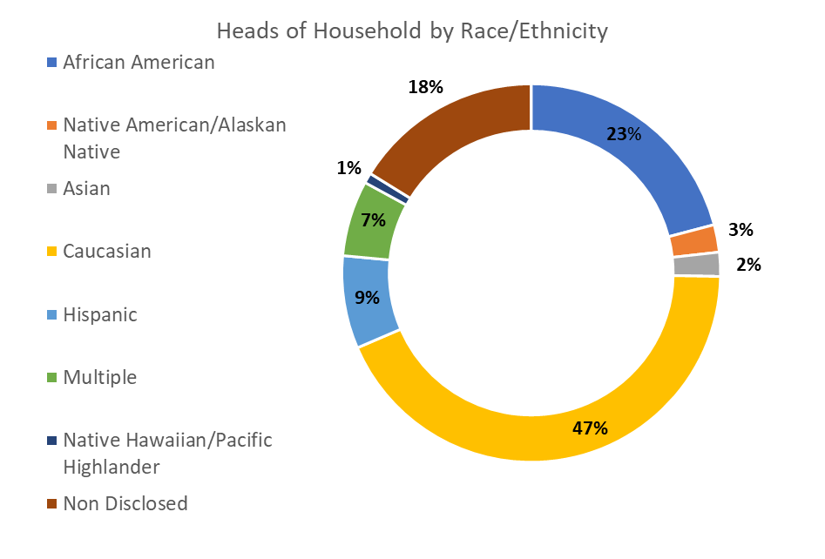
East Burnside and Ellington Demographics
*Tenant data for remaining five open projects not available until after date of presentation.

Slide 9
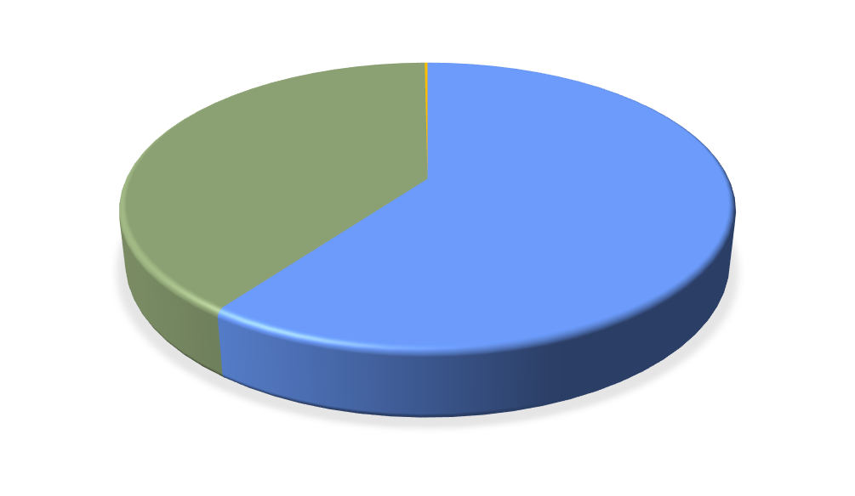
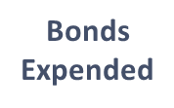
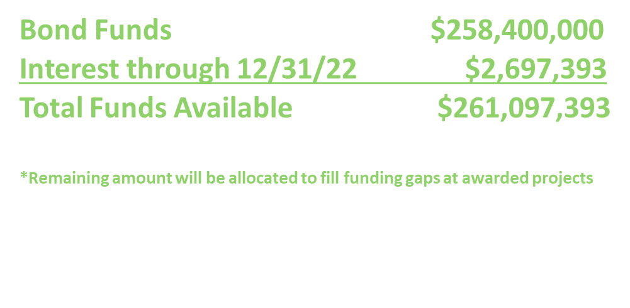
Expenditure Report Highlights (as of 12/31/2022)
​ | Total $​ | % Totals​ | % Change - last Qtr.​
Expended​ | $156.8M​ | 60.1%​ | +4.5%​
Committed​ | $103.8M​ | 39.8%​ | -4.0%​
Remaining*​ | $457.3K​ | 0.2%​ | -79.9%​
BOC Progress Report | 04/19/2023 | Portland's Housing Bond

Slide 13
The Ellington
3000 SE Powell
10506 E Burnside St
5827 NE Prescott
NW 6th Ave (Westwind)
SW 11th Ave. (Joyce Hotel)
8

