Slide 1
Sellwood Sanitary Sewer Extension Project E11162
Melanie Gualotunia, P.E. | NCS Program Manager| Bureau of Environmental Services
Joe Dvorak, P.E.| Division Manager| Bureau of Environmental Services
Item #269 | April 5, 2023
MINGUS MAPPS, COMMISSIONER
DAWN UCHIYAMA, INTERIM DIRECTOR

Slide 2
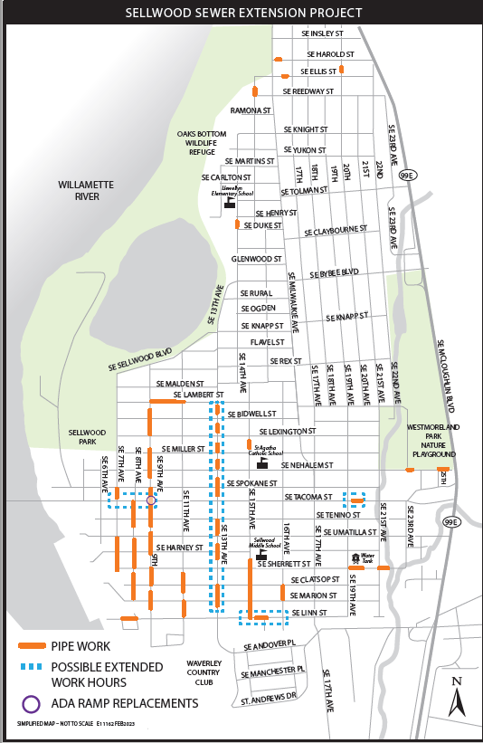
Project Overview
Sellwood Sanitary Sewer Extension Project
~7,200 feet of new 8” diameter mainline pipe
~3,300 feet of 6” diameter service laterals
Provide municipal sewer service to 153 developed properties that currently utilize nonconforming and septic sewer connections.
1 Intersection - ADA Ramp Upgrade
Notes:
This project will: Increase sewer system capacity and reliability, and Protect public health, property, and the environment by reducing the risk of sewage releases and sewer backups.

Slide 3
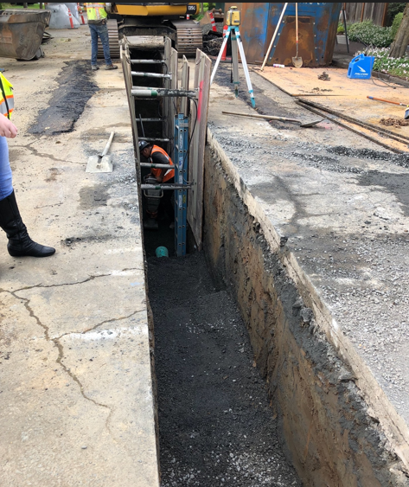
Construction Methods and Scope
Open trench excavation
Limited Trenchless Lateral Installation
Notes:
Trenchless to reduce impacts and restoration.
Method ft %
CIPP 1893 17%
Spot Repairs 42 0.6% (35’ on CIPP mains)
PB 1580 22%
Sect-CIPP 6 0.1%
Auger Boring 94 1.4%
OC 3345 49%
---------------------------------------
Abandon 1794 -
TOTAL 12439
NCS 1368
TOTAL REHAB 11071

Slide 4
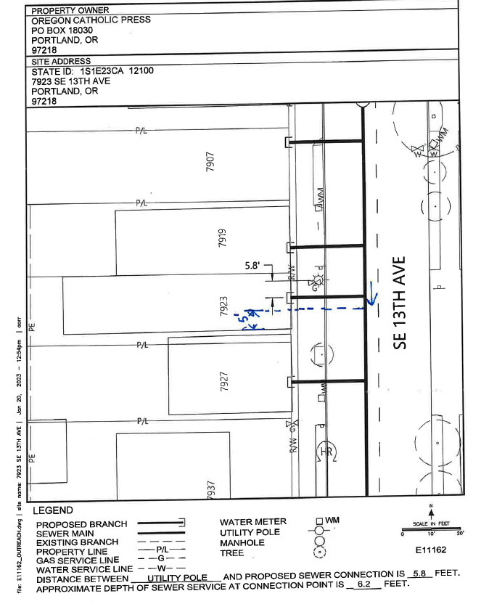
Public Outreach & Impacts
Extensive general outreach conducted via mailings, web, email, and social media
Community workshops
Extensive targeted outreach conducted directly with affected property owners
Contract with JLA Public Involvement for General PI work
Notes:
Working with outreach firms to assist in public involvement.

Slide 5
Connecting to the Public Sewer System
NCS properties are required to connect within 180 days of notice of project completion (or 3 years for septic properties)
Sewer Conversion Fees are due to the City upon connection
Financial assistance programs and deferral options are available

Slide 6
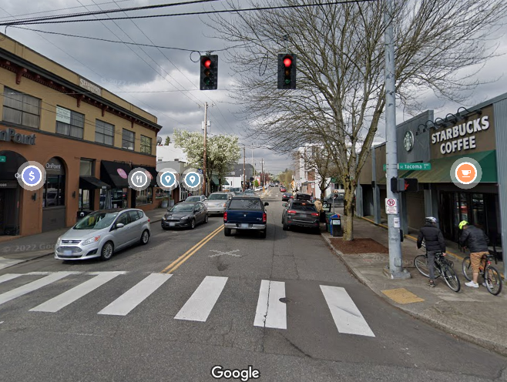
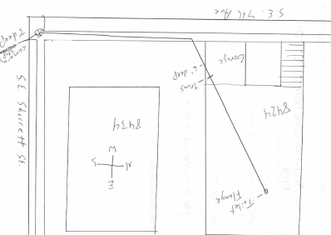
Engineer’s Estimate & Schedule
Engineer’s Estimate:
$7,400,000
Moderate Confidence Level
Advertise Project:
June 2023
Begin Construction:
September 2023
Construction Duration:
~ 2 Years

Slide 7
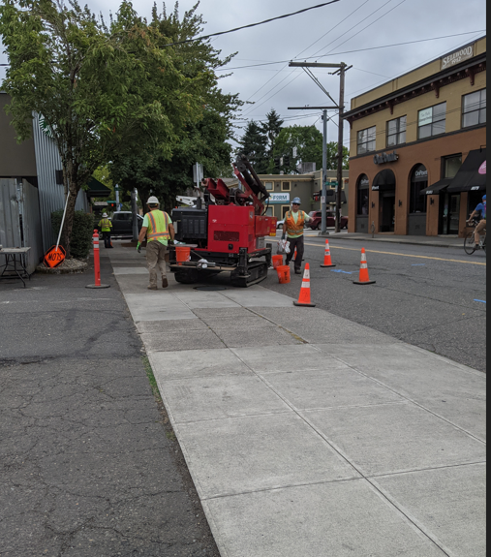
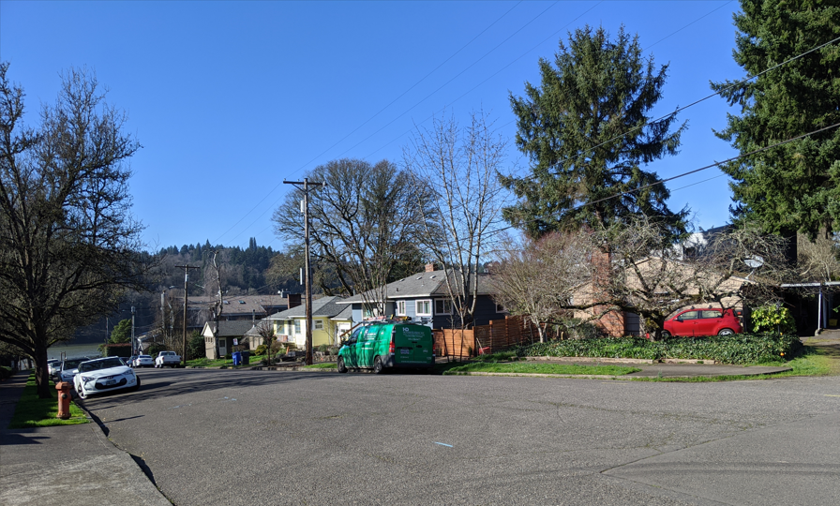
Questions?

