Slide 1
Exemption to Competitive “Low-Bid” Procurement
Inverness Force Main Project
BES Project #: E11531
April 2023
Biko Taylor
Chief Procurement Officer
Muriel Gueissaz-Teufel
BES Engineering Manager
Ronda Fast
BES Project Manager
Council Item #: 268
Date: April 5, 2023

Slide 2
Presentation Overview
Project background, context, and objectives
Low-Bid vs. Alternative Delivery
Project Budget and Schedule
Recommendation

Slide 3
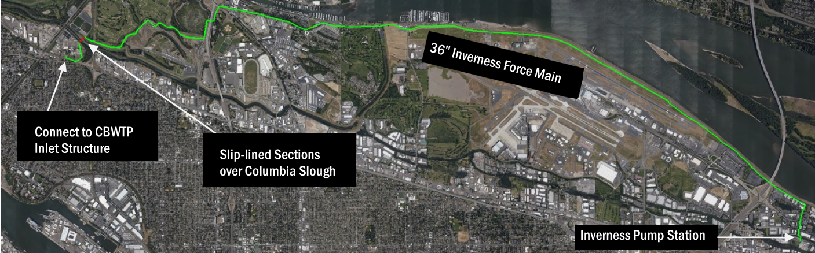
Inverness Force Main System
Inverness Pump Station Service Area

Slide 4
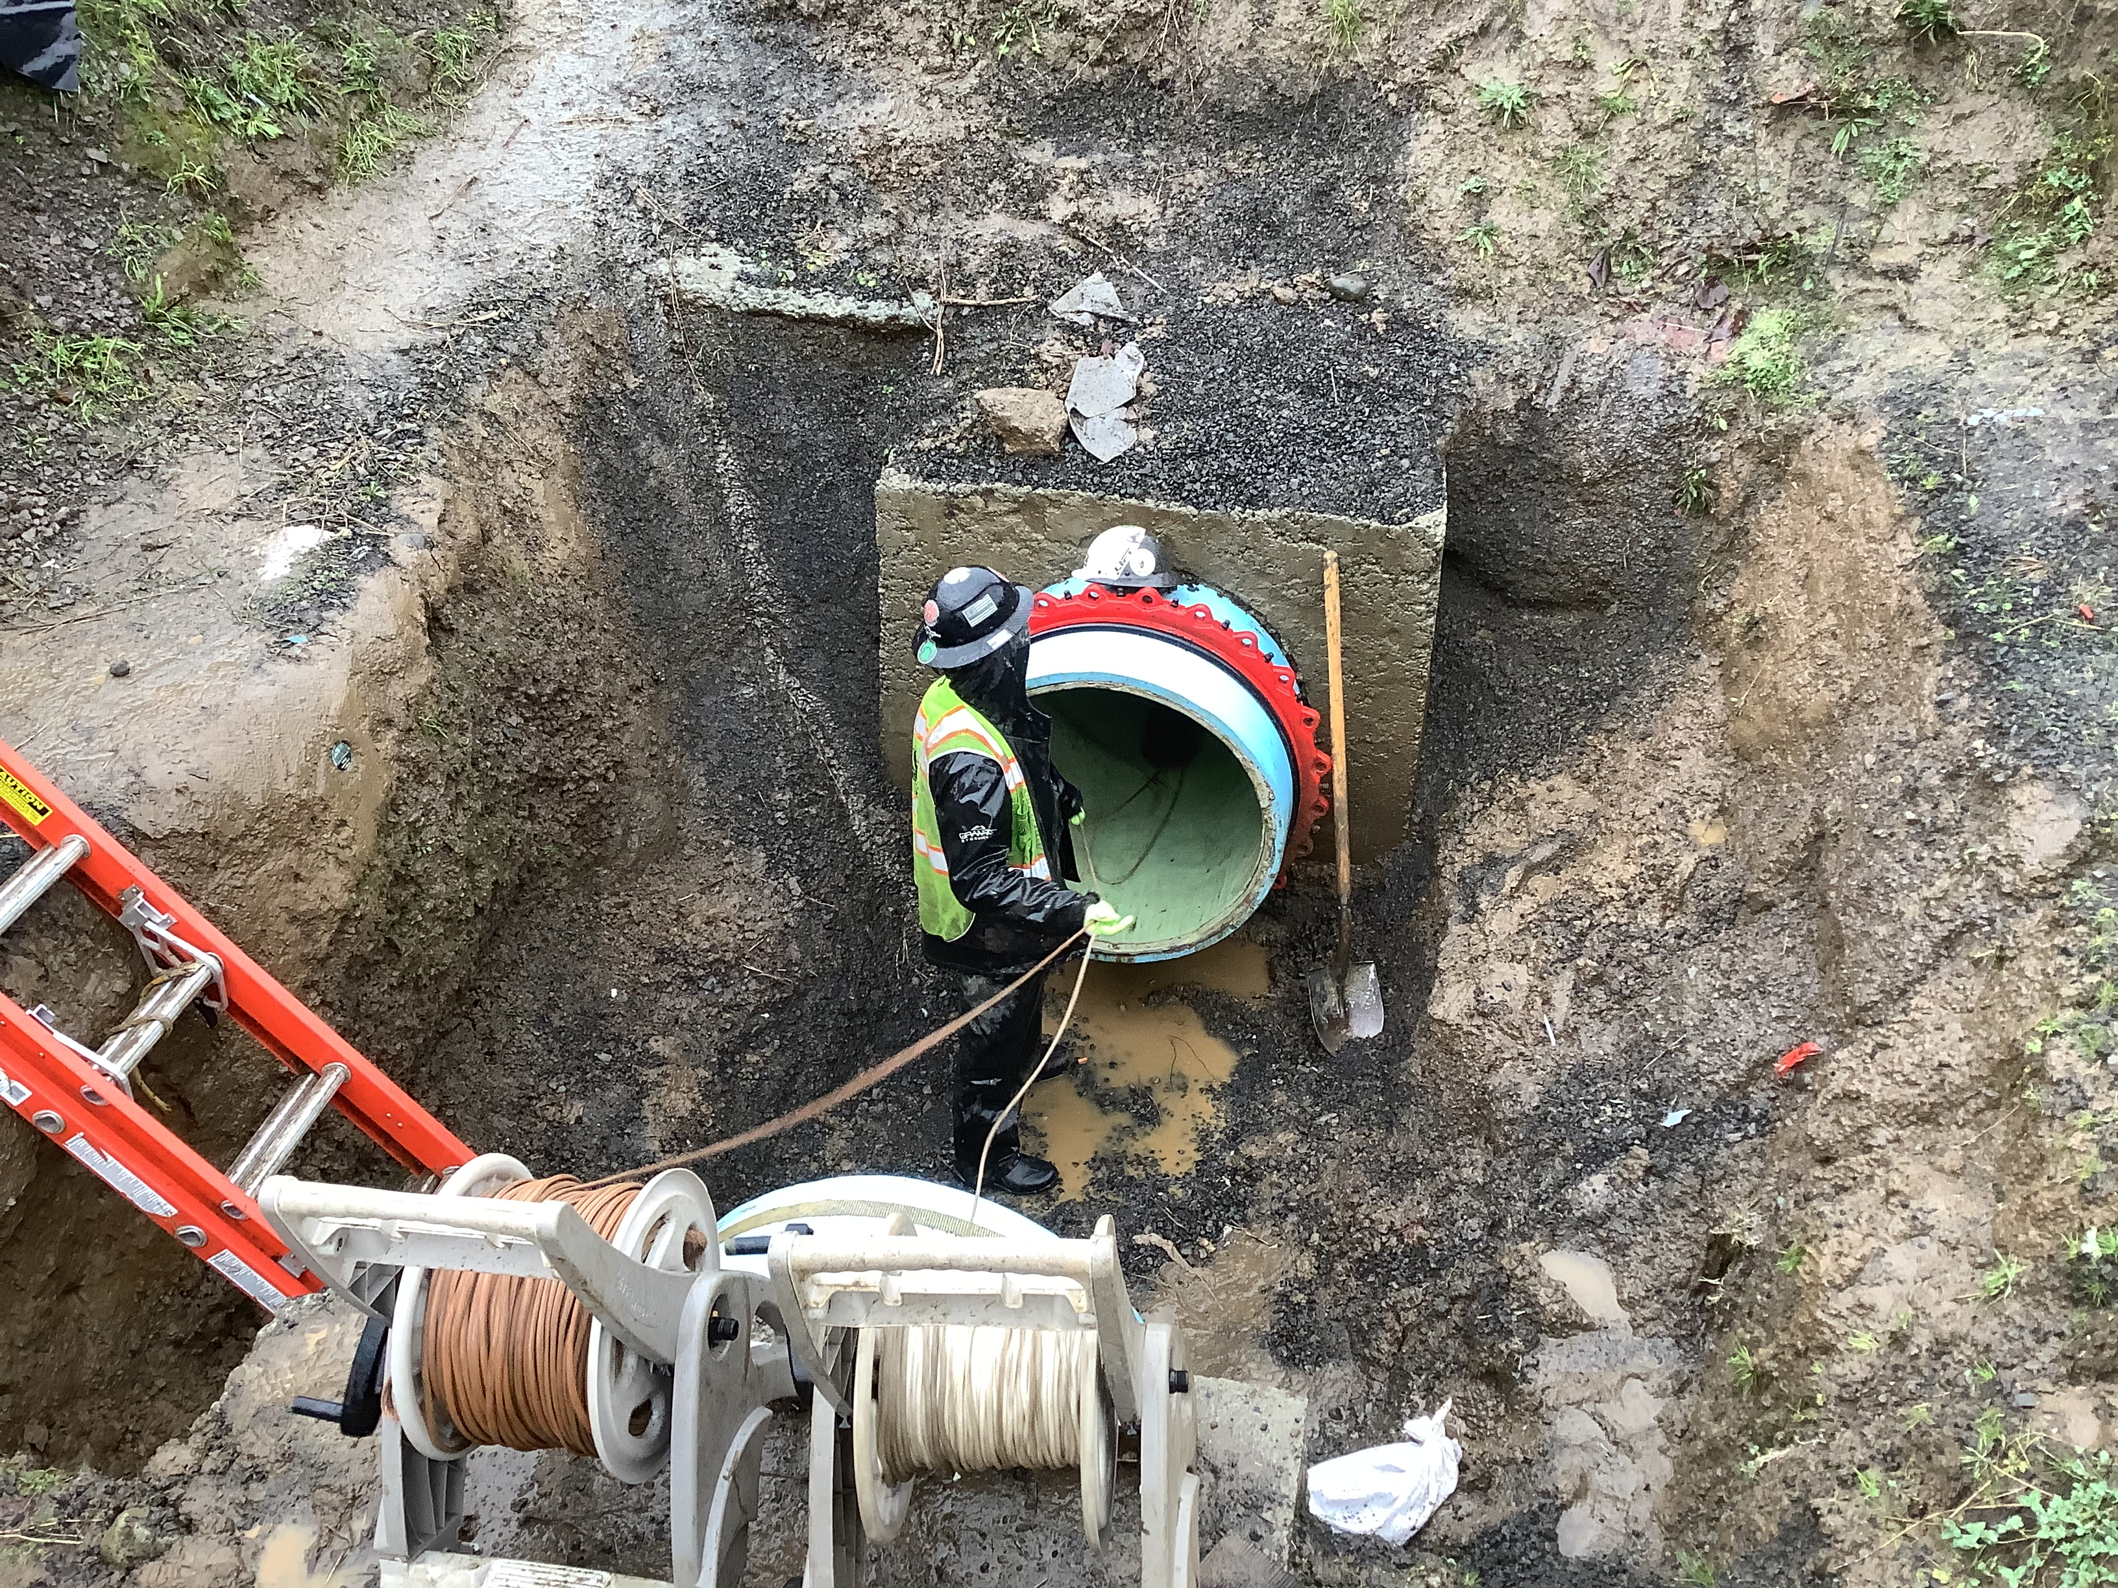
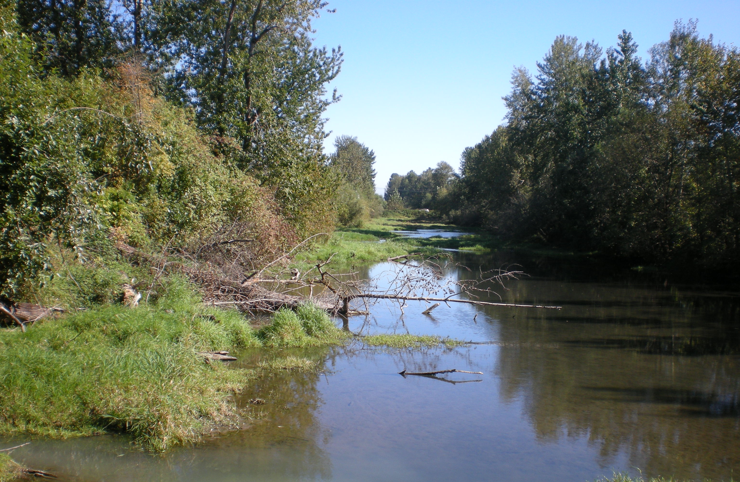
System and Project Requirements
One of BES’s top priority projects
  4 failures since 2014 – 2 since 2020 ($6.3M)
  Condition of pipe is largely unknown
  Major social, environmental, and economic risks

Slide 5
Project Objectives and Overview
Provide reliable service between the Inverness Pump Station and Columbia Boulevard Wastewater Treatment Plant
Project phases:
    Alternatives Analysis and Condition Assessment
    Design
    Construction

Slide 6
“Competitive” Low Bid vs. Alternative Delivery
ORS 279C exemption criteria includes:
No favoritism or diminished competition
Potential for cost savings
Public benefits
Value engineering
Public safety
Reduction in risk to City

Slide 7
Alternative Delivery: Progressive Design Build
Qualifications-based selection
Early contractor-designer “ownership”
Earlier certainty around costs and schedule
Equity, Diversity and Inclusion in Contracting
  Regional Workforce Equity Agreement (RWEA) and Construction Diversity and Inclusion Policy (CDIP)
    Supports recruitment of minority and women workers and sub-contractors
    Anti-harassment protection…and much more

Slide 8
Project Budget and Schedule
PDB contract estimate (AACE Class 5)
  $38-69M
Project completion by 2027, depending on approved scope
Next Steps:
  Request for Proposals (RFP)
  Select PDB Contractor team
  Award contract for first phase (report to council)

Slide 9
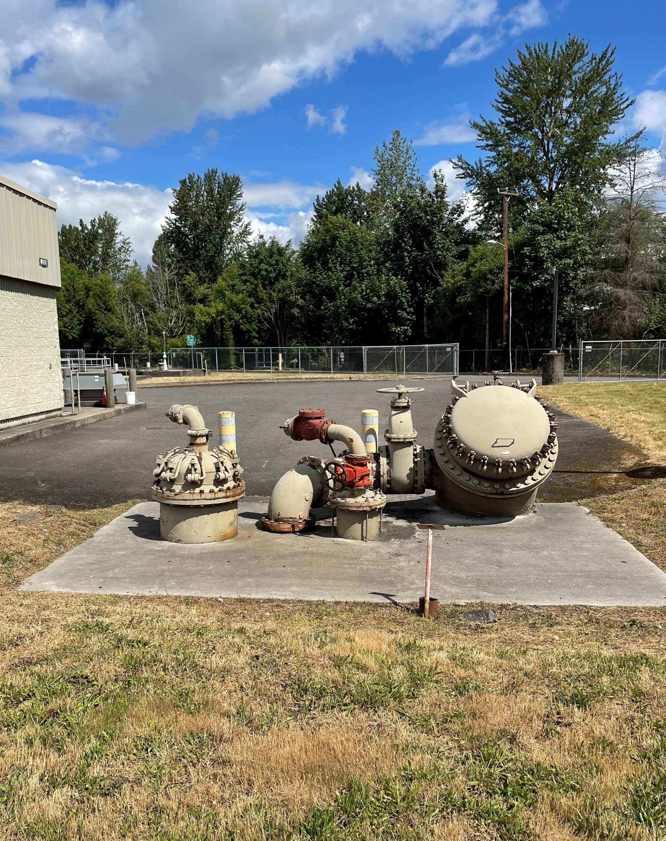
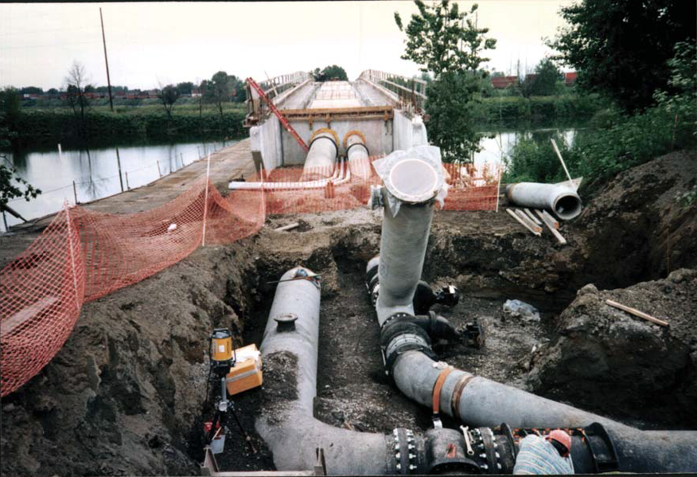
Recommendation
Accept the factual findings
Authorize an exemption from competitive “low-bid” procurement

Slide 10

Questions?

