Slide 1
Portland Police Bureau - Investigations Branch
Small Unmanned Aerial System
(sUAS)
Pilot Project
City Council Presentation
March 2023

Slide 2
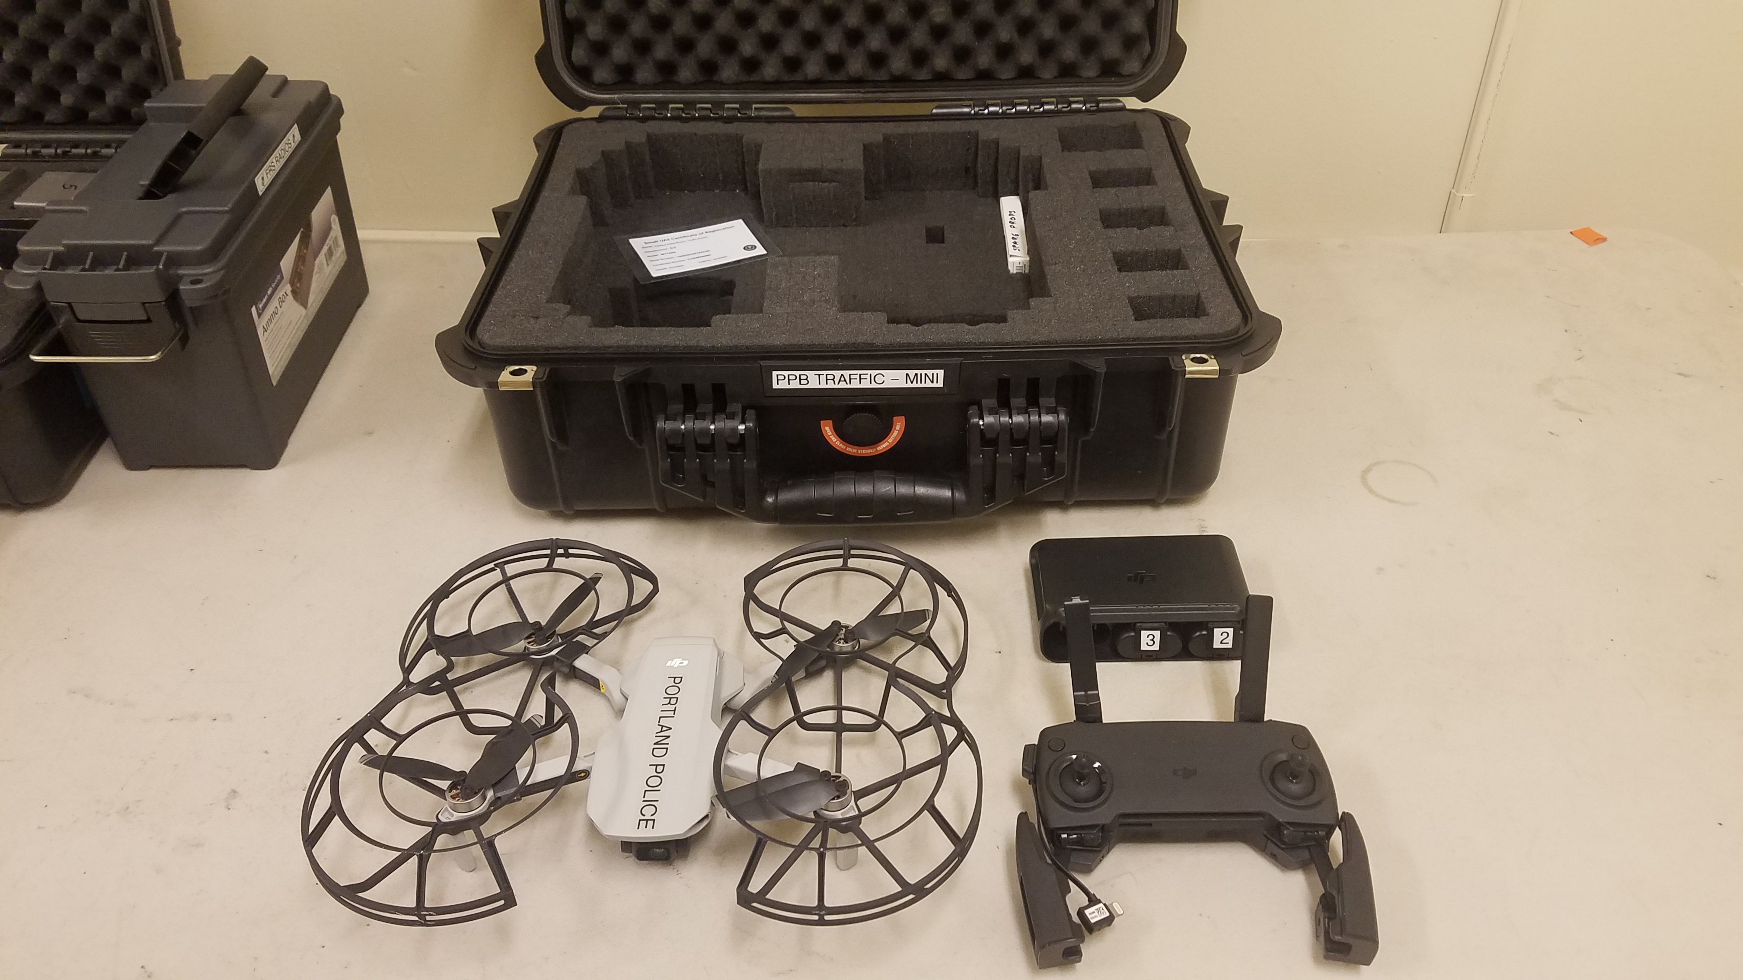
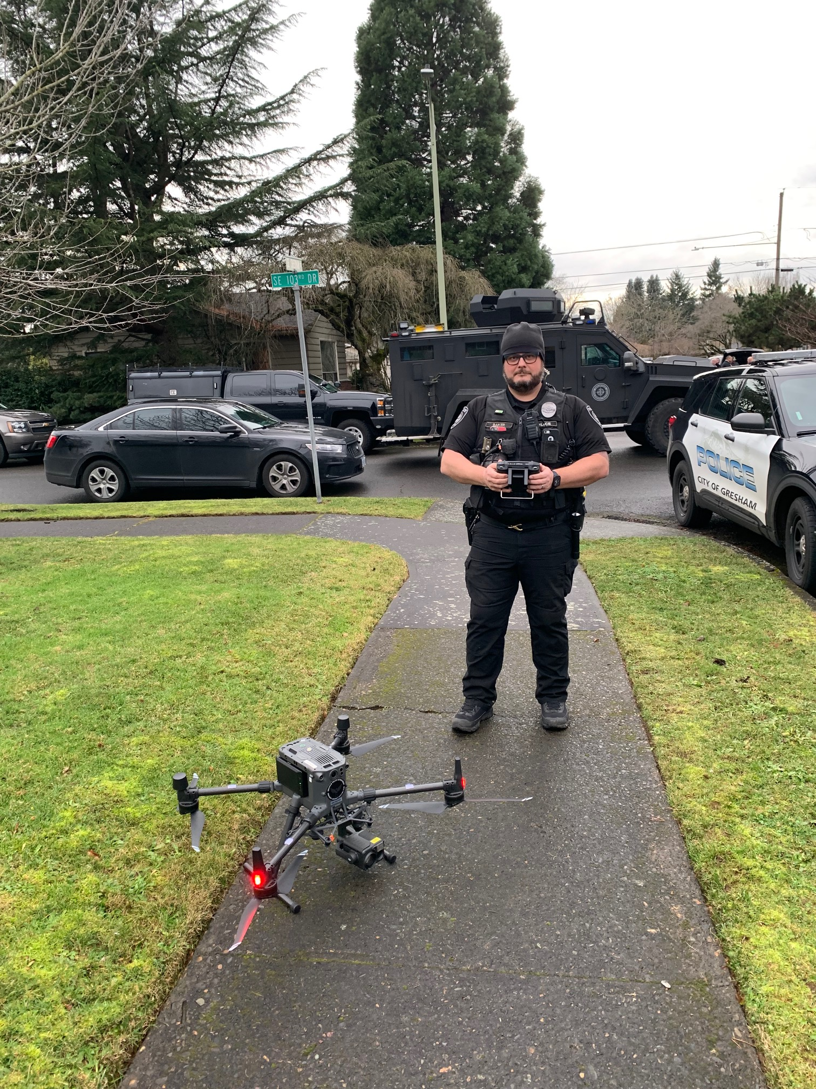
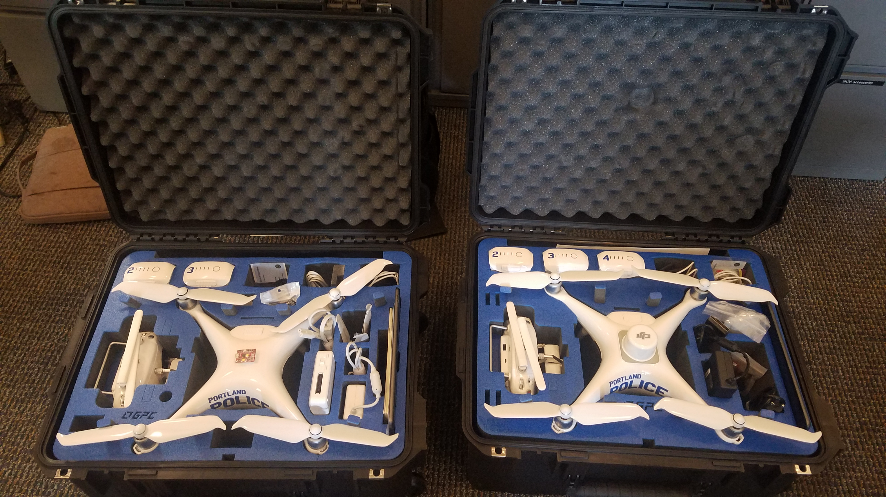
What is an sUAS?
sUAS is the term used for Small Unmanned Aerial Systems, also commonly referred to as “Drones”. sUASs are widely used in the public sector, including nearly every jurisdiction within the Portland Metro area. The regulated use of sUASs by the PPB Investigations Branch will provide improvements in safety for both officers and community members. Additionally, the use of sUAS technology in crime / major crash scene events reduces inconvenience to the public by minimidocumentation time at a scene.
PPB sUASs are exact or slightly modified versions of commercially available products and will be clearly marked with City of Portland or Portland Police logo.

Slide 3

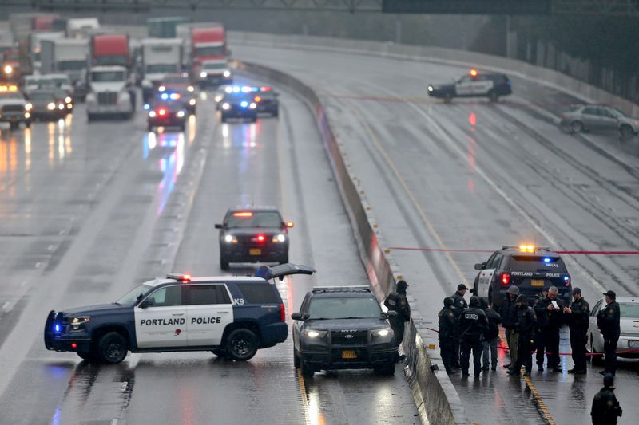
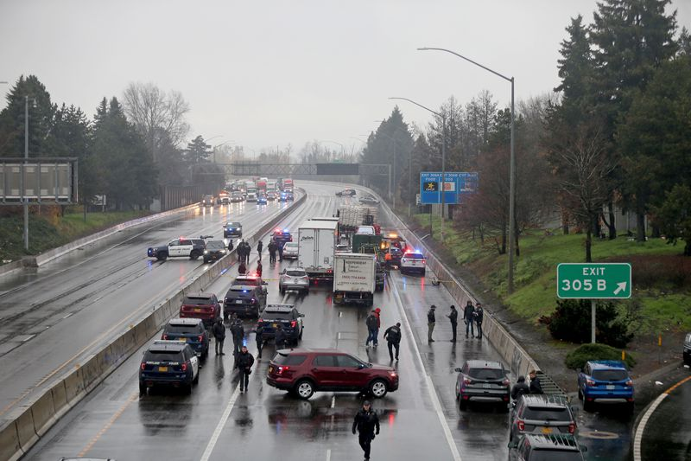





I-5 closed in North Portland (near Rosa Parks Way)
Monday, December 6, 2021
I-5 NB & SB lanes were shut down from 10:30 AM to 5:30PM (7 hours) for crime scene investigation.
I-5 traffic re-routed: WSDOT re-routed I-5 SB traffic across Oregon to I-205. ODOT rerouted I-5 N traffic to parallel routes.
Widespread congestion on Multnomah Co and Clark Co roadways
20,900 hr
(+95%)
$618k
(+90%)
25,700 hr
(+430%)
$809k
(+430%)
WSDOT officials reported 10-mile back-ups on I-205 SB during early PM rush hour traffic
Multnomah County
90-95% increased in vehicle-hours of delay and delay cost on the day of the incident vs normal Mondays
Clark County
430% increased in vehicle-hours of delay and delay cost on the day of the incident vs normal Mondays

Slide 4

Investigations Branch sUAS Pilot Project Summary
TRAFFIC DIVISION | Metro Explosive Disposal Unit
Document scenes of Major Crash Team activations | Quickly gather information on suspicious items from a distance
Document post-crash vehicle damage | Search immediate area for secondary devices
Conduct traffic flow / pattern studies of high crash roadways | Visually clear potential blast area of community members
Provide sUAS support during Search and Rescue Operations | Confirm location of items following render safe operations
 | Provide sUAS support during tactical events upon request of Critical Incident Commander (CIC)
 | Provide immediate support during disasters, building collapse, ie. Safeway Roof Collapse

Slide 5
Investigations Branch sUAS Prohibited Uses

Slide 7
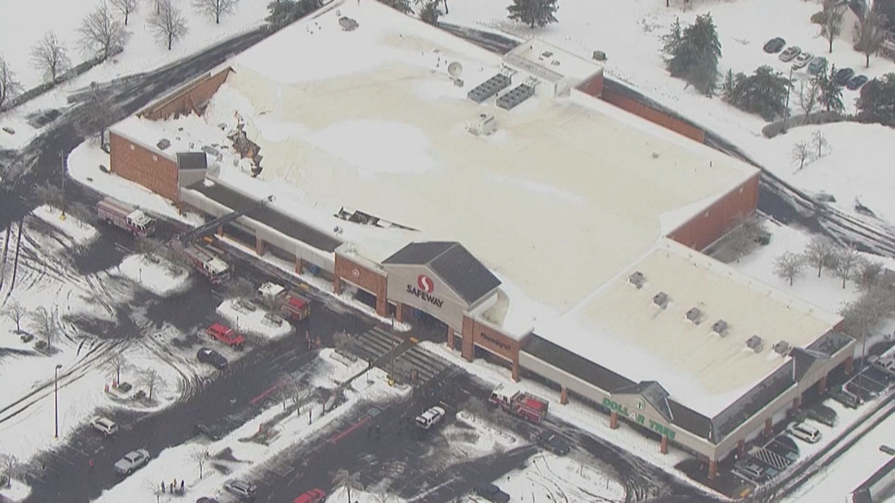
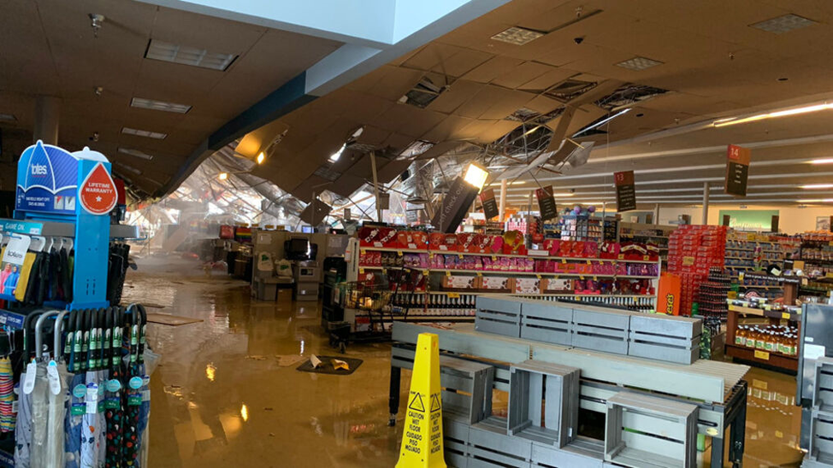
Use Case #1 – Safeway Roof Collapse 2/8/2021
MEDU response with robot
Gresham response with sUAS

Slide 8
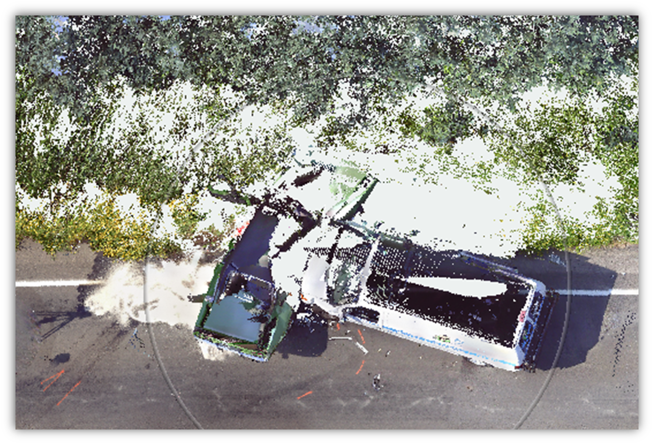
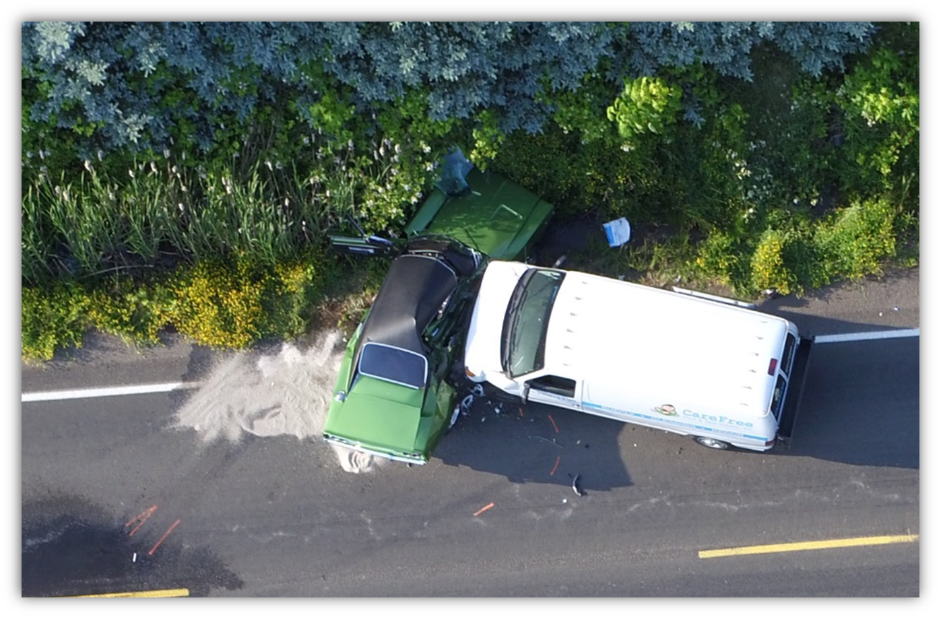
Use case #2 - FARO system vs. sUAS
FARO – 3 hours, 24 minutes
sUAS – 30 minutes

Slide 9
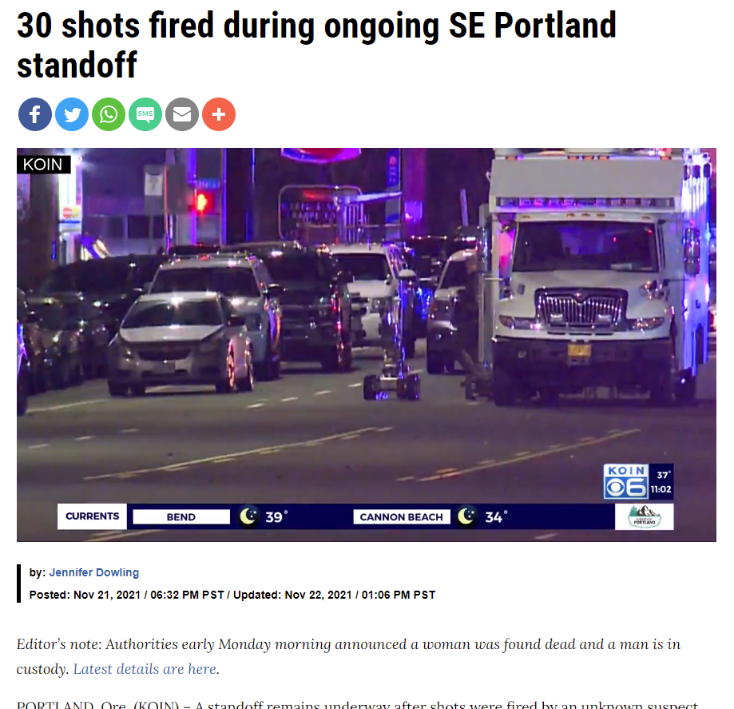
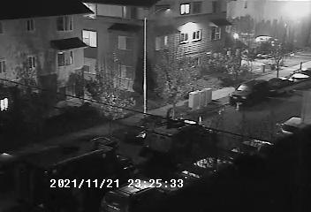
Use Case #3 – SE Division / SE 171st Hostage situation
4th story location – multiple shots fired at police
Utilized Gresham sUAS as de-escalation tool

Slide 10
CVPD UAS VIDEO

Slide 11
PPB sUAS Program Recommendations
Recommendation | Timeline | Responsible Unit
Develop Investigation Branch SOP and authorized use events | Complete | ASU
Reinstate sUAS Pilot Program on Major Crash Team activations when appropriate | 30 days | Council / MCT
Train and license pilots and operators including training on ORS, SOP’s, FAA and internal reporting requirements | 60 days | ASU
Identify equipment needs, test and procure sUAS platforms | 60 days | MEDU
Begin Pilot Project for tactical/potential explosive incidents | 60-90 days | MEDU
Pilot Project Review with statistics, reports, recommendations | Spring 2024 | ASU/MEDU/MCT

