Slide 1
City of Portland
City Council
Special Assessment—Open Space Land
10615 SW 42nd Ave.
March 15, 2023 4 pm time certain
Public Hearing
Staff Presentation

Slide 2
Public Hearing
Special Assessment Process
ORS 308A.306 allows a property owner to apply for an open space assessment.
Application filed December 30, 2022
ORS 308A.312 requires a decision by April 1, 2023
ORS 308A.309 requires a public hearing

Slide 3
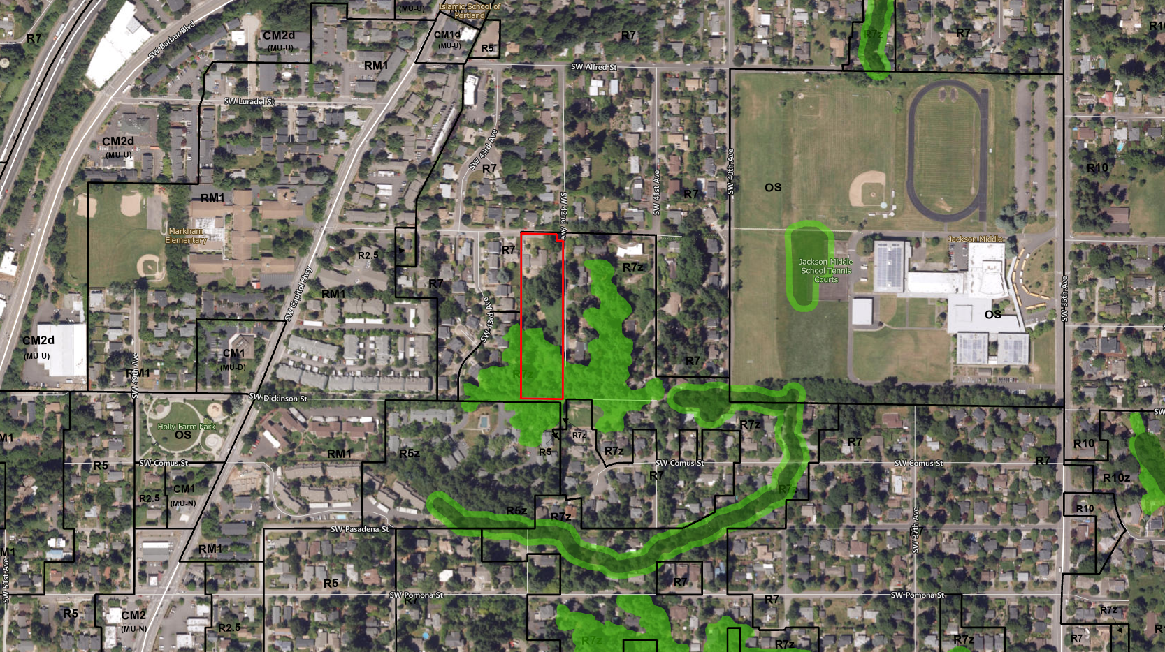
Zoning
2.44 acre tax lot
Zoned R7cz
Property contains a house and accessory dwelling unit

Slide 4
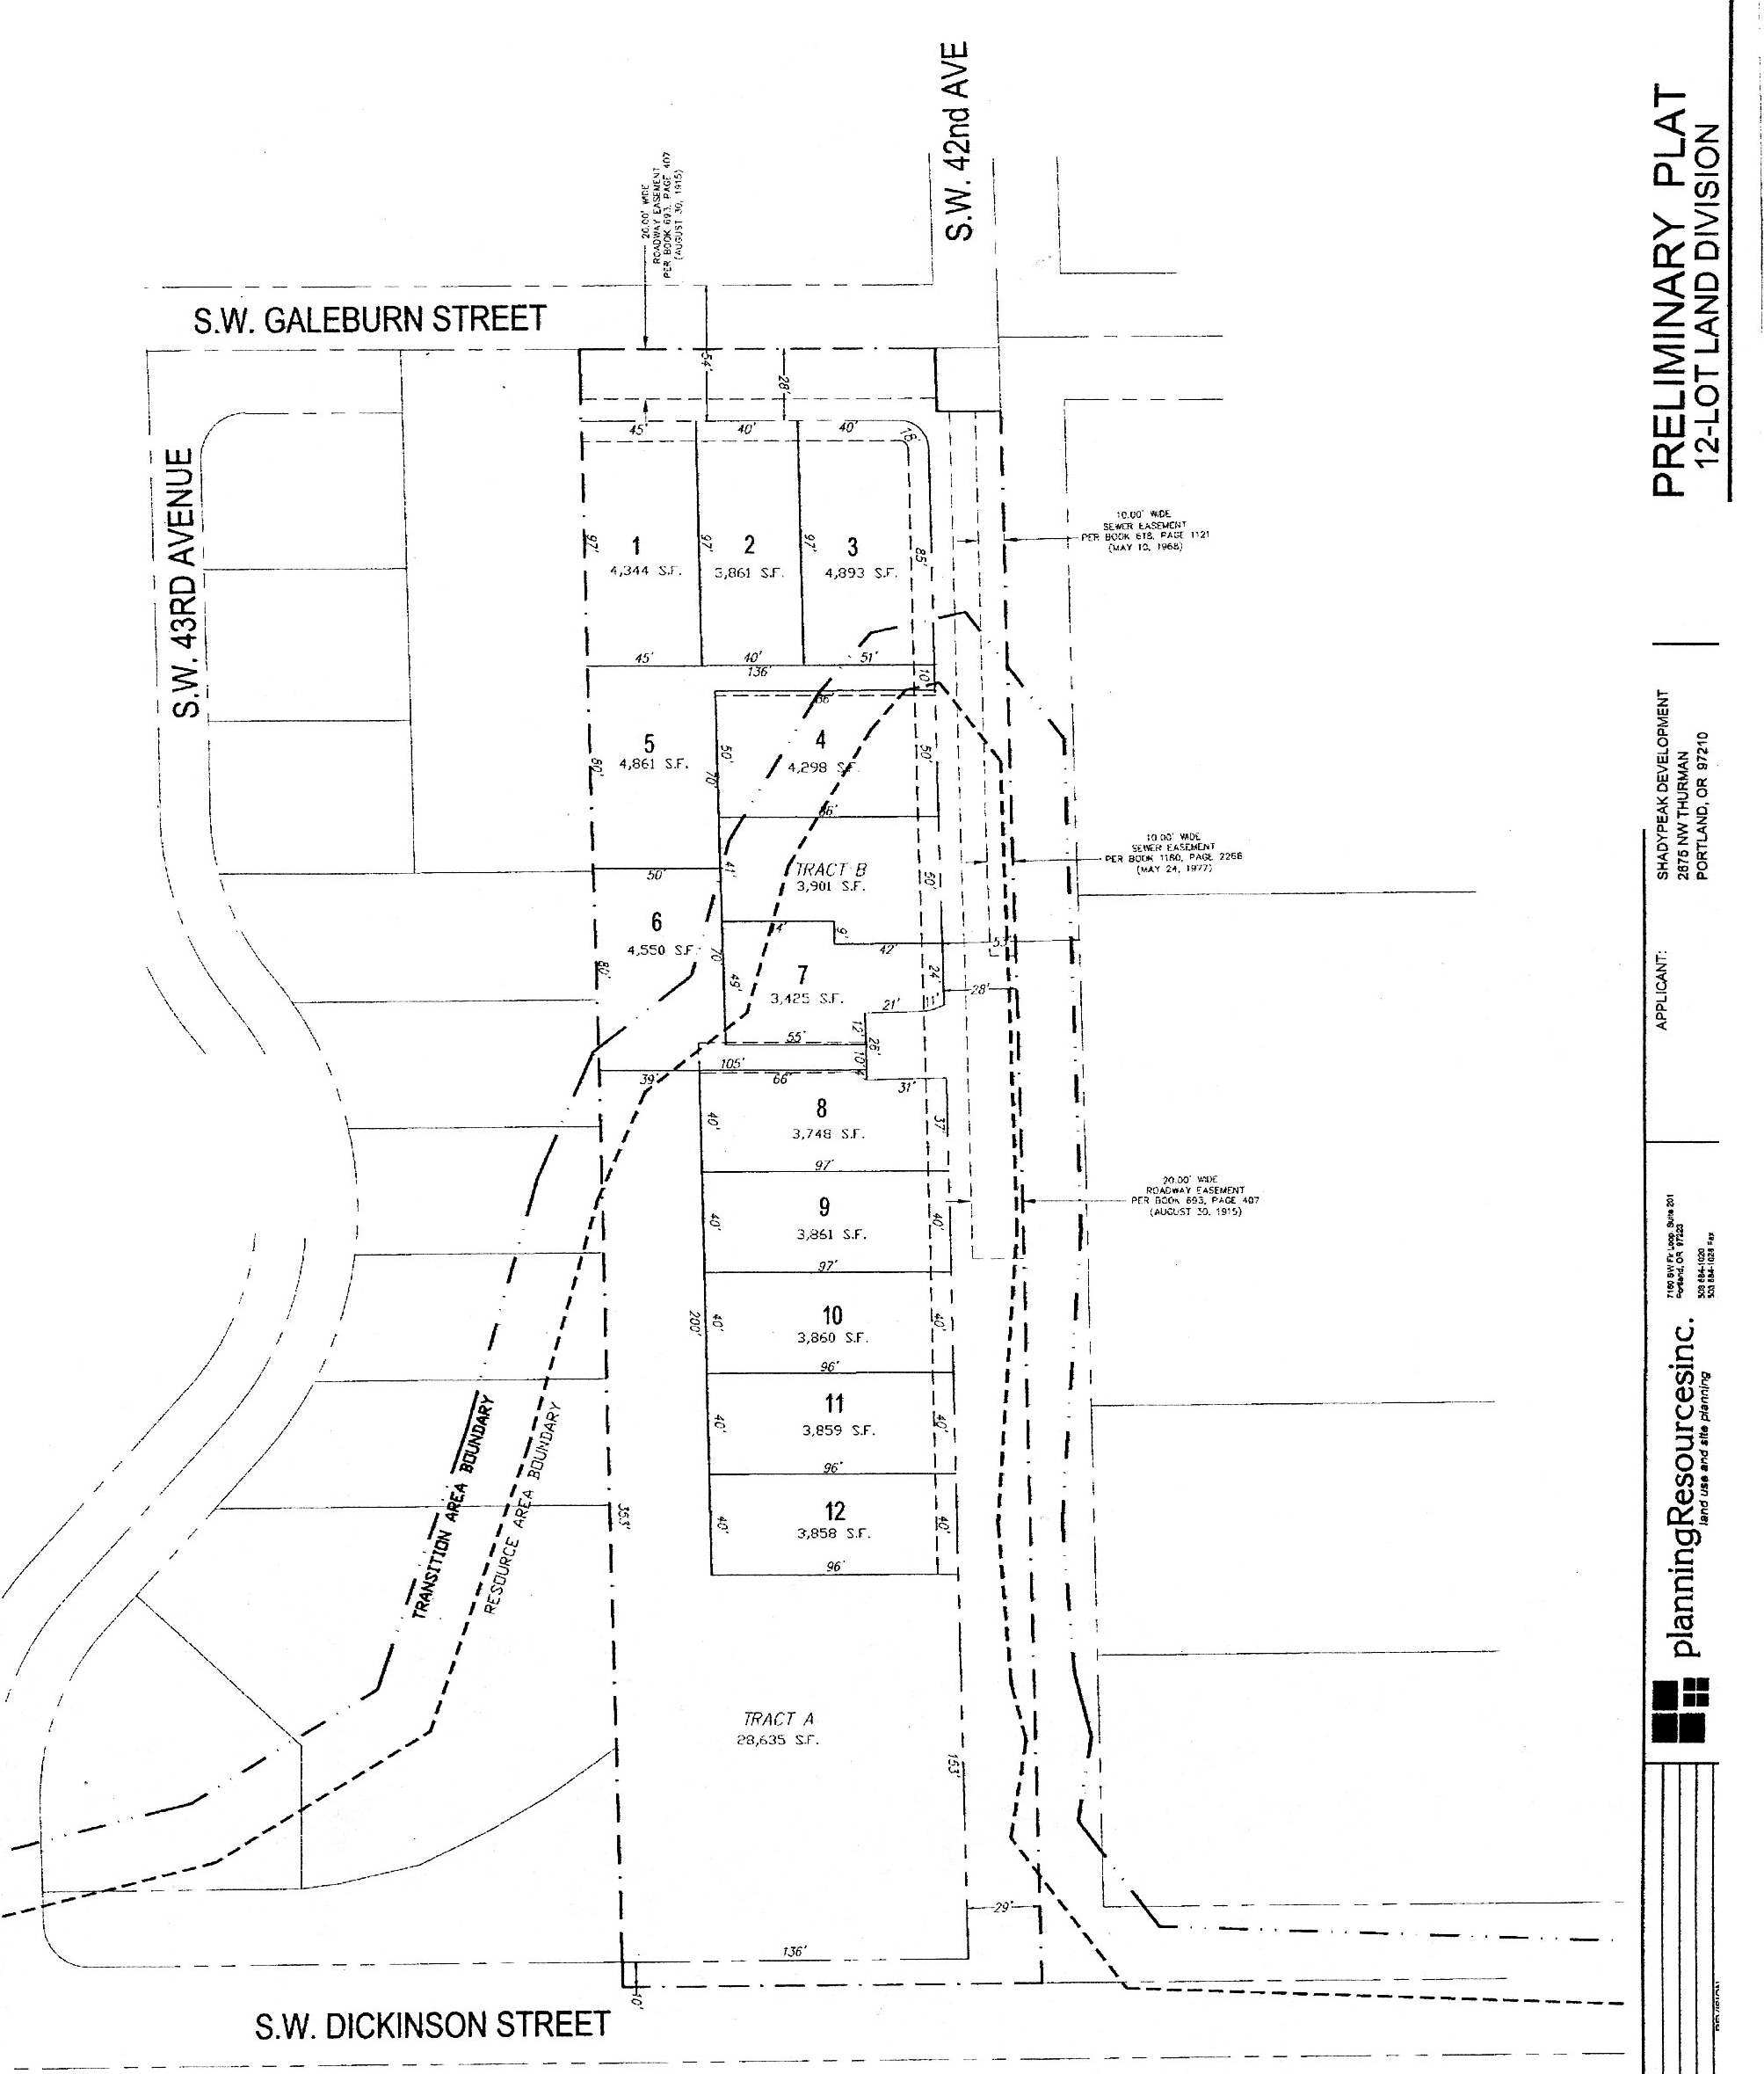
Zoning
2.44 acre tax lot
2007 preliminary subdivision
12 lots proposed

Slide 5
ORS 308A.309 (1) a-d
Factors to Weigh
Factor 1: The projected costs and other consequences of extending urban services to the affected lot or parcel.
Finding: Property has access to urban services: streets, sanitary sewer, water, police and fire protection, parks, public schools and mass transit.
Factor 2: The value of preserving the lot or parcel as open space.
Finding: The value of the property is as residential rather than open space.

Slide 6
ORS 308A.309 (1) a-d
Factors to Weigh
Factor 3: The projected costs and other consequences of extending urban services beyond the affected lot or parcel.
Finding: Urban services, including water and sewer, currently exist to and beyond the property.
Factor 4: The projected costs and other consequences, including the projected costs of extending urban services, of expanding the urban growth boundary in other areas if necessary to compensate for any reduction in available buildable lands.
Finding: Approval would reduce the City’s supply of buildable land.

Slide 7
Staff Recommendation
City Council should vote in favor of the denial.

Slide 8
Questions?

