Slide 1
Regulatory Division
Towing Administration
Private for-Hire Transportation
Notes:
Good morning, Mayor Wheeler and Commissioners. My name is Mark Williams, and I am the Regulatory Division Manager for the Portland Bureau of Transportation. With me today are Tim Moore, PBOT Towing Administrator & Wendy Serrano with PBOT External Equity Services. The Ordinance before you this morning is to Authorize the solicitation and execution of contracts for Vehicle Towing and Storage and Abandoned Vehicle Towing and Storage.
We would also like to take a few moments to talk about the program and highlight some of the changes we proposing as well as the rates that will be offered to our vendors with the new contract agreements.

Slide 2
Towing Administration
Towing Program
The city manages the towing contracts for several agency partners that utilize these services via Intergovernmental Agreements.
The city also regulates Private Property Impounds as well as all rates the towers can charge vehicle owners for tows within the City of Portland.
Notes:
PBOT manages towing contracts used for Towing Services by other City Bureaus and external Regional Partner Agencies through Intergovernmental Agreements. In addition, PBOT Regulates and issues permits for Private Property Impound Towing Operations throughout the Portland area. All rates associated with our Towing Agreements as well as Private Property Impound tows are established by the City. This means that the towers can only charge constituents the set established rates. We plan to present recommended changes to the Private Property Impound Code to this Council later this year.

Slide 3
Towing Administration
Types of tows
Contract/Abandoned Vehicle Tows
Tows requested by City Bureaus and Agency Partners; rates regulated by the city.
Private Property Impound (PPI) Tows
Tows requested by owners to remove vehicles from private commercial and multifamily properties; rates regulated by the city.
Private Tows
Tows requested by private constituents and roadside assistance programs such as AAA; rates are not regulated by the city.
Notes:
Towing can be complicated, so I want to take a moment to explain the three basic types of tows that take place in our city.
Contract and Abandoned Vehicles Tows – These are the tows associated with our tow contracts in which the city regulates the rates that the towers can charge.
Private Property Impound Tows – These are tows that are provided to private property owners and occur on Private Property. The City Regulates these Services and rates through Portland city code.
Finally, there are constituents who requested private tows. These tows represent services requested through roadside assistance programs such as AAA, or anytime a constituent calls any tower licensed to operate in this state. Rates associated with Private Tows are not Regulated by the City.

Slide 4
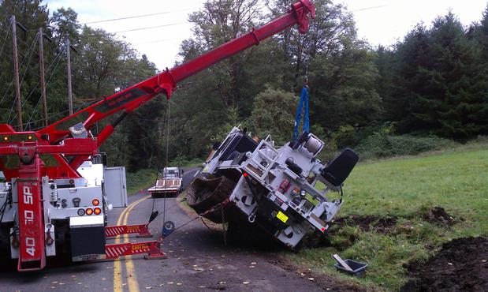
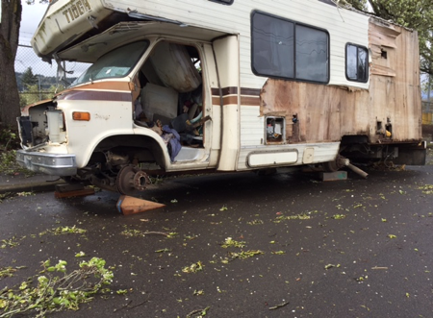
Towing Administration
Services Provided
Accident recovery
Towing hazards from the right of way
Towing broken down or damaged city equipment and vehicles
Transporting vehicles that are evidence in a crime
Towing abandoned vehicles and boats from the right-of-way
Removing dangerous recreational vehicles (RVs) from the public right-of way
Notes:
These are a few services our contracted towers provide. They range from accident recovery on our roads and freeways within the City and Multnomah County to removing derelict RV’s from the Right-of-way.

Slide 5
Towing Administration
The City contracts with several local tow companies to provide towing and storage services for the City of Portland, and various partner city agencies.
City Fleet
PBOT Maintenance Operations
Parking Enforcement
Portland Police Bureau
Portland Parks and Recreation
Portland Water Bureau
Port of Portland
Multnomah County Sherriff
Multnomah County Fleet
ODOT
Portland Streetcar
Notes:
As I stated earlier, All these services provided through our Tow Contract Agreements are available to our city Bureaus and Regional Agency Partners, including Port of Portland Multnomah County and the Oregon Department of Transportation. These organizations can request towing services through our Automated Dispatch System.

Slide 6
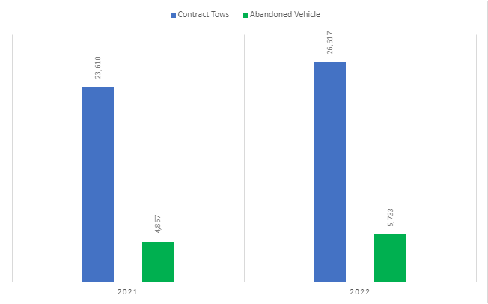
Towing Administration
Notes:
This chart shows the number of tows provided through the contract over the last two years.
The blue bar represents the tows requested by our City and Agency Partners for services such as accident recovery, removing hazardous vehicles from the right of away, vehicles towed as evidence of a crime, or towing city-owned vehicles that may have broken down and need to be towed back in for repair.
The green bar represents Abandoned Vehicles and Abandoned RV Tows almost exclusively requested by Parking enforcement.

Slide 7
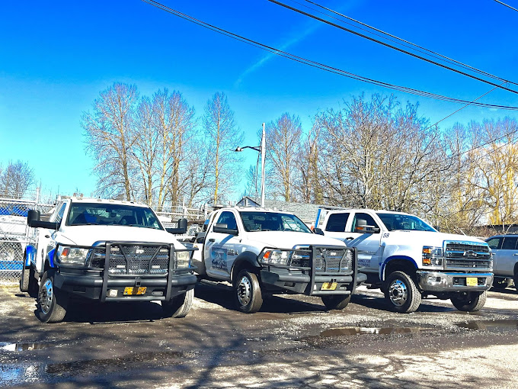
Towing Administration
Industry Challenges Today
Shortage of CDL Drivers; competing wages
Rising cost of equipment, vehicles, and fuel
Increased costs for insurance and bonds
Costs associated with maintaining and securing storage lots
Notes:
Much like other industries, the towing industry is facing challenges. For example, recruiting and retaining qualified CDL drivers, the rising cost of insurance and bonds, and rising fuel costs.

Slide 8
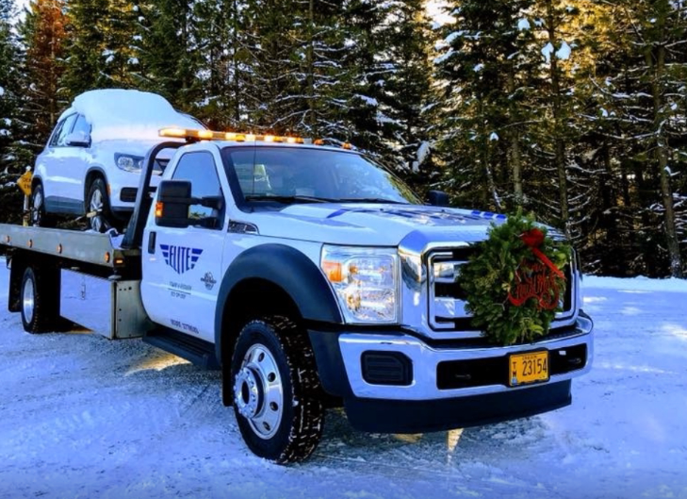
Towing Administration
Bureau and Agency Challenges
Delayed Response to First Responder tow requests
Delayed response to some Abandoned Vehicle Requests, including Derelict RV and Derelict Boat Request
Notes:
And as you can imagine, some of those challenges impact their ability to provide services. Bureaus and Agency Partners can experience delays in response times. This can have a negative impact on our communities and the safety of the public and first responders.

Slide 9
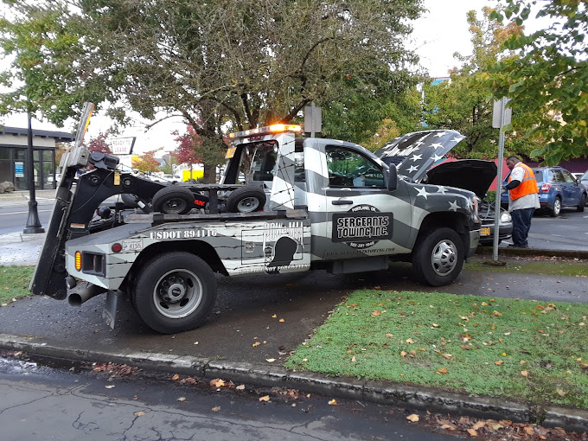
Towing Administration
Increasing Opportunities
Financial Hardship Fund
Notes:
The new contracts issued as a result of this RFP will contain changes designed to be more inclusive, improve service levels, and maintain consumer protections. I would like to take a few moments to highlight two of the changes we are excited about.

Slide 10
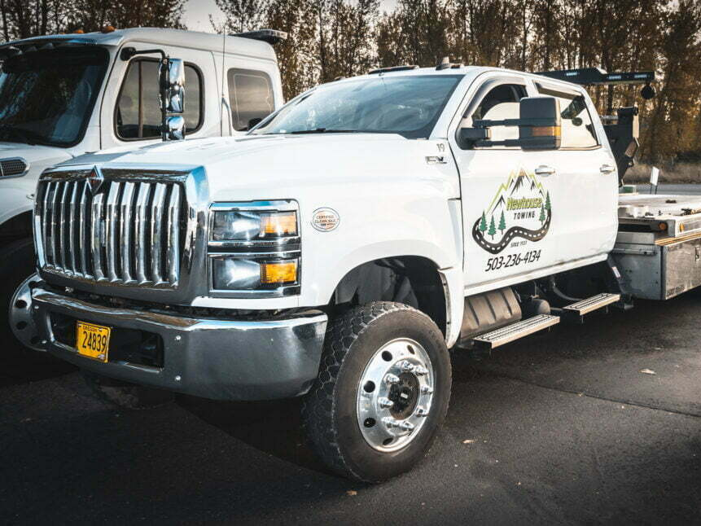
Towing Administration
Increasing Opportunities
Includes qualifying criteria language that opens the door to smaller tow companies.
Notes:
We have redefined the company qualifying criteria in an effort to attract MWESB Owned Tow Companies. By reducing the number of tow vehicles a company must have to be issued a contract, we hope to open the door to smaller companies to fill gaps in services the larger companies are unable to respond to. Furthermore, we hired a consultant to research and identify all of these companies licensed to operate in the state of Oregon so that we can alert them when this RFP is published.

Slide 11
Towing Administration
Financial Hardship Program
This program aims to make retrieving a vehicle more equitable and affordable by subsidizing tow and storage expenses for qualifying vehicle owners.
Notes:
The second change we are excited about is the new Financial Hardship Program. Let’s face it, for many of our constituents, having your vehicle impounded for any reason can be life-altering. For many working families, a vehicle is needed to get to work, transport children to school and pick-up food for your family. Qualifying individuals can apply to receive a subsidy to reduce the cost of towing and storage services. This program will be funded by a $5.00 Hardship Fee added to the city service fee.

Slide 12
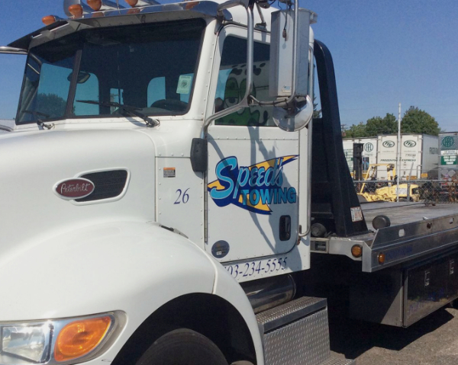
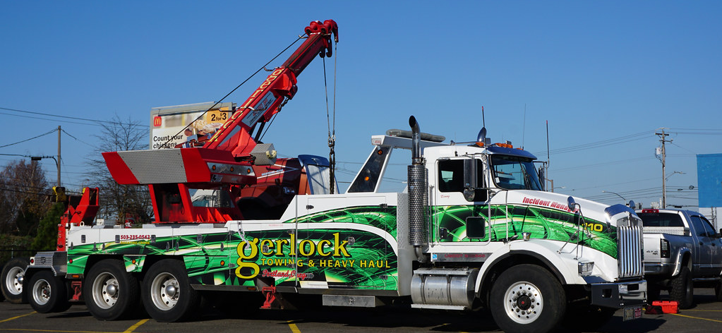
Towing Administration
2016 Tow Rate Market Study
Notes:
As stated earlier, the rates that towers can charges are established in the contract. In 2016, we hired a consultant to conduct a Tow Rate Market Study. The lessons we learned from that study are still applicable today.

Slide 13
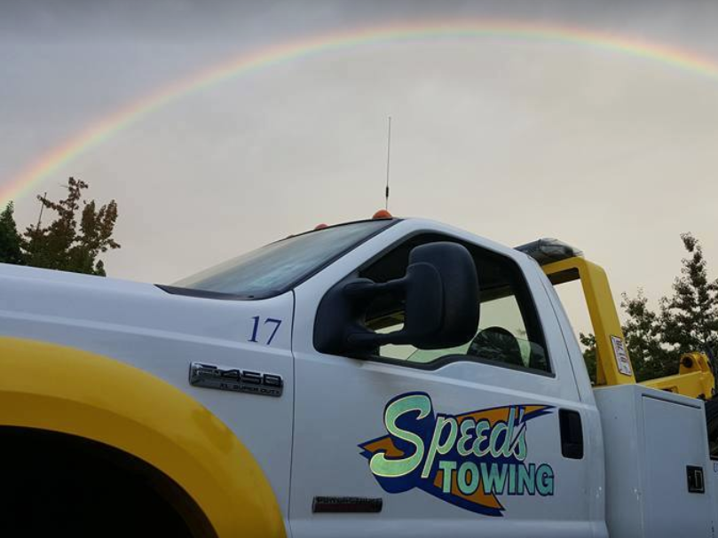
Towing Administration
2016 Tow Rate Market Study
Insurance rates increased
Increased cost for trucks and equipment
Portland rates have not kept up with the rest of the market
Notes:
The costs tow companies pay for insurance have increased substantially
The cost of trucks and specialized equipment continues to rise
The City Portland’s tow rates lag behind comparable cities.

Slide 14
Towing Administration
After Market Study Rate Adjustment
2017 Tow rates adjusted 6.08% + 2.1% COLA
2019, 3.35% COLA
There have been no additional rate increases since 2019.
Notes:
In response to that study, in 2017 the City increased the tow rates by 6.08% plus just over a 2.1% COLA
And in the fall of 2019 a 3.35% COLA was applied.
There have been no additional increases to the rates since 2019.

Slide 15
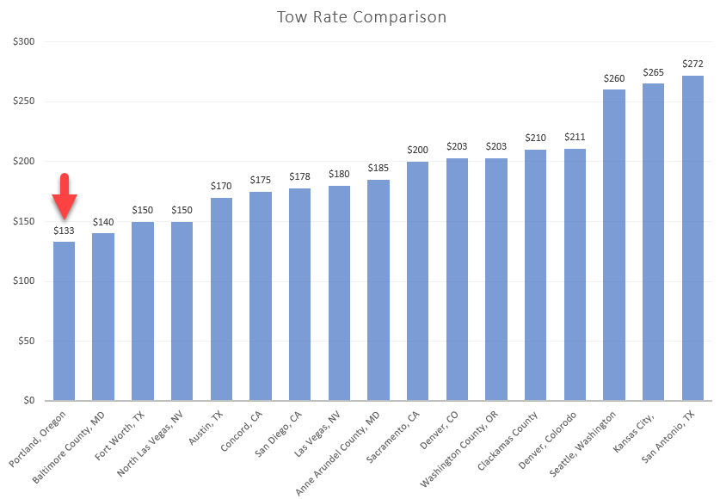
Towing Administration
Notes:
Tow Rates are complicated, so for this comparison, I am only illustrating the cost for a Class A Tow. A Class A tow is a standard passenger vehicle and represents about 85% of the tows in Portland. This comparison represents tow rates for a class A tow in a number of American cities. They do not include storage fees, mileage fees or any additional service or administrative fees. Specifically, I would like to highlight the rates charged in WA and Clackamas County.
Our goal here is not to lead or lag the market. However, a rate adjustment is necessary to attract and retain qualified towers. For that reason, we recommend the following rate adjustments.

Slide 16
Tow Rates
Recommended Rate Adjustments 2023
3% increase upon execution of the contract
3% increase annually for an additional two years
Up to a maximum of 5% each fiscal year based on COLA
Notes:
A 3% increase upon execution of the contract. And an additional 3% on the anniversary date for the next two years. This gradual increase of 9% is specifically designed to get Portland closer to alignment with the rest of the Market.
Additionally, we recommend up to a maximum 5% Cost of Living increase annually, based on CPI, for the term of this agreement.

Slide 17
Towing Administration
Maximum 5% COLA Annually
2025
3% + COLA
Fall of 2023
3% + COLA
2024
3% + COLA
Notes:
Should Council approve this recommendation, this graph illustrates how Portland would compare to these other cities over the next three years. However, this graph does not take into consideration any rate increase that may occur in those cities.
(Mark goes over chart)

Slide 18
Towing Administration
Administrative Fees
Notes:
Now, the rates on the previous slide represent just what the towers charge for a class A tow. However, what matters the most is the total cost the consumer pays to get their vehicle out of impound. The City of Portland, like most cities, charges Administrative Fees.

Slide 19
Towing Administration
Parking Enforcement Fee
Offsets enforcement costs
Covers Towing Administration Program Cost 1.75 FTE
$144.00 New 2023 Tow Fee
$86.00 City Service Fees
$230.00 Consumer Pays
Notes:
On this slide, we illustrate the city service fees that we add to the cost of every tow, and what those fees are used for.
Parking Enforcement Fee – This fee only applies to Parking Enforcement tows with the exception of abandoned auto tows and is used to offset the cost of Parking Enforcement operations.
City Service Fee – This fee funds the towing program within PBOT. Among other administrative duties, this program investigates consumer complaints, Attends code hearings, and helps coordinate towing logistics between our Bureau and Agency Partners and our contracted towers. Towing Administration is a cost recovery program and does not receive any General Transportation Revenue.
The dispatch fee – this fee is passed-through to cover the cost of our Dispatch technology, which is the software and mobile application used to request and assign tows. This per-tow licensing approach is used by other cities that use a software-supported dispatch system and this model offers unlimited user licenses.
Derelict RV Fee – Currently at $9.00, and we recommend an increase to $15.00. This fee helps offset the costs to Tow and demolish Derelict RVs. The Derelict RV Program currently Costs the City around $1.2M annually. With the increase from $9.00 to $15.00 we hope to offset that cost by $260,000 during the next fiscal year.
Hardship Fee – This is a NEW fee that will be used to fund the New Financial Hardship Program
If the council approves the rates proposed today, a standard Class A Tow would cost the consumer $144.00 plus city service fees at $86.00. Again, this does not include storage fees are any other towing related exspenses.

Slide 20
Towing Administration
Objectives
Maintain consumer protections by regulating rates
Adjust rates for better market alignment
Provide opportunities for MWESB towers
Improve response times
Support people facing financial challenges
Notes:
In closing, I would like to recap our main objectives.
Maintain consumer protections by regulating rates
Adjust rates the tower can charge for better market alignment
Provide opportunities for MWESB towers
Improve Safety and response times
And provide Support to people facing financial challenges
That concludes my presentation. At this time, I would like to invite Wendy Serrano, from PBOT External Equity Services, to say a few words. Tim and I will remain here to respond to any questions Council may have.

Slide 21
Regulatory Division
Towing Administration
Private for-Hire Transportation

